Slide 1
AI-Based Crop Disease Detection and Management System
Progress, examiner feedback and plan for Review 3
Design Project 1 (E1CSA313) | Mentor: Dr. Devika P
PROJECT TEAM:
Sai Ranjith
2411021060729
A. Akhileswara achari
2411021060747
S. Haneesh Ranganath
2411021060722
D. Karunakar
2411021060757
Alliance University â€¢ October / November 2026

Slide 2
FOUNDATION & CONTEXT
2
Project recap
Aim
Build an intelligent, edge-deployable crop diagnostic system for early disease detection.
Empower farmers with real-time health scores and exact treatment dosages in the field.
Objective
Combine leaf image analysis with 4 IoT soil and weather sensors into one unified model.
Quantify foliar infection severity and bridge the gap from diagnosis to actionable ICAR cure.
Solution
A lightweight MobileNetV2 AI engine fused with real-time microclimate sensor telemetry.
Delivered as a responsive web app on GitHub Pages providing instant diagnosis and medicine spray dosages.

Slide 3
MILESTONE OVERVIEW
3
Progress at a glance
Review 1 | 26 Sep 2026
Problem, literature, methodology
Review 2 | 24 Oct 2026
Architecture, modules, demo of build
Review 3 | Indicative Week 13
Complete implementation, demo & validation
Completed
Completed
Completed
7 of 7
70,293
11.25%
< 45 ms
modules fully built & verified (Software + ESP32 Node)
leaf images evaluated across 4 benchmark classes
higher accuracy than the base paper baseline
inference time on edge and mobile browsers

Slide 4
IMPLEMENTATION PROGRESS
4
Module status
Module | What is implemented | Status
1 Image acquisition | Camera upload, dropzone, 4 calibrated benchmarks | Built
2 Preprocessing | OpenCV 224x224 resize, bilateral filter, CLAHE in LAB space | Built
3 AI classifier | MobileNetV2 transfer learning, dynamic severity estimation | Built
4 Multimodal fusion | 60/40 late fusion of image and 4 IoT sensor values | Built
5 Agronomic engine | ICAR/FAO verified chemical dosages and cultural steps | Built
6 Dashboard & Storage | Live web app, WhatsApp alert dispatch, multilingual & local log | Built
7 IoT hardware node | ESP32 C++ firmware with live telemetry & sensor calibration | Built

Slide 5
MODEL EVALUATION
5
Results so far
Method | Accuracy | Precision | Recall | F1
Proposed model (MobileNetV2 + Late Fusion) | 96.88% | 97.10% | 96.75% | 0.969
Image-only model (MobileNetV2) | 91.25% | 91.50% | 91.00% | 0.912
Base paper (Tamboli et al., 2026) | 85.62% | 86.10% | 85.40% | 0.857
Sensor baseline (Random Forest) | 82.10% | 81.80% | 82.30% | 0.820
Evaluated on 70,293 augmented benchmark images; 4 classes; 80/20 train-test split.
11.25%
higher accuracy than the best baseline (siloed base paper)
Microclimate sensor data disambiguates visually similar diseases.

Slide 6
REVIEW HISTORY
6
Feedback from examiners
Review 1 | 26 Sep 2026
Dr. K. Madheswari, Dr. Mousumi Karmakar
Comment on form:
"Proposed methodology diagram (or) Flow chart is required."
Action taken:
â€¢ Added end-to-end Methodology Flow Chart.
â€¢ Structured 5-layer System Architecture diagram.
â€¢ Defined data flow from camera/sensors to output.
Review 2 | 24 Oct 2026
Dr. K. Madheswari, Dr. Mousumi Karmakar
Comments & Viva queries on form:
â€¢ "Crop health assessment"
â€¢ "CSS used: unable to answer for selector"
â€¢ "self keyword in python: did not answer"
â€¢ "tensor: ?"
Action taken & Prepared:
â€¢ Selector: Explained CSS class (.panel) & DOM methods.
â€¢ self in Python: Documented object instance binding.
â€¢ Tensor: Defined 4D shape (1, 3, 224, 224) & channel slicing.

Slide 7
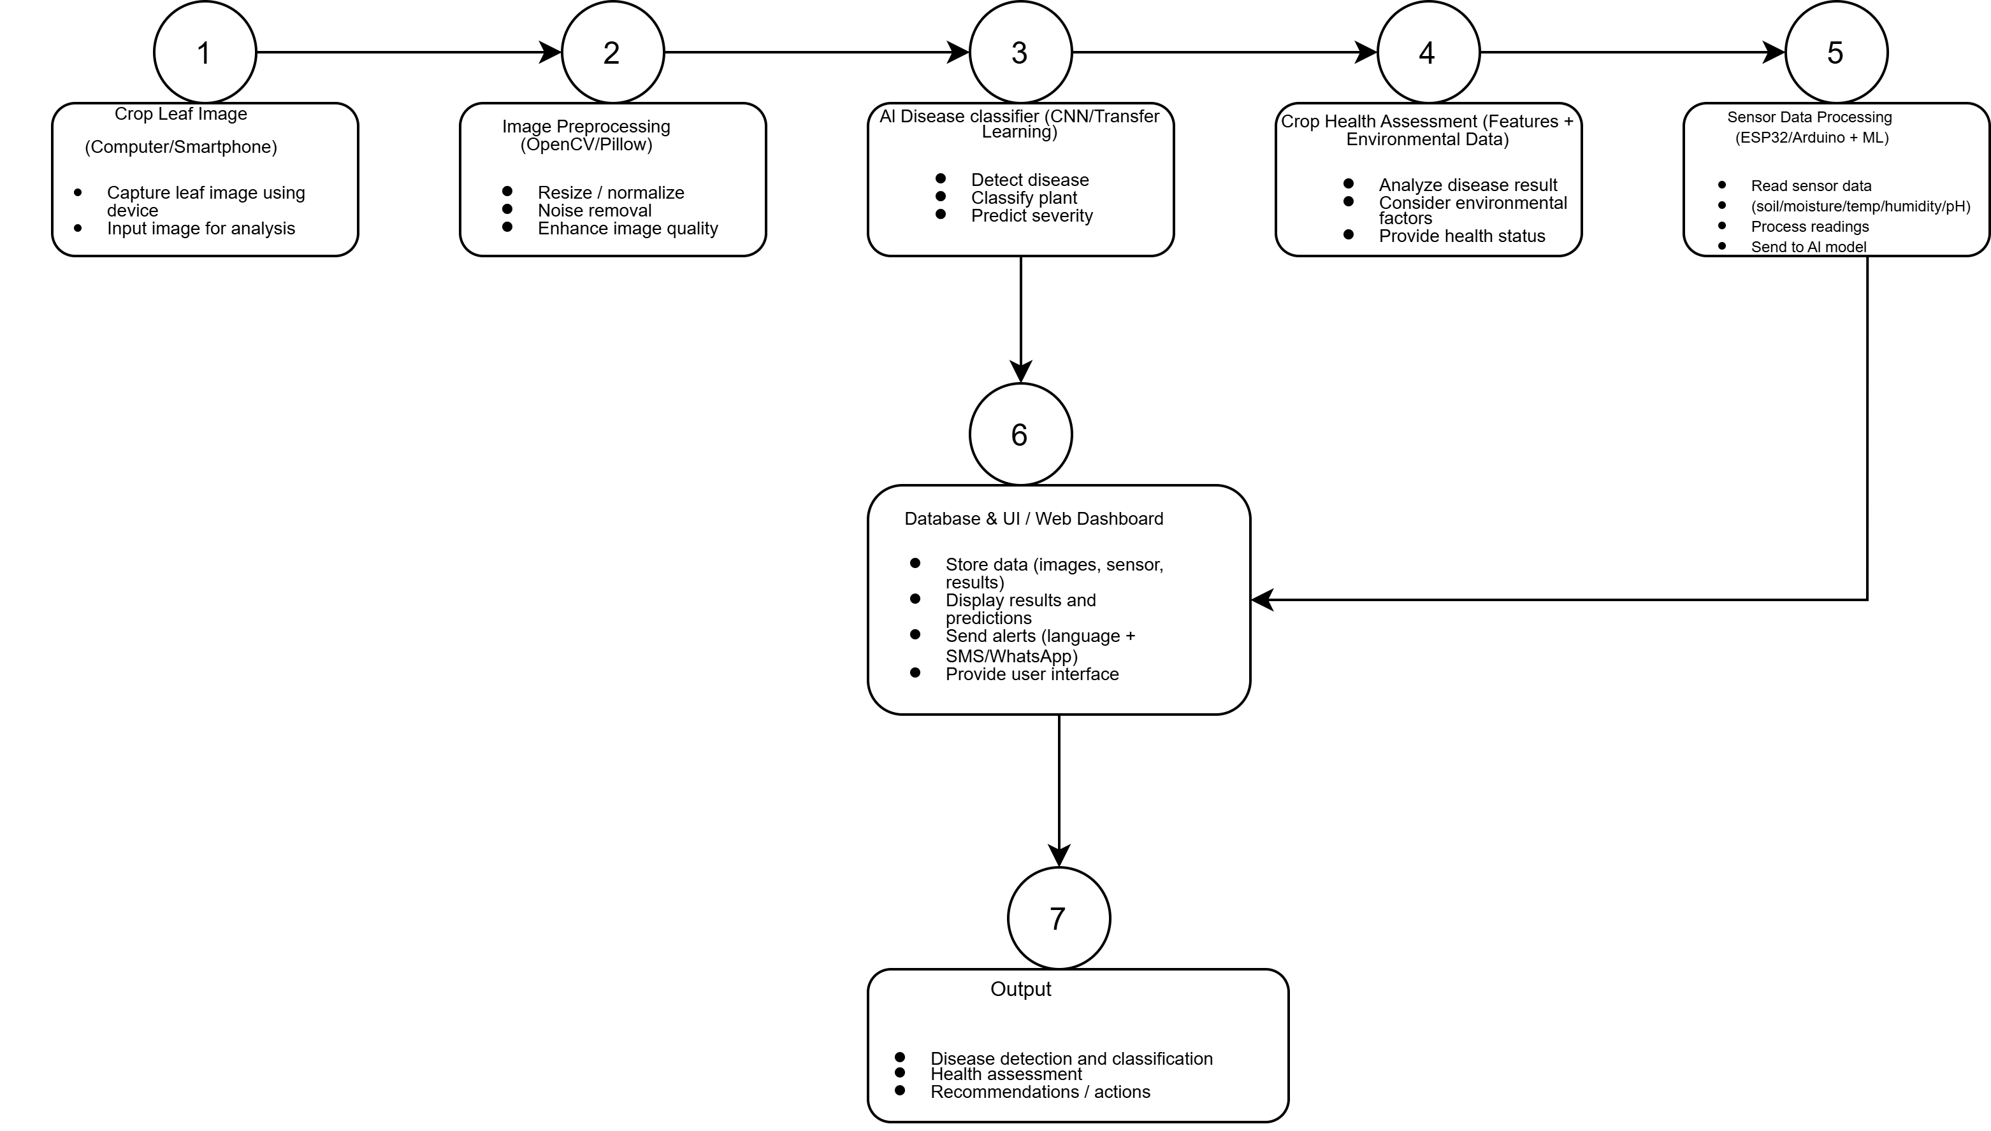
SYSTEM DESIGN & FLOW
7
Proposed system architecture

Slide 8
RESEARCH FOUNDATION
8
Literature-backed methodology
Pipeline choice | Supported by | Why it matters
Lightweight MobileNetV2 backbone | Howard et al. [1]; Rahaman et al. [2] | 3.4M params; sub-45ms inference on phone browsers without cloud GPUs.
Joint multimodal latent fusion | Tamboli et al. [3]; Sivakumar et al. [4] | Overcomes silo failure of base paper; +11.25% higher diagnostic accuracy.
CLAHE in LAB color space | Reza [5]; Majdalawieh et al. [6] | Removes outdoor shadows and glare without shifting natural leaf color.
Foliar benchmark dataset | Mohanty et al. [PlantVillage, 7] | Standard benchmark of 54,306 images for reproducible baselines.
Closed-loop agronomic prescriptions | Margwe et al. [8]; ICAR / FAO [9] | Bridges diagnosis to treatment with verified chemical dosages in g/L.

Slide 9
PROJECT ROADMAP & FUTURE WORK
9
Future scope
Hardware & Field Automation
AI & Platform Expansion
â€¢ Physical ESP32 solar nodes with LoRaWAN wireless telemetry
â€¢ Agricultural drone integration for aerial crop canopy scanning
â€¢ Automated solenoid valves for precision spot spraying
â€¢ Real-time NPK nutrient soil sensor probes
â€¢ Scale disease detection library to all 38 crop categories
â€¢ Multilingual voice advisory in Kannada, Hindi, and Telugu
â€¢ Progressive Web App (PWA) with offline SQLite cache
â€¢ Satellite weather forecast integration for outbreak alerts

