Slide 1
LIVE SCHOOL FOR WORLD CLASS FREE EDUCTION
PIP104 PROFESSIONAL PRACTCE-ll
VIVA-VOCE
Batch Number:06
Roll Number | Student Name
20201CEI0004 | DEVATHI VENKATA SAI SUBHASH
20201CEI0016 | TARIGONDA SOWMYA
20201CEI0017 20201CEI0058 | KONDA BHAVYA KURRA BHARGAV REDDY
Under the Supervision of,
Dr. MOHAMED SHAKIR
Professor
School of Computer Science & Engineering
Presidency University

Slide 2
Introduction
In this decade (2023) we are far more educated compared to the previous decade most of the problems regarding education but still, we are facing some of the issues for education some issues are (technological barriers, Economic disparities, lack of quality teachers etc..) this are a few problems for not getting 100% literacy(education).
Our Project, we are doing this project is to solve the above problems and to give quality education to everyone in the world and increase the literacy rate in the world, and to give education to the everyone in the world.
Worldwide access to free education is a critical topic that holds the potential to transform societies and uplift individuals by breaking down barriers to knowledge and skills.

Slide 3
Live school for world-class free education is all about those who can’t afford the fees and unable to get the education this application well proved the education they need. From this application we can increase the literacy rate in the entire world
Education is a fundamental human right and a powerful tool for addressing inequality, promoting economic growth, fostering innovation, and ultimately achieving sustainable development goals.
This concept encompasses primary, secondary, and higher education, encompassing both formal and informal learning environments.

Slide 4
we will delve into the importance of free education at a global level, the challenges in implementing it, and the need for collaborative efforts from governments, institutions, and civil society to create a world where education is truly accessible to all.
The Live School model, as envisioned in this discourse, transcends traditional paradigms, weaving together the threads of innovation, inclusivity, and accessibility.
In a world where educational disparities persist, Live Schools emerge as beacons of hope, offering dynamic and immersive learning environments that go beyond mere dissemination of information.

Slide 5
Literature Review
1]Title: "The Evolution of Open Education"
This review traces the historical development of open education, highlighting the shift towards live and interactive learning environments. It explores how Live Schools contribute to breaking down barriers and expanding access to quality education.
2]Title: "Digital Pedagogy: A Framework for Live Schools"
Focusing on pedagogical aspects, this review investigates how digital tools within Live Schools enhance teaching methodologies. It delves into the effectiveness of real-time engagement, collaborative learning.

Slide 6
Literature Review
3]Title: "Global Inclusivity in Live Education"
Addressing the inclusivity aspect, this review explores how Live Schools break down geographical barriers. It analyzes case studies and testimonials showcasing the impact of live education on learners from diverse cultural and socioeconomic backgrounds.
4]Title: "Assessment Strategies in Live School Environments"
Focusing on evaluation methodologies, this review investigates how Live Schools ensure fair and effective assessment. It explores real-time evaluation methods, continuous feedback loops, and adaptive assessment tools within the virtual classroom.

Slide 7
Research Gaps Identified
The implementation of the "Live School for World Class Free Education" project presents several research gaps. Firstly, there is a need for comprehensive studies on the effectiveness of live teaching methods compared to traditional approaches, assessing their impact on student learning outcomes and engagement. Additionally, exploring the technological infrastructure required for seamless live education delivery, considering factors like internet accessibility and device availability, is crucial. Understanding the socio-economic barriers that might hinder access to live schooling is another area that warrants in-depth investigation. Furthermore, research on the pedagogical strategies tailored to diverse learners within the live school framework is essential. Evaluating the scalability and sustainability of such a project over time is also a research gap that requires attention. Lastly, investigating the role of teacher training and support in the success of the live education model would contribute valuable insights for the project's long-term viability. Addressing these research gaps is fundamental to ensuring the project's effectiveness and inclusivity.

Slide 8
Proposed Method
Designing a world-class free education system requires a comprehensive approach. Our proposed method for a live school revolves around leveraging digital technologies to create an interactive and accessible learning environment.
Firstly, establish a centralized online platform with live streaming capabilities, ensuring real-time interaction between educators and students globally. Implement a diverse curriculum covering various subjects and skill sets to cater to a wide audience.
Integrate collaborative tools for group projects and discussions, fostering a sense of community and teamwork. To ensure inclusivity, provide multilingual support and accessibility features for differently-abled students.

Slide 9
Proposed Method
Employ adaptive learning algorithms to personalize the educational experience, addressing individual learning styles and pace. Gamify elements of the curriculum to enhance engagement and motivation.
Constantly iterate and evolve the system based on user feedback and advancements in educational technology. By combining innovation, inclusivity, collaboration, and adaptability, the proposed live school can serve as a model for world-class free education, promoting lifelong learning and contributing to the global knowledge pool.

Slide 10
Methodology
Needs Assessment and Stakeholder Engagement:
a. Conduct Surveys and Interviews: Engage with diverse stakeholders, including potential learners, educators, policymakers, and community representatives, to understand their needs, preferences, and challenges in accessing education.
b. Analyze Existing Initiatives: Evaluate similar projects, both locally and globally, to identify best practices, lessons learned, and potential collaboration opportunities.
Define Objectives and Scope:
a. Set Clear Project Objectives: Define specific, measurable, achievable, relevant, and time-bound (SMART) objectives to guide the project and measure its success.
b. Establish Scope and Focus Areas: Determine the educational levels (e.g., primary, secondary, higher education), subjects, and geographic regions that the initiative will target.

Slide 11
Objectives
Monitoring, Evaluation, and Continuous Improvement:
a. Implement Metrics and Key Performance Indicators (KPIs): Define and track KPIs to evaluate the project' s impact, user engagement, and educational outcomes.
b. Conduct Regular Reviews: Analyze the data collected, conduct regular reviews, and use the insights to continuously improve the platform, curriculum, and overall project.
Sustainability and Scaling:
a. Explore Funding Models: Investigate sustainable funding models, including grants, sponsorships, donations, and potential revenue streams while maintaining the free education aspect.
b. Plan for Expansion: Develop a scaling strategy to expand the project to new regions, languages, and educational levels, reaching a broader audiences.

Slide 12
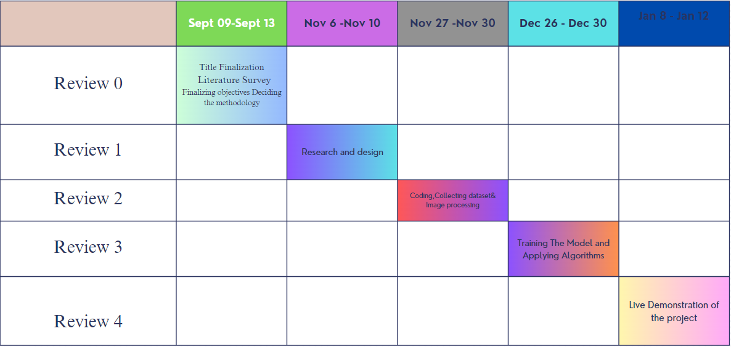
Timeline of the Project

Slide 13
Expected Outcomes
Universal Access to Education:-
• Outcome: Ensuring access to quality education for individuals worldwide, regardless of their geographical location or socioeconomic status. Increased Literacy and Education Levels:-
• Outcome: Elevating global literacy rates and educational attainment, leading to a more informed and knowledgeable population.
Skill Development and Employability:-
• Outcome: Equipping learners with diverse skills and knowledge, enhancing their employability and fostering entrepreneurship.

Slide 14
Conclusion
In conclusion, the vision of a live school delivering world-class free education emerges as a powerful catalyst for positive global change. This groundbreaking concept, rooted in the principles of accessibility, inclusivity, and innovation, has the potential to redefine the landscape of education. As we delve into the intricate layers of this transformative idea, we recognize its capacity to break down the barriers that have historically impeded access to quality education. The live school model, with its emphasis on real-time interaction, opens doors for learners worldwide, providing them with a virtual space where geographical constraints cease to be impediments By intertwining personalized learning experiences with the delivery of world-class curriculum, the live school aspires to cultivate not only knowledgeable individuals but also critical thinkers, problem solvers, and global citizens prepared for the complexities of the modern world.

Slide 15
References
[1] Michael Gaebel, "MOOCs-Massive Open Online courses," EUA Occasional papers, January 2013 (general references). Show in Context Google Scholar
[2] Li Yuan and Stephen Powell, "MOOCs and Open Education: Implications for higher education-A white paper," JISC, CETIS, March 2013, (http://publications. cetis. ac. uk/2013/667). Show in Context Google Scholar
[3] Ellis Booker, "Early MOOC takes a different path," January 2013, (http://www. InformationWeek.co.uk/education/online-learning/earlymooc-takes-a-different-path/240147364) Show in Context Google Scholar
[4] Anant Agarwal, "edX Celebrates Our First Anniversary," June 3, 2013, edX Blog (https://www. edx. O
rg/blog/edx-celebrates-our-first/943) Show in Context Google Scholar
[5] Alexander, P. A. (2003). The Development of Expertise: The Journey From Acclimation to Proficiency. Educational Researcher, 32(8), 10–14. doi:10.3102/0013189X032008010

Slide 16
[6] Anderson, T. (2003). Getting the Mix Right Again: An Updated and Theoretical Rationale for Interaction. The International Review of Research in Open and Distance Learning. Retrieved from http://www.irrodl.org/index.php/irrodl/article/view/149/230
[7] Beck, K., Beedle, M., Van Bennekum, A., Cockburn, A., Cunningham, W., Fowler, M., … Thomas, D. (2001). Agile Manifesto. Software Development. San Francisco, CA: Miller Freeman, Inc. Retrieved from http://agilemanifesto.org/
[8] Clark, R.C & Mayer, R.E. (2011). E-learning and the Science of Instruction. San Francisco: Pfeiffer.

Slide 17
Thank You

