Slide 1

SUPPLY CHAIN ANALYTICS(DA)-CAPSTONE PROJECT
Notes:
Objective

Slide 2
IMPACT OF LOADER CLASS IN PERFORMANCE
Notes:
Objective

Slide 3
Objective
Background
Key findings
Recommendations
Appendix:
Data sources
Data methodology
Data model assumptions
AGENDA
Notes:
Objective

Slide 4
OBJECTIVE
Improve the efficiency of production
Improve our understanding about equipment with low and high performance
Provide recommendations to our operations team
Notes:
Objective

Slide 5
BackGround
Top 5 performing equipment belongs to equipment category Shovel class in terms of Average rate .
Bottom 5 performing equipment belongs to equipment category Loader class in terms of Average rate .
Performance and quality of the equipment plays a vital role in deciding the OEE .
Notes:
Objective

Slide 6
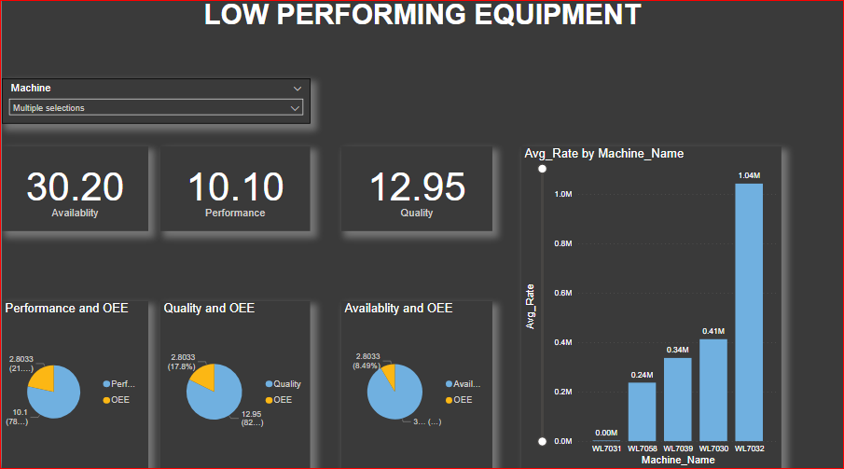
Low Performing Equipment
Average production rate of the bottom 5 machine is less than 2 million.
All the Bottom 5 performing machines belongs to the Loader Class Category.
OEE of the Truckers in this category is very low .
Notes:
Objective

Slide 7
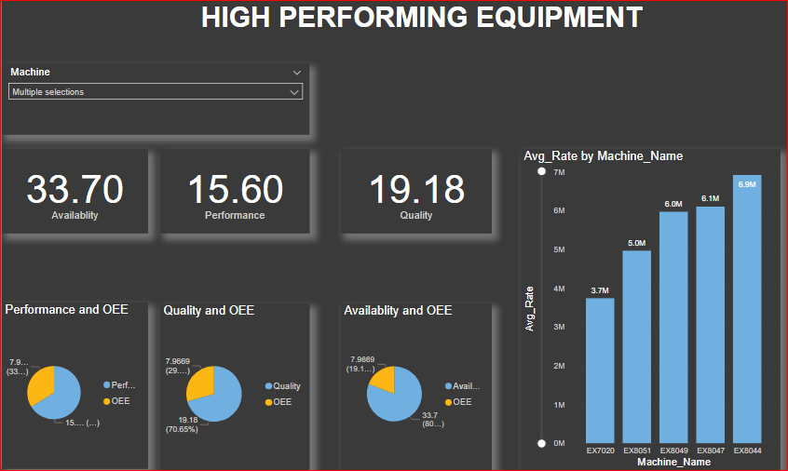
High Performing Equipment
Average production rate of the Top 5 machine is around 28 million.
The top 5 performing machines belongs to the Shovel Class Category.
OEE of the top 5 Truckers is three times more than the OEE of the bottom 5 Truckers..
Notes:
Objective

Slide 8
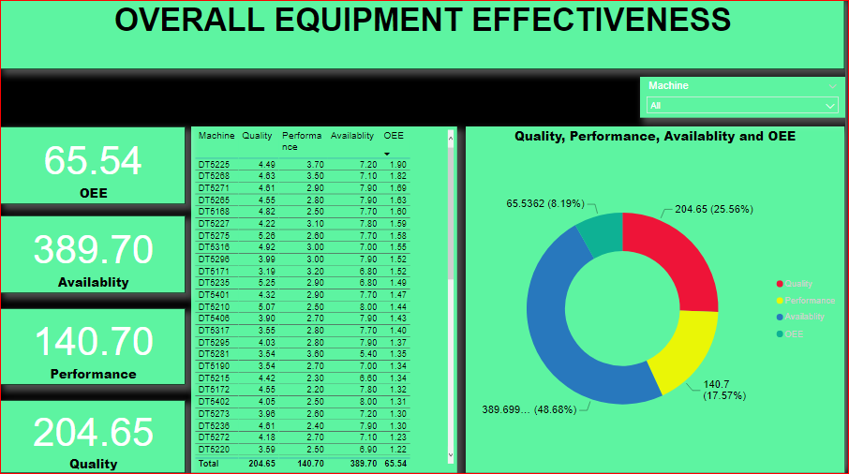
OEE
Availability of equipment category Truck is significantly high .
High Availability results in decrease in performance.
Top and Bottom 5 Truckers are related with shovel and Loader class category.
Notes:
Objective

Slide 9
RECOMMENDATIONS
Focus more on Loader class machines to increase the production.
Reduce the volume of bottom 5 truck class and Increase the volume of the top 5 Truck class and observe the OEE.
Increase the capacity of Loader class.
Notes:
Objective

Slide 10
APPENDIX - DATA SOURCES:
Here is a snapshot of our data dictionary.
Machine info such as Primary ,secondary machine name ,Equipment type and their category , Time duration for each type of cycle etc.
Location Id , Name , latitude, longitude
Delay info such as delay id ,delay class, start and end time of delay ,Machine name etc.
The team used the following data sources:
Cycle Data
Location Data
Delay Data
Notes:
Objective

Slide 11
APPENDIX - DATA METHODOLOGY
We conducted a thorough analysis of the open pit mining Dataset. The process included:
Cleaning the data set using jupyter notebook (python)
Imputed missing values ,capped outliers and done the basic checks of the EDA before loading it in to MYSQL
Cleaned data is loaded into to MYSQL by integrating python with MYSQL and created tables and stored procedures in MYSQL. Derived new columns to understand the insights better and finally imported the MYSQL data to POWER BI & created visualization for the analysis.
Notes:
Objective

Slide 12
There were certain gaps due to data unavailability as well as dated information.
Assumption that decreasing availability will result in increase in performance and quality.
Assumption that volume increase in Top 5 Truck class will also result in increase in the performance
Focusing more on bottom 5 truck class to find out the exact reason for their drop in OEE is because of Loader class performance.
APPENDIX - DATA ASSUMPTIONS
Notes:
Objective

