Slide 1
Temperature Control Using PC Cooling Fan
1
Venkata Sasikiran VEERAMACHANENI
g00977751

Slide 2
ABOUT PROJECT
2
The main idea of the project is to vary speed of a cooling fan based upon the temperature reading from a temperature sensor and at the same time to display the temperature reading and the fan speed on a mobile device connected through a Bluetooth module.
Components:
MSP430FR6989(Micro-Controller)
HC-06(Bluetooth Module)
LM-35(Temperature sensor)
MGT8012UR-W25(4-Wire Cooling Fan)

Slide 3
CONNECTION DIAGRAM
FG
MGT8012UR-W25
4-WIRE COOLING FAN
LM35
TEMPERATURE SENSOR
Vcc
PWM
Gnd
Out
Pwr
Gnd
3
12V
1KΩ
R1
3.3V
P4.2
P9.1
P4.3
MSP430FR6989
P2.0
P3.3
GND
Vcc
HC-06
BLUETOOTH MODULE
RXD
TXD
Gnd

Slide 4
ABOUT SCHEDULER
4
Application was divided into 5 tasks
Co-operative Scheduler has been used to schedule the tasks
Program has a main task which consists of multiple leave points to the scheduler.
RTOS objects used:
Tasks
ISRs
Binary Semaphores
Hard Timers
Counters
Stack

Slide 5
TASKS
5
5 Tasks:
Sending data to mobile device to display on its screen
Taking a reading of temperature
Controlling the speed of the fan
Calculating the speed of Cooling Fan
Push Button(Disturbance)
Tasks 1, 2, 3 are regular tasks and they have same priority.
Tasks 4, 5 are ISR tasks and they have highest priority compared to regular tasks. Between task 4 and task 5 both have same priority.
Push button task is used to induce some disturbance into the system

Slide 6
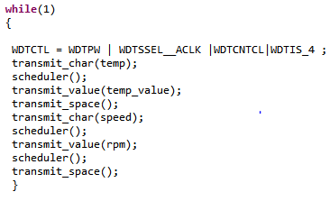
TASK 1:- Data Transmission
6
Sending temperature reading and RPM of fan to a mobile device using HC-06 Bluetooth module
On a mobile device we use a open source mobile application to display the readings
It is the main task that has multiple leave points to the scheduler
This task executes in infinite loop
Leave points
FIG: Snippet of code

Slide 7

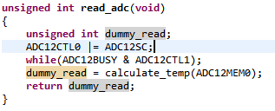
TASK 2:-Temperature Measurement
7
LM-35 has been used to measure the temperature
Its output is voltage in millivolts equivalent to temperature measured
12 bit ADC samples the output voltage from the sensor
The ADC value is transformed into its equivalent temperature reading using appropriate transfer function
FIG: Snippet of code

Slide 8
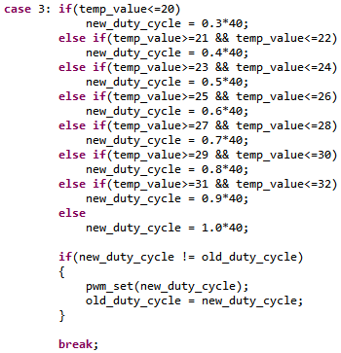
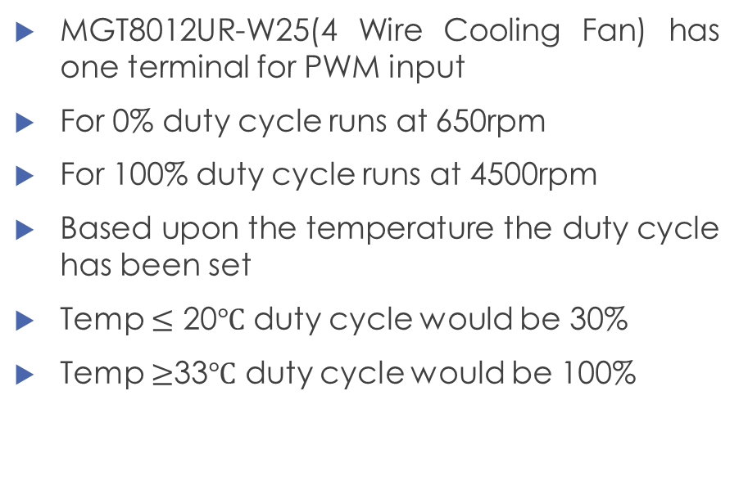
TASK 3:- Speed Control
8
MGT8012UR-W25(4 Wire Cooling Fan) has one terminal for PWM input
For 0% duty cycle runs at 650rpm
For 100% duty cycle runs at 4500rpm
Based upon the temperature the duty cycle has been set
Temp $≤$ 20$℃$ duty cycle would be 30%
Temp $≥$33$℃$ duty cycle would be 100%
FIG: Snippet of code

Slide 9
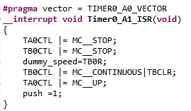

TASK 4:- Measurement of Speed
9
MGT8012UR-W25(4-Wire Cooling Fan) has been used to give cooling effect
It has inbuilt Hall sensor which gives out two pulses for every revolution of fan
These pulses are fed as clock source for Timer B0 to count the pulses
Timer A0 has been used to generate interrupt for every 0.5 sec in order to measure the speed
Task has been divided into ISR + Daemon task
ISR takes the counter value and assigns to some variable
Daemon task computes the speed of fan from the value in variable
ISR
Daemon
FIG: Snippet of code

Slide 10
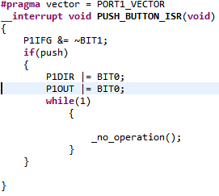
TASK 5:- Push Button
10
This task is for induction of some disturbance into the system
When Push Button S1 on the Launchpad pressed, it generates interrupt and makes the Processor to run in an empty infinite loop
Simulated to demonstrate starvation by high priority task
Simulated to demonstrate resilience shown by the application when some unexpected disturbance occurs
FIG: Snippet of code

Slide 11
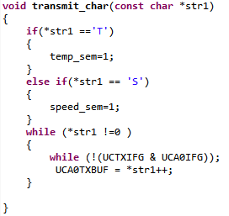
TASK SYNCHRONIZATION
11
Semaphores used:
temp_sem
speed_sem
Temp_sem is set when string “TEMP:” is transmitted to a mobile through Bluetooth module
Speed_sem is set when string “SPEED:” is transmitted to a mobile through Bluetooth module
FIG: Snippet of code

Slide 12
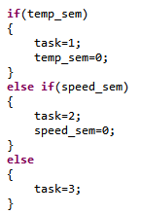
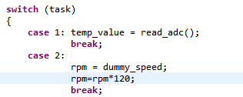
TASK SYNCHRONIZATION…..(contd)
12
Next when scheduler is called, it checks the semaphore and executes the respective task
If temp_sem is set temperature measurement task is executed
If speed_sem is set speed measurement task is executed
FIG: Snippet of code

Slide 13
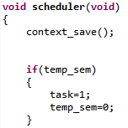
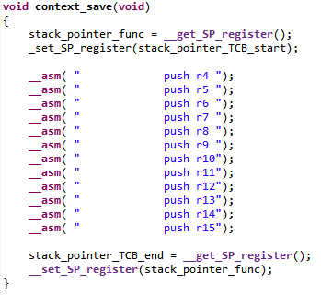
CONTEXT SWITCH
13
When scheduler is called, first of all context_save() function is executed.
It sets the Stack Pointer to 0x00239C address and saves the general purpose registers from that address top to down in the stack
It also saves the end address and reverts the Stack pointer to the address that it had before it started saving the context
Next scheduler checks the semaphores and choose corresponding task
FIG: Snippet of code

Slide 14

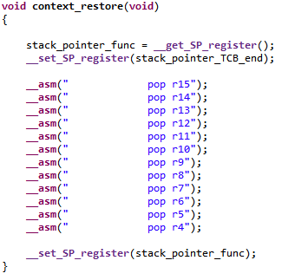
CONTEXT SWITCH…….(contd)
14
After the corresponding task execution done, before the scheduler exited, context_restore() function is executed.
It sets the Stack Pointer to end address of task context and pops the values into general purpose registers from that address, down to top, from the stack
After the restore is done, the scheduler is exited
The main task execution resumes from the point where it was interrupted
FIG: Snippet of code

Slide 15
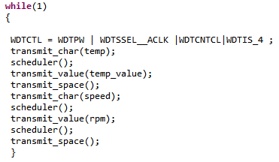
RESILIENCE
15
Watch Dog Timer is implemented in the application in order to make it resilient to unexpected faults
WDT is kicked at the start of every loop of Task 1
The timer has been set to 1sec
If some unexpected disturbance occurs in the execution, this prevents kicking the WDT
This makes the timer to expire and reset of the system is made
Kicking WDT
FIG: Snippet of code

Slide 16
ANY QUESTIONS????
16
THANK-YOU…..!!!!
Demo follows….!!!!

Slide 17
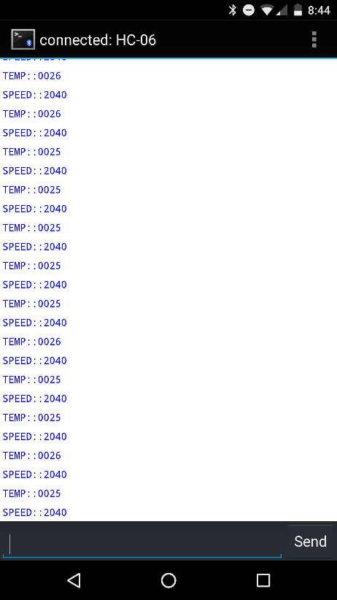
17

