Slide 1
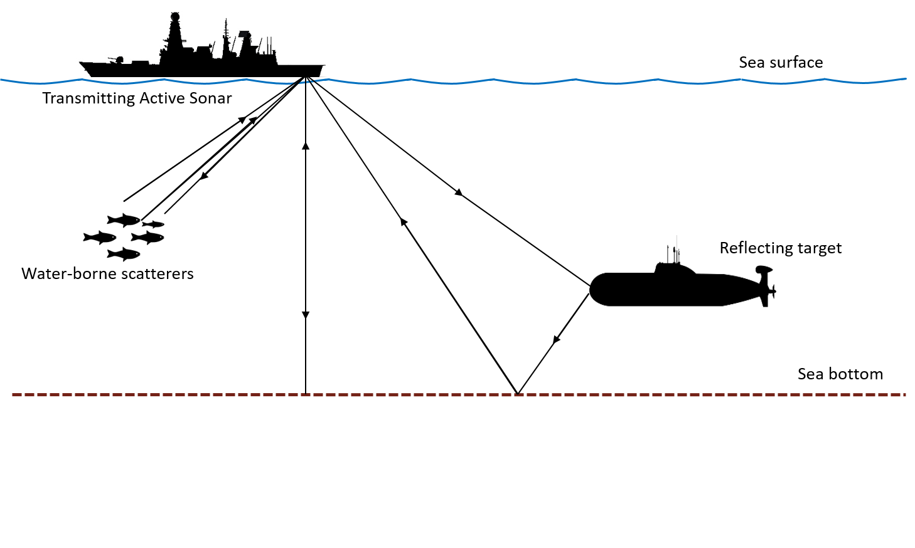
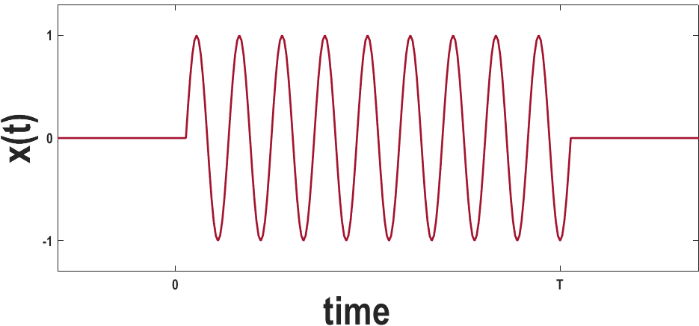
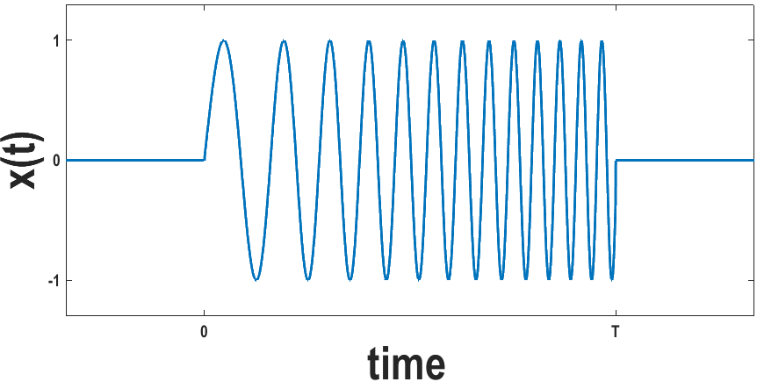

Intelligent Selection of Transmission Waveform for Active Sonar
using Predicted Target State
Venkata Sasikiran Veeramachaneni
Electrical and Computer Engineering
George Mason University
October 9th, 2019
CW
FM
Thesis Director: Dr. Jill K Nelson
1/46

Slide 2
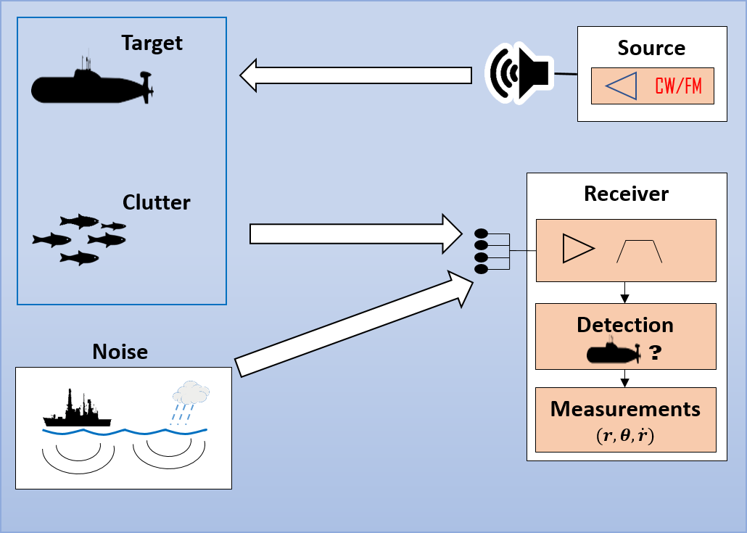


An underwater tracking system is a combination of an active sonar subsystem
and a tracking filter algorithm
Sonar Platform
$$0°$$
bearing
$$\begin{matrix}x \\ y \\ \dot{x} \\ \dot{y}\end{matrix}$$
Target
Y-axis
range
Target
X-axis
Tracking
Filter
Estimated State
Active sonar subsystem
Notes:
Combination of slide 4 and 5 in old presentation
Talk about range bearing range rate
Talk about clutter points also in measurements
Tracking filter efilters out the noise and estimate the state in terms of position in x and y and xdot and y dot

Slide 3
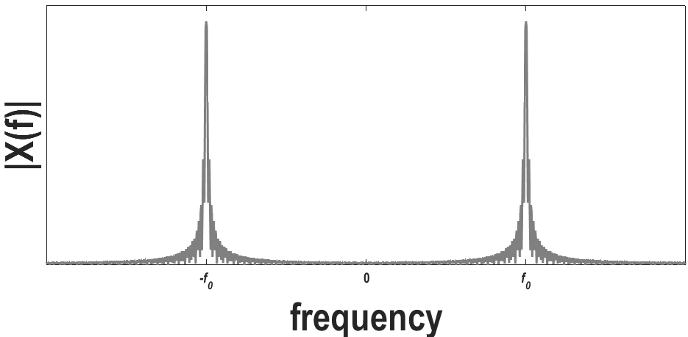
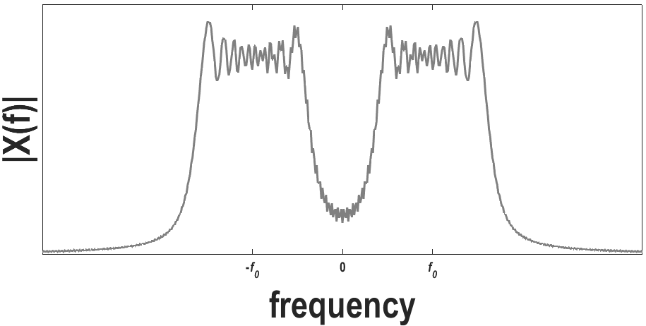
CW and FM pulses are the common sound pulses used in the transmission by an active sonar
Continuous wave (CW) pulse
Frequency modulate (FM) pulse
FM
Notes:
These are the not only pulses available

Slide 4
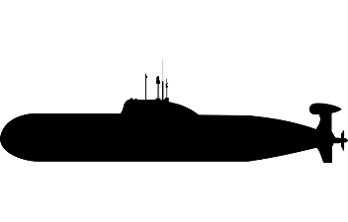


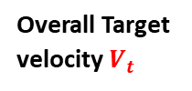
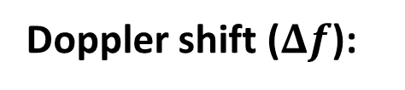



CW and FM pulses differ in terms of range resolution they provide and
Doppler shift sensitivity
$$ΔR$$
Range resolution ($ΔR$):
Target A
Target B
Sonar Platform
Line of sight
Doppler shift ($Δf$):
$$V_{los}$$
$$Δf∝{|V}_{los}|$$
Overall Target velocity $V_{t}$
Target
$$V_{orth}$$
Notes:
Range resolution is the required minimum separation between closely spaced targets. Vlos is also known as range-rate or radial velocity

Slide 5







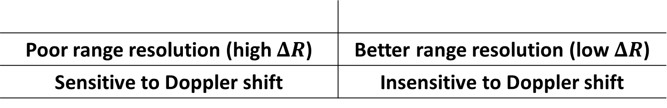

CW and FM pulses differ in terms of range resolution they provide and
Doppler shift sensitivity
CW
FM
Poor range resolution (high $ΔR$) | Better range resolution (low $ΔR$)
Sensitive to Doppler shift | Insensitive to Doppler shift
$$Δf$$
$$Δf$$
$$BT=20$$
$$R$$
$$\frac{0.9}{T}$$
$$R$$
$$\frac{12}{T}$$
$$33T$$
$$450T$$
3dB contours of ambiguity function

Slide 6
CW and FM transmission corresponds to the input of 3-D and 2-D measurements, respectively, to the tracking filter
3-D measurements (noisy range, noisy bearing, & noisy range-rate)
CW Transmission
Tracking
Filter
Estimated State
2-D measurements (noisy range & noisy bearing)
Estimated State
FM Transmission
Tracking
Filter

Slide 7
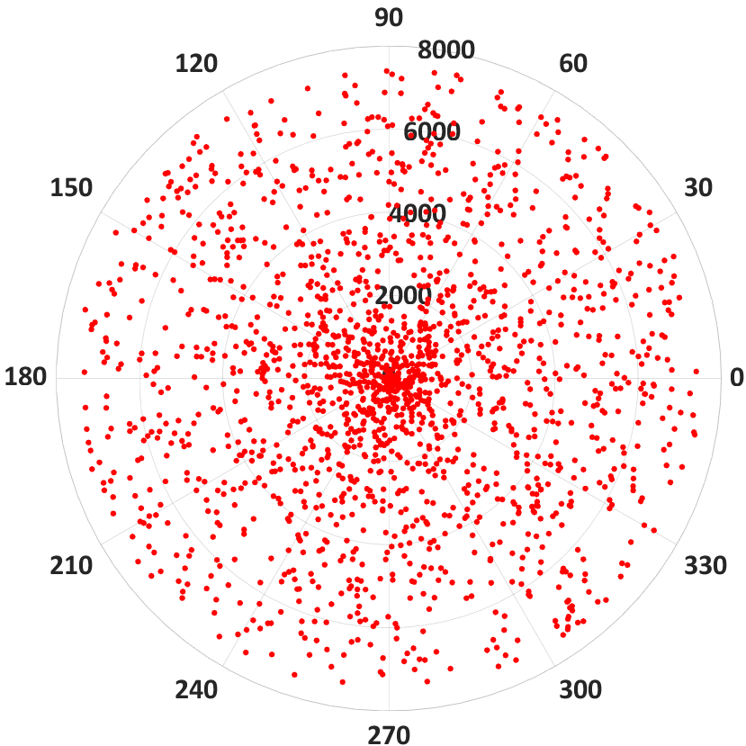

An FM pulse is preferable for low Doppler targets, whereas a CW pulse is for high Doppler targets
Clutter measurements
High Doppler
Low Doppler
Sonar platform
Sensitivity to Doppler shift Required
Low $ΔR$ Required
Clutter dominated environment
CW
FM
Notes:
Doppler means range-rate

Slide 8
Existing adaptive approaches do not consider target’s Doppler or environment characteristics in choosing the transmission waveform
Waveform optimization
Tracking
Filter
Mean square tracking error
Estimated State
Notes:
We want investigate the impact of waveform selection based on the target and environement characteristics on the target tracking

Slide 9
Proposed approach uses predicted target Doppler in choosing the sound pulse for the next transmission instant
PSBS: Predicted State Based Selection
PSBS
Predicted State
Tracking
Filter
Estimated State
Notes:
We propose an approach called predicted state based selectionb

Slide 10







Proposed approach uses predicted target Doppler in choosing the sound pulse for the next transmission instant
Sonar Platform
$$|V_{los}|≥{|V}_{orth}|$$
Line of sight
$$φ≤45°$$
True
False
$$V_{los}$$
CW
FM
Overall Target velocity $V_{pred}$
$$φ$$
$$V_{orth}$$

Slide 11
Active sonar subsystem can be abstracted by a target path simulator and a measurement data modeler together
PSBS
Target Path Simulator
Measurement Data Modeler
Predicted State
Tracking
Filter
Estimated State

Slide 12
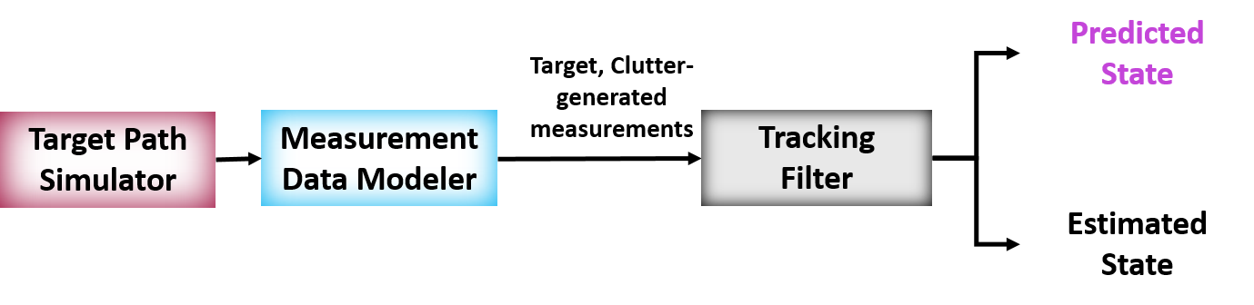

A tracking system model is required to test the PSBS approach performance
Target Path Simulator
Tracking System Model
Measurement Data Modeler
Measurements
$$(r,θ,\dot{r})$$
Measurements
Tracking Filter Algorithm
Tracking
filter
Estimated State

Slide 13
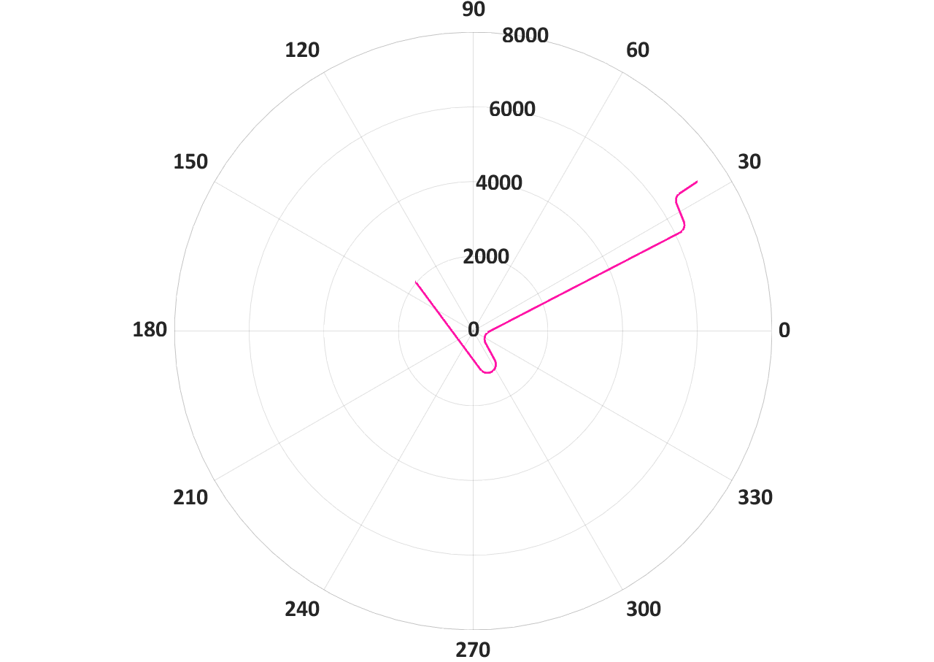




Simulated target paths have straight-line and maneuver segments, offering varying levels of Doppler
Coordinated turn Model:
$$\left(\begin{matrix}x_{k+1} \\ y_{k+1} \\ {\dot{x}}_{k+1} \\ {\dot{y}}_{k+1}\end{matrix}\right)= \left(\begin{matrix}1 & 0 & \frac{\sin\left(\frac{ω}{f}\right)}{ω} & \frac{\cos\left(\frac{ω}{f}\right)−1}{ω} \\ 0 & 1 & \frac{1−\cos\left(\frac{ω}{f}\right)}{ω} & \frac{\sin\left(\frac{ω}{f}\right)}{ω} \\ 0 & 0 & \cos\left(\frac{ω}{f}\right) & −\sin\left(\frac{ω}{f}\right) \\ 0 & 0 & \sin\left(\frac{ω}{f}\right) & \cos\left(\frac{ω}{f}\right)\end{matrix}\right)\left(\begin{matrix}x_{k} \\ y_{k} \\ {\dot{x}}_{k} \\ {\dot{y}}_{k}\end{matrix}\right)$$
$f:$ Sampling frequency
$ω:$ Target turn-rate
Start location
Constant Velocity Model:
$$\left(\begin{matrix}x_{k+1} \\ y_{k+1} \\ {\dot{x}}_{k+1} \\ {\dot{y}}_{k+1}\end{matrix}\right)=\left(\begin{matrix}1 & 0 & \frac{1}{f} & 0 \\ 0 & 1 & 0 & \frac{1}{f} \\ 0 & 0 & 1 & 0 \\ 0 & 0 & 0 & 1\end{matrix}\right)\left(\begin{matrix}x_{k} \\ y_{k} \\ {\dot{x}}_{k} \\ {\dot{y}}_{k}\end{matrix}\right)$$
Notes:
Talk about f and omega

Slide 14
A tracking system model is required to test the PSBS approach performance
Target Path Simulator
Target-generated measurement
Tracking System Model
Measurement Data Modeler
Measurements
$$(r,θ,\dot{r})$$
Clutter-generated measurements
Measurements
Tracking Filter Algorithm
Tracking
filter
Estimated State

Slide 15
Structure of the target-generated measurement depends on the transmitted waveform
Target-generated measurement
CW version
(3-D vector)
FM version
(2-D vector)
Noisy range
Noisy bearing
Noisy range-rate
Noisy range
Noisy bearing

Slide 16





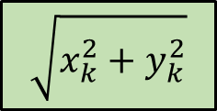
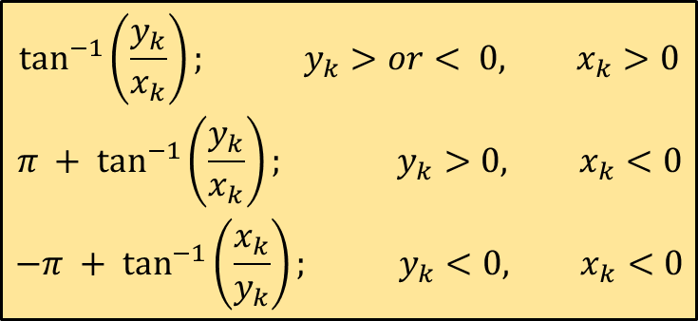
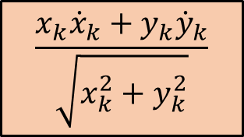




Range, bearing, and range-rate are obtained by using standard nonlinear conversion functions on the simulated state
Range:
$$\sqrt{x_{k}^{2}+y_{k}^{2}}$$
$$x\left(k\right)$$
$$r_{k}$$
$$h_{r}$$
$$\begin{aligned}\tan^{−1}\left(\frac{y_{k}}{x_{k}}\right); y_{k}>or< 0, x_{k}>0 \\ &π + \tan^{−1}\left(\frac{y_{k}}{x_{k}}\right); y_{k}>0, x_{k}<0 \\ −π + \tan^{−1}\left(\frac{x_{k}}{y_{k}}\right); y_{k}<0, x_{k}<0\end{aligned}$$
Bearing:
$$x\left(k\right)$$
$$θ_{k}$$
$$h_{θ}$$
$$\frac{x_{k}{\dot{x}}_{k}+y_{k}{\dot{y}}_{k}}{\sqrt{x_{k}^{2}+y_{k}^{2}}}$$
Range-rate:
$$x\left(k\right)$$
$$r_{k}$$
$$h_{\dot{r} }$$

Slide 17
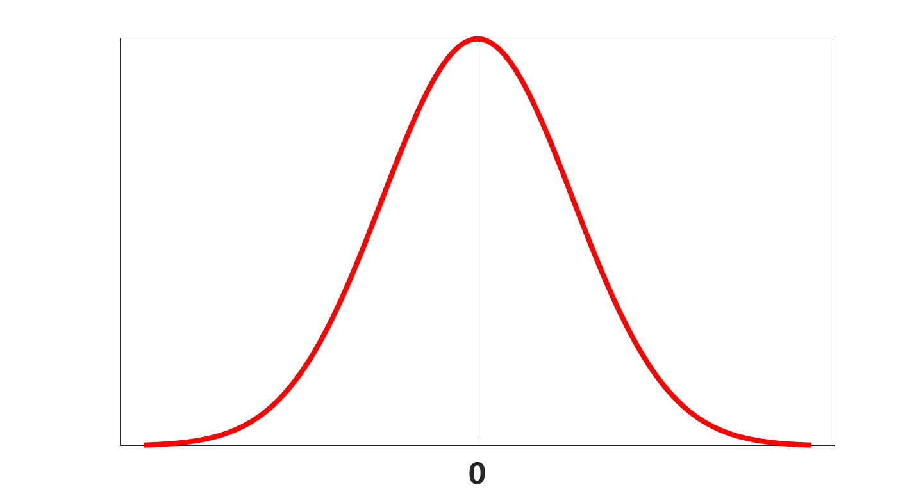
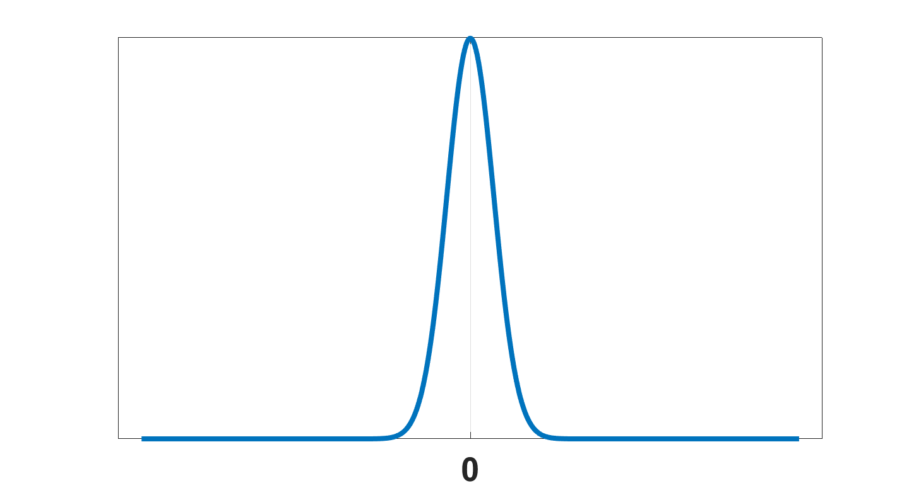
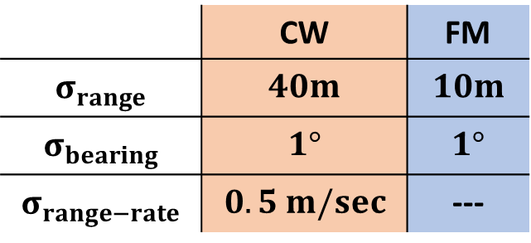
Range, bearing, and range-rate are corrupted with Gaussian noise of corresponding variance to model the target-generated measurement
CW version
Target range
Range
FM version
Target range
Range
 | CW | FM
$$σ_{range}$$ | $$40m$$ | $$10m$$
$$σ_{bearing}$$ | $$1°$$ | $$1°$$
$$σ_{range−rate}$$ | $$0.5 m/sec$$ | ---
Measurement noise version 1

Slide 18
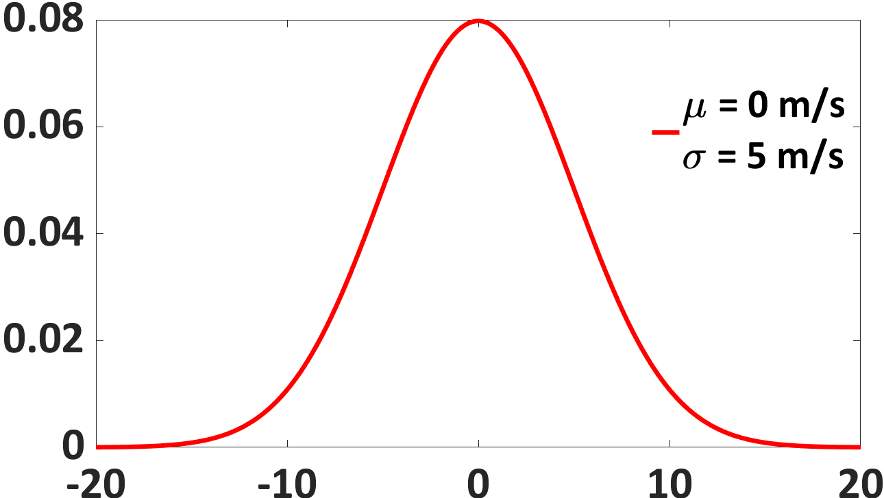
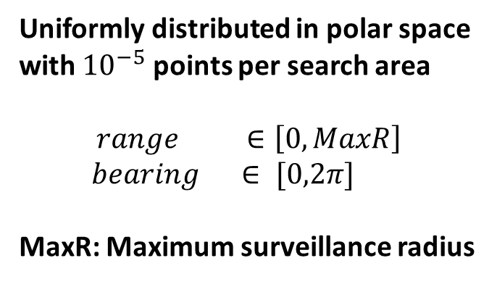
Clutter-generated measurements are modeled as uniformly distributed points in polar space
Uniformly distributed in polar space with ${10}^{−5}$ points per search area
$$range ∈\left[0, MaxR\right]$$
$bearing ∈ [0,2π]$
MaxR: Maximum surveillance radius
Sonar platform
Range-rate
Notes:
With this the

Slide 19
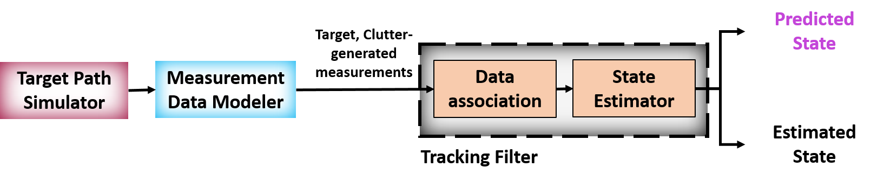
A tracking system model is required to test the PSBS approach performance
Target Path Simulator
Tracking System Model
Measurement Data Modeler
Measurements
$$(r,θ,\dot{r})$$
Data Association
Measurements
Tracking Filter Algorithm
Tracking
filter
Estimated State
State Estimator
Notes:
Next we talk about the the tracking filter algorithm. It is a combination of state estimator and data association. More details about the both are discussed in the following slides.

Slide 20



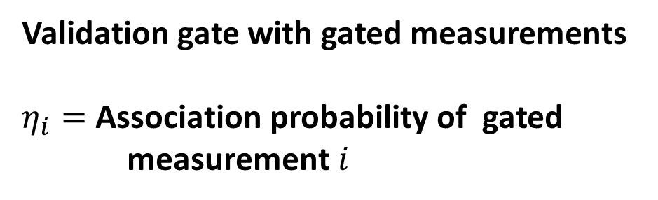









Data association is used to extract a single measurement or its equivalent from multiple observed measurements
Validation gate with gated measurements
$η_{i}=$ Association probability of gated measurement $i$
$$z_{3}$$
$$\hat{z}$$
Predicted measurement
$$z_{2}$$
$$z_{1}$$
$$z_{1}$$
$$η_{1}$$
$$z_{2}$$
$$η_{2}$$
$$z_{s}$$
Weighted measurement
$$.$$
.
$$z_{m}$$
$$η_{m}$$
Notes:
Explain v, \gamma, e, b m_k
Explain the gated region as the mahalonabis distance between the

Slide 21

State estimator estimates the current state of the target based on the input weighted noisy measurement
Prior information
Dynamic motion model
Predicted State
Weighted measurement
$$z_{s}$$
Measurement model
Estimated State
UKF
algorithm
State estimator
Notes:
State estimator estimates current state of the target using noisy measurement based on the dynamic motion model and observation model. The dynamic motion model is an abstraction of the targets true behavior which helps in modeling the evolution of target state in time and the measurement model helps in relating the target state and the measurement. The UKF algorithm estimate the target state based on the both models.

Slide 22
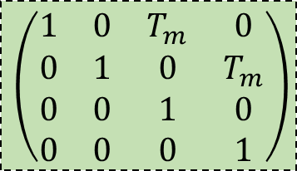
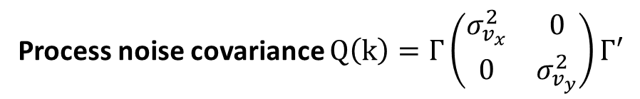




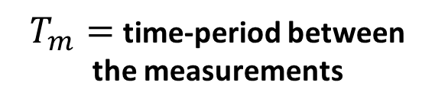
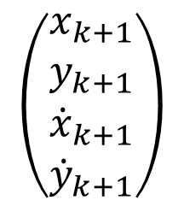
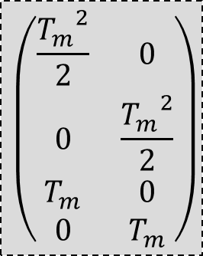
Dynamic motion model approximates the target’s behavior
$$\left(\begin{matrix}x_{k} \\ y_{k} \\ {\dot{x}}_{k} \\ {\dot{y}}_{k}\end{matrix}\right)$$
$$\left(\begin{matrix}x_{k+1} \\ y_{k+1} \\ {\dot{x}}_{k+1} \\ {\dot{y}}_{k+1}\end{matrix}\right)$$
F
$$Γ$$
$$\left(\begin{matrix}\frac{{T_{m}}^{2}}{2} & 0 \\ 0 & \frac{{T_{m}}^{2}}{2} \\ T_{m} & 0 \\ 0 & T_{m}\end{matrix}\right)$$
$$\left(\begin{matrix}v_{x} \\ v_{y}\end{matrix}\right)$$
$$\left(\begin{matrix}1 & 0 & T_{m} & 0 \\ 0 & 1 & 0 & T_{m} \\ 0 & 0 & 1 & 0 \\ 0 & 0 & 0 & 1\end{matrix}\right)$$
White noise
$T_{m}=$time-period between the measurements
Process noise covariance $Q\left(k\right)=Γ\left(\begin{matrix}σ_{v_{x}}^{2} & 0 \\ 0 & σ_{v_{y}}^{2}\end{matrix}\right)Γ′$
where $σ_{v_{x}}=σ_{v_{y}}=a_{max}$
Notes:
Gamma

Slide 23
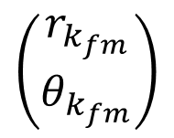
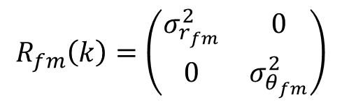

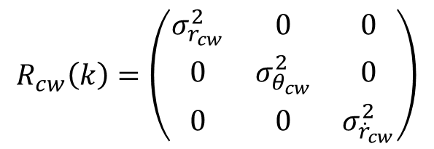
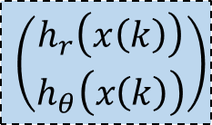
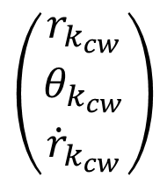
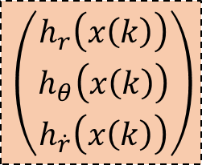





Measurement model relates the target state and the noisy input measurement
$$h_{cw}$$
$$\left(\begin{matrix}r_{k_{cw}} \\ θ_{k_{cw}} \\ {\dot{r}}_{k_{cw}}\end{matrix}\right)$$
Measurement noise covariance
$$x\left(k\right)$$
$$R_{cw}\left(k\right)=\left(\begin{matrix}σ_{r_{cw}}^{2} & 0 & 0 \\ 0 & σ_{θ_{cw}}^{2} & 0 \\ 0 & 0 & σ_{{\dot{r}}_{cw}}^{2}\end{matrix}\right)$$
$$\left(\begin{matrix}w_{r_{cw}} \\ w_{θ_{cw}} \\ w_{{\dot{r}}_{cw}}\end{matrix}\right)$$
$$\left(\begin{matrix}h_{r}\left(x\left(k\right)\right) \\ h_{θ}\left(x\left(k\right)\right) \\ h_{\dot{r}}\left(x\left(k\right)\right)\end{matrix}\right)$$
Measurement noise
$$\left(\begin{matrix}r_{k_{fm}} \\ θ_{k_{fm}}\end{matrix}\right)$$
$$x\left(k\right)$$
$$h_{fm}$$
Measurement noise covariance
$$R_{fm}\left(k\right)=\left(\begin{matrix}σ_{r_{fm}}^{2} & 0 \\ 0 & σ_{θ_{fm}}^{2}\end{matrix}\right)$$
$$\left(\begin{matrix}w_{r_{fm}} \\ w_{θ_{fm}}\end{matrix}\right)$$
$$\left(\begin{matrix}h_{r}\left(x\left(k\right)\right) \\ h_{θ}\left(x\left(k\right)\right)\end{matrix}\right)$$
Measurement noise

Slide 24
State estimator estimates the current state of the target based on the input weighted noisy measurement
Prior information
Dynamic motion model
Predicted State
Weighted measurement
$$z_{s}$$
Measurement model
Estimated State
UKF
algorithm
State estimator

Slide 25
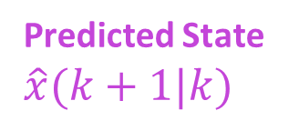
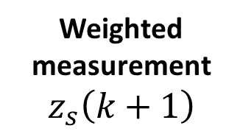
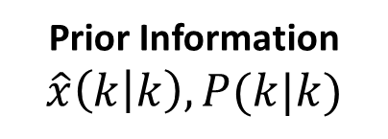
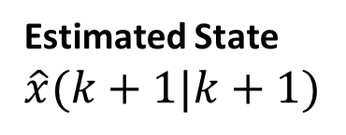
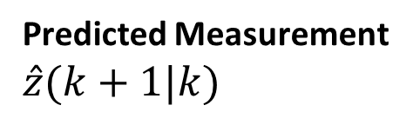
With the measurement model being nonlinear, UKF is a suitable state estimation algorithm
Prior Information
$$\hat{x}\left(k | k\right), P(k|k)$$
Predict Target state
Predicted State $\hat{x}(k+1|k)$
Predict Target measurement
Predicted Measurement $\hat{z}(k+1|k)$
Weighted measurement
$$z_{s}\left(k+1\right)$$
Update Target state
Estimated State $\hat{x}(k+1|k+1)$
Unscented Kalman filter (UKF) algorithm

Slide 26
The tracking system is a combination of the target path simulator, the measurement data modeler, and the tracking filter algorithm
Prior information
Waveform decision
Dynamic motion model
Predicted State
Target, Clutter-generated measurements
Target Path Simulator
Measurement Data Modeler
Data association
Measurement model
UKF
algorithm
Estimated State
State estimator
Tracking filter

Slide 27


Monte Carlo simulations are performed on the tracking system with the PSBS approach to evaluate its performance
Algorithm and a simulation example
PSBS Approach
Performance metrics and comparison graphs
$$|V_{los}|≥{|V}_{orth}|$$
True
False
PSBS shortcomings
CW
FM
Enhanced PSBS and its performance

Slide 28

PSBS approach establishes a feedback loop between the tracking filter and the measurement data modeler
PSBS
$$\hat{x}(k+1|k)$$
CW/FM
Prior information
Dynamic motion model
Predicted State
Target, Clutter-generated measurements
Target Path Simulator
Measurement Data Modeler
Data association
Measurement model
UKF
algorithm
Estimated State
State estimator
Tracking filter

Slide 29
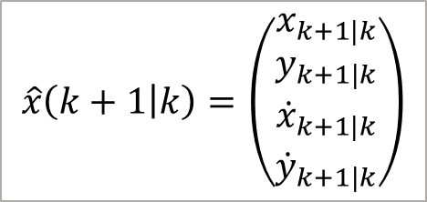


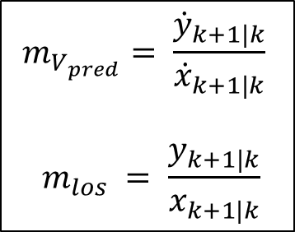

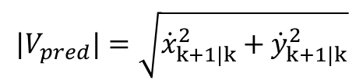



PSBS algorithm chooses CW pulse if the angle between the target’s predicted velocity vector and the line of sight is not greater than $45°$
$$\hat{x}\left(k+1 | k\right)=\left(\begin{matrix}x_{k+1|k} \\ y_{k+1|k} \\ {\dot{x}}_{k+1|k} \\ {\dot{y}}_{k+1|k}\end{matrix}\right)$$
Sonar platform
$$m_{V_{pred}}= \frac{{\dot{y}}_{k+1|k}}{{\dot{x}}_{k+1|k}}$$
$$m_{los} = \frac{y_{k+1|k}}{x_{k+1|k}}$$
Line of sight
$$φ=\tan^{−1}\left(\frac{\left|m_{V_{pred}} −m_{los}\right|}{1+m_{V_{pred}}⋅m_{los}}\right)$$
$$V_{los}$$
Overall Target velocity $V_{pred}$
$$φ$$
$$φ≤45°$$
True
False
$$|V_{pred}|=\sqrt{{\dot{x}}_{k+1|k}^{2}+{\dot{y}}_{k+1|k}^{2}}$$
$$V_{orth}$$
CW
FM

Slide 30




Example: Tracking system using PSBS approach is able to track the target until the end, whereas the other approaches failed

Slide 31




Example: Waveform selection based on target’s predicted Doppler helped the tracking system track the target until the end

Slide 32







TIP and RMSE are performance metrics used to quantify the tracking system performance
Estimated state $\hat{x}\left(k | k\right)=\left(\begin{matrix}x_{k|k} \\ y_{k|k} \\ {\dot{x}}_{k|k} \\ {\dot{y}}_{k|k}\end{matrix}\right)$
Estimated location
$$δ_{k}$$
Target in-track percentage (TIP)=
$\frac{\text{\#} \text{of} \text{tracked} \text{points}}{\text{\#} \text{of} \text{estimated} \text{locations}}×100$
$$(x_{k|k},y_{k|k})$$
$$(x_{true},y_{true})$$
True
$$δ_{k}<ε$$
False
Target position root mean square error (RMSE) = $\sqrt{\frac{\sum_{\left\{k: δ_{k}<ε\right\}}{δ_{k}^{2}}}{\text{\#} \text{of} \text{tracked} \text{points}}}$
A tracked point
Not a tracked point

Slide 33

PSBS improved the TIP, on average, by 1% and 6% relative to
All-CW and All-FM approaches, respectively
 | CW | FM
$$σ_{range}$$ | $$40m$$ | $$10m$$
$$σ_{bearing}$$ | $$1°$$ | $$1°$$
$$σ_{range−rate}$$ | $$0.5 m/sec$$ | ---

Slide 34
PSBS reduced the RMSE, on average, by 9% and 7% relative to
All-CW and All-FM approaches, respectively
Measurement noise version-1

Slide 35

PSBS improved the TIP, on average, by 10% and 14% relative to
All-CW and All-FM approaches, respectively
 | CW | FM
$$σ_{range}$$ | $$75m$$ | $$25m$$
$$σ_{bearing}$$ | $$1°$$ | $$1°$$
$$σ_{range−rate}$$ | $$0.5 m/sec$$ | ---
Measurement noise version-2

Slide 36
PSBS reduced the RMSE, on average, by 11% and 14% relative to
All-CW and All-FM approaches, respectively
Measurement noise version-2

Slide 37




One shortcoming of PSBS: It exhibits unstable performance similar to the All-FM approach at higher turn-rates

Slide 38




Example: Tracking system using PSBS approach fails to track target in high turn-rate, similar to All-FM approach

Slide 39


Example: Series of FM pulse transmissions result in loss of the target track by the tracking system

Slide 40



















Data association error resulting from too many measurements inside the validation gate is responsible for target track loss
$$z_{T}$$
$$z_{C10}$$
$$z_{C9}$$
$$z_{C10}$$
$$z_{C9}$$
$$z_{T}$$
Validation gate with gated measurements
$η_{i}=$ Association probability of gated measurement $i$
$\hat{z}=$ Predicted measurement
$m=$ total # of gated measurements
$$z_{C11}$$
$$z_{T}$$
$$z_{C8}$$
$$z_{C8}$$
$$\hat{z}$$
$$\hat{z}$$
$$\hat{z}$$
$$z_{C2}$$
$$z_{C2}$$
$$z_{C3}$$
$$z_{C13}$$
$$z_{C3}$$
$$z_{C1}$$
$$z_{C1}$$
$$z_{C1}$$
$$z_{C4}$$
$$z_{C4}$$
$$z_{C12}$$
$$z_{C5}$$
$$z_{C5}$$
$$z_{C6}$$
$$z_{C6}$$
$$z_{C2}$$
$$z_{C7}$$
$$z_{C7}$$
Notes:
Why only it happens in fm explain

Slide 41




PSBS approach can be enhanced by selecting the CW pulse for transmission when the number of the gated measurements exceeds a pre-defined threshold
$γ=$Pre-defined threshold # of gated measurements
$m=$ total # of gated measurements
True
False
$$m>γ$$
CW
Calculate $φ$
PSBS algorithm
$$φ≤45°$$
True
False
CW
FM

Slide 42

Enhanced PSBS chooses the transmission waveform based on the predicted target state and the number of gated measurements in the previous cycle
EPSBS
$$\hat{x}(k+1|k)$$
CW/FM
Prior information
$$m$$
Dynamic motion model
Predicted State
Target, Clutter-generated measurements
Target Path Simulator
Measurement Data Modeler
Data association
Measurement model
UKF
algorithm
Estimated State
State estimator
Tracking filter

Slide 43


Example: Tracking system using EPSBS approach is able to track target in high turn-rate, whereas PSBS failed to do the same

Slide 44

EPSBS improved the TIP, on average, by 2% relative to PSBS at turn-rates $6°/sec$ and above
 | CW | FM
$$σ_{range}$$ | $$40m$$ | $$10m$$
$$σ_{bearing}$$ | $$1°$$ | $$1°$$
$$σ_{range−rate}$$ | $$0.5 m/sec$$ | ---
Measurement noise version-1

Slide 45
EPSBS reduced RMSE, on average, by 2% relative to PSBS at turn-rates $6°/sec$ and above
Measurement noise version-1

Slide 46




To conclude, in an active sonar, choosing transmission pulses based on the target and environment characteristics delivers better target tracking
CW
FM

