Slide 1

Department of Computer Science and Engineering
Loan Approval Prediction using Machine Learning
PRESENTED BY
B. Venkata Siva (20471A05K0)
Sk. Aariz Ahmed (21475A0516)
Sk. Mastanvali (21475A0526)
Under the Guidance of,
Dr. Rama Krishna Eluri _{M.Tech.Ph.D}
Asst.Professor,
Department of Computer Science and Engineering,
Narasaraopeta Engineering College (Autonomous),
Narasaraopet- 522 601.

Slide 2
OUTLINE
Abstract
Introduction
Literature Survey
Research Gaps
Problem Statement
Objectives
Block Diagram / Flow Diagram
Dataset Details
Methodology
Implementation
Results and Analysis
Conclusion & Future Scope
References
Question and Answers
Acknowledgements

Slide 3
ABSTRACT
Loans are a crucial part of the modern world, and banks receive a significant portion of their profits from them. However, deciding whether to grant a loan to an applicant is a complex process that requires banks to consider many factors.
In this study, we suggest a machine learning-based method to streamline the loan acceptance prediction process. To determine whether or not a loan applicant's profile is relevant for approval, we employ effective machine learning algorithms. We base our predictions on important features. Additionally, we present a comparison study of various categorization methods to demonstrate how machine learning algorithms might enhance the loan approval procedure. Our results show that machine learning algorithms can significantly reduce the risk of loan defaults and improve the loan approval process. Moreover, to enhance prediction accuracy, we incorporate a voting ensemble technique into our methodology. This additional layer of analysis further refines our predictions, contributing to more reliable loan approval decisions.

Slide 4
INTRODUCTION
Like many other business ventures, the banking sector is increasingly looking to take advantage of the opportunities presented by modern technologies to improve their processes, productivity and reduce costs.
The success or failure of most lending platforms largely depends on their ability to evaluate credit risk .
The loan approval process is a challenging task for any financial institution.
We focused on developing Efficient Machine Learning models to predict loan eligibility, which is vital in accelerating the decision-making process and determining if an applicant gets a loan or not.

Slide 5
LITERATURE SURVEY
No | Title | Author | Journal Name & Year | Methodology Adapted | Key Findings | Gaps
1 | Empirical Study on Loan Default Prediction Models | Uzair Aslam et al. | Journal of Computational and Theoretical Nanoscience,2019 https://doi.org/10.1166/jctn.2019.8312 | Support Vector Machine (SVM), Logistic Regression (LR) | SVM and LR achieved accuracies of 79% and 86%, respectively, in predicting loan defaulters. | Need for adaptable and resilient predictive frameworks with high accuracy.
2 | Loan Prediction by using Machine Learning Models | Pidikiti Supriya et al. | International Journal of Engineering and Techniques, Volume 5 Issue 2, 2019 Microsoft Word - sush _1_ (ijetjournal.org) | Decision Tree | Decision tree algorithm used to predict loan approvals achieved 81% accuracy. | Further exploration needed on additional features' impact and lack of comparative analysis.
3 | Customer Loan Approval Prediction Using Logistic Regression | Mahankali Gopinath et al. | Smart Intelligent Computing and Communication Technology, 2021 40ee51ce5c13f328cda550c34a0a0b3442c4.pdf (semanticscholar.org) | Logistic Regression | Identified significant predictors for loan approvals and Achieved 80.945% accuracy rate. | Potential for further exploration of additional features, addressing biases in the dataset.

Slide 6
No | Title | Author | Journal Name & Year | Methodology Adapted | Key Findings | Gaps
4 | Loan default prediction using decision trees and random forest: A comparative study | Mehul Madaan et al. | IOP Conf. Series: Materials Science and Engineering, 2021 https://doi.org/10.1088/1757-899X/1022/1/012042 | Decision Tree, Random Forest. | Decision Tree and Random Forest outperform Logistic Regression due to their non-linearity handling capabilities. | Lacks in-depth analysis of model explainability and bias, limited data set size.
5 | Loan Prediction Model Using Data Mining Techniques | Ramachandra H V et al. | International Conference on Emerging Smart Computing and Informatics (ESCI), 2021 https://doi.org/10.1109/ESCI50559.2021.9397049 | Logistic Regression, Decision Tree | The model successfully predicts loan approval status based on given data using Logistic Regression And Decision Tree. | Lack of Comparative Evaluation with Existing Loan Prediction Models.

Slide 7
RESEARCH GAPS
After the keen observation we found the research gaps that are to be rectified in our project are:
The research gap lies to the absence of comprehensive analyses and effective methodologies in addressing the complexities of loan approval processes, which our research aims to fill through a machine learning-based approach.
The research gap is characterized by a deficiency in comparative analysis with prevalent machine learning models and constrained data sources.
The research gap necessitates proper data pre-processing and feature engineering to achieve optimal performance.
The research gap is evident in the absence of thorough scrutiny of model explainability and bias, compounded by limitations in the data source.

Slide 8
PROBLEM STATEMENT
The current loan approval system within the banking industry exhibits inefficiencies, relying on outdated processes that hinder both efficiency and accuracy.
The implications of the inefficiencies of Existing Models range from the potential for financial losses to the heightened risk of systemic disruptions impacting the broader economy.
Recognizing these shortcomings, our objective is to enhance the accuracy and efficiency of the loan approval system by implementing effective methodologies.

Slide 9
OBJECTIVES
Develop a machine learning system to automate and simplify the loan approval process using the Machine Learning Approaches.
Improve the efficiency and accuracy of the existing loan approval system, contributing to a more robust banking process.
Learning the algorithms using less features and highly preprocessed data for precise loan approval predictions.
Analyze and compare various classification algorithms to identify the most effective method and developing voting ensemble model from the best three models for predicting loan approvals.
Develop rich user interfaces to promote the efficient user interactions with the Loan Approval System.

Slide 10
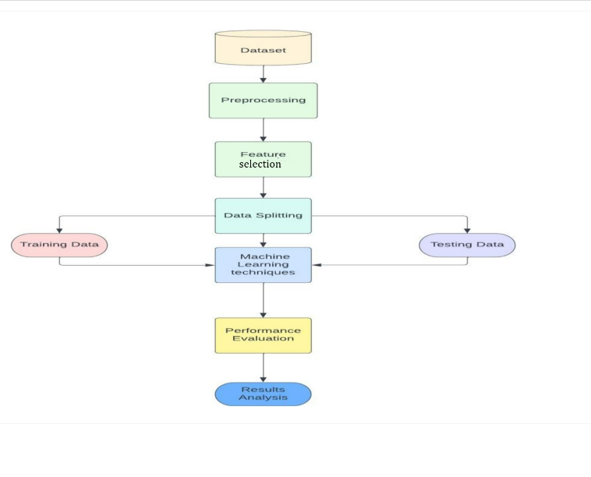
BLOCK DIAGRAM OR FLOW DIAGRAM
Fig.1 Flow chart

Slide 11
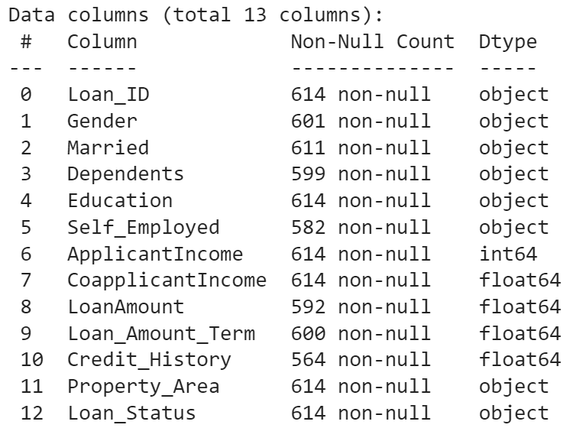
Dataset Information
Dataset Source:https://www.kaggle.com/datasets/altruistdelhite04/loan-prediction-problem-dataset/

Slide 12
METHODOLOGY
Acquiring dataset from Kaggle website
Pre-Processing: Eliminating Null Values, dealing Outliers, correlation, Square root transformations
Feature Selection: Recursive Feature Selection
Model Development: Classification Models
Model Selection: Selecting the Voting Esemble Model
User-Interface: Developing effective user interfaces
Connecting the model with the User-Interface

Slide 13
IMPLEMENTATION
Software Specifications:
Operating System:Windows 10 Home,64-bit Operating system
Coding Language:Python
Python distribution:Anoconda,Google Colab
Hardware Specifications:
CPU:Intel Corei7,AMD (Ryzen)
RAM:8GB
Storage:SSDs(500GB to 1TB SSD)
Code link: https://github.com/NEC-PROJECTS-2024/DB2.git

Slide 14
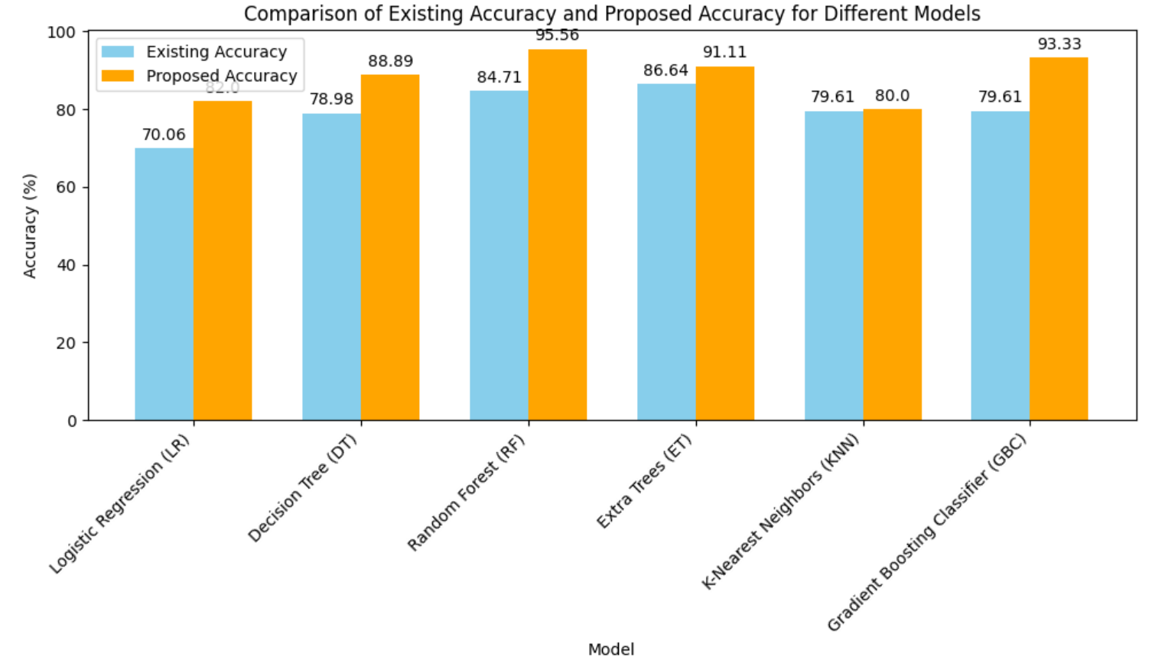
RESULT AND ANALYSIS
Table 1: Existing vs Proposed Accuracies
Model Name | Existing Accuracy | Proposed Accuracy
Logistic Regression | 70.06 | 82.0
Decision Tree | 78.98 | 88.89
Random Forest | 84.71 | 95.56
Extra Tree | 86.64 | 91.11
KNN-Classifier | 79.61 | 80.0
Gradient Boosting Classifier | 79.61 | 93.33
Fig.2 Comparing Accuracies

Slide 15
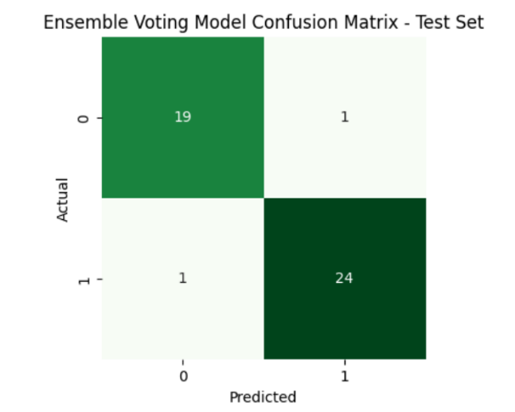
Table 2: Overall Accuracy Performance
Research | Accuracy (%) of Voting Ensemble Model
Existing Model | 87.26
Proposed Model | 95.56
Fig.3 Confusion Matrix of Voting Ensemble Model

Slide 16
CONCLUSION AND FUTURE SCOPE
Leveraged ML techniques and meticulous preprocessing to significantly improve loan approval prediction, achieving an accuracy of 95.56%—a notable leap from the previous baseline of 87.26%.
Demonstrated ML's transformative potential by surpassing previous accuracy benchmarks, highlighting the efficacy of our rigorous methodology in enhancing predictive precision.
Contributed to advancing loan approval prediction through thorough dataset examination and sophisticated preprocessing methods, underscoring the profound impact of ML in delivering precise predictions.

Slide 17
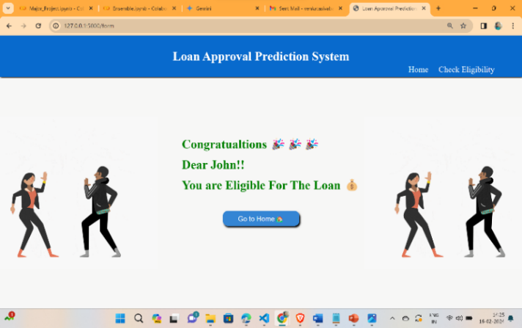
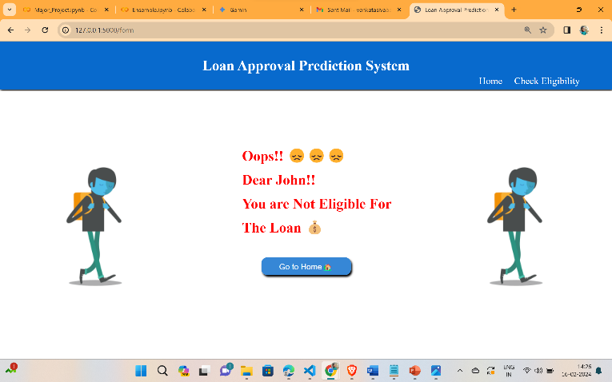
OUTPUT SCREENS
Fig.4 Approval Status
Fig.5 Disapproval status

Slide 18
REFERENCES
Gopinath, Mahankali, K. Srinivas Shankar Maheep, and R. Sethuraman. 2021. “Customer Loan Approval Prediction Using Logistic Regression.” Advances in Parallel Computing. https://doi.org/10.3233/apc210103.
Pidikiti Supriya, Myneedi Pavani, Nagarapu Saisushma,Namburi Vimala Kumari, k Vikash,“Loan Prediction by using Machine Learning Models”, International Journal of Engineering and Techniques.Volume 5 Issue 2, Mar-Apr 2019.
M. Madaan et al. "Loan default prediction using decision trees and random forest: A comparative study" IOP Conf. Ser.: Mater. Sci. Eng. 2014. doi: 10.1088/1757-899X/1022/1/012042.
Ramachandra, H. V., G. Balaraju, R. Divyashree, and Harish Patil. 2021. “Design and Simulation of Loan Approval Prediction Model Using AWS Platform.” 2021 International Conference on Emerging Smart Computing and Informatics (ESCI). https://doi.org/10.1109/esci50559.20219397049.
N. Uddin, M.K. Uddin Ahamed, M.A. Uddin, Md. Manwarul Islam, Md. Alamin Talukder, and Sunil Aryal, "An ensemble machine learning based bank loan approval predictions system with a smart application," International Journal of Cognitive Computing in Engineering, vol. 4, pp. 327-339, 2023.https://doi.org/10.1016/j.ijcce.2023.09.001.

Slide 19

QUESTIONS and ANSWERS
Open the floor for questions from the audience

Slide 20

ACKNOWLEGEMENTS
Express gratitude for the opportunity to present
Provide contact information for further inquiries

