Slide 1
PREDICTING THE DELIVERY EFFICIENCY USING RANDOM FOREST ALGORITHM

Slide 2
PROBLEM STATEMENT
Challenges faced by supply chain management in terms of transportation.

Slide 3
FEATURES
MODE_OF_TRANSPORTATION
WEATHER
GEOPOLITICAL_RISKS
ROUTE_OPTIMIZATION
NO_OF_DELIVERED
CUSTOMER_RATING

Slide 4
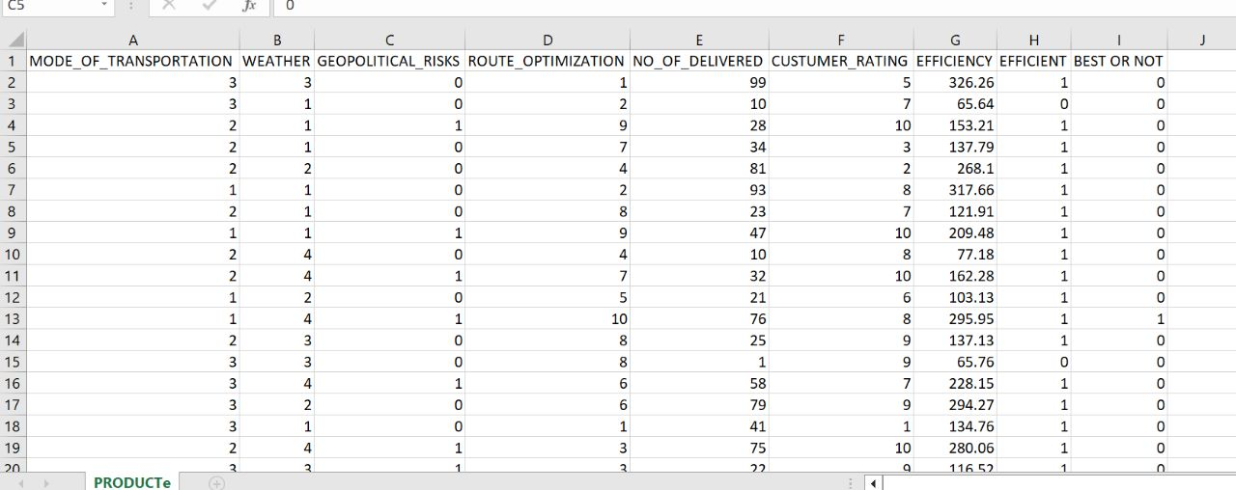
DATASET

Slide 5
MODEL SELECTION
Selected Model : RANDOM FOREST ALGORITHM
Reason : Numeric value and Accuracy.
Type of the data : Labelled data

Slide 6
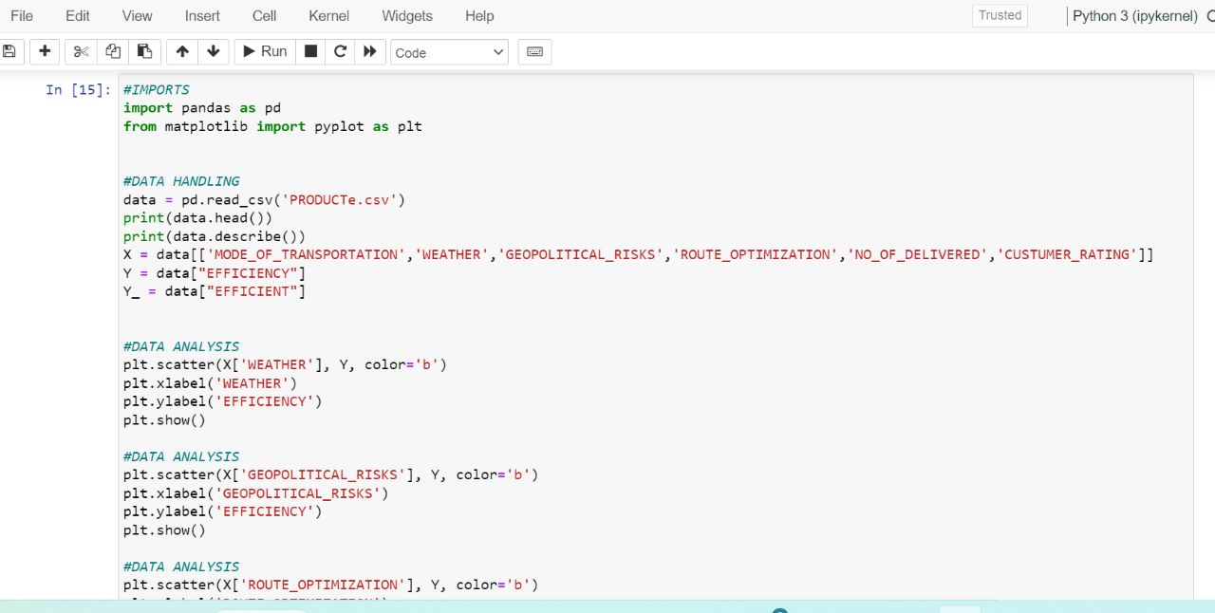
SAMPLE OF CODE

Slide 7
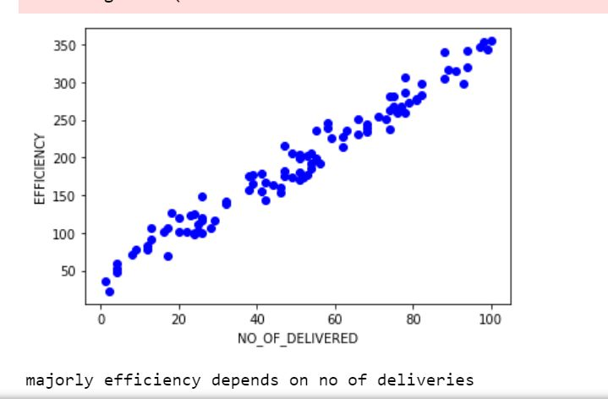
OUTCOME
EFFICIENCY
ACCURACY:99.3

Slide 8
OBSERVATION
Number of deliveries and Efficiency
Number of deliveries and other features

Slide 9
AREAS OF APPLICATION
Online shopping
Start Ups
Postal department

Slide 10
Thank You

