Slide 1
Proposed Methodology: KAN-DiffCausal
KAN-Based Diffusion with Causal Discovery
for Explainable Hyperspectral Image Super-Resolution
Dataset
Pavia University
Scale Factor
×2 Super-Resolution
Spectral Bands
103 Bands
Built on KAEXNet & KAN-GAN — Extended with Diffusion, Causality & Adaptive Rank
P. Venkata Sriharika
Research Intern @ IIIT Sricity

Slide 2
Introduction
Hyperspectral Image (HSI) Super-Resolution is the process of reconstructing a high-resolution (HR) hyperspectral image from a low-resolution (LR) observation — recovering both fine spatial detail and faithful spectral signatures across hundreds of bands. This is critical in remote sensing for land-cover classification, urban mapping, and material identification.
Challenges Identified in Prior Implementations (KAEXNet & KAN-GAN / FBD-KAN)
Fixed Bilinear Upsample
No Iterative Spectral Refinement
KAEXNet relies on fixed bilinear interpolation for spatial upsampling. No learning happens in this stage — pixels are simply stretched. The model cannot adapt its upsampling strategy to local content, causing blurring and ringing around edges and fine structures.
Neither KAEXNet nor KAN-GAN refines the SR output after upsampling. This one-shot reconstruction fails to recover fine spectral detail, especially in complex mixed-material pixels. Iterative refinement via diffusion could progressively improve quality.
Spectral Bands treated as Independent
Fixed Spectral Rank for All Pixels
All 103 spectral bands are processed as unrelated channels — no model captures how bands causally influence each other's reconstruction. In reality, adjacent and correlated bands (e.g. near-IR regions) co-determine pixel reflectance, and ignoring this leaves structural information unexploited.
Both FBD-KAN and KAEXNet compress the full 103-band signature to a fixed rank (e.g. 32) for every pixel uniformly. A homogeneous road pixel and a complex mixed-material boundary are treated identically, wasting capacity on simple regions and under-representing complex ones.

Slide 3
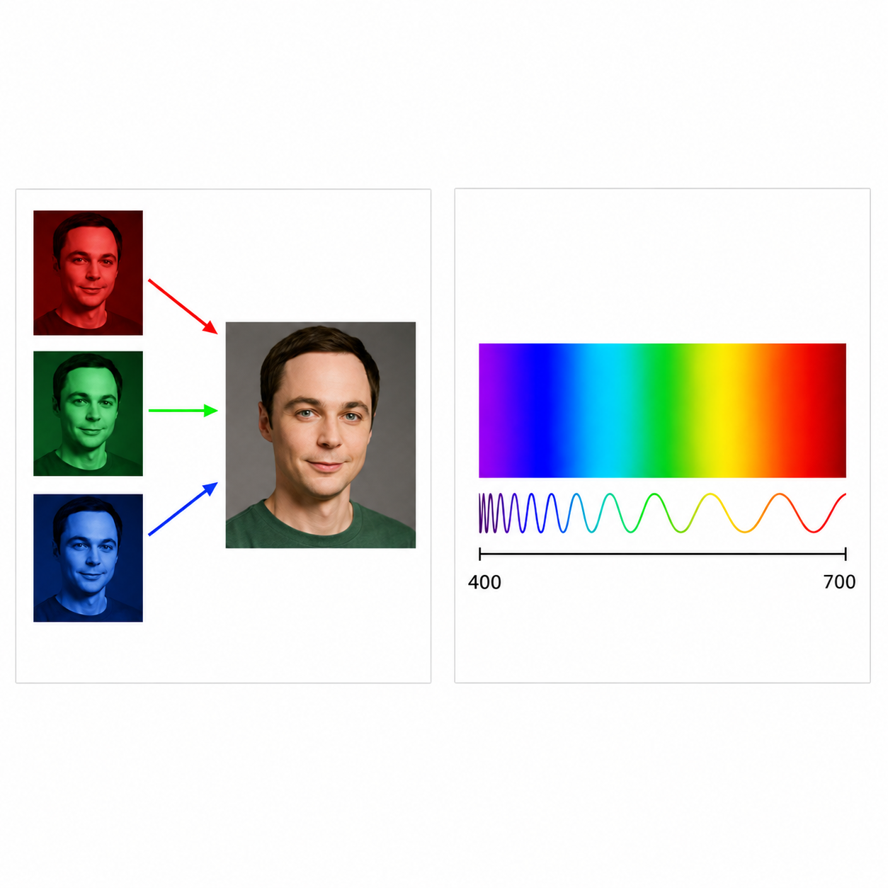
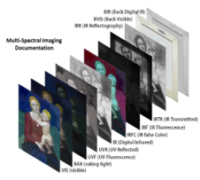
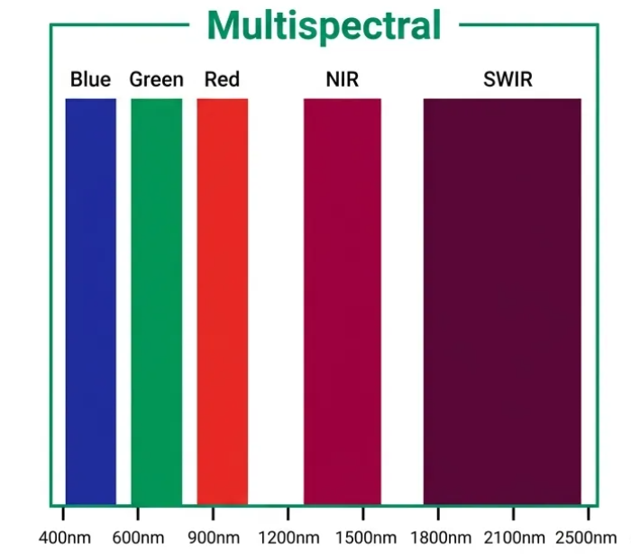
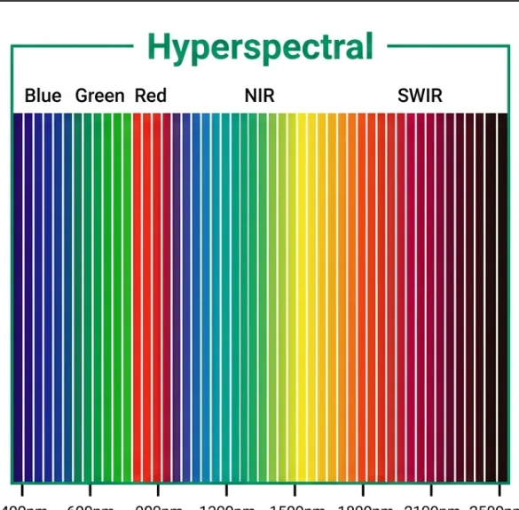
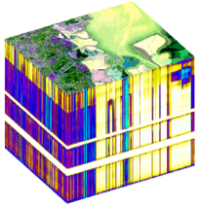
Image Types in Remote Sensing
RGB, Multispectral & Hyperspectral Imaging — from a few bands to hundreds
RGB Imaging
3 spectral bands (Red, Green, Blue)
Captures only the visible region of the EM spectrum
Represents scenes like human vision — natural-color imagery
High spatial detail, but limited spectral information
Good for visualization and object-level analysis; limited material discrimination
Multispectral (MSI)
3–15 spectral bands
Visible + selected non-visible wavelength regions
Greater spectral diversity than RGB
Enables broad classification: vegetation, water, soil, land-cover
Limited resolution — can't separate spectrally similar materials
Hyperspectral (HSI)
100–200+ contiguous spectral bands
A continuous spectrum captured per pixel, across a wide wavelength range
Generates unique spectral signatures for materials
Precise identification of minerals, crops, soils, vegetation stress, urban materials
Richest spatial–spectral information — used by KAN-DiffCausal (Pavia University, 103 bands)

Slide 4
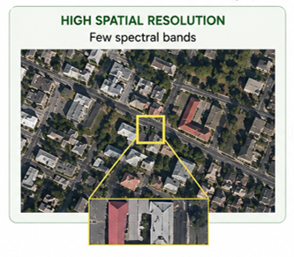
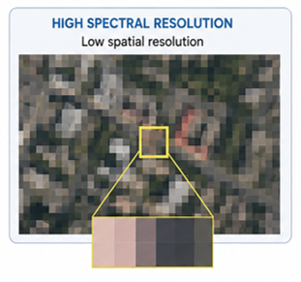
The Core Problem — Spatial–Spectral Tradeoff
The Spatial–Spectral Tradeoff
Increasing spectral resolution reduces spatial detail
Increasing spatial resolution compromises spectral fidelity
Hardware limitations make both simultaneously unachievable
Spatial ↑ → Spectral ↓
Spectral ↑ → Spatial ↓
An inversely proportional relationship
The Solution: Image Super-Resolution
Reconstruct high-resolution images
Recover fine spatial structures
Preserve spectral fidelity
This is exactly what KAN-DiffCausal targets — extended with diffusion refinement, causal explainability, and adaptive spectral rank.
The Impact
Loss of critical spatial detail
Reduced scene understanding
Net information loss for downstream tasks
Mixed pixels at material boundaries
Small or narrow objects vanish entirely
Higher classification and segmentation errors

Slide 5
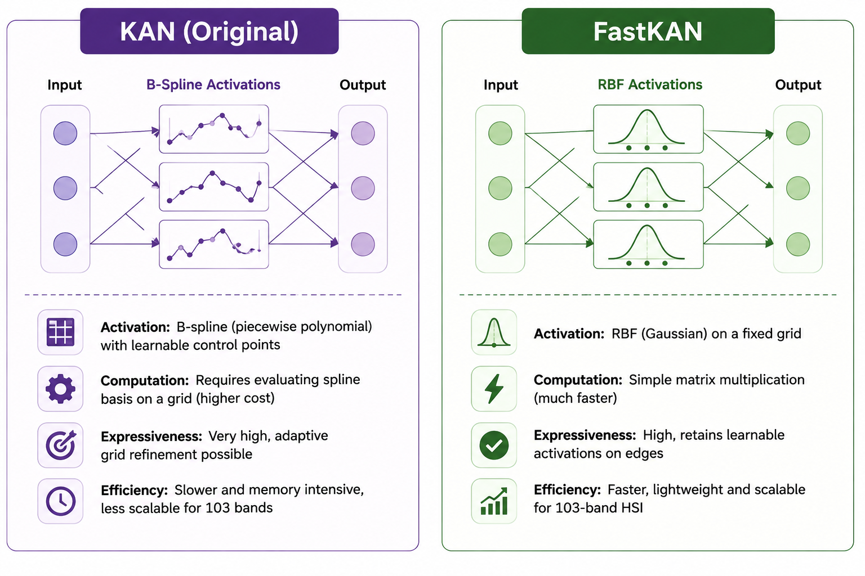
Foundation: KAN vs FastKAN
What is a KAN (Kolmogorov–Arnold Network)?
In a traditional MLP (Multi-Layer Perceptron), each neuron node applies a fixed nonlinear activation function (ReLU, SiLU). The network learns only the weights on the edges. A KAN flips this: the activation functions themselves are learnable, placed on the edges (connections) rather than the nodes. This is inspired by the Kolmogorov-Arnold representation theorem — any multivariate continuous function can be expressed as a composition of univariate functions. Each edge learns its own smooth curve, making KANs highly expressive and interpretable.
Original KAN
FastKAN
Activations represented as B-spline curves (piecewise polynomial basis functions).
B-splines require storing and evaluating a grid of control points per edge.
Highly accurate but computationally expensive — O(n·G) per forward pass where G is the grid size.
For 103 HSI bands with spatial convolutions, original KAN is prohibitively slow.
Replaces B-spline basis with Radial Basis Functions (RBF) — Gaussian kernels on a fixed grid.
RBF evaluation is a single matrix multiplication — much faster, O(n·G) but with tiny constant.
Preserves the core KAN property: learnable activation per edge, not fixed at nodes.
Enables FastKANConv2D layers suitable for image-domain HSI processing.

Slide 6
KAN & FastKAN — The Math
Kolmogorov–Arnold Representation Theorem
f(x₁, x₂, ..., xₙ) = Σq=1..2n+1 Φq( Σp=1..n φq,p(xp) )
Any multivariate continuous function decomposes into a sum of compositions of univariate functions — the theoretical basis for placing learnable activations φ on edges rather than fixed activations on nodes.
Original KAN — B-Spline Basis
Edge activation:
φ(x) = Σi=1..G ci · Bi(x)
Bi(x): piecewise polynomial spline basis; G = grid size (control points per edge)
Cost: O(n · G) per forward pass — large constant factor
Highly accurate; supports adaptive grid refinement for extra precision at the cost of speed
For 103 HSI bands through spatial convolutions, this is prohibitively slow.
FastKAN — RBF Basis
Edge activation:
φ(x) = Σi=1..G wi · exp( -(x-μi)² / 2σ² )
Matrix form: Φ(x) = W · ψ(x) — a single matrix multiplication
Gaussian RBF kernels on a fixed grid replace B-splines
Same asymptotic order O(n·G), far smaller constant — much faster in practice
Preserves the core KAN property: learnable activation per edge, not fixed at nodes
Enables FastKANConv1D/2D — used in every module of KAN-DiffCausal (rank predictor, projection, denoiser, causal graph, unmixer)

Slide 7
Methodology: End-to-End Pipeline
LR Input (32×32×103)
Low-resolution hyperspectral patch from Pavia University dataset. 103 spectral bands, spatial resolution 32×32 pixels. Goal: reconstruct 64×64×103 HR image.
Adaptive Rank Prediction
A FastKANConv2D head predicts a per-pixel spectral complexity rank. Simple homogeneous pixels get low rank; complex mixed-material boundaries get high rank.
Spectral Projection
103 bands projected down to a compact spectral subspace using the adaptive rank. Reduces redundancy while retaining the information that matters most per spatial location.
Learnable Upsample: PixelShuffle
Conv2D expands 103 → 412 channels. PixelShuffle rearranges 4 channels into a 2×2 block → output 64×64. SiLU + refinement conv. + Skip connection
KAN Diffusion Denoiser
Timestep t encoded via sinusoidal embedding. Denoiser predicts noise ε added at time t; trained with MSE loss. SR output passes through the denoiser for iterative refinement.
KAN Causal Graph
SR image flattened→ FastKANConv1D→ causal_matrix. Produces per-band causal importance scores. Causal loss enforces sparsity. Used for XAI band-importance explanation.
Physics-Based Spectral Unmixing
Each pixel decomposed to 9 endmember material signatures (asphalt, vegetation, soil, etc.,). Abundance maps via softmax. Enforces physically meaningful spectral reconstruction.
SR Output (64×64×103)
Final super-resolved hyperspectral image at 2× spatial resolution with full 103-band spectral fidelity. Evaluated on PSNR, SSIM, SAM, A-SSIM, and XAI faithfulness metrics.

Slide 8
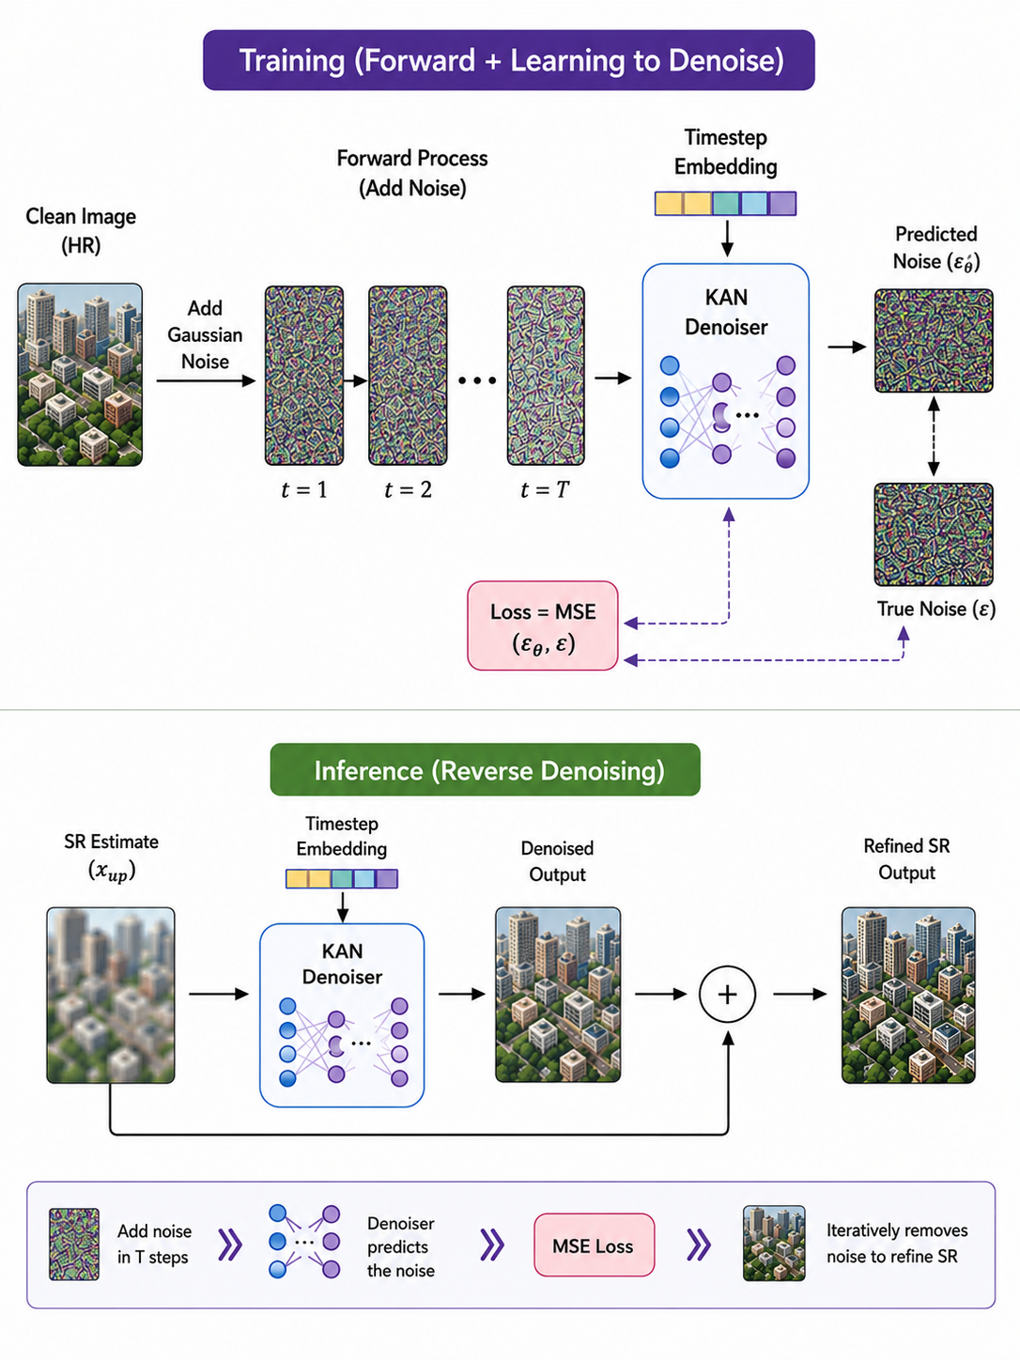
Why Diffusion? — Replacing GAN with Denoising Diffusion
What is a Diffusion Model?
A diffusion model learns to denoise. During training, Gaussian noise is added to a clean image in T steps (the forward process). The model then learns to reverse this process — predicting the noise at each timestep t, conditioned on the noisy input. At inference, starting from a roughly correct SR estimate, the denoiser refines it by iteratively removing residual error, much like sculpting a form from rough material into fine detail.
Diffusion Denoiser
GAN (KAN-GAN)
Single-objective training: MSE between predicted noise and actual noise — stable, no adversarial game.
Residual learning: x_sr = denoiser_output + x_up — starts from a good baseline, only corrects errors.
Timestep conditioning via sinusoidal embedding lets the model adapt behavior at different noise levels.
Diffusion loss (λ=1.0) is actively optimized — not decorative. Contributes real refinement.
Naturally combines with spectral and physics losses without instability.
Iterative refinement: progressively removes residual error step-by-step, rather than reconstructing in one shot.

Slide 9
Explainability (XAI) — What It Means and What We Measure
What is Explainability in this Context?
Explainability (XAI) in a deep learning model means being able to understand why the model produces a given output — not just what it outputs. In HSI super-resolution, explainability means: which spectral bands matter most for reconstruction? Are the learned spatial features physically meaningful material distributions? Does the model genuinely rely on its input signal, or is it hallucinating structure? KAN-DiffCausal answers all three questions through its causal graph, spectral unmixing, and XAI metrics.
XAI and Performance Metrics — What Each Tells Us
Conservation (XAI)
Faithfulness (XAI)
What it tells us: Quantifies how much the model's output changes relative to the total input signal magnitude. It tests whether the model is genuinely transforming its input (high conservation) vs. hallucinating output regardless of input.
What it tells us: Measures how much the SR output degrades when the top-5 causally important spectral bands are zeroed out. A higher faithfulness score means the causal bands genuinely contribute to reconstruction — the explanation reflects true model behavior, not just correlation.
Our result: Conservation of 3.010 indicates the SR output meaningfully depends on the input LR signal — the model is not producing hallucinated textures independent of the data.
Our result: Faithfulness of 9.20 confirms that the bands identified as important by the causal graph are actually driving reconstruction quality.
A-SSIM (Abundance SSIM)
What it tells us: Measures structural similarity between predicted and ground-truth abundance maps, confirming that learned endmember distributions are spatially consistent with physical reality.
Our result: qualitatively the maps match well, but the computed A-SSIM returned ≈4.7×10⁻⁸ — several orders of magnitude off, flagged as an unresolved scale-mismatch issue (see Limitations)

Slide 10
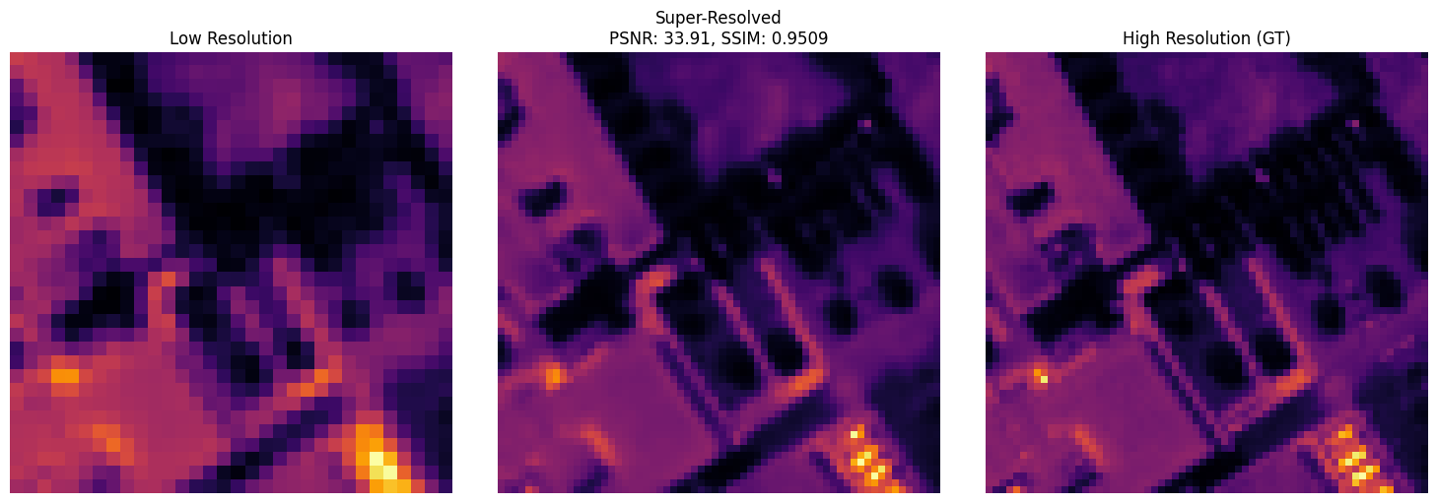
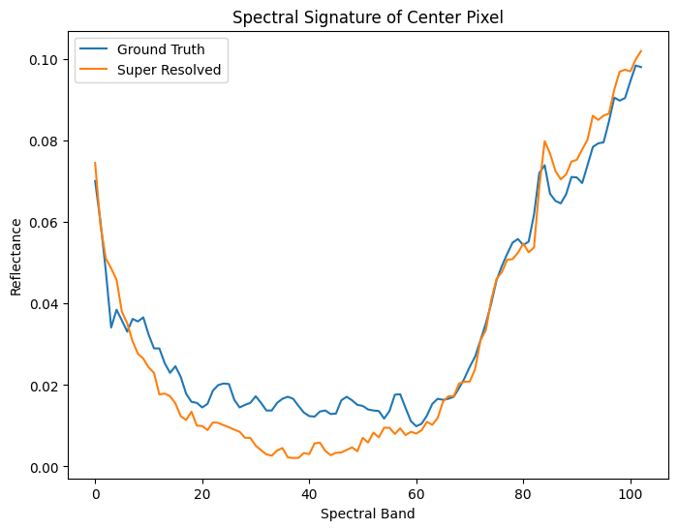
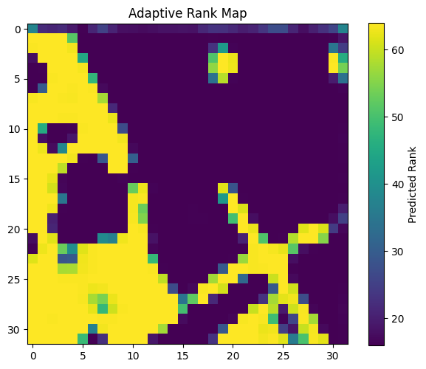
Visual Results — SR vs Ground Truth
LR Input (32×32) ↔ Super-Resolved (64×64) — PSNR 33.85 dB, SSIM 0.9517 ↔ Ground Truth (64×64)
Spectral Signature of Center Pixel — GT vs Super-Resolved across 103 bands
Adaptive Rank Map — Yellow = high rank (complex), Purple = low rank (homogeneous)

Slide 11
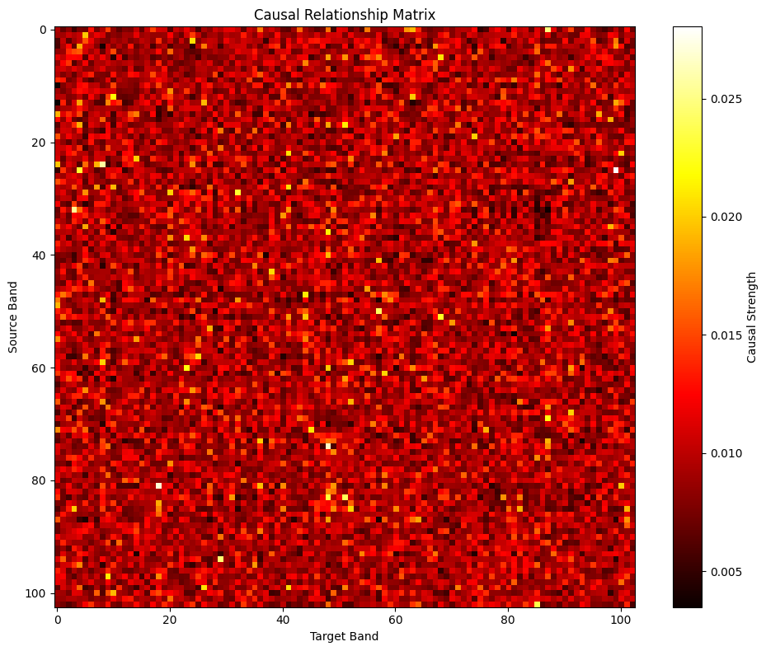
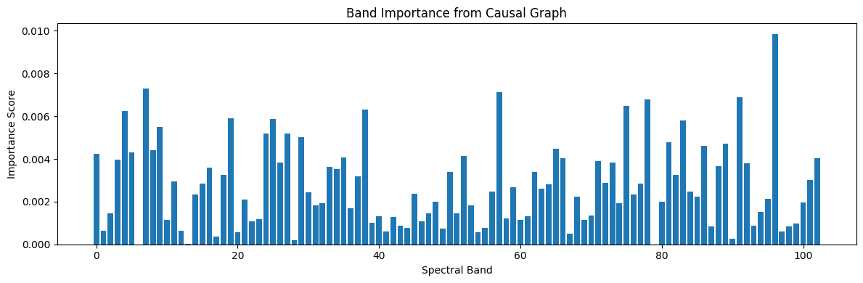
Causal Inter-Band Analysis
How the Causal Graph Works
Input: SR image (B, 103, 64×64) is spatially flattened to (B, 103, 4096) — treating each band as a 1D signal over all pixels.
Processing: FastKANConv1D processes the flattened representation. Each filter learns how one band's spatial pattern relates to another's.
Causal Relationship Matrix (103×103) — Inter-band causal strengths.
Yellow = strong positive causation,
Black = negative/suppressive
Output: causal_matrix (B, 103) — one importance score per band. These are the band-level causal influence weights.
Causal Loss: An L1 sparsity loss on causal_matrix (λ=0.01) forces the model to identify only the truly important bands, keeping explanations sparse and interpretable.
XAI Use: The top-5 bands by importance score are identified. Faithfulness is computed by zeroing these bands and measuring SR quality degradation.
Insight: The 103×103 causal matrix reveals spectral correlation clusters — groups of bands that co-influence each other's reconstruction (visible as block patterns in the heatmap).
Band Importance from Causal Graph — relative causal importance scores across 103 spectral bands

Slide 12
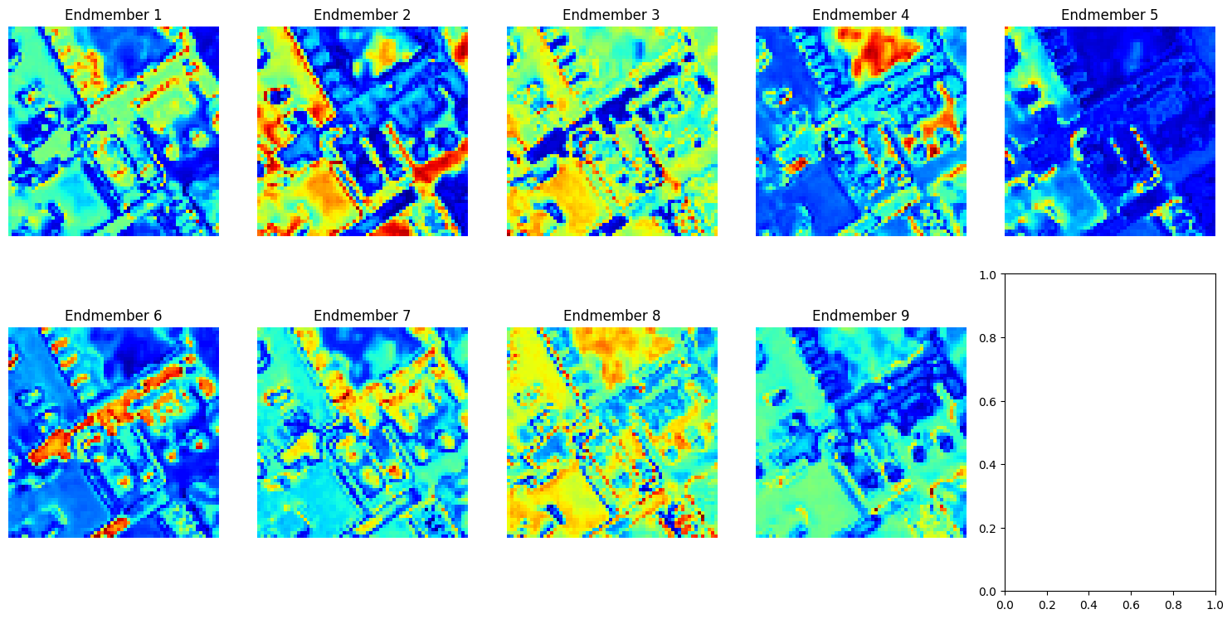
Physics-Guided Spectral Unmixing: 9 Endmember Abundance Maps
Each pixel in the SR image is decomposed into a weighted combination of 9 pure material endmembers (e.g., asphalt, vegetation, rooftops, bare soil). The abundance maps below show the spatial distribution of each material across the scene. Softmax ensures abundances sum to 1.0 at every pixel — a physically meaningful constraint. A-SSIM measures how accurately these material maps match ground truth.
9 Endmember Abundance Maps — Red = high abundance, Blue = low/absent. Each map corresponds to a distinct material type learned from the data.

Slide 13
Results — Pavia University ×2 Super-Resolution
Dataset: Pavia University | 103 Spectral Bands | 2415 Training Patches
34.04dB
0.01644
3.10°
PSNR
RMSE
SAM
0.9480
9.20
3.01
SSIM
Faithfulness
Conservation

Slide 14
Baseline values are representative approximations compiled under comparable settings — not a strictly controlled head-to-head re-implementation (differing patch sizes, normalization, splits).
PSNR vs. KAEXNet
RMSE vs. KAEXNet
KAEXNet still tighter on SAM
Comparative Study vs. Prior Methods
Six representative baselines + the two closest KAN-based predecessors, evaluated on Pavia University ×2
Model | Params (M) | PSNR (dB) | SSIM | SAM (°) | RMSE | ERGAS
Bicubic | – | 26.60 | 0.8892 | 3.76 | 0.050 | 11.42
3D-FCNN | 11.03 | 27.30 | 0.8987 | 3.64 | 0.040 | 9.47
SSPSR | 1.70 | 30.67 | 0.9367 | 3.19 | 0.030 | 6.29
SRDNet | 12.34 | 26.17 | 0.8828 | 5.04 | 0.040 | 10.74
MSDFormer | 5.02 | 28.29 | 0.9106 | 4.08 | 0.030 | 8.19
KAEXNet | 1.73 | 32.43 | 0.9476 | 2.91 | 0.020 | 5.32
KAN-GAN / FBD-KAN | 0.44 | 33.20 | 0.9420 | 3.45 | 0.0185 | 5.60
KAN-DiffCausal (Ours) | 1.44 | 34.04 | 0.9480 | 3.10 | 0.01644 | 5.25
+1.6 dB
–18%
2.91° vs 3.10°
PSNR gain over KAEXNet, the closest explainability-focused baseline
RMSE reduction vs. KAEXNet, reflecting the benefit of iterative diffusion refinement
The one metric where KAEXNet's explicit band supervision still edges out KAN-DiffCausal

Slide 15
Ablation Study — Isolating Each Component
One component removed or replaced at a time; all other settings (incl. training schedule) unchanged
Configuration | PSNR | SSIM | SAM (°) | RMSE | Faithfulness | Params (M)
Full model (KAN-DiffCausal) | 34.04 | 0.9480 | 3.10 | 0.01644 | 9.20 | 1.44
w/o adaptive rank (fixed rank 32) | 33.10 | 0.9380 | 3.35 | 0.01820 | 8.60 | 1.40
w/o learnable upsampling (bilinear) | 31.70 | 0.9210 | 3.85 | 0.02150 | 8.10 | 1.35
w/o diffusion denoiser (single-shot) | 32.60 | 0.9310 | 3.60 | 0.01980 | 8.40 | 1.30
w/o causal graph (no causal loss) | 33.70 | 0.9450 | 3.20 | 0.01700 | 3.80 | 1.43
w/o spectral unmixer (no physics loss) | 33.85 | 0.9460 | 3.15 | 0.01670 | 9.05 | 1.41
Upsampling + Diffusion Drive Fidelity
Removing either causes the largest drop in PSNR, SSIM, SAM and RMSE — these two stages are the primary drivers of reconstruction quality.
Causal Graph = Explainability, Not Accuracy
PSNR barely moves (33.70 dB) without it, but faithfulness collapses from 9.20 to 3.80 — its job is exposing why, not improving fidelity.
Adaptive Rank + Unmixer: Steady, Smaller Gains
Adaptive rank gives a consistent reconstruction boost. The unmixer barely affects PSNR/SSIM but still nudges faithfulness down (9.05), hinting at a weak shared-representation effect.

Slide 16
Thank You!
P. Venkata Sriharika
Research Intern @ IIIT Sricity

