Slide 1
Movie Recommendation System using PySpark
Batch-10: Team Members:
Venkata Subba Rao Inti - 16303989
Siva Rama Krishna Bheemanaboyana- 16322363
Venkata Satya Sai Krishna Malakalapalli - 16322741

Slide 2
Contents:
Introduction: What is Movie Recommendation System?
Related Work: Different methods for Recommendation Systems
Methodology: Introduction to ALS Approach
Dataset Description
Project Workflow
Project illustration step by step with code
Dataset Visualization using MatplotLib library
Some recommendations for specific users
Results & Enhancements
Team Contributions

Slide 3
What is Movie Recommendation System?
Recommender System is an information filtering tool that tries to forecast which product a user would like and then suggests a few products to them based on that prediction.
Some of the examples are:
Amazon can suggest new buying products,
Netflix may suggest new movies, and
Google can suggest news stories that a customer might be interested in.

Slide 4
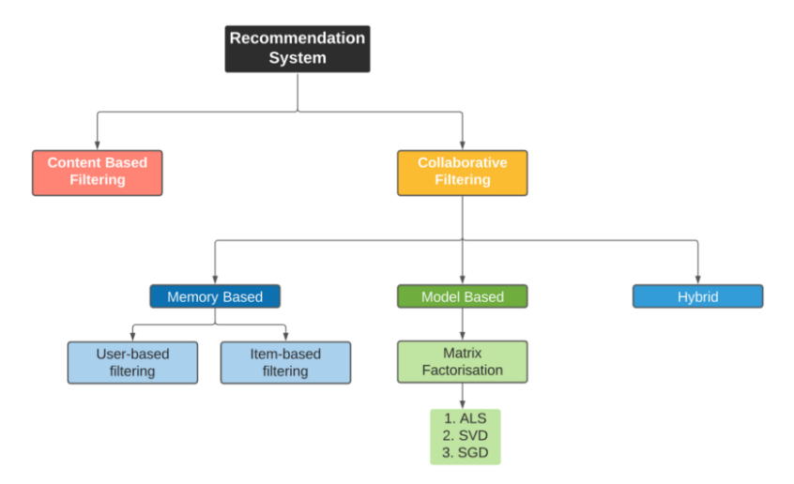
Related Work: Different Methods of Recommendation System:

Slide 5
Different Methods for Recommendation System(contd):
There are mainly two categories in recommendation systems. They are:
1. Content Based Filtering Systems
2. Collaborative Filtering Systems
The similarity of movie properties is used in content-based techniques. If a user sees one movie, comparable movies are recommended using this type of recommender system.
The approach for collaborative filtering is based on previous interactions between users and movies. A collaborative filtering system's input is made up of historical data from user interactions with the movies they view.

Slide 6
Methodology: Introduction to ALS Approach:
For collaborative filtering, ALS is one of the low rank matrix approximation techniques.
ALS decomposes the user-item matrix into two low-rank matrices: the user matrix and the item matrix. Users and products are described by a small number of latent characteristics in collaborative filtering, which can be used to forecast missing entries.
Matrix factorization is used by the ALS algorithm to learn these latent factors.

Slide 7
Dataset Description:
MovieLens, a movie recommendation service, provided this dataset (ml-latest), which describes 5-star rating and free-text tagging activities.
You can find more info at (https://files.grouplens.org/datasets/movielens/ml-latest-README.html)
It contains 27753444 ratings and 1108997 tag applications across 58098 movies.
These data were created by 283228 users between January 09, 1995 and September 26, 2020.

Slide 8
Dataset Description(contd):
Columns present in ratings.csv are:
userId, movieId, rating, timestamp
Columns present in movies.csv are:
movieId, title, genres
Columns present in links.csv are:
movieId, imdbId, tmdbId
Columns present in tags.csv are:
userId, movieId, tag, timestamp
userId, movieId are synchronous in all tables and are related.

Slide 9
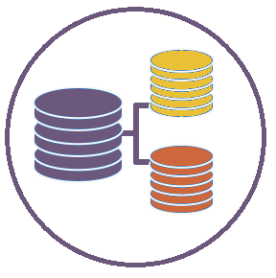
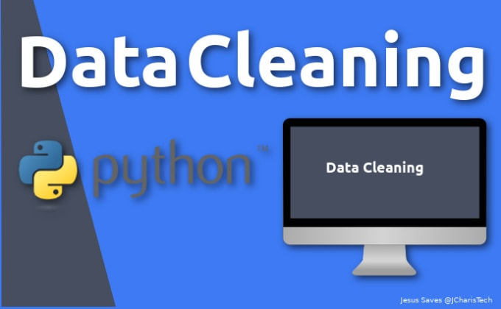
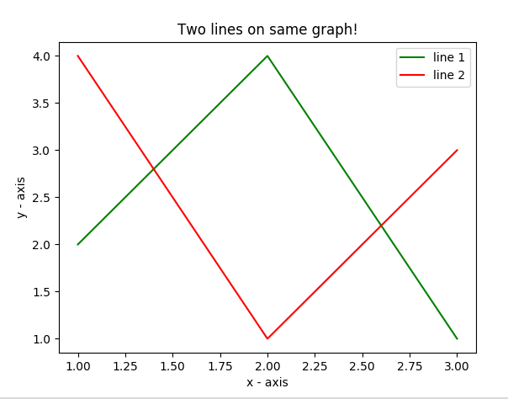
Project Workflow:
Splitting the Data into Train and Test sets
Collecting Dataset
Apply ALS Algorithms on Train set
Recommending movies to users
Transform the Test Set using the ALS Model
Plotting some results

Slide 10
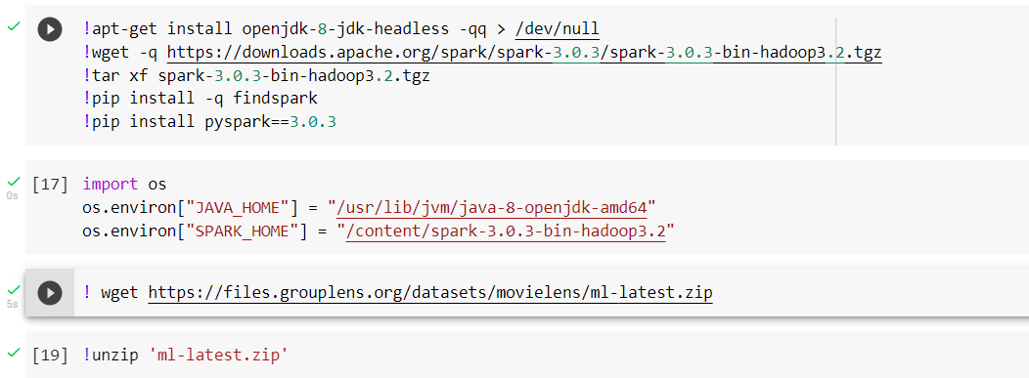
Project illustration step by step with code:
Step1: Installing required Java & PySpark, setting up environmental variables in Google Colab

Slide 11
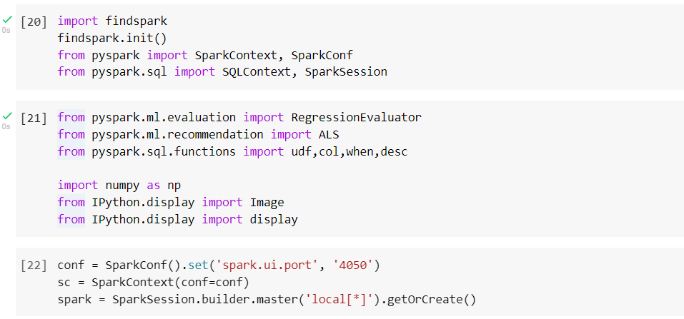
Project illustration step by step with code(contd):
Step-2: Importing required libraries and initializing the spark context and spark session.

Slide 12
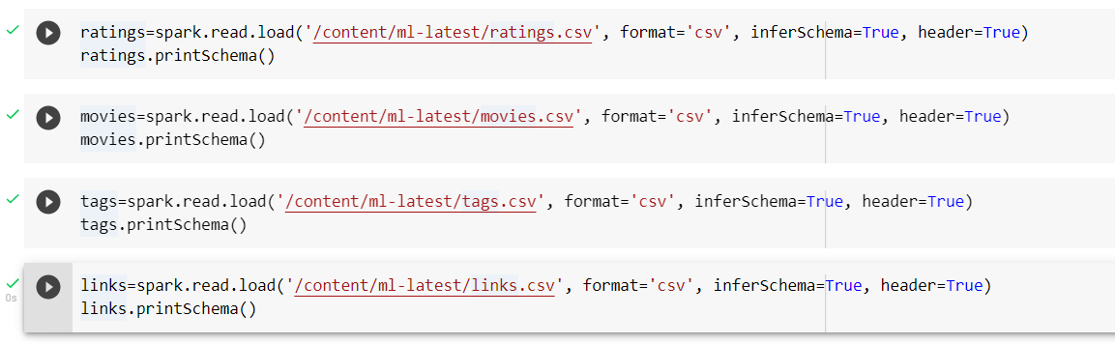
Project illustration step by step with code(contd):
Step-3: Loading the Dataset downloaded into the spark dataframes.

Slide 13
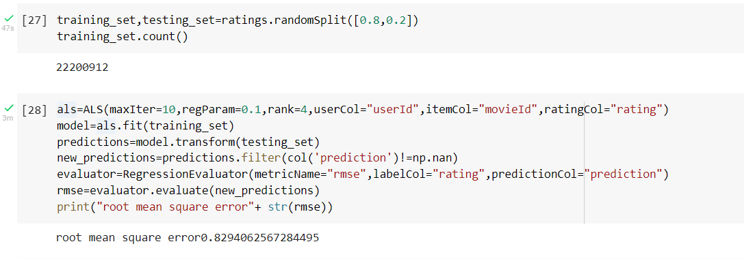
Project illustration step by step with code(contd):
Step-4: Splitting the dataset into training and testing dataset & Applying ALS approach for recommendation system.

Slide 14
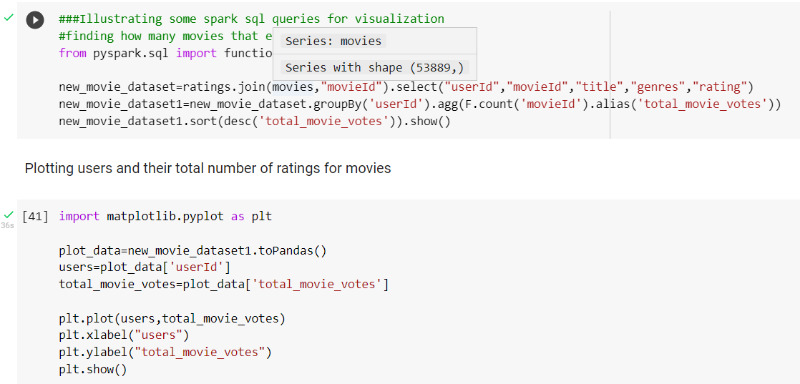
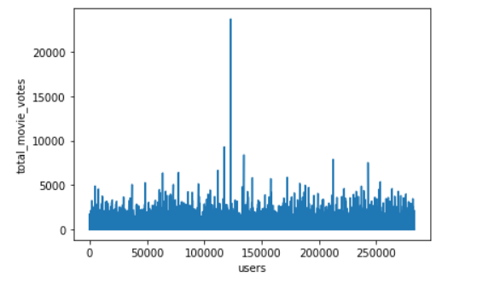
Plotting some key features:
Plotting1: Total number of ratings that a single user gave

Slide 15
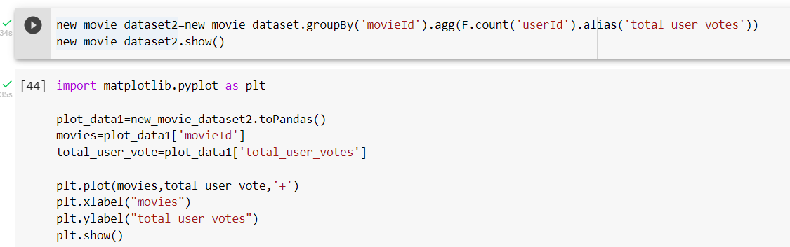
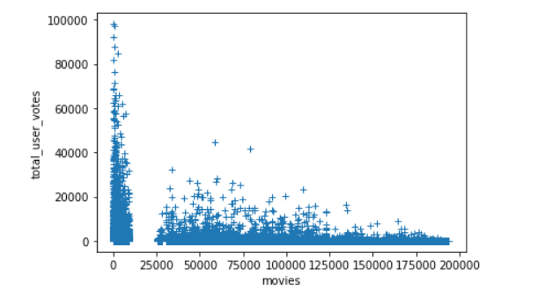
Plotting some key features(contd):
Plotting2: How many rating that each movie got

Slide 16
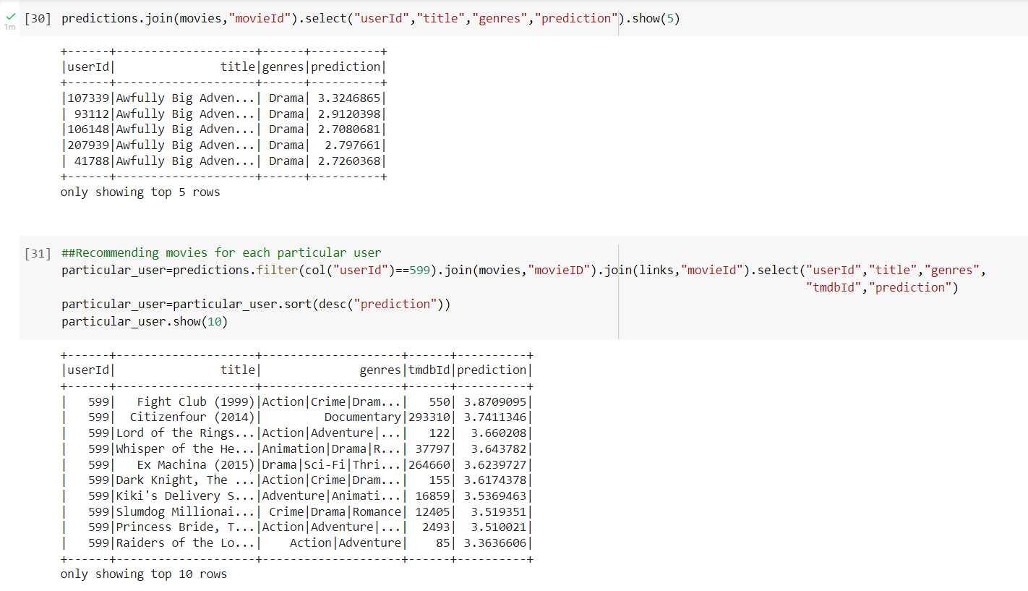
Recommendations for users:
Movie Recommendations for specific users based on the model that we developed.

Slide 17
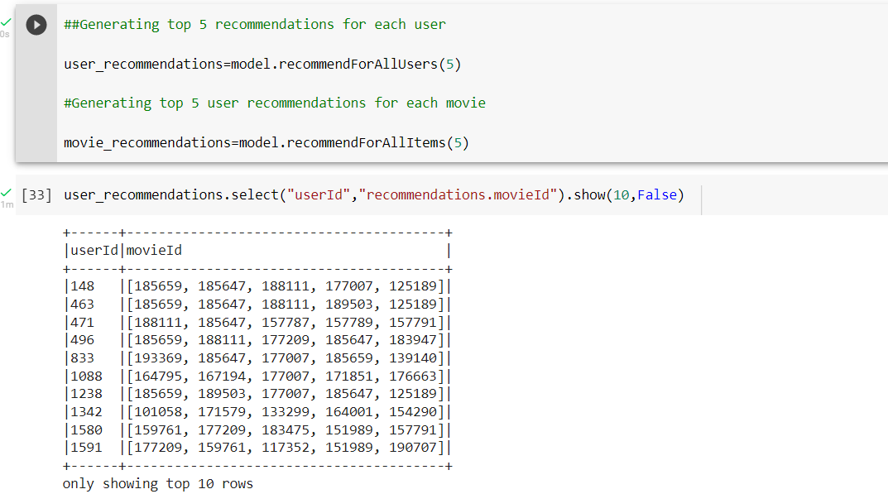
Recommendations for users(contd):
Top 5 Movie Recommendations for all users

Slide 18
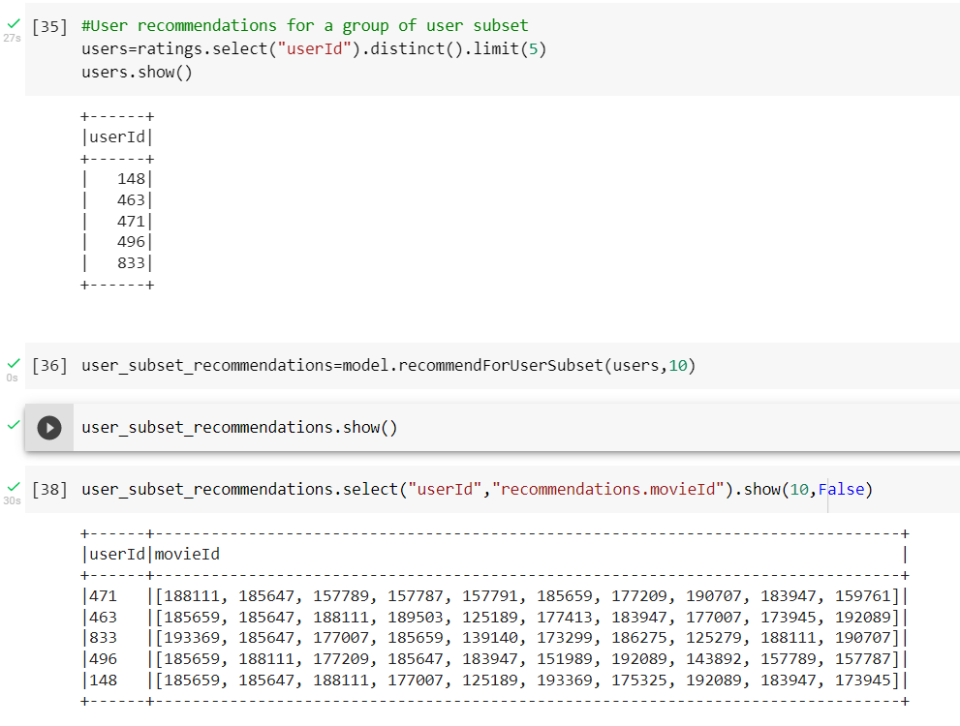
Recommendations for users(contd):
Top 10 Movie Recommendations for the subset of users

Slide 19
Results:
We built a movie recommendation system based on the user-user similarity, movie-movie similarity, global averages, and matrix factorization.
On the Test Data, our model resulted 0.83 RMSE Value, which is a good-to-go model. A model with RMSE < 2 is considered good.
What happens if a user never watched a movie or is a new user?
This problem is called as “Cold Start in Recommendation System”

Slide 20
Enhancements:
This model can be further enhanced by including features like Location, genre and interests while recommending a movie to users.
“Cold Start Problem” can be eliminated if we apply “Cross Validation” on the ALS Model. This is one of the major enhancement that can be done.
Using “Hybrid Filtering” will improve the performance of proposed system

Slide 21
Team Contributions:
Venkata Subba Rao Inti(Team Leader)
Applying the ALS Method(Alternating Least Squares method) using Matrix Factorization method to the cleaned data.
Projecting the movie recommendations for individual and group of users and also finding accuracy of used model.
Integrating all the individual tasks related to Project Code completion.
Doing the Final Project Report
Siva Rama Krishna Bheemanaboyina(Developer)
Collect the 27Million Dataset of size 250MB related to movie ratings from movielens.
Data Cleaning which covers Checking for any invalid data for doing tranformations like having NaN fields in the place invalid data.
Doing Project Presentation Slides
Sai Krishna Malakalapalli(Developer)
Plot some of the results using python library MatplotLib
Identifying Mean Squared Value from the model and the data that we used
Doing Project Presentation Slides

Slide 22


Slide 23


