Slide 1
T
Taskflow
A Full-Stack Multi-User Task Manager — Built, Containerized, and CI/CD-Tested
Production-style deployment simulation: React · Flask · SQLite · Docker · GitHub Actions · Kubernetes
Taskflow — Multi-user Task Manager
1

Slide 2
Project Objective
Simulate a production-like full-stack deployment, end-to-end, on a developer laptop.
MVC Architecture
Full-Stack App
Containerized
CI/CD Pipeline
Clean separation of models, views, and controllers on the backend
React frontend + Flask REST API + SQLite — a real multi-user CRUD product
Docker images for every service, orchestrated with docker-compose
GitHub Actions: lint, test, build images, run integration tests
Why it matters: this mirrors a real engineering workflow — design, build, containerize, automate testing/deployment, and (optionally) simulate Kubernetes infrastructure — compressed into something runnable entirely on a laptop.
Taskflow — Multi-user Task Manager
2

Slide 3
Architecture — MVC
Clear separation of concerns across the backend
MODELS
VIEWS
CONTROLLERS
SQLAlchemy ORM
Flask Blueprints (routing only)
Business logic
▸ User
▸ Project
▸ Task
▸ /api/auth
▸ /api/projects
▸ /api/tasks
▸ /api/users
▸ Ownership checks
▸ Assignment rules
▸ Validation
Frontend mirrors the same discipline: pages/ (route-level screens) call services/api.js, state lives in context/ (AuthContext), and components/ stay presentational and reusable.
Taskflow — Multi-user Task Manager
3

Slide 4
Technology Stack
Backend
Frontend
Database
Python + Flask
React + Vite
SQLite
REST API, JWT auth, bcrypt password hashing
React Router, dark-themed SPA, component-driven UI
Lightweight, file-based, zero external dependency for local dev
Containers
CI/CD
Infra Sim
Docker + docker-compose
GitHub Actions
Nginx + Kubernetes
Per-service Dockerfiles, Nginx reverse proxy
Lint → test → build images → integration test, on every push
Reverse proxy routing; K8s manifests for Minikube/Kind
Taskflow — Multi-user Task Manager
4

Slide 5
The End-to-End Journey
Not just a CRUD list — a real small-team workflow, start to finish
1
Sign up
2
Onboard
3
Create a project
Register / log in with JWT auth
First-time users are guided to create their first project
Group related work under a shared goal
4
Add tasks
5
Assign teammates
6
Track to completion
Set priority (Low/Med/High) and a due date
Delegate tasks to any registered user
Dashboard, per-project progress, and "My Work" views
Taskflow — Multi-user Task Manager
5

Slide 6
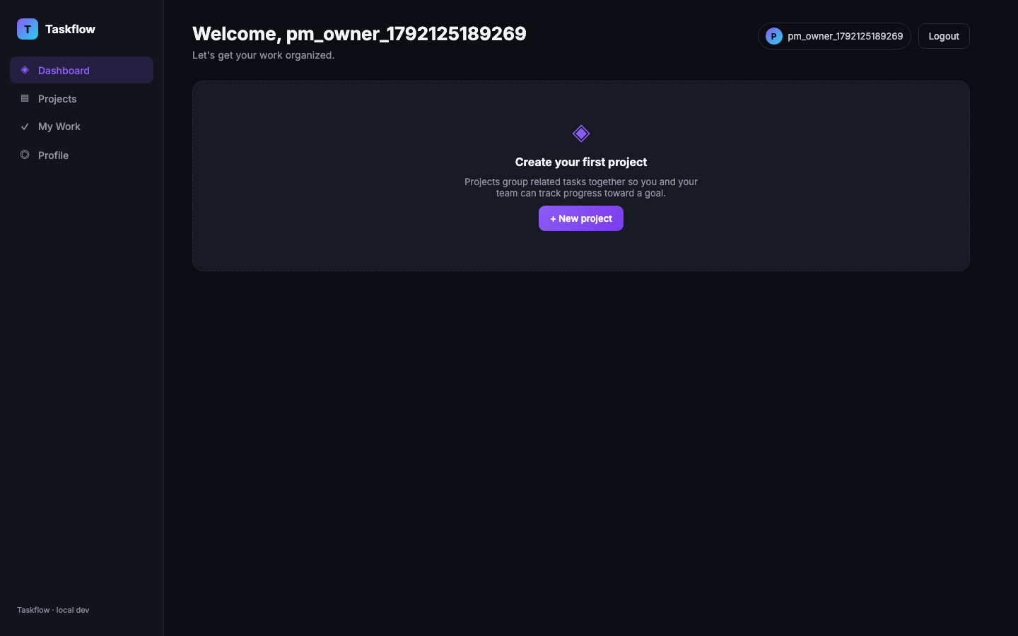
Day One: Guided Onboarding
A first-time user never lands on an empty, confusing screen
Taskflow — Multi-user Task Manager
6

Slide 7
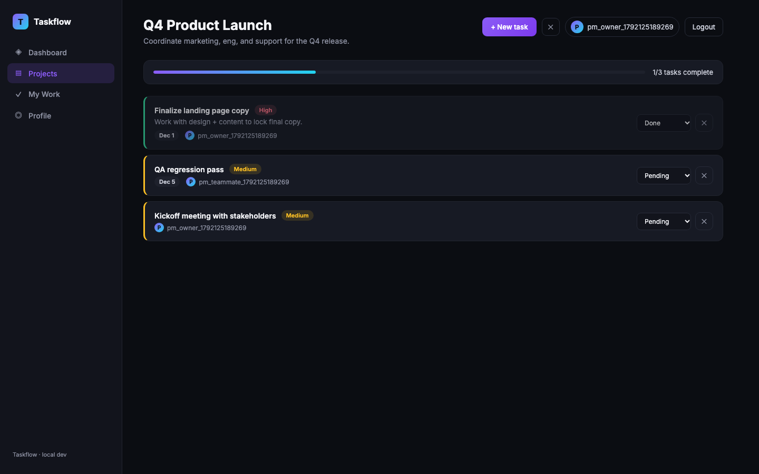
Projects, Priority & Assignment
Tasks carry priority, due dates, and can be delegated to any teammate
Taskflow — Multi-user Task Manager
7

Slide 8
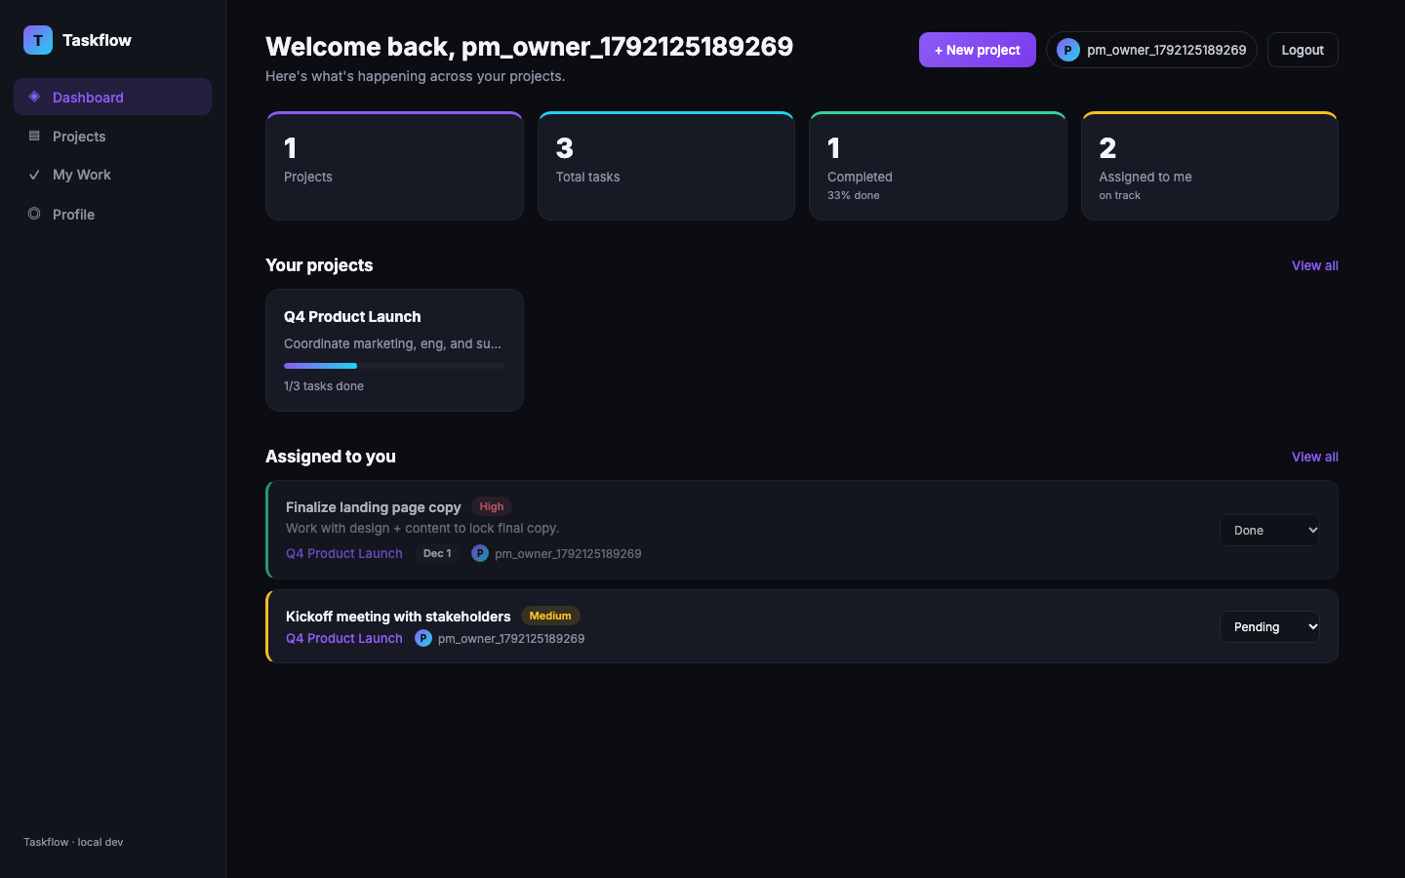
Dashboard: Progress at a Glance
Live stats across projects, plus what's assigned to you
Taskflow — Multi-user Task Manager
8

Slide 9
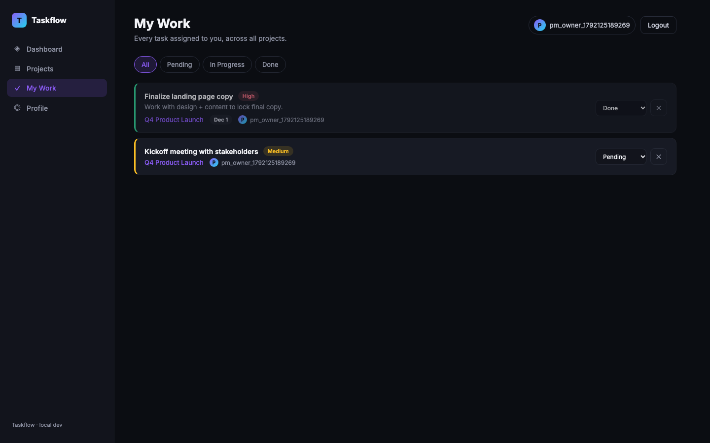
My Work: One View, Every Project
Everything assigned to you, filterable by status
Taskflow — Multi-user Task Manager
9

Slide 10
Containerization & CI/CD
Lint & Test
(backend + frontend)
Build Docker
Images
docker-compose
Up
Integration
Smoke Test
▸ GitHub Actions — runs on every push to main
▸ Dockerfiles — per service — backend (gunicorn) and frontend (nginx-served SPA)
▸ docker-compose — wires backend, frontend, and an Nginx reverse proxy together
▸ Integration test — registers a user, creates a project + task, verifies the stack end-to-end
▸ Infra simulation — standalone Nginx reverse proxy + Kubernetes manifests
▸ Kubernetes — Namespace, Deployments, Services, Secret, Ingress — for Minikube/Kind
▸ Verified — pipeline is green on GitHub — all 4 jobs passing
Taskflow — Multi-user Task Manager
10

Slide 11
Quality & Testing
30
93%+
0
4/4
Backend tests
(pytest)
Code coverage
(backend)
Flake8 / lint
errors
CI jobs
passing
▸ Authorization tested — assignees can update status only; owners can edit/delete; cross-user access is rejected (403)
▸ Validation tested — required fields, invalid status/priority values, malformed dates all rejected (400)
▸ Isolation tested — users only see their own projects/tasks by default, with an explicit opt-in to view everyone's
Taskflow — Multi-user Task Manager
11

Slide 12
Summary & Next Steps
▸ Delivered — A working multi-user task manager with a real onboarding-to-completion journey
▸ Production-style practices — MVC separation, containerization, automated CI/CD, infra-as-code
▸ Verified — 30 passing tests, clean lint, green CI pipeline on GitHub
▸ Potential next steps — Swap SQLite for PostgreSQL to support true horizontal scaling
▸ Notifications — Email/in-app alerts when a task is assigned or nearing its due date
▸ Deploy for real — Point the existing Kubernetes manifests at a managed cluster
Taskflow — Multi-user Task Manager
12

