Slide 1
Airline Passenger Satisfaction (Classification)
Vellanki Venkat Aditya [RA2111003011799]

Slide 2
Introduction
In the highly competitive airline industry, passenger satisfaction is a critical determinant of an airline’s success and reputation. Understanding and predicting factors that influence passenger satisfaction can help airlines enhance their services, retain customers, and attract new ones. This project focuses on classifying airline passengers’ satisfaction levels using machine learning techniques, specially Decision Tree and Naive Bayes classifiers. By analyzing various aspects of the flight distance, service quality, seat comfort, and punctuality, we aim to develop predictive models that can accurately classify passengers as satisfied or dissatisfied. This project not only provides insights into the key drivers of passenger satisfaction but also demonstrates the practical application of machine learning in improving customer service and operational efficiency in the airline industry.

Slide 3
About the Project
This project aims to classify airline passengers’ satisfaction levels using Decision Tree and Naive Bayes classifiers. We utilized a comprehensive dataset containing various aspects of passengers’ flight experiences, including flight distance, departure/arrival delays, service quality, and in-flight amenities. The process began with data preprocessing, where missing values were handled, categorical features were encoded, and numerical features were scaled. Through exploratory data analysis, we visualized data distributions and correlations to identify key factors influencing satisfaction. The dataset was split into training and testing sets to build and evaluate our models. We trained a Decision Tree classifier, optimizing its hyperparameters to improve performance and interpret feature importance. Simultaneously, we employed a Naive Bayes classifier, taking advantage of its simplicity and effectiveness for probabilistic predictions. The results were compared based on accuracy, precision, recall, and F-1 score to determine the most effective model for predicting passenger satisfaction. This project highlights the application of machine learning techniques in enhancing airline service quality and passenger experience.

Slide 4
Features of the Project
Gender: Gender of the passengers (Female, Male)
Customer Type: The customer type (Loyal customer, disloyal customer)
Age: The actual age of the passengers
Type of Travel: Purpose of the flight of the passengers (Personal Travel, Business Travel)
Class: Travel class in the passengers’ flight (First, Business, Premium Eco, Economy)
Flight Distance: The flight distance of the journey
Inflight wifi service: Satisfaction level of inflight wifi service (0:Not Applicable;1-5)
Departure/Arrival time convenient: Satisfaction level of Departure/Arrival time convenient

Slide 5
Features of the Project (Continued…)
Ease of Online booking: Satisfaction level of online booking
Gate location: Satisfaction level of Gate location
Food and drink: Satisfaction level of Food and drink
Online boarding: Satisfaction level of online boarding
Seat comfort: Satisfaction level of Seat comfort
Inflight entertainment: Satisfaction level of inflight entertainment
On-board service: Satisfaction level of inflight entertainment
Leg room service: Satisfaction level of On-board service
Baggage handling: Satisfaction level of baggage handling
Check-in service: Satisfaction level of Check-in service
Inflight service: Satisfaction level of inflight service
Cleanliness: Satisfaction level of Cleanliness
Departure Delay in Minutes: Minutes delayed when depature

Slide 6
Brief overview of the dataset and the problem statement
The dataset contains information from an airline passenger satisfaction survey. It includes various factors such as gender, customer type, age, type of travel, class, flight distance, and satisfaction ratings for different services provided during the flight. The problem statement resolves around understanding the factors influencing passenger satisfaction and building predictive models to classify passengers as satisfied or dissatisfied based on their characteristics and satisfaction ratings.

Slide 7
Objective of the project
The objective of the project is to analyze the dataset to identify factors highly correlated with passenger satisfaction and to develop machine learning models that can accurately predict passenger satisfaction based on their demographic and flight-related attributes. Specifically, we aim to compare the performance of two classification algorithms, Decision Tree and Naive Bayes, in predicting passenger satisfaction.

Slide 8
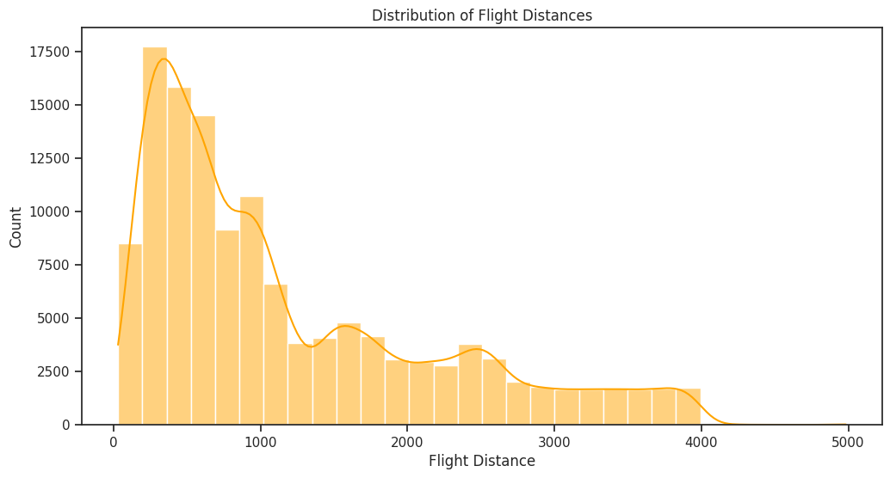
Solution
To address the challenge of classifying airline passenger satisfaction, we propose a machine learning-based solution that leverages Decision Tree and Naive Byes classifiers. Our approach involves:

Slide 9
Data Preprocessing
Loading the Dataset:
The dataset is loaded into a pandas Dataframe from a CSV file.
Handling Missing Values:
Missing values in the ‘Arrival Delay in Minutes’ column are filled with the mean value of the column to ensure completeness of the data.
Dropping Unnecessary Columns:
Columns like ‘Unnamed:0’ are dropped as they do not provide any relevant information for analysis or modeling.
Identifying categorical and numerical columns:
Categorical columns such as gender, customer type, type of travel, and class are identified, along with numerical columns like age, flight distance, and satisfaction ratings.
Preprocessing categorical data:
Categorical features are one-hot encoded using the OneHotEncoder to convert them into numerical format, making them suitable for modeling.
Preprocessing numerical data:
Numerical features are standardized using Standard Scaler to bring them to a common scale, which helps in improving the performance of certain algorithms and ensures that no feature dominates due to its scale.

Slide 10
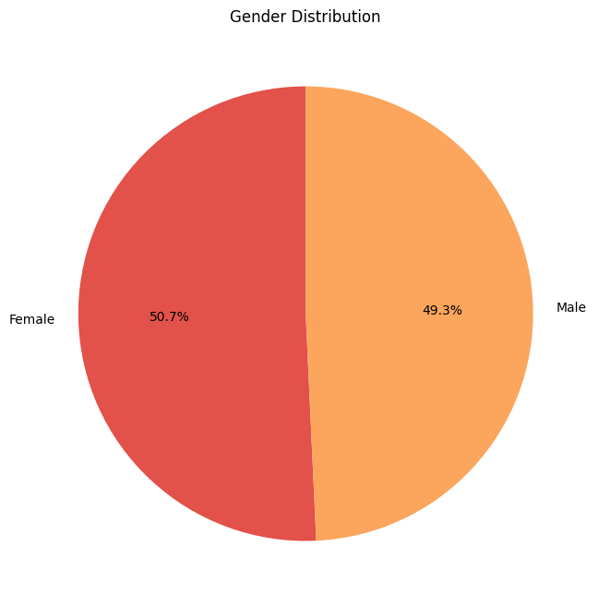
Splitting the Data
Splitting the dataset into training and testing sets:
The dataset is divided into two subsets: a training set used to train the models and a testing set used to evaluate the performance of the trained models.
Explanation of why splitting the data is important for model evaluation:
Splitting the data helps in assessing the generalization performance of the models by evaluating them on unseen data. It prevents overfitting by providing an unbiased estimate of the model’s performance on new data.

Slide 11
Building Models
Brief explanation of Decision Tree and Naive Bayes algorithms:
Decision Tree is a non-parametric supervised learning method used for classification and regression tasks. It creates a tree-like model of decisions based on features to predict the target variable.
Naive Bayes is a probabilistic classifier based on Bayes’ theorem and the assumption of feature independence. It calculates the probability of each class given a set of features and selects the class with the highest probability.
Description of pipelines for both algorithms:
Preprocessor: StandardScaler for numerical features and OneHotEncoder for categorical features are applied to process the data.
Classifier: DecisionTreeClassifier for Decision Tree and GaussianNB for Naive Bayes are used as the classification algorithms.

Slide 12
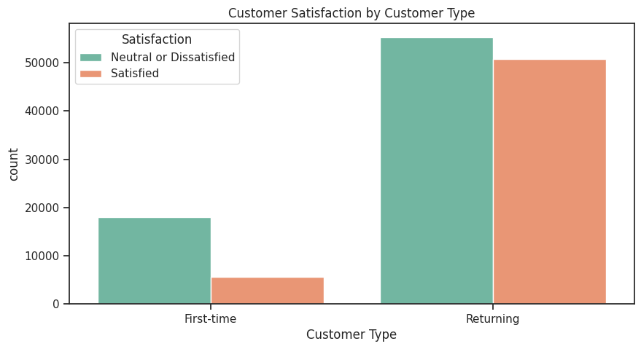
Training Models
Separating features and target variables:
The features (independent variables) and the target variable (dependent variable) are separated to train the models.
Training Decision Tree and Naive Bayes models on the training data:
The models are trained on the training data to learn the underlying patterns and relationships between features and the target variable.

Slide 13
Model Evaluation
Predicting on the test data using both models:
The trained models are used to make predictions on the test data to assess their performance on unseen data.
Printing classification reports and confusion matrices for both models:
Classification reports provide precision, recall, F-1 score, and support for each class, while confusion matrices visualize the performance of the models by showing the count of true positives, false positives, true negatives, and false negatives.
Printing classification reports and confusion matrices for both models:
Classification reports provide precision, recall, F-1 score, and support for each class, while confusion matrices visualize the performance of the models by showing the count of true positives, false positives, true negatives, and false negatives.

Slide 14
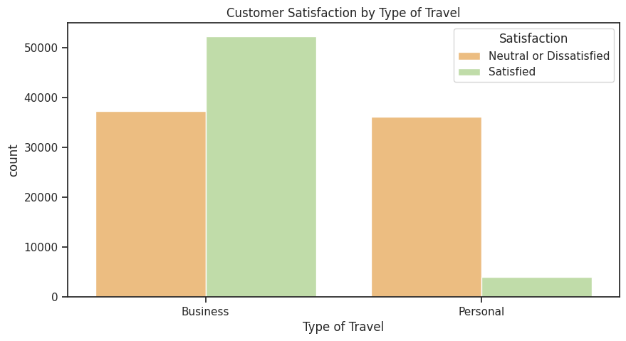
Comparative Analysis
Comparison of Decision Trees and Naive Bayes based on:
Accuracy: Overall performance of the models.
Precision, Recall, F-1 score: Performance on individual classes (satisfaction levels).
Interpretability: How easy it is to interpret the models.
Robustness: Sensitivity to outliers and noisy data.
Computational Complexity: Time and resource requirements for training and prediction.

Slide 15
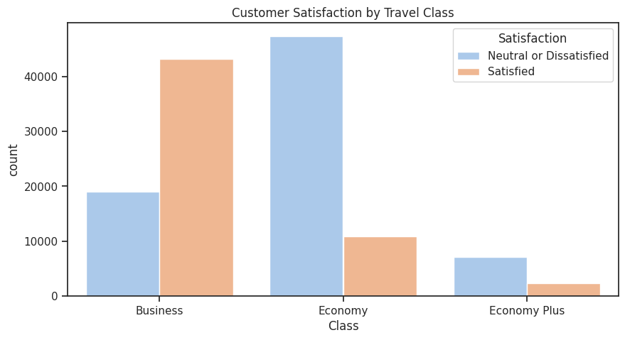
Factors Correlated to Passenger Satisfaction
Analysis of feature importance:
Using feature_importances_attribute for Decision Tree.
Exploring coefficient values for Naive Bayes.
Identification of factors highly correlated to passenger satisfaction.

Slide 16
Conclusion
In summary, our project effectively applies Decision Tree and Naive Bayes classifiers to classify airline passenger satisfaction based on key flight experience factors. Through rigorous data preprocessing and model evaluation, we identified crucial features influencing satisfaction, such as service quality and punctuality. Decision Tree outperforms Naive Bayes in terms of accuracy, precision, recall, and F1-score. Decision tree offers higher interpretability but may suffer from overfitting. Naive Bayes is computationally efficient and robust to noisy data but relies on the independence assumption. Decision Tree would be preferred if interpretability is crucial, while Naive Bayes might be chosen for its simplicity and efficiency in large-scale applications. By leveraging these insights, airlines can enhance service quality, optimize operations, and foster greater customer satisfaction and loyalty. This project underscores the transformative potential of machine learning in improving airline service delivery and customer experiences.

