Slide 1
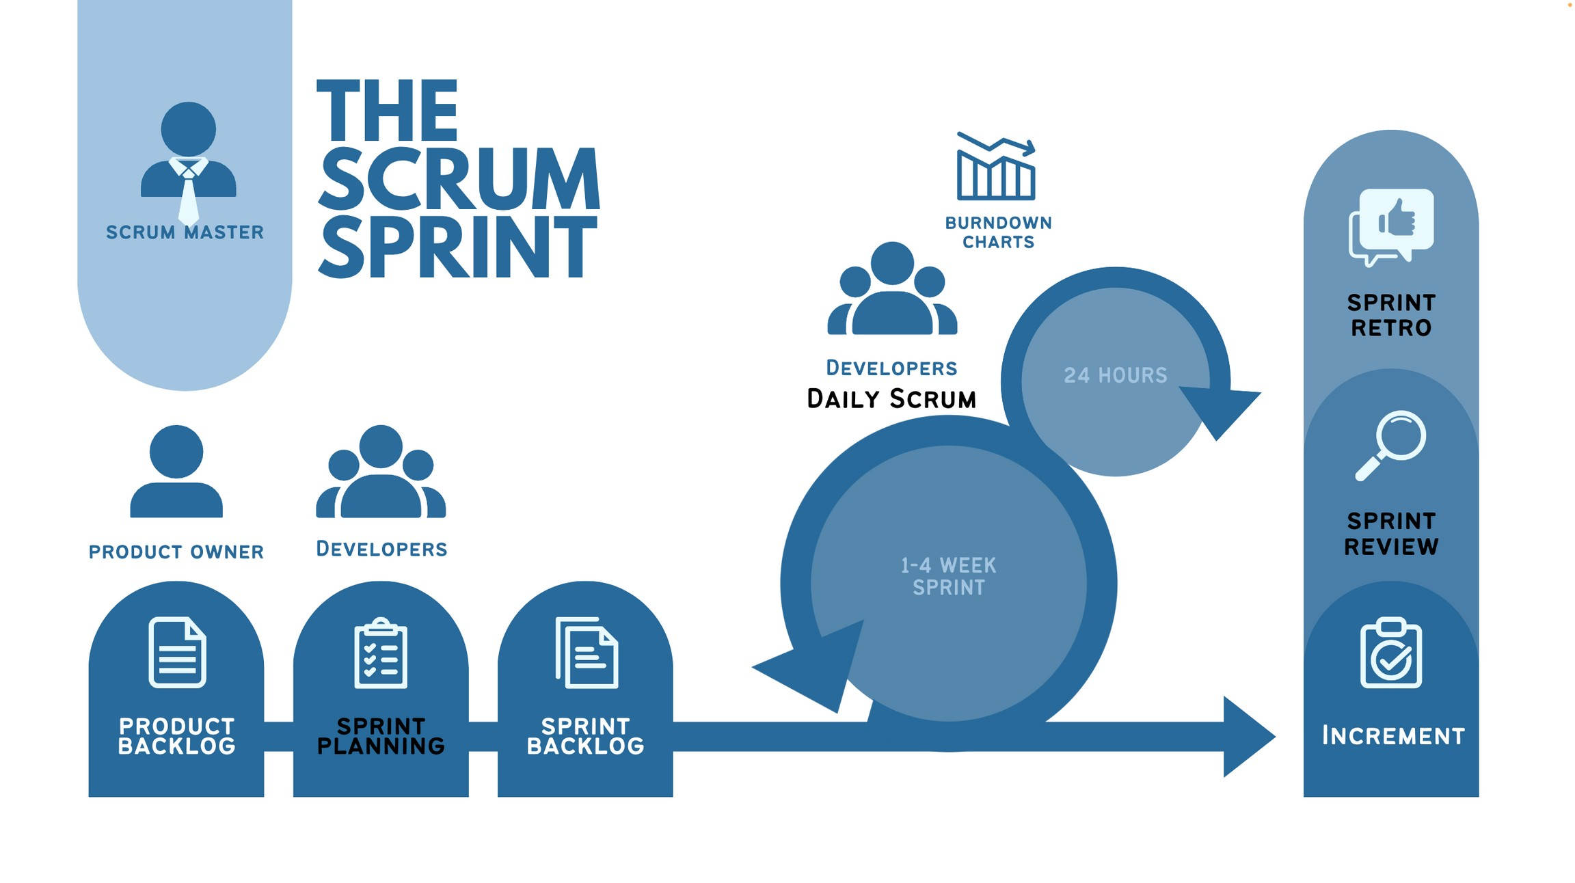


THE SCRUM SPRINT
scrum master
burndown charts
sprint retro
Developers
Daily Scrum
24 HOURS
sprint review
product owner
Developers
1-4 WEEK SPRINT
product
sprint
sprint
Increment
backlog
planning
backlog

Slide 2
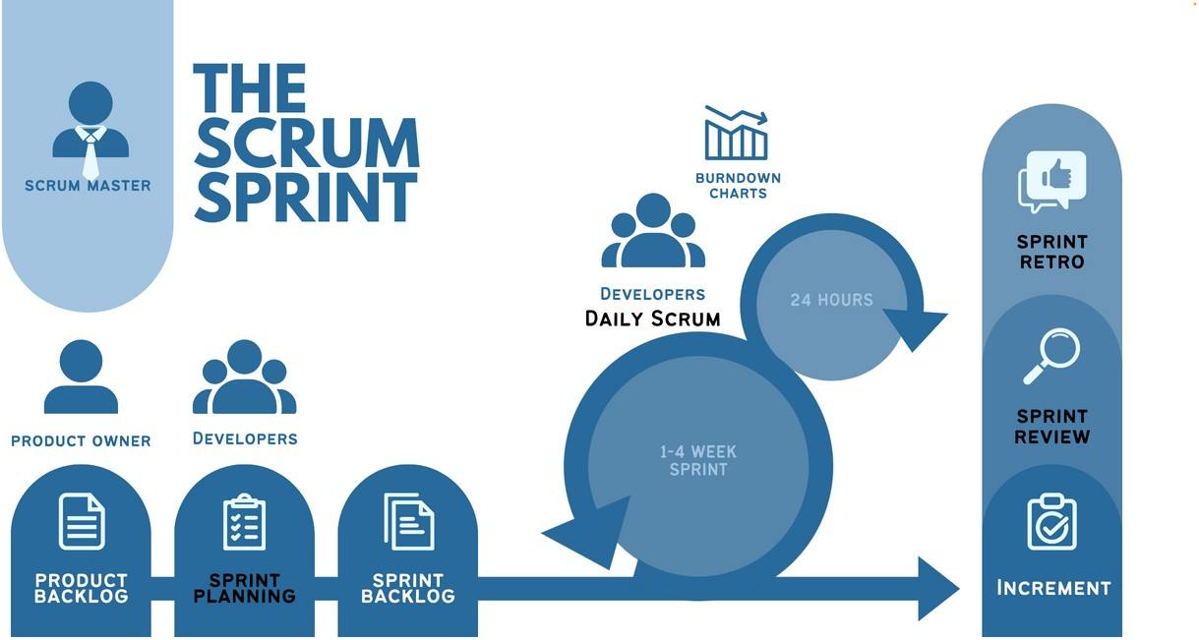
Scrum in a nutshell
Product Owner orders Product Backlog.
Scrum team chooses a Sprint Goal and tasks from Product Backlog to be developed during the next Sprint in Sprint Planning.
Scrum Team and stakeholders inspect the increments created (Sprint Review) and determine future adaptations for the next Sprints.
The Scrum Team review their effectiveness and quality (Sprint Retrospective) and make adjustments for the next Sprints. The process repeats.

Slide 3
Sprint | PHARMAMMYY
Particulars | To prepare a targeted sales by the Business Head for the month, Team will assess the existing stocks and balance stocks to be produced, Raw requirements will be assessed as per production & dispatch schedule based on weekly basis, production will be planned as per customer requirements, Despatches will be carried as per Marketing requirement, Review will be carried based on Target versus Achieved, Customer Complaints, Quality Issues, Non-productive issues, Raw Material quality & timely supply, productivity, Excess Production, Rejection, Employee Communication, New Idea Generation, Collective Team Efforts, Learning from each Sprint to be implemented in the next Sprint. All activities will be recorded by the Business Head & reviewed by the Management at the end of each Sprint
Start Date | 01st day of Month
End Date | Last day of Month

Slide 4
Scrum Team
scrum master
product owner
Developers
Coaches Scrum Causes removal of Impediments
Value Maximizer
Create any aspect of a usable Increment each Sprint
NOTE: The Scrum Team is limited to 10 or fewer members.

Slide 5
SCRUM TEAM
Scrum Master | Mr. P.S. Rao
Product Owner | Mr. Arnab Paul
Developers | Mr. Murali – Marketing Co-Ordinator Mr. Manohar - Production Mr. B.Venkateswara Rao – Logistics Mr. Raja Baju – Logistics Mr. Subba Rao – QC Mr. Prasanna - QC

Slide 6


Scrum Team
Self-managed
Cross-functional
No hierarchies
Collective Accountability
Holding each other accountable as professionals.
Internally decides who does what, when, and how.
Members have all the skills necessary to create value each Sprint.
It is a cohesive unit of professionals aligned to the same goals
NOTE: The Scrum Team is limited to 10 or fewer members.

Slide 7
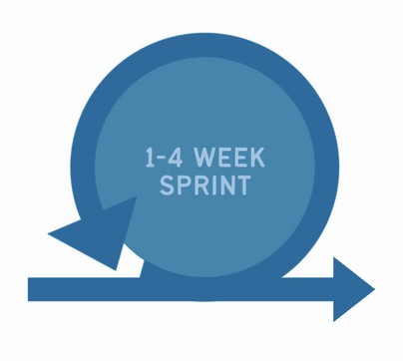




Scrum Events
Sprint - max 1 calendar month. Goal is to produce usable Increments at the end of the
1-4 WEEK SPRINT
Max 4 hours (Usually shorter for shorter Sprints).
For Scrum Team and Key Stakeholders.
To review increments and determine what is next.
Sprint.
sprint review
Max 8 hours (Usually shorter for shorter Sprints).
The Sprint Goal is agreed upon.
sprint
planning
Max 3 hours (Usually shorter for shorter Sprints).
For the Scrum Team. Discuss improvements to effectiveness and quality.
Max 15 minutes.
For the Developers only.
To monitor progress towards the Sprint Goal
sprint retro
Daily Scrum

Slide 8
SCRUM EVENTS
Sprint | Entire Month
Sprint Planning | 01st of Month
Daily Scrum | 15 Minutes – Daily
Sprint Review | 25th of Month
Sprint Retro | Last day of Month

Slide 9
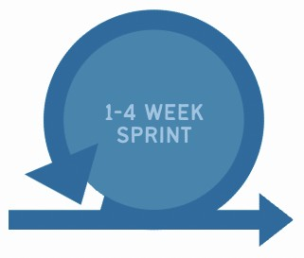
During the Sprint
No changes are made that would endanger the Sprint Goal
Quality goals do not decrease
Developers track progress in Daily Scrums
The Product Backlog is refined as needed
Scope may be clarified and renegotiated between the Product Owner and Developers as more is learned.
Only the Product Owner can cancel the Sprint.
1-4 WEEK SPRINT

Slide 10
Scrum Artifacts
The Product Backlog is the single source of work undertaken by the Scrum Team. The Commitment to the Product Backlog is the Product Goal.
product
backlog
The Sprint Backlog is a set of product backlog tasks that have been
chosen to be developed during the next Sprint to meet the Sprint Goal. The Commitment to the Sprint Backlog is the Sprint Goal.
sprint
backlog
An Increment is a concrete stepping stone toward the Product Goal, by completing product backlog tasks during a Sprint.
The Commitment to the Increment is the Definition of Done.
The Definition of Done lists the agreed quality standards of increments.
Increment

Slide 11
Scrum Artifacts
product
sprint
backlog
Increment
backlog
Only Ever One Product Backlog
Only One Product Goal Items estimated by Developers Continuous refinement by the Scrum Team Product Owner’s accountability.
A plan by and for the Developers
Updated throughout the Sprint
Developer’s accountability
Each Increment is additive to all prior Increments.
Multiple Increments may be created within a Sprint.
Should meet the Definition of Done.

Slide 12
Definition of Done
Is a list of conditions that must be true in order to
consider Increments truly done. Defined by the Organization if available
If not, must be mutually defined by Scrum Teams.

Slide 13

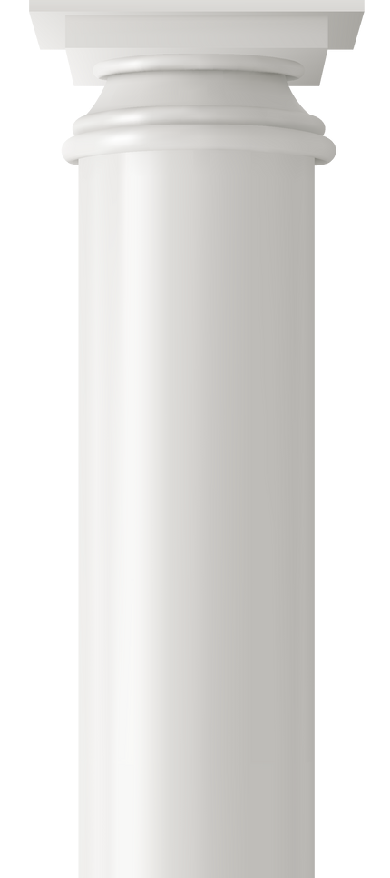
3 Pillars of Scrum
SCRUM
“Founded on Lean Thinking and
Empiricism“
Transparency - Making work and outputs clear and visible
Inspection - Frequent checks on progress towards goals, to detect deviations from the path to the goal.
Adaption -Adjusting the process as soon as possible to minimize any further deviation or issues.
Transparency
Adaption
Inspection

Slide 14






Courage
Scrum Team members have the courage to do the right thing and work on tough problems.
Focus
Everyone focuses on the work of the Sprint and
the goals of the Scrum Team.
Commitment
People personally commit to achieving the
goals of the Scrum Team.
S
s
Respect
Scrum Team members respect each other to be
capable, independent people.
Openness
The Scrum Team and its stakeholders agree to
be open about all the work and the challenges with performing the work.
c
e
r
u
u
l
m
V
a

Slide 15

Characteristics
Self-organizing teams
Product progresses in a series of month-long “sprints”
Requirements are captured as items in a list of “product backlog”
No speciﬁc engineering practices prescribed
Uses generative rules to create an agile environment for delivering projects
One of the “agile processes”

Slide 16

Product owner
Deﬁne the features of the product
Makes scope vs. schedule decisions
Responsible for achieving ﬁnancial goals of the project
Prioritize the product backlog
Adjust features and priority every sprint, as needed
Accept or reject work results

Slide 17

Scrum Master
Responsible for enacting Scrum values and practices
Removes impediments
Coaches the team to their best possible performance
Helps improve team productivity in any way possible
Enable close cooperation across all roles and functions
Shield the team from external interference

Slide 18





The Team
Typically 5-9 people
Cross-functional:
Members should be full-time
May be exceptions
Teams are self-organizing
Ideally, no titles but rarely a possibility
Membership should change only between sprints
Members who are involved

Slide 19
Scrum framework
Ceremonies
Sprint planning
Daily scrum meeting
Sprint review
Sprint retrospective
Artifacts
Product backlog
Sprint backlog
Increment

Slide 20
Sprint planning
Team selects items from the product backlog they can commit to completing
Sprint backlog is created
Tasks are identiﬁed and each is estimated (1-16 hours)
Collaboratively, not done alone by the ScrumMaster
High-level design is considered

Slide 21



Product backlog
Business Head will prepare the Targets to be achieved during the Sprint based on Commodities with Volumes in excel file – PHARMA0524 (PHARMAMMYY) and share the link with view option to all team mates during the sprint planning and this will be google share only. Concerned team can view the file and carry the work based on this to achieve the Target. Any modifications to this file will be carried by the Product Owner – Business Head
This is the product backlog

Slide 22
Managing the sprint backlog
Individuals sign up for work of their own choosing
Work is never assigned
Estimated work remaining is updated daily
Any team member can add, delete or change the sprint backlog
Work for the sprint emerges
If work is unclear, deﬁne a sprint backlog item with a larger amount of time and break it down later
Update work remaining as more becomes known

Slide 23
The daily scrum
Parameters
Daily
15-minutes
Stand-up
Not for problem solving
Whole world is invited
Only team members, ScrumMaster, product owner, can talk
Helps avoid other unnecessary meetings

Slide 24
The sprint review
Team presents what it accomplished during the Sprint
Typically takes the form of a demo of new features or underlying architecture
Informal
2-hour prep time rule
No slides
Whole team participates
Invite the world

Slide 25
Sprint Retrospective
Periodically take a look at what is working and what is not working
Typically around Max 3 hours (Usually shorter for shorter Sprints).
Done after every sprint
Whole team participates
ScrumMaster
Product owner
Team
Possibly customers and others

Slide 26
Start / Stop / Continue
Whole team gathers and discusses what they’d like to:
Start Doing
Stop Doing
Continue Doing
Any previous backlogs to be executed in next sprint
Any Customer Complaints
Any conflicts

Slide 27

THANK YOU

