Slide 1
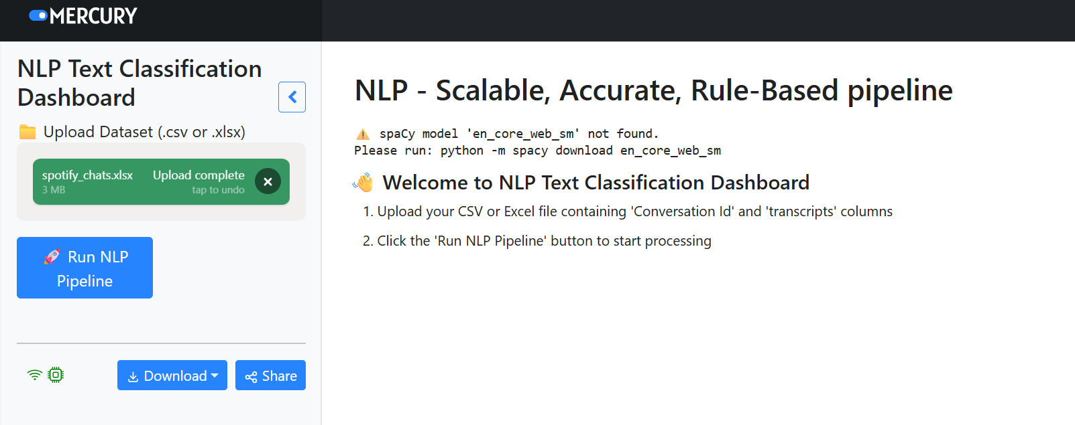
Challenges

Slide 2
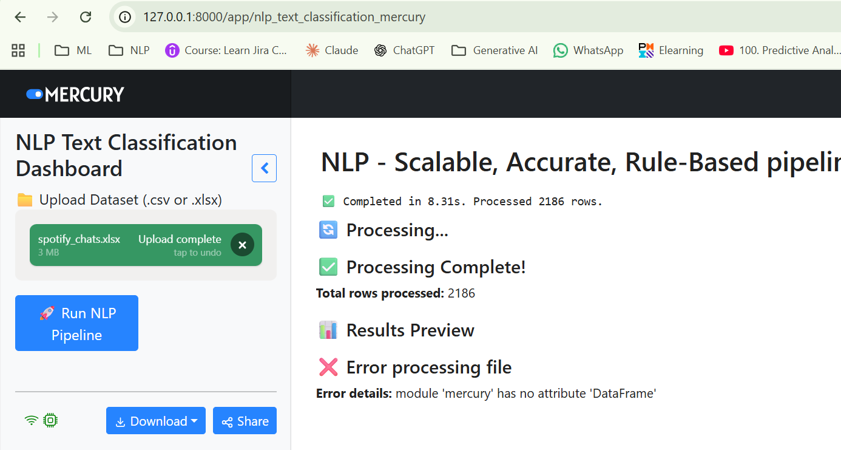
Challenges

Slide 3
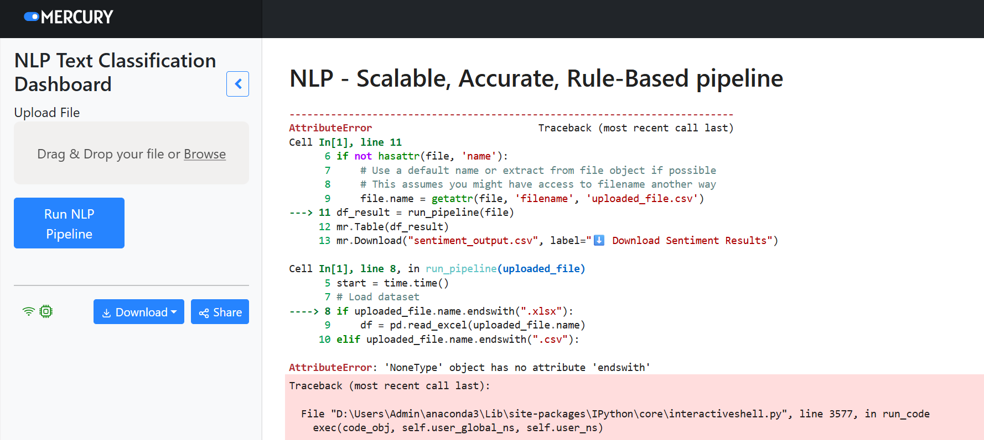
Challenges

Slide 4
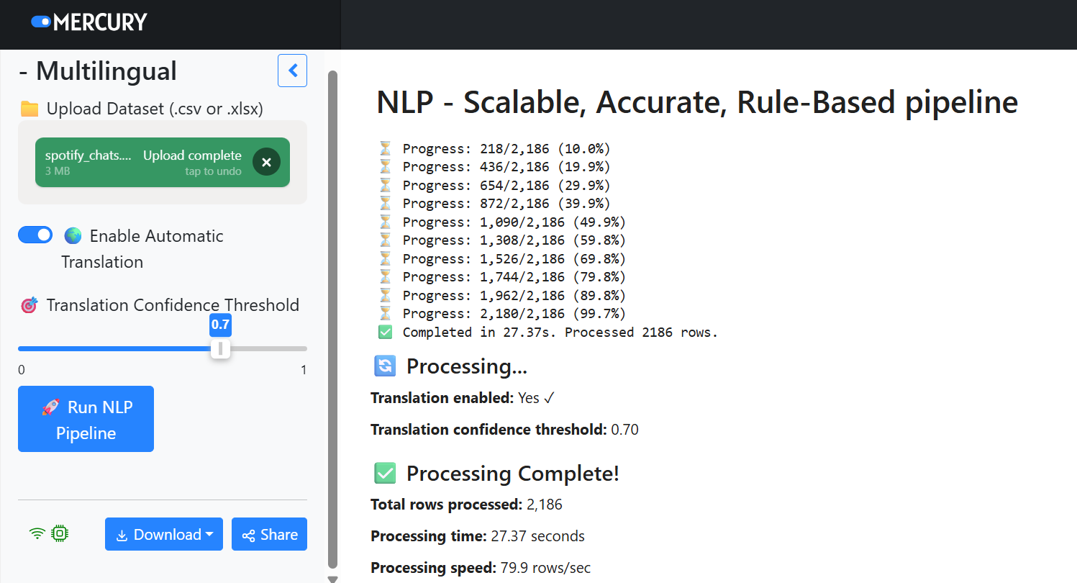
Solution
http://127.0.0.1:8000/app/nlp_text_classification_mercury

