Slide 1

JavaScript
By
Venkat.CH
* See slide notes for page directions
Notes:
When listing all project collaborators, either use commas or bullets

Slide 2
Functions
JavaScript functions are blocks of code that can be defined and invoked to perform a specific task or calculation
function addNumbers(a, b)
{
console.log(a + b);
}

Slide 3
Type of Functions
Pre-defined Functions
User Defined Functions

Slide 4
Primary concepts
Named Functions
Functions with Parameters
Variables
Functions
Function with return value (pure function)
Anonymous functions
Call back functions
IIFE (immediate invoke functions)

Slide 5
Ways of Writing Functions
Function Declaration
Function Expression
Arrow Function

Slide 6
Function declarations
A function definition (also called a function declaration, or function statement) consists of the function keyword, followed by:
The name of the function.
A list of parameters to the function, enclosed in parentheses and separated by commas.
The JavaScript statements that define the function, enclosed in curly brackets, { /* … */ }.
function square (number) {
return number * number;
};
console.log(square(4)); // 16

Slide 7
Function expressions
While the function declaration above is syntactically a statement, functions can also be created by a function expression.
Such a function can be anonymous; it does not have to have a name. For example, the function square could have been defined as:
const square = function (number) {
return number * number;
};
console.log(square(4)); // 16

Slide 8
Arrow Functions
Arrow functions, also known as fat arrow functions, are a concise syntax introduced in ECMAScript 6 (ES6) for creating functions in JavaScript.
They provide a shorter and more readable way to define functions compared to traditional function expressions.
const square = (number) => {
return number * number;
};
console.log(square(4)); // 16

Slide 9
Arrow Functions
Short hand syntax
Implicit return
Callback function

Slide 10
Scope
Global Scope
Function Scope
Block Scope
Lexical Scope / Static Scope
Closures
Higher Order Functions,
pure functions
impure functions
Currying,
Function composition.
Functional Programming..

Slide 11
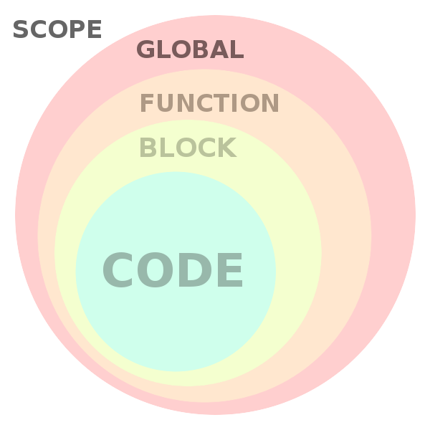
Scope

Slide 12
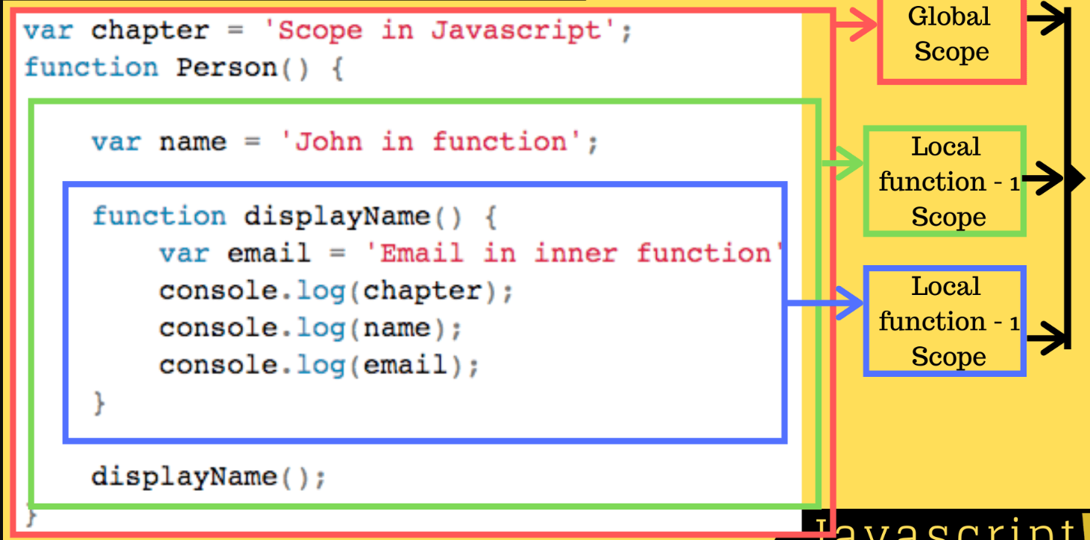

Slide 13
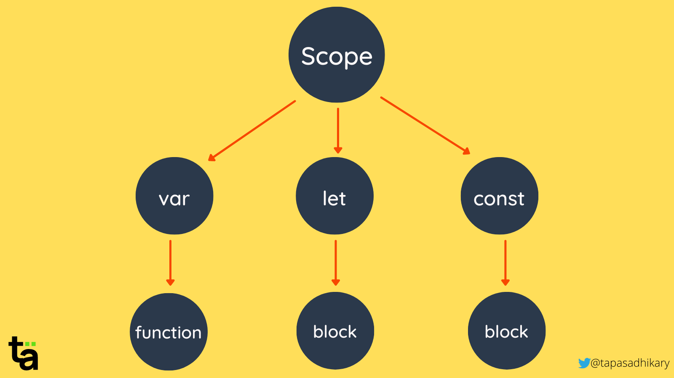

Slide 14
Lexical Scope
Lexical scope, also known as static scope, is a concept in programming languages that determines how variable names are resolved and accessed based on their physical location in the source code.
It defines the visibility and accessibility of variables and functions in relation to their enclosing scopes.

Slide 15
Lexical Scope
function outer() {
var x = 10;
function inner() {
var y = 20;
console.log(x + y); // Accesses variables from the lexical scope (closure)
}
return inner;
}
var innerFn = outer(); // innerFn now holds a reference to the inner function
innerFn(); // Output: 30

Slide 16
Closures
A closure is a combination of a function and the lexical environment within which that function was declared.
It is a runtime concept that allows a function to retain access to variables from its outer scope, even after the outer function has finished executing or gone out of scope.
In simpler terms, a closure is formed when a nested function references variables from its parent function, creating a "closed-over" scope that preserves those variables.

Slide 17
Closures
function createCounter() {
var count = 0;
function increment() {
count++;
console.log(count);
}
function decrement() {
count--;
console.log(count);
}
return {
increment: increment,
decrement: decrement
};
}
var counter = createCounter();
counter.increment(); // Output: 1
counter.increment(); // Output: 2
counter.decrement(); // Output: 1

Slide 18
Closures
"A closure in JavaScript is a function that remembers its outer variables and can access them even when called independently."

