Slide 1

JavaScript
By
Venkat.CH
* See slide notes for page directions
Notes:
When listing all project collaborators, either use commas or bullets

Slide 2
JavaScript ?
JavaScript is a high-level, dynamic, interpreted programming language that is primarily used for adding interactivity to websites and web applications.
It was originally created by Netscape (later Mozilla) and has since become one of the most widely used programming languages for front-end and back-end web development.
Over time, JavaScript has also extended its reach beyond the browser through technologies like Node.js, which allows it to be used for server-side programming.
This enables developers to build entire web applications using JavaScript on both the client and server sides.

Slide 3
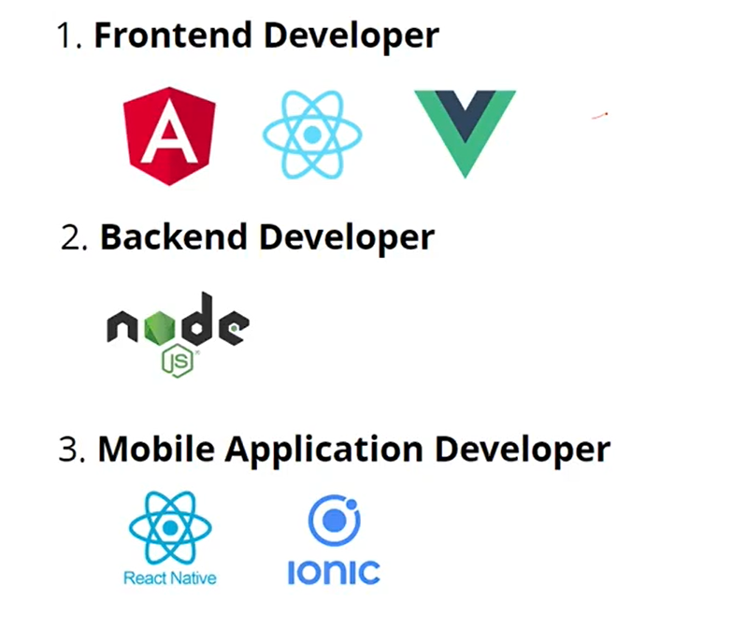
What we can do with JS

Slide 4
What are going to Cover
Programming
DOM
Object Orient Programming
Functional Programming
Asynchronous Programming

Slide 5
JavaScript Engine
A JavaScript engine is a software component that executes JavaScript code. The first JavaScript engines were mere interpreters, but all relevant modern engines use just-in-time compilation for improved performance.
JavaScript engines are typically developed by web browser vendors, and every major browser has one. In a browser, the JavaScript engine runs in concert with the rendering engine via the Document Object Model.
Since ECMAScript is the standardized specification of JavaScript, ECMAScript engine is another name for these engines..

Slide 6
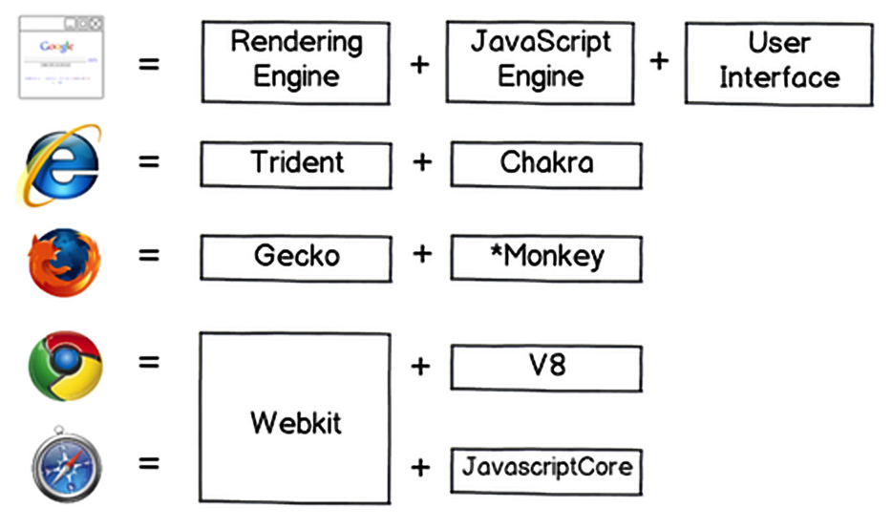
Few JS Engines

Slide 7
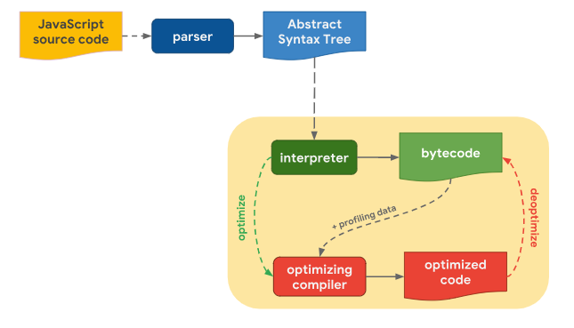

Slide 8
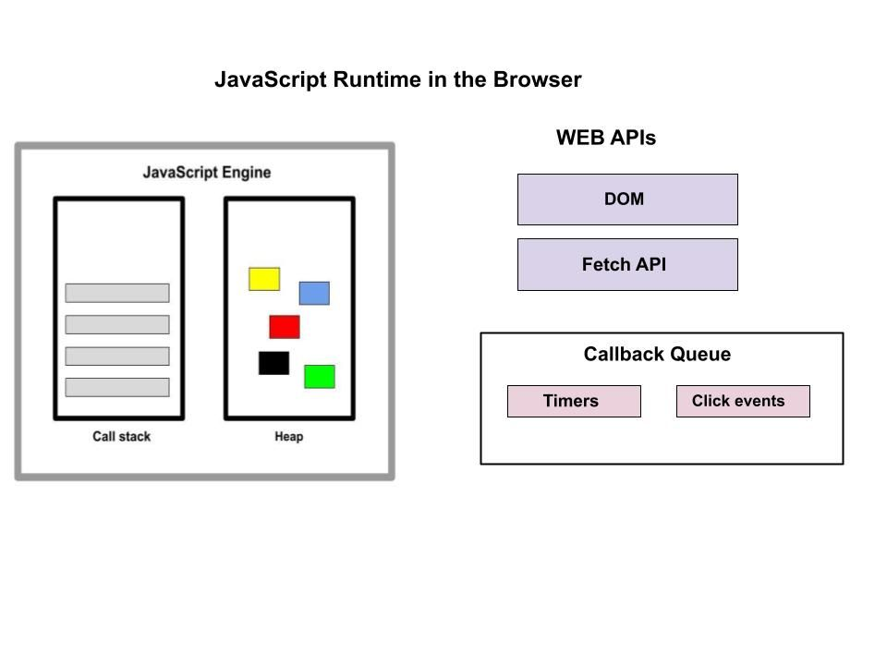

Slide 9
Question
Why we call JavaScript as ES/ ECMAScript ?

Slide 10
Variables
Variables allow you to store and manipulate data throughout your program
Var i=10;
Var name=“Venkat”
Var isActive=true

Slide 11
Ways of create Variable
Using the var keyword
Var i=10;
Using the let keyword:
Let i =10;
Using the const keyword:
Const i=10;

Slide 12
Keywords
Keywords in JavaScript are reserved words that have special meanings and purposes within the language
class
If
else
for
function
Let
Var
Const
While

Slide 13
Way of writing JavaScript
Inline Script
You can include JavaScript directly within an HTML file using the <script> tag
External Script
For larger codebases or when you want to separate your JavaScript code from HTML, you can create an external .js file and link it to your HTML using the <script>

Slide 14
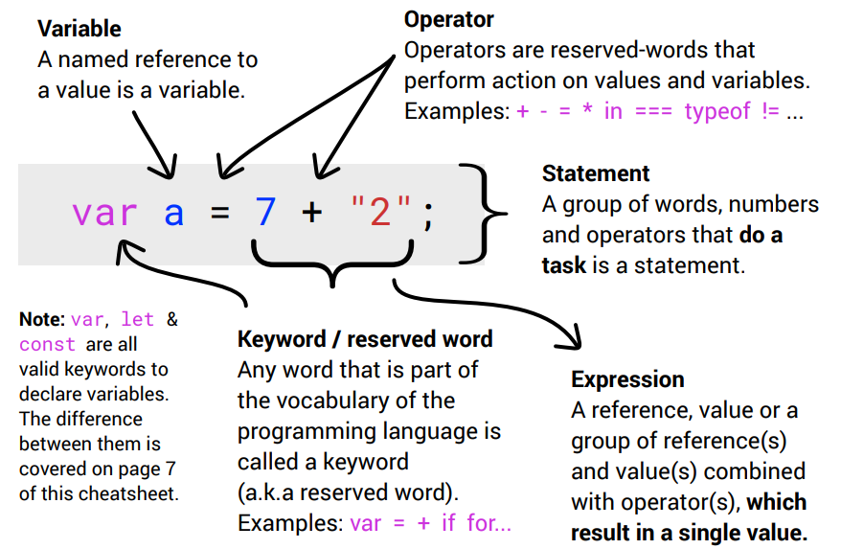

Slide 15
Questions
What is Variable Declaration ?
What is Variable initialization
What is Variable Assignment ?
What is Variable Hoisting ?

Slide 16
Java Script docs
https://developer.mozilla.org/en-US/docs/Web/JavaScript
https://www.w3resource.com/javascript-exercises/javascript-basic-exercises.php
https://edabit.com/challenges/javascript

Slide 17
Datatypes
Primitive Types:
Primitive types in JavaScript are immutable and represent simple values
String
Number
Boolean
Null
Undefined
Object
Array
Function
Non-Primitive Types :
Non-primitive types are mutable and represent complex objects

Slide 18
Undefined vs null
Undefined:
It is a primitive value that is automatically assigned to a variable that has been declared but has not been assigned a value or to a function that does not explicitly return anything. It indicates the absence of a value
: default value of any variable
Null
It is also a primitive value that represents the deliberate absence of any object value. It is typically assigned explicitly by the programmer to indicate that a variable or object property intentionally has no value
: Something with no value

Slide 19
Operators
Arithmetic Operators:
Addition (+) : Adds two values.
Subtraction (-) : Subtracts the second value from the first.
Multiplication (*) : Multiplies two values.
Division (/) : Divides the first value by the second.
Remainder/Modulus (%) : Returns the remainder of the division.
Increment (++) : Increases the value by 1.
Decrement (--) : Decreases the value by 1.

Slide 20
Operators
Comparison Operators
Equal to (==) : Checks if two values are equal.
Not equal to (!=) : Checks if two values are not equal.
Strict equal to (===) : Checks if two values are equal in both value and type.
Strict not equal to (!==): Checks if two values are not equal in either value or type.
Greater than (>) : Checks if the first value is greater than the second value.
Less than (<) : Checks if the first value is less than the second value.
Greater than or equal to (>=) : Checks if the first value is greater than or equal to the second value.
Less than or equal to (<=): Checks if the first value is less than or equal to the second value.

Slide 21
Operators
Assignment Operators:
Addition assignment (+=):
Adds the right operand to the left operand and assigns the result.
Subtraction assignment (-=):
Subtracts the right operand from the left operand and assigns the result.
Multiplication assignment (*=):
Multiplies the left operand by the right operand and assigns the result.
Division assignment (/=):
Divides the left operand by the right operand and assigns the result.
Remainder assignment (%=):
Performs the modulus operation on the left operand and assigns the result.

Slide 22
Operators
Conditional (Ternary) Operator:
Ternary operator (condition ? expression1 : expression2): Evaluates a condition and returns one of two expressions based on the condition.

Slide 23
Operators
Logical Operators:
Logical AND (&&): Returns true if both operands are true.
Logical OR (||): Returns true if either of the operands is true.
Logical NOT (!): Inverts the truth value of the operand.

Slide 24
Operators
Bitwise Operators
Bitwise AND (&): Performs a bitwise AND operation.
Bitwise OR (|): Performs a bitwise OR operation.
Bitwise XOR (^): Performs a bitwise XOR (exclusive OR) operation.
Bitwise NOT (~): Inverts the bits of the operand.
Left shift (<<): Shifts the bits to the left by the specified number of positions.
Right shift (>>): Shifts the bits to the right by the specified number of positions.
Unsigned right shift (>>>): Shifts the bits to the right by the specified number of positions, filling with zeroes.

Slide 25
Conditional Statements
If : The if statement executes a block of code if a specified condition is true
If(condition){
…
}
Else: The if...else statement allows you to execute one block of code if the condition is true, and another block of code if the condition is false.
If(condition){
…
}
else{
…
}

Slide 26
Conditional Statements
Switch : The switch statement allows you to perform different actions based on different conditions. It is often used as an alternative to if...else if...else statements when there are multiple possible conditions to check.
switch (expression) {
case value1:
…
break;
case value2:
…
break;
…
default:
….
}

Slide 27
Looping Statements
Looping statements, also known as iteration statements, are used in programming to execute a block of code repeatedly. They allow you to automate repetitive tasks and process collections of data efficiently.
For - (entry controlled)
While - (entry controlled)
Do. While - (exit controlled)
4. For.. in – for object
5. For.. Of – for array

Slide 28
For - Loop
The for loop allows you to iterate over a sequence of values or elements for a specific number of times. It consists of an initialization, a condition, and an increment or decrement.
Example:
for (let i = 0; i < 5; i++)
{
// code to be executed
}

Slide 29
While- Loop
The while loop executes a block of code as long as a specified condition is true. It checks the condition before each iteration and continues looping until the condition becomes false.
let i=0;
while (i < 5)
{
// code to be executed;
i++
}

Slide 30
Do. While - Loop
Similar to the while loop, the do-while loop executes a block of code at least once before checking the condition. It continues looping as long as the condition remains true
let i=0;
do {
// code to be executed;
i++
} while (i < 5)

Slide 31
For.. in - Loop
The for...in loop iterates over the enumerable properties of an object.
It is useful for iterating over the keys or properties of an object
const obj = { a: 1, b: 2, c: 3 };
for (let key in obj) {
console.log(key); // output: 'a', 'b', 'c’
console.log(obj[key]); // output: 1, 2, 3
}

Slide 32
For.. of - Loop
The for...of loop is used to iterate over iterable objects such as arrays, strings, and other iterable objects. It provides a concise way to iterate over the values of an iterable.
const arr = [1, 2, 3];
for (let element of arr) {
console.log(element); // output: 1, 2, 3
}

Slide 33
Up coming Topics
Functions
Arrays
Strings
Objects
Regular expressions

