Slide 1


Asynchronous Programming
By
Venkat.CH
* See slide notes for page directions
Notes:
When listing all project collaborators, either use commas or bullets

Slide 2
Async Programming
Asynchronous programming is a programming paradigm that allows tasks to be executed independently and concurrently without blocking the main execution thread.
In traditional synchronous programming, each task is executed one after the other, and the program waits for the completion of each task before moving on to the next one.
Asynchronous programming, on the other hand, enables tasks to run concurrently, potentially improving performance and responsiveness in applications that involve I/O operations or long-running tasks.

Slide 3
Async Programming
Asynchronous programming is particularly useful when working with I/O operations, such as reading from or writing to a file, making network requests, or interacting with databases.
By allowing multiple tasks to run concurrently, it can help improve the overall performance and responsiveness of an application.

Slide 4
Concepts.
Promises
Promises are another popular mechanism for handling asynchronous operations. A promise represents a future value or error that may be returned by an asynchronous task. It provides a way to chain multiple asynchronous operations together and handle their results in a more readable and structured manner.
(Async/Await)

Slide 5
Promises
Promises – learn about Javascript Promises, what they are, and how to use them effectively.
Promise chaining – show you how to execute multiple asynchronous operations in sequence.
Promise composition: Promise.all() & Promise.race() – learn how to compose a new promise out of several promises.
Promise.any() – learn how to use the JavaScript Promise.any() method to return the first Promise that fulfills.
Promise.allSettled() – accept a list of promises and returns a new promise that resolves to an array of values, which were settled (either resolved or rejected) by the input promises.
Promise.prototype.finally() – execute a piece of code when the promise is settled, regardless of its outcome.
Promise error handling – guide you on how to handle errors in promises.
async / await – write asynchronous code in a clearer syntax.

Slide 6
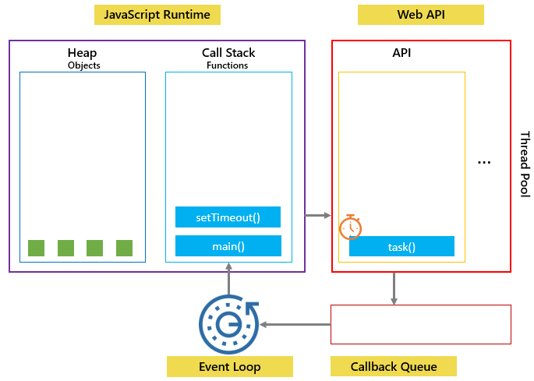
Event Loop
The event loop is a fundamental concept in JavaScript that handles the execution of asynchronous tasks and manages the order of operations in a single-threaded environment.

Slide 7
Ajax
Ajax (Asynchronous JavaScript and XML) is a set of web development techniques used to send and receive data asynchronously between a web browser and a server.
It allows you to update parts of a web page without reloading the entire page, providing a smoother and more interactive user experience.

Slide 8
Fetch API
fetch('https://api.example.com/data')
.then(function(response) {
if (response.ok) {
return response.json();
} else {
throw new Error('Error: ' + response.status);
}
})
.then(function(data) {
console.log(data);
})
.catch(function(error) {
console.log(error);
});

Slide 9
REST Methods
Representational State Transfer
Representational State Transfer (REST) is a software architecture that imposes conditions on how an API should work. REST was initially created as a guideline to manage communication on a complex network like the internet.
List of HTTP Request methods:
GET - is used to request data from a specified resource.
POST - is used to send data to a server to create a resource.
PUT - is used to send data to a server to update a resource.
DELETE - is used to delete the specified resource.

