Slide 1
ComicCraft – AI Comic Story Creator Using Gemini Models
One sentence in. A validated, illustrated, PDF-exportable comic out.
FastAPI · Google Gemini (two-stage structured generation) · Pluggable image providers · fpdf2 PDF export
Final project presentation · Based entirely on the GitHub repository gokulraj0708/ComicCraft v1.0.0
Notes:
Greet the panel and state the exact project title. One-line pitch: the app takes a single story sentence and produces a complete comic — outline, script, per-panel art, browser preview and PDF. Emphasise the title's promise: Gemini models do the writing; a pluggable image layer does the art. Mention that everything shown comes from the actual repository (version 1.0.0) and that the demo runs without API keys.

Slide 2
Introduction
What ComicCraft is and how it works at a glance
▪ What it is: A FastAPI web application that converts a one-sentence story idea into a 3–8 panel comic with preview + PDF export.
▪ User inputs: story idea, main character, setting, tone, art style, panel count — via browser form or JSON API.
▪ Four-step pipeline (shown in the app's own UI): Plan → Write → Illustrate → Publish.
▪ Writing: two-stage Google Gemini workflow (outline model then story model) returning validated JSON.
▪ Illustration: selectable image provider — placeholder (offline Pillow art), hosted Hugging Face SDXL, or local Stable Diffusion (diffusers).
▪ Delivery: responsive web preview + A4 PDF via fpdf2; every comic persisted with a UUID manifest for reopening.
ComicCraft – AI Comic Story Creator Using Gemini Models
Notes:
Explain the input brief and the four pipeline stages exactly as the app presents them on its home page (Plan / Write / Illustrate / Publish card in index.html). Stress dual surface: the same pipeline serves the HTML form and the versioned JSON API. Persistence with UUID workspaces means demos can reopen any previously generated comic.

Slide 3
Problem Statement
Why naive AI comic generation breaks (PROJECT_ANALYSIS.md)
▪ Fragile parsing: original snippets stripped Markdown fences and split text on '**Panel' — any format drift breaks the app.
▪ Stale model IDs: hard-coded Gemini 1.5 names; providers rename models regularly.
▪ Character drift: independent image prompts change the hero's look between panels.
▪ No offline path: original design could not run or be tested without paid services.
▪ Weak failure handling: raw provider errors aborted the whole request.
▪ Unsafe output handling: prompt-based filenames + timestamp collisions; no manifests, no reopen capability.
▪ Nothing to verify with: no tests, no Docker, no editor configuration.
ComicCraft – AI Comic Story Creator Using Gemini Models
Notes:
These seven problems are literally documented in the repository's PROJECT_ANALYSIS.md as the review of the supplied design. They justify every architectural decision shown later: structured output, configurable models, character bible, demo provider, fallbacks, UUID workspaces, and the test suite.

Slide 4
Objectives
Measurable goals the implementation had to meet
▪ Accept a small validated brief and generate a 3–8 panel comic in one request.
▪ Two-stage Gemini generation with Pydantic-validated JSON (count + sequence enforced).
▪ Character continuity via a character bible repeated in every image prompt.
▪ Three interchangeable image providers with deterministic per-panel seeds.
▪ Visible resilience: retry+backoff, model fallback, offline demo story fallback, labelled placeholder panel fallback.
▪ Persist panels/PDF/manifest; reopen by UUID; export print-ready A4 PDF.
▪ Run fully offline by default; pass an automated test suite without network access.
ComicCraft – AI Comic Story Creator Using Gemini Models
Notes:
Each objective maps to repository evidence: validation (schemas.py), two-stage flow (llm.py), character bible (ComicOutline), providers+seeds (images.py), fallbacks (Resilient* services + ProviderInfo), persistence (repository.py), offline tests (tests/conftest.py). Keep this slide short — it sets up the demo.

Slide 5
Existing System
Conventional practice + the supplied partial design
▪ Manual comics: writer + illustrator + layout designer — slow and skill-gated.
▪ Chat-style AI use: unstructured prose — cannot drive a reliable panel pipeline.
▪ Supplied design (documented): right shape — FastAPI form, fast Gemini outline model, stronger story model, SD image per panel, PDF — but delivered as incomplete snippets.
▪ Its gaps: missing imports/config/schemas/templates; brittle text splitting; outdated model IDs; no continuity mechanism; no offline mode; no fallbacks; unsafe filenames; no persistence; no tests/deployment files.
▪ Conclusion: a validated, runnable, testable rebuild was required — this repository.
ComicCraft – AI Comic Story Creator Using Gemini Models
Notes:
Frame fairly: the supplied design had the correct pipeline shape; the implementation simply hardened it. PROJECT_ANALYSIS.md lists all ten gaps verbatim — invite examiners to read it. This slide justifies the 'proposed system' that follows.

Slide 6
Proposed System
ComicCraft as implemented in the repository
▪ Contracts first: Pydantic models validate user input, AI output and API payloads.
▪ Two-stage Gemini: outline → script with JSON mode, retries, jitter, and model fallback lists from .env.
▪ Provider abstraction: placeholder / Hugging Face / diffusers behind one Protocol; sha256-derived per-panel seeds.
▪ Visible fallbacks: demo story fallback + per-panel placeholder fallback are flagged in the UI and API metadata.
▪ Persistence: UUID workspaces + atomic comic.json manifest; cleanup utility included.
▪ Honesty by default: provider chips, warnings banner, inspectable image prompts, cover-page review reminder — placeholder art is never called AI art.
ComicCraft – AI Comic Story Creator Using Gemini Models
Notes:
Tie each bullet back to the problem slide. The differentiator is honesty: users always know which provider made their comic and when a fallback happened, which is rare in demo AI apps. Mention ProviderInfo in ComicResult.

Slide 7
Requirements
Hardware, software and external services
Category | Requirement (as pinned in repository)
Runtime | Python ≥ 3.11 (Docker uses 3.12-slim); ~250 MB environment
Core libs | FastAPI, uvicorn, Jinja2, Pydantic v2 + pydantic-settings, httpx
AI text | google-genai; Gemini outline/story model IDs configurable + fallback lists
AI art | huggingface-hub (hosted); optional torch+diffusers stack (local, GPU recommended)
Output | Pillow (art + sizing), fpdf2 + bundled DejaVu Unicode fonts (PDF)
Testing | pytest + pytest-cov, ruff; suite forces demo+placeholder (zero network)
Hardware | Any modern machine for default mode; CUDA GPU only for local diffusion option
ComicCraft – AI Comic Story Creator Using Gemini Models
Notes:
Point out that the default path needs no GPU and no API keys — only ~250 MB of Python packages. Gemini and Hugging Face keys come from the user's own accounts via .env. Local diffusers is the only GPU-hungry option and is lazy-loaded. Full requirement tables (FR/NFR with IDs) exist in Phase 2 of the submission package.

Slide 8
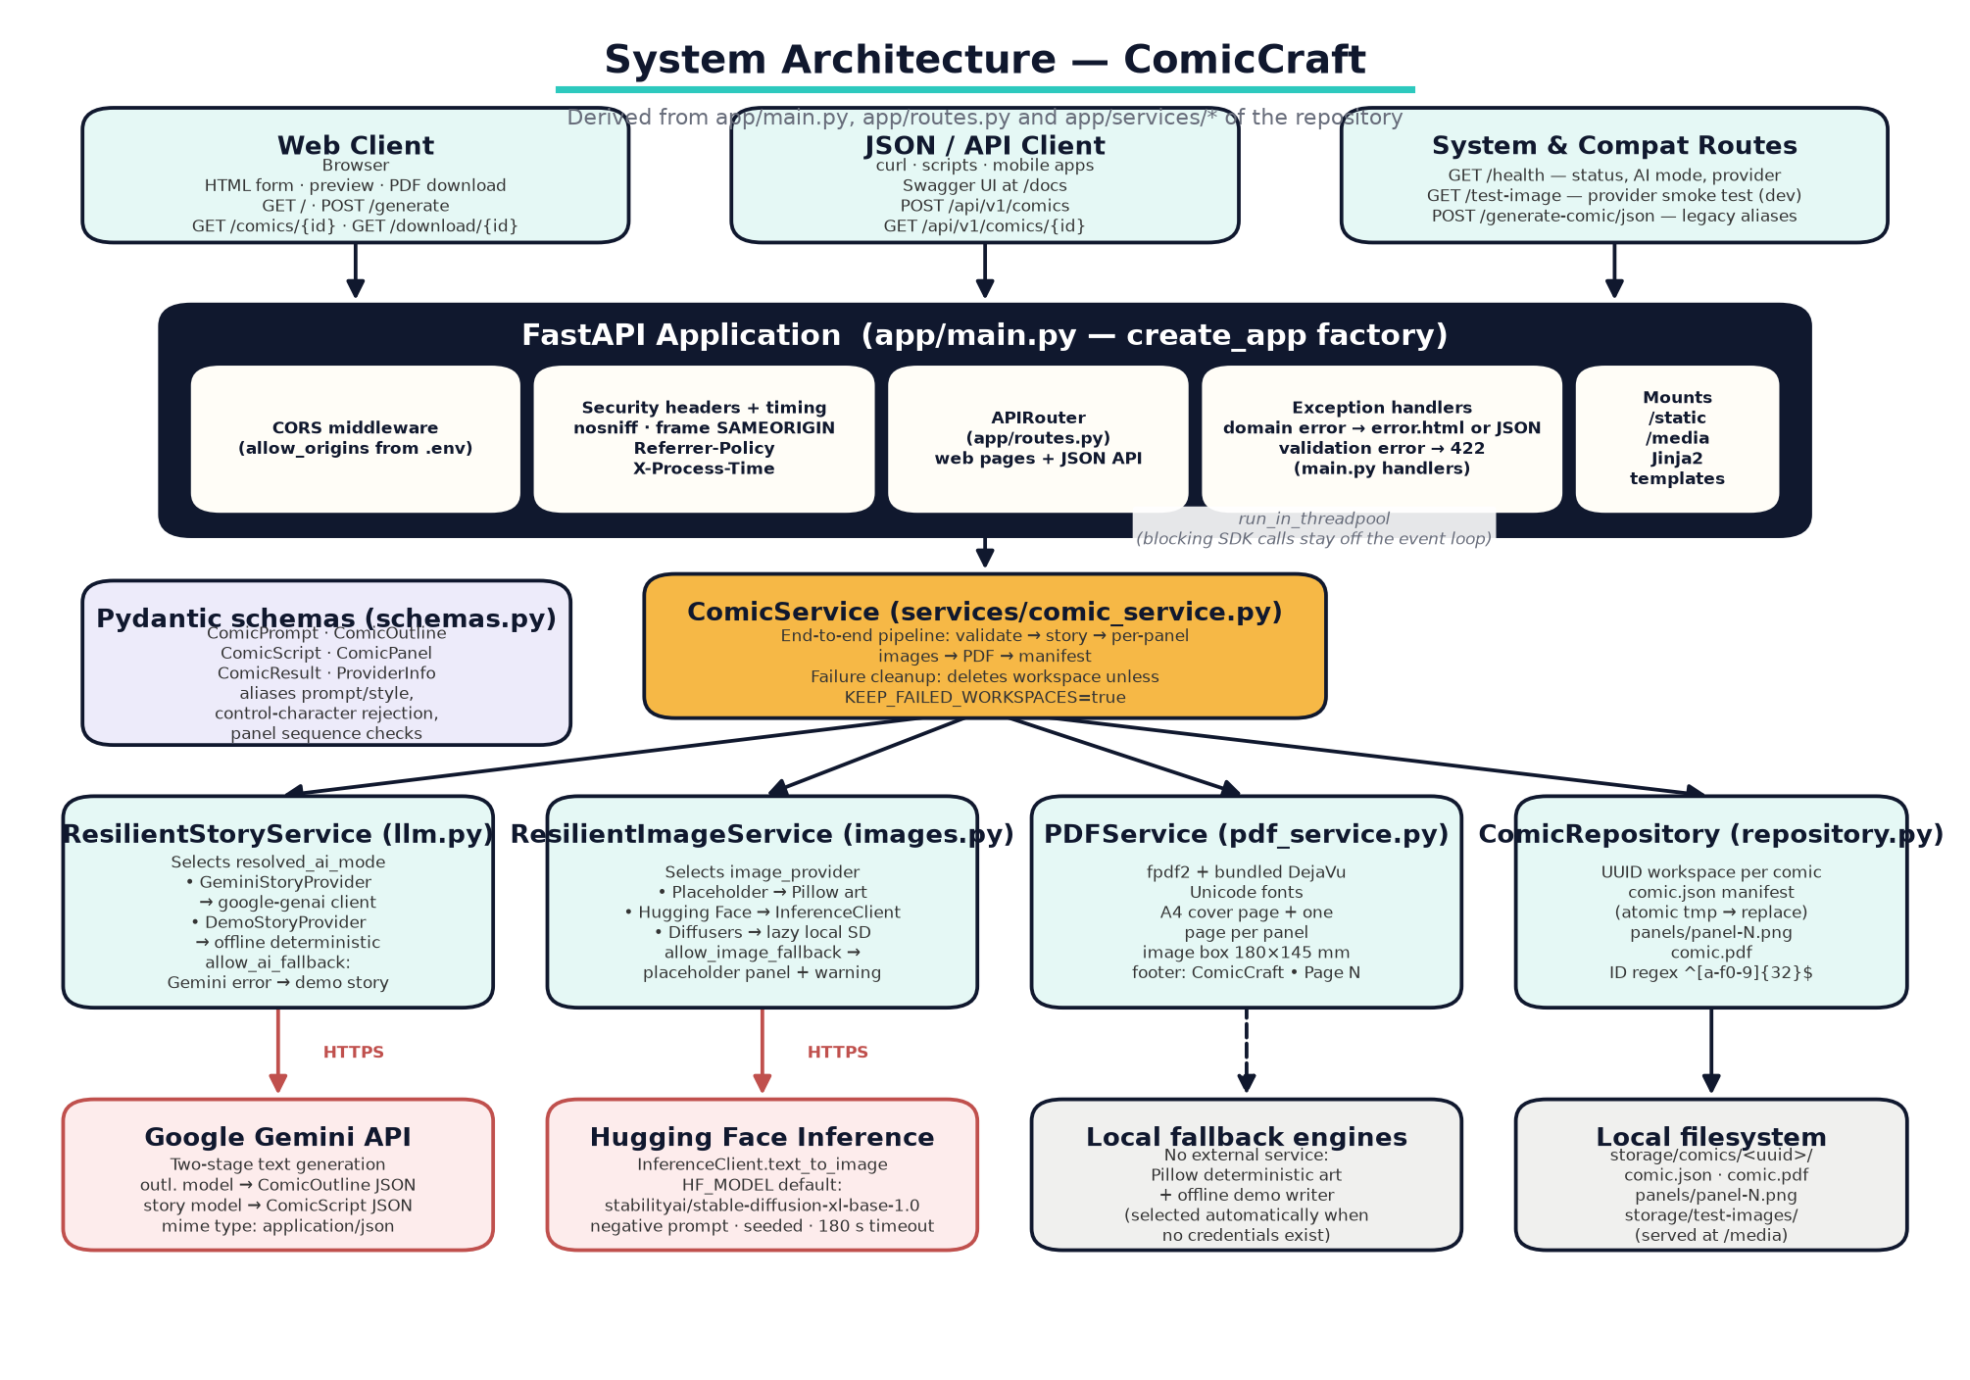
System Architecture
Clients → FastAPI layer → ComicService → services → providers
ComicCraft – AI Comic Story Creator Using Gemini Models
Notes:
Walk left to right: browser/JSON clients hit routing + middleware (security headers, timing) with typed error handling; all generation goes through ComicService in the thread pool; story and image services each pick a provider based on .env; PDF service typesets with fpdf2; repository persists to UUID workspaces. External calls are only Gemini (text) and Hugging Face (hosted art) — everything else is local and free.

Slide 9
Technology Stack
Why each tool was chosen
▪ FastAPI + Uvicorn: async server, OpenAPI docs at /docs for free, dependency injection.
▪ Pydantic v2 + pydantic-settings: one validation layer for users, AI and config; .env secrets via SecretStr.
▪ google-genai: official Gemini SDK; JSON-mode responses; model IDs externalised to .env.
▪ huggingface-hub InferenceClient: hosted text-to-image without owning a GPU.
▪ diffusers + torch (optional): local Stable Diffusion, lazy-loaded with attention slicing and cuda/mps/cpu autodetect.
▪ Pillow + fpdf2 + DejaVu: deterministic placeholder art and Unicode-true A4 PDF.
▪ pytest + ruff + Docker: offline-testable, lint-clean, reproducible deployment.
ComicCraft – AI Comic Story Creator Using Gemini Models
Notes:
Justify choices: FastAPI gives free interactive docs (used in the demo at /docs); Pydantic unifies input and AI-output validation; fpdf2 with bundled fonts makes PDFs identical across machines; pytest fixtures force offline mode so CI never spends money. Versions are pinned with upper bounds in requirements.txt.

Slide 10
Implementation Highlights
The code that makes the promises real
▪ llm.py — two stages: _generate_outline (→ComicOutline) then _generate_script (→ComicScript); both validated + panel sequence checked.
▪ Resilience wrapper: 429/5xx → exponential backoff+jitter; 400/404 → switch model immediately; exhausted → demo fallback with used_fallback flag.
▪ images.py — seeds: seed = sha256(comic_id : panel_number : image_prompt) → reproducible art; per-panel placeholder fallback with warning text.
▪ comic_service.py: workspace → story → per-panel images → PDF → ProviderInfo assembly → atomic save; workspace deleted on failure.
▪ pdf_service.py: A4 cover + one page per panel; 180×145 mm aspect-preserved art; DejaVu fonts; page footer.
▪ repository.py: UUID workspaces, ^[a-f0-9]{32}$ ID guard, tmp→replace atomic manifest.
ComicCraft – AI Comic Story Creator Using Gemini Models
Notes:
These are the six code-level talking points examiners most often probe. If asked to show code, open app/services/llm.py::_generate_json (retry/model-switch), images.py::generate_panel (seed+fallback), and repository.py::save (atomic write). Speaker can quote line-level behaviour confidently.

Slide 11
Testing
Executed evidence — nothing marked PASS without proof
▪ Automated suite: 11/11 pytest tests PASS (Python 3.11.2, pytest 9.1.1) — API lifecycle, aliases, validation, 404, health, home, web form, demo story, Gemini retry/switch, test-image.
▪ Coverage: 80% overall — 99% pdf_service; uncovered lines are live-provider network paths by design.
▪ Live verification (11/11): boot, health JSON, 201 generation, storage layout, PDF download (%PDF-1.3, 4 pages), preview reopen, 404/422, story fallback, image fallback.
▪ Honest register: live Gemini output, hosted art success, local diffusion, Android, Docker build and multi-browser visual QA are NOT EXECUTED — credentials/devices unavailable, never claimed otherwise.
ComicCraft – AI Comic Story Creator Using Gemini Models
Notes:
Show the pytest summary line if asked ('11 passed in 1.34s'). Emphasise covers: mocked Gemini client proves 503 retry-with-backoff and 404 immediate model switch; live fallback runs produced real warning text. The not-executed register is a deliberate honesty feature of the test report (Test_Cases.xlsx sheet 3).

Slide 12
Results
Verified outcomes from the running application
▪ Zero-credential run: ComicCraft 1.0.0 boots in AI=demo, images=placeholder and completes full comics offline.
▪ API generation: POST /api/v1/comics → 201; 3-panel comic id bef9e5c7… with title, panels, URLs and provider_info.
▪ Persistence: comic.json (atomic), comic.pdf and panels/ inside the UUID workspace; preview re-renders from manifest.
▪ PDF: 127,334-byte A4 PDF — cover page + one page per panel, valid %PDF-1.3.
▪ Transparency: provider_info lists demo models and placeholder art; fallbacks raise used_fallback with exact warning strings.
▪ Known cosmetic notes: demo titles can read awkwardly; placeholder caption wrap is tight at some sizes — logged openly in the test report (D1–D3).
ComicCraft – AI Comic Story Creator Using Gemini Models
Notes:
All numbers on this slide are measured: HTTP statuses, byte counts, page counts and the comic id were captured on 23 Sep 2026. The cosmetic notes show engineering maturity — we log even cosmetic findings instead of hiding them.

Slide 13
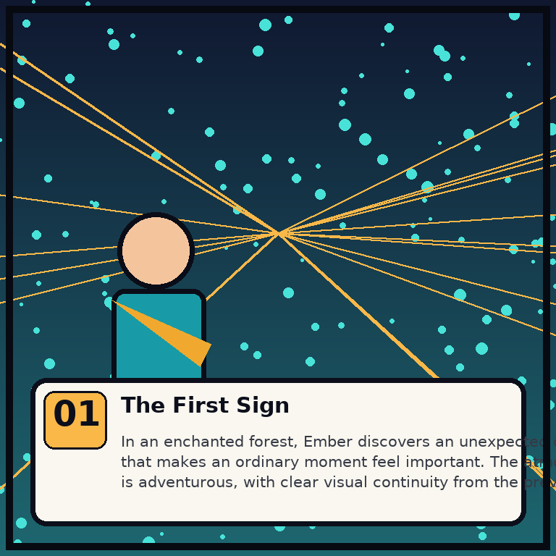
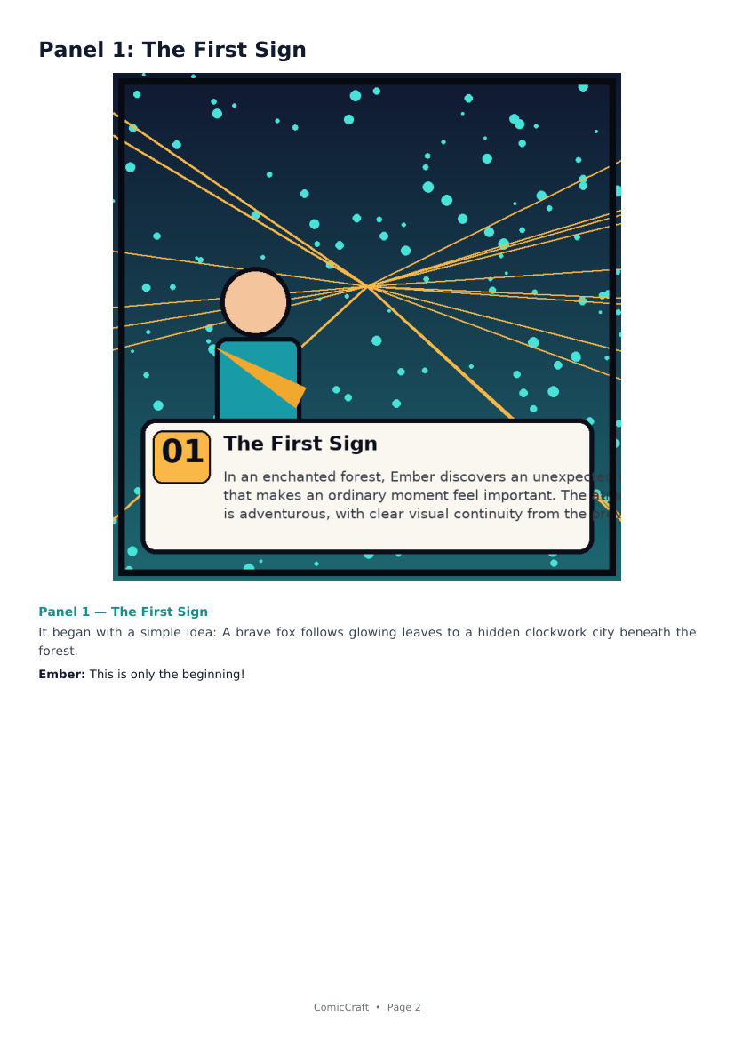
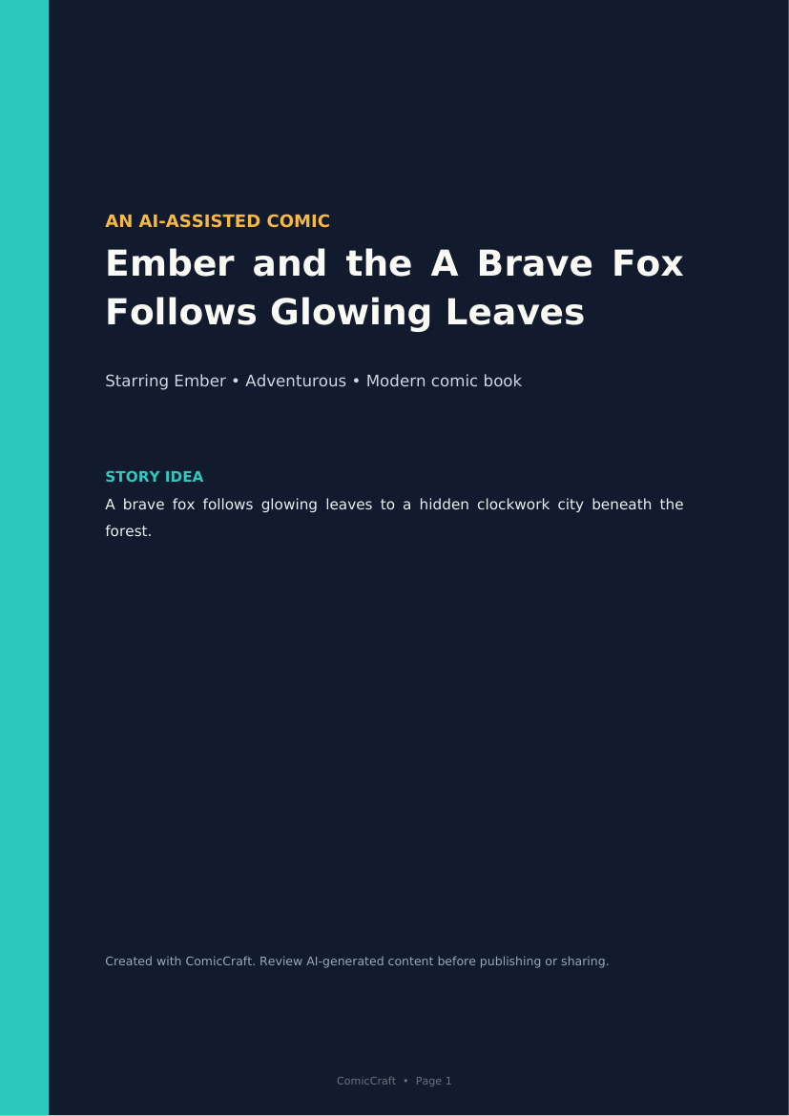
Application Output (real captures)
Generated during verification in demo+placeholder mode
ComicCraft – AI Comic Story Creator Using Gemini Models
Notes:
Left: a real placeholder-mode panel (Pillow-rendered: gradient sky, halftone dots, comic rays, hero silhouette, caption card, panel badge). Centre: the same panel inside the exported PDF with caption, narration and dialogue. Right: the PDF's dark cover page. Live Gemini/HF screenshots are not shown because the review environment has no credentials — said openly rather than mocked up.

Slide 14
Future Enhancements
Not implemented today — proposed next steps
▪ Authentication, per-user quotas, rate limiting (README production checklist).
▪ Background job queue with status polling for long live-provider generations.
▪ Database metadata + object storage; scheduled cleanup automation.
▪ Audience-appropriate content moderation; provider cost budgets and observability.
▪ Editable outline approval step; regenerate single panel; speech-bubble compositing; more styles/layouts.
▪ Test hardening: malformed Gemini JSON, empty responses, visual regression checks; fix logged cosmetic issues D1–D3.
ComicCraft – AI Comic Story Creator Using Gemini Models
Notes:
Keep strictly to not-yet-implemented items — several come straight from the README's own production checklist, which shows self-awareness in the repo. Do not present these as existing features in the viva.

Slide 15
Conclusion
What the project demonstrates
▪ A disciplined small FastAPI codebase can chain AI services into a dependable product.
▪ AI output handled as schema-bound data — never brittle string splitting.
▪ Reliability is layered: validation → retries → model fallback → offline fallback, all user-visible.
▪ Character continuity and determinism are engineered, not hoped for (character bible, seeds, negative prompts).
▪ Fully verifiable: 11/11 automated tests + 11/11 live checks + honest not-executed register.
▪ Thank you — questions welcome. Live demo order: home → form → preview → PDF → /docs → fallbacks.
ComicCraft – AI Comic Story Creator Using Gemini Models
Notes:
Close confidently: the project proves that reliability engineering (contracts, fallbacks, transparency) is the difference between an AI demo and an AI product. Offer the live demo — it runs offline, so nothing in the demo can fail due to network or keys. Invite examiners to try /docs themselves.

