Slide 1


SMART INDIA HACKATHON 2024
TITLE PAGE
Problem Statement ID - 1681
Problem Statement Title - Identification of algorithm from the given dataset using AI/ML Techniques
Theme - Blockchain & Cybersecurity
PS Category - Software
Team ID -
Team Name (Registered on portal)- CarpeDiem

Slide 2
Identification of algorithm from the given dataset using AI/ML Techniques
Carpe
Diem
Idea: Develop a machine learning model to classify cryptographic algorithms from hexadecimal data using a web application.​
Data Processing: Convert hexadecimal strings to integer features and address class imbalance using SMOTE for fair class representation.
Model Training: Use a Random Forest Classifier and validate performance with precision, recall, and F1-score metrics.
Deployment: Integrate the trained model into a web application for real-time data classification.
How It Addresses the Problem:
Automates Classification: Eliminates manual identification of algorithms.
Improves Accuracy: Utilizes advanced ML techniques to enhance prediction reliability.
Scalable Solution: Handles large datasets efficiently and can be integrated into existing systems
Innovation and Uniqueness:
SMOTE Implementation: Effectively handles class imbalance to improve model performance.
User-Friendly Application: Flask-based tool that makes sophisticated ML accessible to non-experts.

Slide 3
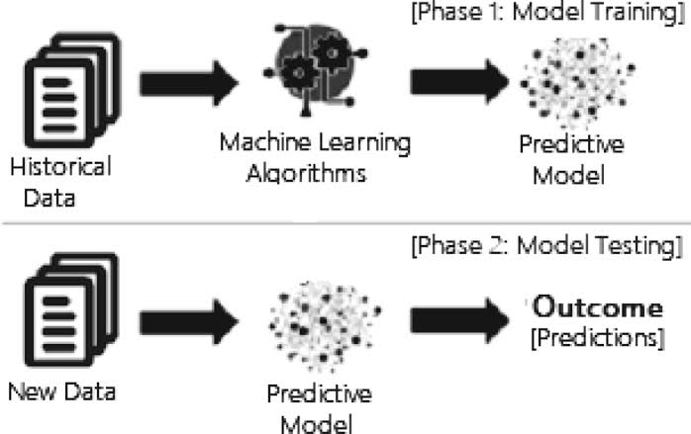
TECHNICAL APPROACH
Carpe
Diem
Programming Languages:
Python
JavaScript
Frameworks and Libraries:
Scikit-learn
Imbalanced-learn (imblearn)
Pandas and NumPy
RandomForestClassifier
Joblib
Methodology:
Deployment and Web Application Development
Model Training and Hyperparameter Tuning
Data Preprocessing and Feature Engineering
Implementation Process:
Prototype Development
Testing and Iteration

Slide 4
FEASIBILITY AND VIABILITY
Carpe
Diem
Technical Feasibility: Converting hexadecimal data to numerical features, training models with scikit-learn, and building a Flask web application are well-supported by existing technologies and libraries.
Economic Feasibility: Utilizes free, open-source tools which minimize costs. Moderate computational needs can be managed with cost-effective cloud or local resources.
Operational Feasibility: The project is practical with its current scope and can be effectively deployed with user-friendly interfaces for data processing and result display.
Scalability: The solution is scalable, allowing for expansion in dataset size and model complexity without significant rework.
Risk Management: Potential risks, such as class imbalance and model performance issues, are manageable with established techniques like SMOTE and hyperparameter tuning.

Slide 5
IMPACT AND BENEFITS
Carpe
Diem
Enhanced Cryptographic Security: By accurately identifying cryptographic algorithms, the project contributes to improved security measures and the ability to detect vulnerabilities in cryptographic implementations.
Improved Algorithm Classification: The use of machine learning to classify algorithms helps in automating and streamlining the process, reducing manual effort and increasing efficiency.
Cost-Efficiency: Utilizing open-source tools and libraries reduces development costs, making advanced cryptographic analysis accessible to a broader audience without significant financial investment

Slide 6
RESEARCH AND REFERENCES
Carpe
Diem
..\..\..\..\..\..\..\Videos\COMPARATIVEANALYSISOFCRYPTOGRAPHIC.pdf
https://youtu.be/NuyzuNBFWxQ?si=x4EmmUMhpKR5wxHv
Dataset Link: https://organiser-sih-2024.github.io/dataset/cipher1.html

