Slide 1
Employee Data Analysis using Excel
STUDENT NAME: Venkatesan S
REGISTER NO: 122202629[asunm1429122202629]
DEPARTMENT: BCOM CS
COLLEGE: ALPHA ARTS AND SCIENCE
1

Slide 2
PROJECT TITLE
Employee Performance Analysis using Excel
2

Slide 3


AGENDA
Problem Statement
Project Overview
End Users
Our Solution and Proposition
Dataset Description
Modelling Approach
Results and Discussion
Conclusion
3/21/2024 Annual Review
3

Slide 4

PROBLEM STATEMENT
The Process of evaluating employee performance to determine , If they are meeting company expectations . It can help identify strengths and areas to improve and align employees goals with organizational objectives .
In an organization there will be a GOOD , AVERAGE and POOR performance of employees . Motivation , Growth, Employees personal development focus can be Analysed by finding according to their performance .
This process also supports fair evaluations, recognizes high performers, addresses performance issues, and informs strategic planning, ultimately driving employee engagement and organizational success.
4

Slide 5

PROJECT OVERVIEW
This analysis evaluates employee performance across five business units of employees.
Performance Levels: Is based on their Employee types
Business Unit Highlights:
Flitering the business unit
Employees names
Ratings of employees
Employee types [ full time , part time , etc]
The goal is to pinpoint trends, celebrate high achievers, and address performance gaps to boost overall effectiveness.
.
5

Slide 6

WHO ARE THE END USERS?
By this particular Analysis there are some people BENEFITED
Employees: Offers constructive feedback for personal growth and career development, potentially increasing job satisfaction. Highlights high performers, boosting morale and motivation of Recognition
Organisation: Provides data-driven insights to make informed decisions about promotions, training, and resource allocation .Helps align employee performance with organizational goals and identify areas for strategic improvement.
Employers : To develop and maintain harmonious relations between management and labour , so essential for high productivity of labour and industrial progress in the country .
Industry : Promote economic efficiency and growth .
6

Slide 7

OUR SOLUTION AND ITS VALUE PROPOSITION
Conditional formatting – Blank value .
Filter – Missing values , also known for a sorting data within a file
Formula – Allocate the performance level of Rating.
Pivot Table – To summarize , organize , and analyze large amounts of data in a variety ways .
Graph – Represent the data in visualize of illustrate relationships in data .
7

Slide 8
Dataset Description
Employee Data Set – Kaggle
Total features – 29
features – 9
Employee id – Numerical value
Name – Text
Gender – Male , Female
Employee rating – Numerical value
Performance level - Grading

Slide 9

THE "WOW" IN OUR SOLUTION
We used the EMPLOYEE TYPE to analysis the performance of employee , which help us find their development according to their particular personal focus on overall organizational growth
3/21/2024 Annual Review
9

Slide 10
MODELLING
Data collection
Koggle – Using this website to collect the data for the project.
Feature collection
Excel spread sheet - Excel sheet is used to arrange the relevant data.
Data cleaning
Conditional formatting – Used to identify the blank area.
Filter Option – This option is used to remove the blanks.
10

Slide 11
MODELLING
Summary
Pivot table – We use the pivot table to get crisp and clear data about the employee performance . For that we used the below details :
Filter – employee type
Column – current employee rating
Row – Business Unit
Value – Count of First name
Visualization
Graph – Graph show the result of this analysis.

Slide 12
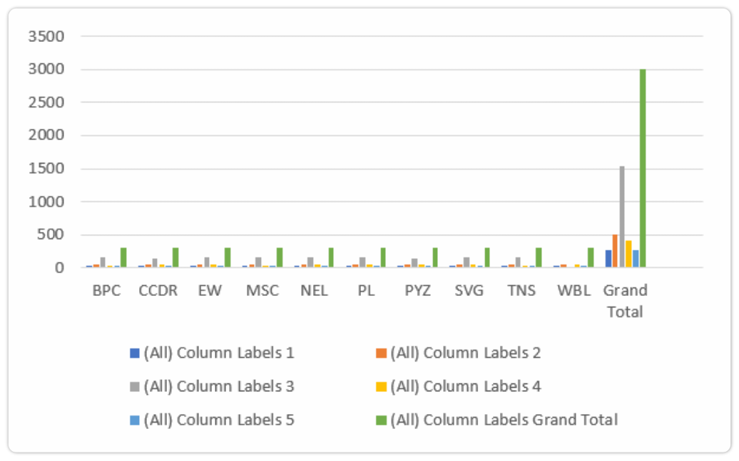
RESULTS
12

Slide 13
conclusion
The Current employee ratings analysis reveals a predominant concentration of employees in the MEDIUM performance category, indicating an average performance level across the organization. With Label 4TH rating at this level, targeted interventions are needed to elevate performance.
The LOW performance category, with LABEL 5TH rating employees, highlights areas for potential improvement and support.
Conversely, the HIGH rating is Label 2ND current rating and VERY HIGH label 3RD current rating performance levels show a strong and exceptional workforce that drives significant organizational success.

