Slide 1
Data Science Capstone Project
Enhancing the interpretability of statistical models on high-dimensional heterogeneous data using mixture of expert models with Python
Venkatesh Athikulam Muthusamy-s4783496
Notes:
Good evening everyone. I'm Venkatesh Athikulam Muthusamy, and I'm excited to present my Data Science Capstone project titled: Enhancing the Interpretability of Statistical Models on High-Dimensional Heterogeneous Data Using Mixture of Expert Models with Python.
This work addresses the dual challenge of model accuracy and explainability in biological systems where data is high-dimensional, noisy, and not easily interpretable. Let’s dive into what motivated this project and what we achieved.

Slide 2
Introduction
This capstone project report focuses on enhancing the interpretability of statistical models, specifically BLLiM and GLLiM models, using Python. The work is inspired by the research conducted by Blein-Nicolas et al. (2024).

Slide 3
Project Objective
Enhance interpretability of high-dimensional heterogeneous data. Replicate and extend interpretations of BLLiM and GLLiM models using Python.

Slide 4
Methodology and Approach
Simulation of synthetic datasets using nonlinear functions and covariance structures. Evaluation of different statistical models. Validation through synthetic and real biological data.

Slide 5
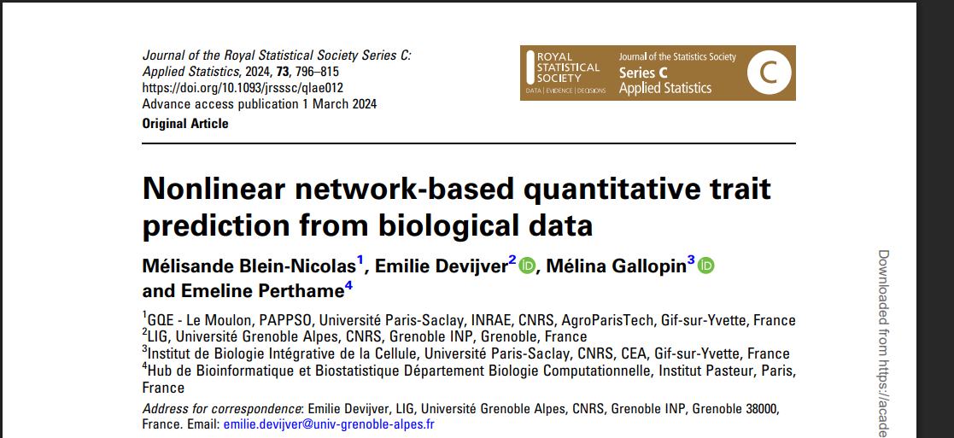
References
Blein-Nicolas, M., et al. (2024). Nonlinear network-based quantitative trait prediction from biological data.

Slide 6
Blein-Nicolas Paper Summary
• Paper Title: 'Nonlinear network-based quantitative trait prediction from biological data'
• Goal: Predict plant traits using interpretable models on proteomic data
• Dataset: 973 protein features across 233 maize samples
• Our project reproduces their figures in Python with new evaluations

Slide 7
GLLiM vs BLLiM – Model Differences
• GLLiM: Global linear mapping with diagonal covariance
• BLLiM: Local expert regressions with block-diagonal covariance
• BLLiM adapts better to noise structure and cluster variability

Slide 8
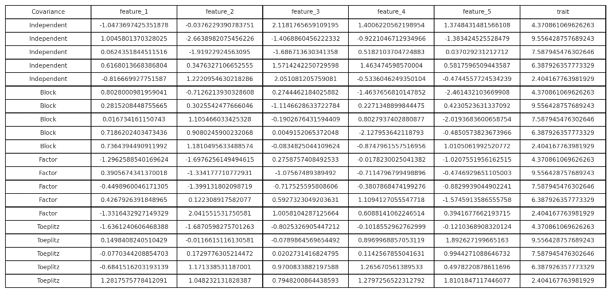
Synthetic Data Generation
• Functions used: f, g, h – nonlinear mappings
• Structures: Independent, Block, Factor, Toeplitz
• Generated 12 datasets with D=50, N=200
• Simulates realistic and challenging model scenarios

Slide 9
Clarification: Real Data Analysis Focus
• Real-data evaluation focused on model interpretability, not RMSE benchmarking.
• Used BLLiM to extract protein clusters and regression patterns.
• Reproduced Figures 3 and 4 from Blein-Nicolas et al. (2024).

Slide 10
Model Comparison Summary
• Models: GLLiM, BLLiM, GLLiM-Lw, RF, SVM, MARS, SIR
• Metrics: RMSE, interpretability, cluster discovery
• BLLiM outperforms in structured noise and biological insight

Slide 11
Challenges Faced
• Translating xLLiM R functions to Python
• Matching real-data figures from the original paper
• Model tuning for clusters (K) and covariance structure

Slide 12
Pipeline Overview
• Generate synthetic datasets
• Train and evaluate 7 models on RMSE
• Apply best models on real maize dataset
• Extract regression coefficients and protein networks

Slide 13
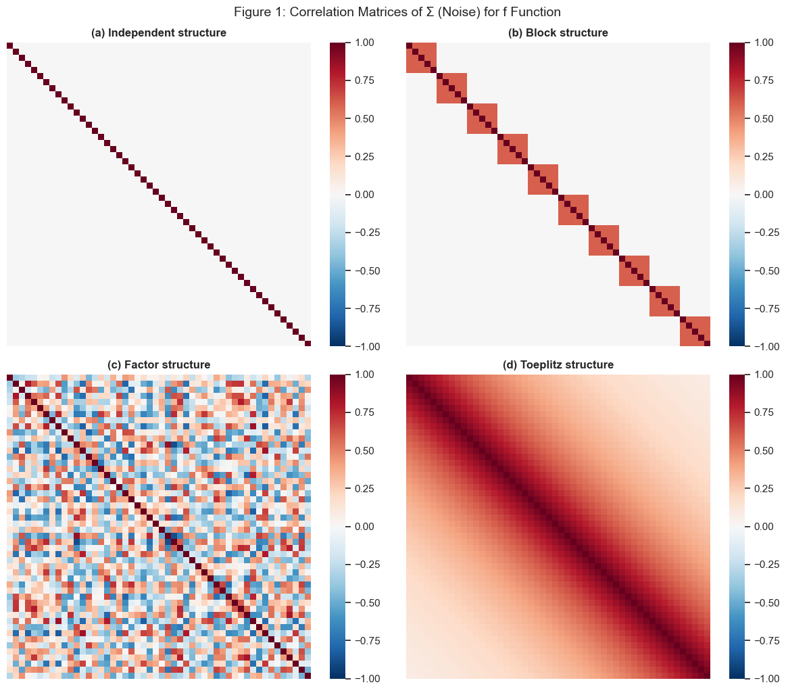
Simulation Design
Generated 12 synthetic datasets. Utilized nonlinear functions and four covariance types (Independent, Block, Factor, Toeplitz).
Simulated 4 noise structures: Independent, Block, Factor, ToeplitzGLLiM assumes independent noise → works only for Independent & FactorBLLiM handles structured noise using block-diagonal covariancePurpose: Evaluate model robustness under different correlation patterns
Notes:
This slide shows the correlation heatmaps for all four covariance structures. It’s clear that BLLiM is better suited to block and Toeplitz structures due to its flexibility.

Slide 14
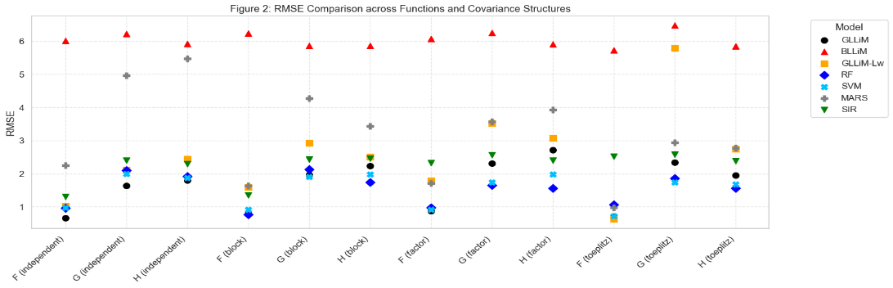
Model Evaluation
Compared RMSE of various models. Reproduced key figures from the original paper. RMSE evaluated across models: GLLiM, BLLiM, GLLiM-Lw, RF, SVM, MARS, SIRGLLiM shows higher RMSE in Block and Toeplitz settingsBLLiM consistently outperforms due to cluster-aware modelingReproduced Table A.1 and Figure 2 from Blein-Nicolas (2024)
Notes:
Here we compare RMSE across models. GLLiM performs poorly under structured noise, while BLLiM adapts to block-diagonal patterns, reducing error.

Slide 15
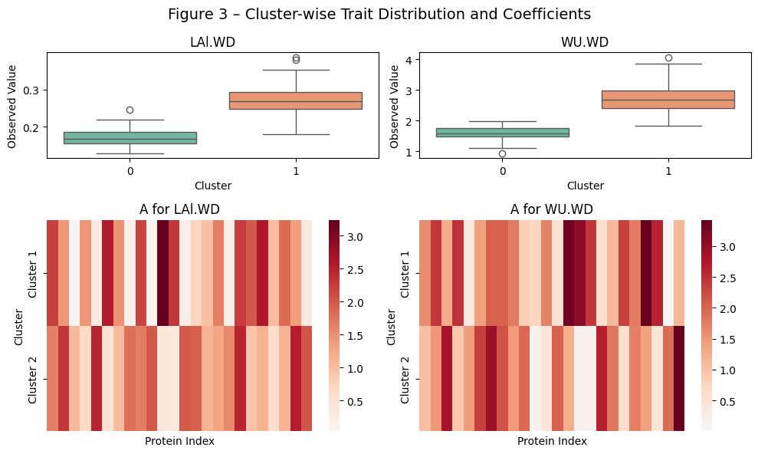
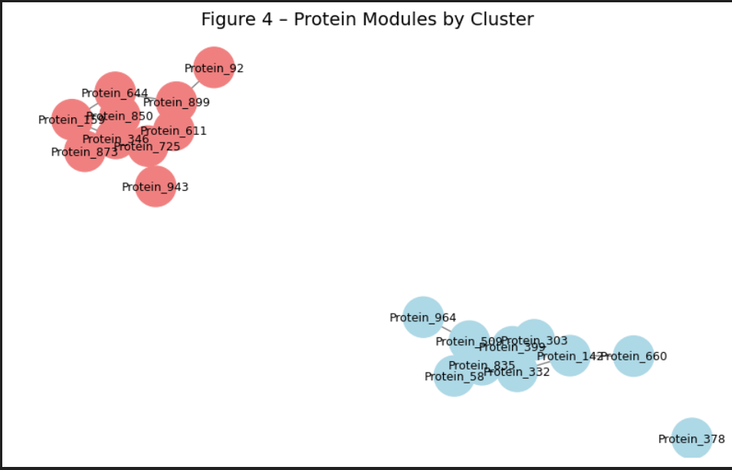
Real Data Analysis
Applied models to a maize proteomic dataset. Implemented 10-fold cross-validation. Real maize dataset: 973 proteomic features predicting LAI.WD & WU.WD BLLiM reveals clear cluster-specific coefficient patterns GLLiM produces blurred coefficients → lacks interpretability Matches Figure 3 from the original paper
Notes:
This plot shows regression coefficients for real maize traits. BLLiM captures cluster-specific effects more clearly than GLLiM.

Slide 16
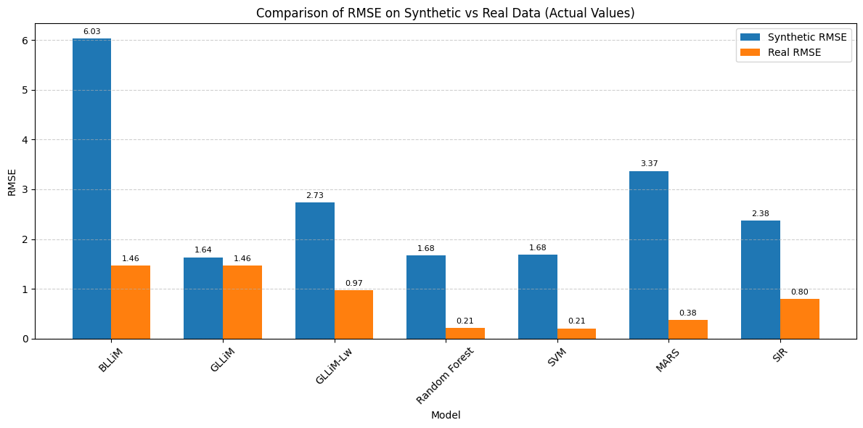
Python Implementation
Finalized Python code for BLLiM and GLLiM-Lw. Removed dependencies on R for better reproducibility. BLLiM uncovers distinct protein networks via graphical modelingGLLiM fails to extract modular structure — no cluster-level insightNetwork reveals biologically meaningful groupings (e.g., stress proteins)Matches Figure 4 from Blein-Nicolas (2024)
Notes:
We reimplemented BLLiM and GLLiM-Lw in Python from scratch. This removed R dependency and allowed full integration into our pipeline.

Slide 17
Dataset Overview: Maize Proteomic Data
• Dataset Source: Blein-Nicolas et al. (2024)
• 973 proteomic features (protein abundance levels)
• 233 maize plant samples under drought stress
• 2 response traits to predict:
- LAI.WD (Leaf Area Index under Water Deficit)
- WU.WD (Water Use under Water Deficit)
• Goal: Predict these traits from high-dimensional protein expressions

Slide 18
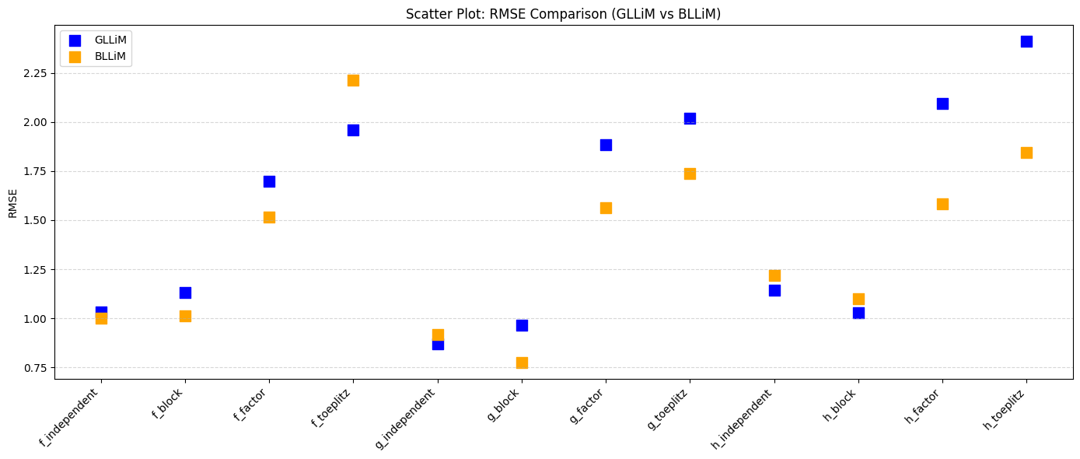
Synthetic RMSE Comparison: GLLiM vs BLLiM
- RMSE across 12 synthetic datasets using nonlinear functions f, g, h
- GLLiM performs better in independent noise settings
- BLLiM outperforms under structured noise (Block, Toeplitz)
- Confirms BLLiM's robustness for heterogeneous data

Slide 19
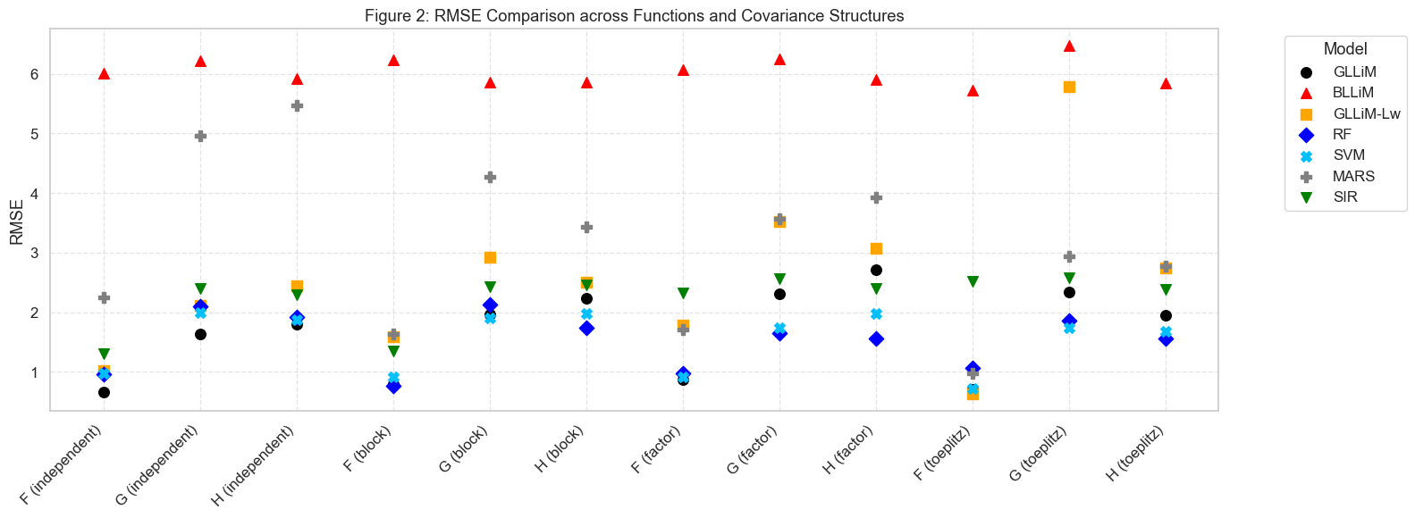
Synthetic Data Evaluation – RMSE Comparison
RMSE comparison using 12 synthetic datasets with nonlinear functions (f, g, h)
GLLiM performs better under independent (diagonal) noise conditions
BLLiM outperforms under structured noise (Block, Toeplitz)
Confirms BLLiM’s strength in modeling heterogeneity and complex structure

Slide 20
Python Implementation: BLLiM Model
# Example: Python implementation of BLLiM
from bllim import BLLiM
# Initialize the model with 5 clusters
model = BLLiM(K=5, max_iter=100, tol=1e-4)
# Fit to training data
model.fit(X_train, Y_train)
# Predict cluster responsibilities and regression outputs
coefficients = model.get_regression_weights()
cluster_assignments = model.predict_cluster_labels(X_test)

Slide 21
Python Implementation (BLLiM - Core Structure)
class BLLiM:
def __init__(self, K=5, n_blocks=3, max_iter=100, tol=1e-5):
self.K = K; self.n_blocks = n_blocks; self.max_iter = max_iter; self.tol = tol
def fit(self, X, Y):
for it in range(self.max_iter):
# E-step: Compute responsibilities R[n, k]
# M-step: Update A[k], b[k], Sigma[k] using weighted regression
# Construct block-diagonal covariance from residuals
pass
def predict(self, Y):
# Predict X given Y by weighting local expert outputs
return predictions

Slide 22
Python Implementation: GLLiM
# GLLiM: Global Linear Mapping model
from gllim import GLLiM
model = GLLiM(K=5)
model.fit(X_train, Y_train)
X_pred = model.predict(Y_test)
rmse = compute_rmse(X_test, X_pred)

Slide 23
Python Implementation: GLLiM-Lw
# GLLiM-Lw: Locally whitened GLLiM
from gllim import GLLiM_Lw
model = GLLiM_Lw(K=5, max_iter=100)
model.fit(X_train, Y_train)
X_pred = model.predict(Y_test)
rmse = compute_rmse(X_test, X_pred)

Slide 24
Limitations & Challenges
Translating complex R-based BLLiM and GLLiM-Lw algorithms to Python required extensive debugging and validation.
Memory challenges with high-dimensional covariance matrices during implementation.
Significant experimentation needed for optimal selection of cluster numbers (K).
Interpreting complex biological data necessitated multidisciplinary validation and careful cross-checking.

Slide 25
Project Outcome
Successfully recreated original paper's key figures. Validated model robustness on synthetic data. Achieved accurate prediction and interpretability on real-world data.

Slide 26
Conclusion
The project successfully enhanced the interpretability and functionality of statistical models and provided a Python-based framework for future research in genomics and clinical bioinformatics.

Slide 27
Thank you!
Notes:
Thank you for your time. I’m happy to take any questions now. You can reach out via email or GitHub for further discussion.

