Slide 1



Anti-Threat Framework
PID_0831
Photo
(Author 1)
Photo
(Author 2)
Venkatesh E
Prasanth A R
Vel Tech Rangarajan Dr.Sagunthala R&D Institute of Science and Technology
Morai, Tamil Nadu
Dr. R Srinivasan
Notes:
Title Text Font Calibri Body Bold, Font Size 34, Name and Designation Font Size 18

Slide 2

Index
1
Challenge Statement
2
Concept of the Solution
3
Novelty / Scope of Solution
4
Pros and Cons of the solution
5
Technical Description
6
Implementation Plan
7
Validation/Testing/Analysis
8
Cost Estimate
9
Assumptions
10
References
0831

Slide 3
ANTI-THREAT FRAMEWORK

Slide 4

Challenge Statement
As the use of AI spreads, cyber attacks against AI models will be new reality.
Many of these attacks rely on standard vulnerabilities, such as poor access control of data, bugs and logic flaws in an AI model, as well as lack of sufficient logging and monitoring of AI model activity.
There are instances where white hackers showed their capabilities to manipulate computer vision so that an autonomous car misinterpret a road sign with the injection of wrong training data.
0831

Slide 5

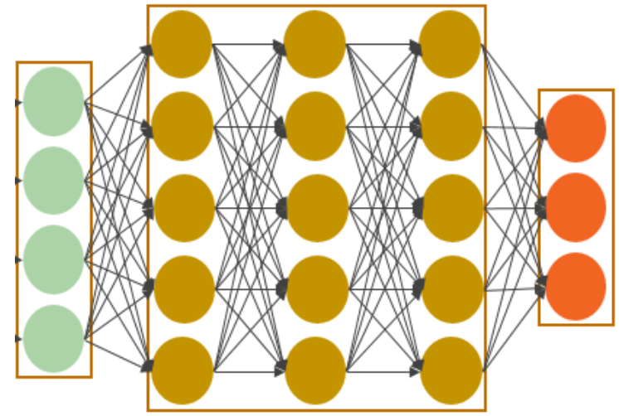
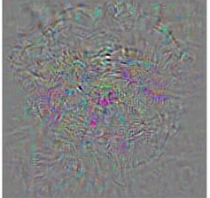

Concept of the solution
An attacker can craft an invalid input data, that could misinterpret the AI to change the behavior of it.
The solution is by implementing a set of processes that runs along the AI during the development and production stages which will learn about the data.
These process will compare the pixel values with there previous one, can change the values depends upon the by comparing the data values as whole.
INPUT
Attack Pattern
PROCESS
OUTPUT
FOX
Image Classifier Model
DOG
DOG
+NOISE
Compares the pixel values with existing one
Image Classifier Model
0831

Slide 6

Novelty / Scope of Solution
To prevent the AI models from the attackers.
To trigger the caution in prior to solve the issues in the security.
To identify the possible vulnerabilities that may cause the model to failure.
To predict the faults in the given input data.
0831

Slide 7
Pros and Cons of the solution
Pros
Identification of vulnerabilities and loop holes in a model is easy.
Creating a awareness between a model and the users.
Can be used on any AI model with simple modification.
Cons
Time consumption.
May or may not handle all cases.
0831

Slide 8

Technical Description
A typical solution to this attacks on the AI model, is that to slowly monitor the performance of the model, and also prevent these before the attackers identify the vulnerabilities.
The Anti-Threat Framework will sit between the input and output of the AI model.
The framework actively monitors the input given and compare them to the previous one
✗
STOP
Image Classifier Model
INCORRECT CLASSIFICATION
“green light”
Attack pattern
✓
Detects the pattern by comparing with the existing stop sign
STOP
CORRECT CLASSIFICATION
“stop sign”
Attack pattern
Image Classifier Model
0831

Slide 9




Implementation Plan
The complete implementation of the solution is depicted below.
framework
Data from developer
Accuracy Scoring Mechanism
INPUT DATA
Analysing given input
Image Classification Model
Score of Model
vs
Score of Framework
Attack Pattern DB
Fetches the output
DOG
Feedback
LOGS
OUTPUT
0831

Slide 10

Validation / Testing / Analysis
The outcome of this method is identified to be efficient than the existing methods to identify the invalid data.
In some critical cases, this framework can able the detect accuracy of the model.
So, below is the test example of the dog image added with randomly generated noise which output.
Dog: 96.7%
110
98
Anti-Threat Framework
Score of Model
(Approx. equal to)
DOG
100
65
Score of Framework
Image Classifier
Model
Dog: 99%
0
0
Anti-Threat Framework
Score of Model
(Is Less than)
DOG
0
0
Image Classifier
Model
Score of Framework
Fox: 99%
INPUT
PROCESSING
OUTPUT
0831

Slide 11
Cost Estimate
It is recommended to purchase an additional component or expanding existing one may overcome this problem.
The minimum cost estimated to run this framework on a recommend hardware comes around ₹ 85,000.
The following table shows details about the components required for running the framework.
S.NO | PRODUCT | PRICE(₹)
1. | GTX 1660 TI | 54,000
2. | INTEL CORE i5-9400 DESKTOP PROCESSOR | 16,500
3. | 16GB (8GBX2) 3200MHz | 7,950
4. | 512GB M.2 NVMe SSD | 5,600
 | TOTAL 84,050
0831

Slide 12
Assumptions
The framework was designed to be running on the latest hardware and software.
It is assumed to cause a bottleneck the AI due to an interference between the I/O and the AI model.
It will differentiate the input data in various form and fetch you a accurate results.
0831

Slide 13
References
Lorenzo Pupillo, Stenfo Fantin, “Artificial Intelligence and Cybersecurity Technology, Governance and Policy Challenges”, Centre for European Policy Studies (CEPS), 2021.
Lucian Constantain, “How data poisoning attacks corrupt machine learning models”, Article on CSO India, 2021.
Chen Wang, Jian Chen, Yang Yang, Xiaoqiang Ma, Jiangchuan Liu, “Poisoning attacks and countermeasures in intelligent networks: Status quo and prospects”, Digital Communications and Networks, 2021.
D.L.A. Nirmana, Anuradha Jayakody, “AI Based Cyber Threats and Vulnerability Detection, Prevention and Prediction System”, International Conference on Advancements in Computing (ICAC), 2019.
Marcus Comiter, “Attacking Artificial Intelligence”, BLEFER CENTER for Science and International Affairs, 2019.
0831

Slide 14


THANK YOU

