Slide 1
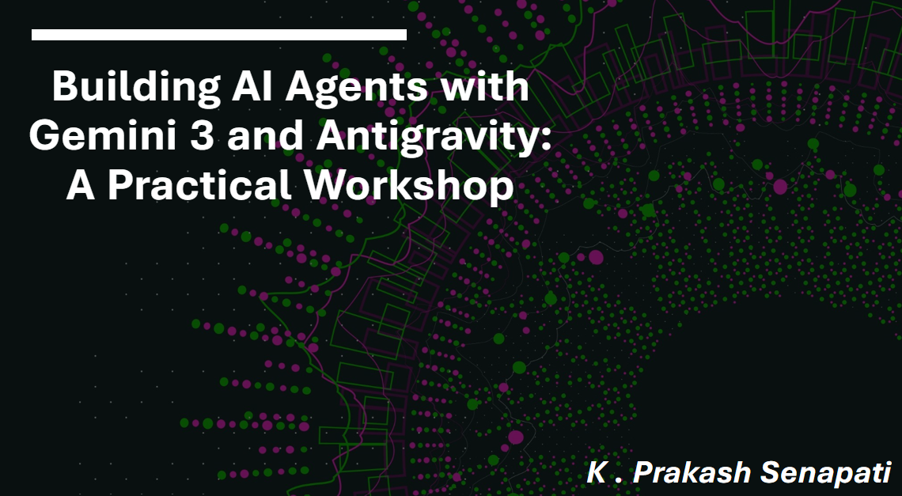
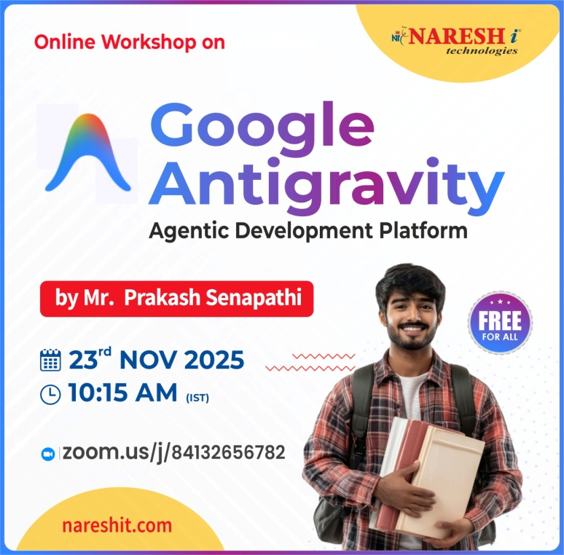

Slide 2
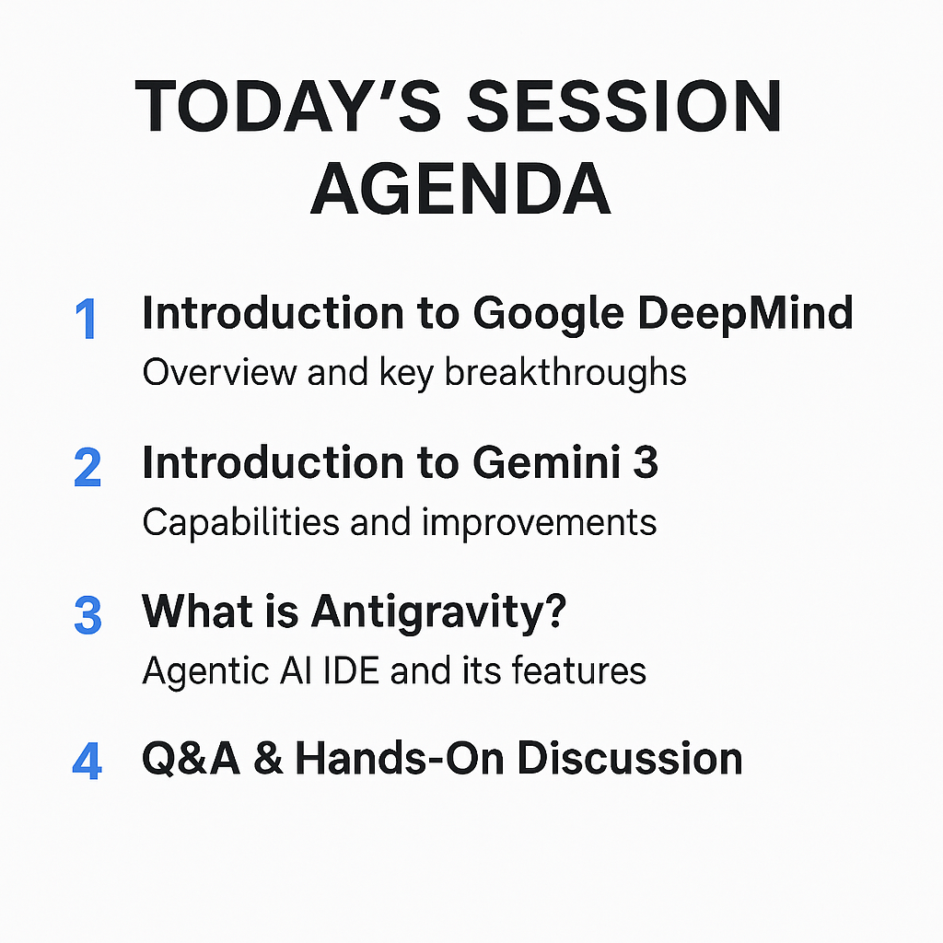

Slide 3
YOUTUBE PLAYLIST
1. Agentic AI è www.youtube.com/playlist?list=PLVlQHNRLflP8Pt3wVlRWRaXZXi79cIwSq
2. N8N Bootcamp --> https://www.youtube.com/watch?v=7iiwSKjKbRA&t=7054s
3. Hugging Face Bootcamp --> https://www.youtube.com/watch?v=QSWFG7Rj9c4&t=7646s
4. Data Analytics & Business Analytics è
www.youtube.com/playlist?list=PLVlQHNRLflP-BgYmMlM8YQpvQM2J99HE0
5. Generative AI è www.youtube.com/playlist?list=PLVlQHNRLflP81c99eg7UhkVZxwPvhTddM
6. AZUR AI (Cognitive Services for Data Scientist) è
https://www.youtube.com/playlist?list=PLVlQHNRLflP8JthpjvJFaofUkJS1A7qa1
7. Resume Building Bootcamp for Data Analytics, BA, Data Science & GEN AI Roles è
https://www.youtube.com/playlist?list=PLVlQHNRLflP-SaPff3325gkISMHEznEix

Slide 4
WHAT IS AGENTIC AI ➔
What is Agentic AI in Simple Terms?
Agentic AI refers to AI systems that can take independent actions, make decisions, and complete tasks without constant human input. Unlike traditional AI, which only responds when asked, Agentic AI plans, reasons, and executes tasks on its own.
Example →
AutoGPT & BabyAGI → AI agents that set goals and complete tasks automatically.
Self-Driving Cars → Analyze the road, make driving decisions, and adjust routes.
AI Personal Assistants → Plan schedules, book flights, and send emails without manual input.
Stock Trading Bots → Make buying and selling decisions based on market trends.

Slide 5
How Does Agentic AI Work?
Understands Goals → AI knows what needs to be done.
Plans & Strategizes → Breaks tasks into steps and finds the best way to complete them.
Takes Actions → Executes tasks independently (e.g., searching the web, sending emails, making decisions).
Learns & Adapts → Improves over time based on past actions.
Why is Agentic AI Special?
✅ Autonomous Decision-Making – Works without needing constant instructions.
✅ Multi-Step Task Handling – Can complete complex workflows.
✅ Self-Learning – Improves and adapts based on experience.
Agentic AI is like an AI assistant that doesn’t just follow orders—it thinks, plans, and acts on its own to get things done!

Slide 6
Agentic AI Frameworks
LangChain & LangGraph
Phi data
Crew AI
AutoGen
Smolagents
Manus AI
Grok3
n8n
Auto GPT
Baby AGI
Antigravity

Slide 7
1. Introduction to Google DeepMind
Overview of DeepMind’s evolution
Key breakthroughs in AI (AlphaGo, AlphaFold, robotics, RL, Generative AI)
DeepMind’s role in shaping modern AI research
How DeepMind connects to Gemini model development

Slide 8
Introduction to Gemini 3
What is Gemini 3?
Key capabilities: multimodal reasoning, long-context (1M+ tokens), faster inference
Improvements over earlier Gemini models
Real-world applications (code, vision, agents, productivity)
Comparison with other leading LLMs

Slide 9

What is Antigravity?
Introduction to Antigravity (Google’s agentic AI IDE)
How developers use Antigravity for agent-based workflows
Key features:
Autonomous coding
Task planning + execution
Browser + terminal + editor integration
Debugging + validation loops
Why Antigravity is a game-changer for developers

Slide 10

Agentic AI Overview
What is agentic AI?
How agents differ from traditional LLMs
Agents that plan, reason, act, and self-correct
Gemini 3 + Antigravity → fully autonomous development environment
Future of agentic workflows in 2025–2026

Slide 11
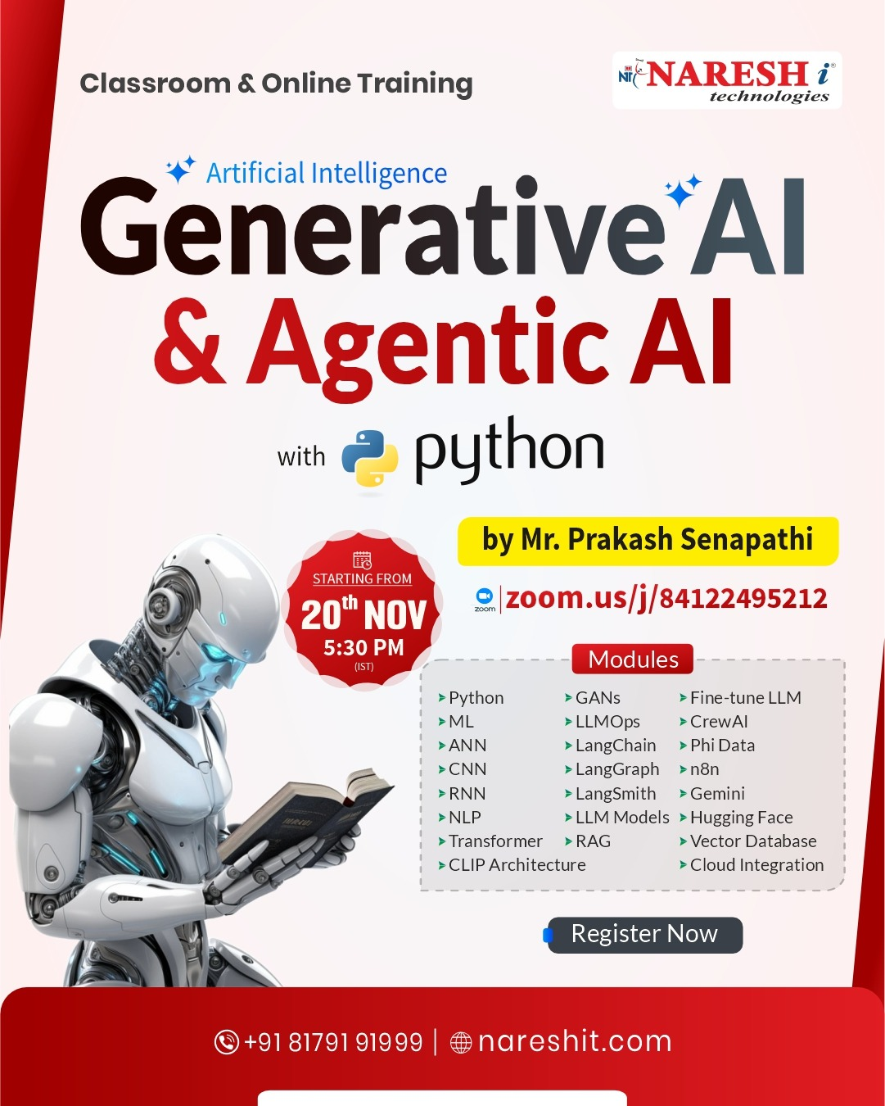
New Batch Announcement
AI, Generative AI & Agentic AI with Python @ 5:30 PM (IST) Webinar Link:
https://zoom.us/j/84122495212
Registration Link :-https://us06web.zoom.us/webinar/register/WN_qn0STmrAR4uppU_FoO04gA
2-Days Recording Link -->
Day-1 : https://www.youtube.com/watch?v=PBAfL60LyE8&t=4337s
Day-2 : https://www.youtube.com/watch?v=oKzJ5BE8vVc&t=3s
Connect to Mr. Areef @ +91 - 9154861173

