Slide 1
Automatic Vehicle Entry Control System using Image Processing
Sinhgad College of Engineering, Pune
Bachelor of Engineering
Department of E&TC
Group No: D37
By
Vyankatesh Nilkanth Vibhute B400230748
Rushikesh Balasaheb Wakde B400230753
Shravani Shrimant Yewale B400230762
Guide: Prof.(Mrs.) P.P. Gaikwad
2024-25

Slide 2
Contents
Introduction
Problem Statement
Aim & Objective
Literature Survey
Block Diagram
Flow Chart
Selection Criteria
Components with Specifications
Conclusion
Future Scope
Reference

Slide 3
Introduction
The Automatic Vehicle Entry Access Control System leverages advanced image processing and OCR techniques for real-time license plate recognition. This technology replaces manual checks, improving accuracy and efficiency in various applications like toll collection and security access.
Key Features:
OCR (Optical Character Recognition)
Real-time Image Processing of Vehicle Plate
MySQL Database for Secure Data Management

Slide 4
Problem Statement
Challenges in Vehicle Access Control:
Security
Accuracy
Speed
Integration
Maintenance

Slide 5
Aim & Objectives
Aim:
To automate vehicle entry control using image processing for license plate verification.
Objectives:
To automate toll collection through efficient image processing.
To Enhance security
To get Accuracy and Reliability for real-time operations.

Slide 6
Literature Survey
Sr No | RESEARCH PAPER NAME | AUTHOR | OUTCOME | FUTURE SCOPE
1. | Automatic Gate Opening System (April, 2024) | Pooja Gaikwad, Et al. | Work Done - Developed an Automatic Gate Opening System. Uses sensors to automatically open gates based on predefined conditions. Gaps Identified – There is Security concern with this system. | Can be expanded for Smart Access Control System. Potential applications in parking systems and automated entry for residential or industrial settings

Slide 7
Literature Survey
Sr No | RESEARCH PAPER NAME | AUTHOR | OUTCOME | FUTURE SCOPE
2. | Vehicle Number Plate Detection System Using Image Processing Approach (8 July, 2023) | NI Tushar, Et al. | Work done – Vehicle Number Plate is detected and Text is recognized. Technology used - Automatic Number Plate Recognition (ANPR) image processing technology that uses a vehicle's license plate to identify it | ANPR process can be used for Toll Collection and Vehicle entry control system to recognize the user owning number plate have sufficient balance to pay toll fee automatically.

Slide 8
Literature Survey
Sr No | RESEARCH PAPER NAME | AUTHOR | OUTCOME | FUTURE SCOPE
3. | An IOT-Based Automotive and Intelligent Toll Gate Using RFID (15 Dec, 2022) | S.Chandrappa, Etal. | Work done - A toll collection system that is based on RFID technology was built with the help of the Raspberry Pi Gap Identified – There is more time complexity in the process. | Automation in Toll collection and vehicle entry-exit control is very much efficient way to reduce traffic and secure way in itself.
4. | Automated Gate for Vehicular Entry Using Image Processing (Mar, 2020) | Saurabh Charde, Etal. | Work done – The image processed and recognized using Optical Character Recognition (OCR) through Tesseract and OpenCV libraries in Python. Technology used – Machine Learning and Image Processing techniques through OpenCV and Tesseract libraries | For instance, by integrating the system with a centralized database, the vehicle’s number plate can be processed to track entries.

Slide 9
Literature Survey
Sr No | RESEARCH PAPER NAME | AUTHOR | OUTCOME | FUTURE SCOPE
5. | Automated License Plate Recognition using Different Camera Angles | Andre Calitz, Etal. | Work done - providing real-time tracking and alerts with minimal human intervention. Gap Identified – hindered by environmental factors like poor lighting and weather conditions | The system's accuracy can be improved further by using machine learning models to handle environmental variations like poor lighting or bad weather.
6. | Image Recognition Technology Based on Machine Learning (2017) | Lijuan Liu, Etal. | Work done – Image has been processed and recognized using machine learning. Technology used – Machine Learning is used to process an image and recognize its naming or behaviour. | This process can be integrated with various automation system such as Toll collection. By processing image of Number plate, authority can charge toll fee contact free.

Slide 10
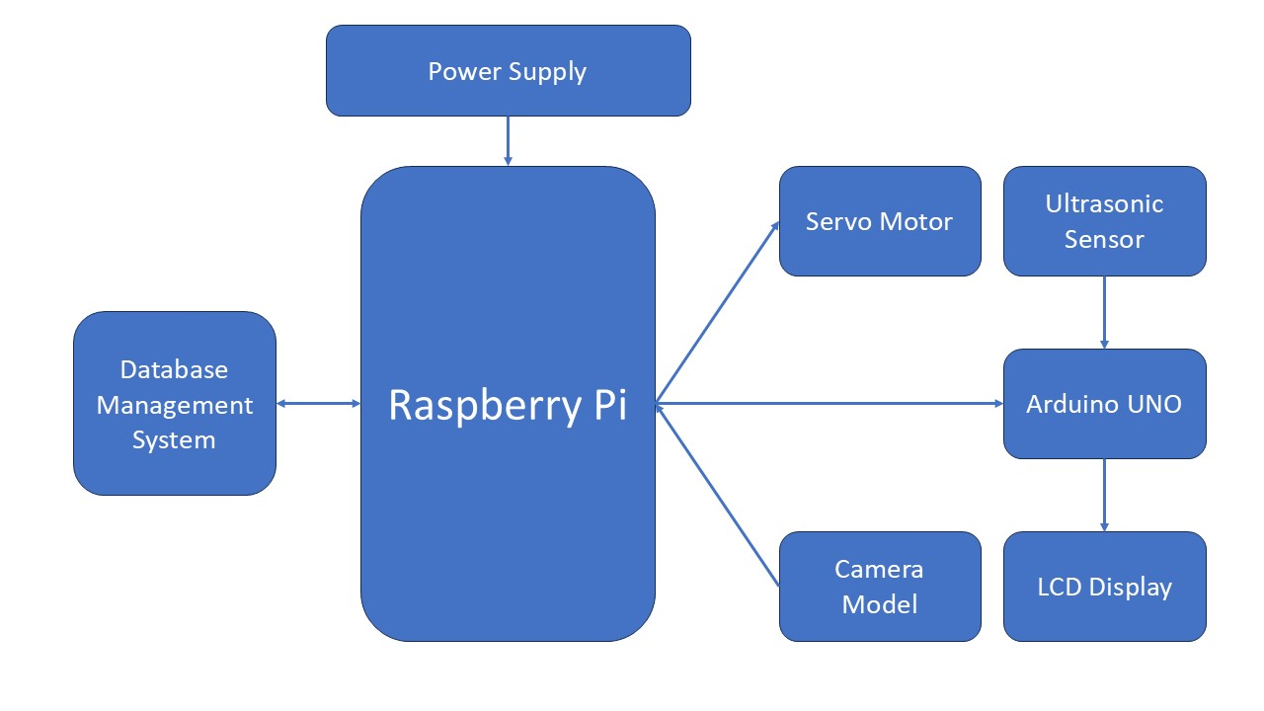
Block Diagram

Slide 11
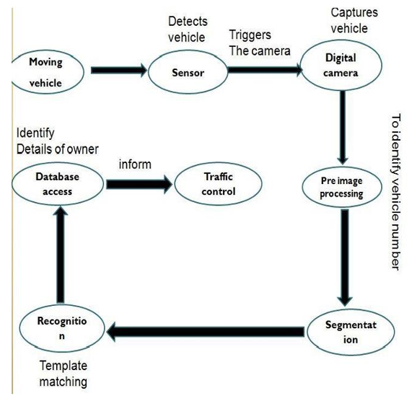
Block Diagram

Slide 12
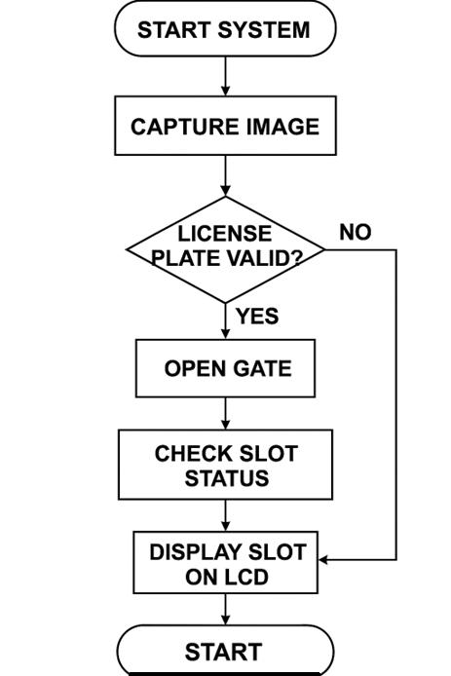
Flowchart
STOP

Slide 13
Selection Criteria of Components
Microcontroller :
Must support camera modules and have Wi-Fi capability for database communication.
Sufficient to handle image processing and control tasks simultaneously.
GPIO Pins: Adequate pins to control motor drivers and interface with sensors.
Example: Raspberry Pi chosen for its Wi-Fi support and compatibility with Raspberry Pi-CAM.
Camera Sensor :
Resolution: Capable of capturing clear images of vehicle license plates.
Integration: Must be easily integrable with the selected microcontroller.
Example: Raspberry Pi-CAM for high compatibility and ease of use.
Motor and Driver :
Motor Type: DC motor for barrier control, suitable for continuous rotation.
Driver Capability: Ability to control motor direction and speed using the selected microcontroller.
Example: L298N motor driver for its compatibility with Raspberry Pi and ability to control the motor.

Slide 14
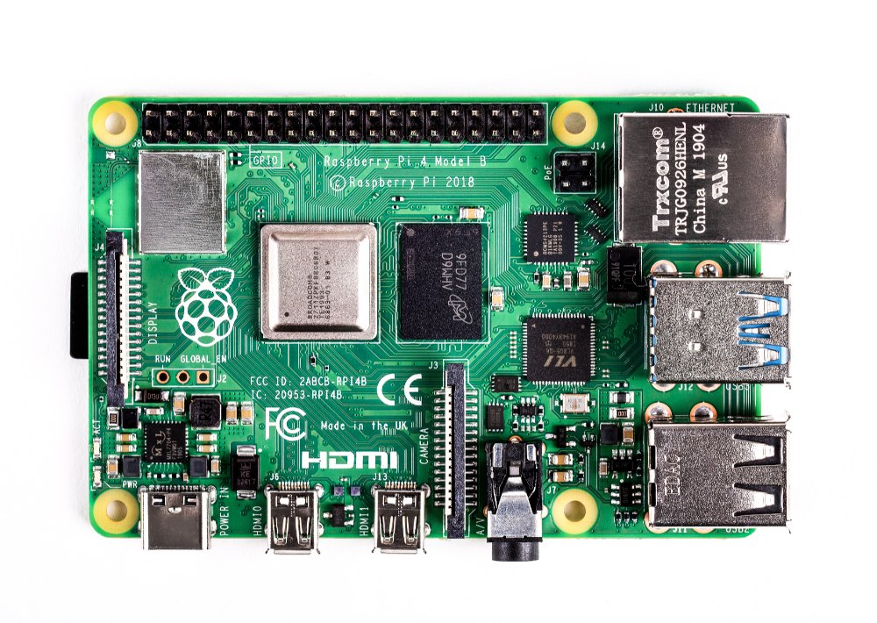
Components with Specifications
1. Microcontroller : Raspberry Pi -
Processor: 1.2 GHz 64-bit quad-core ARM Cortex-A53
RAM: 1 GB LPDDR2
Connectivity:
Wi-Fi: 802.11n Wireless LAN
Bluetooth: Bluetooth 4.1, Bluetooth Low Energy (BLE)
Ports:
USB: 4 x USB 2.0 ports
HDMI: Full-size HDMI
GPIO: 40-pin GPIO header
Camera: 15-pin MIPI CSI connector for camera modules
Display: DSI display port
Operating System: Raspbian, Ubuntu, or other Linux-based OS
Power Supply: 5V/2.5A micro USB

Slide 15
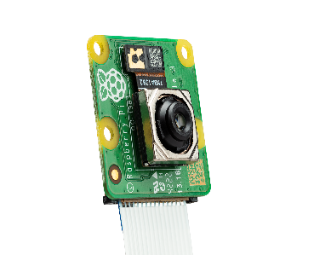
Components with Specifications
2. Camera Sensor : Raspberry Camera Module
Resolution: 8 or 12 megapixels (depending on the model)
Sensor: Sony IMX219 (for the 8MP version), Sony IMX477 (for the 12MP HQ version)
Video: Supports 1080p30, 720p60, and 640x480p90 video recording
Connection: 15-pin ribbon cable for the CSI interface
Lens: Fixed focus (8MP) or interchangeable lens (12MP HQ)
Dimensions: Small form factor, compatible with Raspberry Pi models

Slide 16
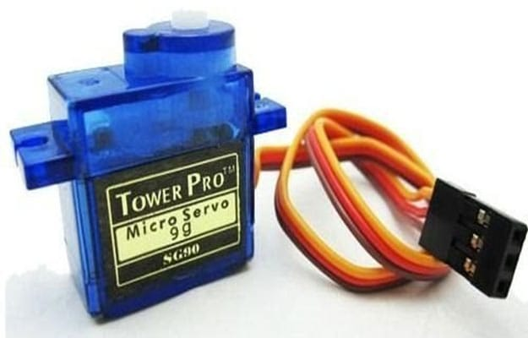
Components with Specifications
3. Servo Motor
Torque: 10–15 kg·cm
Speed: 0.15 sec/60°
Operating Voltage: 4.8V to 6V
Angle Range: 0° to 180°
Current Draw: 500 mA to 1.5 A
Control Signal: PWM (50 Hz)

Slide 17
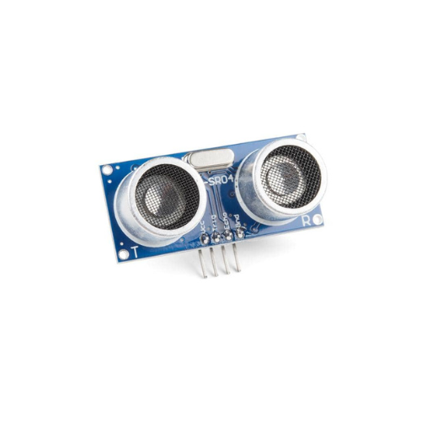
Components with Specifications
4. HC-SR04 Ultrasonic Sensor
Operating Voltage: 5V DC
Operating Current: 15mA
Measure Angle: 15°
Ultrasonic Frequency: 40kHz
Max Range: 4 meters
Min Range: 2 cm
Accuracy: ±3 mm

Slide 18
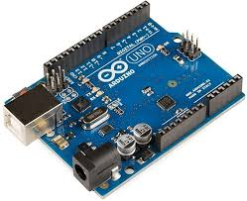
Components with Specifications
5. Arduino UNO
Operating Voltage: 5V DC
Operating Current: 7-12 V
Digital I/O Pins: 14
Analog Input Pins: 6
Flash Memory: 32KB
Clock Speed: 16MHz

Slide 19
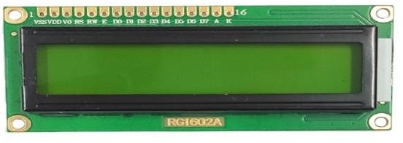
Components with Specifications
6. 16x2 LCD
Display Type: Alphanumerical
Characters: 16 characters per line, 2 lines
Operating Voltage: 4.7V to 5.3V
Backlight: LED
Interface: Parallel
Character Size: ~5-8 pixel matrix per character

Slide 20
Components with Specifications
5. Database : MySQL
Server: MySQL 5.7 or above
Database Size: Scalable based on storage (typically starts at 1 GB)
Connectivity: Wi-Fi (through Raspberry Pi to MySQL server)
Security: Supports SSL/TLS for encrypted communication
User Management: Multi-user support with role-based access
Query Language: SQL (Structured Query Language)Data Types Supported: Integer, Varchar, Date-Time, etc.

Slide 21
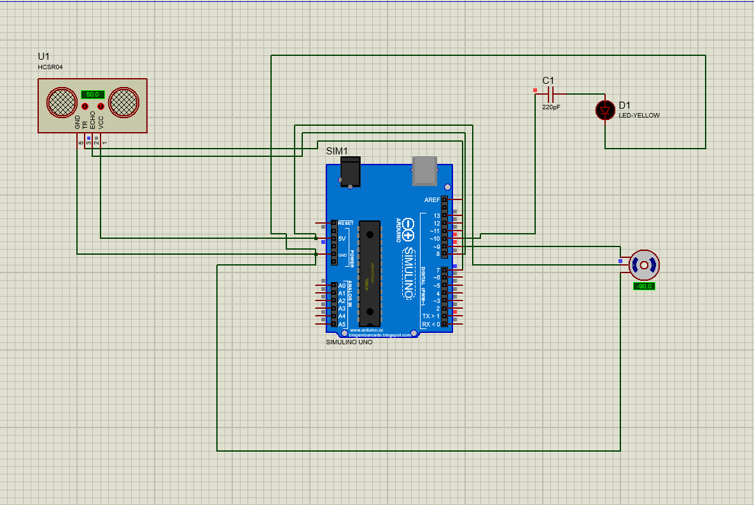
Simulation

Slide 22
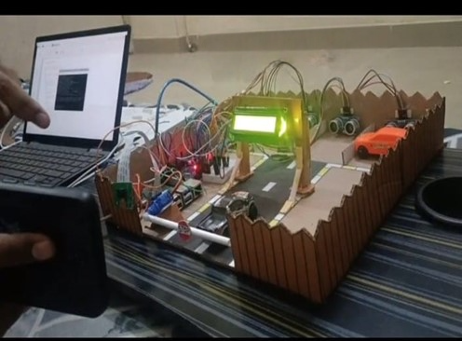
Results
System Prototype in Action

Slide 23
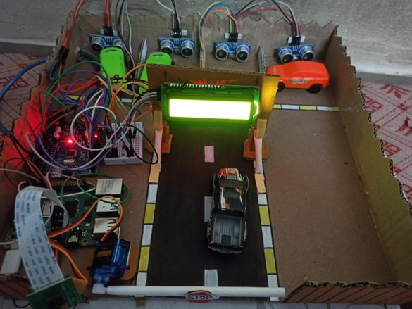
Results
Top View of the Smart Parking Prototype with Integrated Components

Slide 24
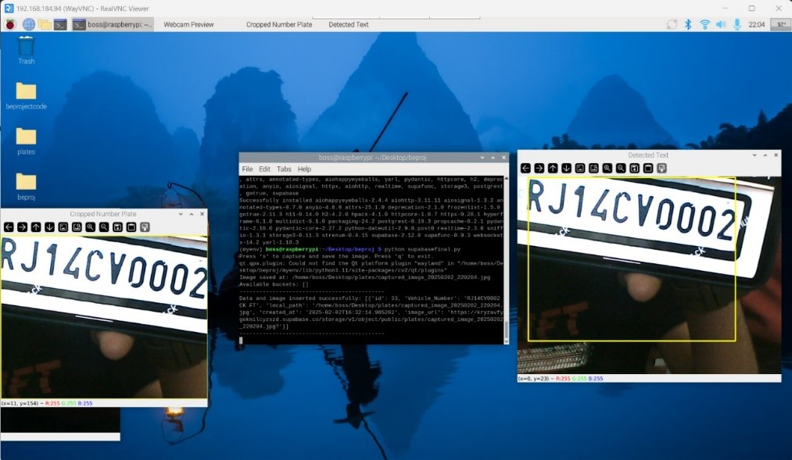
Results
Number Plate Detection and Recognition Interface

Slide 25
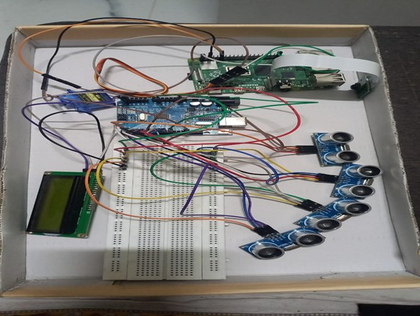
Results
Electronic Components and Circuitry Layout

Slide 26
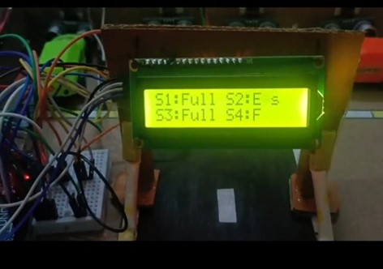
Results
Parking Slot Status Display on LCD

Slide 27
Comparative Study with Existing Work
Ref | Author | Title | Technology Used | Performance Metrics
[1] | Pooja Gaik wad(2024) | Automatic Gate Opening System | IR Sensors | Response time: 2s; No identification; False trigger rate: 8%
[2] | NI Tushar (2023) | Vehicle Number Plate Detection Using Image Processing | OpenCV, OCR | Accuracy: 72%; Lighting sensitivity; Processing time: 1.5s/image
[3] | S. Chandrappa (2022) | IoT-Based Intelligent Toll Gate Using RFID | RFID, Rasp berry Pi | Detection ac curacy: 90%; Vulnerable to tag cloning; Avg. processing: 1s

Slide 28
Comparative Study with Existing Work
Ref | Author | Title | Technology Used | Performance Metrics
[4] | Saurabh Charde (2020) | Automated Gate Entry Using Image Processing | OpenCV, Tesseract OCR | Accuracy: 75% under normal conditions; drops below 60% with noise/angle
[5] | Andre Calitz | License Plate Recognition Using Different Camera Angles | Multi-angle Image Pro cessing | Flexibility im proved; Accuracy: 85%; Processing time: 2.5s
[6] | Lijuan Liu (2017) | Image Recognition Using Machine Learning | CNN-based ML model | Accuracy: 92%(after training); Inference time: 1.8s;Requires large dataset

Slide 29
Comparative Study with Existing Work
Ref | System | Title | Technology Used | Performance Metrics
[7] | Proposed System (2025) | Automatic Vehicle Entry Control System using Image Processing | OpenCV, Tesseract, ML Classifier | Accuracy: 95.6%; Real time response: less than1s; Improved noise tolerance and angle handling

Slide 30
Applications
Highway Toll Plazas
Parking Facilities
Private Community Gates
Commercial Building Access
Smart Cities
Industrial Complexes
Event Management

Slide 31
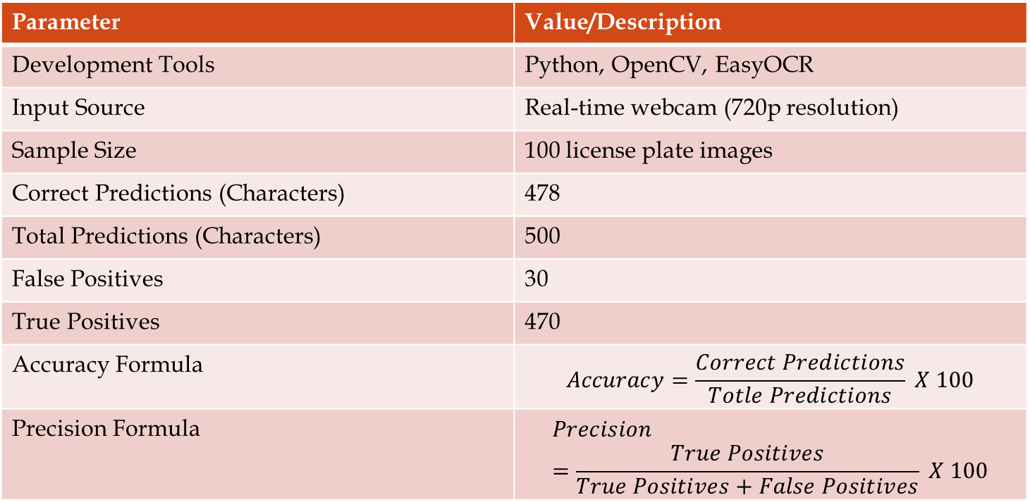
Performance Evaluation of License Plate Recognition System
Parameter | Value/Description
Development Tools | Python, OpenCV, EasyOCR
Input Source | Real-time webcam (720p resolution)
Sample Size | 100 license plate images
Correct Predictions (Characters) | 478
Total Predictions (Characters) | 500
False Positives | 30
True Positives | 470
Accuracy Formula | $$Accuracy=\frac{Correct Predictions}{Totle Predictions} X 100$$
Precision Formula | $$Precision=\frac{True Positives}{True Positives+False Positives} X 100$$

Slide 32
Performance Evaluation of License Plate Recognition System
Parameter | Value/Description
Highlighted Output | Detected text (e.g., MH 37 CF 4902) is outlined in green
Validation Output | Confidence scores shown in terminal for each character (e.g., “T”– 99.3%, “N”– 98.7%)
Storage Path | Captured and processed images stored in: /results/license plates/

Slide 33
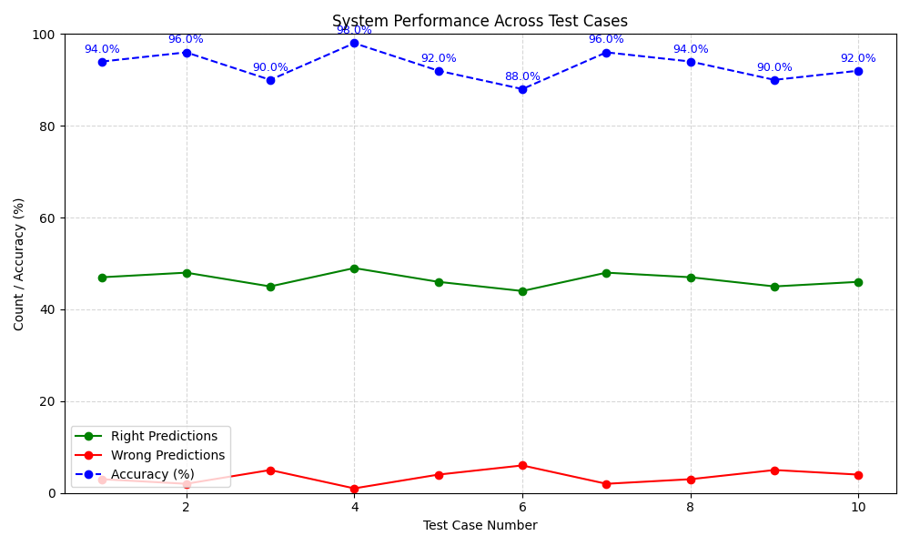
Analysis

Slide 34
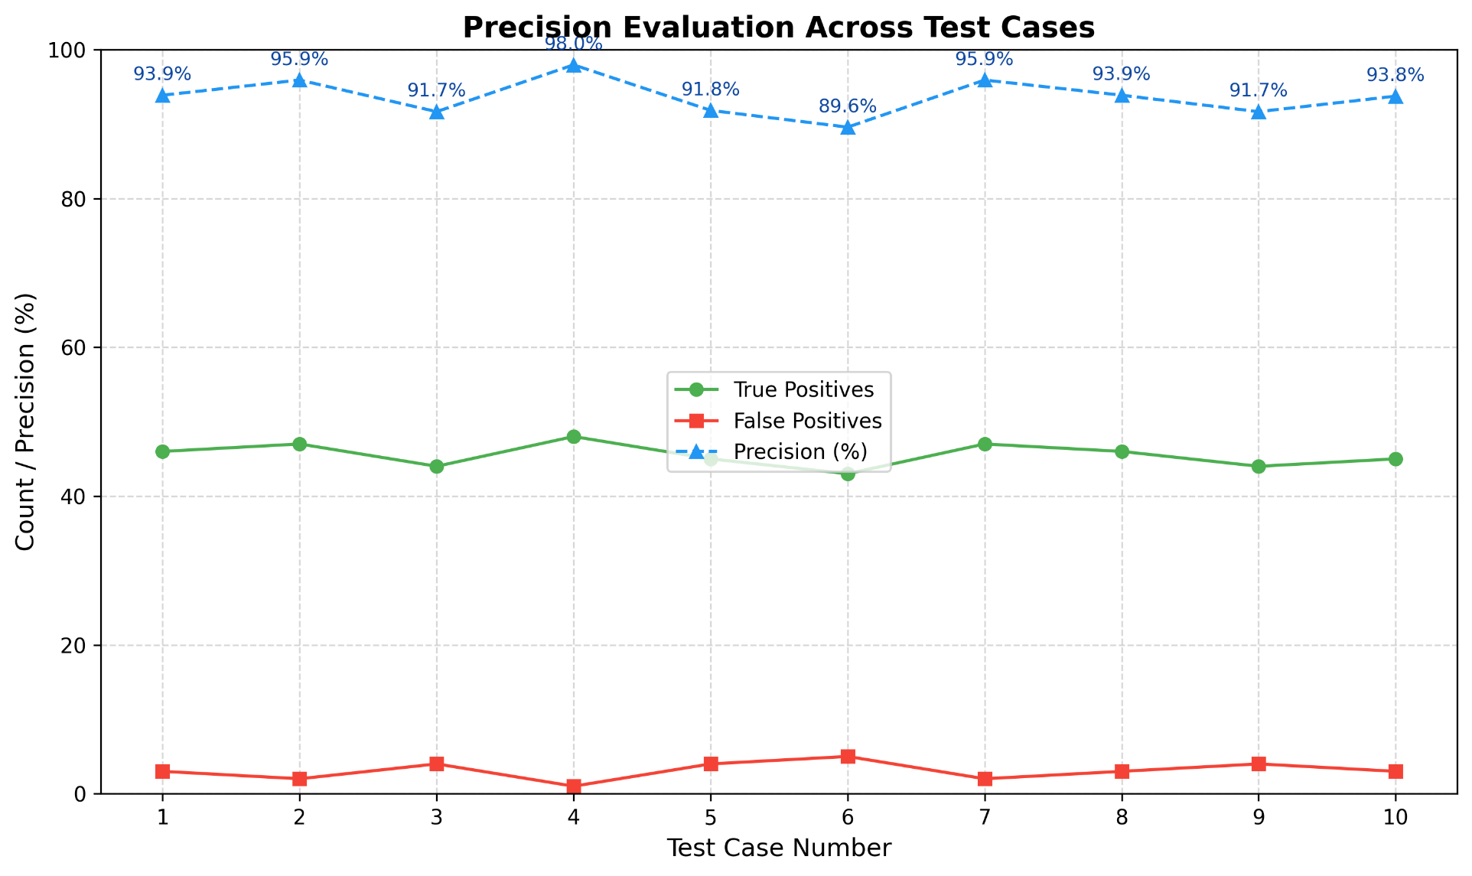
Analysis

Slide 35
Advantages
Enhanced Security
Automated Secured Access to vehicles
Real-Time Database Management
Improved Traffic Flow

Slide 36
Conclusion
The project successfully automates vehicle entry and toll collection using a combination of image processing and database management. The system is scalable and adaptable for future enhancements, offering a reliable solution for modern access control needs.

Slide 37
Future Scope
Energy Efficiency : Solar-powered options for remote installations.
Integration with RFID : For dual authentication methods.
Enhanced Image Processing : Implement AI-driven image recognition for higher accuracy.

Slide 38
References
[1] P. Gaikwad, “Automatic gate opening system,” International Journal of Re search Publication and Reviews, vol. 5, no. 4, pp. 123–127, April 2024.
[2] N. I. Tushar, “Vehicle number plate detection system using image process ing approach,” in Proc. IEEE Int. Conf. Comput. Commun. Netw. Technol. (ICCCNT), vol. 14. IEEE, July 2023, pp. 240–245.
[3] S. Chandrappa, “An iot-based automotive and intelligent toll gate using rfid,” Lecture Notes in Electrical Engineering, vol. 853, pp. 112–118, December 2022.
[4] S. Charde, “Automated gate for vehicular entry using image processing,” In ternational Research Journal of Engineering and Technology (IRJET), vol. 7, no. 3, pp. 88–93, March 2020.
[5] A. Das, “Deep learning-based automatic toll collection system,” in Proc. IEEE Int. Conf. Intell. Transp. Syst. (ITSC). IEEE, September 2020, pp. 1525 1530

Slide 39
QUESTIONS ?

Slide 40
THANK YOU

