Slide 1
VEHICLE ROUTING PROBLEM HEURISTICS
Tanzim Mokammel
Venkatesh Mahadevan
Yasser Khan

Slide 2
What is VRP?
Combinatorial optimization problem
Seeks to service a number of customers with a fleet of vehicles, delivering goods from a central depot
  Goal: Minimize the route cost
Important in fields of transportation, distribution and logistics
NP Complete problem in combinatorial optimization: deterministic and heuristics methods are available

Slide 3
What is VRP: Combinatorial Optimization
Find an optimal object from a finite set
NP-complete: given solution can be verified quickly in polynomial time, but there is no known way to locate the solution
Techniques for solving:
  Approximation
  Heuristics
    Produce a solution in a reasonable time frame within acceptable accuracy
Notes:
http://en.wikipedia.org/wiki/Heuristic_(computer_science)

Slide 4
Why Parallelize the Issue?
NP-Complete problem, requires high performance
Parallelization will improve time taken to reach optimal solution

Slide 5
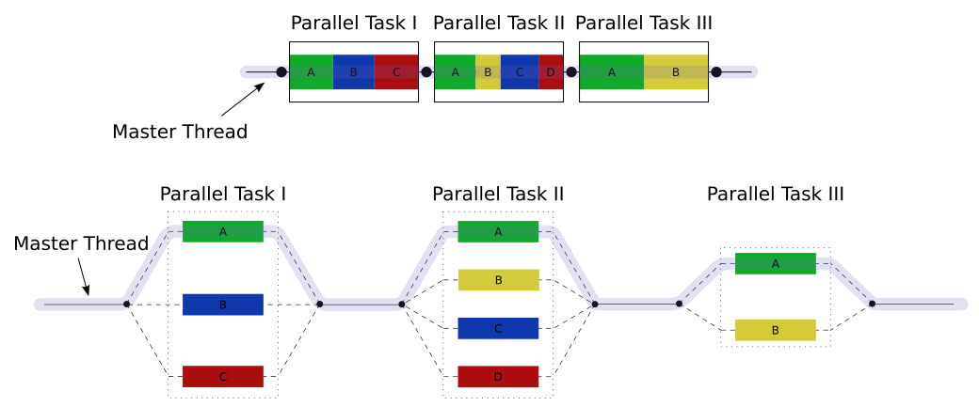
What is Open Multi-Processing (OpenMP)
An API supporting shared memory multiprocessing programming in C,C++, and Fortran
An implementation of multithreading: master thread allocates slave threads for concurrent execution
Utilizes the fork-join model, initiated with pre-processor directive
Each thread executes independently, but work sharing model may be designed
Can achieve both task and data parallelism
Notes:
http://en.wikipedia.org/wiki/OpenMP

Slide 6
Why OpenMP?
No considerations for message passing as in MPI
No dramatic changes needed to the code
Same code b/w serial and parallel applications as constructs are treated as comments if a sequential compiler is used
  Original code doesn’t get modified and therefore less chances of introducing bugs
Data layout and decomposition are handled automatically
Notes:
http://en.wikipedia.org/wiki/OpenMP

Slide 7
Agenda
Algorithms Overview
  Clarke-Wright
  Sweep
  Local Search Operators
Source Code Description
  Parallelized APIs
  Modified APIs
Methodology
  Environment
  Test Bench
Preliminary Results
Future Work

Slide 8
Clarke-Wright Savings Algorithm
Given n-node problem, the Clarke-Wright algorithm starts with n-routes
  Each vehicle visits a node and returns to the depot
Merge routes together in an order by the savings criterion
Variables
  d₀: Depot
  d_{ij}: Distance b/w nodes i,j
  s_{ij}: Savings created by merging two initial routes

Slide 9
Clarke-Wright Savings Algorithm
Total route length of initial solution:
Savings from merging each pair of nodes:
Using the savings, determine the order in which the routes are merged to create larger routes

Slide 10
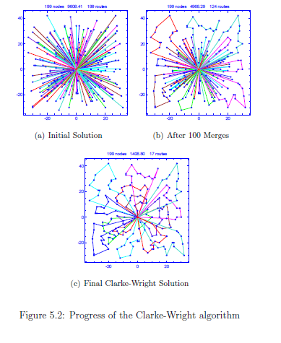
Clarke-Wright Savings Algorithm
Initial Solution After 100 Merges Final Clarke-Wright Solution

Slide 11
VRP – The Sweep Algorithm
Select a random customer and draw a ray connecting this node to the depot; this is the first node on the first route
Sweep this node around the depot until another node is found; this node is added to the current route
When the route is about to become infeasible due to capacity constraints, or distance constraint: start a new route
Repeat until all customers are routed
Notes:
Pg 124 of groer

Slide 12
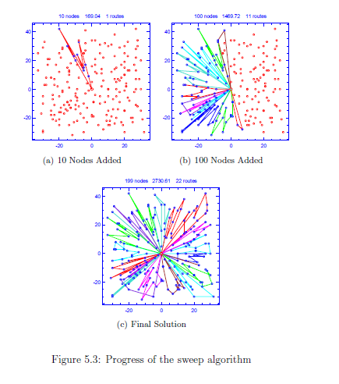
VRP – The Sweep Algorithm
Initial Solution After 100 Nodes Final Sweep Solution
Notes:
Pg 124 of groer

Slide 13
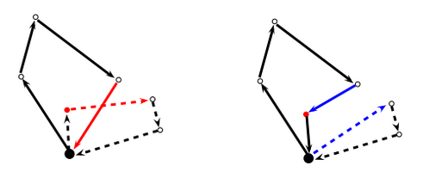
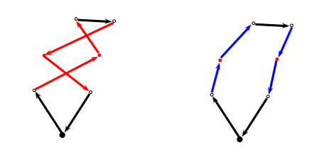
Local Search Operators
One point move
  Shift one node between routes
Two point move
  Rearrange the position of two nodes in a route

Slide 14
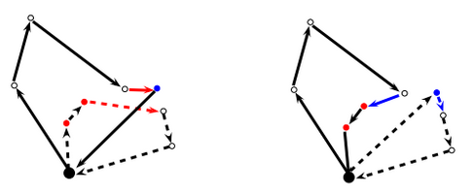
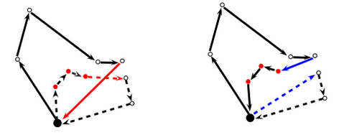
Local Search Operators
Three point move
  Make each route go through all nodes in it’s neighbourhood before going to depot
Or-Opt
  Remove a string of nodes and add them to another route

Slide 15
VRPH API
void VRP::create_neighbor_lists(int nsize)
bool VRP::create_default_routes()
void ClarkeWright::CreateSavingsMatrix(class VRP *V, double lambda, bool use_neighbor_list)
void VRP::normalize_route_numbers()
bool VRP::create_search_neighborhood(int j, int rules)
void clean_route(int r, int heuristics)

Slide 16
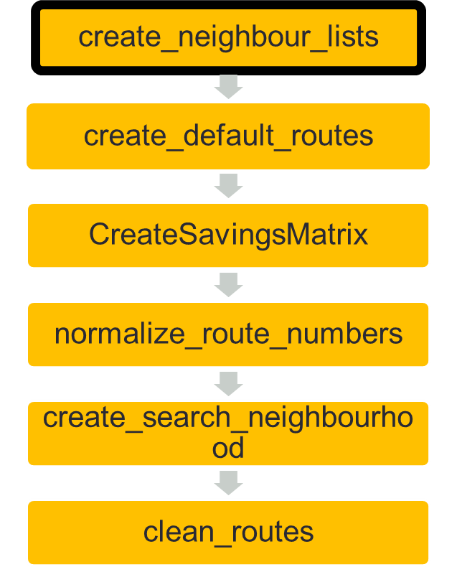
VRPH API
void VRP::create_neighbor_lists(int nsize):
Creates a neighbor list for VRPH_DEPOT first by identifying a few key nodes.
Results in the creation of a list of nodes and distances from VRPH_NODE.
The maximum distance from above is stored as the new maximum.
Now creates a list of neighbours for all nodes that are not VRPH_DEPOT and stores the list along with their distances.
The maximum computed previously is compared to the maximum computed above and greater of the two is taken as the new maximum.

Slide 17
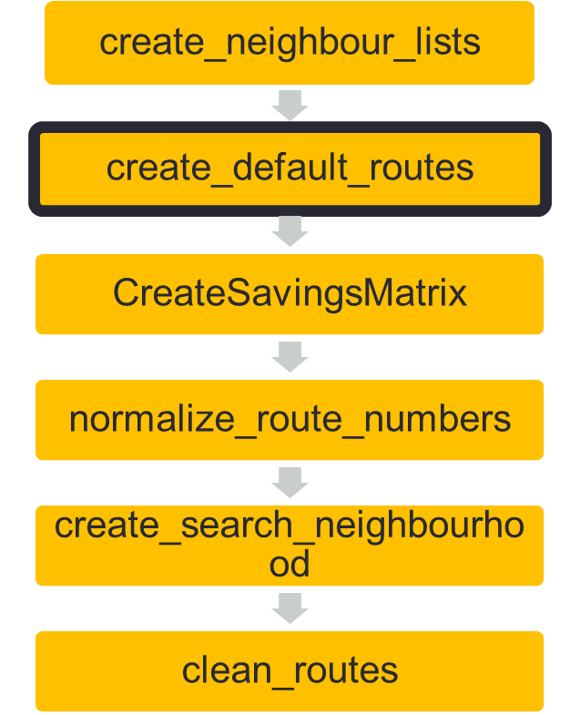
VRPH API
void VRP::create_default_routes()
Creates routes for all nodes identified previously and initialize all the associated arrays.
Attempts to predict the route capacity beforehand.
Checks route capacity against capacity in TSPLIB file and classifies the route as feasible/non-feasible.
Keeps track of the worst violations when doing so. .

Slide 18
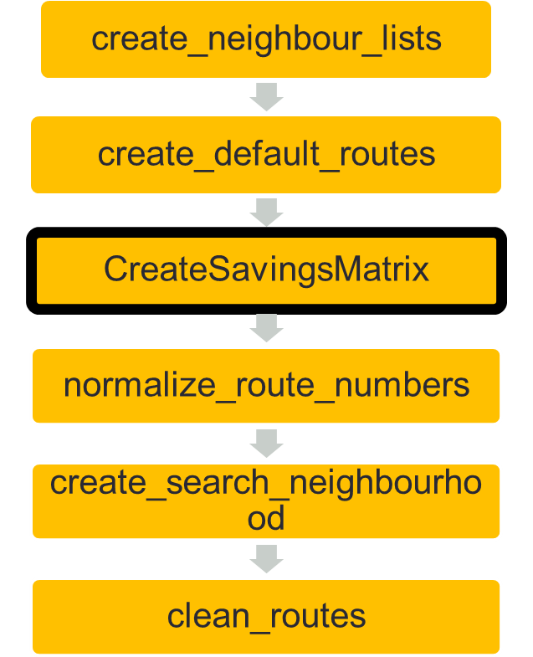
VRPH API
void ClarkeWright::CreateSavingsMatrix(class VRP *V, double lambda, bool use_neighbor_list)
This tries to create a savings matrix for any pair of nodes which are routed.
The savings matrix is of the form (val, I, j), where I and j are the 2 nodes which are routed, and val is the savings that results from applying the optimizations described previously
Allows for computing savings that result from inter-neighborhood or intra-neighborhood routes.
Returns a sorted list of pairs of nodes with increasing savings starting from the lowest value.

Slide 19
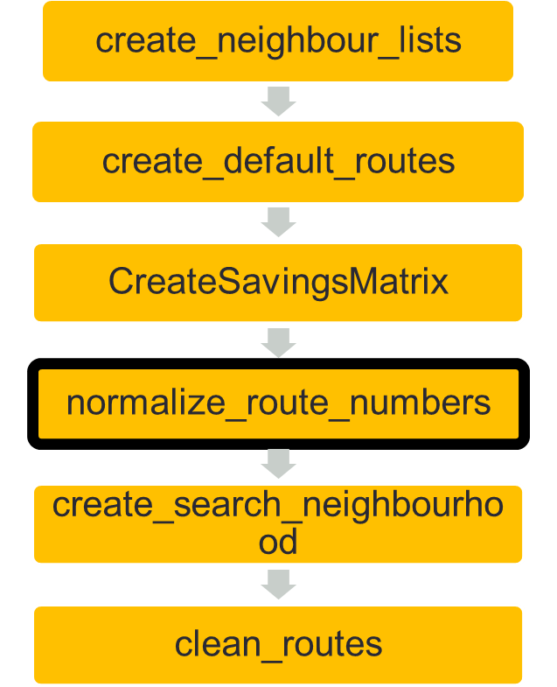
VRPH API
void VRP::normalize_route_numbers()
After Clarke-Wright, routes may be numbered arbitrarily and multiple times.
Hence, it is required that they be in increasing order in order to make the traversal easier.
This function renumbers routes so that with R routes, they are numbered 1,2,3 .. R.
At the end, routes will be in an increasing order from a inter-neighborhood and intra-neighborhood perspective.

Slide 20
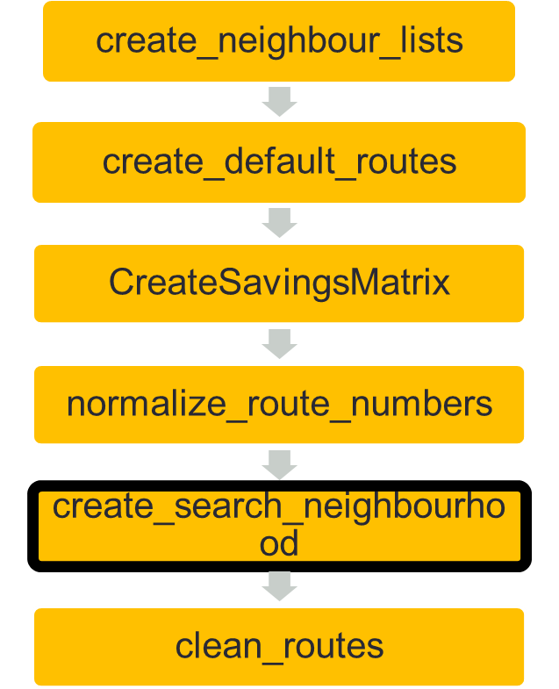
VRPH API
bool VRP::create_search_neighborhood(int j, int rules)
This creates the search size and search space for a given node j using certain rules.
Examples → VRPH_USE_NEIGHBOR_LIST, VRPH_INTER_ROUTE_ONLY, VRPH_INTRA_ROUTE_ONLY, VRPH_FORWARD, VRPH_BACKWARD, VRPH_RANDOMIZED.
VRPH_INTRA_ROUTE_ONLY and VRPH_INTER_ROUTE_ONLY can be used with all of the above rules.
VRPH_RANDOMIZED is used only when search space cannot be defined using any of the above methods.

Slide 21
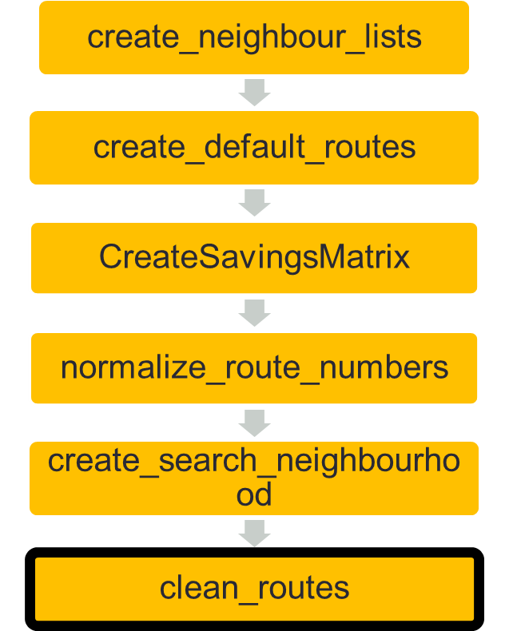
VRPH API
bool VRP::clean_routes (int r, int heuristics)
FSM-based approach wherein the heuristic to be used is compared with the given rules and the corresponding action is taken.
Rules are the same as described previously, i.e ONE_POINT_MOVE, TWO_POINT_MOVE, THREE_POINT_MOVE etc.
The distance before/after optimizations are applied are compared and if > VRPH_EPSILON, signal the algorithm to iterate again.
Return when minimum distance has been achieved i.e cannot improve any further.

Slide 22
Methodology – Environment
Hardware Configuration
  AMD FX 8 core processor
    2 hardware threads per processor
Software Configuration
  Ubuntu 14.04
  GCC4.8
  OpenMP3.1
  Plplot

Slide 23
Methodology – Test Bench
Input Three real world datasets in VRP files
  Named after computer scientists working in transportation field
Christofides - 50 nodes
Taillard - 400 nodes
Li - 1200 nodes
Use Plplot to verify parallel solution vs serial solution
Chart the execution time of each function in parallel and serial case

Slide 24
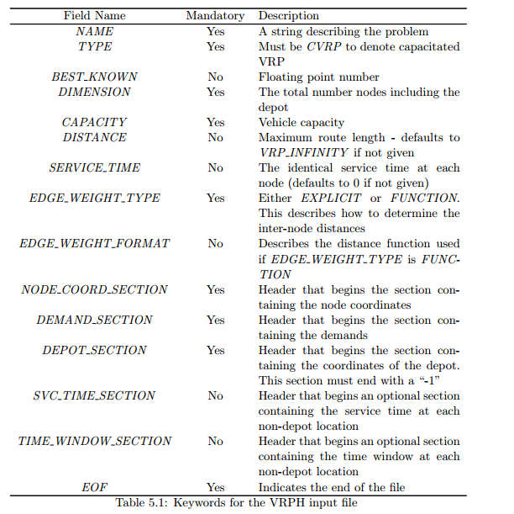
Methodology – Test Bench
Uses the TSPLIB format, with a few modifications for VRP
Not all headers required

Slide 25
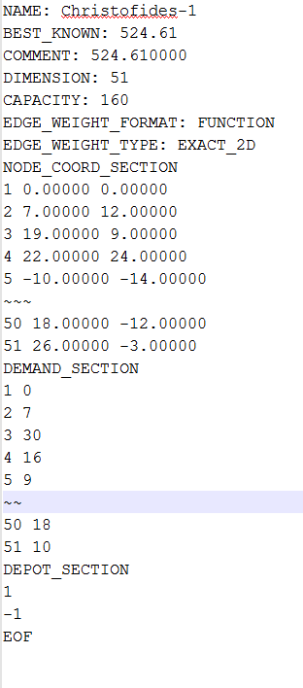
Methodology – Input File
Euclidean distance
  Straight line distance
Geographical distances
  node locations are latitude and longitude coordinates
Manhattan distance
  Right angle distance
Maximum distance
  max(|x1 − x2|, |y1 − y2|)
• Rounded Euclidean distance
  Sqrt((x1 − x2)2 + (y1 − y2))

Slide 26
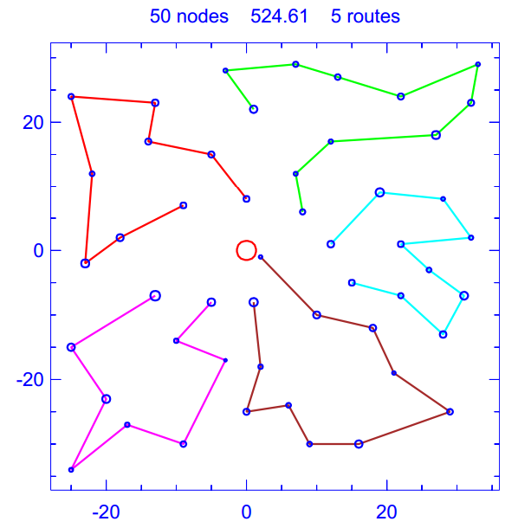
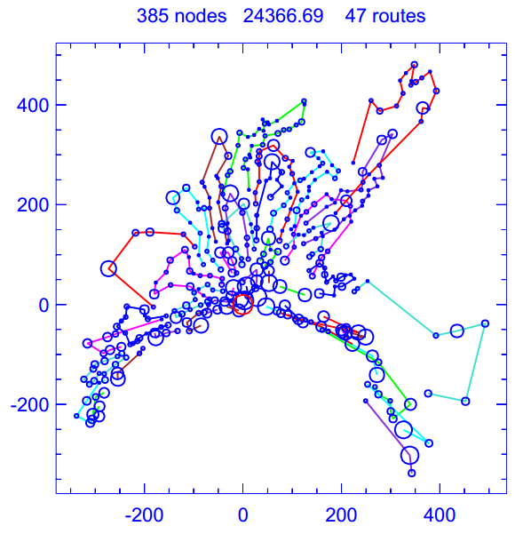
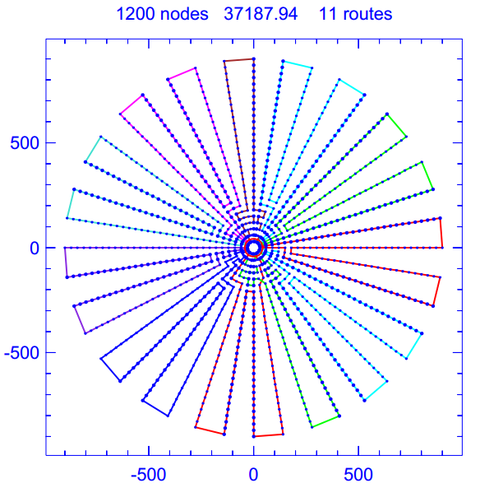
Methodology - PLPlot
Library of subroutines used to make scientific plots
VRP project outputs ps files, which can be input into PLplot to display the solutions
Christofides Taillard Li

Slide 27
Methodology - Considerations
Assumptions
  Assume parallelization is valid if solution is same as serial, or all nodes are reached
Limitations
  Various HW configurations behave differently. Only a single configuration was used in the interest of time

Slide 28
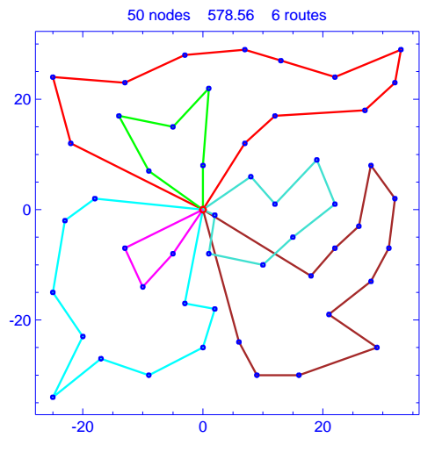
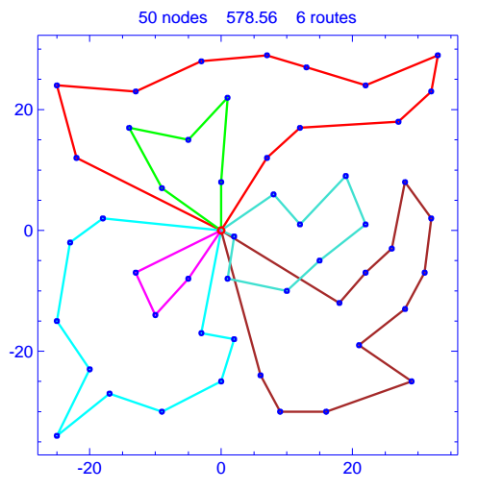
Preliminary Results – CW Christofides
Serial Parallel

Slide 29
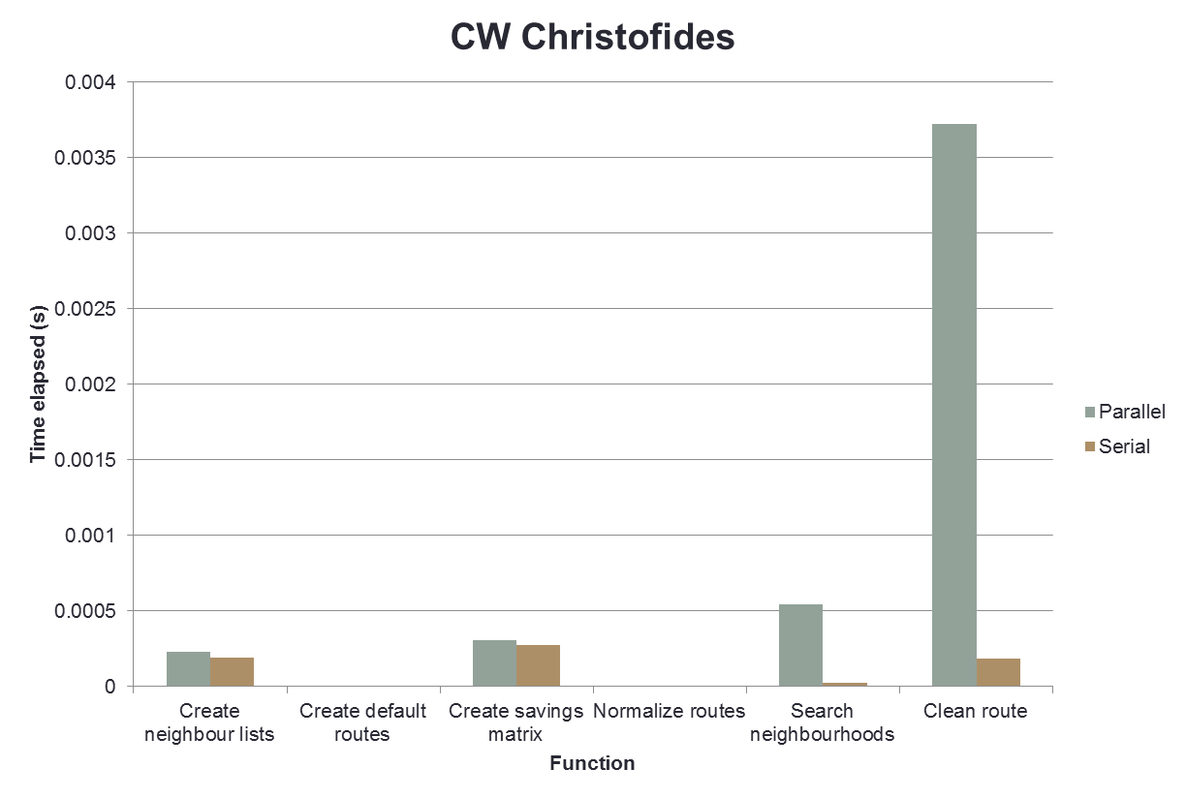
Preliminary Results

Slide 30
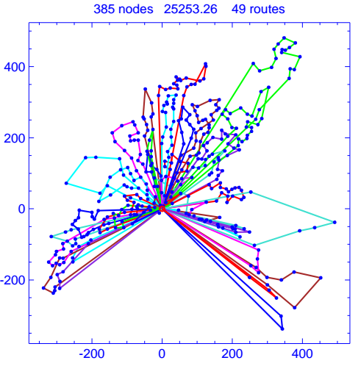
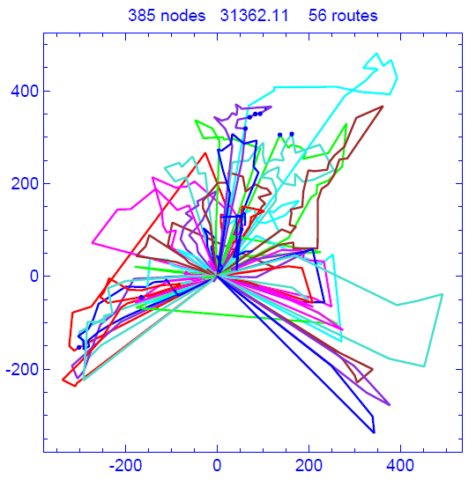
Preliminary Results – CW Taillard
Serial Parallel

Slide 31
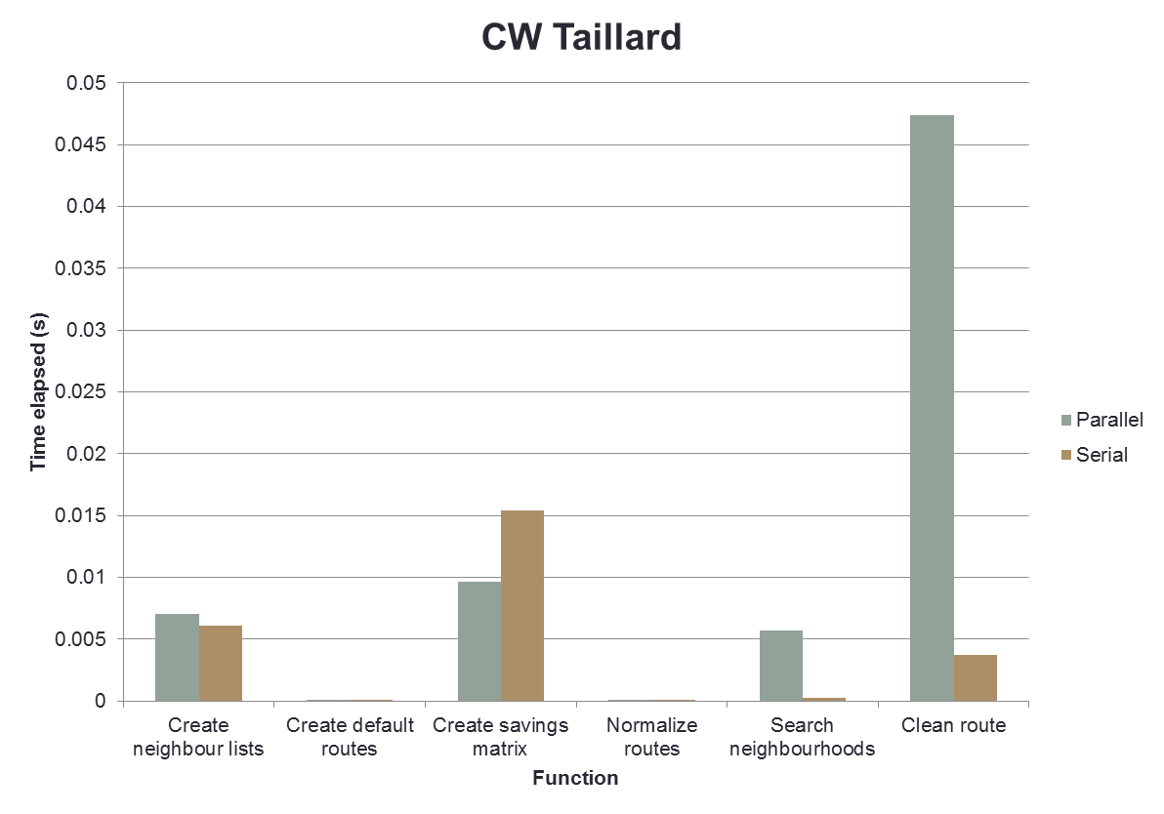
Preliminary Results

Slide 32
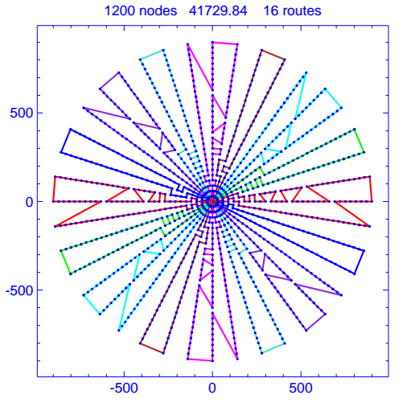
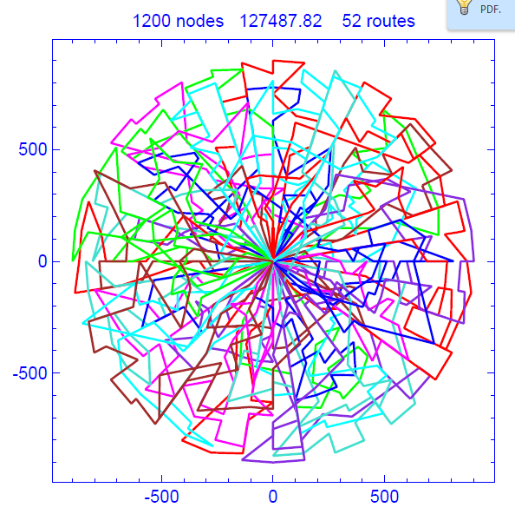
Preliminary Results – CW Li
Serial Parallel

Slide 33
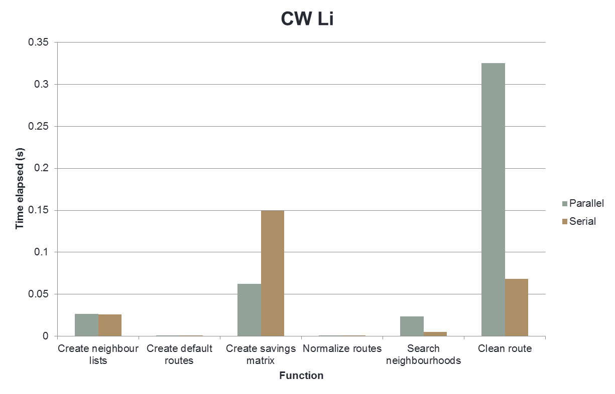
Preliminary Results

Slide 34
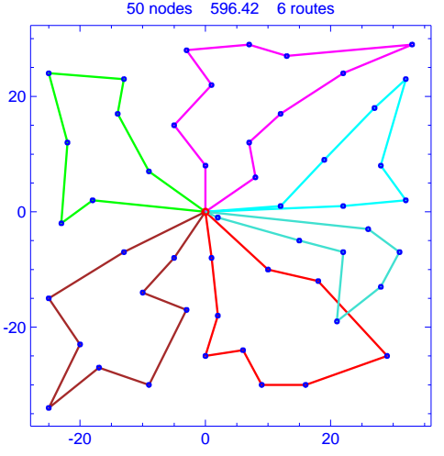
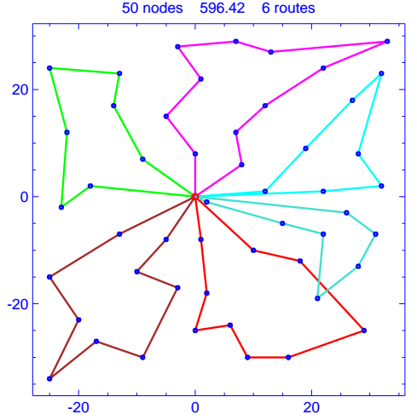
Preliminary Results – Sweep Christofides
Serial Parallel

Slide 35
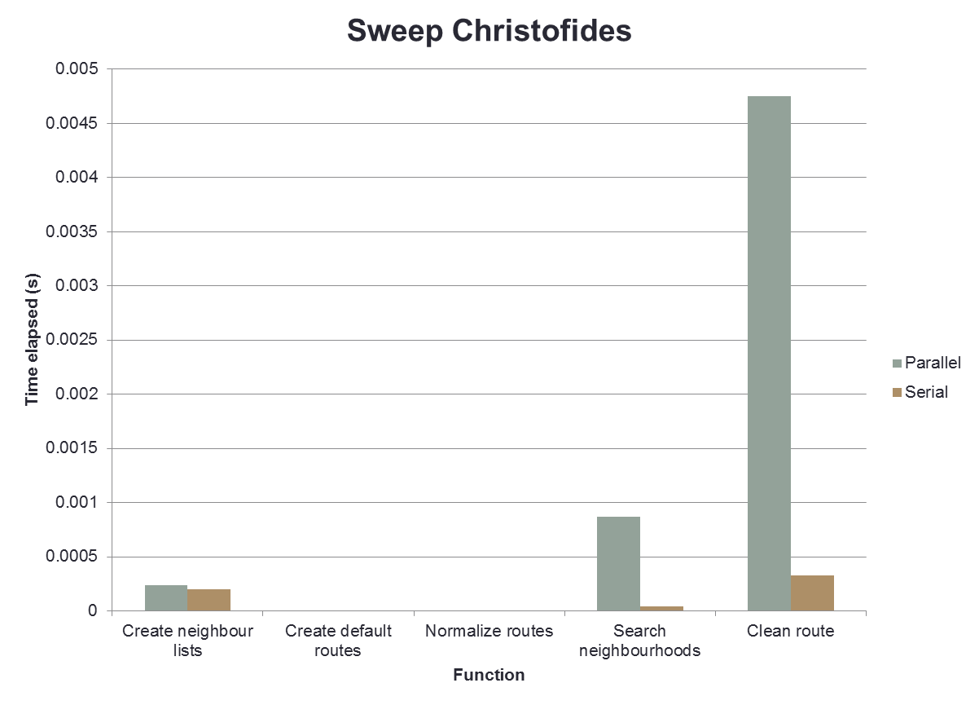
Preliminary Results

Slide 36
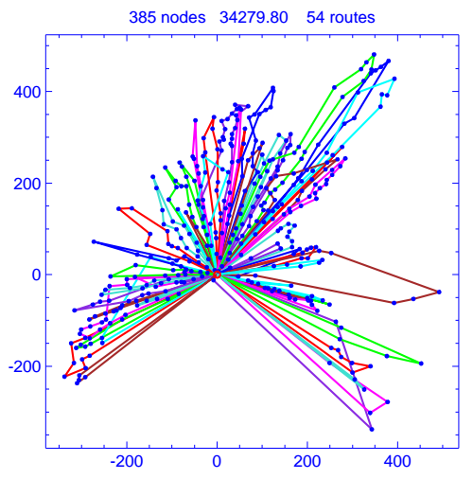
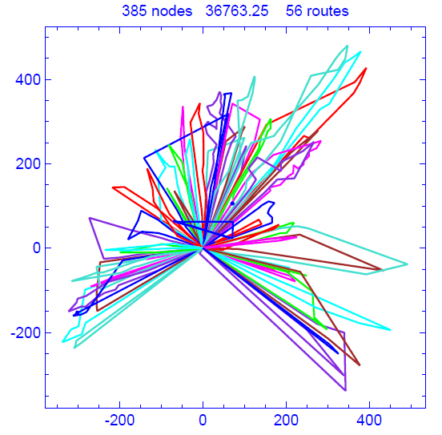
Preliminary Results – Sweep Taillard
Serial Parallel

Slide 37
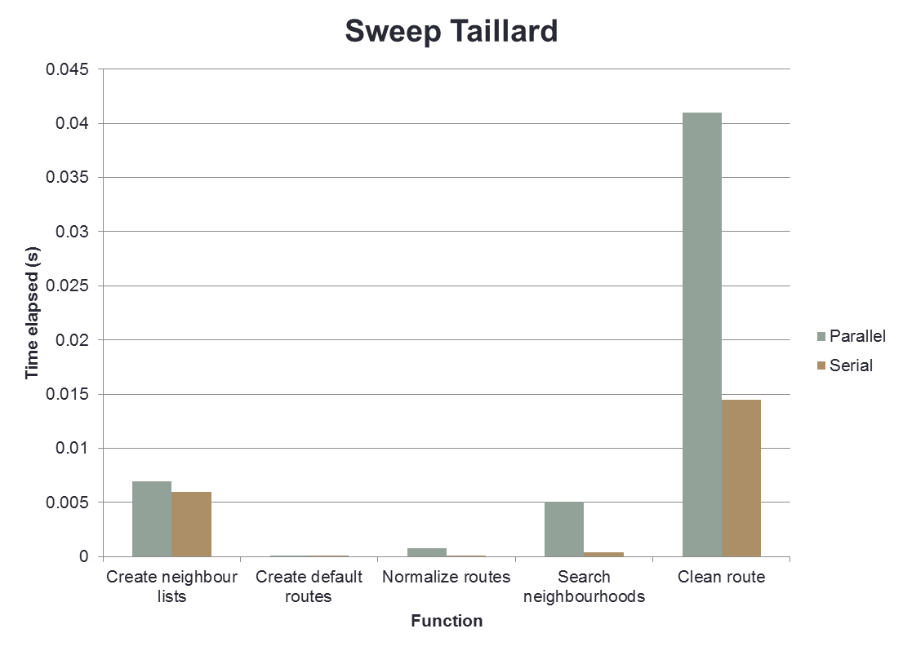
Preliminary Results

Slide 38
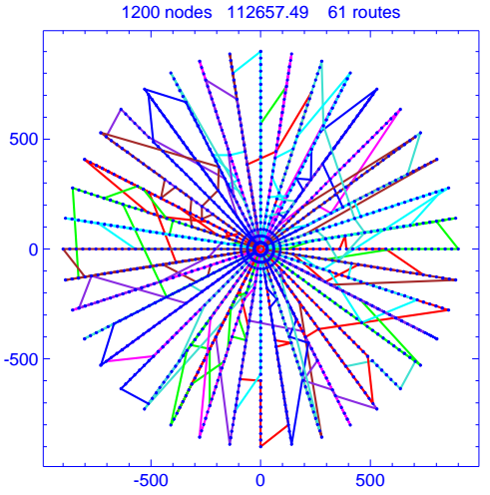
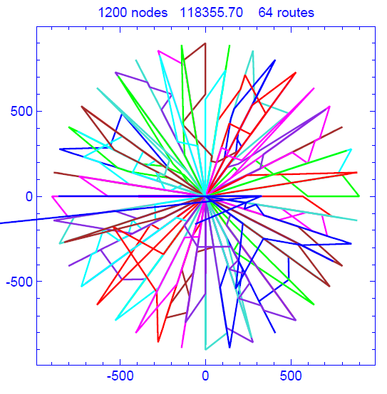
Preliminary Results – Sweep Li
Serial Parallel

Slide 39
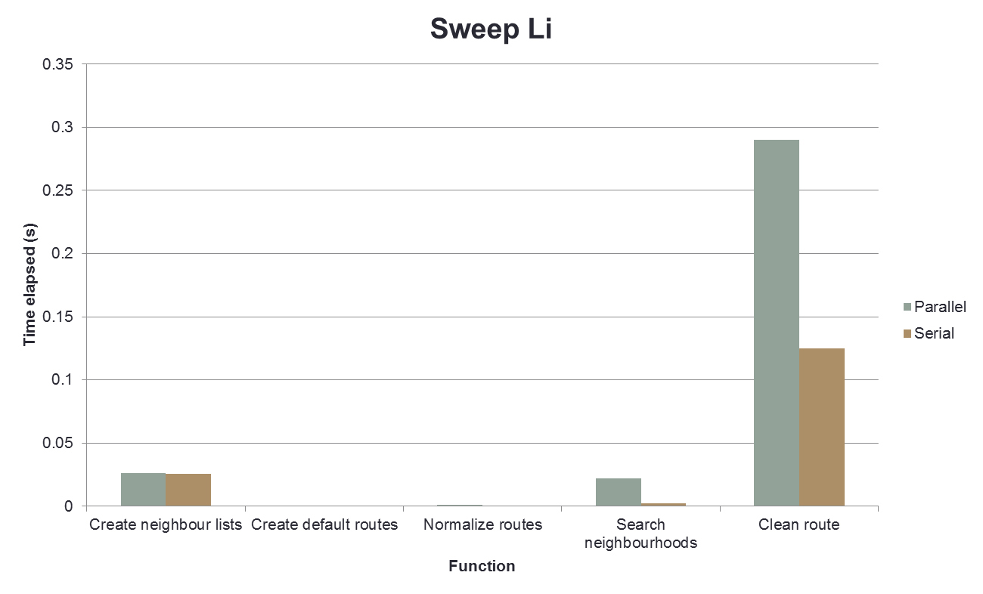
Preliminary Results

Slide 40
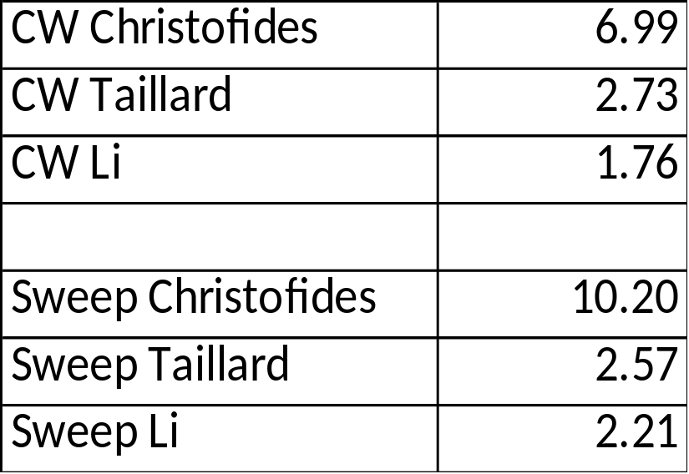
Preliminary Results – Summary
Serial performance vs Parallel performance:
Performance of parallel depends on many factors
  Algorithms
  Datasets
  Hardware

Slide 41
Future Work
Parallelize other algorithms
  VRP record-to-record, simulated annealing, ejection
Improve thread utilization/optimal solution tradeoff
Compare results for different size workloads of datasets
Compare serial and parallel results for real world data sets that are not VRP related
  Portfolio optimization
  Genomic mapping

Slide 42
Conclusions
Parallelized VRPH aiming to achieve speedups in performance
  Focused on Clarke-Wright, Sweep for initial solutions
  Modified logic to equally distribute workload among threads
Verified solution using 3 real-world data sets
  Observed difference between serial and parallel solutions in plplot
Measured performance by comparing time taken by serial and parallel implementations
  Parallel performance was 2x-10x slower

Slide 43
Q&A

