Slide 1
ECE 1373 Project Proposal
Convolutional Neural Networks for Speech and Image Recognition using FPGA’s
Proposed By:
Venkatesh.R.M,
Arjun Gandhi

Slide 2
Agenda
What are Neural Networks?
What are CNN’s?
Where are they used?
Why did we choose CNN’s?
How do we plan to implement?

Slide 3
What are Neural Networks ?
Information processing paradigm inspired by the way biological systems such as the brain process information.
Composed of large number of highly interconnected elements (neurons) working in unison to solve specific problems.
ANN’s (Artificial Neural Networks) can be configured for specific applications via learning processes.
Similar to adjusting synaptic connections in the brain.

Slide 4
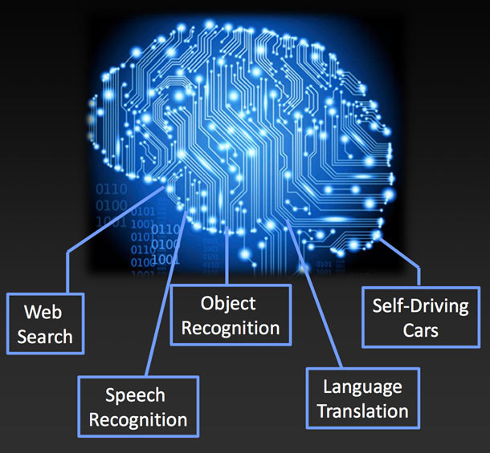
Largest ANN (created by Stanford and Google)

Slide 5
What are CNN’s?
Type of feed-forward artificial neural network where individual neurons are tiled so as to respond to overlapping regions in the visual field.
Inspired by biological processes.
Variations of multilayer perceptrons – designed to use minimal amounts of processing.
Widely used for image and video recognition.

Slide 6
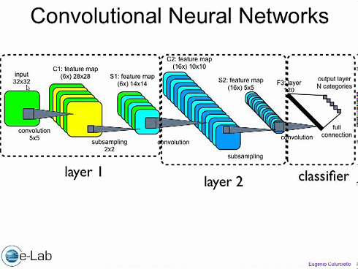
CNN used for artificial and robotic vision

Slide 7
Where are they used?
Image recognition
Video analysis
Natural Language Processing
Playing the computer game Go

Slide 8
Gesture recognition example
https://www.youtube.com/watch?v=2Mr7tyk6MzE

Slide 9
Why did we choose CNN’s?
Libraries present for CPU and GPU:
Caffe (C++) -> University of California at Berkerley
Torch7 (LuaJIT) -> Open collaboration (Facebook, Deepmind, Google)
Overfeat (C/C++) -> CILVR Lab at NYU
Cuda – convnet (C++/CUDA) -> Alex Krizhevsky
MatConvnet (Matlab) -> A. Vedaldi, K.Lenc
Theano (Python) -> Open collaboration, see http://deeplearning.net/tutorial/lenet.html
None of these target FPGA’s.
We hope to use accelerators to improve the results obtained with FPGA’s.

Slide 10
How do we plan to implement?
Implement algorithms in C++ using Caffe
Test with sample images
Test against MNIST and/or ILSVRC 2014
Implement with FPGA’’s
Synthesize and optimize RTL using directives
If proven to be efficient, do HLS
Measure performance on FPGA’s
Measure performance on CPU/GPU
Compare

