Slide 1
Convolutional Neural Networks
Arjun Gandhi, Mahmud Khalafalla, Venkatesh.R.M
April 02, 2015

Slide 2
Agenda
Layer architecture
Memory architecture
Roadmap

Slide 3
Layer architecture
7 layers in total
Layers defined on the basis of function performed
Different permutations used
Based on application requirements

Slide 4
Layer definitions
Convolutional – Set of filters used to identify characteristic features of input.
PCA (Principal Component Analysis) – Distill key features from amongst the many identified by the Convolutional layer for downstream processing.
Max Pooling – Identify the maximum for each feature set using a mask of specified size.
Local Response Normalization (LRN) – Normalize neurons across adjacent feature maps to inhibit their activity
Classifier – Identify various categories of features in the input image by grouping them into classes.
ConvMax – (to be filled)
Compression/decompression – compress/decompress features from PCA for efficient memory storage.

Slide 5
System-level diagram
CONV
PCA
MAXPOOL
LRN
CLASS
CONVMAX
OLD
COMPRESS
DECOMPRESS
NEW
MEMORY

Slide 6
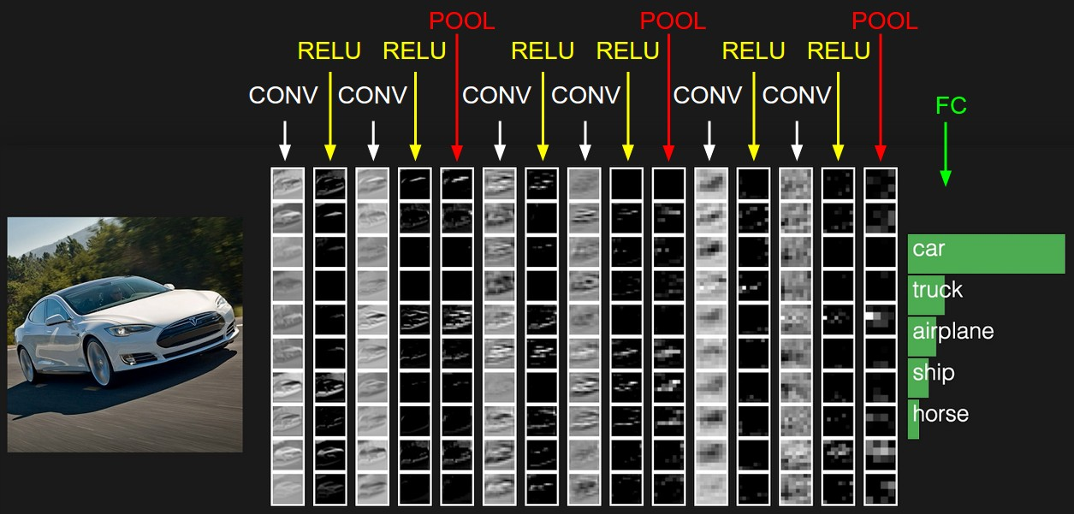
Example identification using ConvNet

Slide 7
Convolutional layer
Out(fo, x,y)= ∑∑∑w(fi,fo)*in(fi,x+kx,y+ky).
in(fi, x, y) – input at (x,y) in feature map fi.
w(fi,fo) – synaptic weight at kernel position (kx,ky).
Summation over all dimensions of filter and feature maps.
Weights determine impact of specific attributes.
Output is same size as input.

Slide 8
PCA layer
variance(PX)=P*variance(X)*Pinverse.
Used to measure covariance of P w.r.t X.
uses an orthogonal transformation to convert a set of observations of possibly correlated variables into a set of values of linearly uncorrelated variables called principal components.
Output size <= input size.
Implementation in progress.

Slide 9
Max Pooling layer
Out(fo,x,y)= max(in(fi,x+kx,y+ky))
in(x+kx, y+ky) – input at (x,y) in feature map fi
Reduce input layer dimensionality, allowing for coarse-grain features to emerge.
Output size < input size.

Slide 10
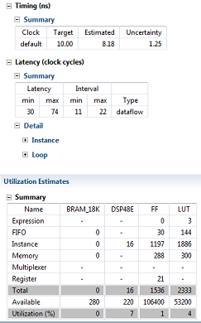
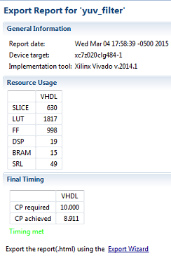
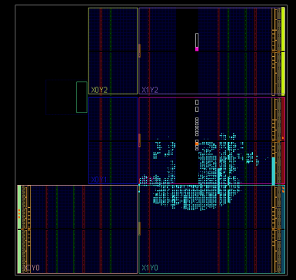
Results of initial implementation
Synthesis results
Implementation results
Placed design

Slide 11
Local Response Normalization
Out(fo,x,y)= in(fi,x,y)/(c+a*∑(activation(g,x,y)^2)^b)
in(fi,x,y) – input at (x,y) for feature map fi.
activation(g,x,y) activation value of input at (x,y) for feature map g.
g goes from min(0, f-k/2) to max(Nf-1, f+k/2).
f – feature map index.
k- number of adjacent feature maps.
Nf – total number of feature maps.
a, b, c constants.

Slide 12
Local Response Normalization (Cont.)
Activation function used to inhibit neuron response across adjacent layers
Five different types currently supported:
STEP - output 1 or 0 depending on greater/less than threshold value.
LINEAR COMBINATION – add a constant bias to data.
CONTINUOUS LOG SIGMOID – Perform sigmoid calculation on data.
CONTINUOUS TAN SIGMOID – Perform hyperbolic tangent calculation on data.
SOFTMAX – Normalize data to the range 0-1.

Slide 13
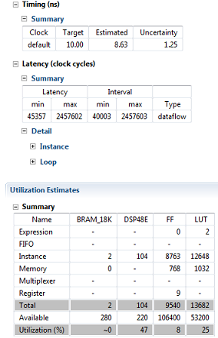
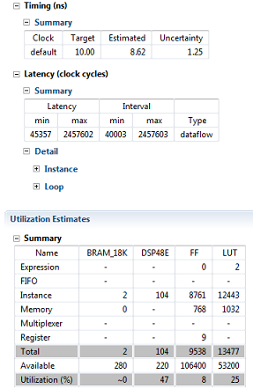
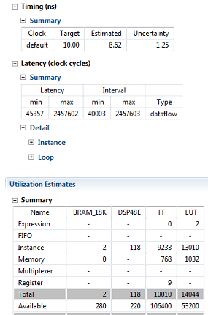
Results of initial implementation
STEP
LINEAR COMBINATION
CONTINUOUS LOG SIGMOID

Slide 14
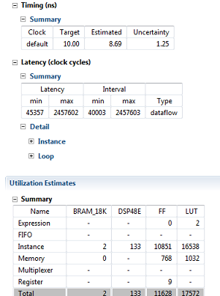
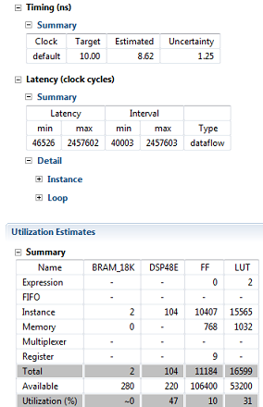
Results of initial implementation (Cont.)
CONTINUOUS TAN SIGMOID
SOFTMAX

Slide 15
Classifier
Out(fo,x,y) = t(∑w(fi,fo)*in(fi,x,y)).
w(fi,fo) – synaptic weight for feature maps (fi,fo)
in(fi,x,y) - input at (x,y) for feature map fi.
Summation over all input feature maps.
t is a transfer function that can be any one of the activation functions used in LRN.
Main purpose is to create feature classes.
Output size = input size.

Slide 16
Results of initial implementation

Slide 17
Compression
Input image size can be larger than size of input supported by hardware synthesized via HLS.
Needs to be broken down.
Subset of features extracted via PCA can still be larger than hardware input size.
Need to reduce memory bandwidth usage as well.
Data can be compressed before being stored in memory.
Various algorithms in current use:
FELICS
Goulomb-Rice with Differential-Differential Pulse Code Modulation
LOCO-I
LZSS
JPEG
Arithmetic
Huffman

Slide 18
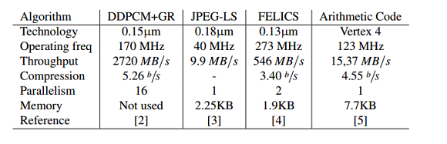
Comparison of compression algorithms from current research
Source: http://www.diva-portal.org/smash/get/diva2:651974/FULLTEXT01.pdf

Slide 19
Decompression
Needed to retrieve data after compression.
Possible encoding scheme (based on current research):
Prediction scheme based on LOCO-I to reduce correlative redundancy between sequential pixels
Data is encoded by Golomb coding.
The data packages after source coding contain a continuous stream of prefix codes, in order to eliminate the header data imposed by more advanced packing schemes.
Higher demand on the decoding side in terms of resource usage, because of the need for high parallelism when a new prefix code is counted and decoded each clock cycle
Faster decompression via parallel decoder modules – may reduce quality.
Work in progress.

Slide 20
Memory architecture
n port memory for parallelism.
Two major segmentations:
One part will be used to store image.
Second part will store the output of respective layers.
The controller decides which part will be the input part and which will be the output part depending on the application.
2 dimensional indexing via:
Type of units
Number of units of each type

Slide 21
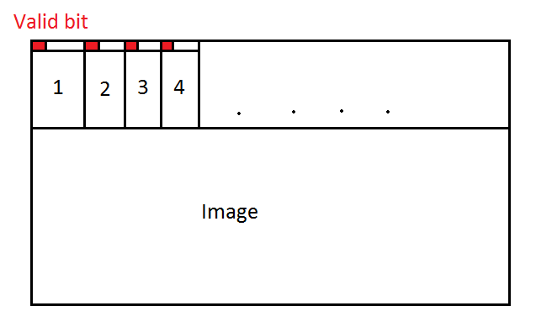
Memory segmentation

Slide 22
Handshaking
Handshaking will be simple.
Preceding layer sets a valid bit adjacent to the dedicated output memory when writing valid data.
On seeing the valid asserted, the succeeding layer samples data and clears the valid bit, performs the computation on the data and the same process is repeated for the next layer in line depending on the application.
No need for tagging as in TCP/IP – only need to clear one single bit.
Dedicated output memory is input for next layer.

Slide 23
Handshaking
Also, the de-assertion of the valid bit will let the previous layer know that it can write the next set of output values at that memory location.
After that it can go back to poll for a new input if available.
This takes care of generating the necessary backpressure.

Slide 24
Roadmap
Initial implementation of all modules – May 1, 2015
Integration – May 20 , 2015
Development of application framework – June 15, 2015
Testing with weights from Caffe – July 1, 2015
Presentation – July 30, 2015

