Slide 1
Droid Nurse v1.0
ANDROID Application
With
MONGO DB
http://youtu.be/EoB7u0FhiLQ
AUTHOR:
VENKATESH BALASUBRAMANIAN
SANDEEP RAMAMOORTHY
AUG - 2014

Slide 2
DROID NURSE
Objective:
The main objective of this project is to create an interactive mobile application(Android) that collects user’s prescriptions and health metrics to provide him/her with an overview of the medications consumed, status of the prescriptions, online prescription refill, track expenses, search for physician details and drugs thereby taking a step ahead in simplifying daily tasks.

Slide 3




TOOLS USED
Platform
IDE Android Studio (Beta 0.82)
Language Java
Storage
Host (Single Node Development)
Cloud Provider Amazon Web Services / Google Cloud Platform
Source Code Location
https://github.com/venkatesh891/CS5200

Slide 4
SYSTEM FEATURES
Ability to refill medications with Walgreens API
Generate expense report on the total health expenses of the user
Notification alerts for the medication that needs to be taken by the user
Facilitates the end user with the visual image of the pills to avoid confusion when there is more than one medication to be taken
Facilitates the end user to input and track various metrics like blood pressure, blood glucose level, weight etc.
Provides various information about doctors, physicians and health insurance plans based on the user queries
Provides the end user to locate near by hospitals and pharmacies in real time based on his geo location

Slide 5
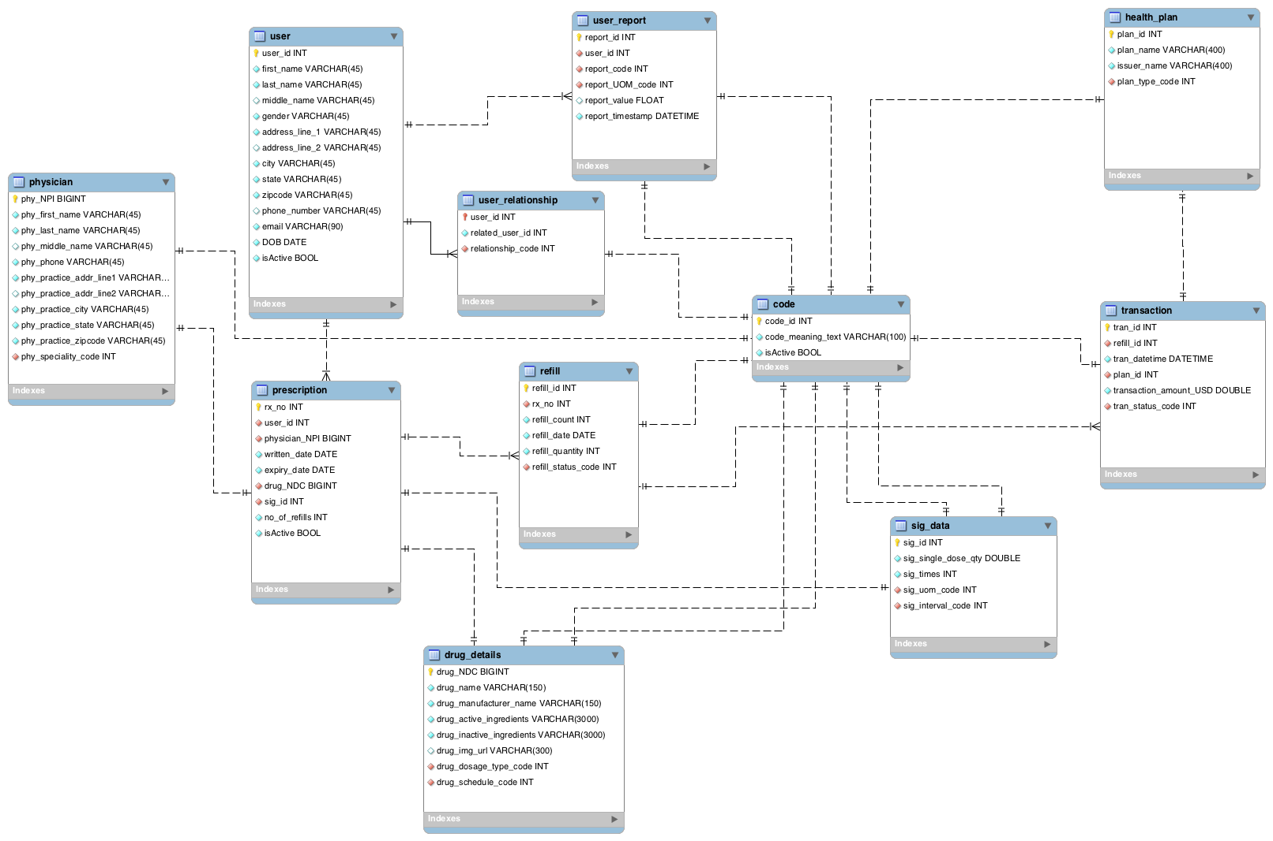
Database Diagram

Slide 6
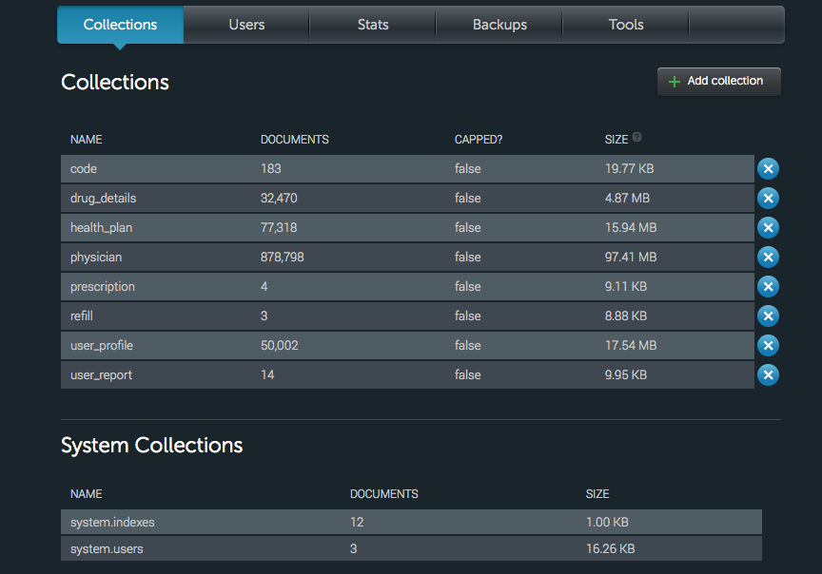
MongoDB Collections

Slide 7
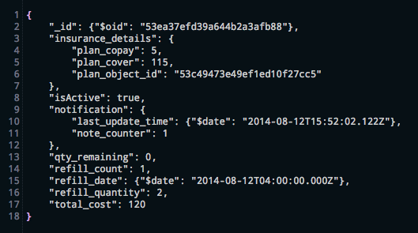
MongoDB Documents

Slide 8
API’s Consumed
API | USE | REFERENCES
Walgreen’s Prescription API | Allows the user to refill prescription online at Walgreen pharmacy | Walgreens API Documentation
PillBox API | Provide details about various drugs along with images | PillBox API Documentation
Socrata Physician API | Provide details about registered physician within United States | Socrata Physician API
Socrata Health Plan API | Provide details about health insurance plans for the states that are participating in the Federal Health Insurance Market Place | Socrata Health Plan API
Google Maps API | 3D rendering of Google Maps with customized markers and location service | Google Maps API Android
Google Places API | Provides information about places with geographic locations | Google Places API

Slide 9
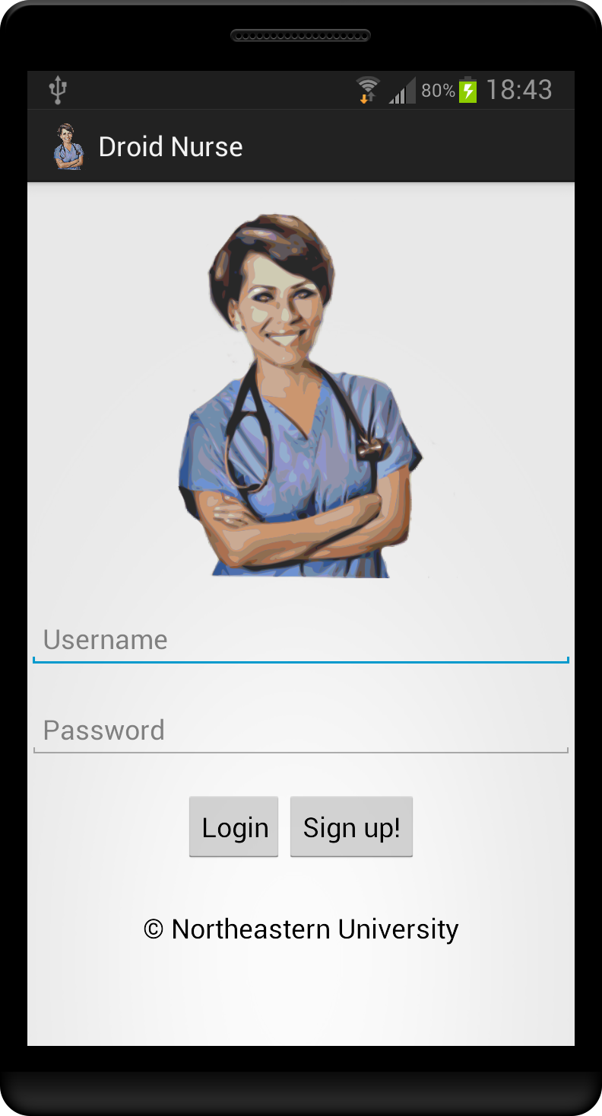
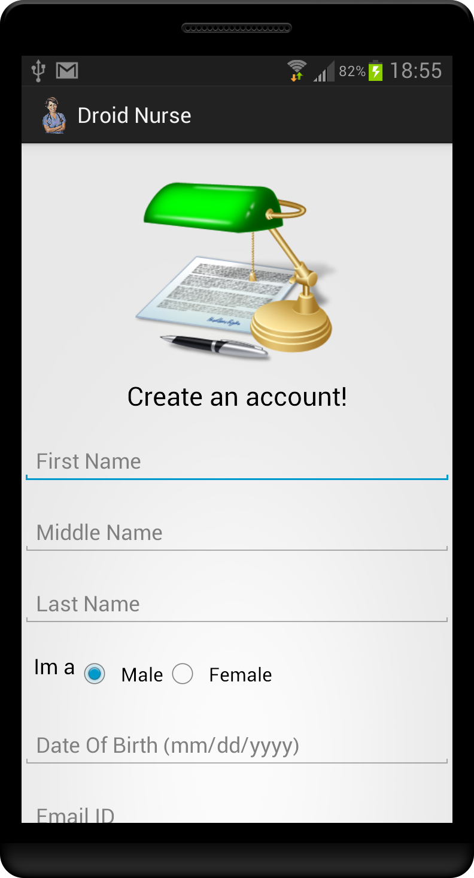
Login & Sign Up

Slide 10
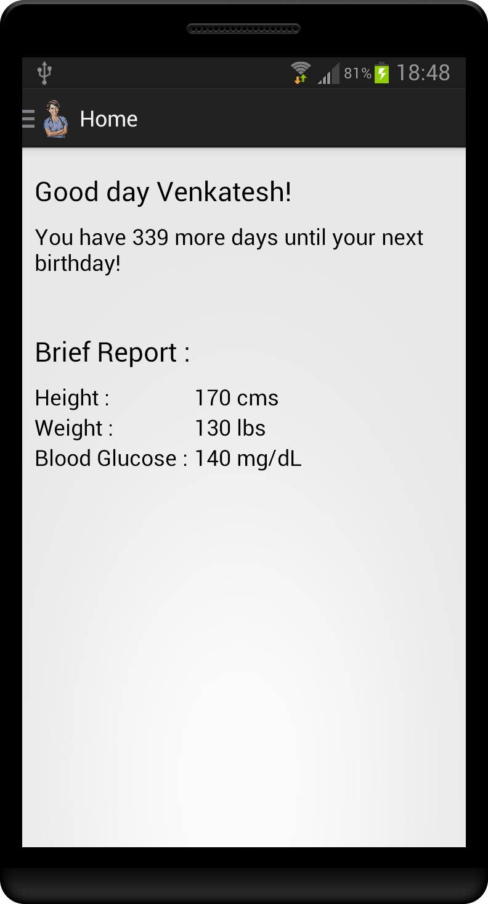
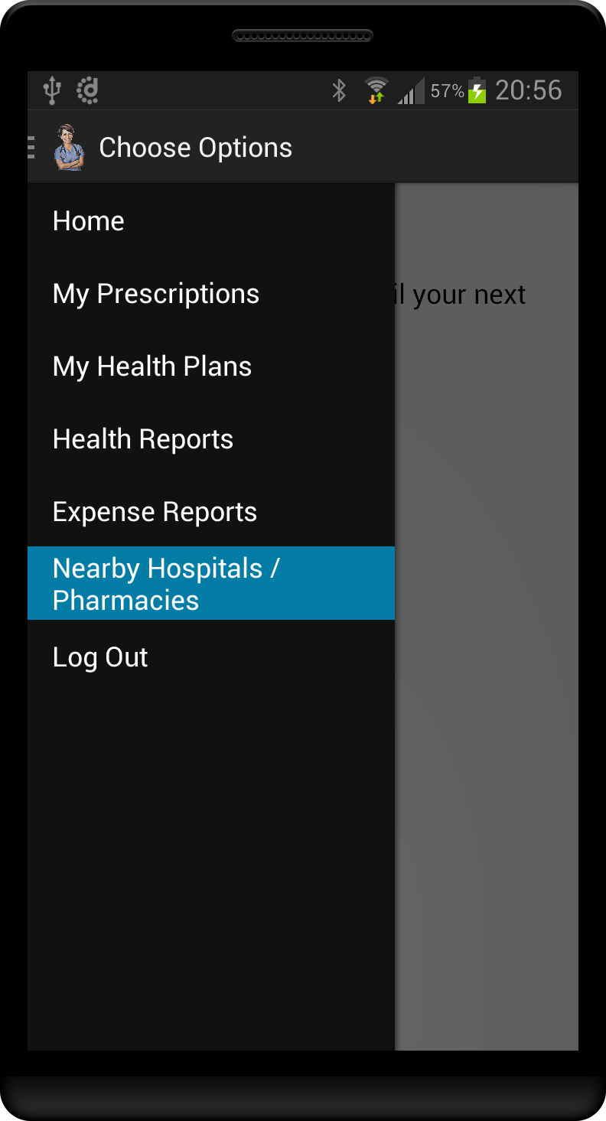
Home Screen & Menu Options

Slide 11
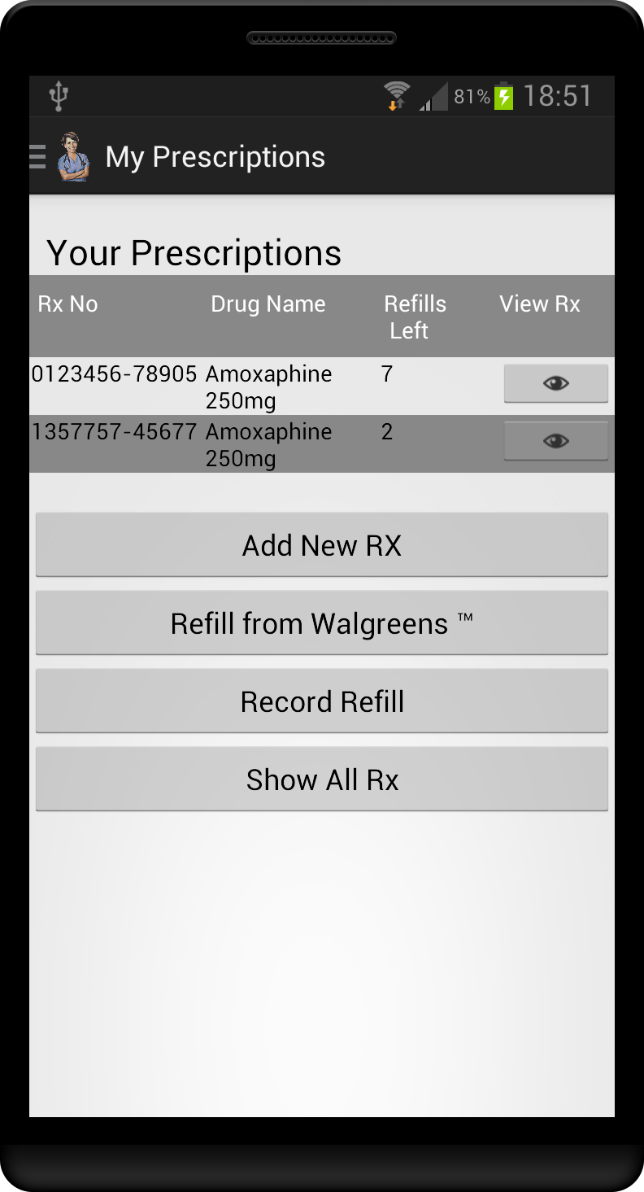
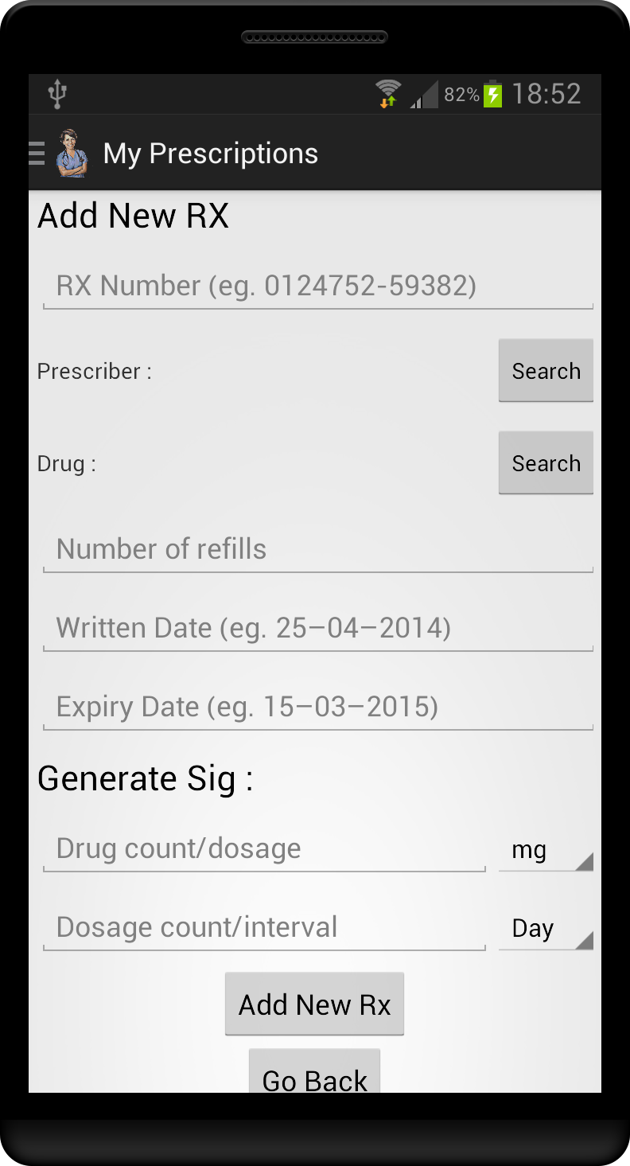
My Prescription & AddRX

Slide 12
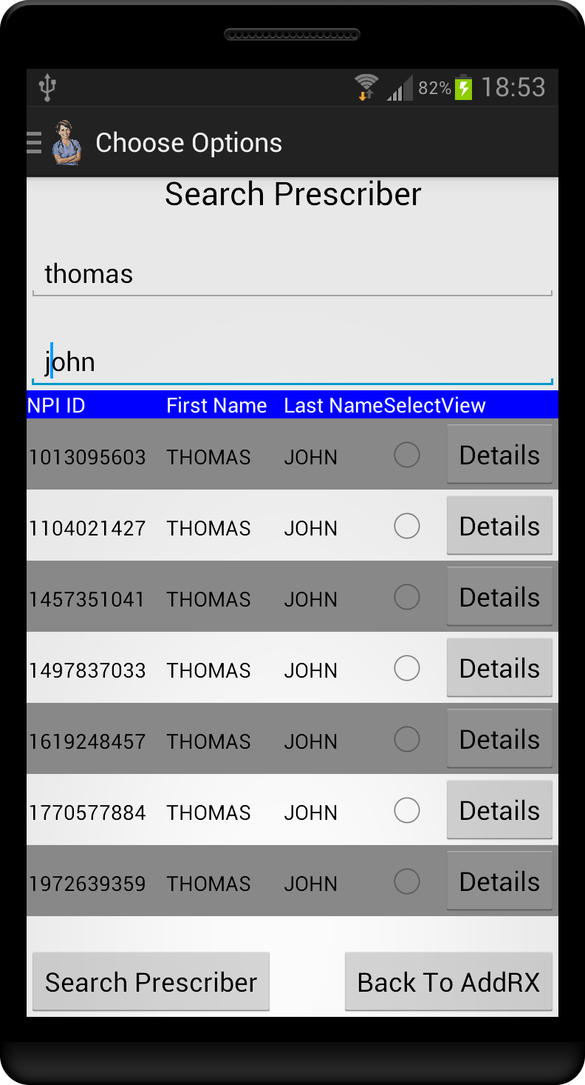
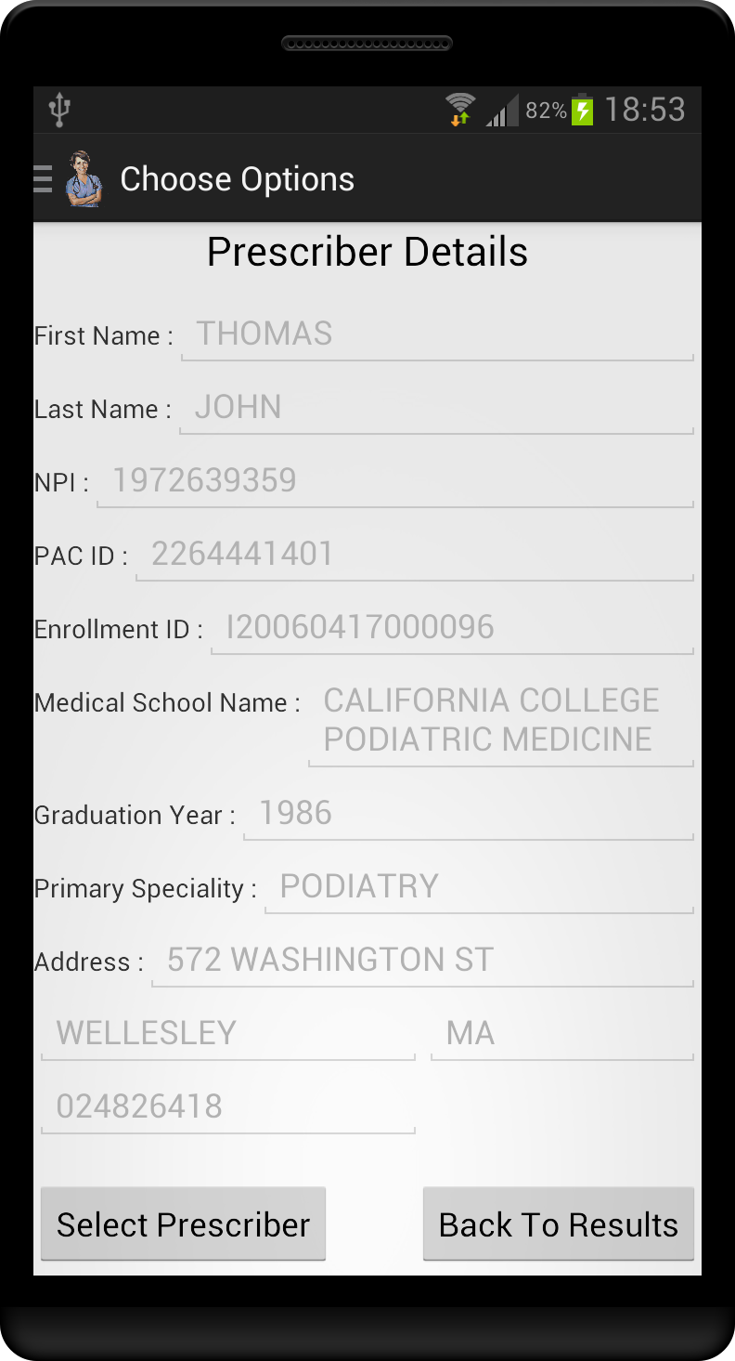
Search Prescriber & Prescriber Details

Slide 13
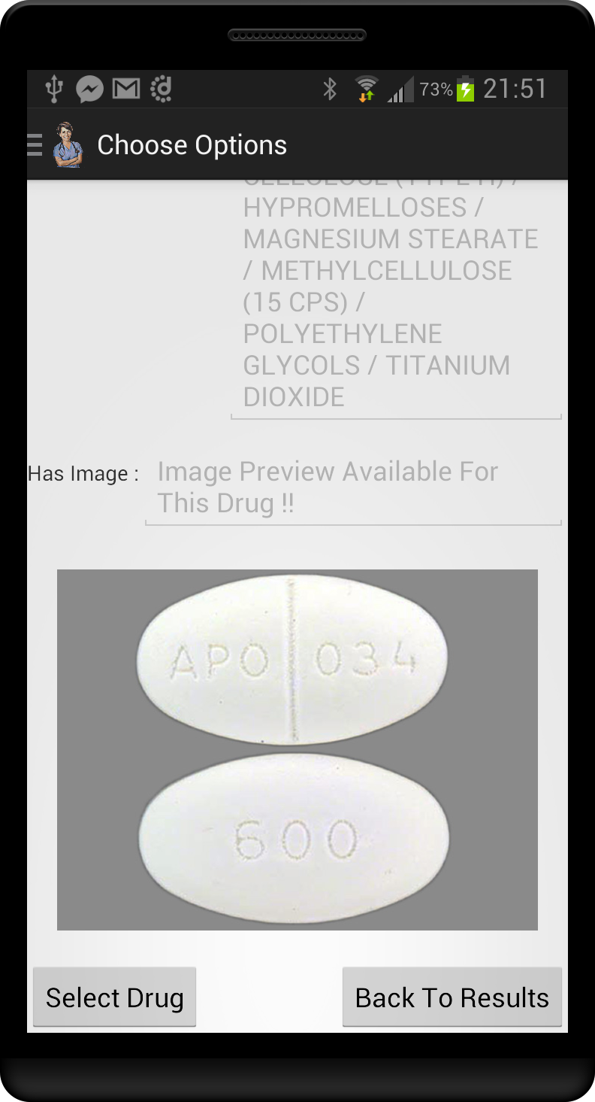
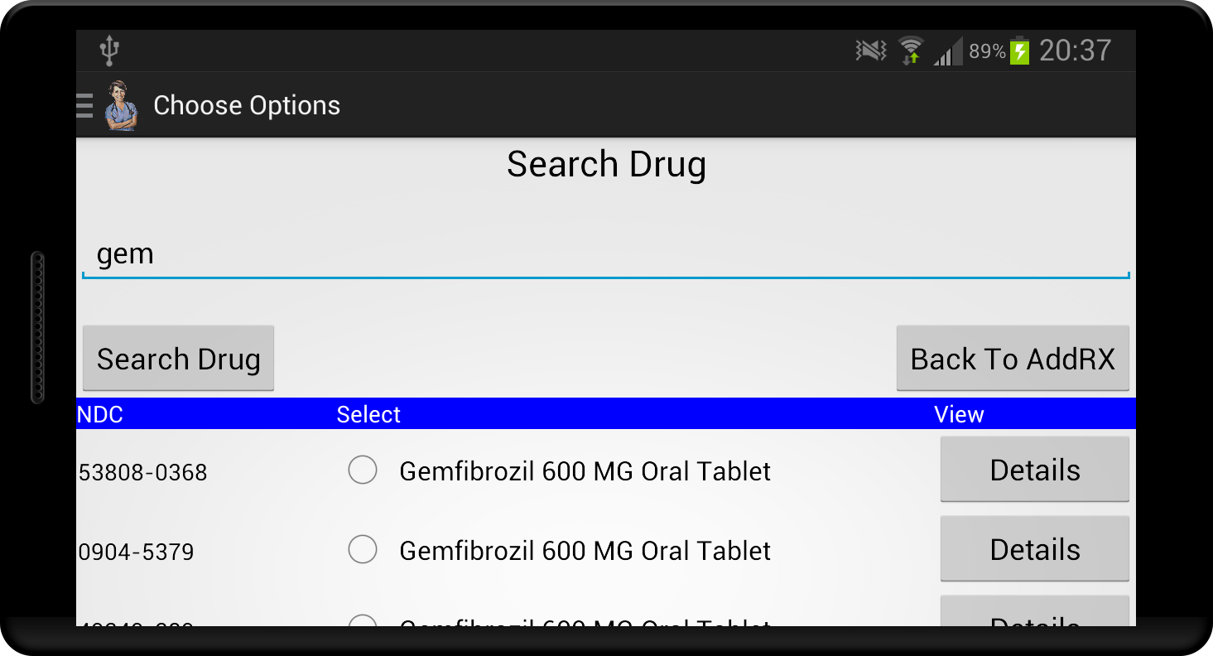
Search Drug & Drug Details

Slide 14
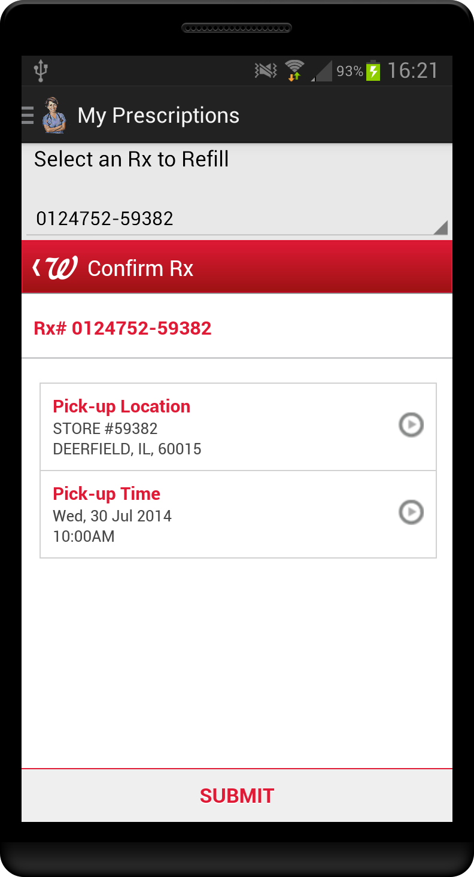
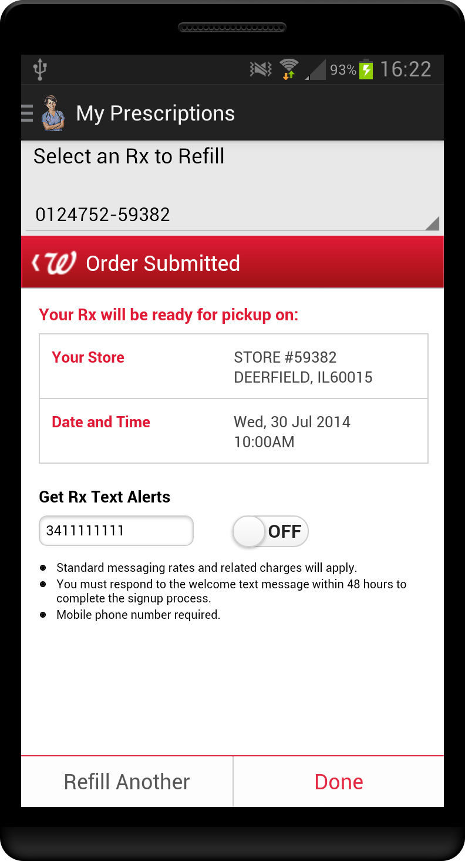
Prescription Refill – Walgreens API

Slide 15
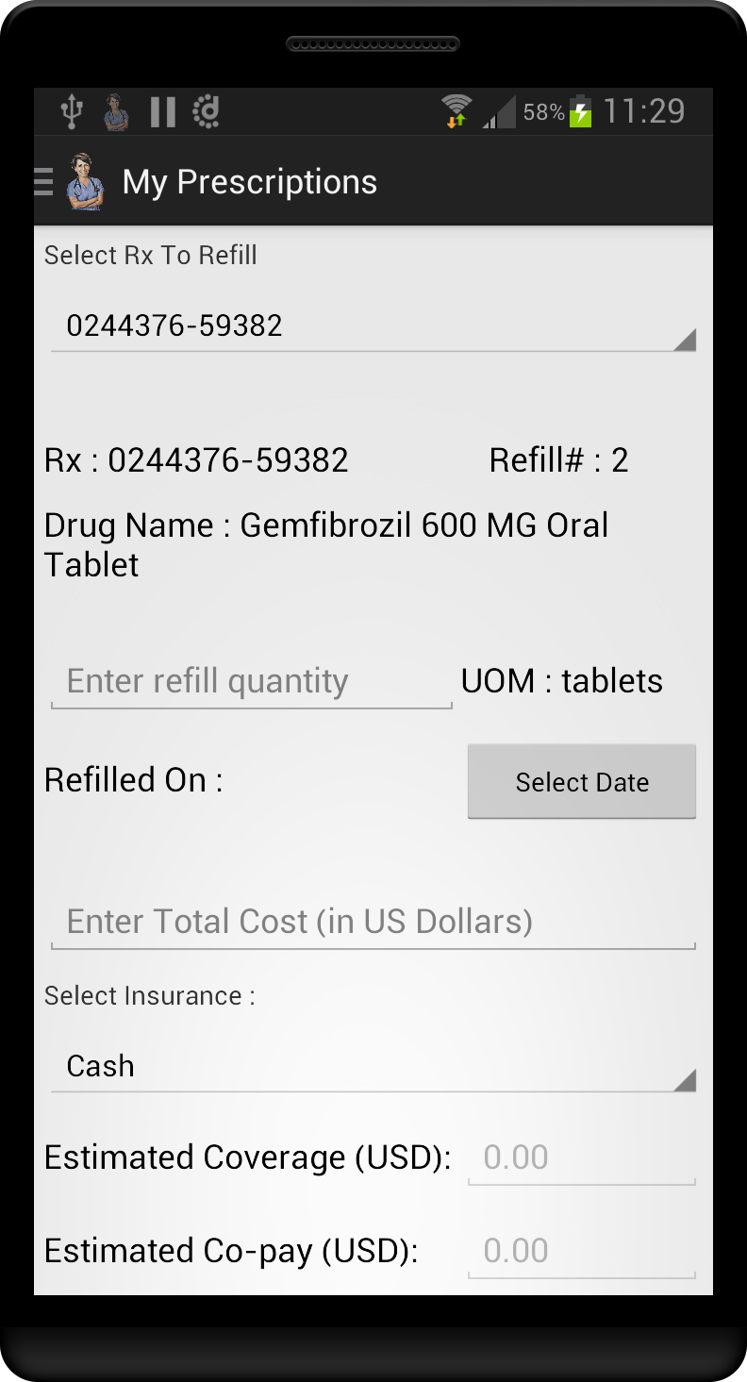
Record Refill

Slide 16
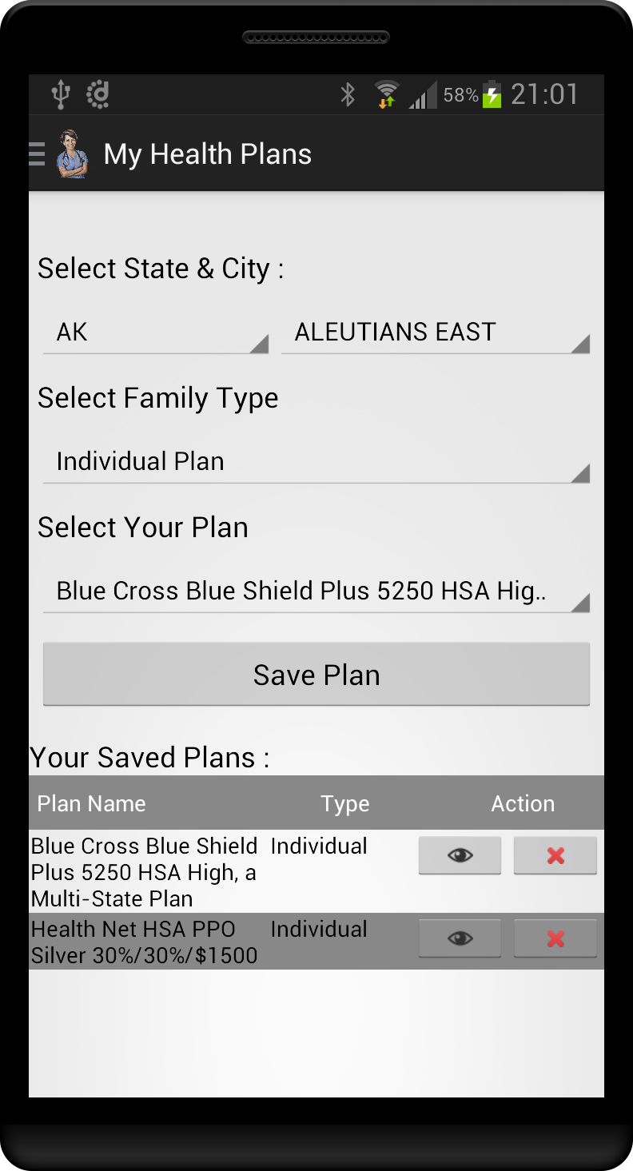
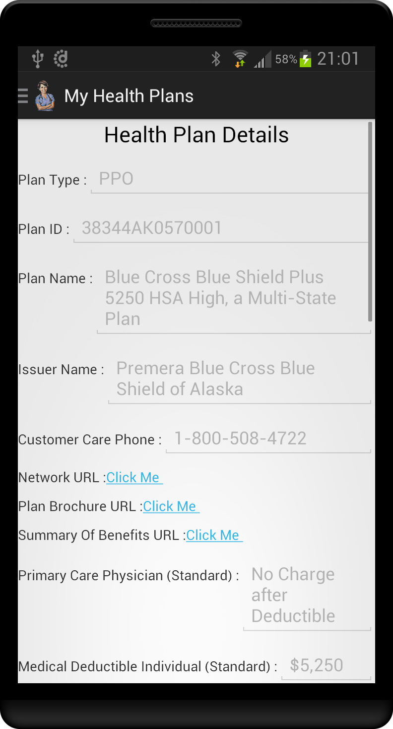
Health Plan & Plan Details

Slide 17
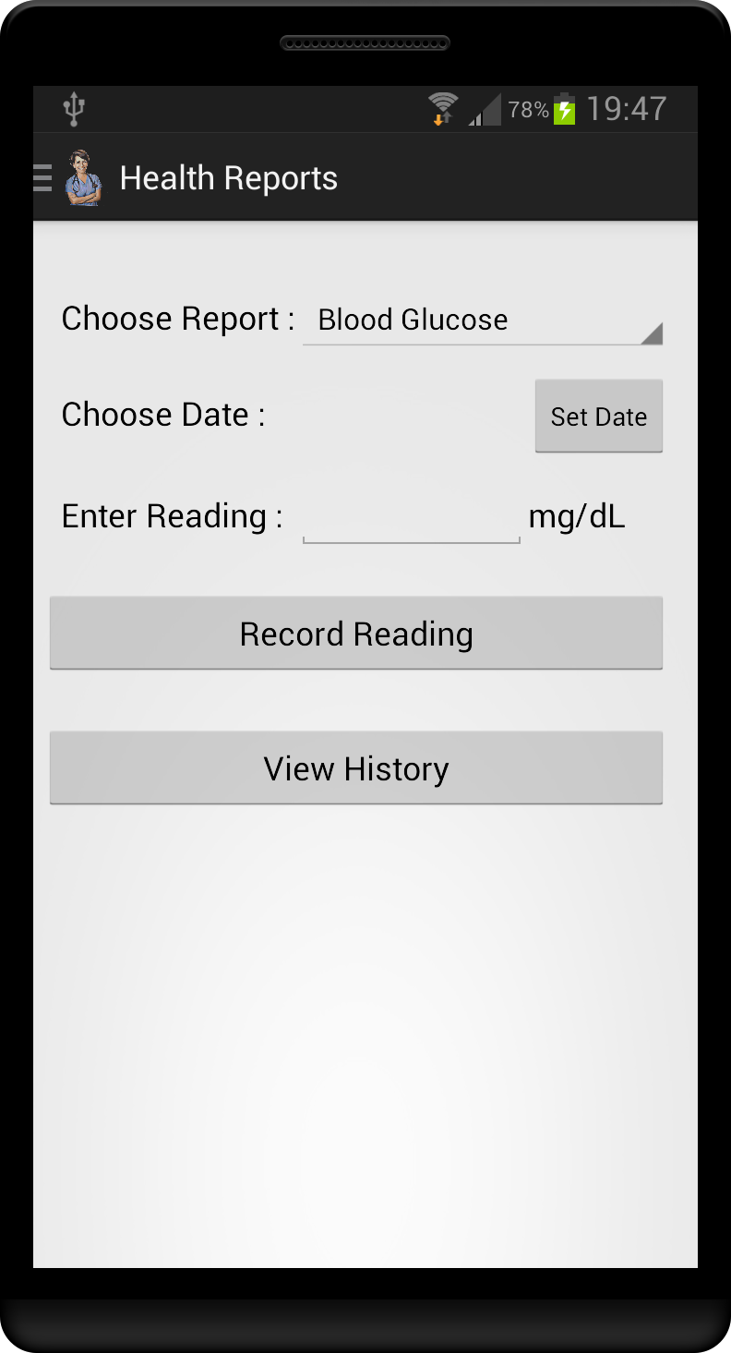
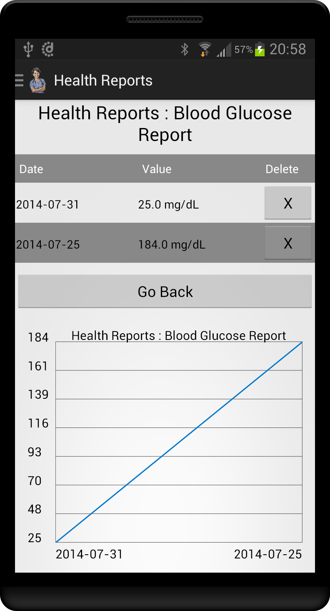
Health Reports

Slide 18
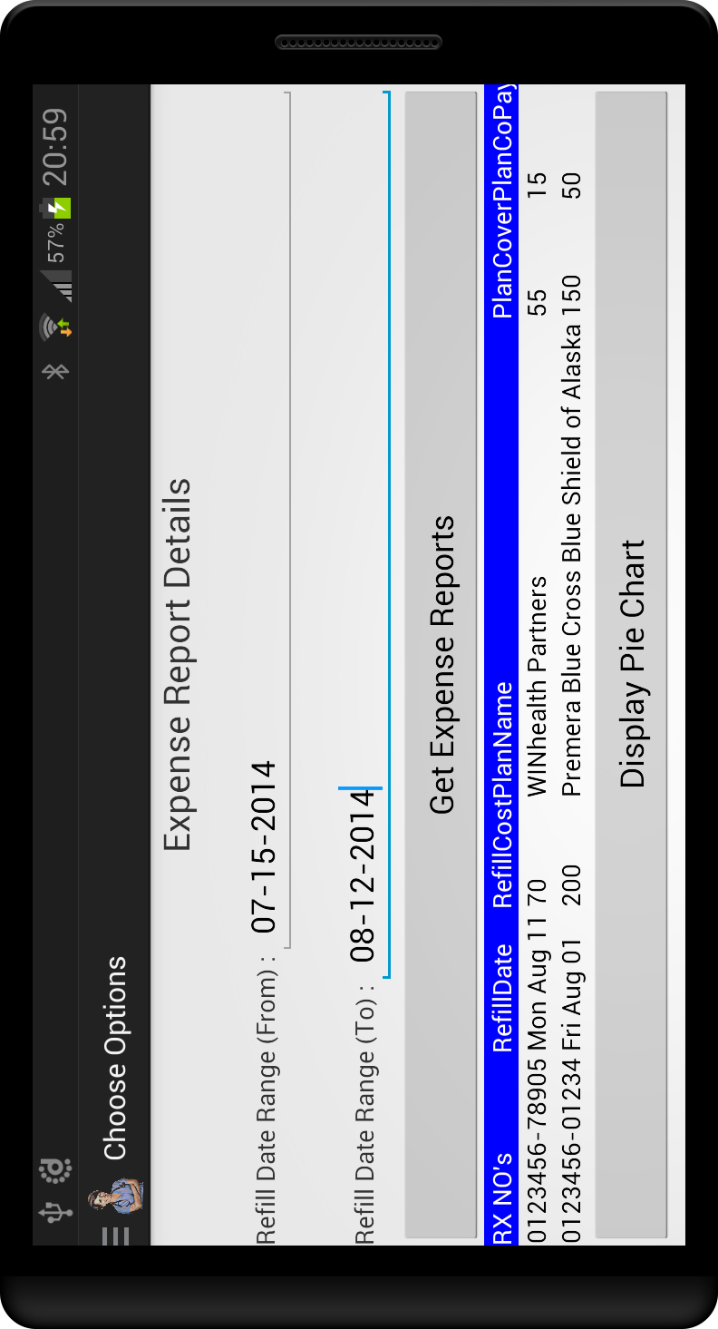
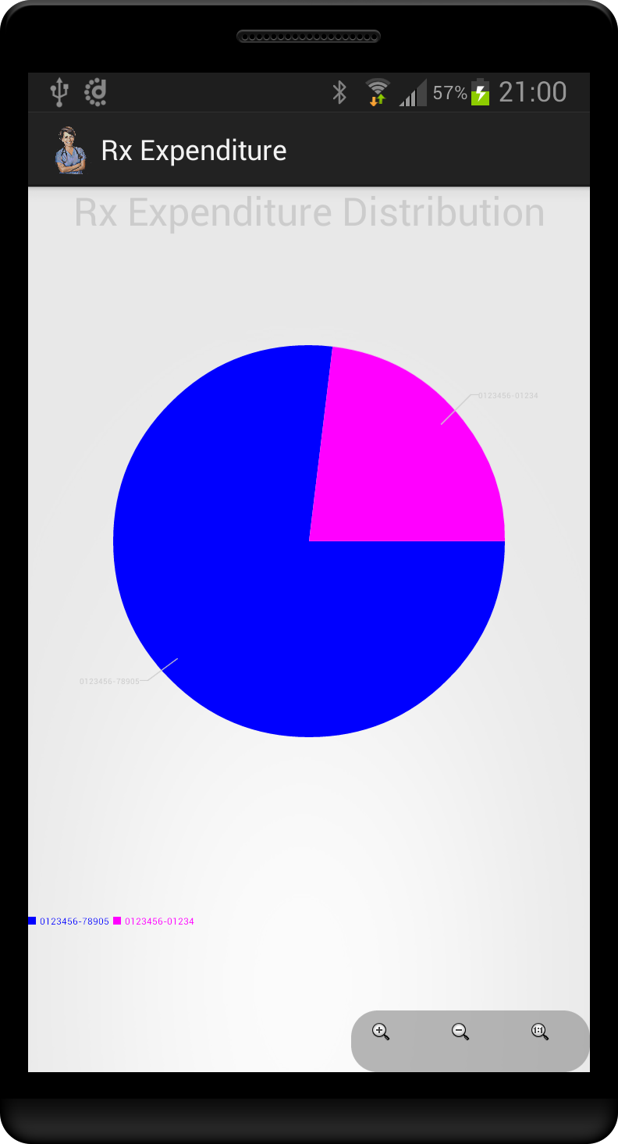
Expense Reports

Slide 19
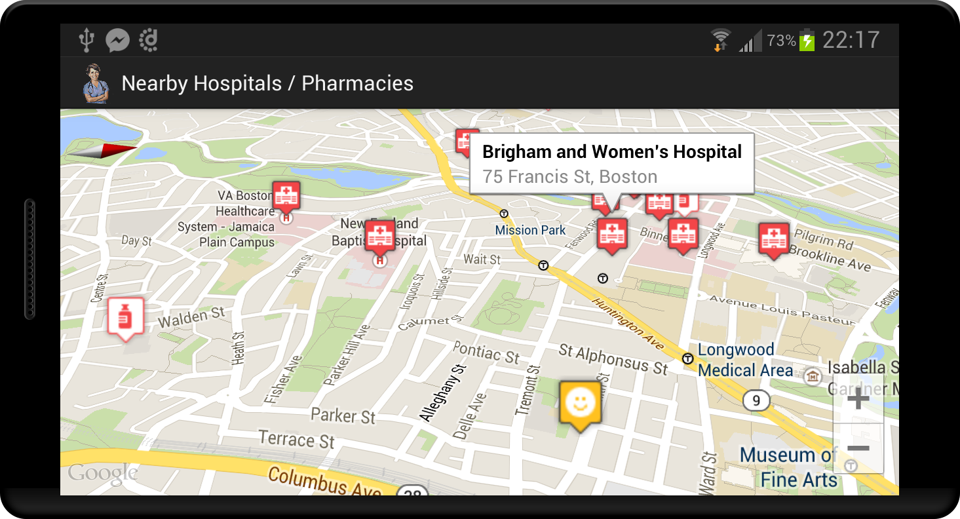
Nearby Hospitals / Pharmacies

Slide 20
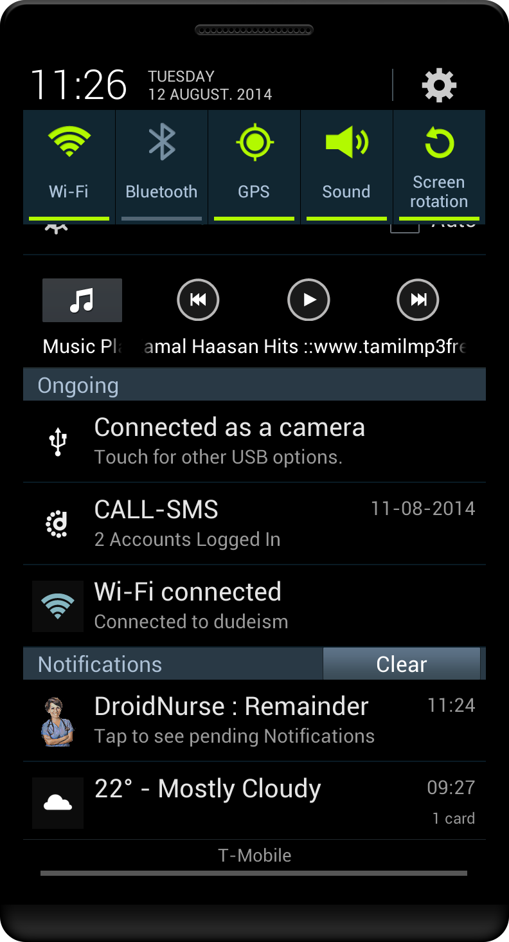
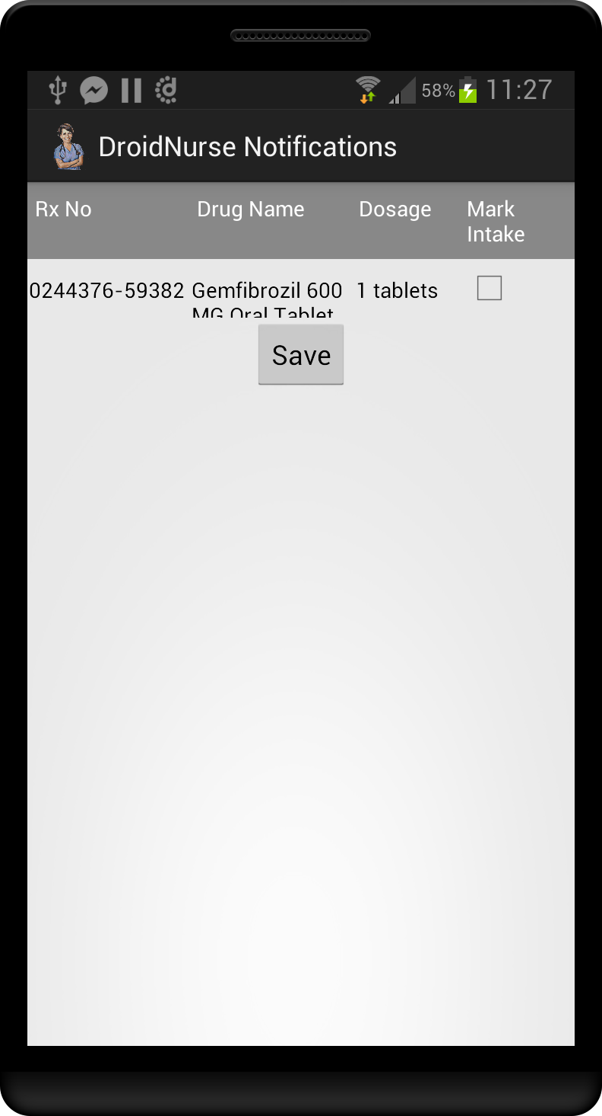
Notifications

Slide 21
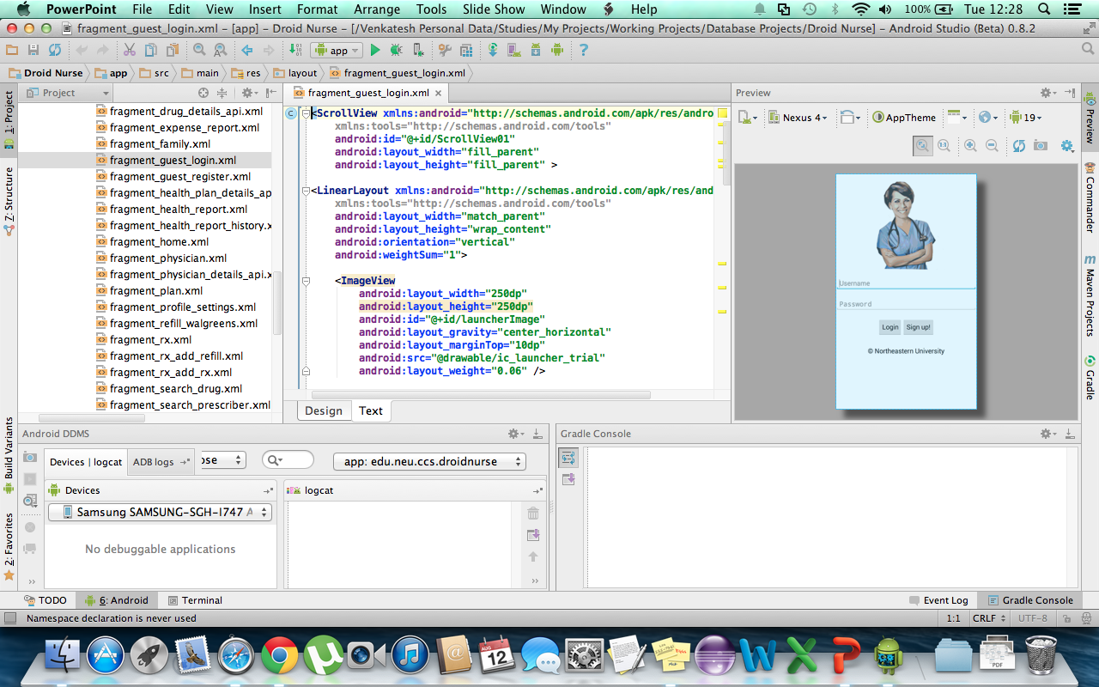
Android Studio IDE

Slide 22
Future Scope
Reminds the user of any appointments or periodical health check ups.
Ability to add nearby/regular physicians, health plans and Walgreens pharmacies to the user profile
Ability to add family members to monitor their health and medication status

Slide 23
Challenges Faced
Quick ramp up over the Android platform
Gathering over million records in the database
Integrating the Walgreens API prescription refill
Rendering huge volumes of data in the front end
Gaining knowledge over the pharmaceutical domain and its regulations

Slide 24
Lessons Learnt
Transition from traditional RDBMS to NoSQL (Mongo DB)
How to design Android applications
How to retrieve data from various API
Migrated from Eclipse IDE to Android Studio IDE
Generating signed APK using Android KeyStore

Slide 25
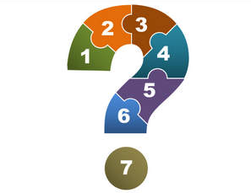
Queries
Thanks,
Venkatesh Balasubramanian
Sandeep Ramamoorthy

