Slide 1
MBTA-T-TIMINGS
WEB APPLICATION
http://net4.ccs.neu.edu/home/venkat89/
https://www.youtube.com/watch?v=pHv-T4BL34Y
AUTHOR:
VENKATESH BALASUBRAMANIAN
APRIL - 2014

Slide 2
MBTA-T-TIMINGS
Objective:
The objective of this web development project is to design a website, enabling the end user to enter the boarding and destination place to obtain the schedule for next available train. MBTA-realtime RESTful web service is consumed to fetch the live data and is then processed with logics to extract the required train timings.

Slide 3
TOOLS USED
Technology HTML-5, CSS-3, Javascript, jQuery, ASP .NET
IDE Microsoft Visual Studio 2012 Ultimate Edition
Language C#
Storage MS SQL Server 2008

Slide 4
SYSTEM FEATURES
Green-Line Train Search: User has the ability to search for next available train timings in the Green-Line for all the routes (B, C, D & E) with both Inbound & Outbound directions.
Orange-Line Train Search: User has the ability to search for next available train timings in the Orange-Line for both Inbound & Outbound directions.
Red-Line Train Search: User has the ability to search for next available train timings in the Red-Line with both Inbound & Outbound directions.
Blue-Line Train Search: User has the ability to search for next available train timings in the Blue-Line with both Inbound & Outbound directions.
Google-Maps Integration: User has the ability to view the train routes in google maps based on boarding and destination stops. The latitude and longitude of the corresponding stops are identified and then it is plotted over google maps with colored markers.
Nearby-Stop: The Nearby-Stop locator, assists the end user to identify which MBTA-T stop is in proximity. Inorder to leverage the user interaction, the places are marked in google maps with colored markers.
_x0013_

Slide 5
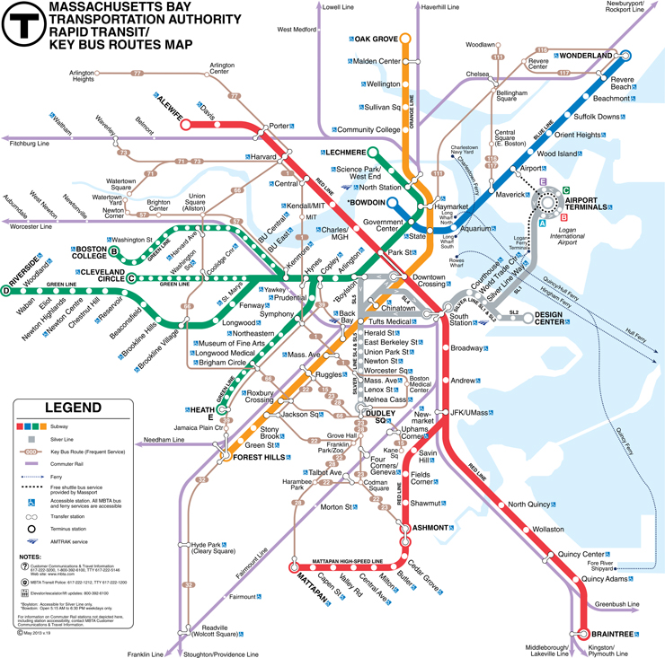
MBTA T-MAP

Slide 6
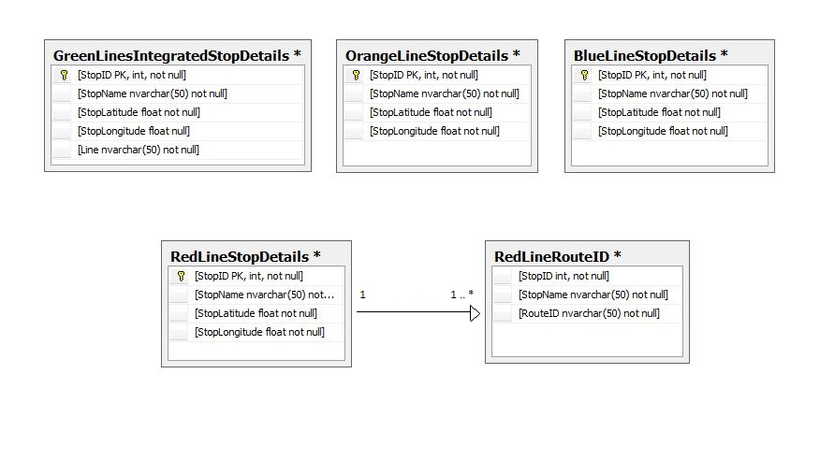
Class Diagram

Slide 7
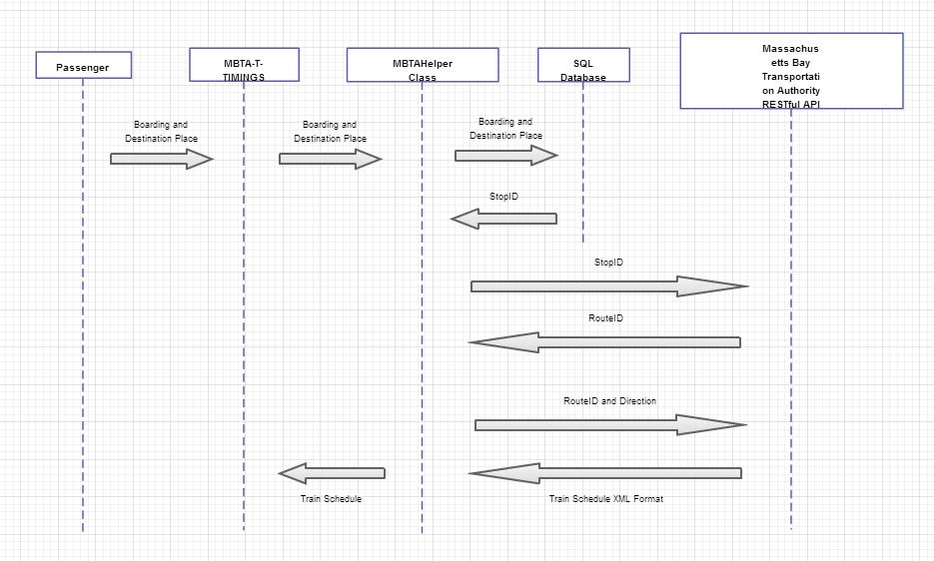
SEQUENCE DIAGRAM

Slide 8
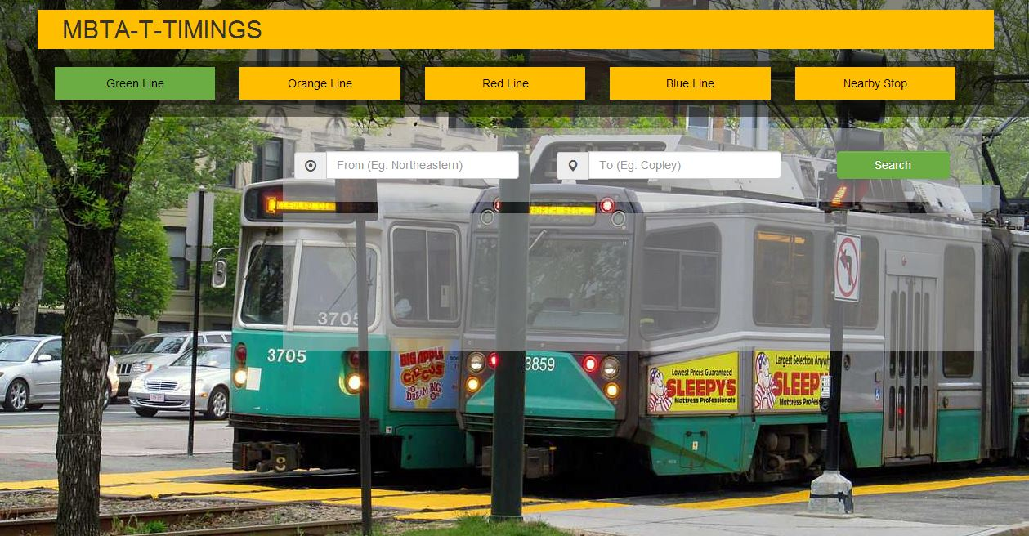
SCREENSHOT

Slide 9
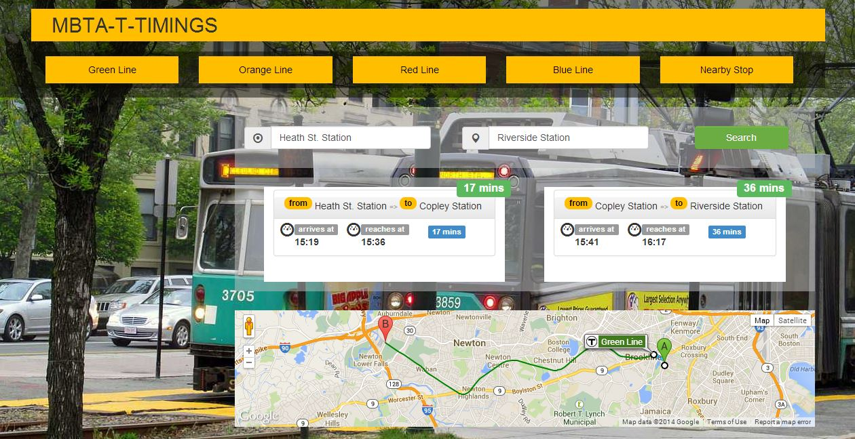
SCREENSHOT

Slide 10
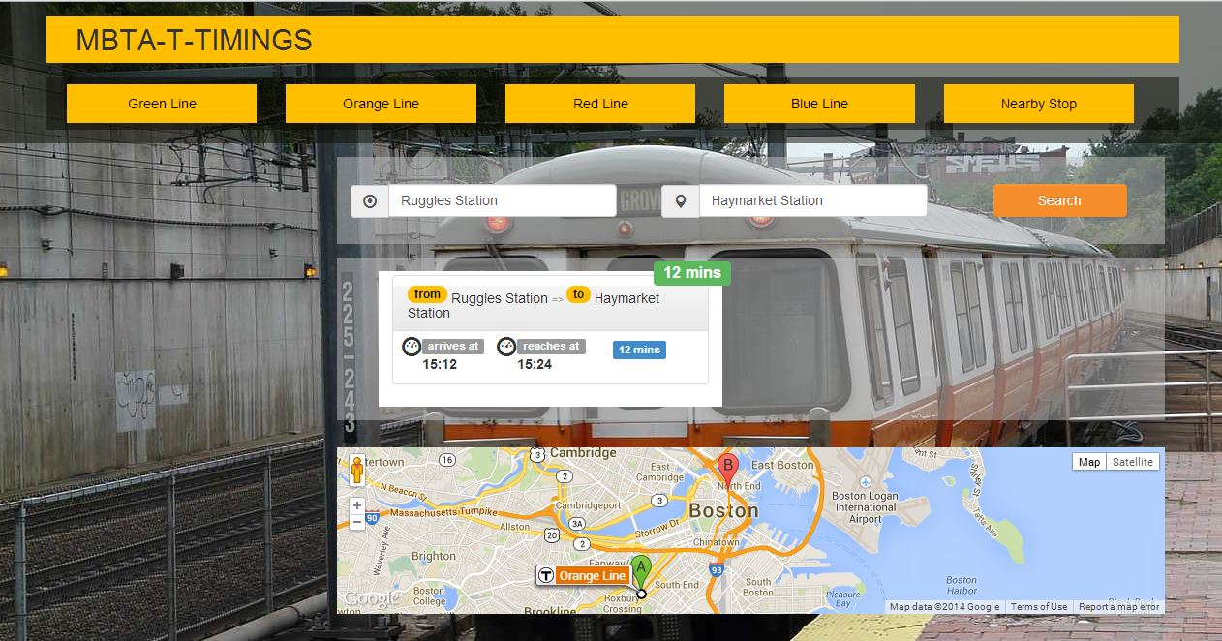
SCREENSHOT

Slide 11
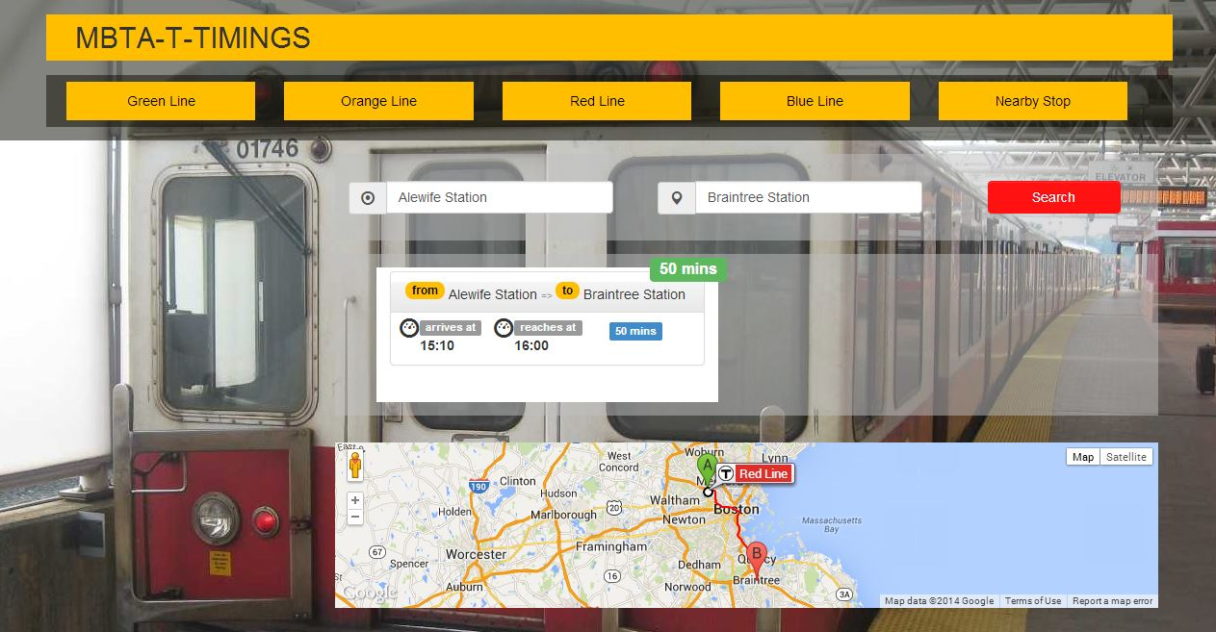
SCREENSHOT

Slide 12
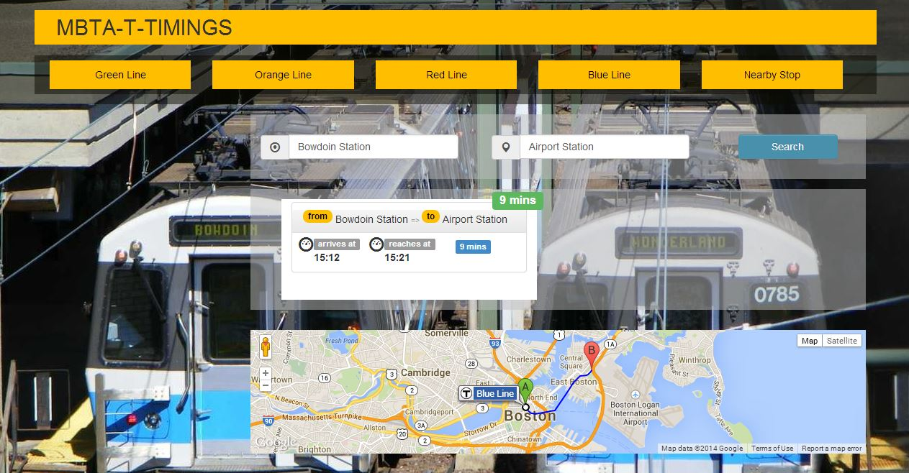
SCREENSHOT

Slide 13
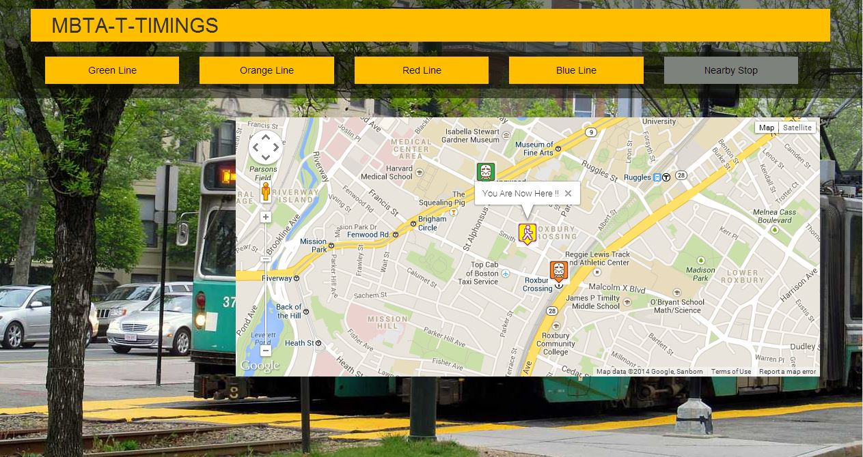
SCREENSHOT

