Slide 1
Welcome to the machine learning project
Created by Venkatesh gorla

Slide 2
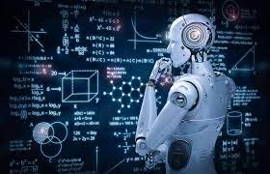
Agenda
.Introduction to Machine Learning
.What are the python modules used in this project
.Speech Recognition
.Conclusion To The project

Slide 3
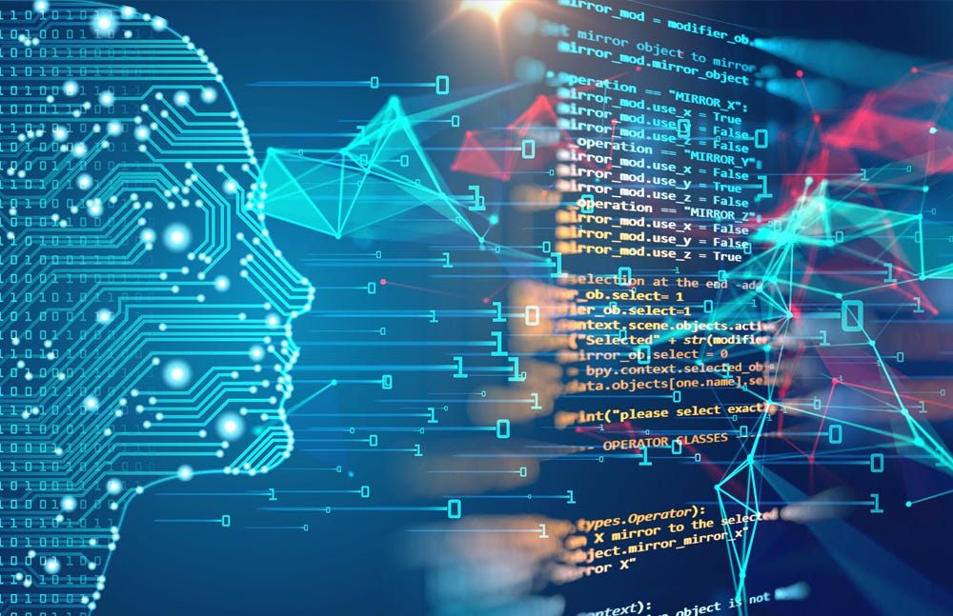
Machine learning introduction
Machine learning (ML) is a branch of artificial intelligence (AI) that enables computers to “self-learn” from training data and improve over time, without being explicitly programmed. Machine learning algorithms are able to detect patterns in data and learn from them, in order to make their own predictions.

Slide 4
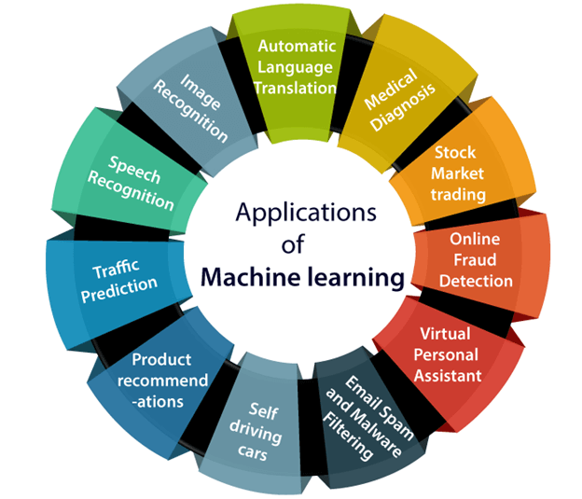
Applications of machine learning
1.Image Recognition
2.Speech Recognition
3.Traffic Prediction
4.Product Recommendations
5.Self Driving Cars
6.Email Span and Malware Filtering
7.Virtual Personal Assistant
8.Online Fraud Detection
9.Stack Market Trading
10.Medical Diagnosis

Slide 5

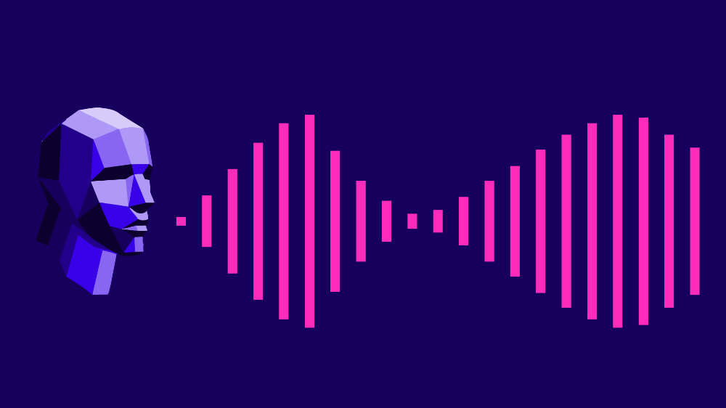
Python modules used in this project
Python modules
Pipwin module
Speech Recognizer module
Matplotlib module

Slide 6

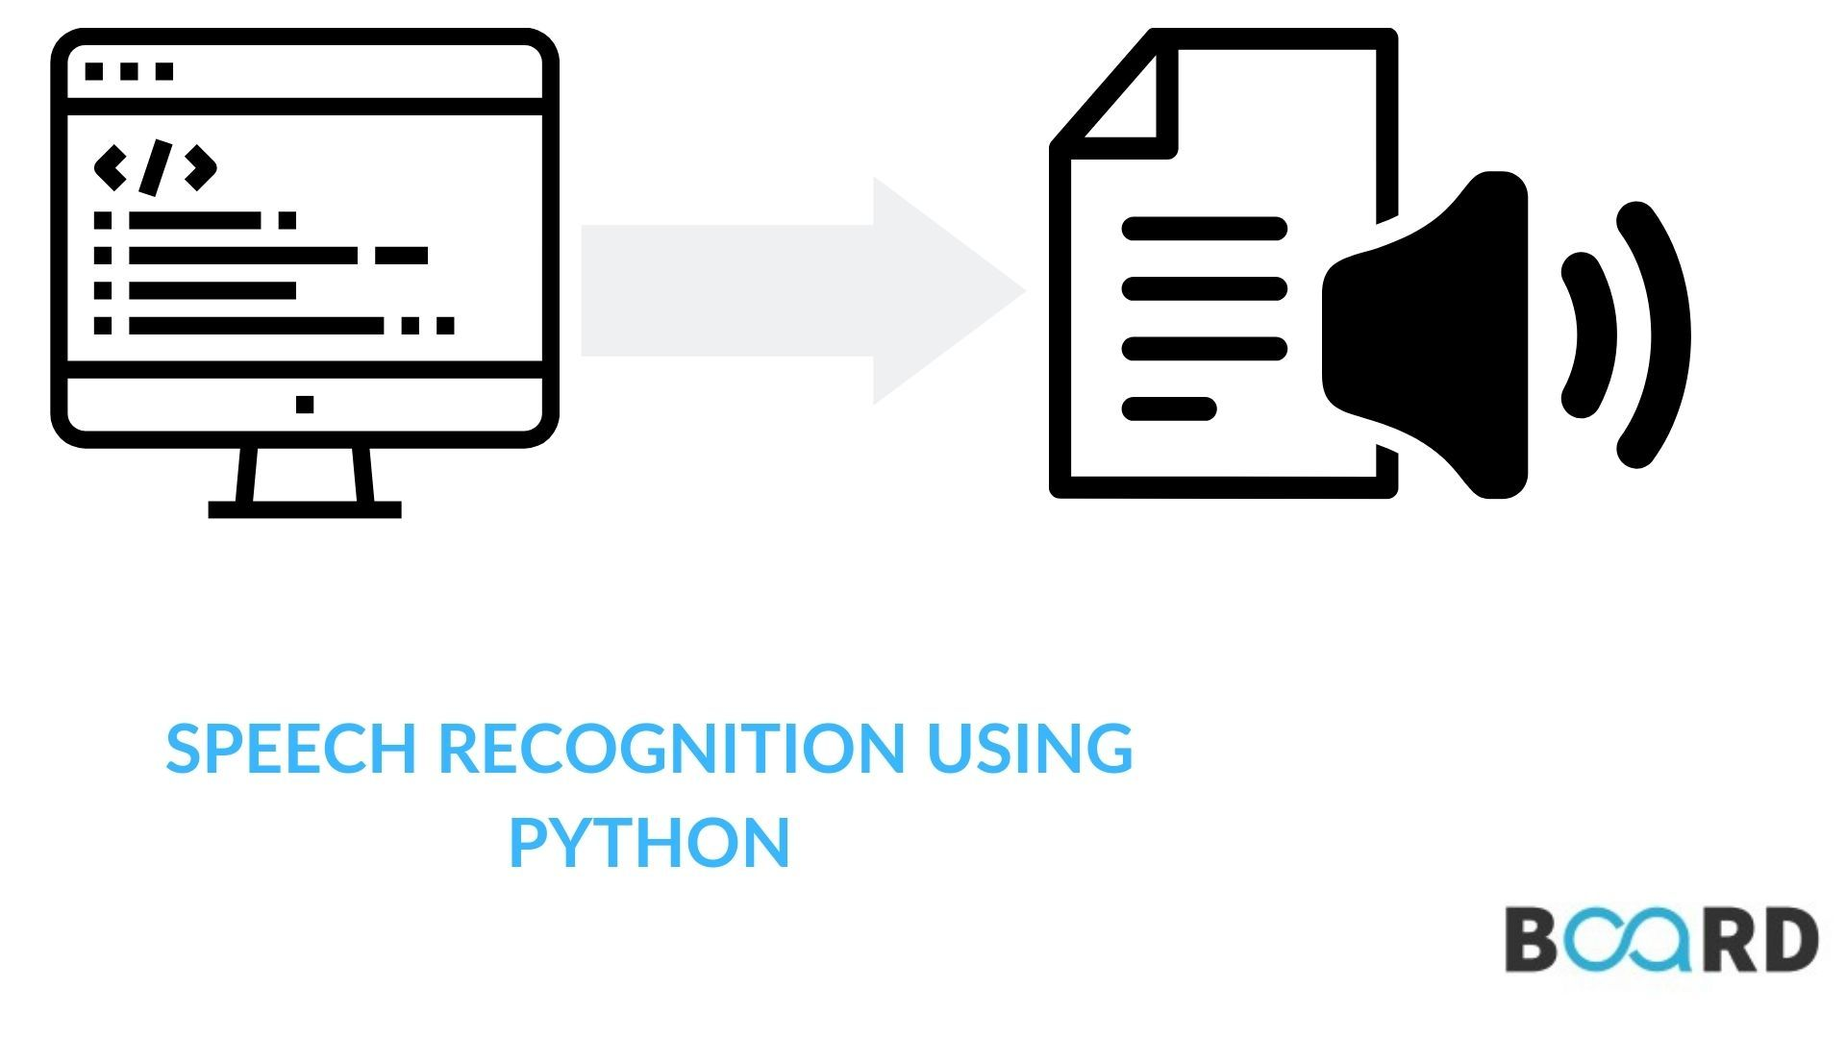
What is speech recognition
Speech recognition, or speech-to-text, is the ability of a machine or program to identify words spoken aloud and convert them into readable text. Rudimentary speech recognition software has a limited vocabulary and may only identify words and phrases when spoken clearly.
Voice or speaker recognition is the ability of a machine or program to receive and interpret dictation or to understand and perform spoken commands. Voice recognition has gained prominence and use with the rise of artificial intelligence (AI) and intelligent assistants, such as Amazon's Alexa and Apple's Siri.

Slide 7
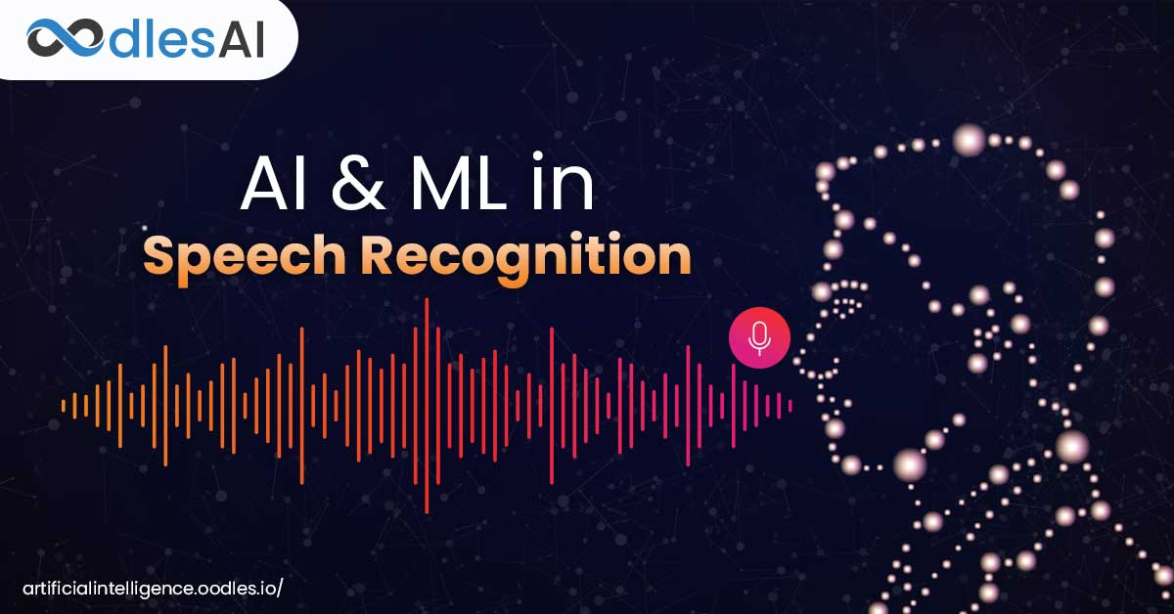
Speech recognition
Work in speech recognition started with converting speech to text (or creating a transcript). With that, the first level of information was captured (the words or the literal meaning of the speech).
And then It will display what you have said to the computer.
In this project it can only understand or recognize what you are saying and it can stores voice and give in the form of words as output.

Slide 8
Types of speech recognition
Text Dependent
Text Independent
They are three styles of speech: isolated, connected and continuous. Isolated speech recognition systems can just handle words that are spoken separately. This is the most common speech recognition systems available today. The user must pause between each word or command spoken.

Slide 9

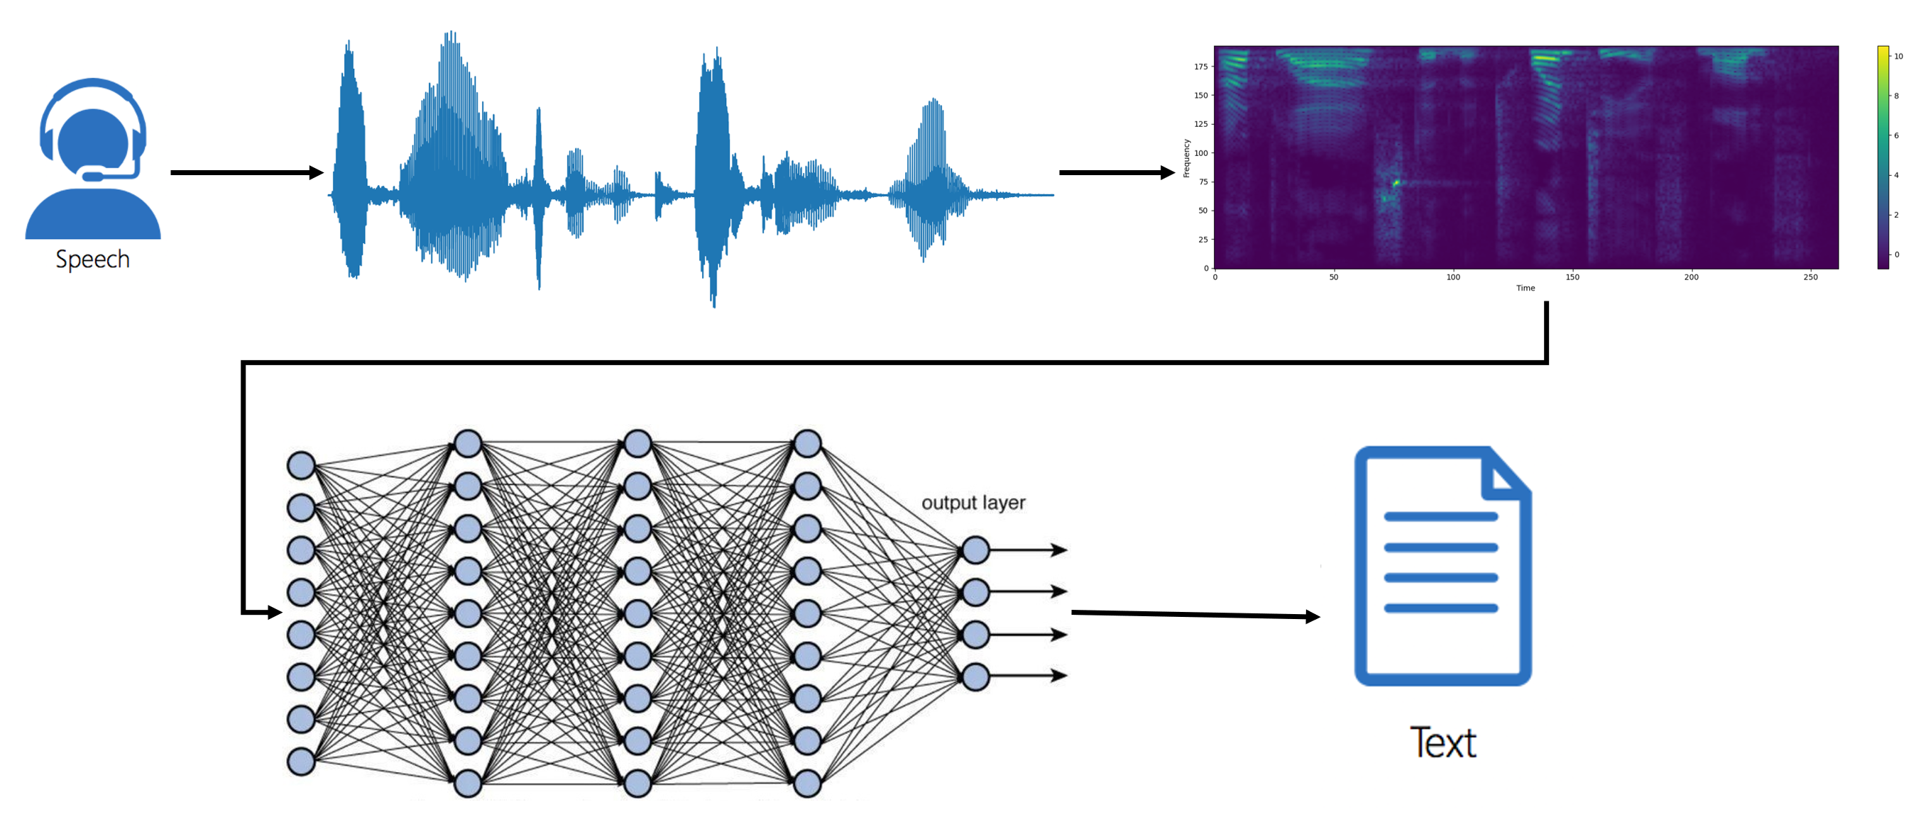
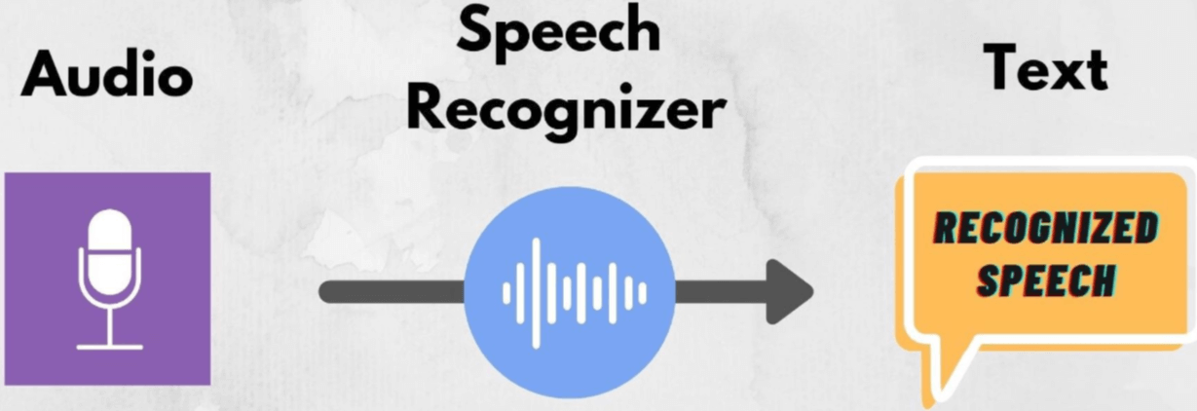
How it can convert voice into text

Slide 10
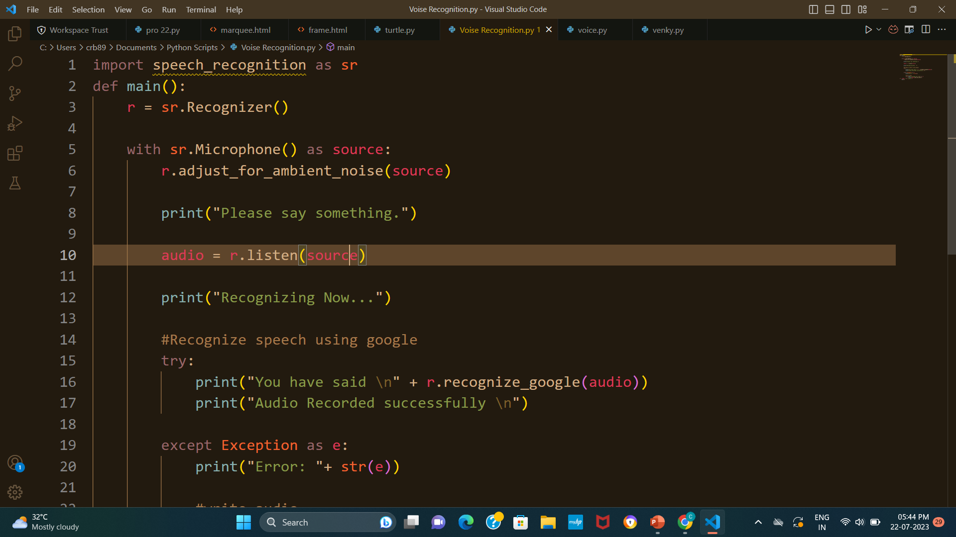
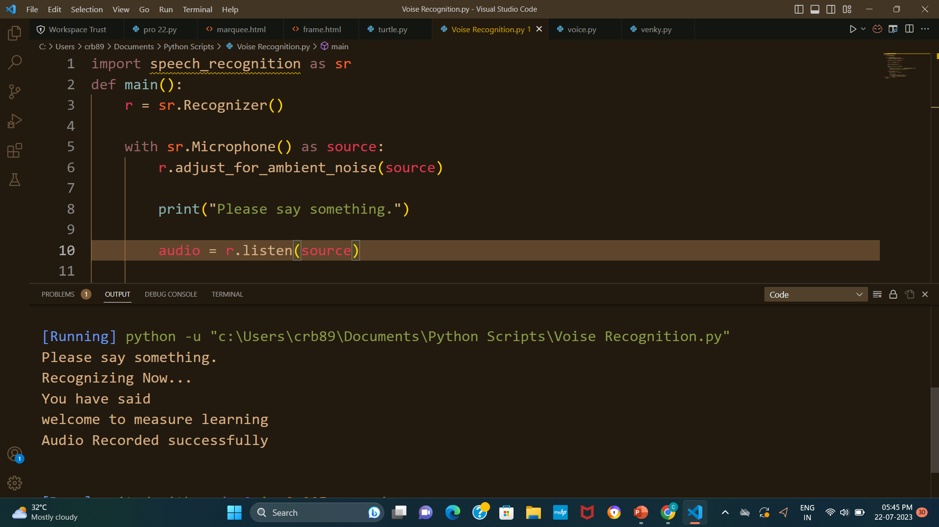
Final conclusion of my speech recognition project
Program with output in Vs code
Program in Vs code

Slide 11
Thank You
A power point presentation by Venkatesh Gorla based on the project speech recognition

