Slide 1
Ranking Relationships on the Semantic Web
Budak Arpinar
This work is funded by NSF-ITR-IDM Award#0325464 titled '‘SemDIS: Discovering Complex Relationships in the Semantic Web’ and NSF-ITR-IDM Award#0219649 titled ‘Semantic Association Identification and Knowledge Discovery for National Security Applications.’

Slide 2
Outline
Background
Motivation
Ranking Approach
System Implementation
Ranking Evaluation
Document Ranking
Conclusions and Future Work

Slide 3
The Semantic Web*
An extension of the Web
  Ontologies used to annotate the current information on the Web
  RDF and OWL are the current W3C standard for metadata representation on the Semantic Web
Allow machines to interpret the content on the Web in a more automated and efficient manner
* BERNERS-LEE, T., HENDLER, J., AND LASSILA, O. 2001. The Semantic Web. Scientific American, (May 2001)

Slide 4
Semantic Web Technology Evaluation Ontology (SWETO)^
Large scale test-bed ontology containing instances extracted from heterogeneous Web sources
Developed using Semagix Freedom*
  Created ontology within Freedom
  Use extractors to extract knowledge and annotate with respect to the ontology
^Boanerges Aleman-Meza, Chris Halaschek, Amit Sheth, I. Budak Arpinar, and Gowtham Sannapareddy, SWETO: Large-Scale Semantic Web Test-bed, International Workshop on Ontology in Action, Banff, Canada, June 20-24, 2004
*Semagix Inc. Homepage: http://www.semagix.com

Slide 5
SWETO - Statistics
Covers various domains
  CS publications, geographic locations, terrorism, etc.
Version 1.4 includes over 800,000 entities and over 1,500,000 explicit relationships among them

Slide 6
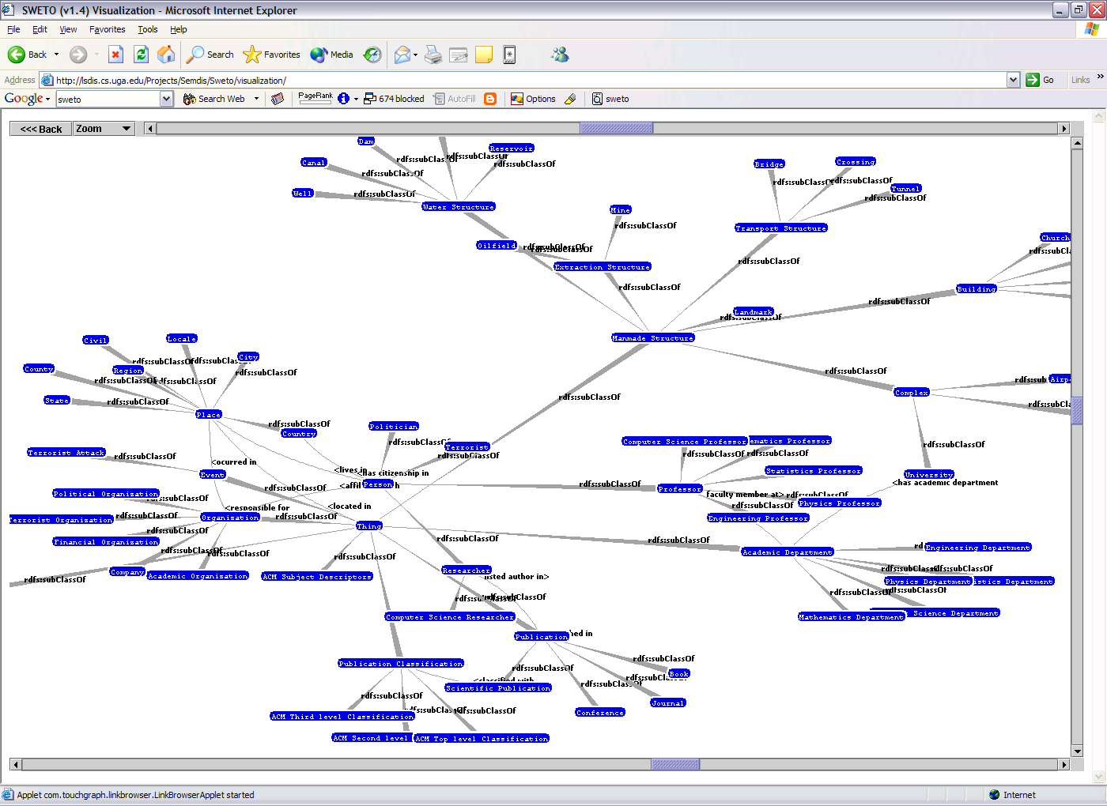
SWETO Schema - Visualization

Slide 7
Semantic Associations*
Mechanisms for querying about and retrieving complex relationships between entities
A is related to B by x.y.z
x
y’
y
2. A is related to C by
  i. x.y’.z’
A
z
  ii. u.v (undirected path)
B
z’
3. A is “related similarly” to B
as it is to C
(y’ ⊆ y and z’ ⊆ z → x.y.z ≅ x.y’.z’)
So are B and C related?
u
?
v
C
* ANYANWU, K., AND SHETH, A. 2003. r-Queries: Enabling Querying for Semantic Associations on the Semantic Web. In Proceedings of the 12th International World Wide Web Conference (WWW-2003) (Budapest, Hungary, May 20-24 2003).

Slide 8
Semantic Connectivity Example
“Chris”
Semantically Connected
fname
name
“The University
of Georgia”
&r1
&r6
“Halaschek”
lname
worksFor
associatedWith
&r5
name
“LSDIS Lab”

Slide 9
RDF Instance Graph
String
typeOf(instance)
Passenger
purchased
Ticket
fname
for
subClassOf(isA)
String
lname
forflight
number
subPropertyOf
String
purchased
paidby
creditedto
no
Flight
Bank
Account
String
Customer
Payment
amount
holder
FFlyer
fflierno
FFNo
ffid
float
String
CCard
Cash
Client
&r4
ffid
“XYZ123”
&r11
fflierno
holder
“John”
fname
&r1
purchased
&r2
paidby
&r3
“Smith”
lname
creditedto
purchased
paidby
fname
“Jeff”
&r5
for
&r6
“Bill”
lname
“Brown ”
fname
“Jones”
&r7
purchased
&r8
paidby
&r9
holder
lname

Slide 10
ρ-path Problem
Given:
  An RDF instance graph G, vertices x and y in G, an integer k
Find:
  All simple, undirected paths p which connect x and y

Slide 11
Motivation
Query between “Hubwoo [Company]” and “SONERI [Bank]” results in 1,160 associations
Cannot expect users to sift through resulting associations
Results must be presented to users in a relevant fashion…need ranking

Slide 12
Observations
Ranking associations is inherently different from ranking documents
  Sequence of complex relationships between entities in the metadata from multiple heterogeneous documents
  No one way to measure relevance of associations
Need a flexible, query dependant approach to relevantly rank the resulting associations

Slide 13
Ranking – Overview
Define association rank as a function of several ranking criteria
Two Categories:
  Semantic – based on semantics provided by ontology
    Context
    Subsumption
    Trust
  Statistical – based on statistical information from ontology, instances and associations
    Rarity
    Popularity
    Association Length

Slide 14
Context: What, Why, How?
Context captures the users’ interest to provide them with the relevant knowledge within numerous relationships between the entities
Context => Relevance; Reduction in computation space
By defining regions (or sub-graphs) of the ontology

Slide 15
Context Specification
Topographic approach
  Regions capture user’s interest
    Region is a subset of classes (entities) and properties of an ontology
  User can define multiple regions of interest
    Each region has a relevance weight

Slide 16
Context: Example
has Account
e3:Organization
supports
e2:Financial
Organization
e4:Terrorist
Organization
e7:Terrorist
Organization
e6:Financial
Organization
works For
involved In
located In
member Of
e8:Terrorist
Attack
e5:Person
member Of
friend Of
at location
e1:Person
located In
e9:Location
Region1: Financial Domain, weight=0.25
Region2: Terrorist Domain, weight=0.75

Slide 17
Context Issues
Issues
  Associations can pass through numerous regions of interest
  Large and/or small portions of associations can pass through these regions
Associations outside context regions rank lower

Slide 18



Context Weight Formula
Refer to the entities and relationships in an association generically as the components in the associations
We define the following sets, note c R_{i} is used for determining whether the type of c (rdf:type) belongs to context region R_{i}:
  where n is the number of regions A passes through
  X_{i} is the set of components of A in the i^{th} region
  Z is the set of components of A not in any contextual region

Slide 19
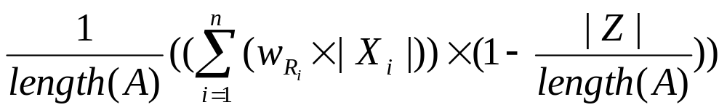
Context Weight Formula
Define the Context weight of a given association A, C_{A}, such that
C_{A} =
  n is the number of regions A passes through
  length(A) is the number of components in the association
  X_{i} is the set of components of A in the i^{th} region
  Z is the set of components of A not in any contextual region

Slide 20
Subsumption
Organization
Specialized instances are considered more relevant
More “specific” relations convey more meaning
Political
Organization
Democratic
Political
Organization
Ranked
Higher
H. Dean
member Of
Democratic
Party
Ranked
Lower
H. Dean
member Of
AutoClub

Slide 21
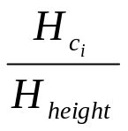

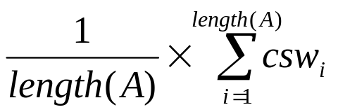
Subsumption Weight Formula
Define the component subsumption weight (csw) of the i^{th} component, c_{i}, in an association A such that
csw_{i} =
  is the position of component c_{i} in hierarchy H
  H_{height} is the total height of the class/property hierarchy of the current branch
Define the overall Subsumption weight of an association A as
S_{A} =
  length(A) is the number of components in A

Slide 22
Trust
Entities and relationships originate from differently trusted sources
  Assign trust values depending on the source
  e.g., Reuters could be more trusted than some of the other news sources
Adopt the following intuition
  The strength of an association is only as strong as its weakest link
    Trust weight of an association is the value of its least trustworthy component

Slide 23

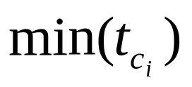
Trust Weight Formula
Let represent the component trust weight of the component, c_{i}, in an association, A
Define the Trust weight of an overall association A as
T_{A} =

Slide 24
Rarity
Many relationships and entities of the same type (rdf:type) will exist
Two viewpoints
  Rarely occurring associations can be considered more interesting
    Imply uniqueness
    Adopted from [3] where rarity is used in data mining relational databases
      Consider rare infrequently occurring relationship more interesting

Slide 25
Rarity
Alternate viewpoint
  Interested in associations that are frequently occurring (common)
    e.g., money laundering…often individuals engage in normal looking, common case transactions as to avoid detection
User should determine which Rarity preference to use

Slide 26
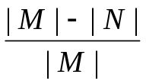

Rarity Weight Formula
Define the component rarity of the i^{th} component, c_{i}, in A as rar_{i} such that
rar_{i} =
  , where
  (all instances and relationships in K), and
  With the restriction that in the case res_{j} and c_{i} are both of type rdf:Property, the subject and object of c_{i} and res_{j} must be of the same rdf:type
rar_{i} captures the frequency of occurrence of the rdf:type of component c_{i}, with respect to the entire knowledge-base

Slide 27
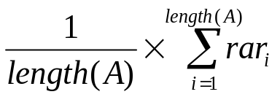
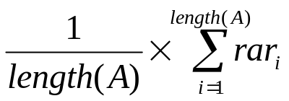
Rarity Weight Formula
Define the overall Rarity weight, R, of an association, A, as a function of all the components in A, such that
(a) R_{A} =
(b) R_{A} = 1 –
  where length(A) is the number of components in A
  rar_{i} is component rarity of the i^{th} component in A
To favor rare associations, (a) is used
To favor more common associations (b) is used

Slide 28
Popularity
Some entities have more incoming and outgoing relationships than others
  View this as the Popularity of an entity
Entities with high popularity can be thought of as hotspots
Two viewpoints
  Favor associations with popular entities
  Favor unpopular associations

Slide 29
Popularity
Favor popular associations
  Ex. interested in the way two authors were related through co-authorship relations
    Associations which pass through highly cited (popular) authors may be more relevant
Alternate viewpoint…rank popular associations lower
  Entities of type ‘Country’ have an extremely high number of incoming and outgoing relationships
    Convey little information when querying for the way to persons are associated through geographic locations

Slide 30
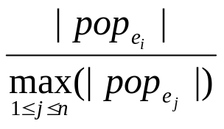



Popularity Weight Formula
Define the entity popularity, p_{i}, of the i^{th} entity, e_{i}, in association A as
p_{i} =
where
  n is the total number of entities in the knowledge-base
  is the set of incoming and outgoing relationships of e_{i}
  represents the size of the largest such set among all entities in the knowledge-base of the same class as e_{i}
p_{i} captures the Popularity of e_{i}, with respect to the most popular entity of its same rdf:type in the knowledge-base

Slide 31
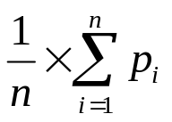
Popularity Weight Formula
Define the overall Popularity weight, P, of an association A, such that
(a) P_{A} =
(b) P_{A} = 1 –
  where n is the number of entities (nodes) in A
  p_{i} is the entity popularity of the i^{th} entity in A
To favor popular associations, (a) is used
To favor less popular associations (b) is used

Slide 32
Association Length
Two viewpoints
  Interest in more direct associations (i.e., shorter associations)
    May infer a stronger relationship between two entities
  Interest in hidden, indirect, or discrete associations (i.e., longer associations)
    Terrorist cells are often hidden
    Money laundering involves deliberate innocuous looking transactions

Slide 33
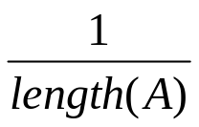
Association Length Weight
Define the Association Length weight, L, of an association A as
(a) L_{A} =
(b) L_{A} = 1 –
  where length(A) is the number of components in the A
To favor shorter associations, (a) is used, again
To favor longer associations (b) is used

Slide 34
Overall Ranking Criterion
Overall Association Rank of a Semantic Association is a linear function
Ranking
Score
  where k_{i} adds up to 1.0
Allows a flexible ranking criteria
k₁ × Context +
k₂ × Subsumption +
k₃ × Trust +
k₄ × Rarity +
k₅ × Popularity +
k₆ × Association Length
=

Slide 35
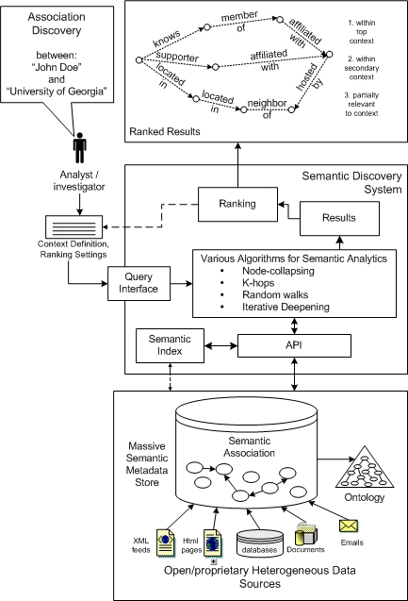
System Implementation
Ranking approach has been implemented within the LSDIS Lab’s SemDIS² and SAI³ projects

Slide 36
System Implementation
Native main memory data structures for interaction with RDF graph
Naïve depth-first search algorithm for discovering Semantic Associations
SWETO (subset) has been used for data set
  Approximately 50,000 entities and 125,000 relationships
SemDIS prototype⁴, including ranking, is accessible through Web interface
⁴SemDIS Prototype: http://vader.cs.uga.edu:8080/semdis/

Slide 37
Ranking Configuration
User is provided with a Web interface that gives her/him the ability to customize the ranking criteria
Use a modified version of TouchGraph⁵ to define the query context
  A Java applet for the visual interaction with a graph
⁵TouchGraph Homepage: http://www.touchgraph.com/

Slide 38
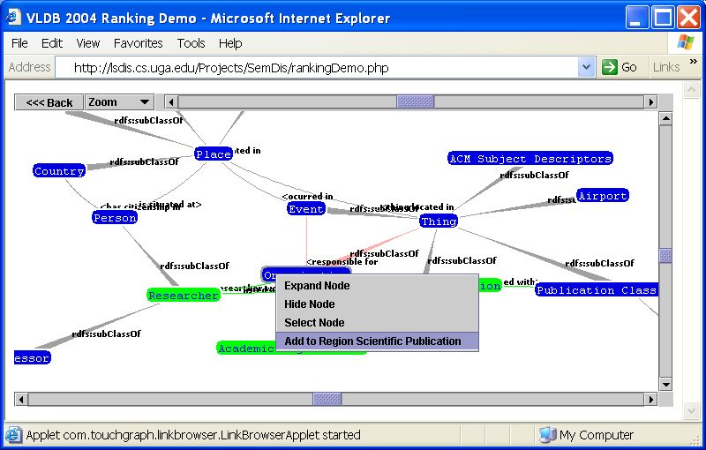
Context Specification Interface

Slide 39
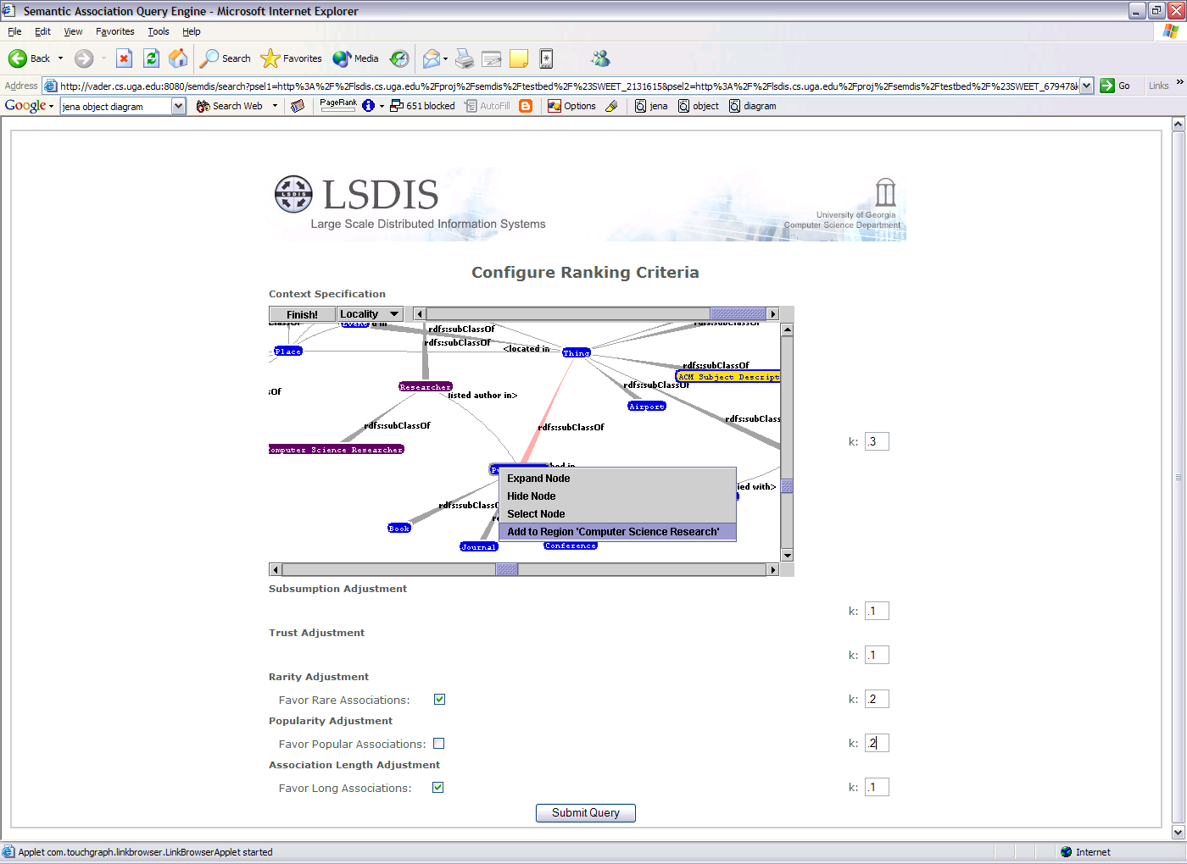
Ranking Configuration Interface

Slide 40
Ranking Module
Java implementation of the ranking approach
Unranked associations are traversed and ranked according to the ranking criteria defined by the user
Ranking is decomposed into finding the context, subsumption, trust, rarity, and popularity rank of all entities in each association

Slide 41
Ranking Module
Context, subsumption, trust, and rarity ranks of each relationship are found during the traversal as well
  When the RDF data is parsed, rarity, popularity, trust, and subsumption statistics of both entities and relationships are maintained
  Finding the context rank consists of checking which context regions, if any, each entity or relationship in each association belongs to

Slide 42
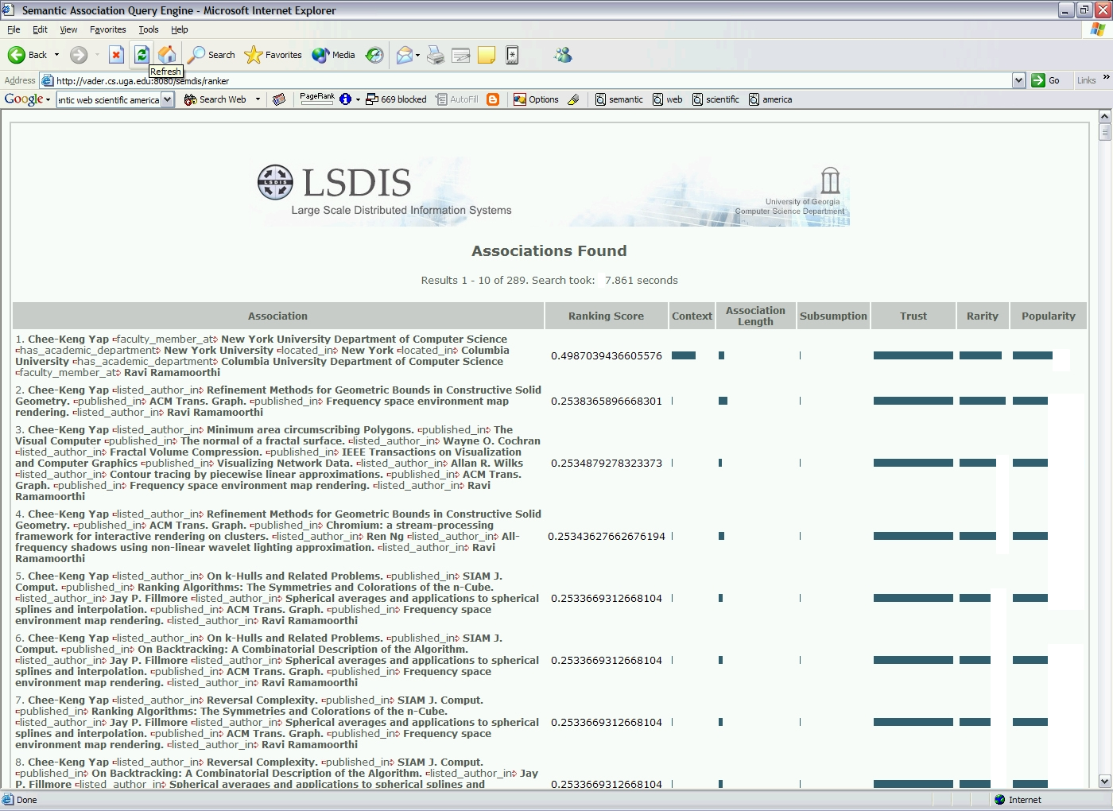
Ranked Results Interface

Slide 43
Ranking Evaluation
Evaluation metrics such as precision and recall do not accurately measure the ranking approach
Used a panel of five human subjects for evaluation
  Due to the various ways to interpret associations

Slide 44
Ranking Evaluation
Evaluation process
  Subjects given randomly sorted results from different queries
    each consisting of approximately 50 results
  Provided subjects with the ranking criteria for each query
    i.e., context, whether to favor short/long, rare/common associations, etc.
  Provided type(s) of the components in the associations
    To measure context relevance
  Subjects ranked the associations based on this modeled interest and emphasized criterion

Slide 45
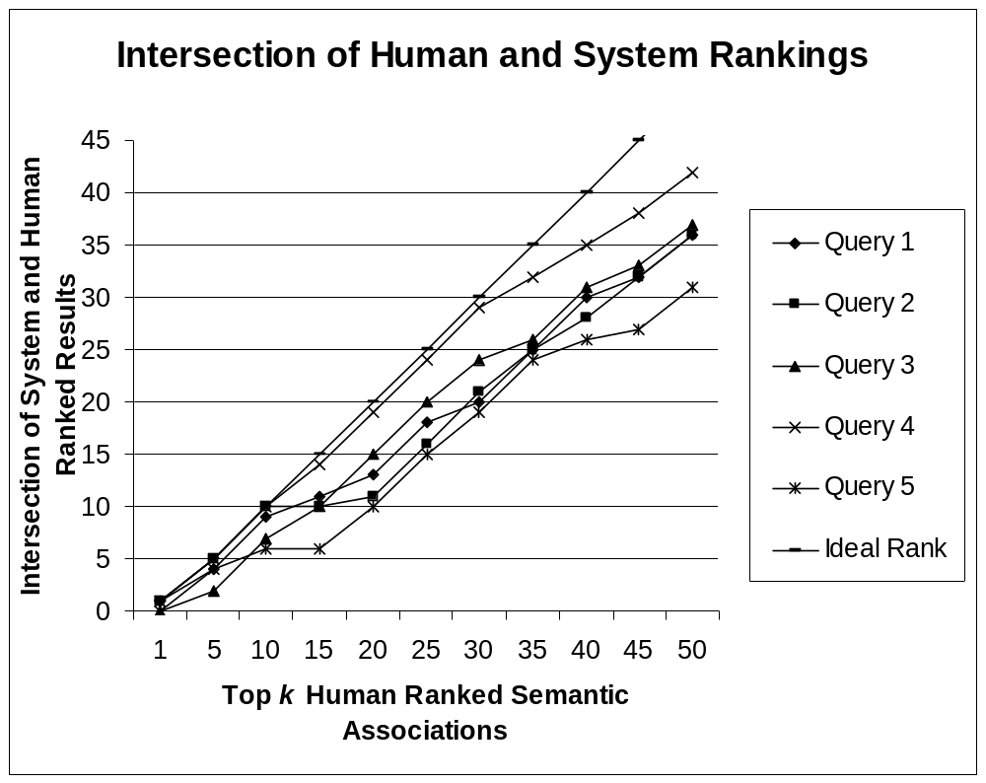
Ranking Evaluation (1)

Slide 46
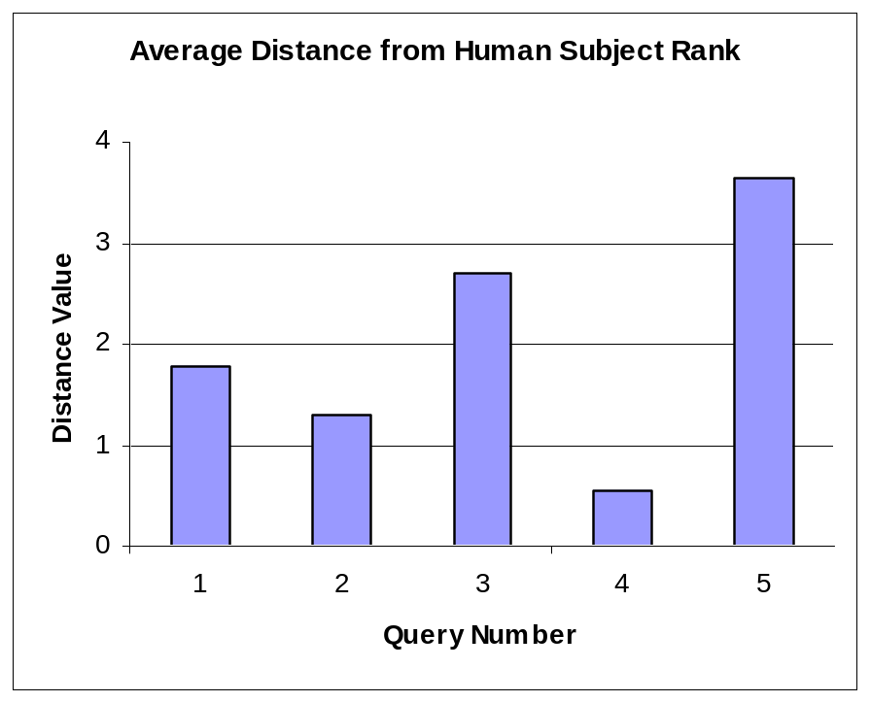
Ranking Evaluation (2)
Average distance of system rank from that given by subjects
  Based on relative order

Slide 47
Conclusions
Defined a flexible, query dependant approach to relevantly rank Semantic Association query results
Presented a prototype implementation of the ranking approach
Empirically evaluated the ranking scheme
  Found that our proposed approach is able to capture the user’s interest and rank results in a relevant fashion

Slide 48
Future Work
‘Ranking-on-the-Fly’
  Ranks can be assigned to associations as the algorithm is traversing them
    Possible performance improvements
Use of the ranking scheme for the Semantic Association discovery algorithms (scalability in very large data sets)
  Utilize context to guide the depth-first search
  Associations that fall below a predetermined minimal rank could be discarded
Additional work on context specification
Develop ranking metrics for Semantic Similarity Associations

Slide 49
Publications
[1] Chris Halaschek, Boanerges Aleman-Meza, I. Budak Arpinar, Cartic Ramakrishnan, and Amit Sheth, A Flexible Approach for Analyzing and Ranking Complex Relationships on the Semantic Web, Third International Semantic Web Conference, Hiroshima, Japan, November 7-11, 2004 (submitted)
[2] Chris Halaschek, Boanerges Aleman-Meza, I. Budak Arpinar, and Amit Sheth, Discovering and Ranking Semantic Associations over a Large RDF Metabase, 30th Int. Conf. on Very Large Data Bases, August 30 September 03, 2004, Toronto, Canada. Demonstration Paper
[3] Boanerges Aleman-Meza, Chris Halaschek, Amit Sheth, I. Budak Arpinar, and Gowtham Sannapareddy, SWETO: Large-Scale Semantic Web Test-bed, International Workshop on Ontology in Action, Banff, Canada, June 20-24, 2004
[4] Boanerges Aleman-Meza, Chris Halaschek, I. Budak Arpinar, and Amit Sheth, Context-Aware Semantic Association Ranking, First International Workshop on Semantic Web and Databases, Berlin, Germany, September 7-8, 2003; pp. 33-50

Slide 50
References
[1] [2] BERNERS-LEE, T., HENDLER, J., AND LASSILA, O. 2001. The
Semantic Web. Scientific American, (May 2001)
[3] LIN, S., AND CHALUPSKY, H. 2003. Unsupervised Link Discovery in Multi-relational Data via Rarity Analysis. The Third IEEE International Conference on Data Mining.

