Slide 1
The Leading Question
How can you get crowds to do what your business needs done?

Slide 2
Findings
Collective intelligence has already been proven to work
CI systems can be designed and managed to fit specific needs
CI building blocks, or “genes,” can be recombined to create the right kind of system
Four main questions drive CI “genome” design:
What is being done?
Who is doing it?
Why?
How?

Slide 3
Harnessing Crowds: Mapping the Genome of Collective Intelligence
Thomas W. Malone, Robert Laubacher, and Chrysanthos Dellarocas

Slide 4
Terms & Examples
Examples:
Google
Wikipedia
Threadless
Terms:
Radical decentralization
Crowd-sourcing
Wisdom of crowds
Peer production
Wikinomics

Slide 5
Collective Intelligence
Groups of individuals doing things collectively that seem intelligent
Families, companies, countries, and armies
Web-based collective intelligence

Slide 6
Understanding CI
Fuzzy collection of “cool” ideas
Deeper understanding
The “genes”
250 examples of Web enabled collective intelligence
Building block:
A gene
A particular answer to one of the key questions (Who, Why, What, or How) associated with a single task in a collective intelligence system

Slide 7
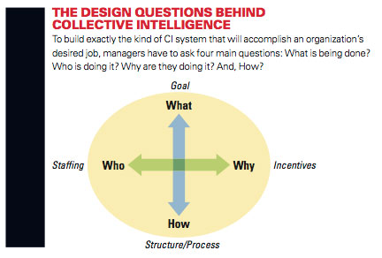
CI Genome

Slide 8
Who?
Who undertakes the activity?
(1) Hierarchy:
Someone in authority assigns a particular person or group of people to perform the task
Linux community:
Linus Torvalds and his lieutenants

Slide 9
(2) Crowd
Activities can be undertaken by anyone in a large group who chooses to do so
Linux module
Link to a Web page
Wikipedia article
T-shirt design in Threadless

Slide 10
Why?
Why do people take part in the activity?
What motivates them to participate?
What incentives are at work?

Slide 11
Incentives
Money
Enhance their professional reputation or improve their skills
Love
Enjoyment
Socialize
Contributing to a cause
Glory

Slide 12
More Recent Incentives
Reliance on the Love and Glory genes
“power seller” on eBay
“top reviewer” on Amazon

Slide 13
What?
What is being done?
Create something new
A piece of software code, a blog entry, a T-shirt design
Decide
Actors evaluate and select alternatives
Whether a new module should be included in the next release of Linux
Selecting which T-shirt design to manufacture
Deciding whether to delete a Wikipedia article
Threadless: Both create & design

Slide 14
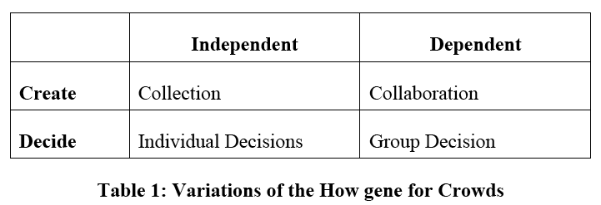
How?
How is it being done?

Slide 15
Collection
Items created independently of each other
YouTube videos
Digg: a collection of news stories
Flickr: a collection of photographs
Contest gene
Best entries receive a prize or recognition
Threadless
InnoCentive
Netflix Prize
IBM’s Innovation Jams
TopCoder

Slide 16
Collaboration
Members of a crowd work together to create something and important dependencies exist between their contributions
Each individual Wikipedia article
Linux
Any other open source software project

Slide 17
Group Decision
Members of the crowd generate a decision that holds for the group as a whole
Threadless
Subset of contributed items that will be included into the final output
Digg
A common rank-ordering of the contributed items
Important variants
Voting
Consensus
Averaging
Prediction markets

Slide 18
Voting
Digg
Most interesting stories
Ebbsfleet United
Kasparov vs. the World

Slide 19
Subtypes
Implicit voting
Buying or viewing
iStockPhoto
YouTube ranks videos
Weighted voting
Google

Slide 20
Consensus
Group members agree on the final decision
Wikipedia articles that remain unchanged
reCAPTCHA

Slide 21
Averaging
Average the numbers contributed by the members of the crowd
Amazon book or CD ratings on a five star scale
Expedia to rate hotels
Internet Movie Database to rate movies
NASA Clickworkers
Marketocracy

Slide 22
Prediction Markets
Crowds estimate the probability of future events
People buy and sell “shares” of predictions
If their predictions are correct, they are rewarded
Google, Microsoft, and Best Buy
Microsoft:
Estimate completion dates for projects

Slide 23
Individual Decisions
Members of a crowd make decisions that, though informed by crowd input, do not need to be identical for all
Individual YouTube users decide which videos to watch
Important variations
Markets
Social Networks

Slide 24
Markets
Formal exchange (like money) involved in the decisions
Each member of the crowd makes an individual decision about what products to buy or sell
iStockPhoto
eBay

Slide 25
Social Networks
Members of a crowd form a network
Levels of trust
Similarity of taste and viewpoints
Other common characteristics
Blogosphere
Web of related content
YouTube channels
Epinions.com
Amazon.com
Collaborative filtering

Slide 26
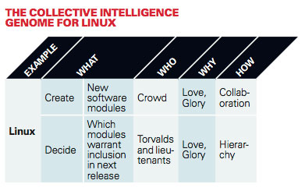
Linux Genome

Slide 27
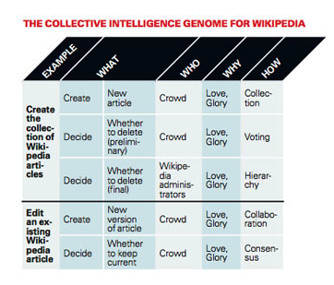
Wikipedia Genome

Slide 28
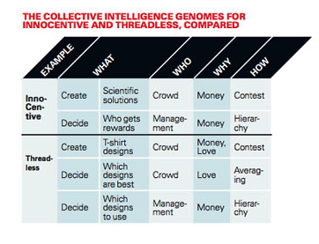
Genomes Compared

Slide 29
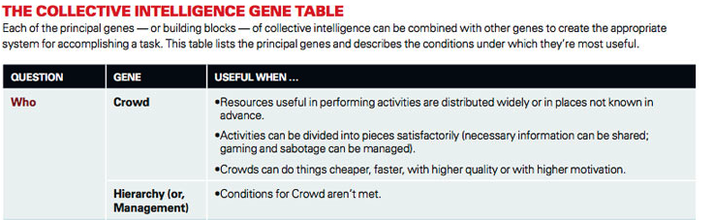
Making Decisions for CI System

Slide 30
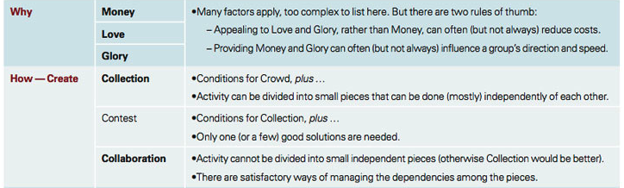
Gene Table

Slide 31
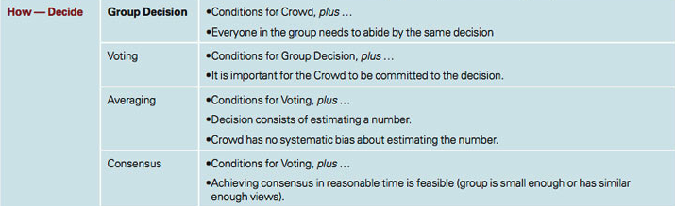
Gene Table

Slide 32
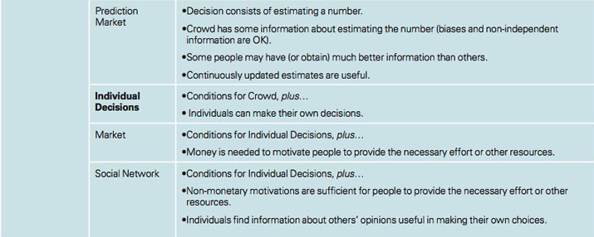
Gene Table

Slide 33
The CI Genome — What’s Next?
Just the beginning
Work to be done to identify all the different genes
Managers:
Systematically consider many possible combinations of answers to questions about What, Who, Why and How
This increases the chances that others can begin to take advantage of the amazing possibilities already demonstrated by systems like Google, Wikipedia and Threadless

