Slide 1
The Live Social Semantics

Slide 2
Goals
Enhance the social experience of an event
Social networking
Integrate
Data from social networking systems
Semantic data sources
Collaboration networks
Communities of practice
Data from infrastructure for sensing face-to-face communication (RFID)

Slide 3
Conferences
Deployed at
2009 European Semantic Web Conference
2009 ACM Hypertext conference
More than 500 attendees
300 accepted to use application

Slide 4
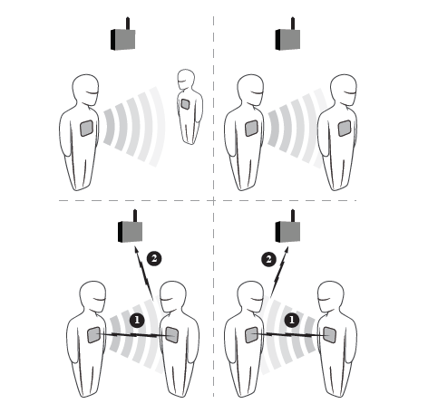
SocioPatterns Platform

Slide 5
System
A uniquely numbered RFID badge
Website of the social application
On-line identities on Delicious, Flickr, and lastFM4,
Facebook application that collects friends

Slide 6
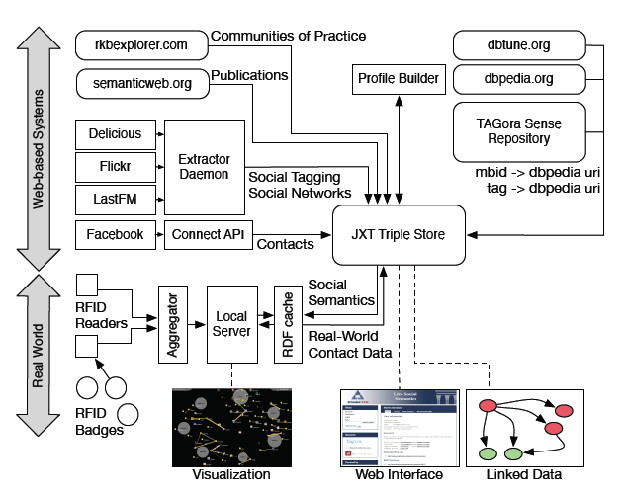
General Architecture

Slide 7
Application
Fusion of data
All the collected data in RDF
A movie
http://www.vimeo.com/6590604

Slide 8
Social Networks
Tagging data
Friend networks
Publications and projects
Communities of practice
via RKBExplorer5 and semanticweb.org

Slide 9
Profiles
The Profile Builder
An individual’s tagging activities
Link them to DBpedia concepts
A user’s interests
Tags used most often
Topics, places, events and people
An agreed ontology and URI syntaxes

Slide 10
Face-to-Face Communication
RFID badges
Multi-channel bi-directional radio communication
Exchange low-power signals
Shielded by the human body
Face-to-face proximity
A good proxy for a social interaction

Slide 11
Proximity Graph
RFID readers
Forward packets to a central server
Aggregation and post-processing
A real-time graph representation of the proximity relations
A time-dependent adjacency matrix
Matrix was updated every 5 seconds

Slide 12
Cumulative Proximity
A weighted graph representation
Cumulative proximity relations
Fraction of application time that individuals i and j spent together

Slide 13
Benefits
The real-world proximity relations are mashed up
Web-based attendee relations that it periodically pulls from the triple store
Visualization
Display real-world relations
Recommendation scheme
Co-present attendees to a third person who is not present but has on-line connections to both attendees

Slide 14
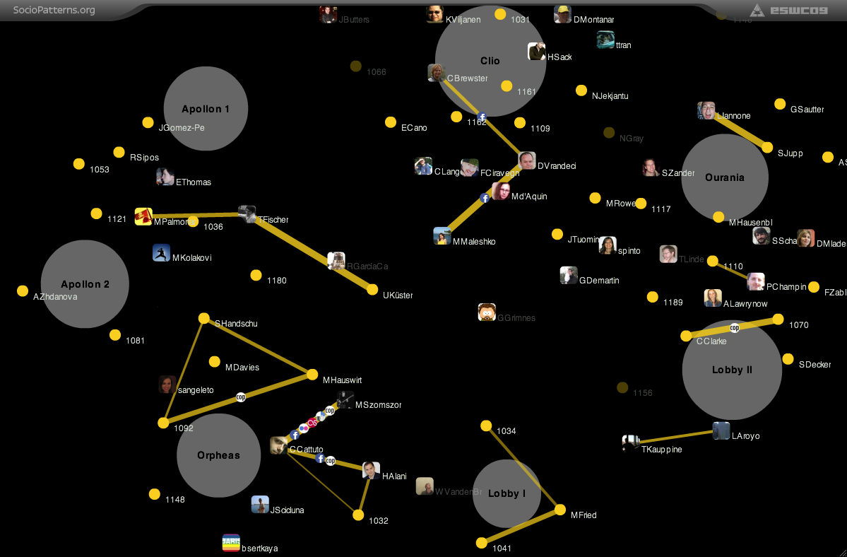
Spatial View

Slide 15
Spatial View
Real-time contact graph
Edge thickness
Weight of the contact
The edges are decorated
Facebook, Flickr, Delicious, LastFM or COP (community of practice) icons
Coarse-grained localization of the participants
With respect to the RFID readers

Slide 16
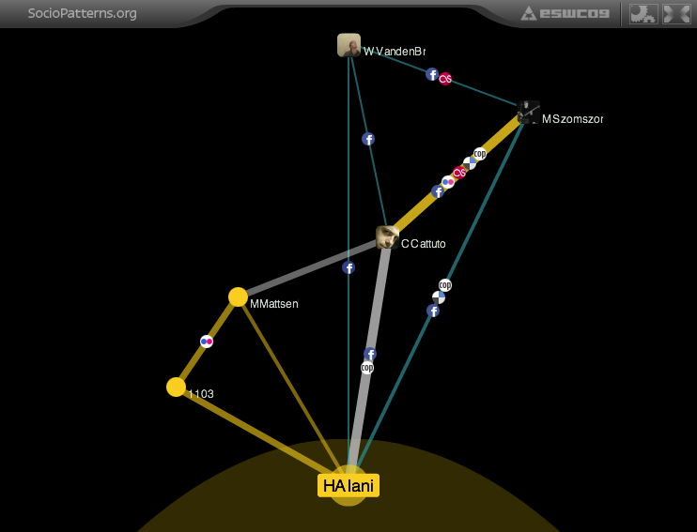
User-focus View

Slide 17
User-focus View
Social neighborhood of the focused upon participant
Proximity-based interactions
Edges:
Current
Historical
Close relevant triangles

Slide 18
Privacy
Permission
Information on the system
Account on the application site
Destroy data
Profile of Interest (POI)
Verify, edit and then activate
Data from RFID badges were encrypted
Data
Stored in a private triple store

Slide 19
Participation
455 attendees of ESWC09 and HT09
300 took part
226 created an account
Face-to-face contacts for anonymous users
Social Networking
126 Facebook accounts
87 Delicious accounts
83 LastFM accounts

Slide 20
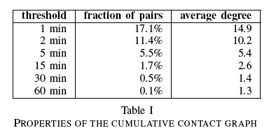
Cumulative Contact Graph
80 hours for ESWC09
72 hours for HT09
Graph is dominated by contacts of short duration

Slide 21
Discussion
One approach to increase extendibility
FOAF, Twitter
Conflicts in privacy and data retention policy
Extend visualizations by encoding the roles of people
More services
‘search for person’
‘I want to meet’
‘find people with similar interests’
‘best attended session or talk

Slide 22
Conclusions
Enhance the real-world interactions
Combine
Semantic data from social media
Real-world encounters of attendees
New way of connecting to people
Mine interesting and serendipitous social connections

