Slide 1






48th ACM Southeast Conference. ACMSE 2010.
Oxford, Mississippi. April 15-17, 2010.
A Taxonomy-based Model for Expertise
Extrapolation
Delroy Cameron, Amit P. Sheth
Ohio Center for Excellence in Knowledge-enabled Computing (Kno.e.sis)
Wright State University, Dayton OH
Boanerges Aleman-Meza
Department of Biochemistry and Cell Biology
Rice University, Houston TX
I. Budak Arpinar, Sheron L. Decker
LSDIS Lab, Department of Computer Science
University of Georgia, Athens GA

Slide 2
BACKGROUND
Realm of Finding Experts
Propagation Method
Human-Centered Information Diffusion
prima facie
Issues
Inconsistent Human Perceptions
Strong vs. Weak ties
Aftefacts
Curricula Vitarium
Version Control Systems, Patents & Research Grants
Citation Linkage
Expertise Granularity
Citation Sentiment Detection
Pied Piper Effect
Adage: The publications of a Researcher is indicative of her expertise.
2

Slide 3
CONTRIBUTIONS
Structured Data
Taxonomy of Topics
Extrapolation
Bibliographic Data
Collaboration Networks
Co-authorship Graph
Prevent Collaboration Stagnation
Search Algorithms
Topic Hierarchy
subtopic_of
Page Rank
DFS, BFS
Semantic Associations
3

Slide 4
s
EXPERTISE MODEL
B = {b₁, b₂, …, b_{n}}
P = {p₁, p₂,…,p_{n}}
T = {t₁, t₂, …, t_{m}}
b₁
p₁
λ₁
Expertise Profile
b₂
p₂
t₁
λ₂
b₃
p₃
λ₃
t₂
b₄
p₄
λ₄
t₃
t_{m}
b_{n}
p_{n}
λ_{n}
a_{i}
author
4

Slide 5
EXPERTISE PROFILES
a_{i} - 81 publications
12 - Semantic Web
#Web
p₄₂
#Know. Acq
#XML
#Know. Man.
p₈
#RDF
p₂₉
p₁₃
p₃₆
p₆₈
p₂₀
p₃₇
p₅₃
#Semantic_Web
#Languages
p₉
p₄₀
p₄₉
p₁₇
p₇₃
p₇₀
#OWL
#A.I.
#Content
#Semantics
#Reasoning
p₅
p₅₀
5

Slide 6
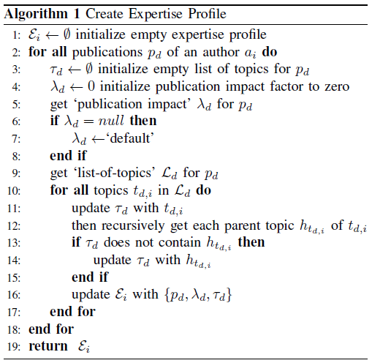
EXPERTISE PROFILES
6

Slide 7
COMPUTING EXPERTISE
#OWL
#A.I.
#Reasoning
p₅
e(#Semantic_Web) = ((p₅(OWL) v p₅(Reasoning) v p₅(A.I.)) λ_{ecai}
e(p₅) = (1 v 0 v 0) 0.69 = 0.69
7

Slide 8
COMPUTING EXPERTISE
e‘’ = 0.69+0.55+1.54+0.1+0.55=3.43
e(p₄₂) = λ_{www} = 1.54
#Web
p₄₂
#Know. Acq
e(p₈) = λ_{ekaw} = 0.55
#XML
#Know. Man.
p₈
#RDF
p₂₉
p₁₃
p₃₆
p₆₈
e’ = 10.40
e(p₅₃) = λ_{ekaw}= 0.55
p₂₀
p₃₇
p₅₃
#Semantic_Web
#Languages
p₉
p₄₀
p₄₉
p₁₇
p₇₃
p₇₀
#OWL
e = 10.40+3.43=13.43
#A.I.
#Content
#Semantics
#Reasoning
p₅
p₅₀
e(p₅₀) = λ_{ewimt} = 0.1
e(p₅) = λ_{ecai} = 0.69
8

Slide 9
DATASET
Papers-to-Topics Dataset
476,299 papers
676,569 relationships to topics
Focus Crawl DBLP
Taxonomy of CS Topics
Manually (320 Topics)
Conference Names (60)
Session Names (216)
Index Terms & Yahoo! Term Extractor (128)
O`Comma Taxonomy (50)
Publication Impact Factors
Citeseer (>1200 Proceedings)
9

Slide 10
DEMO
http://knoesis1.wright.edu/expert_finder
10

Slide 11
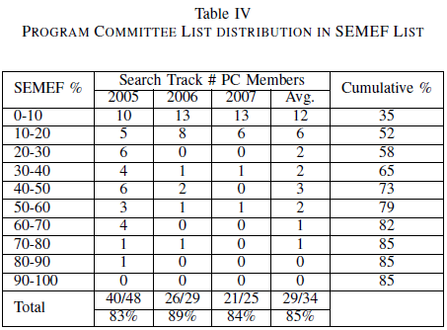
EVALUATION
11

Slide 12
GEODESIC
Geodesic - Shortest path between two vertices in a directed graph
b
a
Geodesic Level | Description w.r.t. PC Chair(s) | Degree of Separation
STRONG | co-authors | One
MEDIUM | common coauthors | Two
WEAK | published in same proceedings | Unspecified
 | coauthors w/ common coauthors | Two
 | coauthor related to editor | Three
EXTREMELY WEAK | coauthors in same proceedings | Three
UNKNOWN | no relationship in dataset | Unknown
12

Slide 13
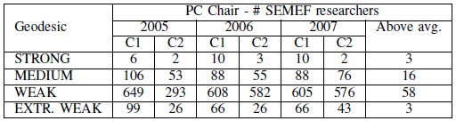
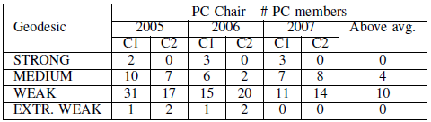
EVALUATION
13

Slide 14
C-Net
C-Net – Measure of collaboration strength within expert subgroups
v₃=0.73
0.5
1.0
v₄=1.81
v_{m}=14.80
0.5
0.5
v₁=0.73
v₂=0.73
M. E. J. Newman, “Coauthorship networks and patterns of scientific collaboration,” in Proceedings of the National Academy of Sciences, 2004
14

Slide 15
LIMITATIONS
Taxonomy of Topics
Semantic Association in Large RDF Graphs
Entity Disambiguation
Paper-to-Topics Mappings
15

Slide 16
CONCLUSION
Semantic Expert Finder
Taxonomy of Topics
Publication Impact Factors
Expertise Profiles
Collaboration Network Analysis
Co-Authorship Graph
Semantic Associations
16

Slide 17
ACKNOWLEDGEMENTS
People
Wenbo Wang
Ajith Ranabahu
Boanerges Aleman-Meza
National Science Foundation Award
SemDis (Discovering Complex Relationships in the Semantic Web)
No. 071441 Wright State University
No. IIS-0325464 to University of Georgia
17

