Slide 1
Ontology Evaluation and Ranking using OntoQA
Samir Tartir and I. Budak Arpinar
Large-Scale Distributed Information Systems Lab
University of Georgia
The First IEEE International Conference on Semantic Computing
September 17-19, 2007
Irvine, California, USA

Slide 2
Outline
Why ontology evaluation?
OntoQA
  Overview
  Metrics
  Overall Score
  Results
Future Work

Slide 3
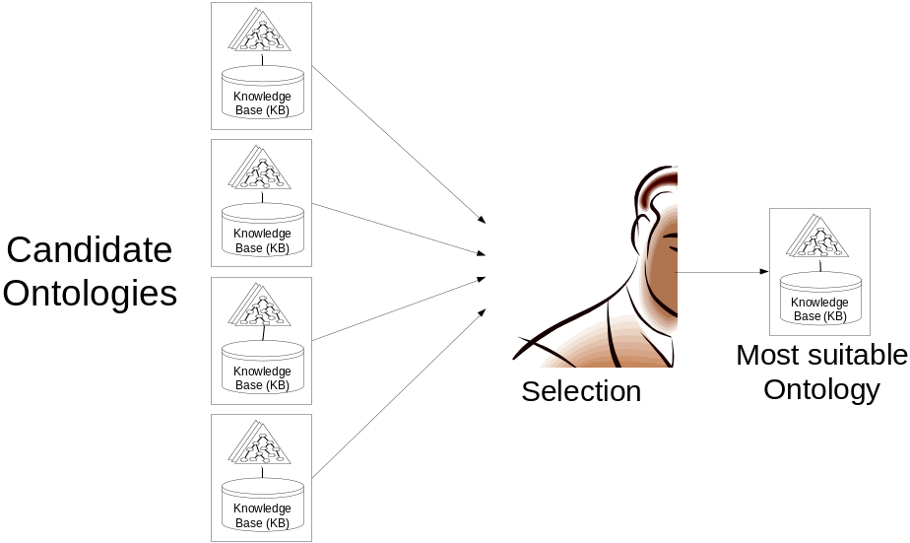
Why Ontology Evaluation?
Having several ontologies to choose from, users often face the problem of selecting the ontology that is most suitable for their needs.
Ontology developers need a way to evaluate their work

Slide 4
OntoQA
a suite of metrics that evaluate the content of ontologies through the analysis of their schemas and instances in different aspects such as the distribution of classes on the inheritance tree of the schema, the distribution of class instances, and the connectivity between instances of different classes.
OntoQA is
  tunable
  requires minimal user involvement
  considers both the schema and the instances of a populated ontology.

Slide 5
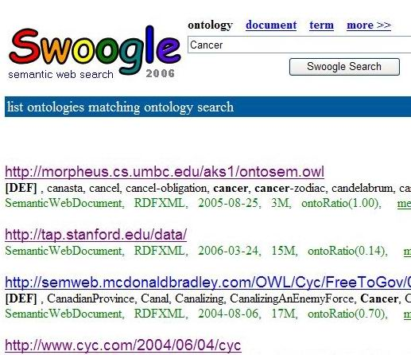
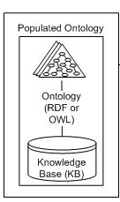
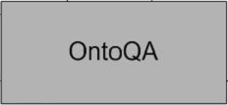
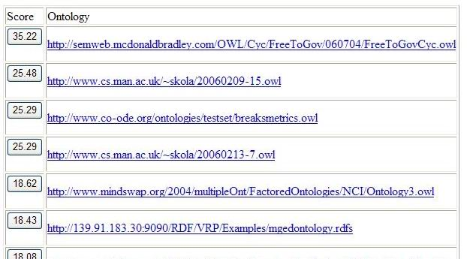
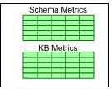

OntoQA Overview
Keywords

Slide 6
I. Schema Metrics
Address the design of the ontology schema.
Schema could be hard to evaluate: domain expert consensus, subjectivity etc.
Metrics:
  Relationship diversity
  Inheritance deepness

Slide 7
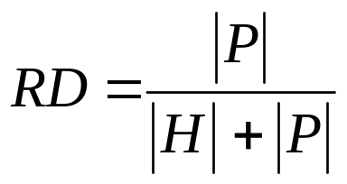
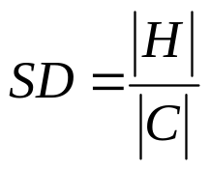
I. Schema Metrics
  Relationship diversity
    This measure differentiates an ontology that contains mostly inheritance relationships (≈ taxonomy) from an ontology that contains a diverse set of relationships.
  Schema Deepness
    This measure describes the distribution of classes across different levels of the ontology inheritance tree

Slide 8
II. Instance Metrics
Evaluate the placement, distribution and relationships between instance data which can indicate the effectiveness of the schema design and the amount of knowledge contained in the ontology.

Slide 9
II. Instance Metrics
Overall KB Metrics
  This group of metrics gives an overall view on how instances are represented in the KB.
Class-Specific Metrics
  This group of metrics indicates how each class defined in the ontology schema is being utilized in the KB.
Relationship-Specific Metrics
  This group of metrics indicates how each relationship defined in the ontology schema is being utilized in the KB.

Slide 10
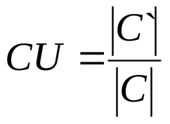
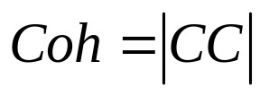
Overall KB Metrics
Class Utilization
  Evaluates how classes defined in the schema are being utilized in the KB.
Class Instance Distribution
  Evaluates how instances are spread across the classes of the schema.
Cohesion (connectedness)
  Used to discover instance “islands”.
CID = StdDev(Inst(Ci))

Slide 11

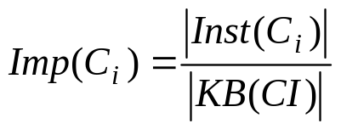
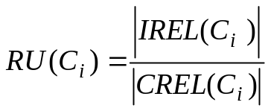
Class-Specific Metrics
Class Connectivity (centrality)
  This metric evaluates the importance of a class based on the relationships of its instances with instances of other classes in the ontology.
Class Importance (popularity)
  This metric evaluates the importance of a class based on the number of instances it contains compared to other classes in the ontology.
Relationship Utilization
  This metric evaluates how the relationships defined for each class in the schema are being used at the instances level.

Slide 12
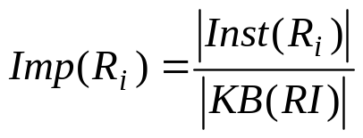
Relationship-Specific Metrics
Relationship Importance (popularity)
  This metric measures the percentage of instances of a relationship with respect to the total number of relationship instances in the KB.

Slide 13
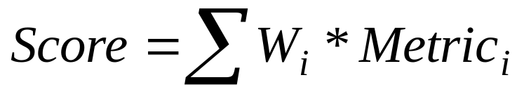
Ontology Score Calculation
Metric_{i}:
{Relationship diversity, Schema Deepness, Class Utilization, Cohesion, Avg(Connectivity(C_{i})), Avg(Importance(C_{i})), Avg(Relationship Utilization(C_{i})), Avg(Importance(R_{i})), #Classes, #Relationships, #Instances}
W_{i}:
Set of tunable metric weights

Slide 14
Results
Symbol | Ontology URL
I | http://ebiquity.umbc.edu/ontology/conference.owl
II | http://kmi.open.ac.uk/semanticweb/ontologies/owl/aktive-portal-ontology-latest.owl
III | http://www.architexturez.in/+/--c--/caad.3.0.rdf.owl
IV | http://www.csd.abdn.ac.uk/~cmckenzi/playpen/rdf/akt_ontology_LITE.owl
V | http://www.mindswap.org/2002/ont/paperResults.rdf
VI | http://owl.mindswap.org/2003/ont/owlweb.rdf
VII | http://139.91.183.30:9090/RDF/VRP/Examples/SWPG.rdfs
VIII | http://www.lehigh.edu/~zhp2/2004/0401/univ-bench.owl
IX | http://www.mindswap.org/2004/SSSW04/aktive-portal-ontology-latest.owl
Swoogle Results for "Paper"

Slide 15
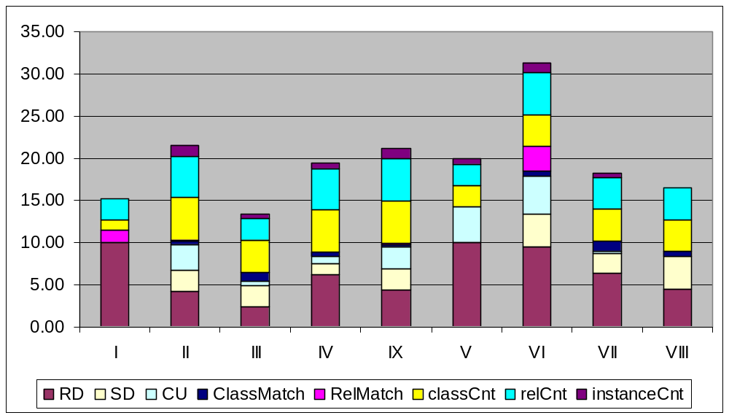
OntoQA Ranking - 1
OntoQA Results for "Paper“ with default metric weights

Slide 16
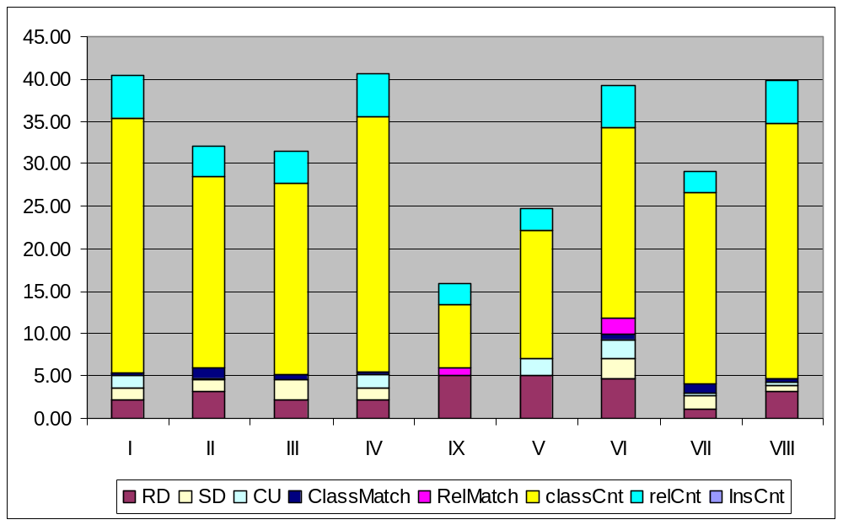
OntoQA Ranking - 2
OntoQA Results for "Paper“ with metric weights biased towards larger schema size

Slide 17
OntoQA vs. Users
Ontology | OntoQA Rank | Average User Rank
I | 2 | 9
II | 5 | 1
III | 6 | 5
IV | 1 | 6
V | 8 | 8
VI | 4 | 4
VII | 7 | 2
VIII | 3 | 7
Pearson’s Correlation Coefficient = 0.80

Slide 18
Future work
Enable the user to specify an ontology library (e.g. OBO) to limit the search in ontologies that exist in that specific library.
Use BRAHMS instead of Sesame as a data store since BRAHMS is more efficient in handling large ontologies that are common in bioinformatics.

Slide 19
Questions

