Slide 1
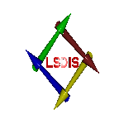
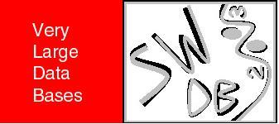
Context Aware Semantic Association Ranking
SWDB Workshop
Berlin, September 7, 2003
Boanerges Aleman-Meza, Chris Halaschek, I. Budak Arpinar, Amit Sheth
Large Scale Distributed Information Systems Lab
Computer Science Department, University of Georgia
This material is based upon work supported by the National Science Foundation
under Grant No. 0219649.

Slide 2
“Finding out about” [ Belew00 ] relationships!
From …..
Finding things
to…..

Slide 3
Outline
From Search to Analysis:
Semantic Associations
Using Context for Ranking
Ranking Algorithm
Preliminary Results / Demo
Related Work
Conclusion & Future Work

Slide 4
Changing expectations
Not documents, not search,
not even entities, but actionable information and insight
Emergence of text/content analytics, knowledge discovery, etc. for business intelligence, national security, and other emerging markets

Slide 5
Example in 9-11 context
What are relationships between Khalid Al-Midhar and Majed Moqed ?
  Connections
    Bought tickets using same frequent flier number
  Similarities
    Both purchased tickets originating from Washington DC paidby cash and picked up their tickets at the Baltimore-Washington Int'l Airport
    Both have seats in Row 12
“What relationships exist (if any) between Osama bin Laden and the 9-11 attackers”

Slide 6
Semantic Associations

Slide 7
ρ - Association
Two entities e₁ and e_{n} are semantically connected if there exists a sequence e₁, P₁, e₂, P₂, e₃, … e_{n-1}, P_{n-1}, e_{n} in an RDF graph where ei, 1 ≤ i ≤ n, are entities and P_{j}, 1 ≤ j < n, are properties
“M’mmed”
Semantically Connected
“Abdulaziz”
fname
fname
&r1
&r6
“Atta”
lname
lname
“Alomari ”
purchased
for
&r5

Slide 8
σ - Association
Two entities are semantically similar if both have ≥ 1 similar paths starting from the initial entities, such that for each segment of the path:
  Property Pi is either the same or subproperty of the corresponding property in the other path
  Entity Ei belongs to the same class, classes that are siblings, or a class that is a subclass of the corresponding class in the other path
Passenger
Ticket
Cash
“M’mmed”
fname
&r1
purchased
&r2
paidby
&r3
“Atta”
lname
Semantic
Similarity
Semantic
Similarity
Semantic
Similarity
“Marwan”
fname
&r7
purchased
&r8
paidby
&r9
“Al-Shehhi”
lname

Slide 9
Semantic Association
ρ - Query
  A ρ - Query, expressed as ρ(x, y), where x and y are entities, results in the set of all semantic paths that connect x and y
σ - Query
  A σ - Query, expressed as σ(x, y), where x and y are entities, results in the set of all pairs of semantically similar paths originating at x and y

Slide 10
The Need For Ranking
Current test bed with > 6,000 entities and > 11,000 explicit relations
The following semantic association query ρ(“Nasir Ali”, “AlQeada”), results in 2,234 associations
The results must be presented to a user in a relevant fashion…thus the need for ranking

Slide 11
Context Use For Ranking

Slide 12
Context: Why, What, How?
Context => Relevance; Reduction in computation space
Context captures the users’ interest to provide the user with the relevant knowledge within numerous relationships between the entities
By defining regions (or sub-graphs) of the ontology we are capturing the areas of interest of the user

Slide 13
Context Specification
Topographic approach (current)
  Regions ‘capture’ user’s interest, such as a region is a subset of classes (entities) and properties of an ontology
View approach (future)
Each region can have a relevance weight

Slide 14
Ranking Algorithm

Slide 15
Ranking – Introduction
Our ranking approach defines a path rank as a function of several ranking criteria
Ranking criteria:
  Universal – query (or context) independent
    Subsumption
  User-Defined - query (or context) specific
    Path Length
    Context
    Trust

Slide 16
Subsumption Weight
Organization
Specialized instances are considered more relevant
More “specific” relations convey more meaning
Political
Organization
Democratic
Political
Organization
Ranked
Higher
H. Dean
member Of
Democratic
Party
Ranked
Lower
H. Dean
member Of
AutoClub

Slide 17
Path Length Weight
Interest in the most direct paths (i.e., the shortest path)
  May infer a stronger relationship between two entities
Interest in hidden, indirect, or discrete paths (i.e., longer paths)
  Terrorist cells are often hidden
  Money laundering involves deliberate innocuous looking transactions

Slide 18
Path Length - Example
SAAD BIN LADEN
Ranked
Lower
(0. 1111)
friend Of
Ranked
Higher
(0. 889)
friend Of
SAIF AL-ADIL
ABU ZUBAYDAH
friend Of
Short
Paths
Favored
OMAR AL-FAROUQ
Long
Paths
Favored
friend Of
member Of
Osama Bin Laden
Al Qeada
member Of
Ranked
Higher (1.0)
Ranked
Lower (0.01)

Slide 19
Context Weight
Consider user’s domain of interest (user-weighted regions)
Issues
  Paths can pass through numerous regions of interest
  Large and/or small portions of paths can pass through these regions
Paths outside context regions rank lower or are discarded

Slide 20
Context Weight - Example
has Account
e3:Organization
supports
e2:Financial
Organization
e4:Terrorist
Organization
e7:Terrorist
Organization
e6:Financial
Organization
works For
involved In
located In
member Of
e8:Terrorist
Attack
e5:Person
member Of
friend Of
at location
e1:Person
located In
e9:Location
Region1: Financial Domain, weight=0.50
Region2: Terrorist Domain, weight=0.75

Slide 21
Trust Weight
Relationships (properties) originate from differently trusted sources
Trust values need to be assigned to relationships depending on the source
e.g., Reuters could be more trusted than some of the other news sources
Current approach penalizes low trusted relationships (may overweight lowest trust in a relationship)

Slide 22
Ranking Criterion
Overall Path Weight of a semantic association is a linear function
Ranking
Score =
where k_{i} add up to 1.0
Allows fine-tuning of the ranking criteria
k₁ × Subsumption +
k₂ × Length +
k₃ × Context +
k₄ × Trust

Slide 23
Preliminary Results & Demo

Slide 24
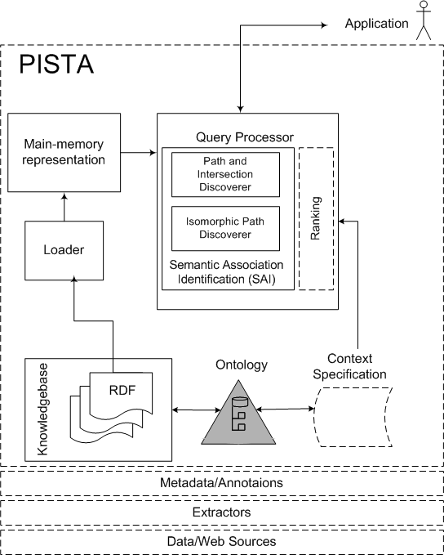
Preliminary Results
Metadata sources cover terrorism domain
Ontology in RDFS, metadata in RDF
Semagix Freedom suite used for metadata extraction
Currently > 6,000 entities and > 11,000 relations/assertions (plan to increase by 2 order of magnitude)

Slide 25
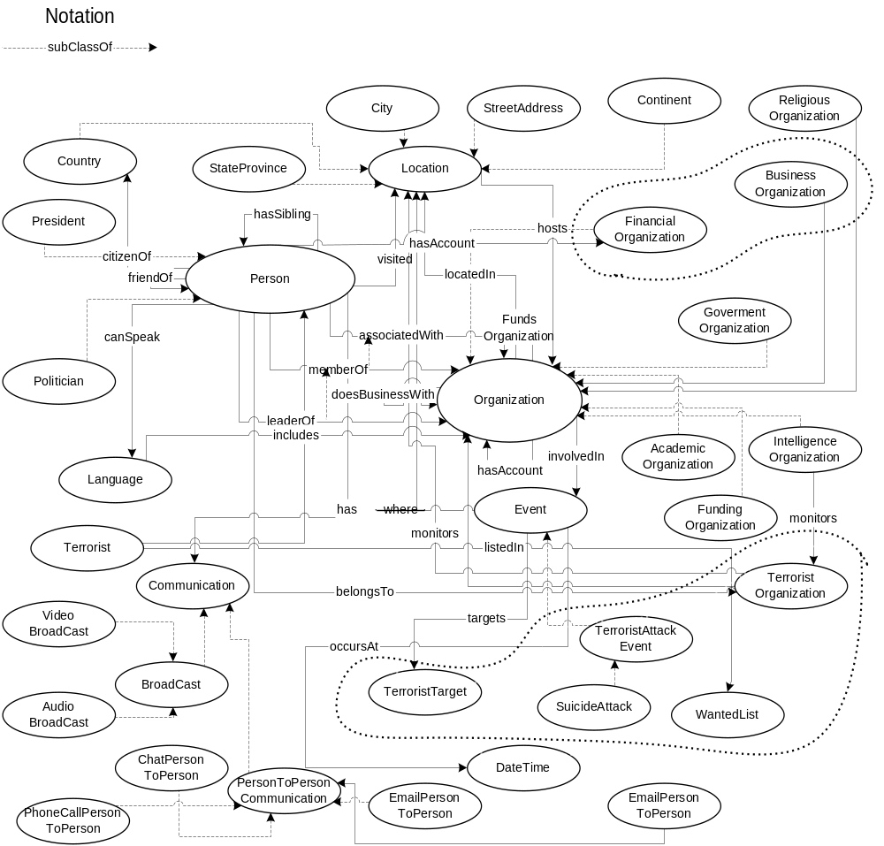
PISTA Ontology

Slide 26
Preliminary Results
Have implemented naïve algorithms for ρ and σ
  Using a depth-first graph traversal algorithm
  Used Jena to interact with RDF graphs (i.e., metadata in main memory)

Slide 27
Demo
Context
  ‘A’ defines a region covering ‘terrorism’ - weight of 0.6
  ‘B’ captures ‘financial’ region - weight of 0.4
Ranking criteria (this example)
  0.6 to context
  0.1 to subsumption
  0.2 to path length (longer paths favored),
  0.1 to trust weight

Slide 28
Demo
Click here to begin demo

Slide 29
Related Work

Slide 30
Related Work
Ranking in Semantic Web Portals
  [Maedche et al 2001]
Our Earlier Work
  [Anyanwu et al 2003]
Contemporary information retrieval ranking approaches
  [ Brin et al 1998], [Teoma]
Context Modeling
  [Kashyap et al 1996], [Crowley et al 2002]

Slide 31
Conclusions & Future Work

Slide 32
Summary and Future Work
This paper: ranking of ρ path
  Even more important than ranking of documents in contemporary Web search
Ongoing: ranking of σ path
Future:
  Formal query language for semantic associations is currently under development
  Develop evaluation metrics for context-aware ranking (different than the traditional precision and recall)
  Use of the ranking scheme for the semantic-association discovery algorithms (scalability in very large data sets)

Slide 33
Questions, Comments, . . .
For more info:
  http://lsdis.cs.uga.edu/proj/SAI/
    PISTA Project, papers, presentations

