Slide 1

ES3N: A Semantic Approach to Data
Management in Sensor Networks
Micah Lewis, Delroy Cameron, Shaohua Xie, I. Budak Arpinar
Computer Science Department
University of Georgia
Athens, GA 30602

Slide 2
Outline
Background
Problem
ES3N Implementation
Semantic Benefits
Future Work
Demo

Slide 3
Background
Cargill Industries Inc.
  Corporate Headquarters in Minneapolis, MN
  Origin as family-owned food business
  Started in 1865
  149,000 employees
  Spans 63 countries

Slide 4
Cargill
International provider of food services
Commercial cereal grain and oil seed storage
Food Processing (soybean and corn)
Provide quality product to consumers

Slide 5
Background…
USDA ARS NPRL
  USDA created 1862
  ARS created 1953
  NPRL established 1965

Slide 6
NPRL
Subsidiary research unit of the ARS
Unshelled and shelled peanut research
Quality for pre and post harvest
Control aflatoxin

Slide 7
Problem
Cargill
  Primitive data acquisition
  No data storage mechanism
  No possibility for data analysis or mining

Slide 8
Problem…
NPRL
  Data management
  Laborious human analysis
  Query functionality nonexistent

Slide 9
ES3N Implementation
Three targeted areas:
  Data acquisition
  Data Storage
  Data Management

Slide 10
ES3N Implementation
Four main components:
  Sensor Network
  Data Analysis and Query Processing Unit
  Ontology
  GUI (Graphical User Interface)

Slide 11
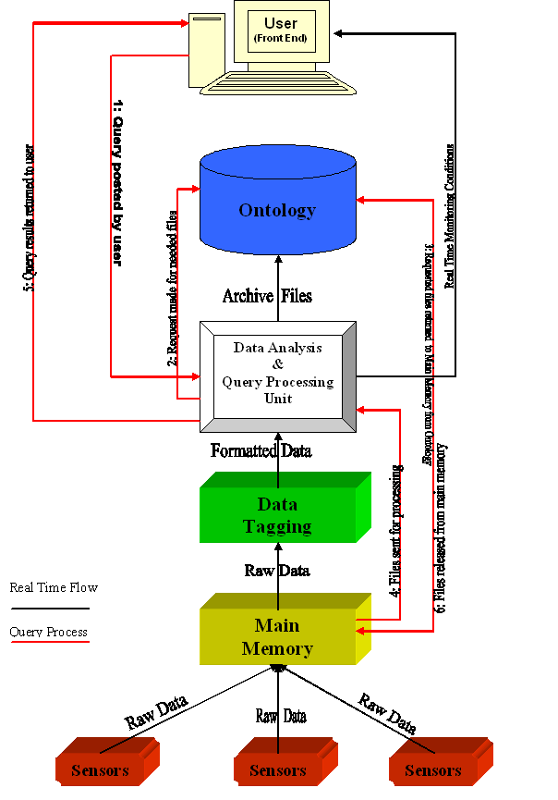

Slide 12
Development
Data collection
Memory caching
Data Tagging
Ontology representation
Query processing

Slide 13
Data Collection
Raw data retrieved from sensors
Ontology provides persistent storage
Data reside in ontology in RDF files

Slide 14
Memory Caching
Preserve efficiency of system
Effectively manage memory
Main memory cleared daily
Daily RDF files generated

Slide 15
Data Tagging
Heterogeneous data usually problematic
Two sensor types:
  Temperature: thermocouples
  Relative humidity: RH sensors
Data are time stamped (has_date & has_time)

Slide 16
Ontology Representation
Function 1: Constraints & Initialization
  Grain/seed specific constraints
  Indication of contents within mini-dome
  Utilization of OWL

Slide 17
Ontology Representation…
Function 2: Record Storage
  Predefined ontology schema
  Each record consists of 21 attributes
  has_date & has_time provide uniqueness
  Utilization of RDF/RDFS

Slide 18
1
0
11-19-05
0
13
has_fan2
has_fan3
has_date
has_time
has_fan1
58.1
52.4
has_humidityin
29.2
71.2
#data13
has_humidityout
has_temp_level3
61.7
has_tempout
53.6
has_temp_level1
56.9
has_temp_level2
50.7
56.6
57.1
65.0
59.6
67.1
53.6
54.1
59.9

Slide 19
Query Processing
Collaboration of SPARQL and Jena
Support for three types of queries:
  Exploratory
  Monitoring
  Range

Slide 20
Query Processing
Needed files determined for query
Files returned to main memory
Files released upon completion of query

Slide 21
56.3
48.3
#data1
#data2
has_fan1
has_fan1
has_date
has_date
11-20-05
1
has_date
has_date
has_fan1
#data4
#data3
has_fan1
0
46.4
70.0

Slide 22
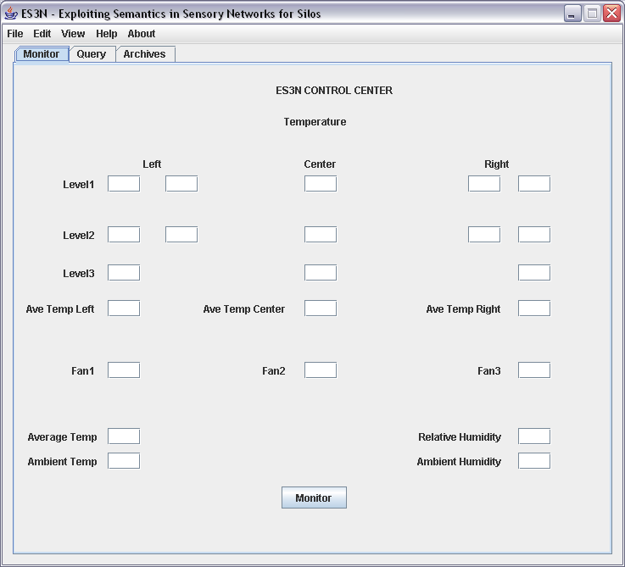
DEMO

Slide 23
Semantic Benefits
Providing meaning to meaningless data
Exploit literal statements
Query Richness

Slide 24
Future Work
Addition of BRAHMS
  Large RDF storage system
  Supports fast semantic association discovery
  Aid in data analysis

Slide 25
Conclusion
Grain storage issues with Cargill & NPRL
ES3N:
  Data Acquisition
  Data Storage
  Data Management
Semantic Relief

