Slide 1
Mobile Web Search Personalization
Kapil Goenka, I. Budak Arpinar, Mustafa Nural

Slide 2
Motivation for Personalizing Web Search
Personalization
Current Web Search Engines:
  Lack user adaption
  Retrieve results based on web popularity rather than user's interests
  Users typically view only the first few pages of search results
  Problem: Relevant results beyond first few pages have a much lower chance of being visited

Slide 3
Motivation for Personalizing Web Search (cont’d)
Personalization approaches aim to:
  tailor search results to individuals based on knowledge of their interests
  identify relevant documents and put them on top of the result list
  filter irrelevant search results

Slide 4
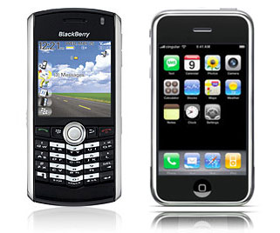
Motivation for Personalizing Web Search (cont’d)
Mobile Clients
In the mobile environment:
  Smaller space for displaying search results
  Input modes inherently limited
  User likely to view fewer search results
  Relevance is crucial

Slide 5
Goal
Personalize web search in the mobile environment
  case study: Apple’s iPhone
Identify user’s interests based on the web pages visited
Build a profile of user interests on the client mobile device
Re-rank search results from a standard web search engine
Require minimal user feedback

Slide 6

User Profiles
store approximations of interests of a given user
defined explicitly by user, or created implicitly based on user activity
used by personalization engines to provide tailored content
Personalization Engine
User Profile
Personalized Content
Content
News
Shopping
Movies
Music
Web Search

Slide 7
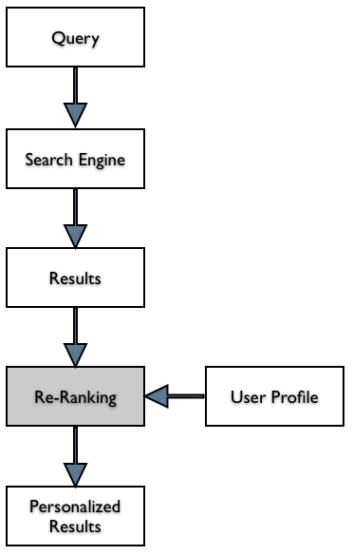
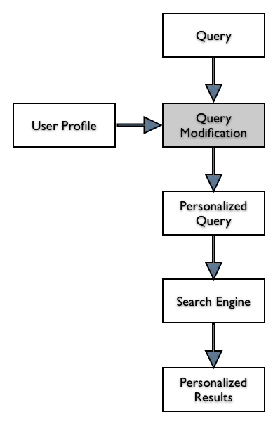
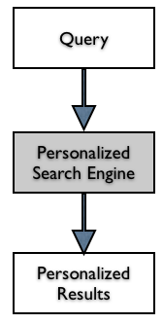
Approaches
Part of retrieval process:
Personalization built into the search engine
Result Re-ranking:
User Profile used to re-rank search results returned from a standard, non-personalized search engines
Query Modification:
User profile affects the submitted representation of the information need

Slide 8
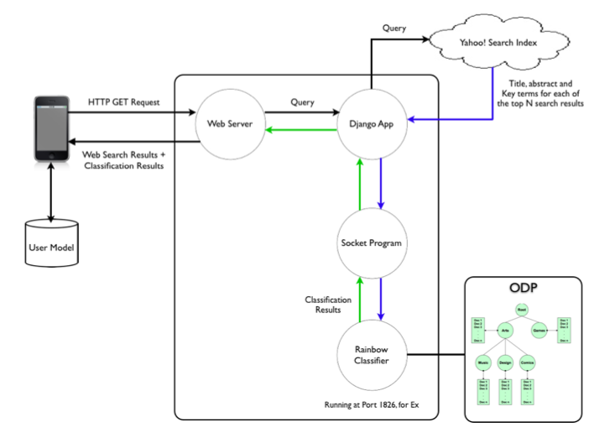
System Architecture

Slide 9
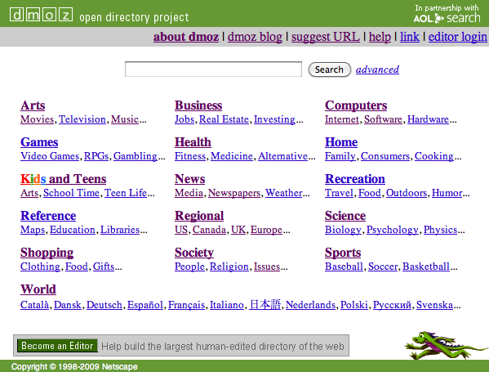
Open Directory Project(ODP)
Popular web directory
Repository of web pages
Hierarchically structured
Each node defines a concept

Slide 10
Open Directory Project(ODP)
Higher levels represent broader concepts
Web pages annotated and categorized
Content available for programmatic access
RDF format, SQL dump

Slide 11
Open Directory Project(ODP)
Replicate ODP structure & content on local hard disk
  Folders represent categories
  Every folder has one textual document containing titles & descriptions of web pages cataloged under it in ODP
Not all categories are useful
  World & Regional branches of ODP pruned

Slide 12
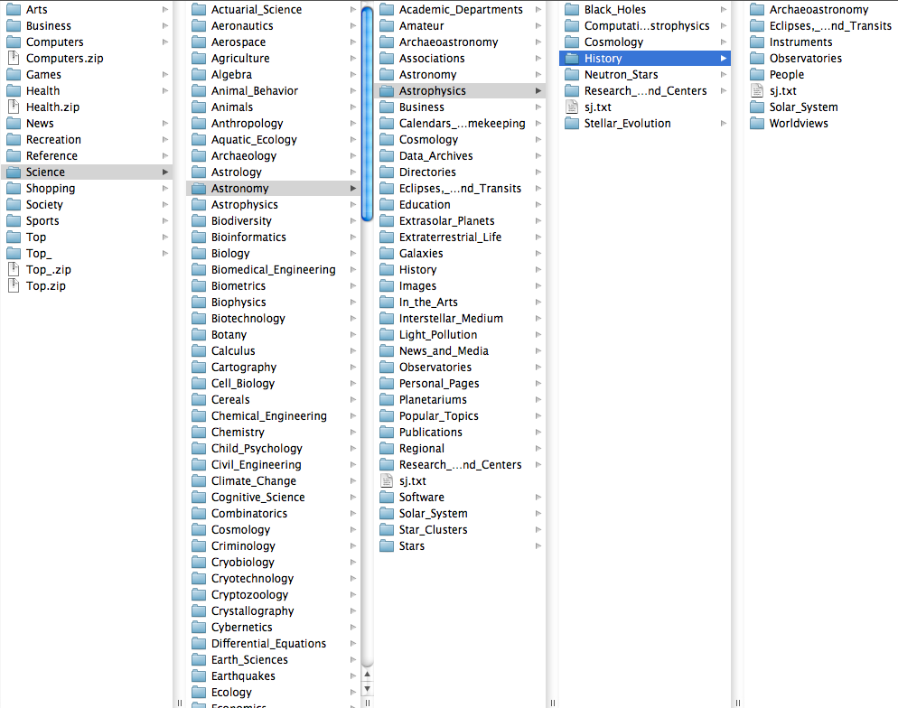
Open Directory Project(ODP)

Slide 13
Text Classification
Task of automatically sorting documents into pre-defined categories
Widely used in personalization systems

Slide 14
Text Classification
Carried out in two phases:
  Training
    the system is trained on a set of pre-labeled documents
    the system learns features that represents each of the categories
  Classification
    system receives a new document and assigns it to a particular category

Slide 15
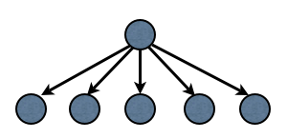
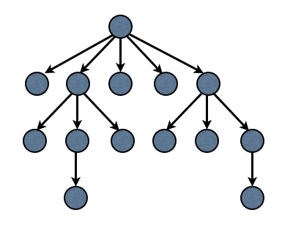
Text Classification
Flat Classifier
No relationship between categories
Widely used in classification
Good accuracy
Single classification produces results
~500 ms for classifying top 100 Yahoo! Search results
Hierarchical Classifier
Parent-child relationship between categories
Used with hierarchical knowledge bases
Improvement in accuracy
One classifier for every node in hierarchy. Document must go through multiple classifications before being assigned to a category
~2 sec for classifying top 100 Yahoo! search results

Slide 16
Text Classification
480 categories selected from top three levels of ODP
No automated way of selecting categories, use best intuition
Categories represent broad range of user interests

Slide 17
Yahoo Web Search API
Provides programmatic access to the Yahoo! search index
For each search result, returns {URL, title, abstract and key terms}
Key terms
  List of keywords representative of the document
  Obtained based on terms’ frequency & positional attributes in the document

Slide 18
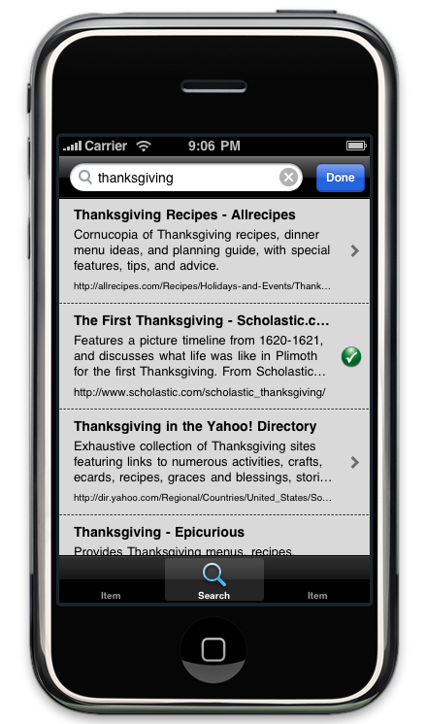
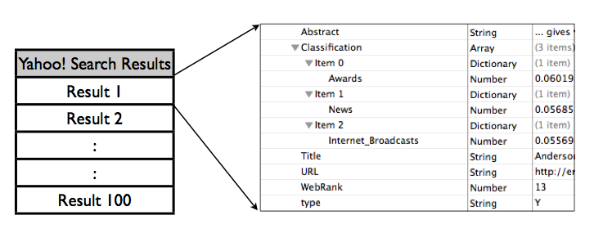
Client
Implemented using iPhone SDK / Objective-C
Maintains a profile of user interests
Receives structured search results data from server
Re-ranks and presents search results to user
Updates user profile based on user activity

Slide 19
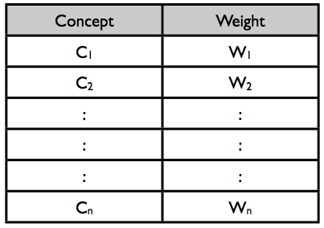
Client
User profile is a weighted category vector
Higher weight implies more user interest
Top 3 categories returned for every search result
When user clicks on a result, its categories are updated proportionally

Slide 20

Client
Re-Ranking
wpi,k = weight of concept k in user profile
wdj,k = weight of concept k in result j
N = number of concepts returned to client

Slide 21
Evaluation Set up
Five users were asked to user our application, over a period of 10 days
Total 20 search results displayed to the user for each query
  Top 10 Yahoo! search results
  Top 10 personalized search results
  Results randomized before displaying, to avoid user bias
Users were asked to carefully review all results before clicking on any search result
Visited results were marked as a visual cue, & their category weights updated
User could uncheck a visited result, it was found to be irrelevant

Slide 22
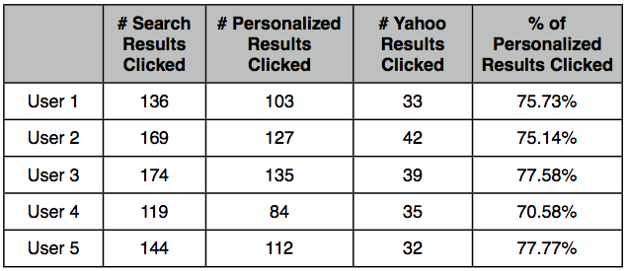
% of Personalized Search Results Clicked

Slide 23
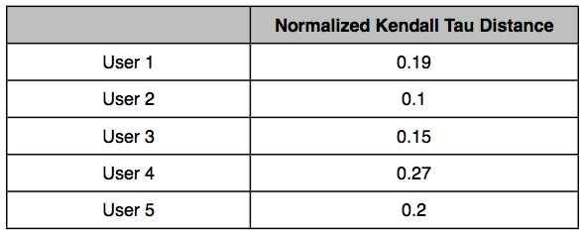
System Generated User Profile vs. True User Profile
Users were shown top 20 system generated categories
Asked to re-order the categories, based on true interests during search session
Computed Kendal Tau Distance between the two ranked lists
  Measures degree of similarity between two ranked lists
  Lies between [0, 1]. 0 = identical, 1 = maximum disagreement

Slide 24
Conclusions
The average time taken to fetch standard search results, re-rank & display them is less than 2 seconds, which is acceptable & almost real-time on a mobile device.
User interests can in fact improve web search results.

