Slide 1

Extraction/Storage Utility for XML Documents
Budak Arpinar, John Miller, and Amit Sheth
LSDIS Lab, Computer Science Department
University of Georgia, Athens, GA

Slide 2
Introduction
Motivation:
XML = standard for document exchange
We are using it for process/workflow exchange (repository) too! (NRL 2000)
Need for XML databases
How to
  store,
  search/browse,
  reuse, export/import and
  exchange workflow processes effectively and efficiently?

Slide 3
Solution:
A Data Extraction and Storage Utility For XML Documents
Define workflows graphically
Convert them to XML
Map them to relational model
Store in a relational DB and use its querying/other capabilities
Re-store original XML documents as needed
You can modify workflow meta-model any time (no manual DB schema change)
XML Utility
NRL’s
NRL’s
Workflow Design
NRL’s
Workflow Design
NRL’s
Workflow Design
Workflow Design
Tool
Tool
Tool
Tool
Metamodel
Extractor
Extractor
Workflow
Workflow
DB
Specification
Specification
Files
Files
(XML)
(XML)
Actual Data (XML)

Slide 4
Outline
Workflow Background
Repository Architecture
Data Filtering and Extraction From XML Documents
XML-Relational Mapping
Wrap up

Slide 5
What is a Workflow Process?
A workflow process is a collection of processing steps (activities) organized to accomplish some business process.
  processing damage claims in an insurance company,
  telecommunication service provisioning,
  gene sequencing/transcription in a genome lab.
An activity is
  a collection of events,
  a set of logically related operations or
  a bounded computation
that can be made to occur by a single logical actor (e.g., by a person with a given role) or a processing entity (information system, resource manager).
  review a damage claim assessment,
  fill out a complaint form,
  perform a database transaction

Slide 6
METEOR Workflow Model
task
task
start
task
end
filter
task
interface
interface
interface
aux. sys
proc.
entity
proc.
entity
proc.
entity
Notes:
4

Slide 7
The Process Repository
A richly structured repository of knowledge about business processes can significantly enhance the creativity of process designers by helping them systematically explore many alternative combinations of process elements.
The tool that implements this approach: Process Repository (XML Utility)
  store meta-data about workflow designs, organizations, informational resources and computational resources
  enhance reusability and facilitate rapid incorporation of resources into workflows.
  supports adaptability
  provides for survivability/fault tolerance
  inter-organizational workflows

Slide 8
Features of XML Utility
General purpose tool actually ..
Filtering of XML (workflow) objects that need to extracted (next slide→)
Generating relational schemas for on-the-fly storage of XML documents,
Loading data from XML documents into relational tables,
Re-storing original XML documents (CLOBs) as needed,
Querying, browsing, and versioning.
Reusing selected components by drag-and-drop

Slide 9
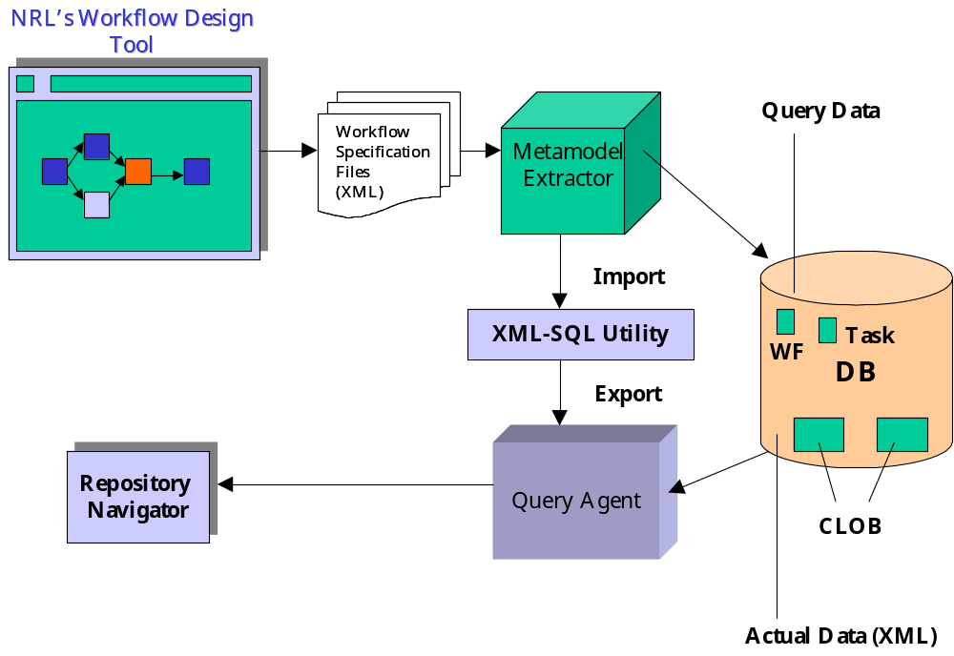
Repository Architecture (1)

Slide 10
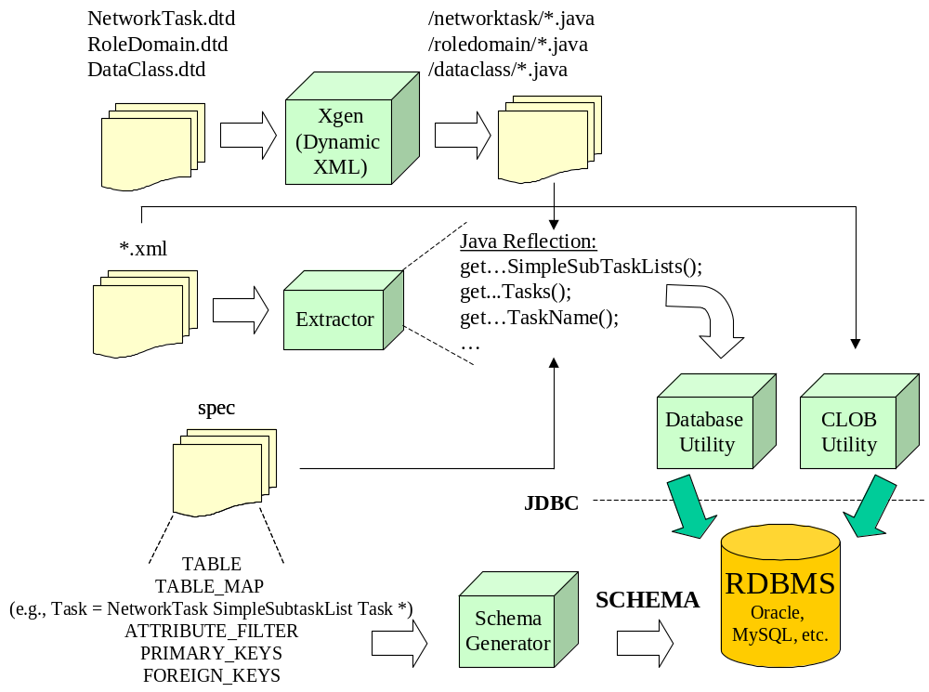
Repository Architecture (2)
(1)
(3)
(2)

Slide 11
How Extraction (Filtering) Works?
<?xml version="1.0"?>
<!DOCTYPE NetworkTask SYSTEM "NetworkTask.dtd">
<NetworkTask id="1">
<Task id="2">
<Name>SampleFlow</Name>
<TaskType>Non-transactional WorkFlow</TaskType>
</Task>
<SimpleSubTaskList>
<Task id="3">
<Name>Start</Name>
<TaskType>Human</TaskType>
</Task>
<Task id="4">
<Name>Close</Name>
<TaskType>Transactional</TaskType>
</Task>
</SimpleSubTaskList>
</NetworkTask>
SampleFlow.xml

Slide 12
XML Document Hierarchy
Legend
Root
DocNode
ElementNode
NetworkTask
AttributeNode
ValueNode
Task
SimpleSubTaskList
Id
Name
TaskType
Id
Task
Task
1
SampleFlow
Non-transactional-
Workflow
2
Name
TaskType
Id
Name
TaskType
Id
Start
Human
3
Close
Transactional
4

Slide 13
Mapping Specification
public static final String [ ] TABLE = {
"xmldoc",
"networktask",
"task",
"dataobject",
"roledomain",
"wfrole"};
public static final String [] TABLE_MAP = {
"", // special root table (no data from XML document itself)
"NetworkTask Task",
"NetworkTask SimpleSubTaskList Task *",
"DataClass",
"RoleDomain",
"RoleDomain Role *"};

Slide 14
Mapping to Relations
Root
Root
NetworkTask
NetworkTask
Task
SimpleSubTaskList
Id
Name
TaskType
Id
Task
Task
1
SampleFlow
Non-transactional-
Workflow
2
Name
TaskType
Id
Name
TaskType
Id
Start
Human
3
Close
Transactional
4

Slide 15
Filtering Attributes
Legend
Root
DocNode
ElementNode
NetworkTask
AttributeNode
ValueNode
Task
SimpleSubTaskList
Id
A subset
of attributes
Name
TaskType
Id
Task
Task
1
SampleFlow
Non-transactional-
Workflow
2
Name
TaskType
Id
Name
TaskType
Id
Start
Human
3
Close
Transactional
4

Slide 16
Initial Relational Database
Legend
Database
Database
Relation
Attribute
Value
XmlDoc
NetworkTask
Task
Task
Name
TaskType
Name
TaskType
Name
TaskType
SampleFlow
Non-transactional-
Workflow
Start
Human
Close
Transactional

Slide 17
Primary/Foreign Keys
Database
XmlDoc
NetworkTask
Task
DocumentId
DocumentText
XmlDoc-
DocumentId
Name
TaskType
XmlDoc-
DocumentId
Name
TaskType
VersionNo
XmlFileName
Dtd

Slide 18
Invalid Keys
Legend
DocNode
ElementNode
AttributeNode
ValueNode
Relation
Valid Foreign
Key
Invalid Foreign
Key

Slide 19
Final Relational Database
Legend
Database
Database
Relation
Attribute
Value
XmlDoc
NetworkTask
Task
Task
DocumentId
XmlFileName
XmlDoc-
DocumentId
XmlDoc-
DocumentId
XmlDoc-
DocumentId
VersionNo
DocumentText
Name
Name
Name
TaskType
TaskType
TaskType
Dtd
SampleFlow
Non-transactional-
Workflow
Start
Human
Close
Transactional

Slide 20
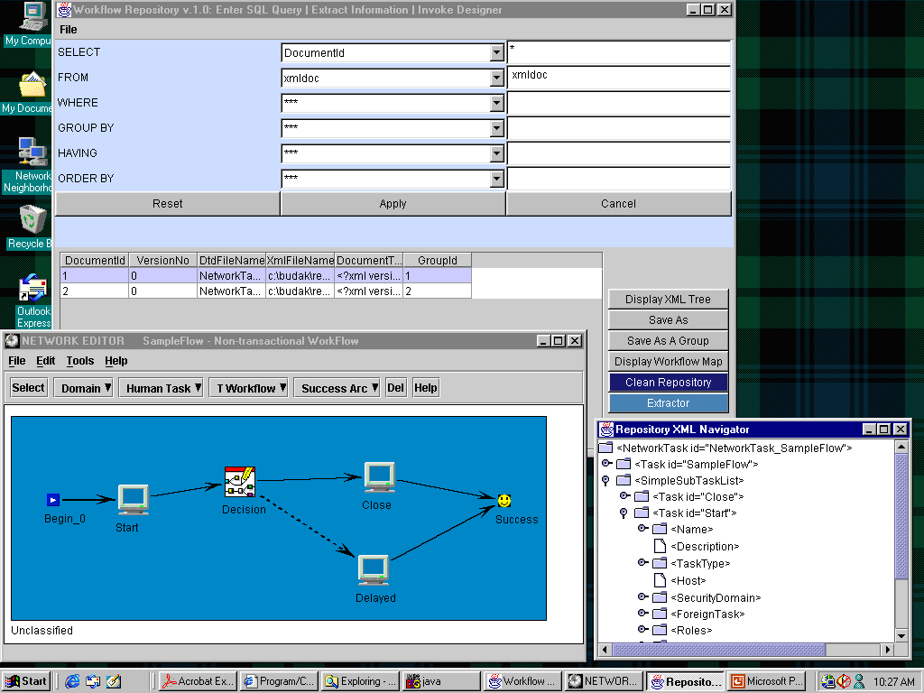

Slide 21
Related Work
Our XML storage scheme is practical and flexible.
  Practicality: the broader acceptance and use of Relational Database Management Systems
  Flexibility is provided by selective extraction mechanism (i.e., filtering) employed by the Extractor
The comparison of our approach with XML databases (e.g., Lore) in terms of efficient storage and querying XML documents
  They support a native data model for XML documents,
  Many XML DBMS do not provide high performance.
Database vendors have started to support XML.
  Axielle by Ardent Software,
  eXcelon by ODI, and
  XML Repository by Poet
    An import and export programming interface, which is compliant with Document Object Model (DOM) from the W3C.

Slide 22
Summary
Recently, XML gains a great acceptance as a data interchange format on the Web.
A flexible and practical solution until XML DBMSs are improved and standardized.
XML based workflow repository provides easy exchange of workflow process definitions between companies, and an integration tool to enable coordination of companies’ business processes

