Slide 1
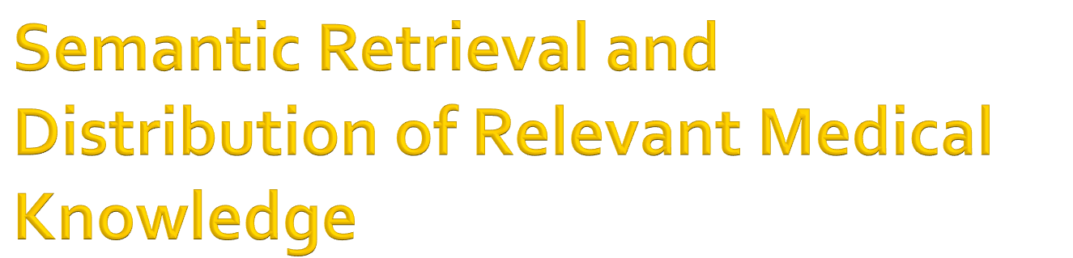
By Asmita Rahman
Major Professor: Dr. Ismailcem Budak Arpinar

Slide 2

Research Overview
Motivation
Related Works
Approach
Building Blocks
Semantic Matchmaking
Semantic Ranking
Workflow Example
Test Cases
Preliminary Evaluation
Conclusion and Future Works

Slide 3

Today, the knowledge in the medical domain is growing at a very fast pace.
Hard to keep track of updates, new treatments, new medications etc.
Our research will solve this issue by making relevant information easily available.

Slide 4

Motivating Scenario # 1:
  Martha- a 65 year old woman, suffering from mild Asthma
  On regular medication (Inhaler)
  Visits Doctor every 6 Month
  Change in Inhaler and has been taken away from shelves
  She has enough stock, so wouldn’t know about the update until she does on of the following:
        Visits the doctor
        Visits the pharmacy
        Doctor locates her and contacts her
        She searches the internet
        She reads the publication

Slide 5
Consequences:
  Side effects of taking the wrong medication
  Unsafe and may be life threatening

Slide 6
Motivating Scenario # 2:
  Mr. Smith had a heart attack in 2005 and is on drug Plavix to reduce the risk of future heart attacks.
  As Plavix leads to acid reflux, the doctor has also prescribed the drug Prilosec to lower acidity.
  In March 2009, a study appeared in the Journal of American Medical Association, which indicated that combination of drugs Clopidogrel (Plavix is the brand name of Clopidogrel) and proton pump inhibitor (PPI- Prilosec is one of the PPIs) in patients with previous histories of heart attacks can actually double the risk of second heart attack.
  This puts him in high-risk category for a second heart attack

Slide 7
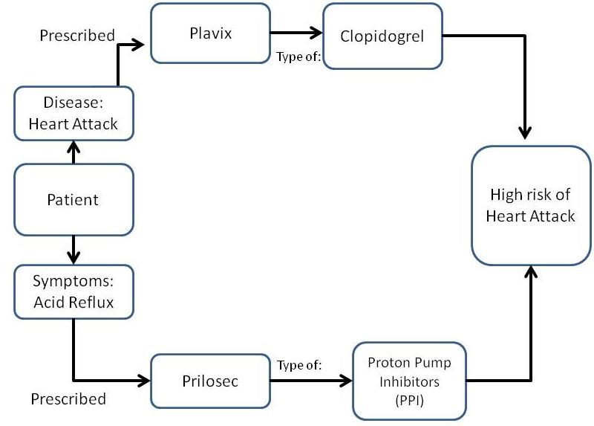

Slide 8
Mr. Brown can learn about the discovery:
    Searching and browsing relevant websites.
    Attending a conference/ professional meeting.
    Through colleagues who may have knowledge about the new information.
    Significant delays between publishing of new information and him becoming aware of new info.

Slide 9

This system consists of two major parts:
  Semantic Matchmaking
    The Matchmaking performs all the core operations of finding the relevant results for any particular health record.
  Semantic Ranking
    Once the results are found the Semantic Ranking provides us a way of calculating the relevance to a particular record.

Slide 10
The Matchmaking and the Ranking process would be is performed semantically .
This will enable the system to use ontology mapping, synonyms calculation and hierarchy for better results.

Slide 11

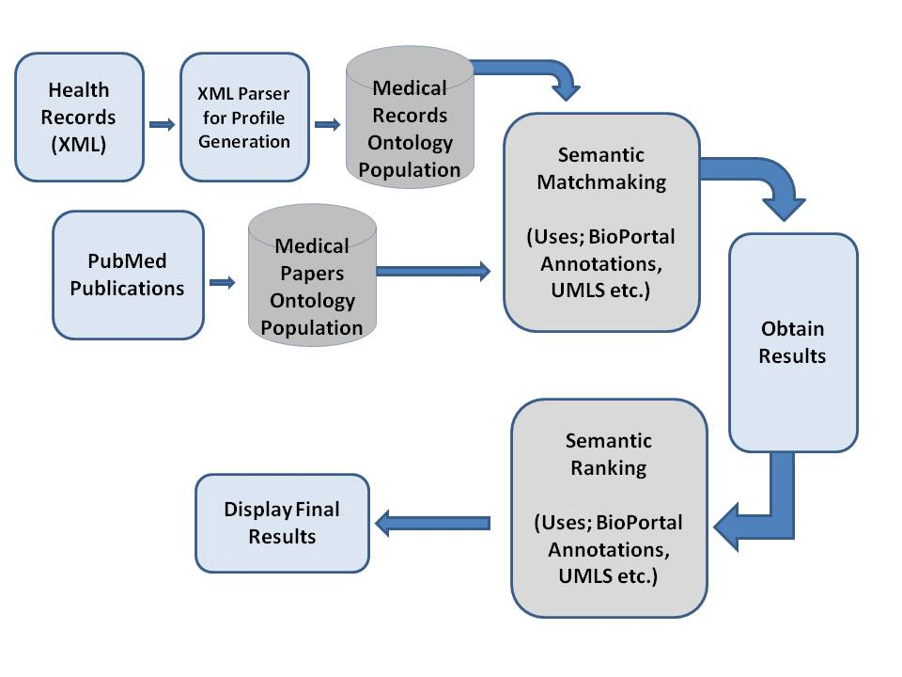

Slide 12

Google Health Records
PubMed
UMLS
NCBO BioPortal

Slide 13

In order to be able to test the system, one must realize the need of health records.
Sensitive Information
No standard found
Generated Sample records of the same format as the format provided by Google Health.
This will enable this application to work properly when fed with real health records.

Slide 14

<Patient>
<Name>Robin Hood</Name>
<Address>1563 South Milton st</Address>
<City>Tuscon</City>
<State>AZ</State>
<Zip>92009</Zip>
<Country>United States</Country>
<Id>1235</Id>
<Age>25</Age>
<KnownDisease>Asthma</KnownDisease>
<Medications>Aerobid, Alvesco</Medications>
<Gender>Male</Gender>
<symptoms>vomiting</symptoms>
<PrimaryPhysician> Dr Smith</ PrimaryPhysician>
<PhysicianId>dc1247</PhysicianId>
<PrimaryPharmacy>Walgreens</PrimaryPharmacy>
<PrimaryPharmacyId>247Phar</PrimaryPharmacyId>
</Patient>

Slide 15

PubMed comprises more than 21 million citations for biomedical literature.
Pubmed is a free resource and it provides an easy to use search interface to search the publications.
We have used PubMed as the knowledge resource in this research.
Research publications (150) were downloaded, annotated and then the knowledgebase (Ontology) is populated.

Slide 16

UMLS stands for Unified Medical Language System is a system that brings together health vocabularies, biomedical terms and standards.
It is a source of a large number of national and international vocabularies and classifications (over 100) and provides a mapping structure between them
UMLS consists of three knowledge sources:
    Metathesaurus
    Semantic Network
    SPECIALIST Lexicon and Lexical Tools

Slide 17
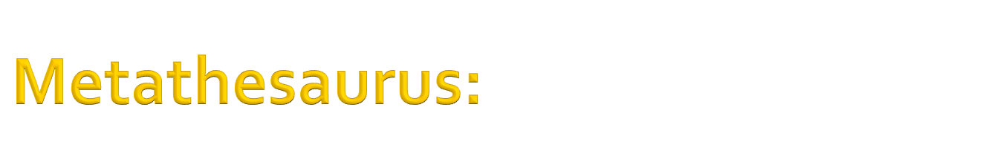
This serves as the base of the UMLS.
It contains over 1 million biomedical concepts and 5 million concept names.
The Metathesaurus is organized by concept and each concept has specific attributes defining its meaning.
There are several relationships established between the concepts such as : is a, is part of, is caused by etc.
In addition, all hierarchical information is retained in the Metathesaurus

Slide 18

Each concept in Metathesaurus is assigned to a semantic type.
These types are then related to each other via semantic relationships.
Semantic Network comprises of all such semantic types and relationship.
Currently there are a total of 135 semantic types and 54 relationships.

Slide 19
Semantic types consist of the following:
    Organisms , Anatomical structures, Biologic function
    Chemicals, Events, Physical objects etc.
Semantic Relationships:
    The primary relationship is an “isa” relationship, which identifies a hierarchy of types
The network has another five (5) major categories of non-hierarchical relationships; these are:
    "physically related to"
    "spatially related to"
    "temporally related to"
    "functionally related to"
    "conceptually related to"

Slide 20

This contains information about English language, biomedical terms, terms in Metathesaurus and terms in MEDLINE.
It contains the syntactic information, morphological information as well as Orthographic information.

Slide 21
Syntactic Information:
  This contains the information on how the words can be put together to generate meaning, syntax etc.
Morphological Information:
  This contains information about the structuring and forms.
Orthographic Information:
  This contains information about the spellings.

Slide 22

NCBO (National Center for Biomedical Ontology) offers a BioPortal, which can be used to access and share ontologies that are actively used on the biomedical community.
By using the BioPortal, one can search the ontologies, search biomedical resources, obtain relationship between terms in different ontologies, obtain ontology based annotations of the text etc.

Slide 23
It can be used for the following:
  Browse, find, and filter ontologies in BioPortal library
  Search all ontologies in the BioPortal library with your terms
  Submit a new ontology to BioPortal library
  Views on large ontologies
  Explore mappings between ontologies

Slide 24
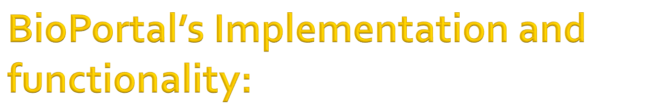
We can access these by one of the following ways:
  Web Browsers
  Web Services (RESTful services)
The BioPortal library consists of the following:
  Total number of ontologies: 173
  Number of classes/types: 1,438,792
These ontologies provide us a basis of the domain knowledge which can be used for data integration, information retrieval etc.

Slide 25
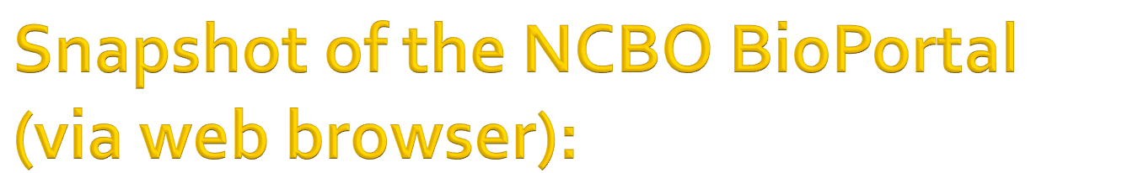
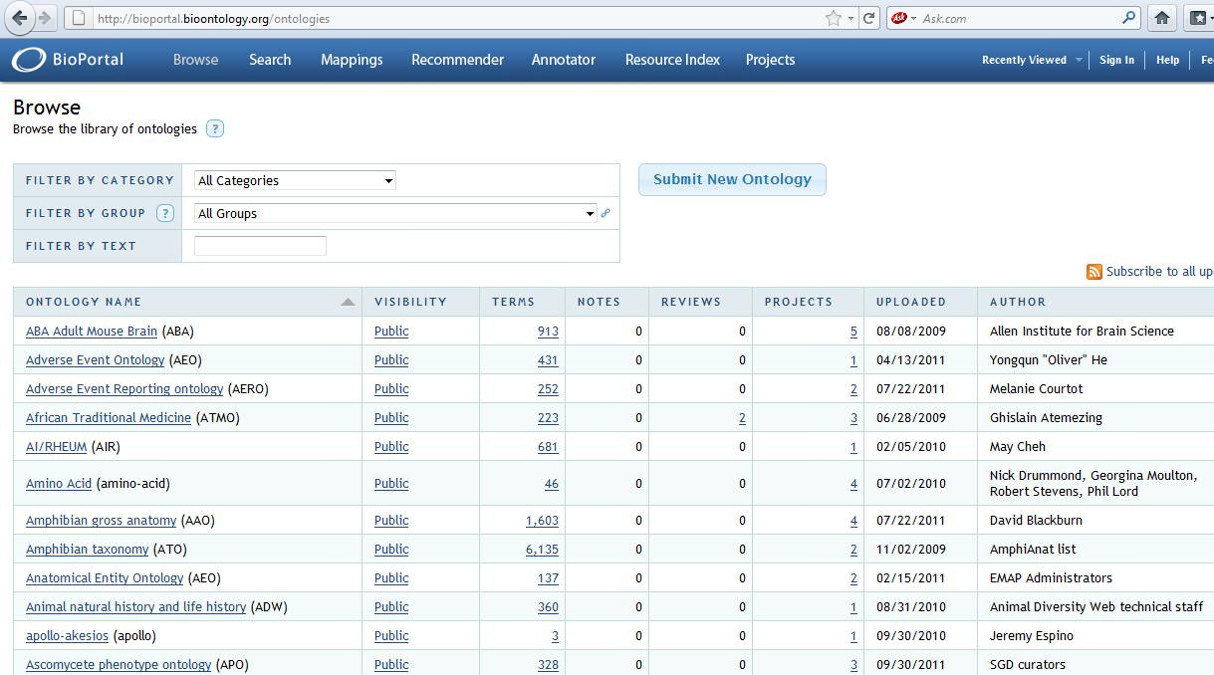

Slide 26

The NCBO annotator provides us with a web service that we can use to process text to recognize relevant biomedical ontology terms.
The NCBO Annotator annotates or “tags” free-text data with terms from BioPortal and UMLS ontologies.
The web service is flexible enough to allow for customizations particular to any application

Slide 27
The annotations are performed in two steps;
  First is the direct annotations by matching the raw text with the preferred name
  Second expanding the annotations by considering the ontology mappings and hierarchy.

Slide 28

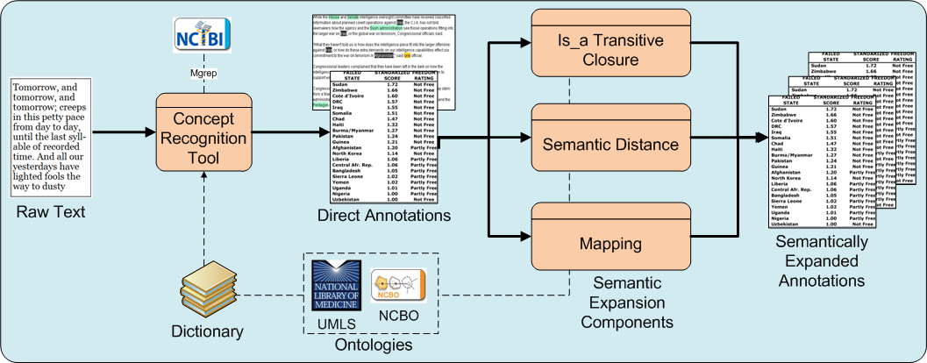

Slide 29

Introduction to Matchmaking:
  Matchmaking is a process by which we calculate or compute the related results with respect to a certain entity.
  Semantic matchmaking is different from any other matchmaking in a way that in semantic matchmaking the results are obtained in light of a shared conceptualization for the knowledge domain at hand, which we call ontology.

Slide 30
Two major ontologies:
  Health Records Ontology
  Paper Publication Ontology

Slide 31

This ontology contains all the patients information with all the results obtained after the annotation process. It consists of the following:
    Name
    ID (Unique)
    Age
    Gender
    Known Disease
    Medications
    Symptoms
    Annotations results for Known Disease (including synonyms)
    Annotations results for Medications (including synonyms)
    Annotations results for Symptoms (including synonyms)

Slide 32

This ontology contains all the paper publications information. Similar to the health records; annotations were obtained to supply better results for the matchmaking. This ontology contains the following information:
    Title
    Abstract
    Body
    Publication Date
    Authors Names
    Annotations for Title
    Annotations for Abstract
    Annotations for Body
    Strength of the Paper*

Slide 33

Calculated by processing the results of the annotations obtained.
Considering the number of top Level concepts found in the Title and the Abstract of any particular paper; the strength of that paper is calculated.
Top Level indicates that a particular concept is in the Top Level; meaning it is a root in the ontology and not the leaves.
  For example, a word like “disease” appears in many ontologies, however, it is not the Top Level concept in most of them. On the other hand, specific medication like “Aerobid” is a Top Level concept in all the ontologies that it appears..

Slide 34
If a paper has more Top Level concepts it indicates the greater strength of the paper compared to a one with no or lesser Top Level Concepts.

Slide 35
The Formula for calculating the Strength of the paper is:
  Strength of the Paper= (Number of Top Level Concepts/Total Number of Concepts)
  The Strength of the paper is between zero (0) and one (1); where one (1) is the highest and zero(0) is the lowest.

Slide 36
example showing the functionality of Strength Of Paper:
  Paper 1:
    Top Level Concepts in Title and Abstract: 4
    Total Concepts in Title and Abstract: 8
    Strength of the paper: (Number of Top Level Concepts/Total Number of Concepts)
    Strength of the paper: 4/8 = 0.5

Slide 37

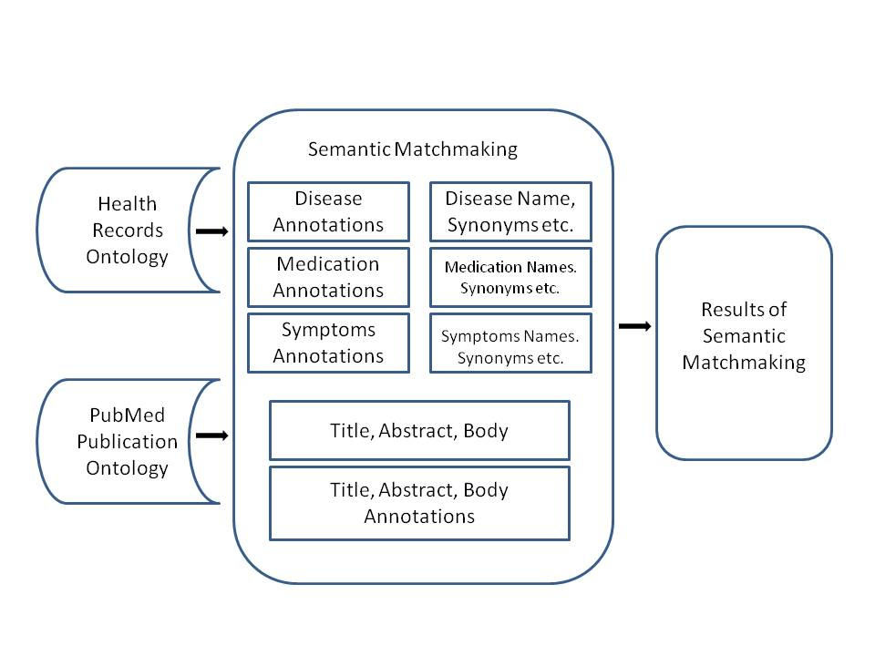

Slide 38
The system performs matchmaking of the health records and publications based on the following:
For the Heath Records:
    Disease Name
    Annotations and Synonyms of the Disease names (Considering semantic hierarchy)
    Medications
    Annotations and Synonyms of the Medication names (Considering semantic hierarchy)
    Symptoms
    Annotations and Synonyms of the Medication names (Considering semantic hierarchy)
For the Publications:
    Title of the Paper
    Abstract of the Paper
    Body of the Paper
    Annotations of the Title (Considering semantic hierarchy)
    Annotations of the Abstract (Considering semantic hierarchy)

Slide 39
In the matchmaking process, the system not only performs the keyword matching, but also takes into consideration the semantic hierarchy, synonyms, annotations etc.
This enables the user to get the relevant results regardless of the “word” or the “term” they enter. For example, a person has a symptom of vomiting, however, is unaware of the disease.

Slide 40
Suppose that there is a new discovery about people having symptoms of Bilious attack and this discovery is found in one of the new research publications.
If that person were to search a normal keyword search from their symptoms they would not be able to locate the paper, which discusses about the new discovery with symptoms of Bilious attack.
However, with this system and with the underlying ontologies that person will get the results of this new discovery even if the paper does not have the word “vomiting” in it.

Slide 41
The system can be run in the following various ways to obtain the relevant information:
    For a particular health record and obtaining all the results relevant to that particular record
    For a cluster (more than one health record) of health records and obtaining all the results relevant to that particular cluster
    For a particular disease and obtaining all the results relevant to that particular disease
    For a cluster of disease names and obtaining all the results relevant to that cluster
    For a particular medication and obtaining all the results relevant to that particular medication.
    For a cluster of medications and obtaining all the results relevant to that cluster
    For a particular symptom and obtaining all the results relevant to that particular symptom.
    For a cluster of symptoms and obtaining all the results relevant to that cluster

Slide 42

This workflow example illustrates the complete lifecycle of a record in our system. It shows what steps are precisely taken and how the results are calculated.

Slide 43

Step 1: We begin with sample health record (XML);
Sample Health Record (XML):
  <Patient>
  <Name>Robin Hood</Name>
  <Address>1563 South Milton st</Address>
  <City>Tuscon</City>
  <State>AZ</State>
  <Zip>92009</Zip>
  <Country>United States</Country>
  <Id>1235</Id>
  <Age>25</Age>
  <KnownDisease>Asthma</KnownDisease>
  <Medications>Aerobid, Alvesco</Medications>
  <Gender>Male</Gender>
  <symptoms>vomiting</symptoms>
  <PrimaryPhysician> Dr Smith</ PrimaryPhysician>
  <PhysicianId>dc1247</PhysicianId>
  <PrimaryPharmacy>Walgreens</PrimaryPharmacy>
  <PrimaryPharmacyId>247Phar</PrimaryPharmacyId>
  </Patient>

Slide 44
Step 2: One parsed, we get the following profile:
  Patient Details:
    Name: Robin Hood
    symptoms: vomiting
    Id: 1235
    Age: 25
    Gender: Male
    Known Disease: Asthma
    Medications: Aerobid, Alvesco

Slide 45
Step 3: We can now populate the ontology with the health record(s):
    <!-- http://www.semanticweb.org/ontologies/2011/8/MedicalInoHealthRecords.owl#patient2 -->
    <owl:Thing rdf:about="#patient2">
    <Name>Robin Hood</Name>
    <Id>1235</Id>
    <Age>25</Age>
    <KnownDisease>Asthma</KnownDisease>
    <Medications>Aerobid</Medications><Medications>Alvesco</Medications>
    <Gender>Male</Gender>
    <symptoms>vomiting</symptoms>
    </owl:Thing>

Slide 46
Step 4: Getting the annotations; here is a sample output file of the annotations results obtained for Asthma. Similarly, we get the annotations for Medication, Symptoms and the Publications as well.

Slide 47
annotations = [AnnotationBean [
score = 20
concept = [localConceptId: 46116/155574008, conceptId: 21567348, localOntologyId: 46116, isTopLevel: 1, fullId: http://purl.bioontology.org/ontology/SNOMEDCT/155574008, preferredName: Asthma, definitions: [], synonyms: [Asthma, Asthma (disorder)], semanticTypes: [[id: 25504782, semanticType: T047, description: Disease or Syndrome]]]
context = [MGREP(true), from = 1, to = 6, [name: Asthma, localConceptId: 46116/155574008, isPreferred: false], ]
], AnnotationBean [
score = 20
concept = [localConceptId: 46116/155574008, conceptId: 21567348, localOntologyId: 46116, isTopLevel: 1, fullId: http://purl.bioontology.org/ontology/SNOMEDCT/155574008, preferredName: Asthma, definitions: [], synonyms: [Asthma, Asthma (disorder)], semanticTypes: [[id: 25504782, semanticType: T047, description: Disease or Syndrome]]]
context = [MGREP(true), from = 1, to = 6, [name: Asthma, localConceptId: 46116/155574008, isPreferred: true], ]
],

Slide 48
  Get the annotations for Disease name. The above annotation file is parsed to obtain the relevant information for a disease name.
  Get the annotations for Medication names
    Similar to Step 4 (a), in this step we obtain and parse annotations for Medication Names
  Get the annotations for Symptoms
    Similar to Step 4 (a), in this step we obtain and parse annotations for Symptoms Names

Slide 49
Step 5: Update the Health records with the annotations:

Slide 50
<!-- http://www.semanticweb.org/ontologies/2011/8/MedicalInoHealthRecords.owl#patient2 -->
<owl:Thing rdf:about="#patient2">
<symptoms>vomiting</symptoms>
<Name>Robin Hood</Name>
<Id>1235</Id>
<Age>25</Age>
<KnownDisease>Asthma</KnownDisease>
<Medications>Aerobid</Medications><Medications> Alvesco</Medications>
<MedicationsSynonyms> flunisolide</MedicationsSynonyms><MedicationsSynonyms> Syntaris</MedicationsSynonyms><MedicationsSynonyms> Flunisolide</MedicationsSynonyms><MedicationsSynonyms> Apo-Flunisolide</MedicationsSynonyms><MedicationsSynonyms> Flunisolide</MedicationsSynonyms><MedicationsSynonyms> Rhinalar</MedicationsSynonyms><MedicationsSynonyms> Nasarel</MedicationsSynonyms><MedicationsSynonyms> ratio-Flunisolide</MedicationsSynonyms><MedicationsSynonyms> flunisolide hemihydrate</MedicationsSynonyms><MedicationsSynonyms> (6alpha</MedicationsSynonyms><MedicationsSynonyms>11beta</MedicationsSynonyms><MedicationsSynonyms>16alpha)-isomer</MedicationsSynonyms><MedicationsSynonyms> Nasalide</MedicationsSynonyms><MedicationsSynonyms> Apotex Brand of Flunisolide</MedicationsSynonyms><MedicationsSynonyms> Elan Brand 1 of Flunisolide</MedicationsSynonyms><MedicationsSynonyms> Roche Brand of Flunisolide</MedicationsSynonyms><MedicationsSynonyms> Forest Brand of Flunisolide</MedicationsSynonyms><MedicationsSynonyms> Ivax Brand of Flunisolide</MedicationsSynonyms><MedicationsSynonyms> Dermapharm Brand of Flunisolide</MedicationsSynonyms><MedicationsSynonyms> flunisolide</MedicationsSynonyms>

Slide 51
<MedicationsSynonyms> (6beta</MedicationsSynonyms><MedicationsSynonyms>11beta</MedicationsSynonyms><MedicationsSynonyms>16alpha)-isomer</MedicationsSynonyms><MedicationsSynonyms> Inhacort</MedicationsSynonyms><MedicationsSynonyms> AeroBid</MedicationsSynonyms><MedicationsSynonyms> flunisolide HFA</MedicationsSynonyms><MedicationsSynonyms> flunisolide</MedicationsSynonyms><MedicationsSynonyms> 6 alpha-fluoro-11 beta</MedicationsSynonyms><MedicationsSynonyms>16 alpha</MedicationsSynonyms><MedicationsSynonyms>21- tetrahydroxypregna-1</MedicationsSynonyms><MedicationsSynonyms>4-diene-3</MedicationsSynonyms><MedicationsSynonyms>20-dione cyclic 16</MedicationsSynonyms><MedicationsSynonyms> 17-acetal with acetone</MedicationsSynonyms><MedicationsSynonyms> RS-3999</MedicationsSynonyms><MedicationsSynonyms> 6 alpha-fluorodihydroxy-16 alpha</MedicationsSynonyms><MedicationsSynonyms>17 alpha-isopropylidenedioxy-1</MedicationsSynonyms><MedicationsSynonyms>4-pregnadiene-3</MedicationsSynonyms><MedicationsSynonyms>20- dione</MedicationsSynonyms><MedicationsSynonyms> Alvesco</MedicationsSynonyms><MedicationsSynonyms> (R)-11beta</MedicationsSynonyms><MedicationsSynonyms>16alpha</MedicationsSynonyms><MedicationsSynonyms>21-tetrahydroxypregna-1</MedicationsSynonyms><MedicationsSynonyms>4-diene-3</MedicationsSynonyms><MedicationsSynonyms>20-dione cyclic 16</MedicationsSynonyms><MedicationsSynonyms>17-acetal with cyclohexanecarboxaldehyde</MedicationsSynonyms><MedicationsSynonyms> 21-isobutyrate</MedicationsSynonyms><MedicationsSynonyms> Omnaris</MedicationsSynonyms><MedicationsSynonyms>Alvesco</MedicationsSynonyms><MedicationsSynonyms>Omnaris</MedicationsSynonyms>
<Synonyms>Bronchial hypersensitivity</Synonyms> <Synonyms>BHR - Bronchial hyperreactivity</Synonyms> <Synonyms>Airway hyperreactivity</Synonyms><Synonyms>Bronchial hyperreactivity</Synonyms><Synonyms>Hyperreactive airway disease</Synonyms><Synonyms>Exercise-induced asthma</Synonyms> <Gender>Male</Gender>
<SymptomsSynonyms>Vomiting</SymptomsSynonyms><SymptomsSynonyms>haematemesis</SymptomsSynonyms><SymptomsSynonyms>Bilious attack</SymptomsSynonyms><SymptomsSynonyms>throwing up</SymptomsSynonyms>
</owl:Thing>

Slide 52
Step 6: We begin with publications (Title and abstract) downloaded from PubMed, currently 150 different publications were downloaded for testing purposes.
Step 7: Populate the Ontology with the Publication Information:

Slide 53
<!-- http://www.semanticweb.org/ontologies/2011/8/MedicalPapers.owl#paper11 -->
<medicalpaper rdf:about="#paper11">
<rdf:type rdf:resource="&owl;Thing"/>
<title>Asthma diagnosis and treatment: Filling in the information gaps</title>
<abstr> Current approaches to the diagnosis and management of asthma are based on guideline recommendations, which have provided a framework for the efforts. Asthma, however, is emerging as a heterogeneous disease, and these features need to be considered in both the diagnosis and management of this disease in individual patients. These diverse or phenotypic features add complexity to the diagnosis of asthma, as well as attempts to achieve control with treatment. Although the diagnosis of asthma is often based on clinical information, it is important to pursue objective criteria as well, including an evaluation for reversibility of airflow obstruction and bronchial hyperresponsiveness, an area with new diagnostic approaches. Furthermore, there exist a number of treatment gaps (ie, exacerbations, step-down care, use of antibiotics, and severe disease) in which new direction is needed to improve care. A major morbidity in asthmatic patients occurs with exacerbations and in patients with severe disease. Novel approaches to treatment for these conditions will be an important advance to reduce the morbidity associated with asthma.</abstr>
<url>http://www.sciencedirect.com/science/article/pii/S0091674911013145</url>
<publishing_date>2011</publishing_date>
<author>Busse WW.</author>
</medicalpaper>

Slide 54
Step 8: Run the NCBO annotator to get the annotations.
Step 9: We parse the relevant information from the file obtained in Step 8 and Update the Publications with the annotations:

Slide 55
Step 10: Once both the Ontologies are populated; we can begin the matchmaking and ranking algorithm

Slide 56
Step 11: We can now run the Matchmaking and Ranking algorithms. here are the results obtained (Partial) :
    Here are the results related to : Robin Woods
    Patient Record Number:1235
    Disease:Asthma
    Rank is:7
    Link is: http://www.sciencedirect.com/science/article/pii/S0954611111002526
    Rank is:7
    Link is: http://www.sciencedirect.com/science/article/pii/S1081120611004261
    Rank is:8
    Link is: http://www.sciencedirect.com/science/article/pii/S1081120611004273

Slide 57

Advance Ontological Search
Discovery of Medication side Effects
Extended search via profile
Enable knowledge discovery without specific input

Slide 58

The semantic matchmaking enables the system to perform advance search based on the ontology concepts and hierarchy, which is not possible by a syntactic matchmaking process.
This enables the user to be able to discover and retrieve results that would not be found by a simple keyword search.
This is an efficient way to discover hidden but important information.

Slide 59

Our system enables a user to not only get the related publications based on the disease they are suffering from, but also enables them to discover any side effects of the medications
For example if a person is on some medication for a long time and if that drug or medication has some side effects; such publications should be displayed to the user.
Our system allows the side effects of drugs to be discovered whether they appear directly or not in the paper since it checks the annotations, synonyms etc.

Slide 60

Our system enables the user to retrieve publications that are not only related to his current disease but related to his entire profile that we generated including medications, symptoms etc.

Slide 61

Our system allows a user to discover the papers related them without having particular information about the disease they might be suffering from.
A person might search based on its symptoms without knowing the name of the disease
For example with our test case scenario number 2, the two drugs together had side effects which we were able to detect since we took the semantic relationship of both the drugs into consideration

Slide 62

Test Case # 1
Test Case # 2

Slide 63

In order to evaluate the functionality of our system, we did an evaluation of our results vs. the results of PubMed.
PubMed provides a user interface to search of publications related to the terms entered.
We use the same interface to enter the disease name, symptoms or medications and retrieve results.
On the other hand, we use our system and find related papers to the same particular record (patient)

Slide 64
Evaluation Profile:
User Profile:
Name: Mathew Burton
Known Disease: Heart Attack
Symptoms: Arm pain, Acidity
Medications: Prilosec, Plavix, Alprenolol

Slide 65

Query 1:
PubMed Input: Heart Attack, Arm pain, Acidity, Prilosec, Plavix, Alprenolol
PubMed Output: No items found.
Query 2: Prilosec, Plavix, Alprenolol
PubMed Output: No items found.
Query 3: Heart Attack, Arm pain, Acidity
PubMed Output: No items found.

Slide 66

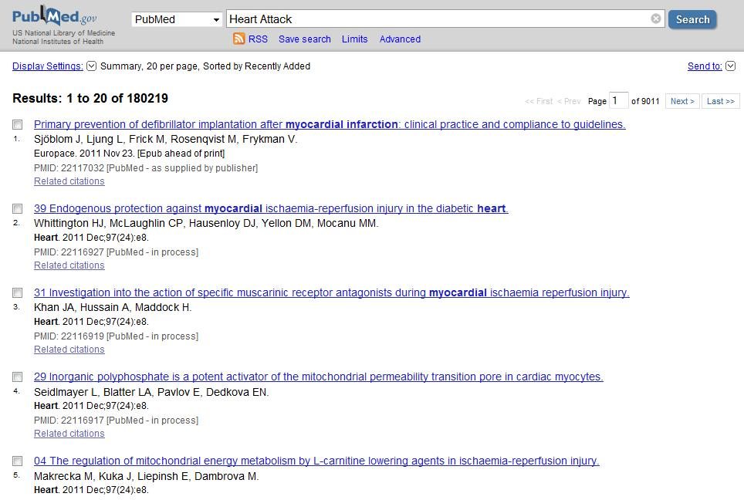

Slide 67
As seen in the above test queries, PubMed only gives results when one term is entered at a time. When we tried entering all the keywords in a given profile, no results were obtained.
In addition, the results are based on syntactic matches on the term “heart attack”, thus the additional relevant information is not obtained, which includes information about medications, side effects, combined effect of drugs etc.

Slide 68

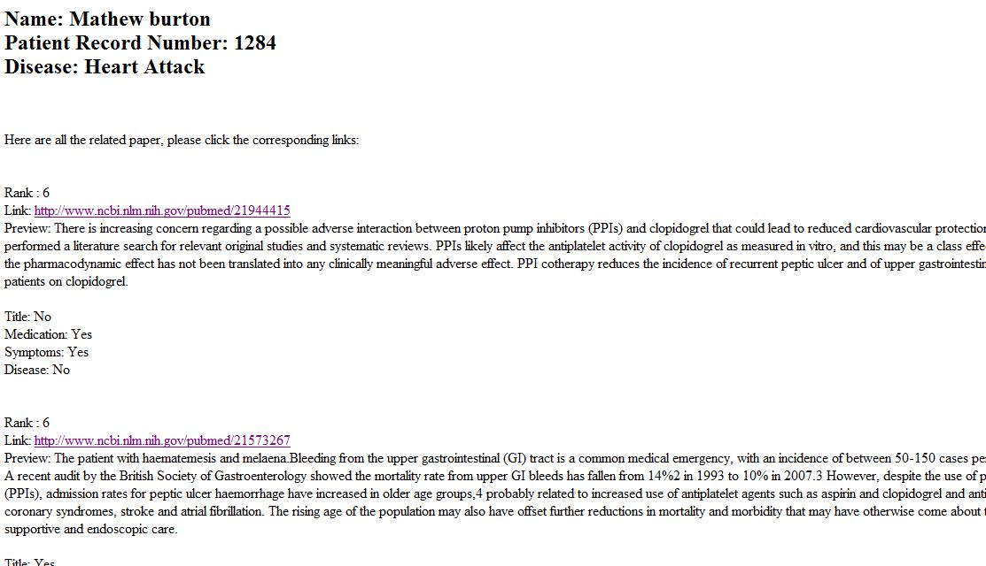

Slide 69
We can see that our system, gave the results of papers discussing the combined effects of both the drugs Prilosec and Plivax together.
Our system was able to discover the semantic relationship between the two drugs and thus showed the related papers in the result which were not found in the PubMed results.
From the above example it is evident that our system performs better than the searches done at PubMed

Slide 70

The amount of knowledge in the medical domain is growing exponentially. With this growth, it is becoming a very hard for physicians or the patients to keep track of all the new discoveries.
Our system addresses this issue and makes this knowledge discovery easier.
Our system performs semantic matchmaking for knowledge discovery and then semantic ranking to rank the results for a particular patient.
This can be used by physicians or by patients to discover resources related to their Personal Health Record. Since the system performs semantic matchmaking, the results are more precise and accurate.
As seen in the above two motivating examples; our system enables the user to discover papers/knowledge that would not have been possible to discover via syntactic matchmaking.

Slide 71

Future works on this system might include taking geographic location, age and gender into consideration when ranking the results for any particular patient.
Geographic location may affect the results as some diseases are more common in some countries than other.
In addition, age and gender may also affect the results as some diseases and publications are for a particular age group or gender
Also, an extended evaluation in form of usability studies can be done with the help of doctors and physicians to identify the accuracy of the results.

Slide 72

Tommaso Di Noia, Eugenio Di Sciascio, Francesco M. Donini. “A Non-Monotonic Approach to Semantic Matchmaking and Request Reﬁnement in E-Marketplaces” International Journal of Electronic Commerce, 2008.
Jonquet, Clement. “Semantic Annotations of BioMedical Data”. http://www.slideshare.net/jonquet/semantic-annotation-of-biomedical-data-7281656. March 2011.
Good, Benjamin. “NCBO Annotator versus MetaMap on GO concept detection”. http://i9606.blogspot.com/2010/12/ncbo-annotator-versus-metamap-on-go.html. December 02, 2010.
Jonquet, Clement. Musen, Mark A and Shah, Nigam. “A System for Ontology-Based Annotation of Biomedical Data”. Proceedings of the 5th international workshop on Data Integration in the Life Sciences. “http://bmir.stanford.edu/file_asset/index.php/1316/Article-DILS08_Jonquet_Musen_Shah_published.pdf.” 2008.
Patricia L. Whetzel, Nigam H. Shah, Natalya F. Noy, Clement Jonquet, Adrien Coulet, Nicholas Griffith, Cherie Youn, Michael Dorf and Mark A. “Ontology Web Services for Semantic Applications”. Stanford University, Stanford CA, USA. “http://www2.lirmm.fr/IC//Supports/FMIN113-ProjetTutore/2010_11/ExemplesPosters/CJ2.pdf.” 2008.
U.S. National Library of Medicine. “MetaMap”. “http://www.nlm.nih.gov/research/umls/implementation_resources/metamap.html” . September 2011.
Alan R. Aronson, PhD and François M. Lang, MSE. “The Evolution of MetaMap, a Concept Search Program for Biomedical Text”. Lister Hill National Center for Biomedical Communications. “http://www.lhncbc.nlm.nih.gov/lhc/docs/published/2009/pub2009041.pdf”. 2009.
Aronson, Alan R. Lang, François-Michel. “An overview of MetaMap: historical perspective and recent advances” J Am Med Inform Assoc (JAMIA). “http://www.lhncbc.nlm.nih.gov/lhc/docs/published/2010/pub2010033.pdf”. 2010

Slide 73
Google Health Samples. “http://code.google.com/p/googlehealthsamples/source/browse/trunk/CCR_samples/”. Retrieved on September 2011.
PubMed.com “http://www.ncbi.nlm.nih.gov/pubmed/” 2011.
PubMed Quick Start. U.S. National Library of Medicine National Institutes of Health. “http://www.ncbi.nlm.nih.gov/books/NBK3827/#pubmedhelp.PubMed_Quick_Start”. Retrieved on Aug 2011.
PubMed FAQS. U.S. National Library of Medicine National Institutes of Health. “http://www.ncbi.nlm.nih.gov/books/NBK3827/#pubmedhelp.FAQs”. Retrieved on Aug 2011.
UMLS. Open Clinical Knowledge Management for Medical Care. “http://www.openclinical.org/medTermUmls.html “ Retreived on Aug 2011.
UMLS. Wikepedia. “http://en.wikipedia.org/wiki/Unified_Medical_Language_System” Retrieved on Aug 2011.
Chintan Patel, Sharib Khan, and Karthik Gomadam. “TrialX: Using semantic technologies to match patients to relevant clinical trials based on their Personal Health Records”. In Proceedings of the 8th International Semantic Web Conference, 2009.
Google Health Vs Microsoft Health Vault. User Centric, Inc. “http://www.usercentric.com/publications/2009/02/02/google-health-vs-microsoft-healthvault-consumers-compare-online-personal-hea” February 2009.
Microsoft Health Vault. Microsoft. http://www.microsoft.com/en-us/healthvault/” retrieved on Sep 2011.
Life Record Personal Medical Record System. Life Records, Inc. http://www.myliferecord.com/ retrieved on Sep 2011.

Slide 74
User Manual Life Record Personal Medical Record System. Life Records, Inc. http://download.liferecord.com/mlruserguide.pdf retrieved on Sep 2011.
Page Rank. Wikepedia http://en.wikipedia.org/wiki/PageRank. retrieved on Sep 2011.
About Google Health. Google Health. http://www.google.com/intl/en-US/health/about/ retrieved on Sep 2011.
OBA Service Workflow. BioOntology Wiki. http://www.bioontology.org/wiki/index.php/File:OBA_service_workflow.png” retrieved on Sep 2011.
Laura Plaza, Alber Diaz. “Retrieval of Similar Electronic Health Records Using UMLS Concept Graphs”. Proceedings of the Natural language processing and information systems, and 15th international conference on Applications of natural language to information systems, 2010.
Barbara Hayes, William Aspray. “Fighting Diabetes with Information: Where Social Informatics Meets Health Informatics”. iConference, 2010.
Semantic Network, U.S. National Library of Medicine National Institutes of Health. “http://www.ncbi.nlm.nih.gov/books/NBK9679/”. Retrieved on Nov 2011.

