Slide 1
Ranking Documents based on Relevance of Semantic Relationships
Boanerges Aleman-Meza
LSDIS lab, Computer Science, University of Georgia
Advisor: I. Budak Arpinar
Committee: Amit P. Sheth
Charles Cross
John A. Miller
Dissertation Defense
July 20, 2007

Slide 2
Outline
Introduction
(1) Flexible Approach for Ranking Relationships
(2) Analysis of Relationships
(3) Relationship-based Measure of Relevance & Documents Ranking
Observations and Conclusions

Slide 3
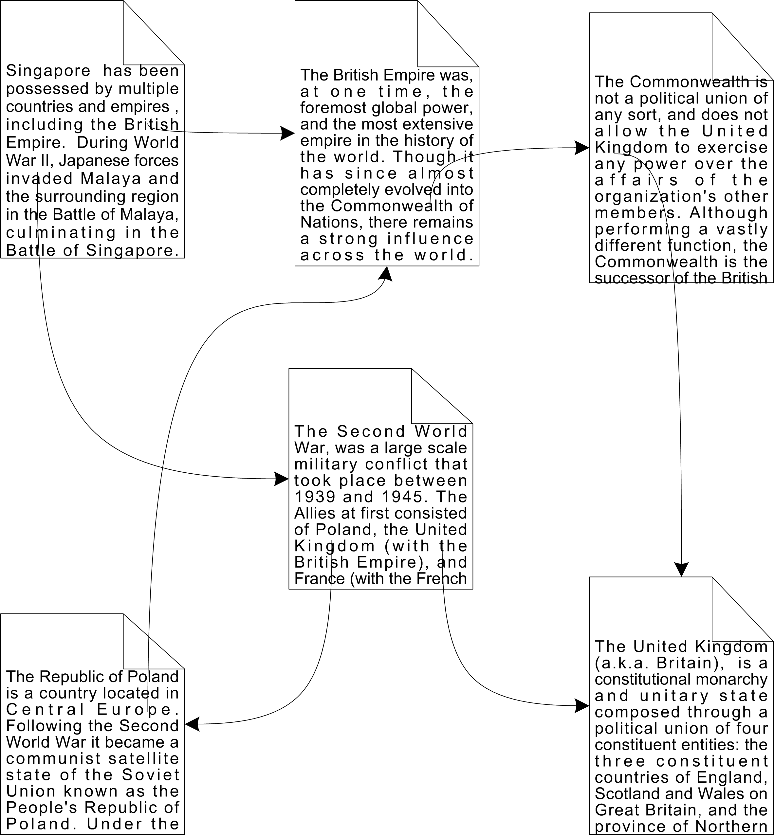
Today’s use of Relationships (for web search)
No explicit relationships are used
  other than co-occurrence
Semantics are implicit
  such as page importance
(some content from www.wikipedia.org)

Slide 4
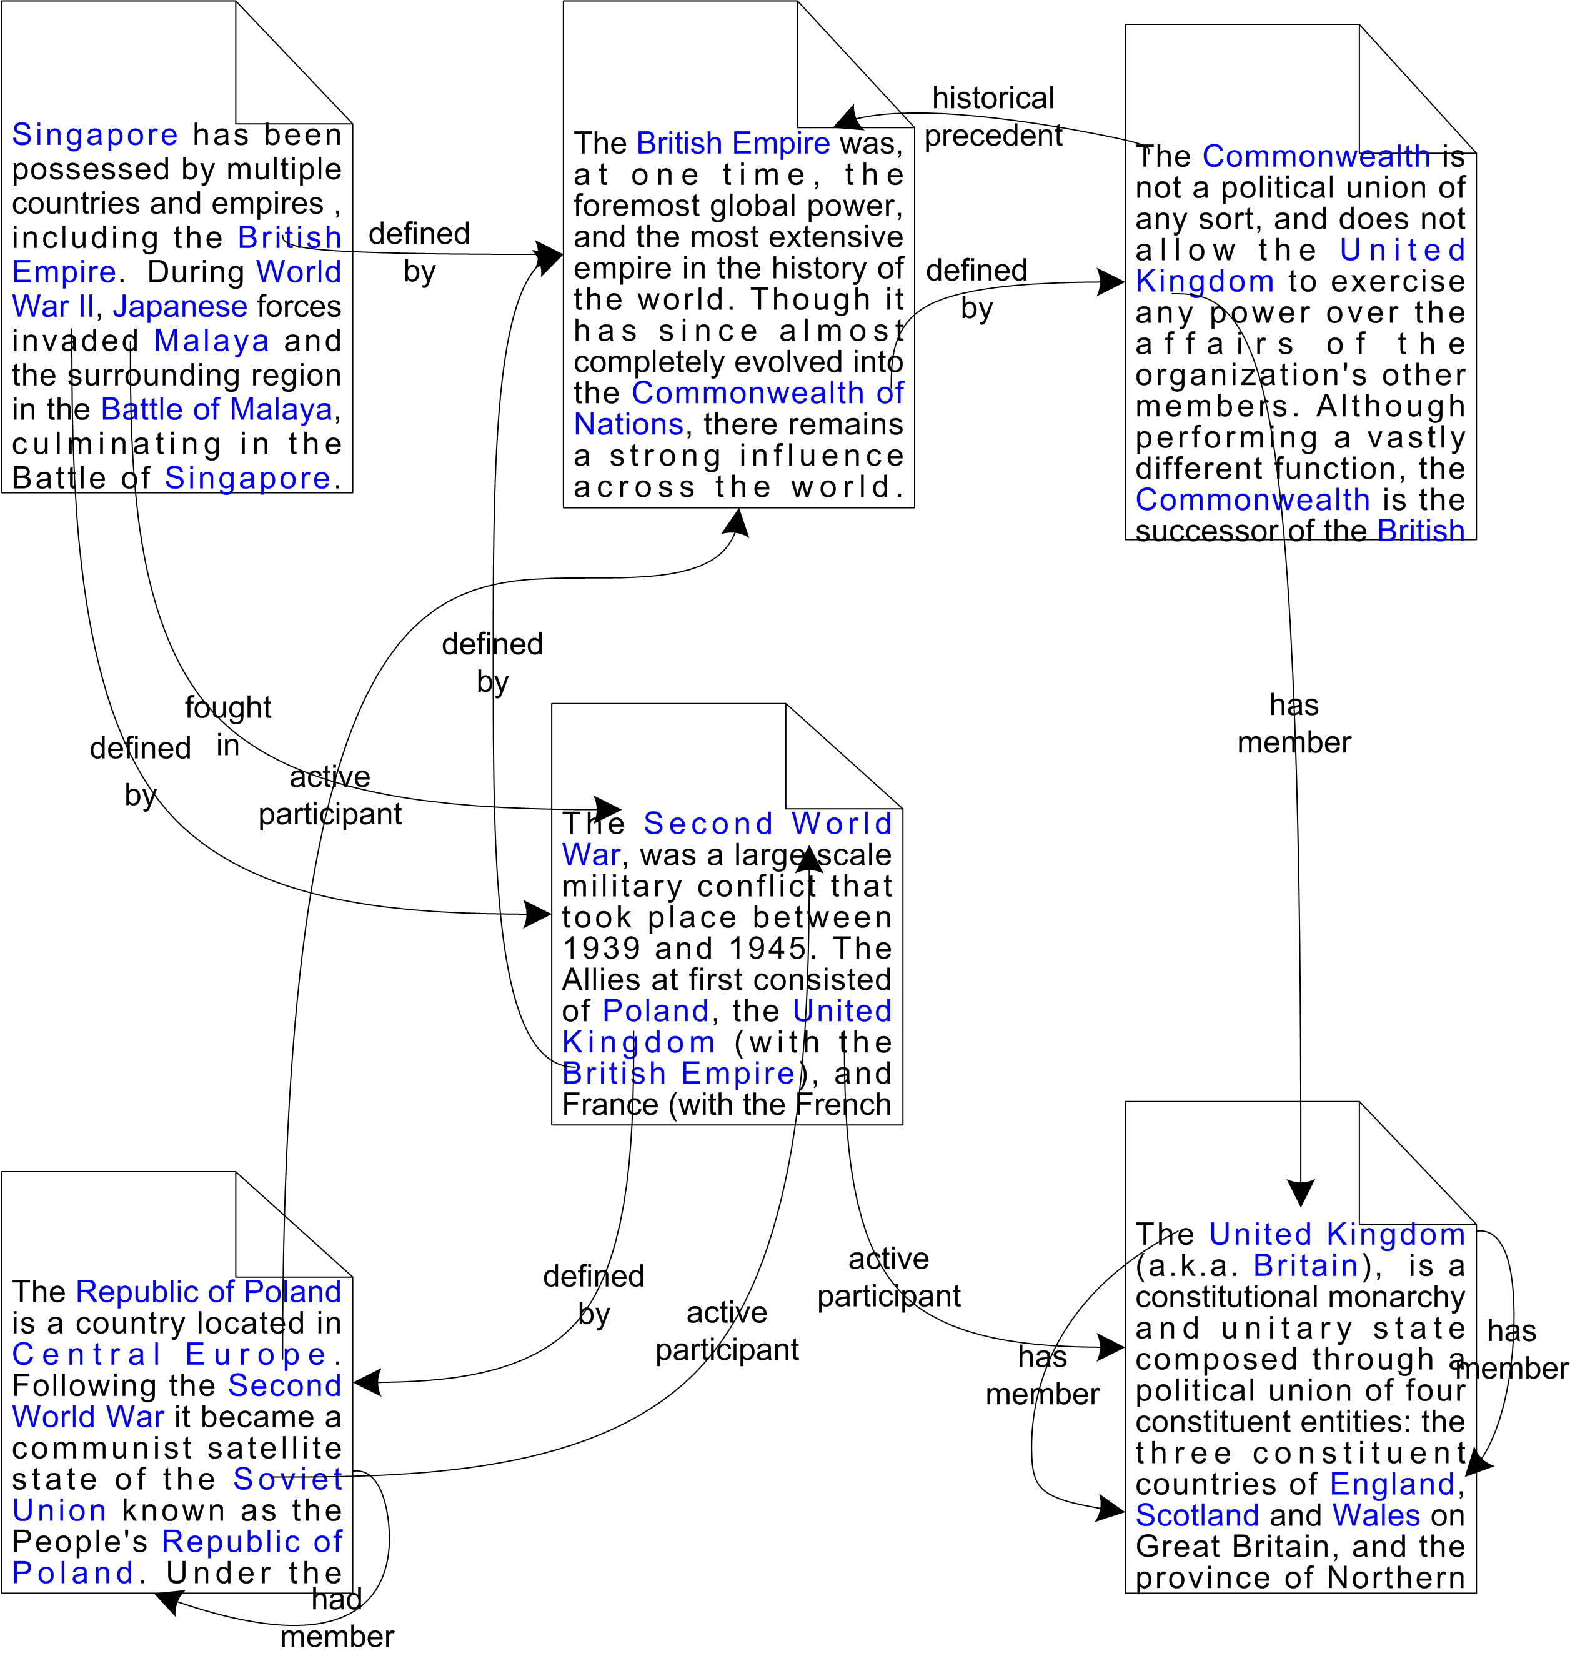
But, more relationships are available
Documents are connected through concepts & relationships
      i.e., MREF [SS’98]
Items in the documents are actually related
(some content from www.wikipedia.org)

Slide 5
Emphasis: Relationships
Semantic Relationships: named-relationships connecting information items
      their semantic ‘type’ is defined in an ontology
      go beyond ‘is-a’ relationship (i.e., class membership)
Increasing interest in the Semantic Web
      operators “semantic associations” [AS’03]
      discovery and ranking [AHAS’03, AHARS’05, AMS’05]
Relevant in emerging applications:
      content analytics – business intelligence
      knowledge discovery – national security

Slide 6
Dissertation Research
Demonstrate role and benefits of
semantic relationships among named-entities
in improving relevance
for ranking of documents?

Slide 7
Pieces of the Research Problem
Large Populated
Ontologies
[AHSAS’04, AHAS’07]
Flexible Ranking of
Complex Relationships
[AHAS’03, AHARS’05]
Ranking Documents
based on Semantic
Relationships
Analysis of Relationships
[ANR+06] [AMD+07-submitted]
Relation-based
Document Ranking
[ABEPS’05]

Slide 8
Preliminaries
Four slides, including this one

Slide 9
Preliminary: Populated Ontologies
SWETO: Semantic Web Technology Evaluation Ontology
    Large scale test-bed ontology containing instances extracted from heterogeneous Web sources
    Domain: locations, terrorism, cs-publications
    Over 800K entities, 1.5M relationships
SwetoDblp: Ontology of Computer Science Publications
    Larger ontology than SWETO, narrower domain
    One version release per month (since September’06)
[AHSAS’04] [AHAS’07]

Slide 10
Preliminary: “Semantic Associations”
ρ-query: find all paths between e₁ and e₂
f
a
g
k
e₂
e₁
h
b
i
c
p
d
[Anyanwu,Sheth’03]

Slide 11
Preliminary: Semantic Associations
(10) Resulting paths between e₁ and e₂
_{e1 → h → a → g ← f → k → e2}
e1 → h → a → g ← f → k → b → p → c → e2
e1 → h → a → g ← b → p → c → e2
_{e1 → h → b ← g ← f → k → e2}
_{e1 → h → b ← k → e2}
_{e1 → h → b → p → c → e2}
_{e1 → i → d → p → c → e2}
e1 → i → d → p → b ← h → a → g ← f → k → e2
e1 → i → d → p → b ← g ← f → k → e2
_{e1 → i → d → p → b ← k → e2}

Slide 12
(1) Flexible Ranking of Complex Relationships
Discovery of Semantic Associations
Ranking (mostly) based on user-defined Context

Slide 13
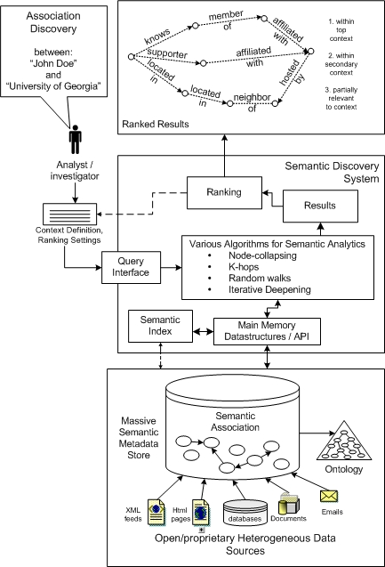
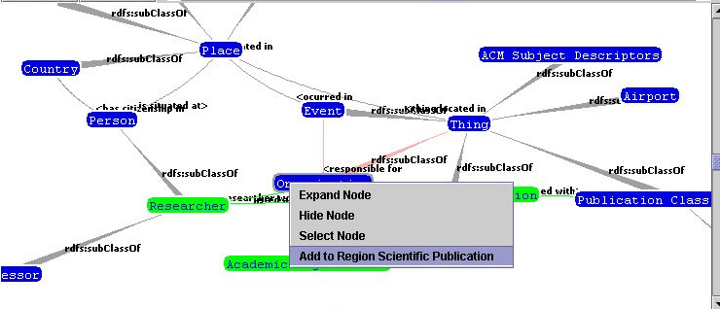
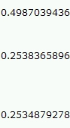
Ranking Complex Relationships
Association Length
Rarity
Organization
Political
Organization
Democratic
Political
Organization
Association
Rank
Subsumption
Trust
Popularity
Context
[AHAS’03] [AHARS’05]

Slide 14
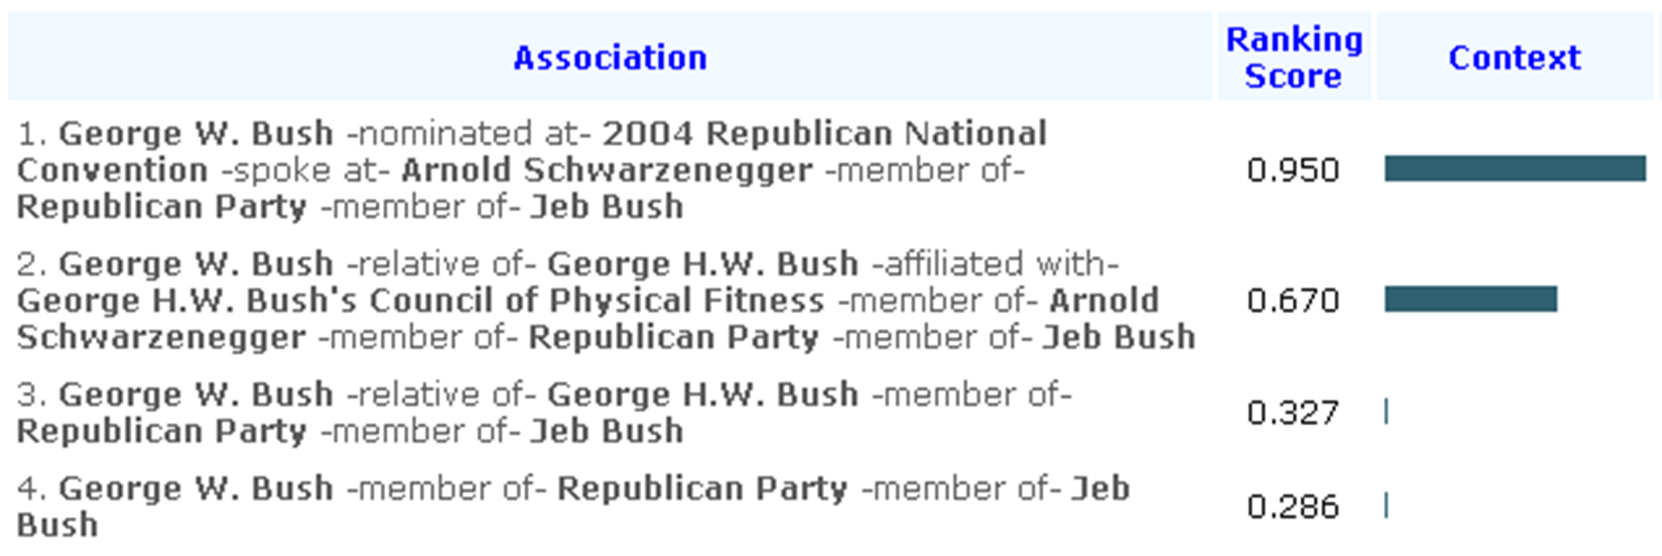
Ranking Example
Query:
George W. Bush
Jeb Bush
Context:
Actor

Slide 15
Main Observation: Context was key
User interprets/reviews/ results
  Changing ranking parameters by user
      [AHAS’03, ABEPS’05]
Analysis is done by human
  Facilitated by flexible ranking criteria
The semantics (i.e., relevance) changing on a per-query basis

Slide 16
(2) Analysis of Relationships
Scenario of Conflict of Interest Detection
(in peer-review process)

Slide 17
Conflict of Interest
Should Arpinar
review Verma’s
paper?
Thomas
Sheth
Verma
Arpinar
Miller
Number of co-authors
in common > 10 ?
If so,
then COI is: Medium
Aleman-M.
Otherwise, depends on weight

Slide 18
Assigning Weights to Relationships
Weight assignment for co-author relation
  #co-authored-publications / #publications
Recent Improvements
  Use of a known collaboration strength measure
  Scalability (ontology of 2 million entities)
co-author
1 / 1
FOAF ‘knows’ relationship
weighted with 0.5
(not symmetric)
Sheth
Oldham
co-author
1 / 124

Slide 19
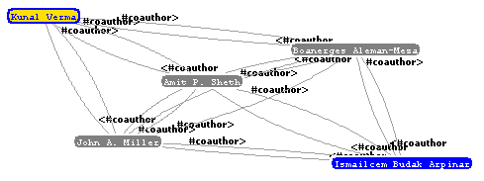
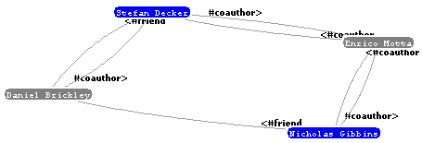
Examples and Observations
Semantics are shifted away from user and into the application
Very specific to a domain
(hardcoded ‘foaf:knows’)

Slide 20
(3)
Ranking using Relevance Measure of Relationships
Finds relevant neighboring entities
Keyword Query -> Entity Results
Ranked by Relevance of Interconnections among Entities

Slide 21
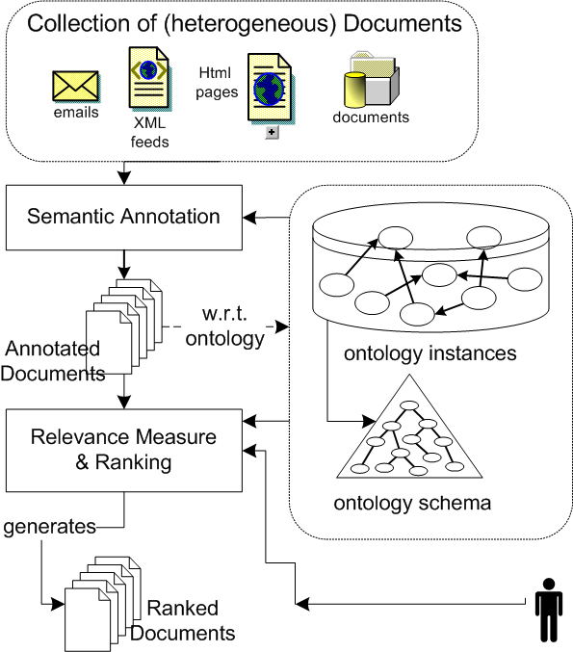
Overview: Schematic Diagram
Demonstrated with small dataset [ABEPS’05]
  Explicit semantics [SRT’05]
Semantic Annotation
    Named Entities
Indexing/Retrieval
    Using UIMA
Ranking Documents
  Relevance Measure

Slide 22
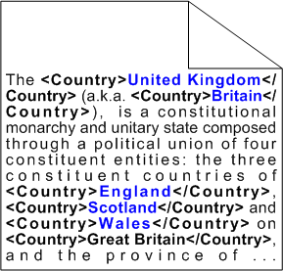
Semantic Annotation
Spotting appearances of named-entities from the ontology in documents

Slide 23
Determining Relevance (first try)
“Closely related entities are more relevant than distant entities”
E = {e | Entity e ∈ Document }
R = {f | type(f) ∈ user-request
and distance(f, e∈E) <= k }
Good for grouping documents w.r.t. a context
(e.g., insider-threat)
Not so good for precise results
[ABEPS’05]

Slide 24
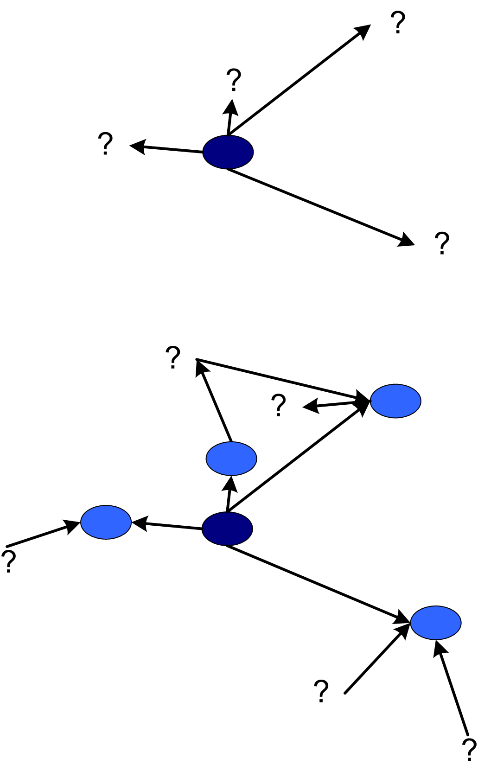
Defining Relevant Relationships
Relevance is determined by considering:
type of next entity (from ontology)
name of connecting relationship
length of discovered path so far
    (short paths are preferred)
other aspects (e.g., transitivity)

Slide 25
… Defining Relevant Relationships
Involves human-defined relevance of
specific path segments
ticker
[Company]
  Does the ‘ticker’ symbol of a Company
  make a document more relevant?
    … yes?
  Does the ‘industry focus’ of a company
  make a document more relevant?
    … no?
[Ticker]
industry
focus
[Industry]

Slide 26
… Measuring what is relevant
has industry focus
Many relationships
connecting one entity . . .
Technology
Consulting
listed in
has
industry
focus
499
(20+) leader of
Fortune 500
listed in
leader of
listed in
based at
Plano
Tina Sivinski
Electronic
Data Systems
7K+
EDS
NYSE:EDS
ticker
listed in

Slide 27
Few Relevant Entities
From Many Relationships . . .
very few are relevant paths
leader of
based at
Plano
Tina Sivinski
Electronic
Data Systems
EDS
ticker

Slide 28
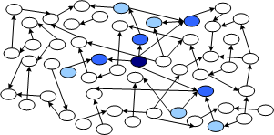
Relevance Measure (human involved)
Input: Entity e
Relevant Sequences (defined by human)
relationship k
relationship g
[Concept B]
[Concept A]
[Concept C]
Entity-neighborhood expansion
delimited by the
‘relevant sequences’
Find: relevant neighbors
of entity e

Slide 29
Relevance Measure, Relevant Sequences
Ontology of Bibliography Data
author
author
High
Publication
Person
Person
affiliation
High
University
Person
affiliation
Low
Person
University
located-in
Place
Medium
University

Slide 30
Relevance Score for a Document
User Input: keyword(s)
Keywords match a semantic-annotation
        An annotation is related to one entity e in the ontology
Find relevant neighborhood of entity e
        Using the populated ontology
Increase the score of a document w.r.t.
  the other entities in the document that belong to e’s relevant neighbors
  (Each neighbor’s relevance is either low, med, or high)

Slide 31
Distraction: Implementation Aspects
The various parts
  (a) Ontology containing named entities (SwetoDblp)
  (b) Spotting entities in documents (semantic annotation)
  Built on top of UIMA
  (c) Indexing: keywords and entities spotted
  UIMA provides it
  (d) Retrieval: keyword or based on entity-type
  Extending UIMA’s approach
  (e) Ranking

Slide 32
Distraction: What’s UIMA?
Unstructured Information Management Architecture (by IBM, now open source)
‘Analysis Engine’ (entity spotter)
      Input: content; output: annotations
‘Indexing’
      Input: annotations; output: indexes
‘Semantic Search Engine’
      Input: indexes + (annotation) query; output: documents
      (Ranking based on retrieved documents from SSE)

Slide 33
Retrieval through Annotations
User input: georgia
Annotated-Query: <State>georgia</State>
    User does not type this in my implementation
    Annotation query is built behind scenes
Instead, <spotted>georgia<spotted>
    User does not have to specify type

Slide 34
Actual Ranking of Documents
For each document:
  Pick entity that does match the user input
  Compute Relevance Score w.r.t. such entity
      Ambiguous entities?
        Pick the one for which score is highest
Show Results to User (ordered by score)
  But, grouped by Entity
    Facilitates drill-down of results

Slide 35
Evaluation of Ranking Documents
Challenging due to unknown ‘relevant’ documents for a given query
      Difficult to automate evaluation stage
Strategy: crawl documents that the ontology points to
  It is then known which documents are relevant
  It is possible to automate (some of) the evaluation steps

Slide 36
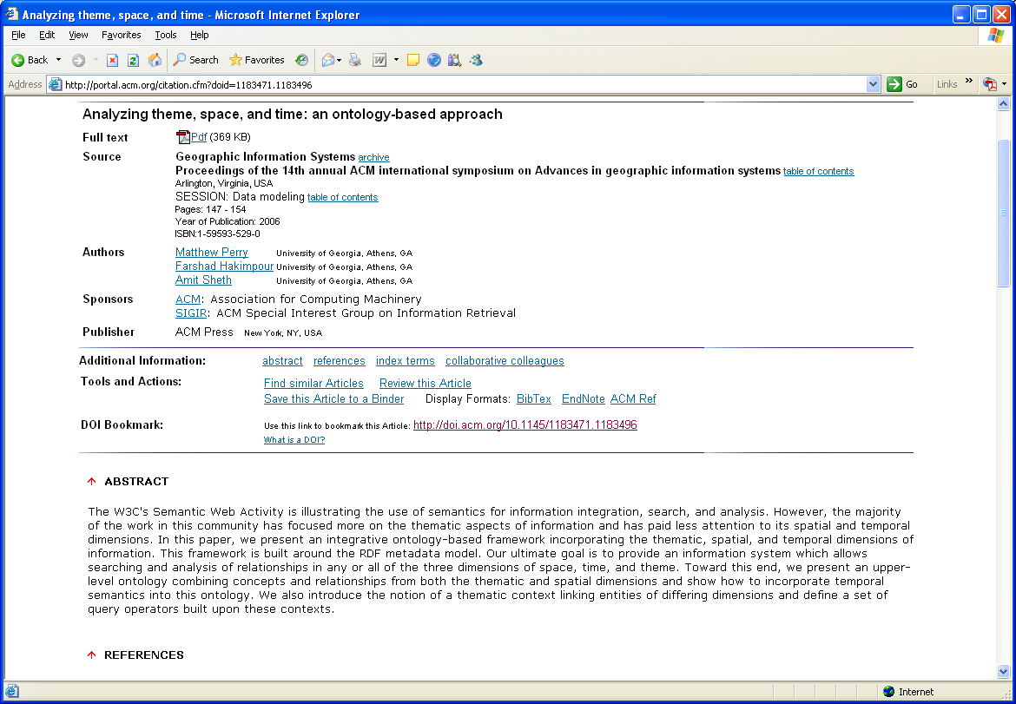
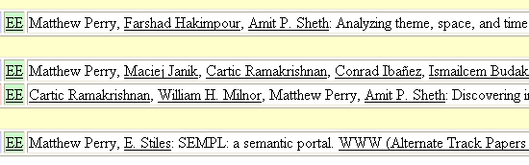
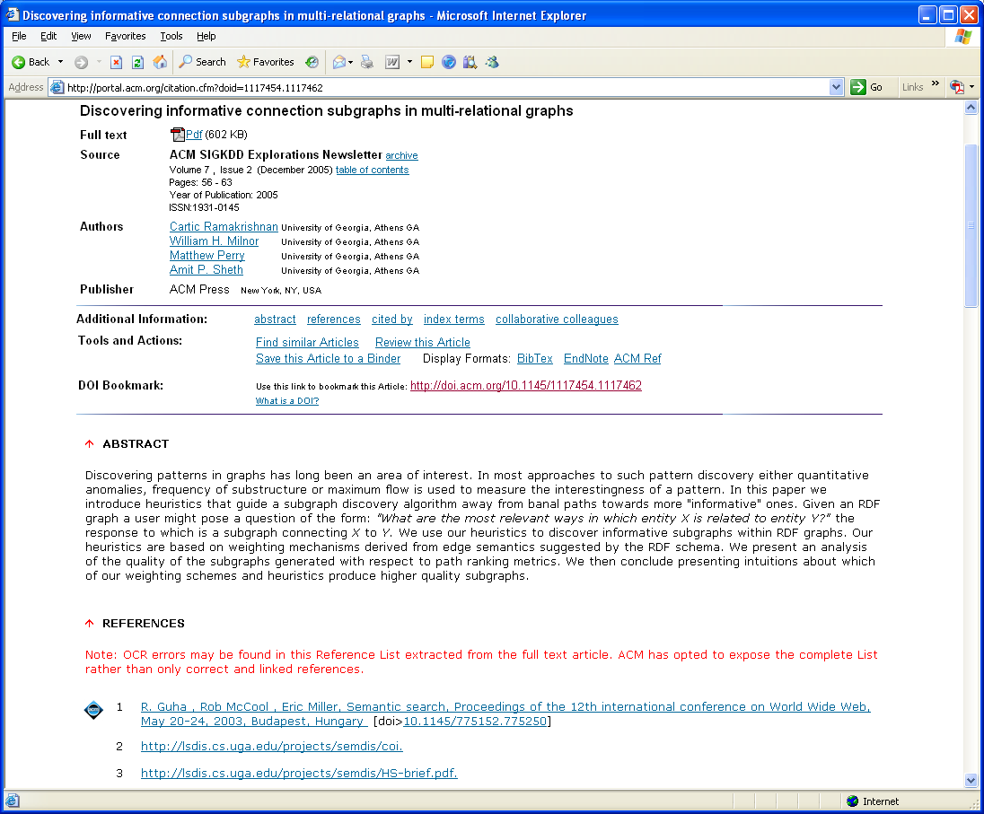
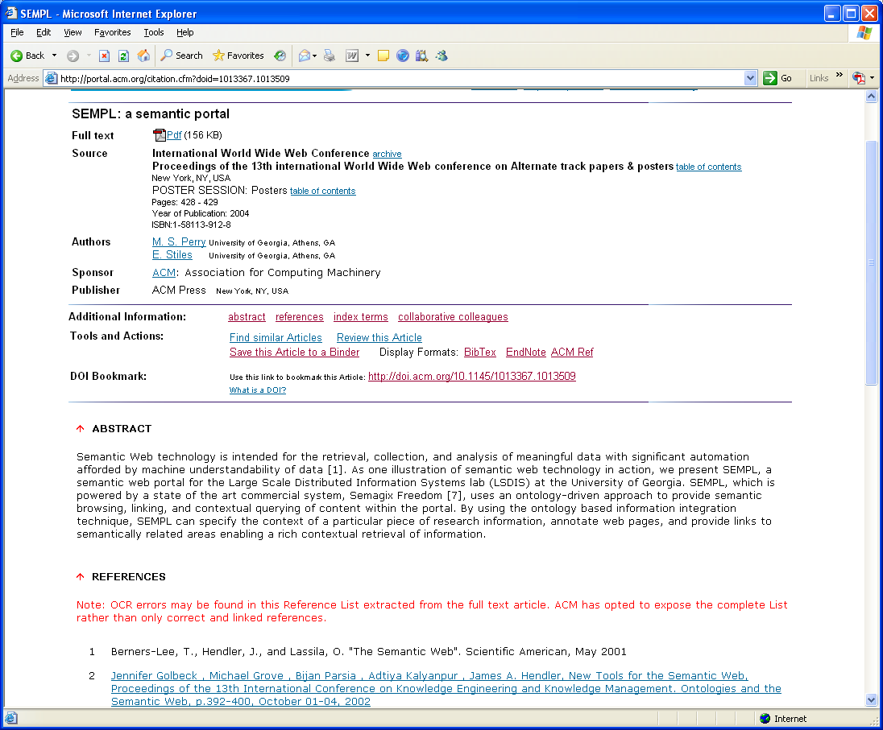
Evaluation of Ranking Documents
Allows ability to measure both precision and recall

Slide 37
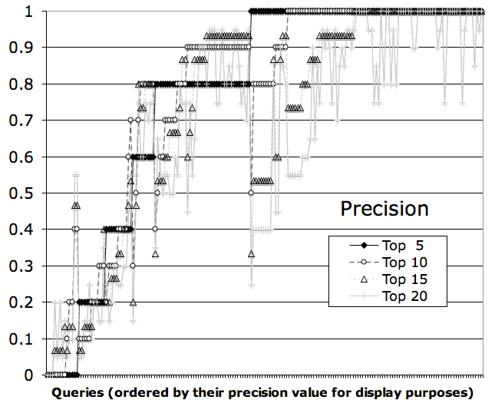
Evaluation of Ranking Documents
Precision for top 5, 10, 15 and 20 results
ordered by their precision value for display purposes

Slide 38
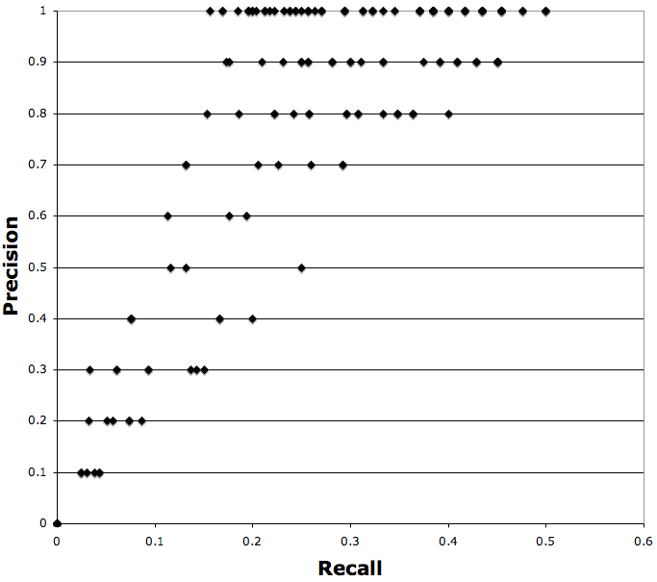
Evaluation of Ranking Documents
Precision vs. Recall for top 10 results
scattered
plot

Slide 39
Findings from Evaluations
Average precision for top 5, top 10 is above 77%
    Precision for top 15 is 73%; for top 20 is 67%
Low Recall was due to queries involving first-names that are common (unintentional input in the evaluation)
    Examples: Philip, Anthony, Christian

Slide 40
Observations and Conclusions
Just as the link structure of the Web is a critical component in today’s Web search technologies, complex relationships will be an important component in emerging Web search technologies

Slide 41
Contributions/Observations
Flexible Ranking of relationships
    Context was main factor yet semantics are in user’s mind
Analysis of Relationships (Conflict of Interest scenario)
    Semantics shifted from user into application yet still tied to the domain and application
    Demonstrated with populated ontology of 2 million entities
Relationship-based document ranking
    Relevance-score is based on appearance of relevant entities to input from user
    Does not require link-structure among documents

Slide 42
Observations
W.r.t. Relationship-based document ranking
  Scoring method is robust for cases of multiple-entities match
    E.g., two Bruce Lindsay entities in the ontology
  Useful grouping of results according to entity-match
    Similar to search engines clustering results (e.g., clusty.com)
  Value of relationships for ranking is demonstrated
    Ontology needs to have named entities and relationships

Slide 43
Challenges and Future Work
Challenges
  Keeping ontology up to date and of good quality
  Make it work for unnamed entities such as events
    In general, events are not named
Future Work
  Usage of ontology + documents in other domains
  Potential performance benefits by top-k + caching
  Adapting techniques into “Search by description”

Slide 44
References
[AHAS’07] B. Aleman-Meza, F. Hakimpour, I.B. Arpinar, A.P. Sheth: SwetoDblp Ontology of Computer Science Publications, (accepted) Journal of Web Semantics, 2007
[ABEPS’05] B. Aleman-Meza, P. Burns, M. Eavenson, D. Palaniswami, A.P. Sheth: An Ontological Approach to the Document Access Problem of Insider Threat, IEEE ISI-2005
[ASBPEA’06] B. Aleman-Meza, A.P. Sheth, P. Burns, D. Paliniswami, M. Eavenson, I.B. Arpinar: Semantic Analytics in Intelligence: Applying Semantic Association Discovery to determine Relevance of Heterogeneous Documents, Adv. Topics in Database Research, Vol. 5, 2006
[AHAS’03] B. Aleman-Meza, C. Halaschek, I.B. Arpinar, and A.P. Sheth: Context-Aware Semantic Association Ranking, First Intl’l Workshop on Semantic Web and Databases, September 7-8, 2003
[AHARS’05] B. Aleman-Meza, C. Halaschek-Wiener, I.B. Arpinar, C. Ramakrishnan, and A.P. Sheth: Ranking Complex Relationships on the Semantic Web, IEEE Internet Computing, 9(3):37-44
[AHSAS’04] B. Aleman-Meza, C. Halaschek, A.P. Sheth, I.B. Arpinar, and G. Sannapareddy: SWETO: Large-Scale Semantic Web Test-bed, Int’l Workshop on Ontology in Action, Banff, Canada, 2004
[AMS’05] K. Anyanwu, A. Maduko, A.P. Sheth: SemRank: Ranking Complex Relationship Search Results on the Semantic Web, WWW’2005
[AS’03] K. Anyanwu, and A.P. Sheth, ρ-Queries: Enabling Querying for Semantic Associations on the Semantic Web, WWW’2003

Slide 45
References
[HAAS’04] C. Halaschek, B. Aleman-Meza, I.B. Arpinar, A.P. Sheth, Discovering and Ranking Semantic Associations over a Large RDF Metabase, VLDB’2004, Toronto, Canada (Demonstration Paper)
[MKIS’00] E. Mena, V. Kashyap, A. Illarramendi, A.P. Sheth, Imprecise Answers in Distributed Environments: Estimation of Information Loss for Multi-Ontology Based Query Processing, Int’l J. Cooperative Information Systems 9(4):403-425, 2000
[SAK’03] A.P. Sheth, I.B. Arpinar, and V. Kashyap, Relationships at the Heart of Semantic Web: Modeling, Discovering and Exploiting Complex Semantic Relationships, Enhancing the Power of the Internet Studies in Fuzziness and Soft Computing, (Nikravesh, Azvin, Yager, Zadeh, eds.)
[SFJMC’02] U. Shah, T. Finin, A. Joshi, J. Mayfield, and R.S. Cost, Information Retrieval on the Semantic Web, CIKM 2002
[SRT’05] A.P. Sheth, C. Ramakrishnan, C. Thomas, Semantics for the Semantic Web: The Implicit, the Formal and the Powerful, Int’l J. Semantic Web Information Systems 1(1):1-18, 2005
[SS’98] K. Shah, A.P. Sheth, Logical Information Modeling of Web-Accessible Heterogeneous Digital Assets, ADL 1998

Slide 46
Data, demos, more publications at
SemDis project web site, http://lsdis.cs.uga.edu/projects/semdis/
Thank You

