Slide 1
From a Genome Database to a
Semantic Knowledge Base
MS Thesis Defense
July 18th, 2008
Bobby E. McKnight
Committee:
I. Budak Arpinar (Major Professor)
John A. Miller
Liming Cai

Slide 2
Contents
Introduction
Motivation
Example Scenario
Data Inventory and Knowledge Engineering
Visual Query Building
  Guided query building
  Natural Language
Data Exploration
Evaluation
Related Works
Future Work
Conclusion

Slide 3
Introduction
Trypanosoma Cruzi
  Responsible for Chagas disease
    Chagas is the third most serious parasitic disease worldwide (World Bank, 1993; Schofield and Dias, 1999)
  TcruziDB.org
    On line Trypansosoma Cruzi database resource
    Provides genome exploration for researchers
Semantic Web
  Provides rich formats for expressing data
  Many advantages over traditional relational database based systems

Slide 4
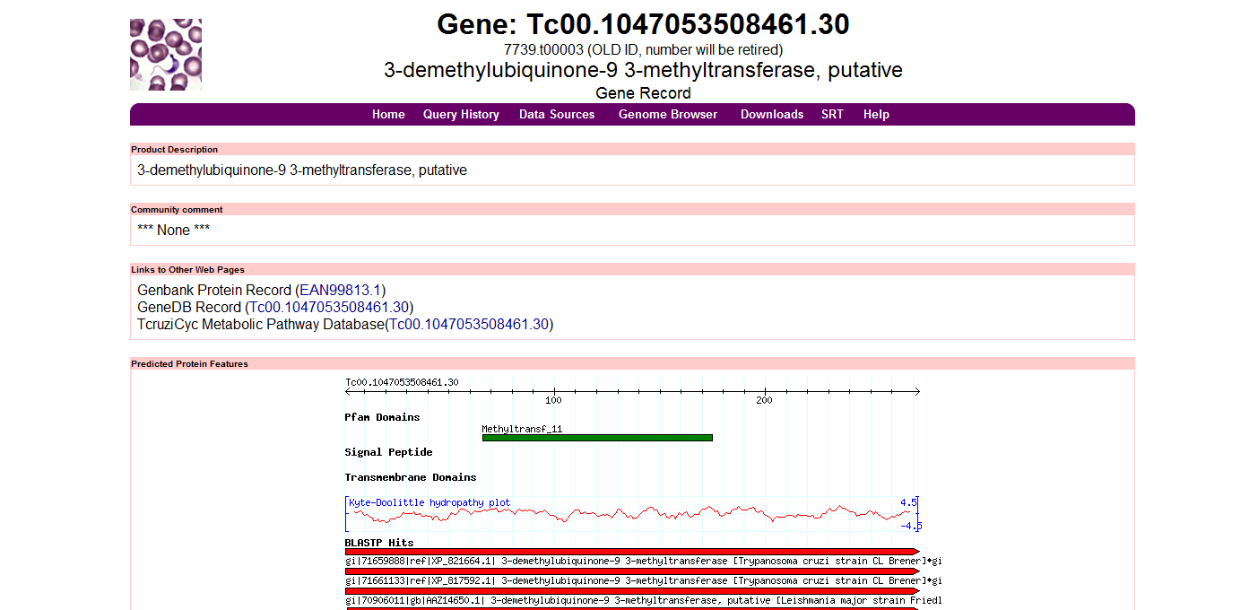
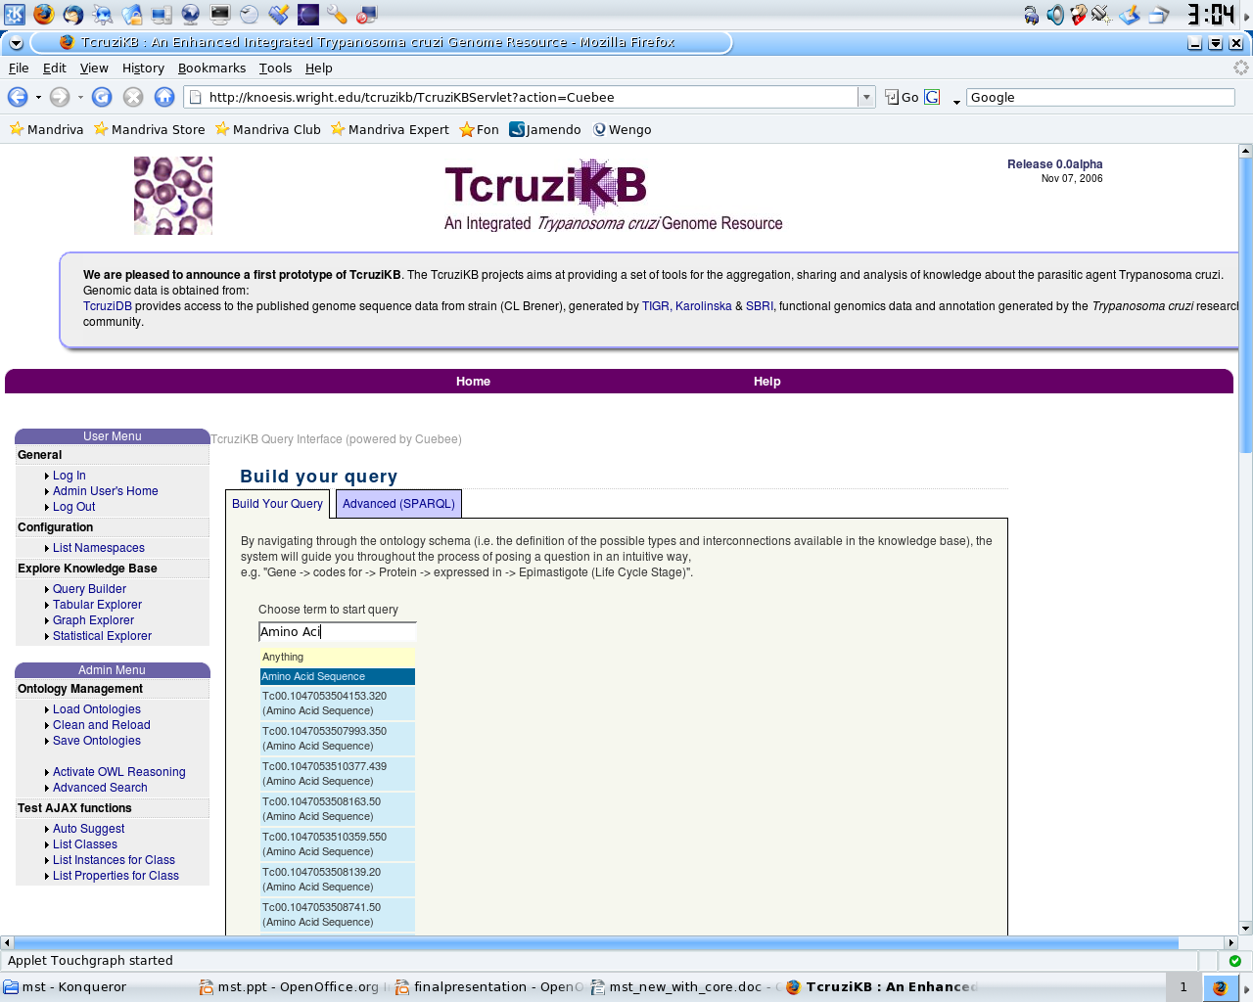
The Big Picture
Outside
Genomic
Resources
tcruzidb.org
PropreO
GlycO
ComGO
EnzyO
RO
GO
SO
Taxonomy
EC
ontologies
TcruziKB

Slide 5
Motivation
“Over most of my career, people could plan their experiments over a weekend, spend six months doing them, and then interpret the results over a weekend. Now, people can do an experiment over a weekend and spend six months thinking about what the results mean.”
Gerald M. Rubin
Vice President for Biomedical Research
Howard Hughes Medical Institute (HHMI)

Slide 6
Why Semantics?
Interoperability: Seamless Integration
  Use known ontologies
Knowledge/Domain Centered
  as opposed to database tables
Automation for Knowledge Exploration
  inferencing
Re-Usable
Standardization

Slide 7
Seamless Integration
Ontology naturally recognizes and maps between different external data sources
GeneXYZ
  has_genbank_index_identifier 12345
  has_accession ENAxxx.1
  has_kegg_identifier TCKxxx
  has_genedb_identifier Tc00.xxxx.30

Slide 8
Knowledge Centered
View concepts, not tables
  Focus on the real world concept, instead of the table where it is stored
  More natural way to access data
Make our data reusable and inter-operable
  Using widely adopted standards
  RDF
  OWL

Slide 9
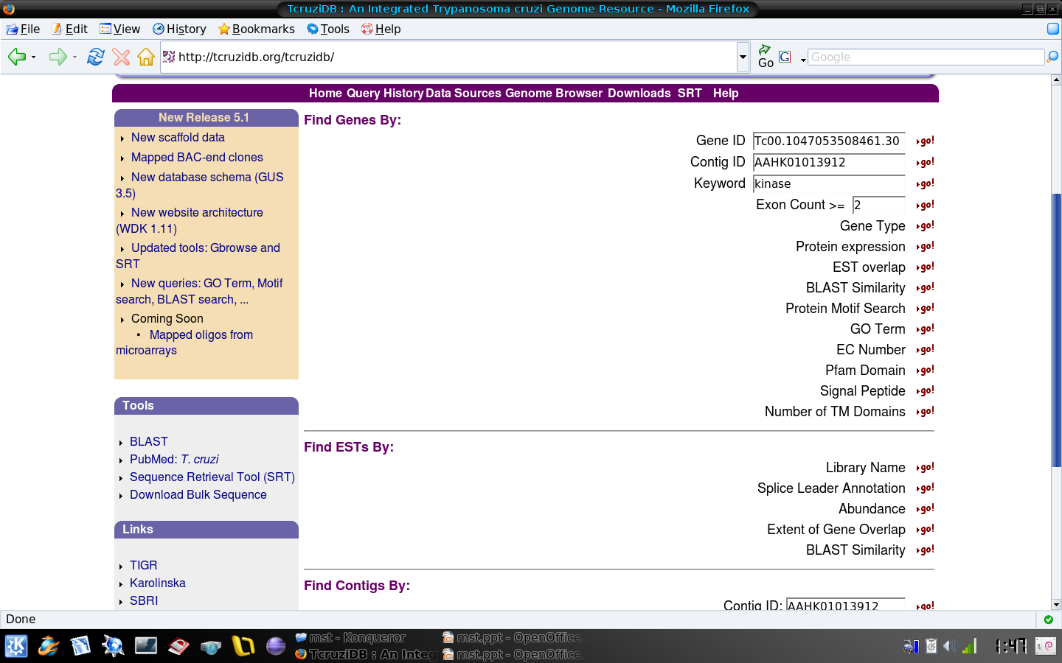
Example Scenario – Querying 1
With TcruziDB if a user wants to find a specific group of genes they must conduct multiple searches and combine the results

Slide 10
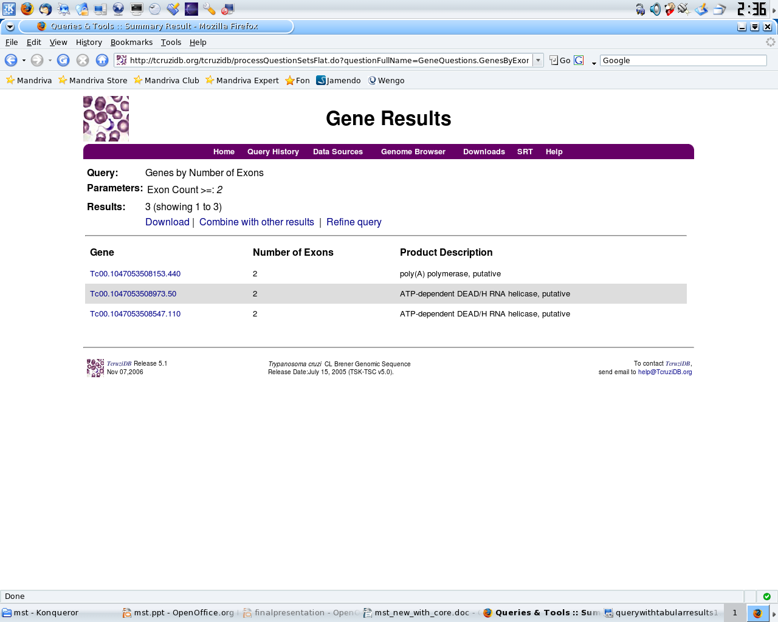
Example Scenario - Querying 2

Slide 11
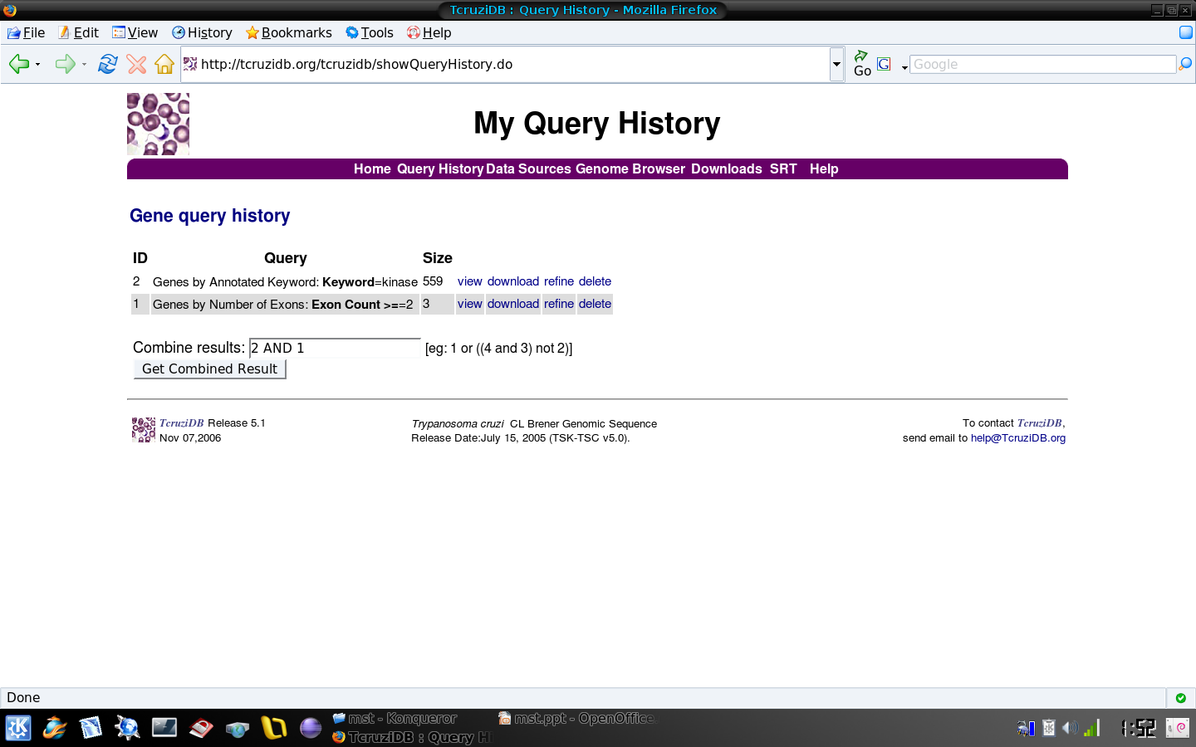
Example Scenario – Querying 3

Slide 12
Example Scenario – Querying 4
This requires a great deal of backtracking
TcruziKB uses a semantic based query building system and natural language query system
  allowing for queries such as this one to be built and executed from one screen
  eliminates the backtracking
  still supports keyword search

Slide 13

Example Scenario - Results
TcruziDB only gives results in tabular format
TcruziKB gives a multi-perspective data view
  Tables
  Statistics
  Graphs
  Related Publications

Slide 14
Example Scenario - Summary
With TcruziKB a user can enter in a complex query without backtracking by using the query builder or natural language query interface
In stead of simple tabular results which require a great deal of human effort in finding significant information, multiple result perspectives can be used
  view your query results along with related publications

Slide 15
Data Inventory and Knowledge Engineering

Slide 16
Knowledge Engineering
System Ontology
  Several popular ontologies exist with classes and properties of interest
  Reuse highly desirable
Ontology Engineering
  List keywords that appear in TcruziDB
    These become the ontology concepts
  Find related classes/properties in existing biological ontologies
    GO, SO, NCBI Taxonomy, etc

Slide 17
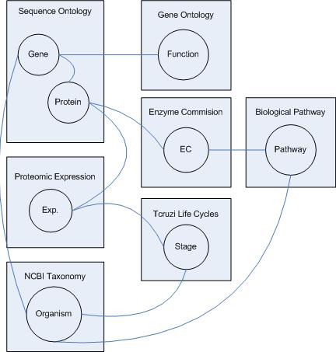
Ontology Schema

Slide 18
Data Collection
TcruziDB
  Relational database using GUS schema
  Mapped to RDF using D2R and a custom built map
  The annotated data can be queried via SPARQL endpoint
Enchance with outside data
  Pfam
    Flat files, converted to RDF
  Interpro
    XML, converted to RDF
  Others such as ortholog groups from OrthoMCL

Slide 19
Visual Query Building

Slide 20
Visual Query Building
We would like to allow the researcher to ask complex questions
Use SPARQL directly
  TcruziKB supports this
Problem
  You can't expect that every biologist knows the language
Solution
  Guided query building¹
  Natural language querying
1. Pablo N. Mendes, Bobby McKnight, Amit P. Sheth, Jessica C. Kissinger. "Enabling Complex Queries For Genome Data Exploration" IEEE Second International Conference on Semantic Computing (ICSC) 2008 in Santa Clara California. (To appear)

Slide 21
Query Building
The ontology schema represents all types of information in the system
By allowing the user to select a class from the schema to begin the query the system can guide them in building a more complex query
The system can provide suggestions as the user types with relevant knowledge from the ontology

Slide 22
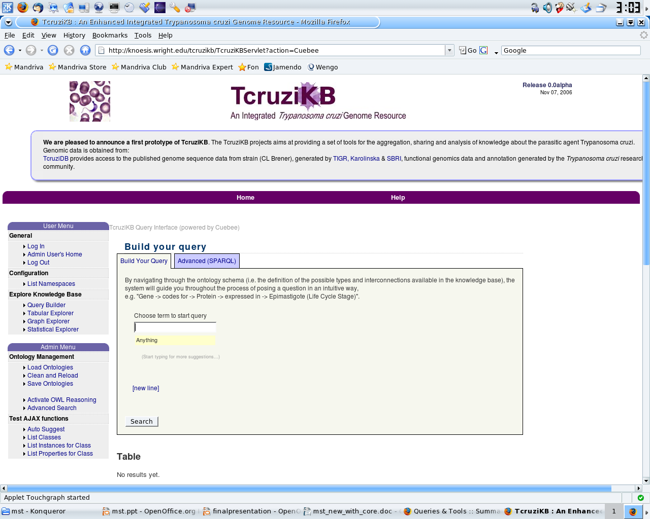
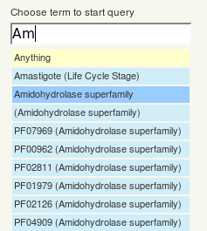
Query Building – Stage 1 – Picking a Class

Slide 23
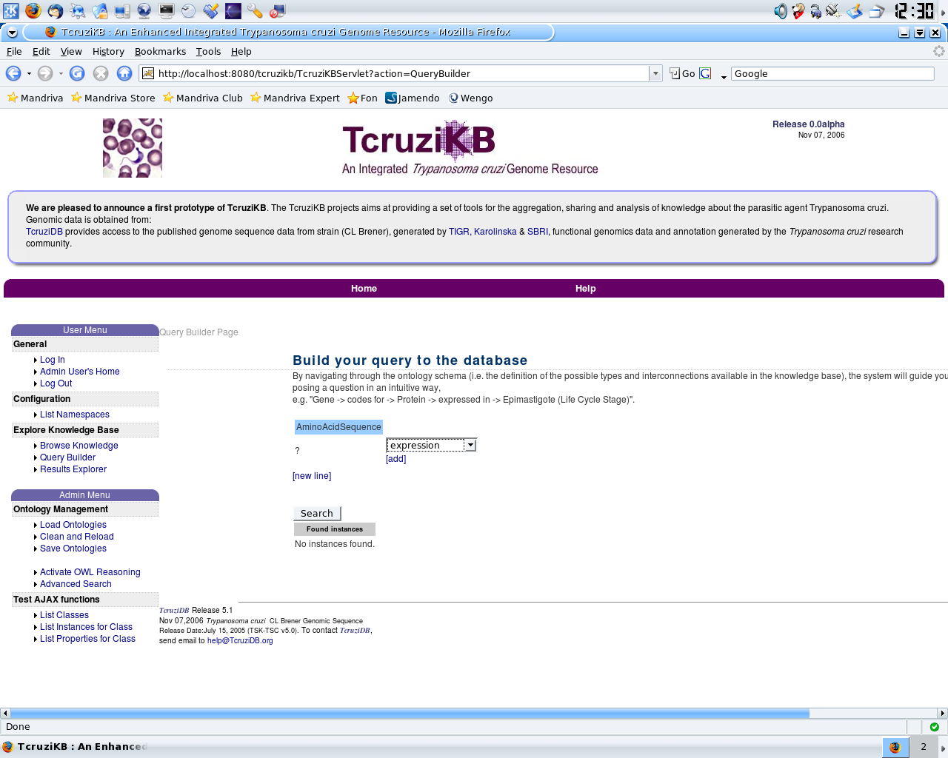

Query Builder – Stage 2 – Picking a Property

Slide 24
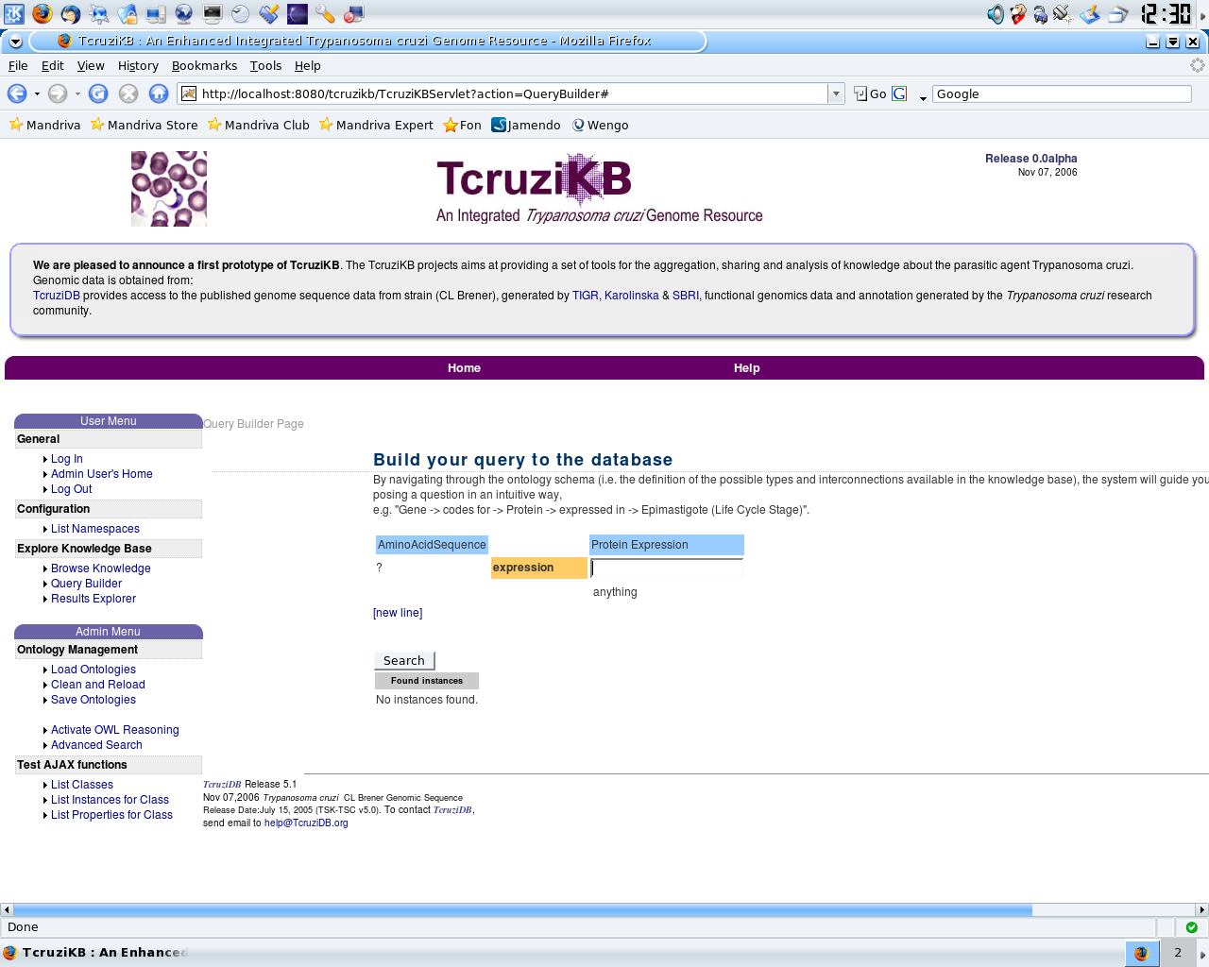
Query Builder – Stage 3 – Complete the Triple

Slide 25
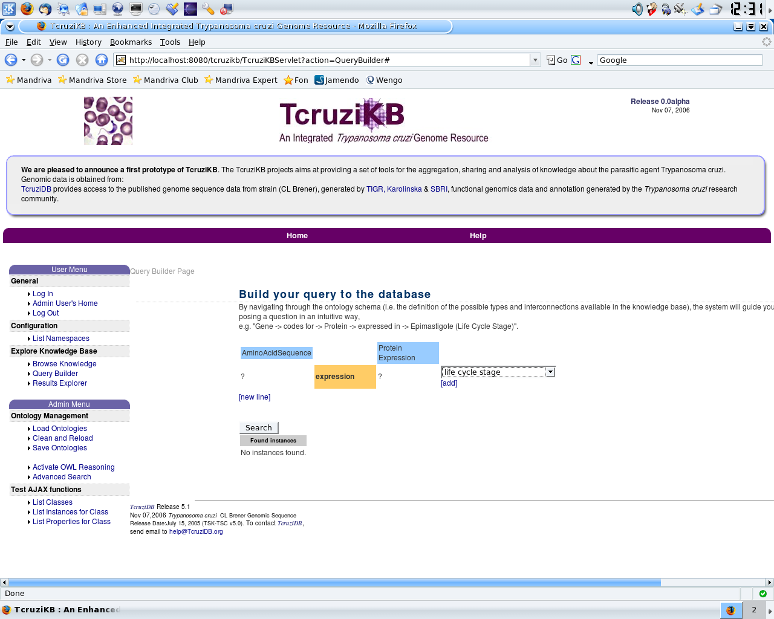
Query Builder – Stage 4 – Continue Building Triples

Slide 26
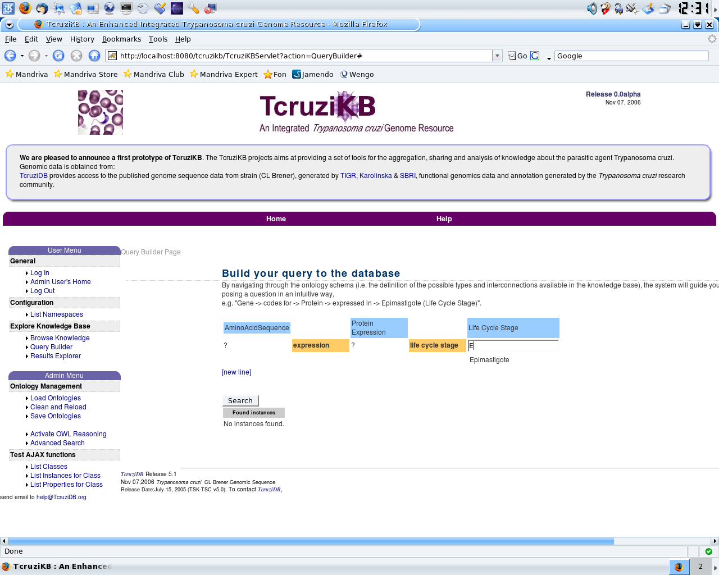
Query Builder – Stage 5 – Finish The Triple

Slide 27
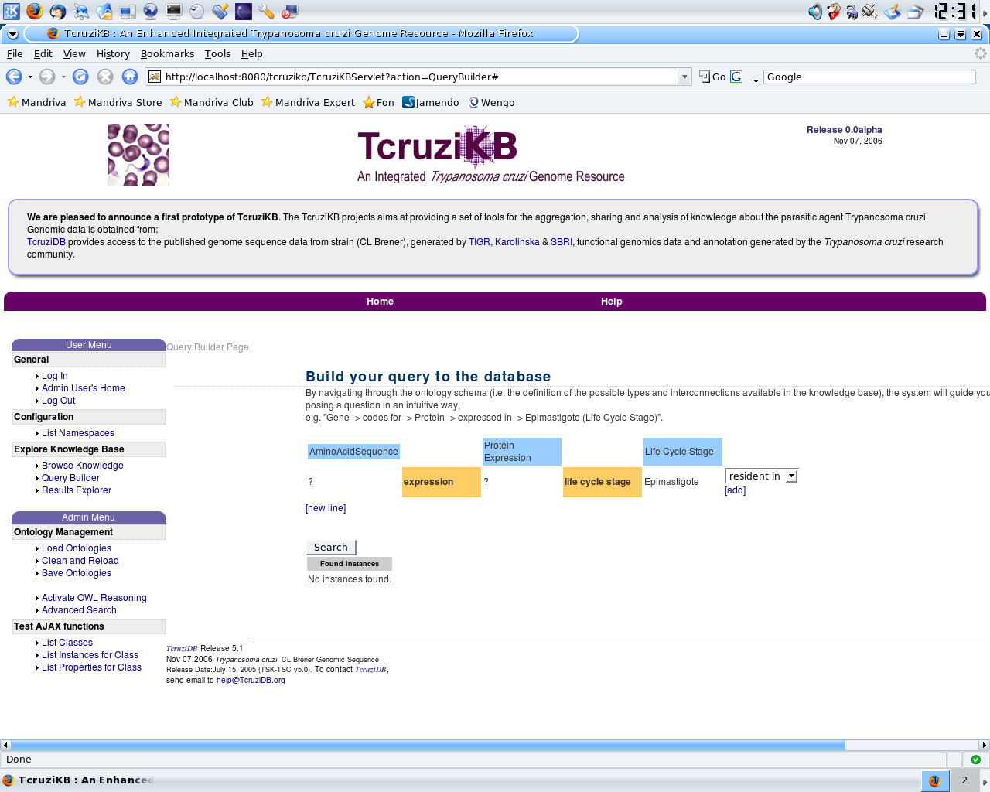
Query Builder – Stage 6

Slide 28
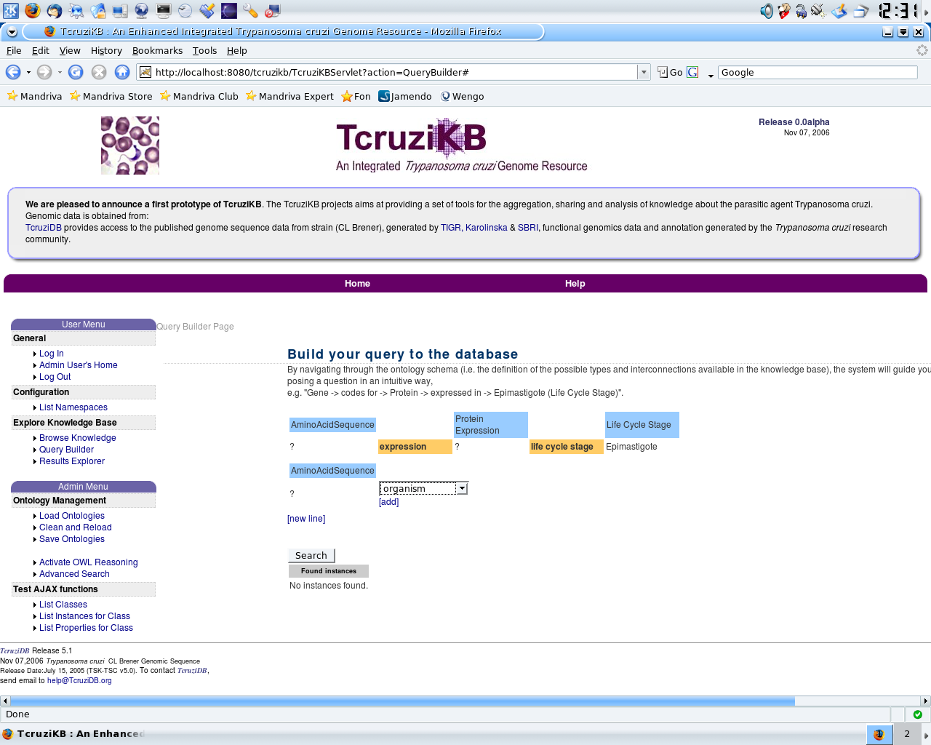
Query Builder – Stage 7 – New Line (AND)

Slide 29
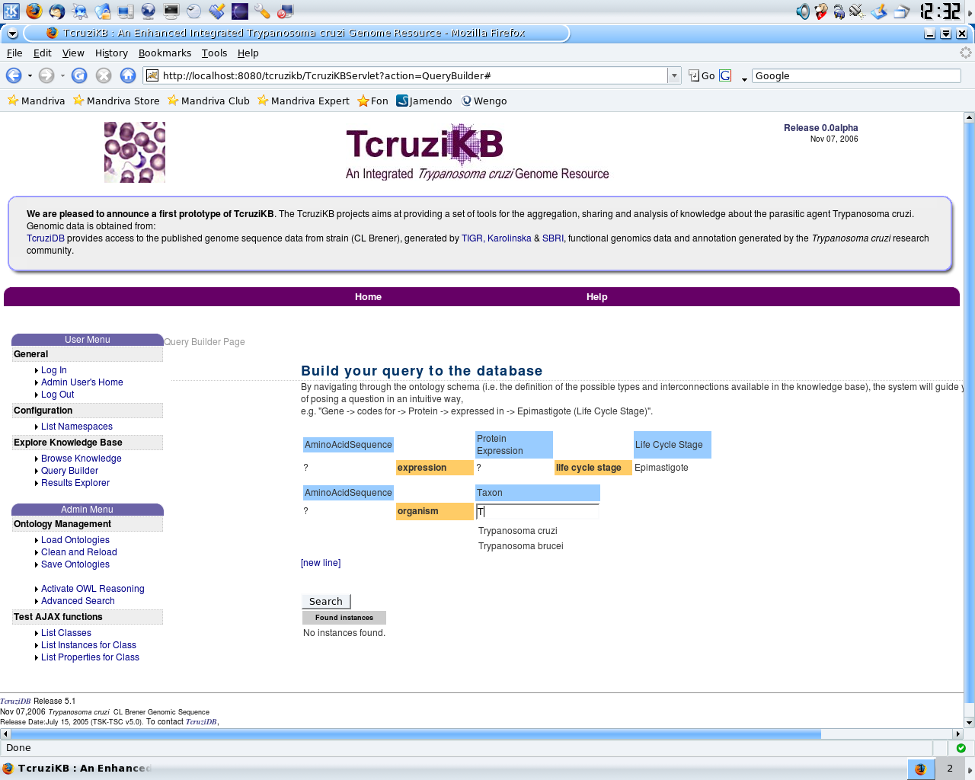
Query Builder – Stage 9

Slide 30
Query Builder Summary
A user can conduct a search on a single class
  Simply selecting “AminoAcidSequence” and pressing search will describe the AminoAcidSequence class
  Selecting “SequenceX” gets all information for the instance SequenceX
The user can build as many triples as needed or can stop after one
Builds SPARQL for the user
  The user also has the option of altering the generated SPARQL

Slide 31
Natural Language Querying
In order to allow for complex queries allow user's to enter in queries in natural English
Use NLP to find ontology concepts in the user's query and form SPARQL
Which genes are expressed in the Epimastigote stage?
SELECT ?gene WHERE {
?gene :life_cycle_stage :Epimastigote
}

Slide 32
NLP – Question Entry
The user enters in a question in plain English
Suggestions are presented to the user in a similar fashion as the query builder
  These suggestions are based on ontology words
  The classes, instances, and properties, previously entered by the user helps determine the priority of the suggestions
What genes are expressed in the
Metacyclic
Epimastigote
Trypanmastigote

Slide 33
NLP – Parse Tree and Part of Speech Tagging
The user's question is converted into a parse tree
Stanford Parser
  Constructs parse tree
  Part of speech tagging
What is the life cycle stage of GeneX?
(ROOT
(SBARQ
(WHNP (WP What))
(SQ (VBZ is)
(NP
(NP (DT the) (NN life cycle stage))
(PP (IN of)
(NP (CD GeneX)))))
(. ?)))

Slide 34
NLP – Tree Traversal
- 2 pre-order traversals
- 1st looks for matches to properties (labels, id, and descriptions)
- If a match if found a triple if formed
- 2nd pass looks for classes and instances (labels, id, and descriptions)
- Matches are placed in the triples found in pass 1
- Synonyms are also used during the matching (WordNet, VerbNet)
root
What
is
the life cycle stage
of
GeneX

Slide 35
Tree Traversal – Stage 1
1. Root is first. The string literal matches nothing
root
2. “What” is a stop word so it's ignored
3. ”is” is a stop word
What
is
4. “the life cycle stage”, the is removed because it's a stop word, the rest matches a property so triple formed:
empty -> life cycle stage -> empty
the life cycle stage
of
5. “of” ignored
GeneX
6. “GeneX” doesn't match a property so ignored

Slide 36
Tree Traversal – Stage 2
1. Root is first. The string literal matches nothing
root
2. “What” is a stop word so it's ignored
3. ”is” is a stop word
What
is
4. “the life cycle stage”, the is removed because it's a stop word, the rest matches a property but now we are looking for classes/instances
the life cycle stage
of
5. “of” ignored
6. “GeneX” matches an instance, we need to add it to an existing triple. Looking at the domain and range of the “life cycle stage” property we can tell where it goes
GeneX

Slide 37
NLP – To SPARQL
After the tree traversals are finished the triples are converted to SPARQL
Any missing entities in the triples are populated with variables
  ?gene,
  ?stage
rdf:labels are added to the SPARQL to make the result set more human readable

Slide 38
Data Exploration

Slide 39
Data Exploration
Most systems only offer a single method of results visualization
  little support is provided for analytical tasks that prioritize summarization and finding relationships between entities
TcruziKB uses a variety of results exploration tools
  Tabular
  Graph
  Statistical
  Publications

Slide 40
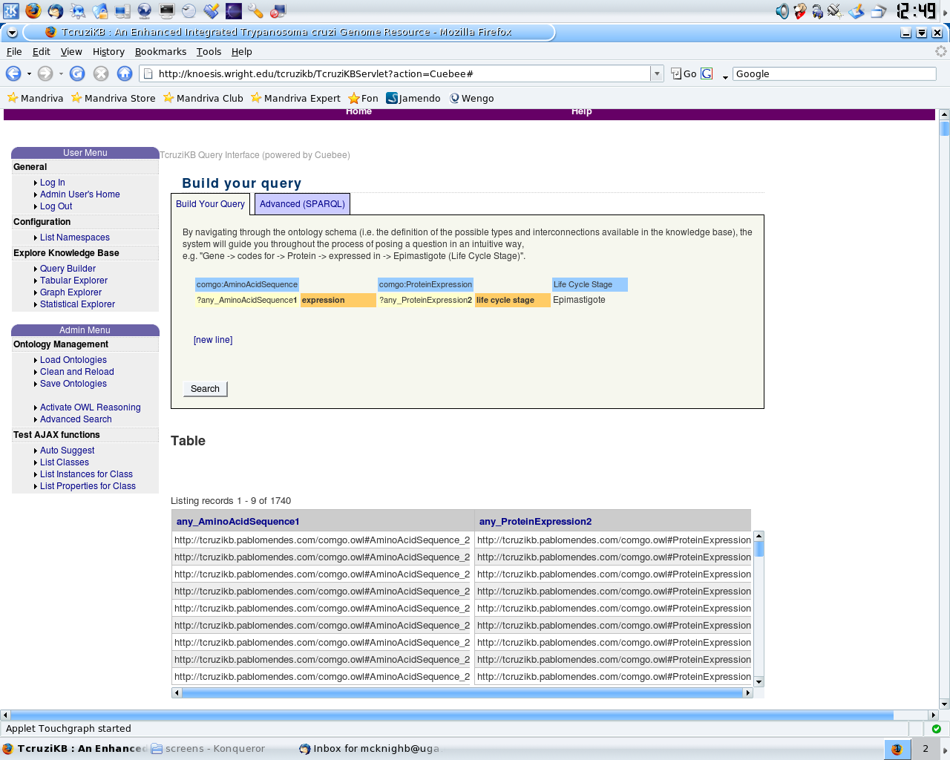
Tabular Explorer
TcruziKB provides support for the familiar and popular results view
Rico Live Grid provides enhanced features
  search within results
  sorting

Slide 41
Graph Explorer
Ontologies define relationships between data which lends itself naturally to a directed graph representation
The query results can be displayed on a graph with classes/instances corresponding to nodes and properties corresponding to edges in the graph
This graph could give a biologist additional insight on the data by looking for clusters or paths between classes

Slide 42
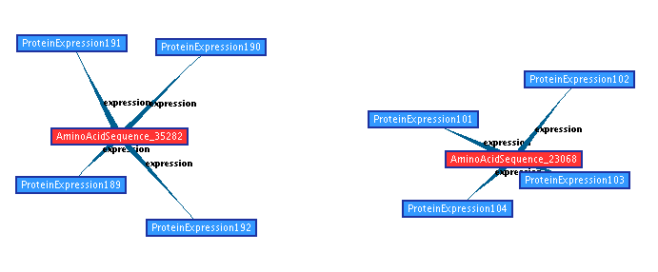
Graph Explorer – Screen Shot

Slide 43
Graph Expansion
By right clicking on a node, the results can be extended by adding additional classes and properties
This could reveal more relationships between the results

Slide 44
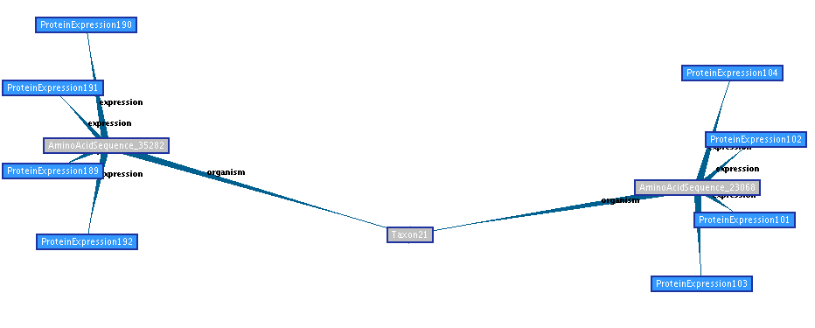
Graph Expansion - Example
Original Query Results
User selects to expand graph based on organism property
Expanded Graph

Slide 45
Feature Selection
A common problem with graph based results is that they can become too complex to navigate through
TcruziKB has the option to run feature selection on the graph to hide nodes and properties that are not statistically important
Edge importance is calculated during a preprocessing step using entropy and gain formulas from information theory

Slide 46
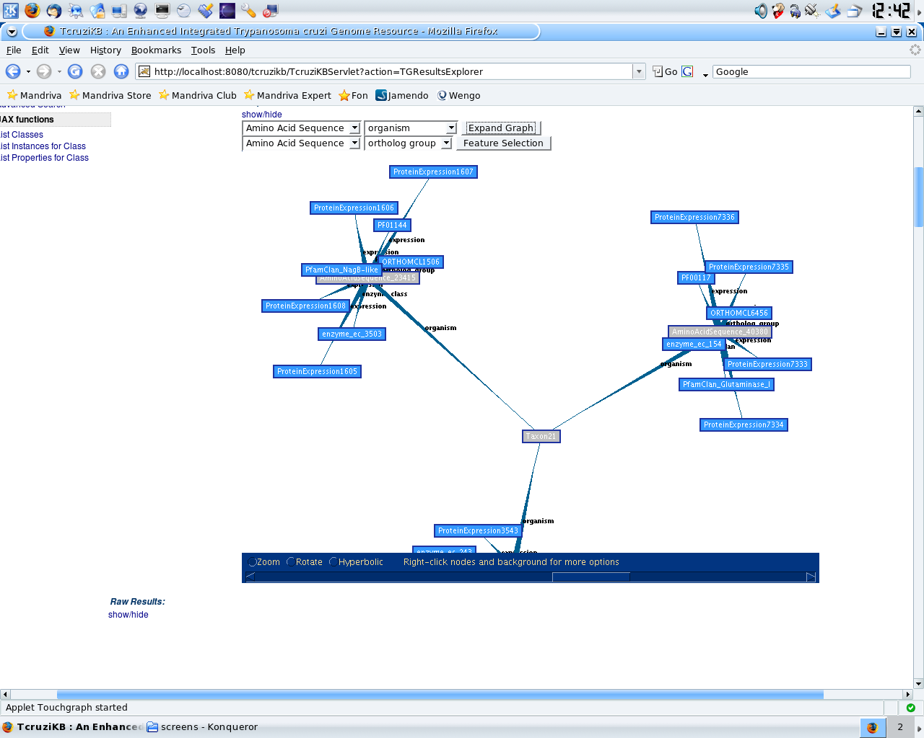
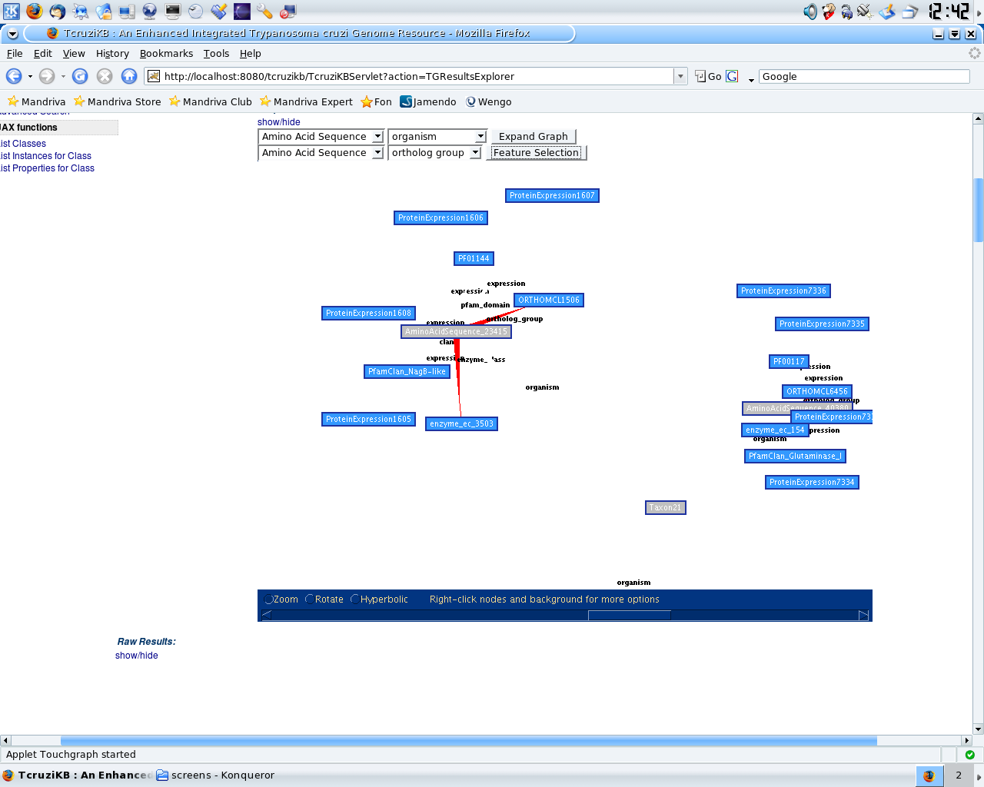
Feature Selection - Example

Slide 47
Statistical Explorer
Allows for an overview of a result set
For each variable in the query, the system offers a chart per property
For each class-property pair, the chart shows the proportion of instances that assume each possible value
Shows how the instances in the result set compares to the overall distribution

Slide 48
Statistical Explorer - Example
A query for all protein expression results, the system would present one pie chart for each property of the class Protein
  life cycle stage, ortholog group, etc
From the graph you can see the distribution of the values of the different properties
  23% have value “Amastigote” for the property “life_cycle_stage”
This distribution can be compared to the distribution of the result set

Slide 49
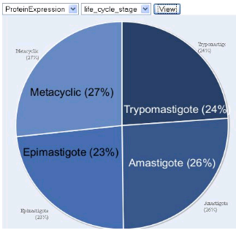
Statistical Explorer – Screen Shot

Slide 50
Publication Explorer
In the field of Genomics, a researcher would commonly execute queries, visualize results and then look for publications that would confirm or complete her knowledge about the results she obtained for a given query
Time consuming process
TcruziKB integrates with PubMed to automatically retrieve documents related to the query

Slide 51
Publication Explorer - Continued
Improved PubMed search by using ontology knowledge
The top features are used to weight the results of the simple keyword based query
Other words added that are in the neighborhood of the instances
  labels, parent class
Document score is computed by multiplying the frequency of the term in the paper by the weight calculated by feature selection and ontology distance

Slide 52
Publication Explorer - Example
Neighboring classes can be added to the query.
PubMed can be searched using the original terms with the new addions.
The results from PubMed can be ranked according to frequency of the term and it's weight (computed from information gain)
D
E
Suppose a query yielded the results A,B,C
PubMed could be searched with “A^B^C” or “AvBv”
-Problems?
A
B
C

Slide 53
Evaluation

Slide 54
Usability Evaluation
Subjective Evaluation
  System Usability Scale (SUS)
Empirical Metrics
  Time needed to complete queries
  Number of interactions needed to complete queries
Natural Language Query Accuracy

Slide 55

SUS
System Usability Scale
  published method of evaluating user interfaces
Panel of 30 university members
  Performed the same set of queries on TcruziDB and TcruziKB
  Recorded their experience on SUS evaluation forms

Slide 56
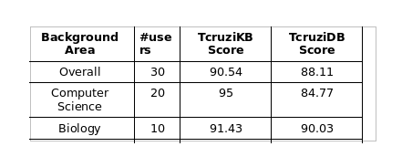
SUS - Results

Slide 57
Empirical Evaluation
The time and number of computer interactions needed to execute a set of queries were also recorded
  The number of interactions is simply the number of keystrokes and mouse clicks
TcruziKB Interactions (Avg): 21.33
TcruziKB Time (Avg): 117.33 seconds
TcruziDB Interactions (Avg): 53.33
TcruziDB Time (Avg): 311.33 seconds

Slide 58
Natural Language Evaluation
Panel members were asked to write 3 questions (in their own words) based the gene finding section of the TcruziDB homepage
Users would look to see what type of query is possible then write it in English
These questions are used to test the Natural Language Query interface

Slide 59
Natural Language Evaluation - Results
50 total questions used
  After removing duplicates
  varying complexity
The questions were entered into the system to see if the correct SPARQL was generated
Recall: 90%
Precision: 83%

Slide 60
Related Work

Slide 61
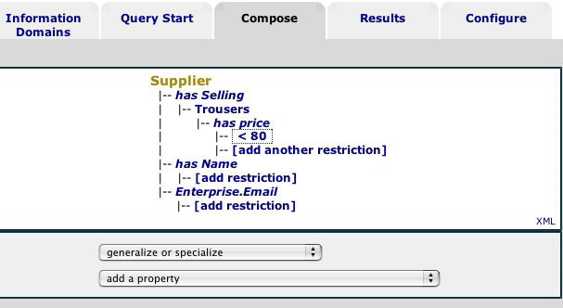
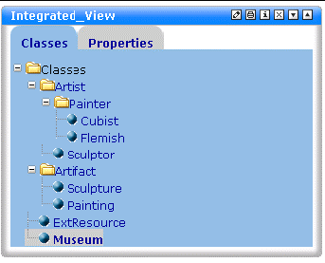
Comparison to Existing Work
Ontology Based Query Building Systems
  GRQL, SEWASIE
    Show a visualized ontology that the user can select classes and properties from
    Large ontologies present a problem
    Do not support multiple query and result exploration mechanisms

Slide 62
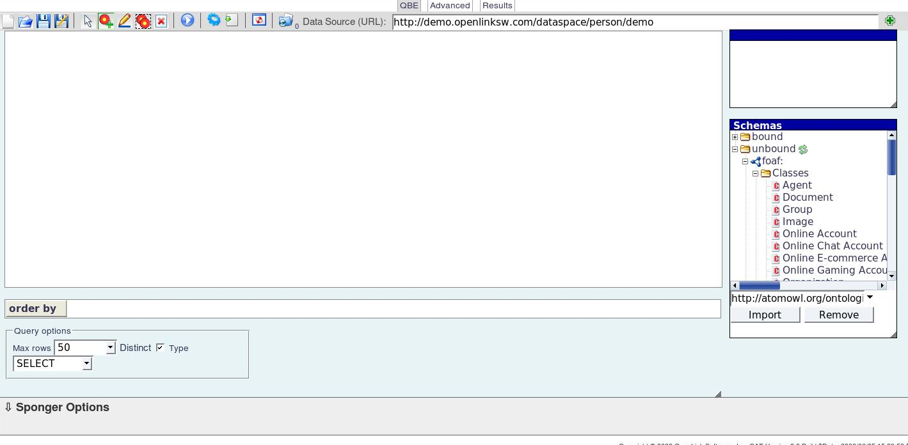
Comparison to Existing Work - Continued
iSPARQL, SDS
    Allow the user to build a graph by drawing nodes and edges
    Very different than traditional search systems
    Relies solely on graphical based query construction

Slide 63
Comparison to Existing Work - Continued
GINSENG
  Natural language query system
  No real NLP, just query building with a dictionary of “rule” words
  No support for synonyms, exact match required
ONLI
  Another natural language query system
  Again, does not support synonyms
  Uses an underlying query language that is non-standard

Slide 64
Future Work and Conclusion

Slide 65
Future Work
Extend query builder for SPARQLER support
  allow for more complex path based queries
AI assisted natural language query
  Cypher
Template based natural language query
Combine semantic querying with web search
  If a query can not be answered with the knowledge base alone use information retrieval methods to query the web
  Complete missing triples in the knowledge base

Slide 66
Conclusion
Semantics allow for a variety of improvements over relational database based systems
  standardization, interoperability, inferencing
Query building is a way to allow users to ask difficult questions easily
  TcruziKB vs TcruziDB
  Similar for natural language querying
Ontologies can be used to express result sets in more meaningful manners

