Slide 1
Ontology-Driven Automatic Entity Disambiguation in Unstructured Text
Jed Hassell

Slide 2
Introduction
No explicit semantic information about data and objects are presented in most of the Web pages.
Semantic Web aims to solve this problem by providing an underlying mechanism to add semantic metadata to content:
  Ex: The entity “UGA” pointing to http://www.uga.edu
  Using entity disambiguation

Slide 3
Introduction
We use background knowledge in the form of an ontology
Our contributions are two-fold:
  A novel method to disambiguate entities within unstructured text by using clues in the text and exploiting metadata from the ontology,
  An implementation of our method that uses a very large, real-world ontology to demonstrate effective entity disambiguation in the domain of Computer Science researchers.

Slide 4
Background
Sesame Repository
  Open source RDF repository
  We chose Sesame, as opposed to Jena and BRAHMS, because of its ability to store large amounts of information by not being dependant on memory storage alone
  We chose to use Sesame’s native mode because our dataset is typically too large to fit into memory and using the database option is too slow in update operations

Slide 5
Dataset 1: DBLP Ontology
DBLP is a website that contains bibliographic information for computer scientists, journals and proceedings:
  3,079,414 entities (447,121 are authors)
  We used a SAX parser to parse DBLP XML file that is available online
  Created relationships such as “co-author”
  Added information regarding affiliations
  Added information regarding areas of interest
  Added alternate spellings for international characters

Slide 6
Dataset 2: DBWorld Posts
DBWorld
  Mailing list of information for upcoming conferences related to the databases field
  Created a HTML scraper that downloads everything with “Call for Papers”, “Call for Participation” or “CFP” in its subject
  Unstructured text

Slide 7
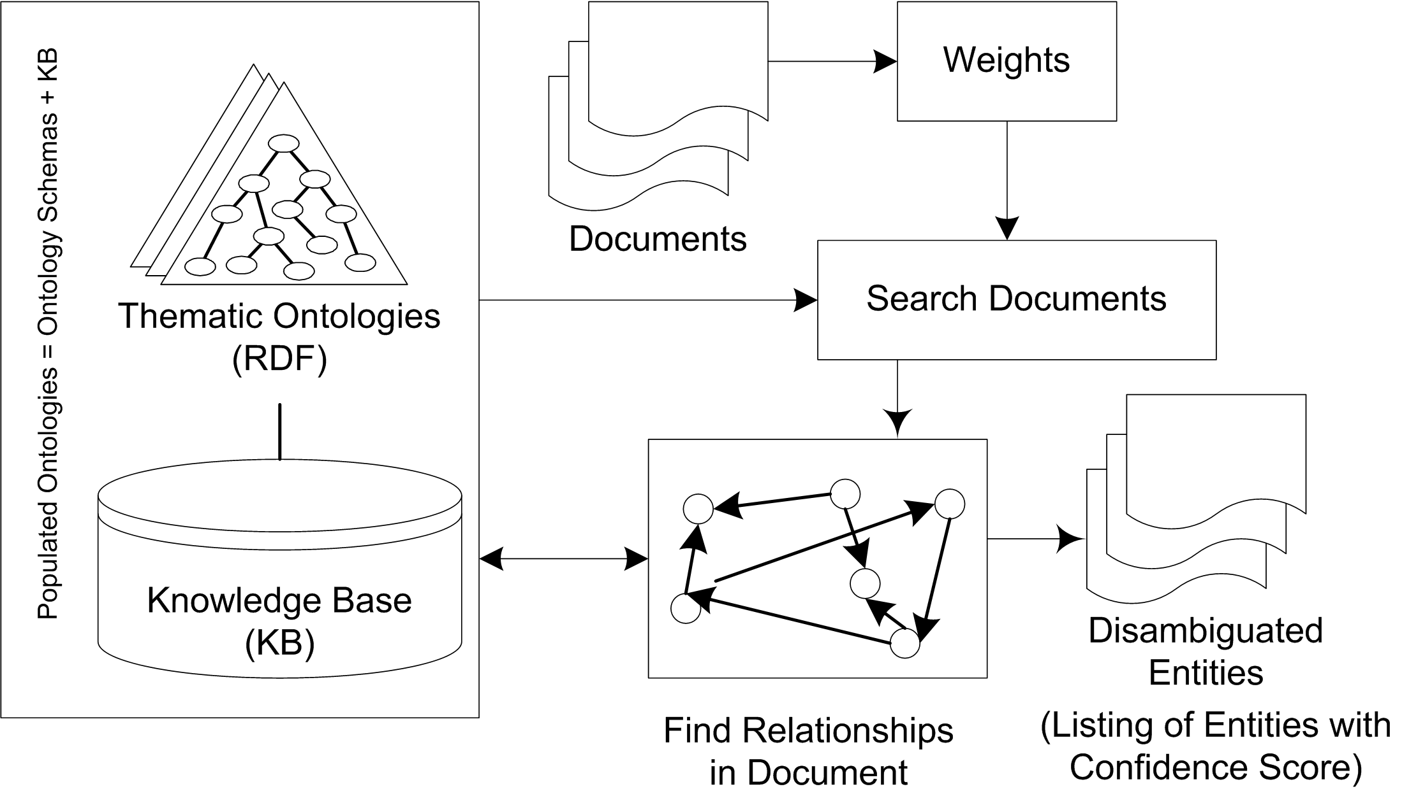
Overview of System Architecture

Slide 8
Approach
Entity Names
  Entity attribute that represents the name of the entity
  Can contain more than one name

Slide 9
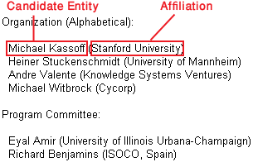
Approach
Text-proximity Relationships
  Relationships that can be expected to be in text-proximity of the entity
  Nearness measured in character spaces

Slide 10
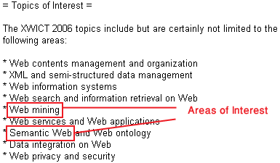
Approach
Text Co-occurrence Relationships
  Similar to text-proximity relationships except proximity is not relevant

Slide 11
Approach
Popular Entities
  The intuition behind this is to specify relationships that will bias the right entity to be the most popular entity
  This should be used with care, depending on the domain
  DBLP ex: the number of papers the entity has authored

Slide 12
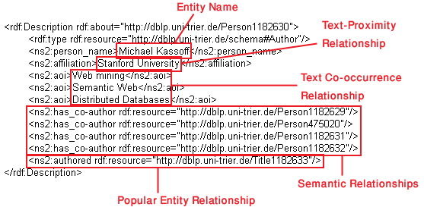
Approach
Semantic Relationships
  Entities can be related to one another through their collaboration network
  DBLP ex: Entities are related to one another through co-author relationships

Slide 13
Algorithm
Idea is to spot entity names in text and assign each potential match a confidence score
This confidence score will be adjusted as the algorithm progresses and represents the certainty that this spotted entity represents a particular object in the ontology

Slide 14
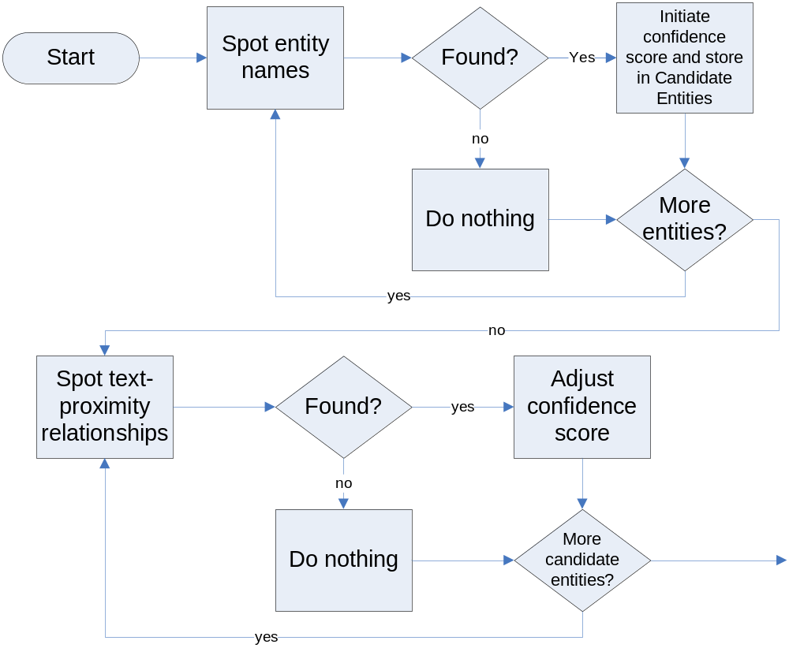
Algorithm – Flow Chart

Slide 15
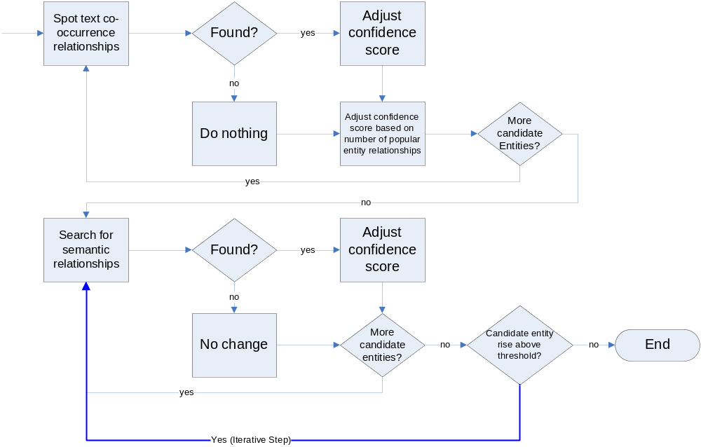
Algorithm – Flow Chart

Slide 16
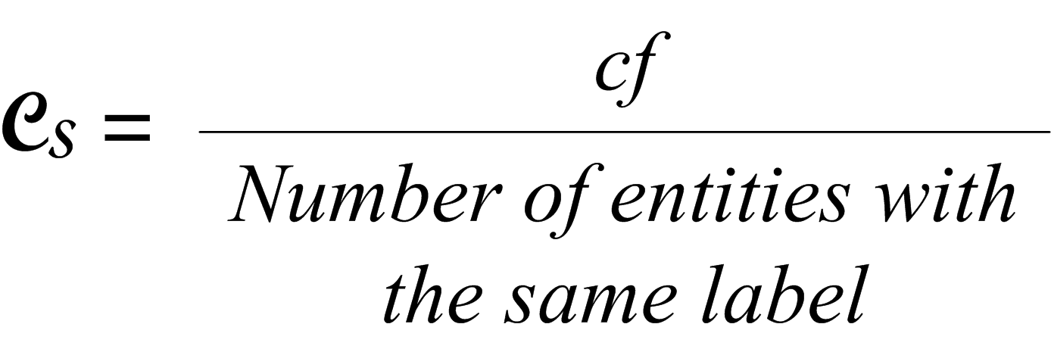
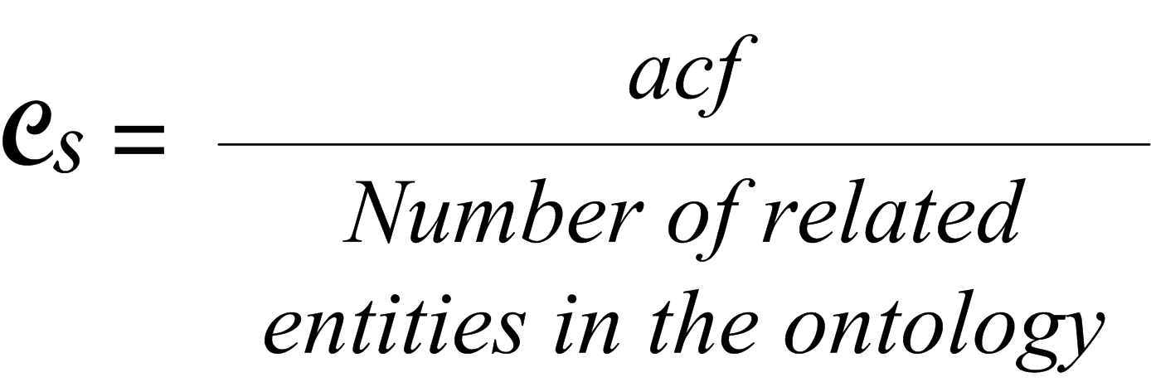
Algorithm
Spotting Entity Names
  Search document for entity names within the ontology
  Each of the entities in the ontology that match a name found in the document become a candidate entity
  Assign initial confidence scores for candidate entities based on these formulas:

Slide 17
Algorithm
Spotting Literal Values of Text-proximity Relationships
  Only consider relationships from candidate entities
  Substantially increase confidence score if within proximity
  Ex: Entity affiliation found next to entity name

Slide 18
Algorithm
Spotting Literal Values of Text Co-occurrence Relationships
  Only consider relationships from candidate entities
  Increase confidence score if found within the document (location does not matter)
  Ex: Entity’s areas of interest found in the document

Slide 19
Algorithm
Using Popular Entities
  Slightly increase the confidence score of candidate entities based on the amount of popular entity relationships
  Valuable when used as a tie-breaker
  Ex: Candidate entities with more than 15 publications receive a slight increase in their confidence score

Slide 20
Algorithm
Using Semantic Relationships
  Use relationships among entities to boost confidence scores of candidate entities
  Each candidate entity with a confidence score above the threshold is analyzed for semantic relationships to other candidate entities. If another candidate entity is found and is below the threshold, that entity’s confidence score is increased

Slide 21
Algorithm
If any candidate entity rises above the threshold, the process repeats until the algorithm stabilizes
This is an iterative step and always converges

Slide 22
Output
XML format
  URI – the DBLP URL of the entity
  Entity name
  Confidence score
  Character offset – the location of the entity in the document
This is a generic output and can easily be converted for use in Microformats, RDFa, etc.

Slide 23
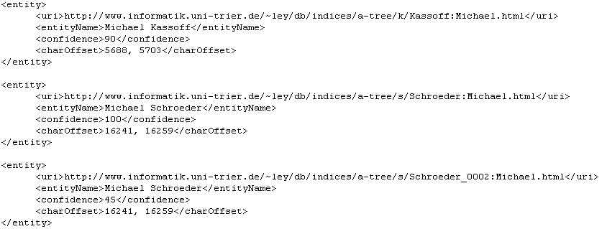
Output

Slide 24
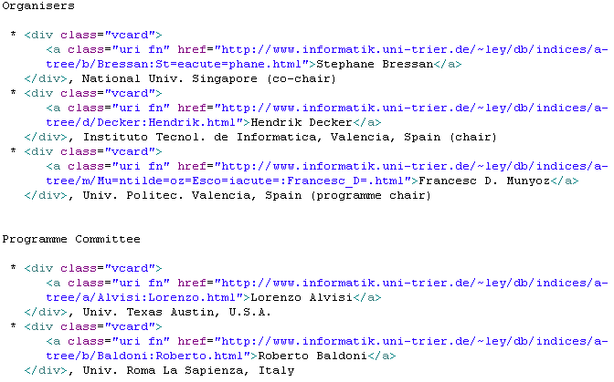
Output - Microformat

Slide 25
Evaluation: Gold Standard Set
We evaluate our system using a gold standard set of documents
  20 manually disambiguated documents
  Randomly chose 20 consecutive post from DBWorld
  We use precision and recall as the measurement of evaluation for our system

Slide 26
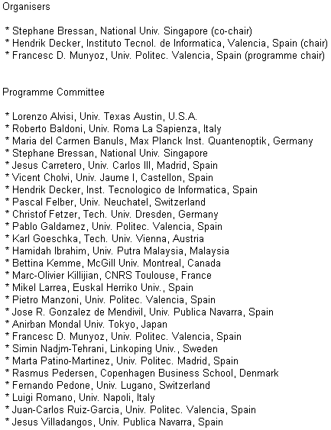
Evaluation: Gold Standard Set

Slide 27
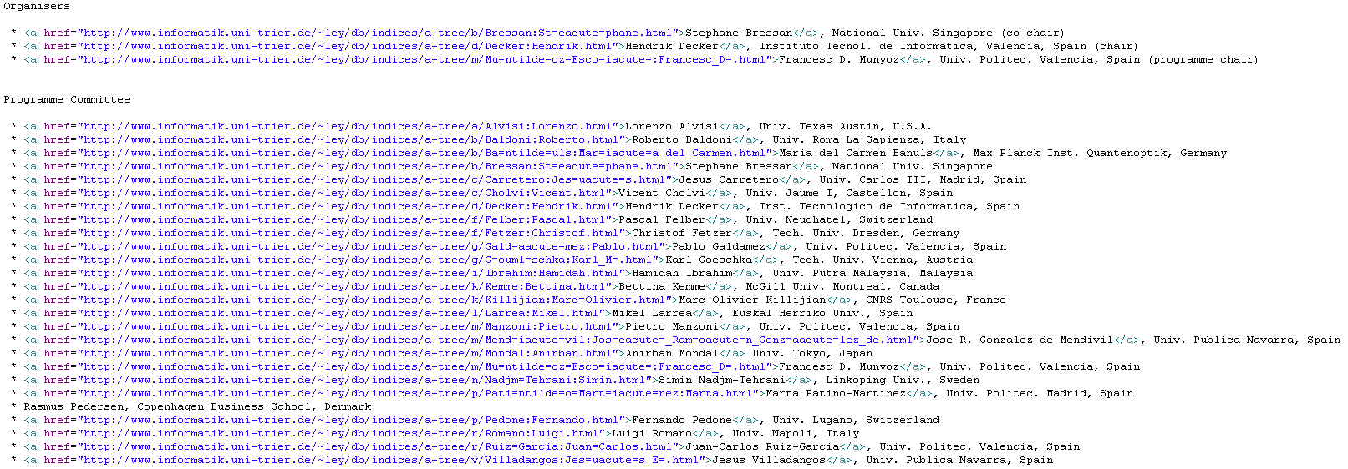
Evaluation: Gold Standard Set

Slide 28
Evaluation: Precision & Recall
We define set A as the set of unique names identified using the disambiguated dataset
We define set B as the set of entities found by our method
The intersection of these sets represents the set of entities correctly identified by our method

Slide 29
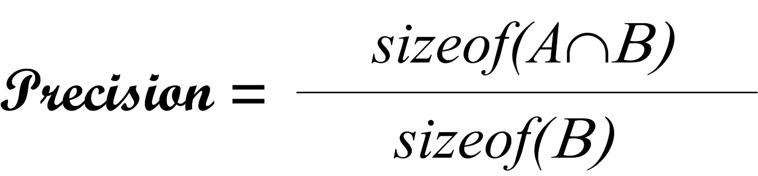
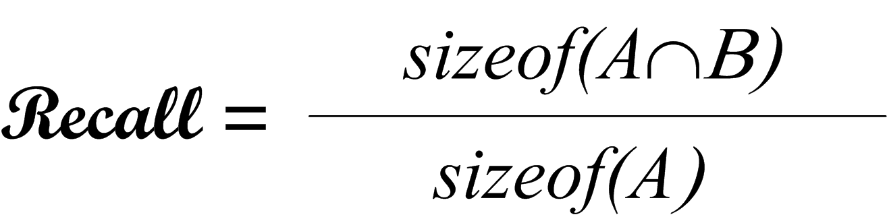
Evaluation: Precision & Recall
Precision is the proportion of correctly disambiguated entities with regard to B
Recall is the proportion of correctly disambiguated entities with regard to A

Slide 30
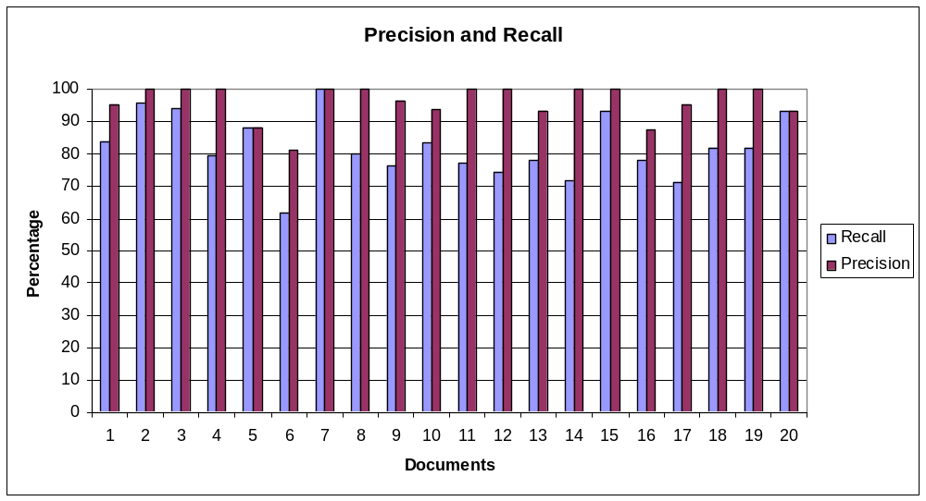
Evaluation: Results
Precision and recall when compared to entire gold standard set:
Precision and recall on a per document basis:
Correct Disambiguation | Found Entities | Total Entities | Precision | Recall
602 | 620 | 758 | 97.1% | 79.4%

Slide 31
Related Work
Semex:
  Personal information management system that works with a user’s desktop
  Takes advantage of a predictable structure
  The results of disambiguated entities are propagated to other ambiguous entities, which could then be reconciled based on recently reconciled entities much like our work does

Slide 32
Related Work
Kim:
  An application that aims to be an automatic ontology population
  Contains an entity recognition portion that uses natural language processors
  Evaluations performed on human annotated corpora
  Missed a lot of entities and results had many false positives

Slide 33
Conclusion
Our method uses relationships between entities in the ontology to go beyond traditional syntactic-based disambiguation techniques
This work is among the first to successfully use relationships for identifying entities in text without relying on the structure of the text

Slide 34
Thank you!

