Slide 1
Mobile Web Search Personalization
Kapil Goenka

Slide 2
Outline
Introduction & Background
Methodology
Evaluation
Future Work
Conclusion

Slide 3
Introduction & Background

Slide 4

Introduction & Background Methodology Evaluation Future Work & Conclusion
Motivation for Personalizing Web Search
Personalization
Current Web Search Engines:
Lack user adaption
Retrieve results based on web popularity rather than user's interests
Users typically view only the first few pages of search results
Problem: Relevant results beyond first few pages have a much lower chance of being visited
Personalization approaches aim to:
tailor search results to individuals based on knowledge of their interests
identify relevant documents and put them on top of the result list
filter irrelevant search results

Slide 5
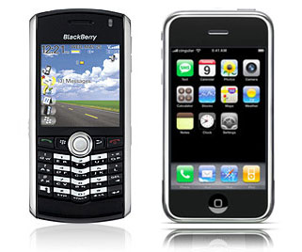
Introduction & Background Methodology Evaluation Future Work & Conclusion
Motivation for Personalizing Web Search
Client interface: mobile device
In the mobile environment:
Smaller space for displaying search results
Input modes inherently limited
User likely to view fewer search results
Relevance is crucial

Slide 6
Introduction & Background Methodology Evaluation Future Work & Conclusion
Goal
Personalize web search in the mobile environment
  case study: Apple’s iPhone
Identify user’s interests based on the web pages visited
Build a profile of user interests on the client mobile device
Re-rank search results from a standard web search engine
Require minimal user feedback

Slide 7

Introduction & Background Methodology Evaluation Future Work & Conclusion
User Profiles
store approximations of interests of a given user
defined explicitly by user, or created implicitly based on user activity
used by personalization engines to provide tailored content
Personalization Engine
User Profile
Personalized Content
Content
News
Shopping
Movies
Music
Web Search

Slide 8
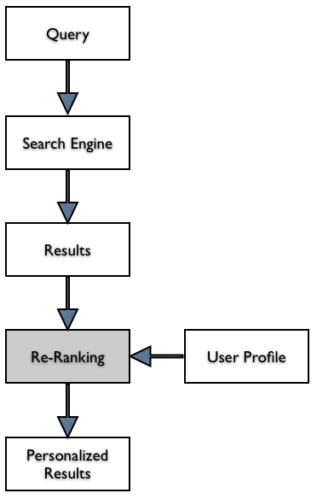
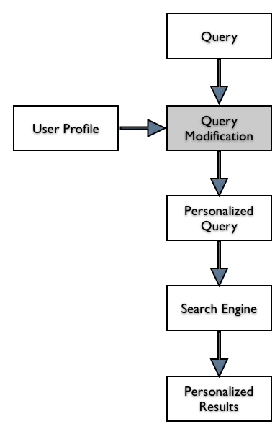
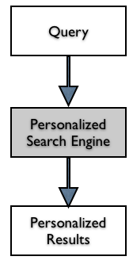
Introduction & Background Methodology Evaluation Future Work & Conclusion
Approaches
Part of retrieval process:
Personalization built into the search engine
Result Re-ranking:
User Profile used to re-rank search results returned from a standard, non-personalized search engines
Query Modification:
User profile affects the submitted representation of the information need

Slide 9
Methodology

Slide 10
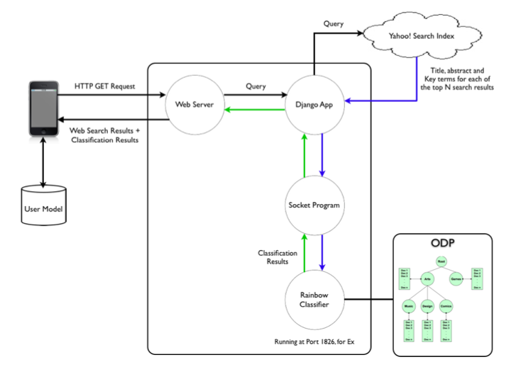
Introduction & Background Methodology Evaluation Future Work & Conclusion
System Architecture

Slide 11
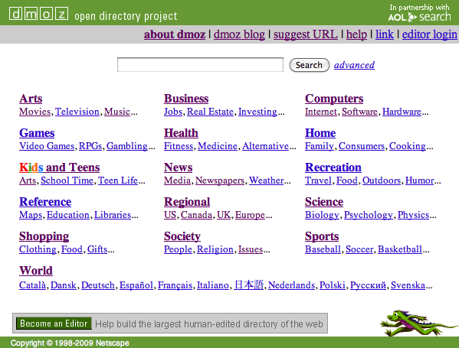
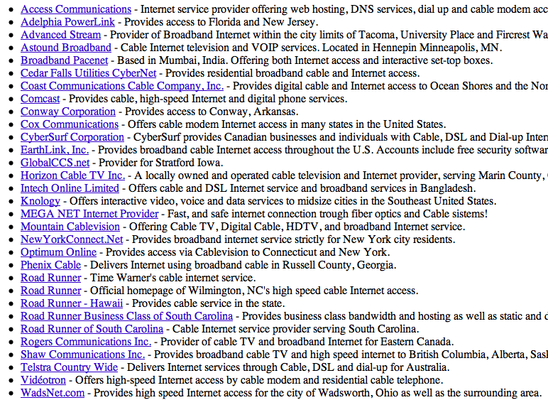
Introduction & Background Methodology Evaluation Future Work & Conclusion
Open Directory Project (ODP)
Popular web directory
Repository of web pages
Hierarchically structured
Each node defines a concept
Higher levels represent broader concepts
Web pages annotated and categorized
Content available for programmatic access
RDF format, SQL dump
Web interface of ODP
List of web sites categorized under a node in ODP

Slide 12
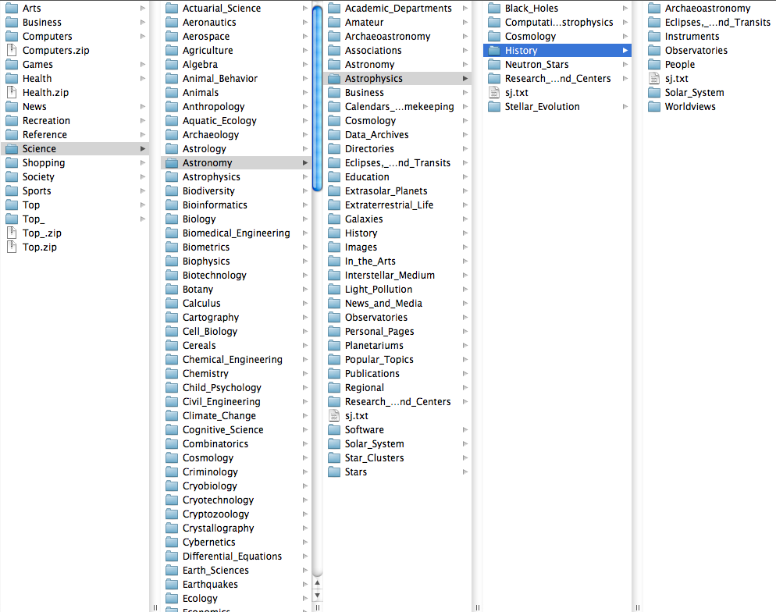
Introduction & Background Methodology Evaluation Future Work & Conclusion
Open Directory Project (ODP)
Replicate ODP structure & content on local hard disk
    Folders represent categories
    Every folder has one textual document containing titles & descriptions of web pages cataloged under it in ODP
Remove structural noise from ODP
    World & Regional branches of ODP pruned

Slide 13
Introduction & Background Methodology Evaluation Future Work & Conclusion
Text Classification
Task of automatically sorting documents into pre-defined categories
Widely used in personalization systems
Carried out in two phases:
  Training
    the system is trained on a set of pre-labeled documents
    the system learns features that represents each of the categories
  Classification
    system receives a new document and assigns it to a particular category

Slide 14
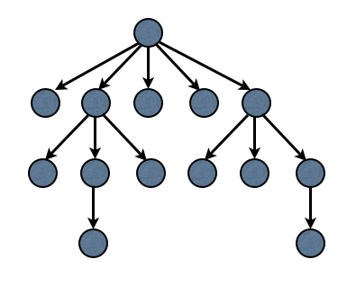
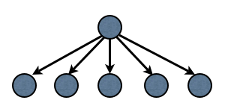
Introduction & Background Methodology Evaluation Future Work & Conclusion
Frequently used learning strategies for hierarchies
Flatten the Hierarchy
No relationship between categories
Widely used in most classification works
Good accuracy
Single classification produces results
~500 ms for classifying top 100 Yahoo! search results
Train a Hierarchical Classifier
Parent-child relationship between categories
Used with hierarchical knowledge bases
Modest to good improvement in accuracy
One classifier for every node in hierarchy. Document must go through multiple classifications before being assigned to a category
~2 sec for classifying top 100 Yahoo! search results

Slide 15
Introduction & Background Methodology Evaluation Future Work & Conclusion
480 categories selected from top three levels of ODPNo automatic way of selecting categories, use best intuitionCategories represent broad range of user interests
Rainbow Text Classification Library
Open source
Operates in two stages
    Reads a set of documents, learning a model of their statistics
    Performs classification using the model
Can be set up to run on a server port
    Receives classification requests over a port
    Returns classification results on the same port

Slide 16
Introduction & Background Methodology Evaluation Future Work & Conclusion
Yahoo! Web Search API
Provides programmatic access to the Yahoo! search index
Currently, offered free of charge to developers
No limit of number of queries made
However, a maximum of 50 search results can be fetched per query
Allows specifying a start position (e.g. start pos = 0 for fetching top 50 results)
To fetch top 500 search results, make 10 queries
For each search result, returns {URL, title, abstract and key terms}
Key terms
List of keywords representative of the document
obtained based on terms’ frequency & positional attributes in the document

Slide 17
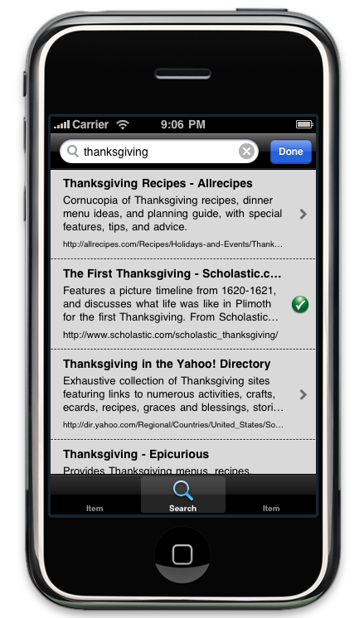
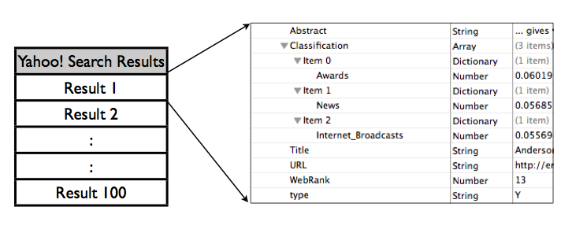
Introduction & Background Methodology Evaluation Future Work & Conclusion
Client Side
Implemented using iPhone SDK / Objective-C
Maintains a profile of user interests
Receives structured search results data from server
Re-ranks and presents search results to user
Updates user profile based on user activity

Slide 18
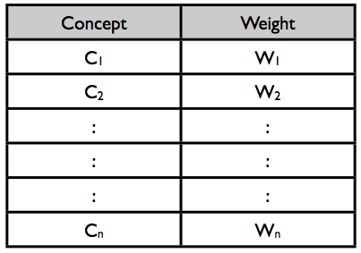

Introduction & Background Methodology Evaluation Future Work & Conclusion
Client Side
User profile is a weighted category vector
Higher weight implies more user interest
Top 3 categories returned for every search result
When user clicks on a result, its categories are updated proportionally
Re-ranking
wpi,k = weight of concept k in user profile
wdj,k = weight of concept k in result j
N = number of concepts returned to client

Slide 19
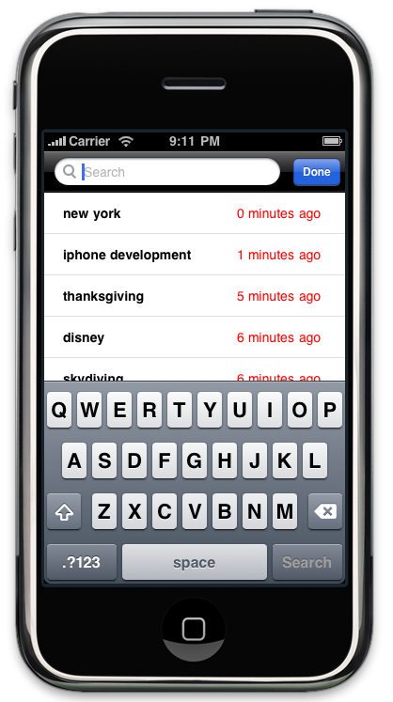
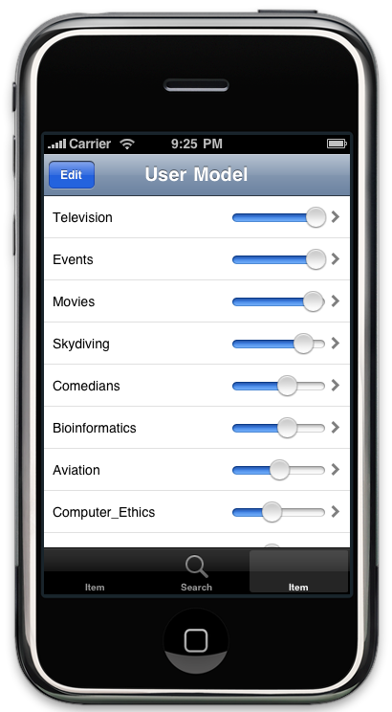
Introduction & Background Methodology Evaluation Future Work & Conclusion
Client Side - Screenshots
Search History:
shows previous searches along with time when search was made
User Profile:
Gives user control over the interest profile

Slide 20
Evaluation

Slide 21
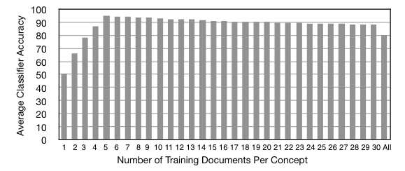
Introduction & Background Methodology Evaluation Future Work & Conclusion
Determining Number of Documents Needed to Train Each Category
Train classifier using increasing number of training documents per category
Test set : 6 randomly selected documents per concept (total: 2880)
Calculate accuracy of each classifier for the selected test set
Repeat, using different training & test documents
Calculate average accuracy
We use 20 training documents per concept

Slide 22
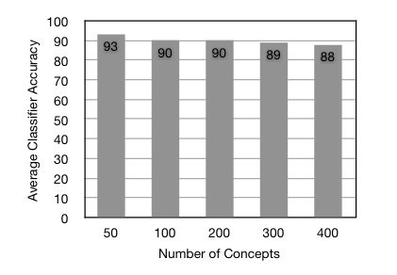
Introduction & Background Methodology Evaluation Future Work & Conclusion
Does Number of Concepts Affects Classifier Precision ?
Train classifier using different subsets of our 480 categories
Calculate average precision in each case
Classifier precision drops only 5% between 50 concepts & 400 concepts
Acceptable, because more categories means richer classification

Slide 23
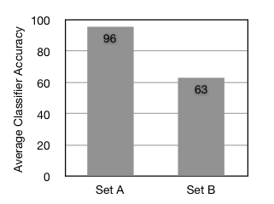
Introduction & Background Methodology Evaluation Future Work & Conclusion
Dependence on the categories chosen
Set A : 480 categories chosen to train our final classifier
Set B : 480 categories, with ~100 regional categories
Regional categories have very similar feature set (‘county’, ‘district’, ‘state’, ‘city’)
Common city names

Slide 24
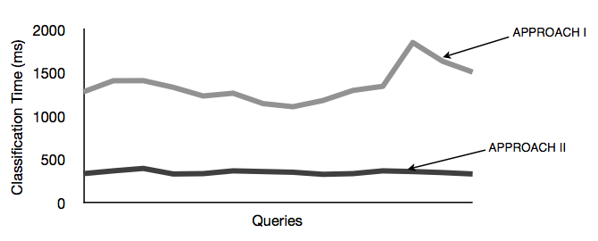
Introduction & Background Methodology Evaluation Future Work & Conclusion
Classification Time
Approach I : Use all documents for training the classifier
Approach II: Use 20 training documents per category

Slide 25
Introduction & Background Methodology Evaluation Future Work & Conclusion
Client Side Evaluation Set up
Five users were asked to user our application, over a period of 10 days
Total 20 search results displayed to the user for each query
  Top 10 Yahoo! search results
  Top 10 personalized search results
  Results randomized before displaying, to avoid user bias
Users asked to carefully review all results before clicking on any search result
Visited results were marked as a visual cue, & their category weights updated
User could uncheck a visited result, it was found to be irrelevant

Slide 26
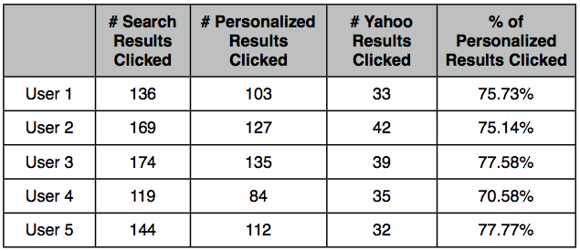
Introduction & Background Methodology Evaluation Future Work & Conclusion
% of Personalized Search Results Clicked

Slide 27
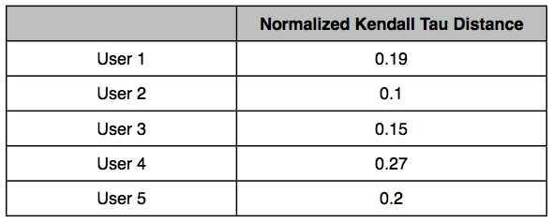
Introduction & Background Methodology Evaluation Future Work & Conclusion
System Generated User Profile vs True User Profile
At the end of evaluation, users were shown top 20 system generated categories
Asked to re-order the categories, based on true interests during search session
Compute Kendal Tau Distance between the two ranked lists
  Measures degree of similarity between two ranked lists
  Lies between [0, 1]. 0 = identical, 1 = maximum disagreement

Slide 28
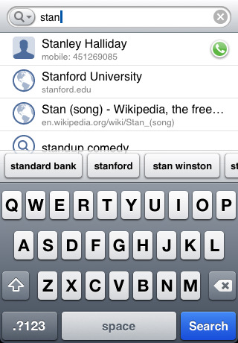



Introduction & Background Methodology Evaluation Future Work & Conclusion
Future Work
Incorporate query auto-completion
  Google iPhone App
Integrate a desktop version of our system with the mobile version
User
Model
User
Model

Slide 29
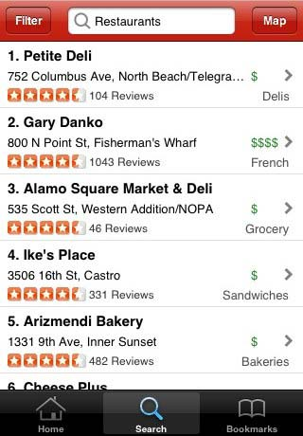
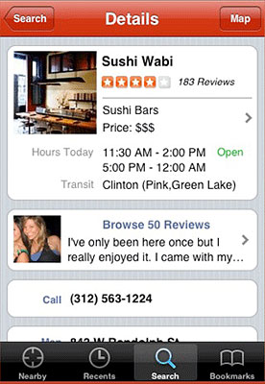
Introduction & Background Methodology Evaluation Future Work & Conclusion
Future Work
Present local search results, in addition to web search
  Yelp iPhone app

Slide 30
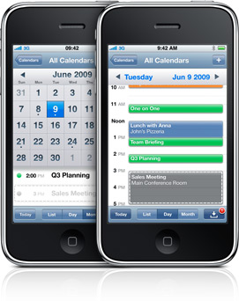
Introduction & Background Methodology Evaluation Future Work & Conclusion
Future Work
  Include more context available through the mobile device
      Eg: Check calendar to get clues about current user activity

Slide 31
Introduction & Background Methodology Evaluation Future Work & Conclusion
Conclusion
Effectiveness of personalized results depend to a large extent on the text classification component. Therefore, it is important that the text classifier is trained carefully and using the right categories.
The average time taken to fetch standard search results, re-rank & display them is less than 2 seconds, which is acceptable & almost real-time on a mobile device.
The fact that in a randomized list of personalized & standard search results, users considered personalized results more relevant shows that integrating user interests can in fact improve web search results.

