Slide 1

DISCOVERING SEMANTIC RELATIONS BETWEEN WEB SERVICES USING THEIR PRE AND POST-CONDITIONS
LIN LIN
Advisor: Dr. I. Budak Arpinar
Committee: Dr. Krys Kochut
Dr. Eileen Kraemer
Notes:
Good morning everyone, thank you for being here for my defense.
First, I would like to introduce my committee members:
my major advisor, Dr. Arpinar,
Two committee members: Dr. Kochut and Dr. Kraemer.
The topic of my thesis is “Discovering …..”.

Slide 2
Presentation Outline
Background on Web Services
Challenges for the Success of Semantic Web Services
Modeling Pre and Post-conditions
Relationships between Web Services
Semantic Relations between Conditions
Conclusion and Future Work
Notes:
First, I will briefly introduce some background information on Web Services.
Then, I will discuss some important challenges that Web services are facing.
After that, I will talk about our approach of discovering relationships between Web services by checking semantic relations between pre an post-conditions.
Finally, I will talk about the conclusion and the future work.

Slide 3
Web Service
A Web Service is a software application identified by a URI, whose interfaces and binding are capable of being defined, described and discovered by XML artifacts and supports direct interactions with other software applications using XML based messages via Internet-based protocols (W3C definition).
A self-contained, self-described, and self-advertised composition unit (application/ component).
Web Services Stack
Service Publication/
Discovery UDDI
Service Description WSDL
XML Messaging SOAP
Transport Network HTTP
Notes:
A Web service is a self-contained, …
According to W3C definition …
UDDI, WSDL, and SOAP are current industry standards developed for e-commerce.

Slide 4


How Do Web Services Work for Us?
Service Registry/
UDDI
Send Request
(XML)
Publish WS
WSDL
Customer
Service Provider
Bind
Receive Form
Check Postcode
Soap Message
Company A
Company B
Notes:
Services are described according to an XML schema, defined by the UDDI specification and registered by the service providers along with keywords for their categorizations.
WSDL describe WSs as a set of endpoints operating on messages.
SOAP is a protocol for exchange of messages between services.

Slide 5

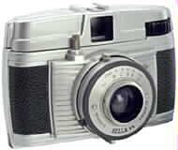


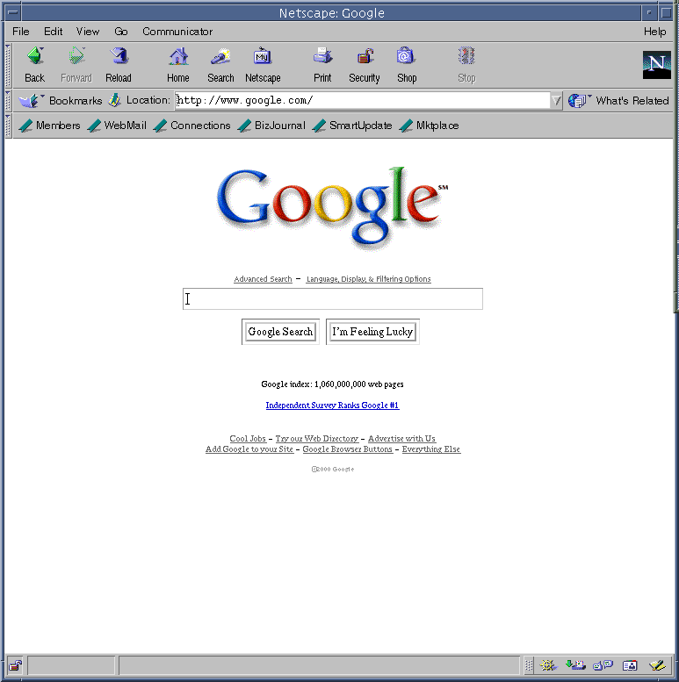



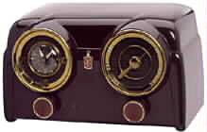
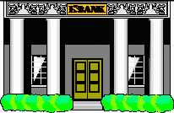








Web is turning into a collection of Web Services
The number of companies that have completed an IT project involving Web services standards has grown in a survey released in 2003 [TechWeb].
By year-end 2004, Radicati Group projects that the market for Web services (including solutions for creation, management, integration, and security) will reach $950 million, and grow to nearly $6.2 billion by 2008.
Notes:
Survey:
Web services extend the current Web from a distributed source of information to a distributed source of services as more and more WSs become available on the Web.

Slide 6
Application Integration/Web Service Composition
An Infoworld survey shows that application integration costs are at least 25% of the total IT budget at many companies.
Gartner Dataquest predicts spending on integration projects will reach a staggering $10.6 billion in 2006 .
The same survey indicated that 55% of the IT managers polled said Web services will make integration projects more viable.
Why Web Service?
  Open standards
  Widespread support and universal access
  Platform-neutral
  (Hopefully) 0-line application development (i.e., automatically composed Web Process)
Notes:
As in the areas of application integration or service composition, …
Thus, the discovering and assembling individual Web services into more complex yet new and more useful Web processes become a very active research area.
However, finding services by looking up in a UDDI registry is time-consuming and ineffective. Manual composition of discovered services is inconvenient.
Current technology around UDDI, WSDL, and SOAP provide limited support in automatic discovery and composition.
Thus, many researchers turn to look for answers using the contribution of the semantic Web.

Slide 7
Semantic Web and Semantic Web Services
Semantic Web is an extension of current Web in which information is given well-defined meaning.
  Ontology: a key enabling technology
    RDF: a light weight ontology system
    OWL: a Web Ontology Language
Semantic Web services are designed to support automatic discovery, composition, invocation, and interoperation.
  WSMF: ontological concepts used in the framework
  OWL-S (formerly DAML-S): an Ontology of Service
Notes:
Semantic Web is an extension ..
This is realized by marking up Web content, its properties, and its relations, in a reasonably expressive markup language with a well-defined semantics.
For example, RDF is one of general-purpose language for representing information on the Web. The RDF specifications provide a lightweight ontology system to support the exchange of knowledge on the Web.
Another example is OWL, a Web Ontology language. OWL is an extension to XML and RDF, it enables the creation and population of ontologies for any domain.
Thus, ontologies are a key enabling technology for the semantic Web. They provide a shared and common understanding of a domain, which can be communicated across people and application systems.
In a similar way, ontological concepts are used to define semantic Web services so that semantic Web services are designed to …
WSMF is a modeling framework for describing the various aspects related to web services. Ontologies are used to define the terminology that is used by the elements of WSMF specification.
OWL-S is developed as a set of language features arranged in ontologies to establish a framework. Within this framework, the Web services may be described in the semantic Web context.

Slide 8


Challenges for the Success of Semantic Web Services
Developing efficient automatic discovery and composition techniques
S
Web services
S
S
S
S
S
S
S
S
S
S
S
how
Automatic discovery and composition
Notes:
Developing efficient automatic discovery and composition techniques is among the most important challenges for the success of semantic web services. Finding a suitable way to put these two features together becomes one of the key points for enabling the location and combination of distributed services to provide a required functionality.

Slide 9
Black Box Description for Web Service
Pre-condition
Post-condition
External aspects of a service:
  A service name
  A description for service goal
  Pre and post-conditions
  Inputs and outputs
Not dealing with the internal complexity of a service:
  The workflow
Name
and
Description
Inputs
Outputs
Notes:
In our work, we are focusing on the external aspects of a service:

Slide 10
Interface Matching Automatic (IMA) Composition Technique
No predefined composition template
Web services are assembled through a forward -chaining method.
  Interface relations (i.e., matching) with different weights are computed among WS interfaces.
  Ontological measures are used for matching.
  A WS net is generated for finding an optimal path among various compositions.
[Arpinar04 & Zhang04]
Notes:
The possible compositions are obtained by checking semantic similarities between inputs and outputs with predefined composition template.

Slide 11
Web Service Selection Network
Price (yuan)
Currency converter
Price/dollar
Price($)
Price($)
Price($)
Price($)
Alcohol-Searcher
Wine-Searcher
American-Wine-
Searcher
Beer-Searcher
Alcohol Name
Wine name
American Wine Name
Beer
Name
Wine name
2
1
3
Food-Wine Matching/1
Food Name
[Zhang04]
Notes:
However, without functionality constraints, IMA technique sometime fail to recognize those services with same input and output parameters but have different functions.

Slide 12
Motivation
Services having same inputs/outputs but offering different functionalities:
Capabilities of services can be semantically expressed in terms of pre and post-conditions.
same ?
int
+
int
-
int
int
int
int
Notes:
We believe that the capabilities or functionalities of services can be …

Slide 13
Our Approach
Identify possible semantic relationship between pair of Web services by checking semantic similarities between their pre and post-conditions.
int
+
int
-
int
int
int
int
Post-condition
Post-condition
Sum is available
Difference is available
Similar ?

Slide 14
Pre and Post-condition for a Service
Pre-condition is the condition that has to be true for the inputs in order for successful execution of the service.
Post-condition is the condition that holds once the service has been executed successfully.
pre-condition:
BBS
post-condition:
He has a valid account and a valid credit card
He buys a book
A Book Buying Service

Slide 15
Current Standard for Pre and Post-conditions
Not available in OWL-S
  Temporary solution: variable terms
  No semantics
Semantic Web Rule Languages:
  SWRL: many formats have been proposed, but no standard format yet
  RuleML: standardize inference rules (forward + backward) on the basis of XML
  DRS: a system for representing logical formulas in RDF, a sort of generalized OWL rules language.

Slide 16
Modeling Pre and Post-conditions
Expressed as, but not limited to, high-level inputs/outputs to the service together with conditions over these inputs/outputs
Making use of Condition Ontology
Modeled as a conjunction of RDF triples
  Each triple: subject, property, and object
p
p
s
o
&
s
o
& …

Slide 17
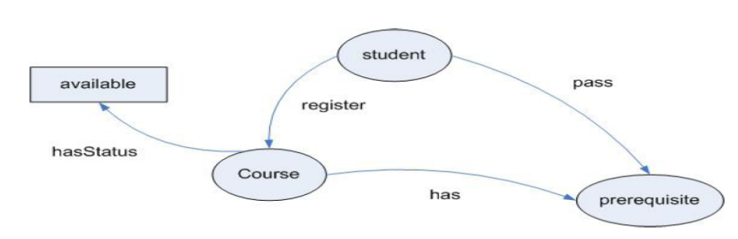
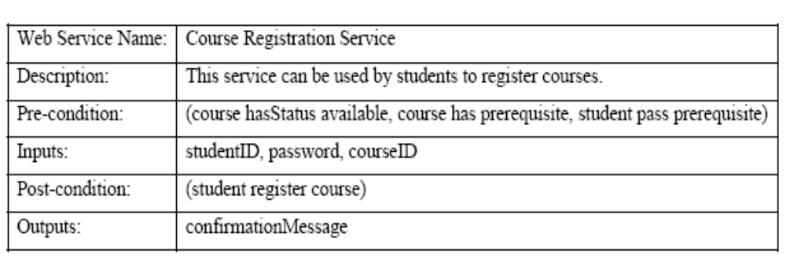
A Simple Example Condition Ontology and a Simple Example Service
Condition Ontology
A Black Box Description of A Course Registration Service

Slide 18
Relationships between Two Services
Two services have a relationship if they can be somehow plugged together to perform a value added service or one of the service can be somehow substituted by the other.
Four types of relationships are identified:
  Prerequisite: Service 1 → Service 2
  Parallel: Service 1 // Service 2
  Substitute: Service 1 ←→ Service 2
  Include: Service 1 Э Service 2

Slide 19
Prerequisite Relationship between Two Services
Service 1 → Service 2
  Service 1 has to finish before service 2 starts.
  Example:
Service 1
Service 2
Booking
service
Payment
service

Slide 20
Parallel Relationship between Two Services
Service 1 // Service 2
  Service 1 and service 2 can execute in parallel, but the results of each service need to be combined for further execution.
  Example:
Protein ID
Service
(SEQUEST)
Protein Results
Comparison
Service
Service 1
+
Service 2
Protein ID
Service
(MASCOT)

Slide 21
Substitute Relationship between Two Services
Service 1 ←→ Service 2
  Service 1 and service 2 can be substituted with each other functionally.
  Example:
Service 1
Service 2
Air Courier
Delivery
Service
Ground
Delivery
Service

Slide 22
Include Relationship between Services
Service 1 Э Service 2
  Service 1 provides services that include the services offered by service 2.
  Example:
Service 1
Service 2
Offers both
ground and
air courier
delivery
Express
Delivery Service
Ground
Delivery
Service

Slide 23
Semantic Relation between Two Conditions
The relationship between two services can be identified by checking the semantic relations between their pre and post-conditions.
Four relations are identified:
  Exact match (→)
  Plug-in match (PI→)
  Plus match (+→)
  Complementary match (CP→)

Slide 24
Exact Match between Two Conditions
C1 → C2: conditions C1 and C2 exactly match.
(1) Both post-conditions are exactly matched.
(2) Both pre-conditions are exactly matched.
(3) Post-condition of S1 exactly matches pre-condition of S2.
S1
S1
S1
C1
C1
C1
S2
S2
S2
C2
C2
C2
If (1) and (2) are both true, service S1 and service S2 provide the same functionality.
Substitute Relationship: S1 ←→ S2
If (3) is true, service S1 need to finish before service S2 starts its execution.
Prerequisite Relationship: S1 → S2

Slide 25
Plus-in Match between Two Conditions
C1 PI→ C2: condition C1 is stricter than condition C2.
Payment by MasterCard is available.
S1
C1
S1
S2
C1
PI
C2
PI
Exact Match
S2
Payment by all major credit cards is available.
C2
Prerequisite Relationship: S1 → S2
Include Relationship: S2 Э S1

Slide 26
Plus Match between Two Conditions
C1 +→ C2: condition C1 only partially satisfies condition C2.
SEQUEST
results are
available.
S1
C1
S2
+
C2
S3
SEQUEST results are available,
and MASCOT results are available.
MASCOT
results are
available.
Parallel Relationship: S1 // S3

Slide 27
Complimentary Match between Two Conditions
C1 CP→ C2: condition C1 compliments condition C2.
Book is
available to
be sold.
Book is
available to
be bought.
…
…
compatible
buy
sell
S1
S2
Condition Ontology
C1
CP
C2
not “similar”, but “compatible”
This service sells books.
This service buys books.
Prerequisite Relationship: S1 → S2

Slide 28
Algorithm for Discovering Semantic Relations between Pre and Post-conditions
Four steps in discovery algorithm
  Evaluate similarity of two triples
  Calculate similarity value between two conditions
  Identify semantic relations between two conditions using similarity value
  Identify semantic relations between pre and post-conditions among services

Slide 29
System Architecture
Visualization Tool
network of web services
Semantic Relations Discovery System
Web Services
Store
Reasoning Engine
Matching Engine
Random Web
Services Generator
Jena APIs
Ontology

Slide 30
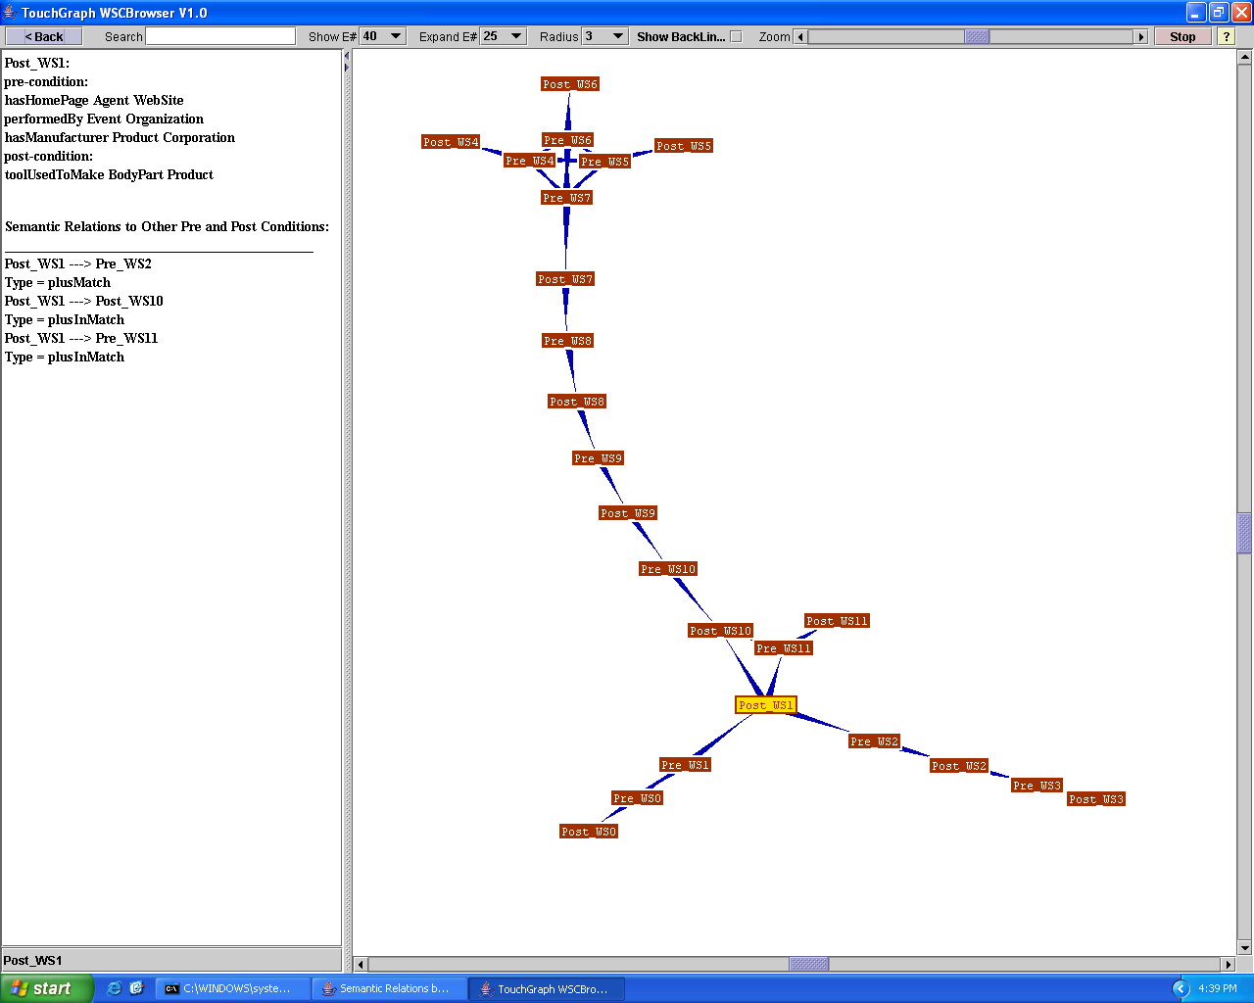
Screen Shot of the User Interface
Each box represents
a pre or post-condition
of a service.
Each arrow represents
a type of match relation
between two
connected
conditions.
When a box is
clicked, a text
Description
shows the types of
semantic relations
identified between
this condition and
other connected
conditions.

Slide 31
Experiments
Random generation of Web services
  Pre and post-conditions are conjunctions of triples
  Triples extracted from TAP [TAPKB] knowledge base.
Ten human subjects
  Asked to identify all possible relations between pre and conditions

Slide 32
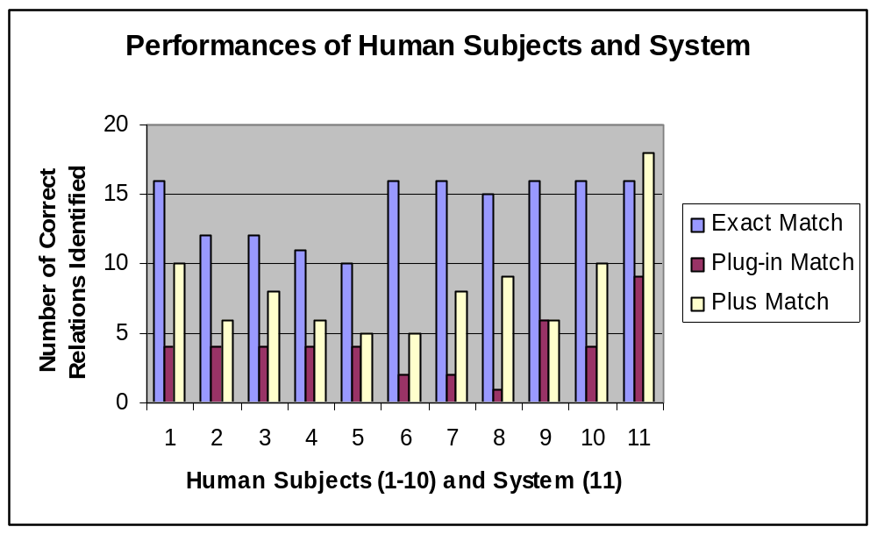
More Experiments

Slide 33
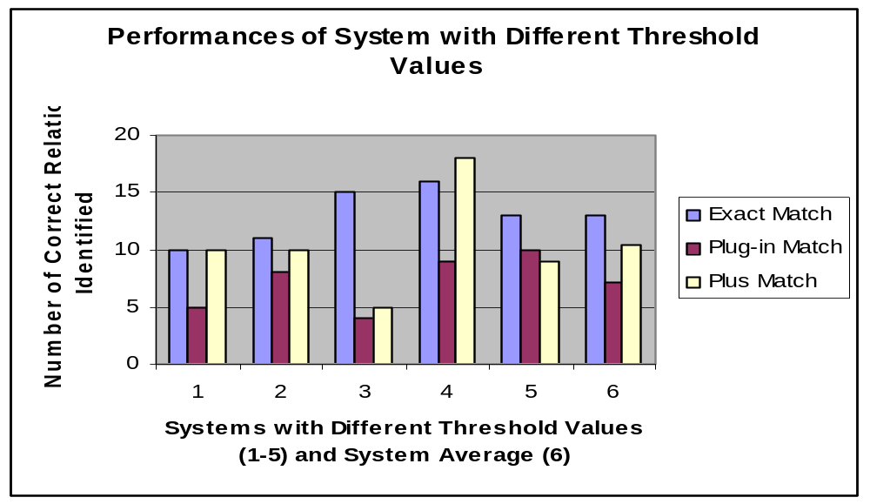
More Experiments

Slide 34
Contributions
Propose to model pre or post-condition as a conjunction of RDF triples
  Expressive
  Condition ontology
  Enable to evaluate using SWRL in the future
Model a service as pre → post
  Captures the functionality of a service
Identify possible relations between pairs of services by checking their semantic similarity between their pre and post-conditions
  Enhance the quality of discovery
Discovering Semantic Relations between Web Services using Their Pre and Post-conditions, L. Lin & B. Arpinar, Poster paper, IEEE SCC 2005 (accepted).

Slide 35
Future Work
Develop a condition ontology for a domain
Our technique can be used in conjunction with inputs and outputs matching technique to enhance the quality of discovery.
Using our technique, potential path traversal algorithm can be applied to obtain actual composition.
Address the issue of multiple inputs and outputs
Improve the usability of our user interface

Slide 36
References
B. Arpinar, R. Zhang, B. Aleman-Meza, and A. Maduko., “Ontology-driven Web Services Composition Platform”, IEEE Intl. Conf. on e-Commerce Technology, San Diego, California, July 6-9, 2004.
I. B. Arpinar, R. Zhang, B. Aleman-Meza, and A. Maduko, “Ontology-Driven Web Services Composition Platform”, Journal of Information Systems and e-Business Management, Special Issue on Service Oriented Enterprise IT Applications and Web Services, (in print).
TAP knowledge base, URL:http://tap.stanford.edu/tap/tapkb.html
R. Zhang, “Ontology-driven Web Services Composition Techniques”, Master Thesis, Computer Science, University of Georgia, 2004.

Slide 37
Questions?

Slide 38
Thank you!

