Slide 1
Ontology-Driven Question Answering and Ontology Quality Evaluation
Samir Tartir
Major Professor:
Dr. I. Budak Arpinar
Committee:
Dr. John A. Miller
Dr. Liming Cai
May 26th, 2009
PhD Dissertation Defense

Slide 2
Outline
The Semantic Web
Ontology-based question answering
  Current approaches
  Algorithm
  Example and preliminary results
Ontology evaluation
  Current approaches
  Algorithm
  Example and preliminary results
Challenges and remaining work
Publications
References

Slide 3
Web 3.0*
Web 1.0
  Web sites were less interactive.
Web 2.0
  The “social” Web. E.g. MySpace, Facebook and YouTube
Web 3.0:
  Real-time
  Semantic
  Open communication
  Mobile and Geography
* CNN
Notes:
Google's Rich Snippets, Yahoo's SearchMonkey

Slide 4
Semantic Web
An evolving extension of the current Web in which data is defined and linked in such a way that it can be used by machines not just for display purposes, but for automation, integration and reuse of data across various applications.
[Berners-Lee, Hendler, Lassila 2001]

Slide 5
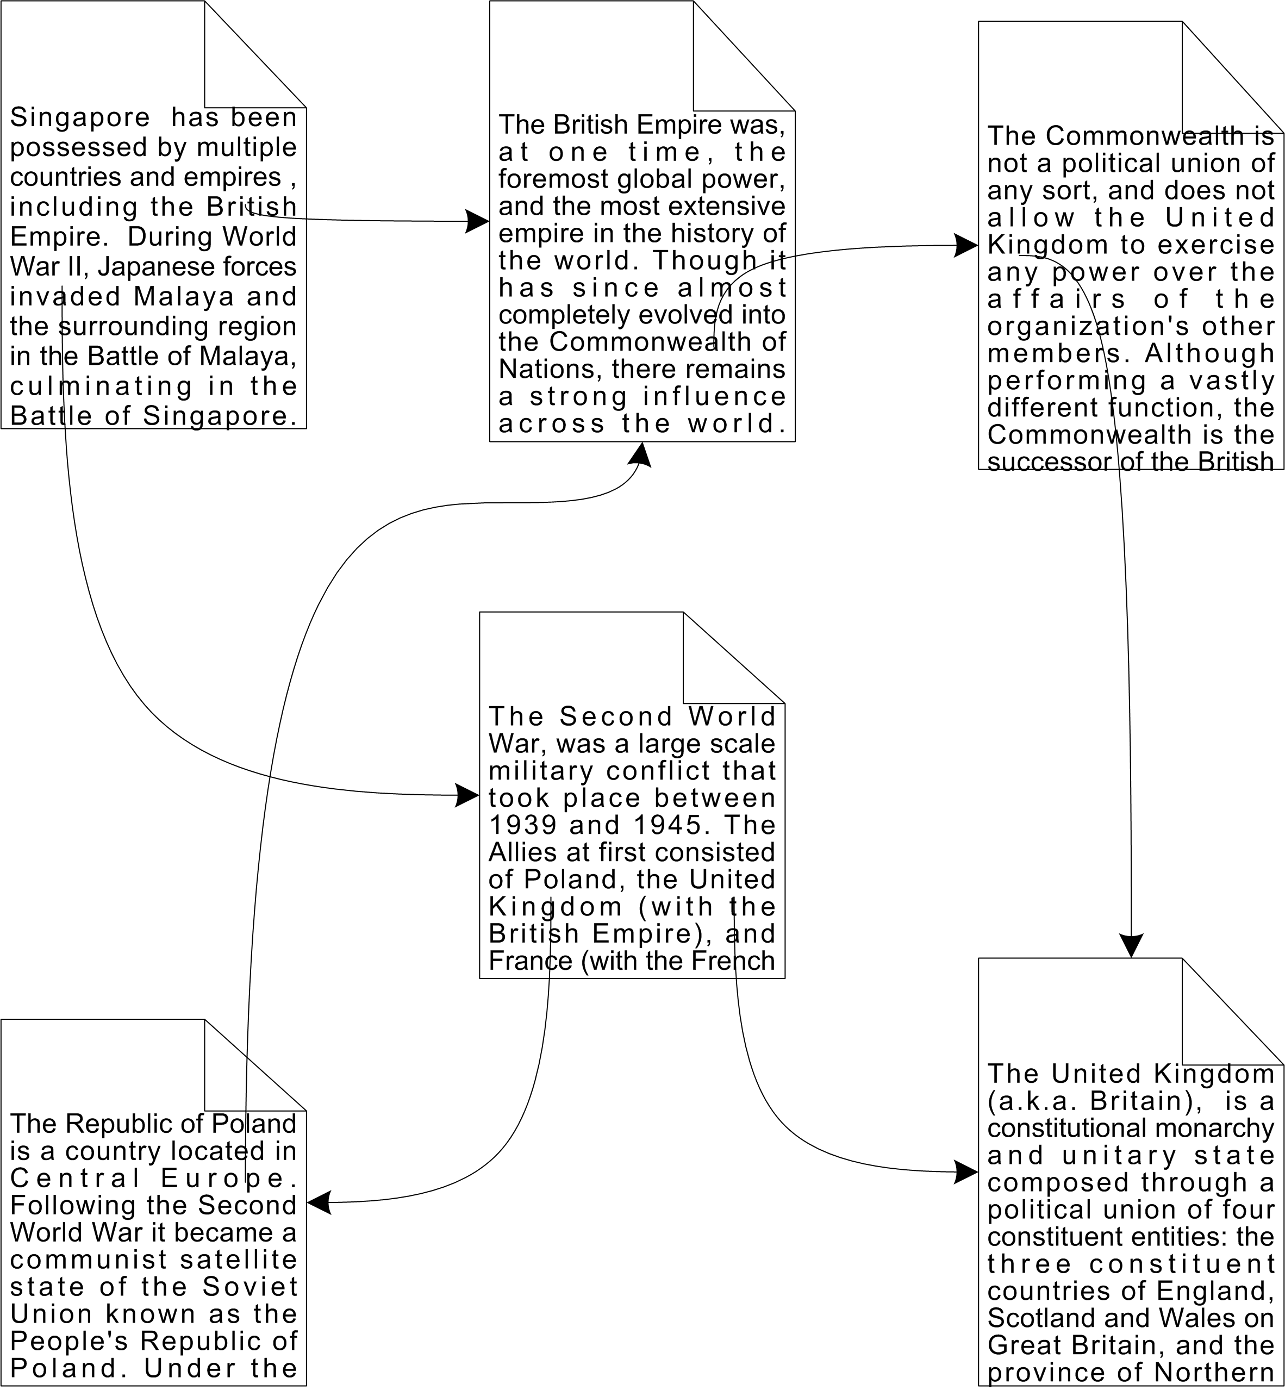
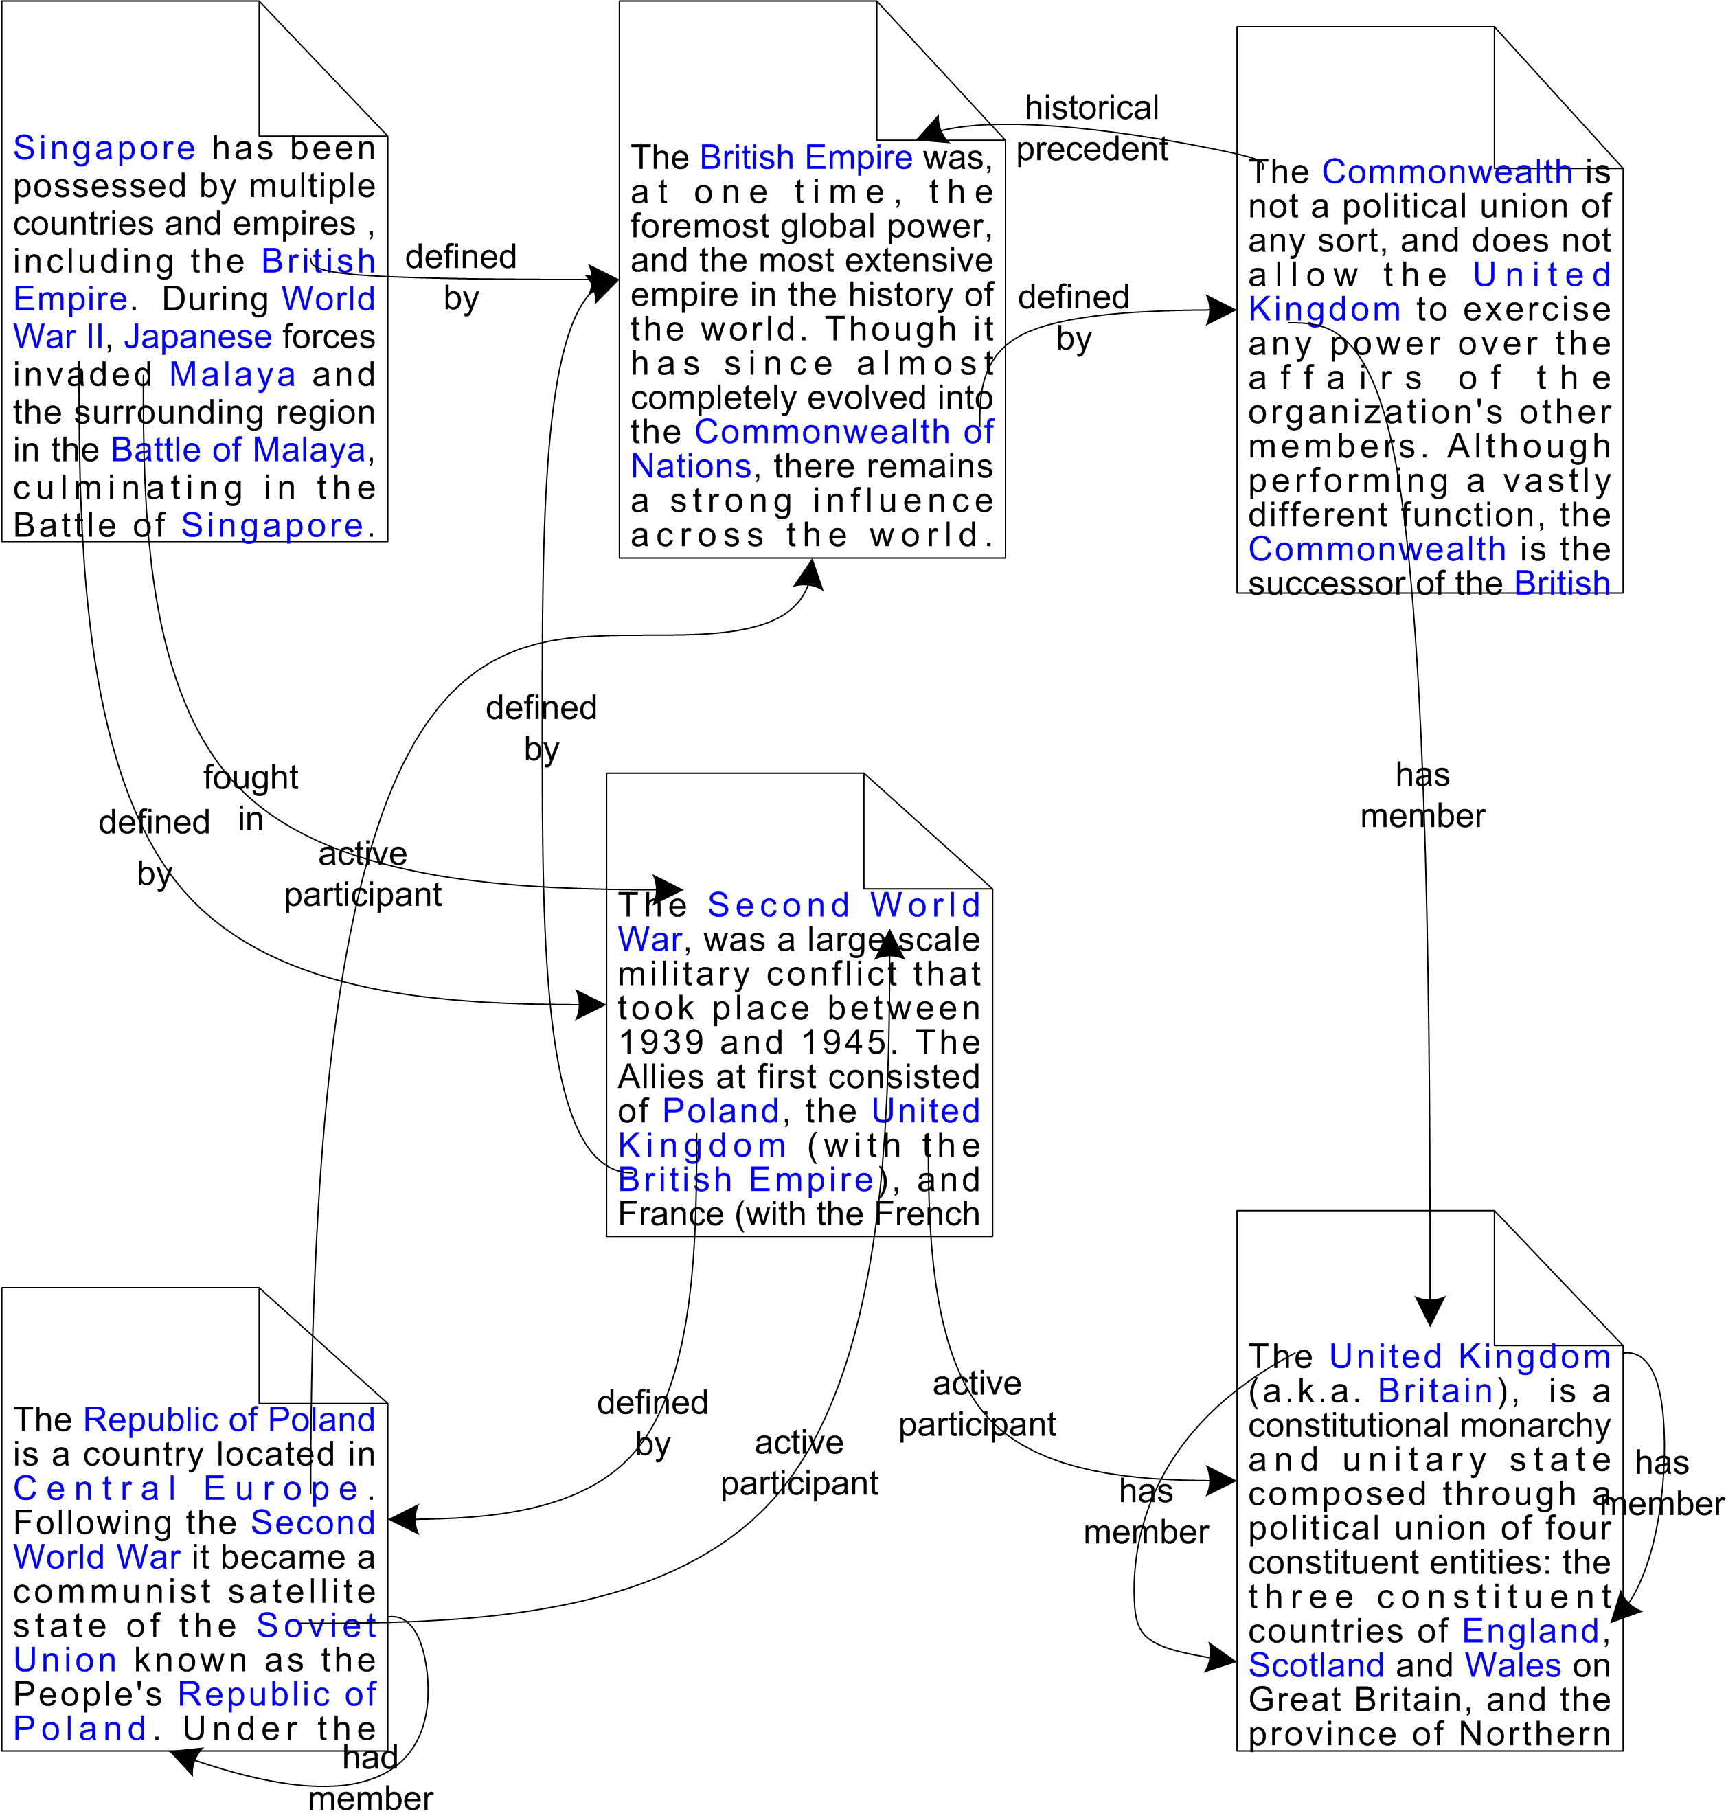
The Semantic Web
The current Web
page ---linksTo--> page
(some content from www.wikipedia.org)

Slide 6
Ontology
“An explicit specification of a conceptualization.”
[Tom Gruber]
An ontology is a data model that represents a set of concepts within a domain and the relationships between those concepts. It is used to reason about the objects within that domain.
[Wikipedia]

Slide 7
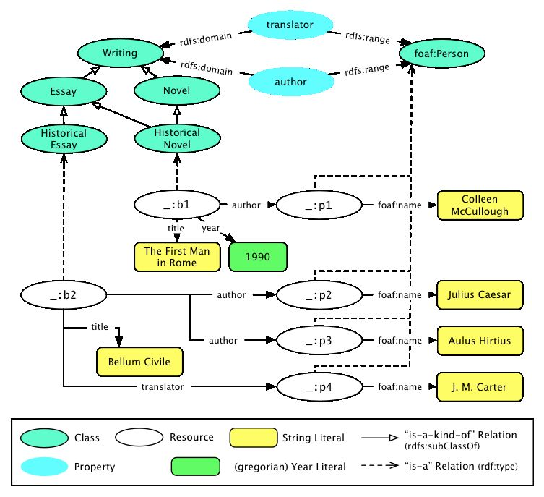
Example Ontology*
Schema
Instances
* F. Bry, T. Furche, P. Pâtrânjan and S. Schaffert 2004

Slide 8
Problem Definition
Question answering (QA), in information retrieval, is the task of automatically answering a question posed in natural language (NL) using either a pre-structured database or a (local or online) collection of natural language documents.
[Wikipedia]

Slide 9
Question Answering by People
People answer a question using their background knowledge to understand its content, and expect what the answer should look like, and search for the answer in available resources.
In our work, this translates to:
  Knowledge
  Content
  Answer type
  Resources
ontology
entities and relationships
ontology concepts
ontology and web documents

Slide 10
Ontologies in Question Answering
Term unification
Entity recognition and disambiguation
Exploiting relationships between entities
  Answer type prediction
Providing answers

Slide 11
Automatic Question Answering
Automatic question answering is traditionally performed using a single resource to answer user questions.
  requires very rich knowledge bases that are constantly updated
Proposed solution
  Use the local knowledge base and web documents to build and answer NL questions.

Slide 12
Current Approaches - Highlights
Only use linguistic methods to process the question and the documents (e.g. synonym expansion).
Only use a local knowledge base.
Restrict user questions to a predefined set of templates or consider them as sets of keywords.
Return the result as a set of documents that the user has to open to find the answer.
Notes:
that are pre-built and static or are dynamic and are updated manually, or automatically periodically using crawlers.

Slide 13
Ontology-based Question Answering
A populated ontology is the knowledge base and the main source of answers.
  Better quality ontologies lead to forming better questions and getting better answers.
  Questions are understood using the ontology.
  Answers are retrieved from the ontology, and web documents when needed.

Slide 14
Our Approach - Highlights
Ontology-portable system
Ontology-assisted question building
  Based on the previous user input, the user is presented with related information from the ontology. [Tartir 2009]
Query triples
  A NL question is converted to one or more query triples that use ontology relationships, classes and instances.
Multi-source answering
  Answer for a question can be extracted from the ontology and multiple web documents.
  Answers from web documents are ranked using a novel metric named semantic answer score.

Slide 15
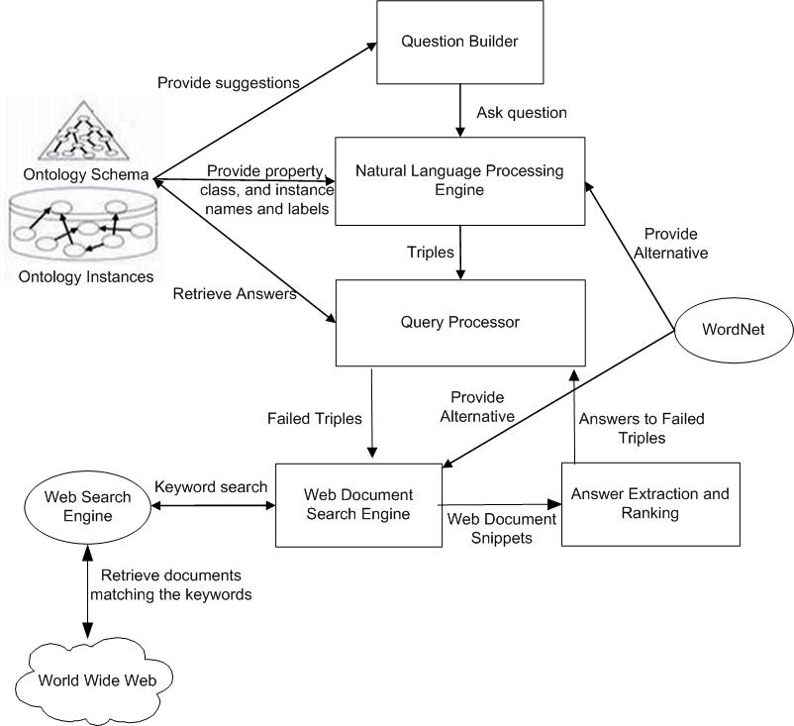
SemanticQA Architecture

Slide 16
Algorithm
Convert question to triples
  Spot entities
  Form triples
Find answer
  Find answer from ontology
  Find answer to failing triples from web documents

Slide 17
Question Processing
Match phrases in question to relationships, classes and instances in ontology.
  Use synonym matching using alternative entity names and WordNet
Using matches, create triples
<subject predicate object>.

Slide 18
Answer Extraction from the Ontology
Build a SPARQL query from the created triples.
  Run this query against the ontology to find the answer.
  If the query can’t be answered from ontology, then some of the triples don’t have an answer in the ontology.

Slide 19
Answer Extraction from Web Documents
For failed triples, get answer from web documents.
  Establish the missing links between entities.
  Use a search engine to retrieve relevant documents.
  Extract answers from each web document.
  Match answers to ontology instances, the highest ranked answer is used.
  This answer is passed to the next triple.

Slide 20
Semantic Answer Score
Extract noun phrases from snippets.
Score_{NP} = W_{Answer Type} * Distance_{Answer Type} +
W_{Property} * Distance_{Property} +
W_{Others} * Distance_{Others}
Weights are being adjusted based on experiments.

Slide 21
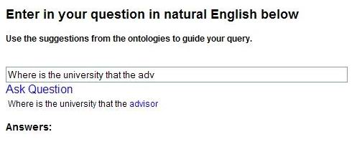
Ontology-Assisted Question Building

Slide 22
Algorithm Details - Spotting
Ontology defines known entities, literals or phrases assigned to them.
Questions must contain some of these entities to be understood – otherwise it is outside of the ontology scope.
Relationships, classes and instances are discovered in the question.
Assigns spotted phrases to known literals, and later to entities and relationships.
  Stop word removal, stemming and WordNet are used.

Slide 23
Entity Matching Example
Where is the university that the advisor of
Samir Tartir got his degree from
located?
Class
Relationship
Instance, GraduateStudent
Relationship
Relationship

Slide 24
Algorithm Details - Triples
Create triples using recognized entities
The number of triples is equal to the number of recognized relationships + the number of unmatched instances
  unmatched instances are instances that don’t have a matching relationship triple

Slide 25
Example, cont’d
Where is the university that the advisor of Samir Tartir got his degree from located?
<GradStudent2 advisor ?uniPerson>
<?uniPerson degreeFrom ?uniUniversity>
<?uniUniversity located ?uniCity>

Slide 26
Algorithm Details – Ontology Answer
Build a SPARQL query from the created triples.
Run this query against the ontology to find the answer.

Slide 27
Example
Where is the university that the advisor of Samir Tartir got his degree from located?
SELECT ?uniCityLabel
WHERE {
GradStudent2 advisor ?uniPerson .
?uniPerson degreeFrom ?uniUniversity.
?uniUniversity located ?uniCity .
?uniCity rdfs:label ?uniCityLabel .
}

Slide 28
Algorithm Details – Web Answer
If no answer was found in the ontology.
  Find the first failed triple, get its answer from web documents.
  Match extracted web answers to ontology instances, the highest ranked match is used.

Slide 29
Example, cont’d
SELECT ?uniPersonLabel
WHERE {
GradStudent2 advisor ?uniPerson .
?uniPerson rdfs:label ?uniPersonLabel .
}
No answer, use the web

Slide 30
Example, cont’d
Generate keyword sets and send to Google
  “Samir Tartir” Professor Advisor
  “Samir Tartir” Prof Advisor
  “Samir Tartir” Professor Adviser
  “Samir Tartir” Prof Adviser
CURRICULUM VITA September 2007 NAME: Ismailcem Budak
Arpinar MAJOR PROFESSOR OF: 1. Samir Tartir, (PhD), in
progress…. Christian Halaschek (MS – Co-adviser: A. Sheth),
“A Flexible Approach for Ranking ...

Slide 31
Algorithm Details - Propagating
Match web answers starting with the lowest semantic answer distance to ontology instances of the same expected answer type.
Add the matched answer to the query.
Try next triple.

Slide 32
Example, cont’d
New query:
SELECT ?uniCityLabel
WHERE {
professor1 degreeFrom ?uniUniversity.
?uniUniversity located ?uniCity .
?uniCity rdfs:label ?uniCityLabel .
}
Arpinar has a degreeFrom triple in the ontology = Middle East Technical University.
But Middle East Technical University has no located triple in the ontology, answer will be found using a new web search.

Slide 33
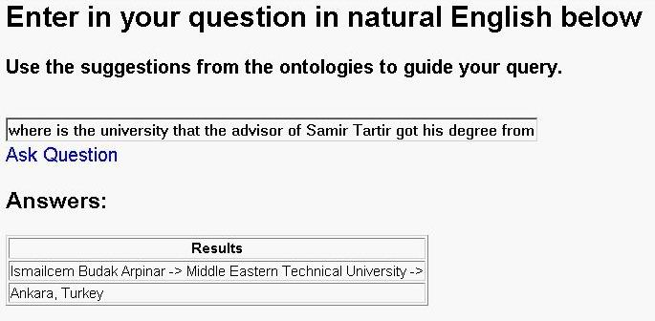
Example, cont’d
Answer that was obtained from three sources: Ontology, and two documents:

Slide 34
Evaluation
Initially used small domain-ontologies.
Use Wikipedia to TREC questions
Wikipedia
  Several snapshots exist
  DBpedia’s infobox was used
TREC
  Text Retrieval Conference
  Has several tracks, including Question Answering

Slide 35
Preliminary Results - SwetoDblp
SwetoDblp [Aleman-Meza 2007]: 21 classes, 28 relationships, 2,395,467 instances, 11,014,618 triples
Precision: 83%, recall: 83%
Question | Correct Answer (s) | Rank
What is the volume of “A Tourists Guide through Treewidth in Acta Cybernetica”? | Volume 11 | 1
What is the journal name of “A Tourists Guide through Treewidth”? | Acta Cybernetica | 1
What university is Amit Sheth at? | Wright State University* | Not Found
What is the ISBN of Database System the Complete Book? | ISBN-10: 0130319953 | 1

Slide 36
Preliminary Results - LUBM
LUBM [Guo 2005]: 42 classes, 24 relationships
Precision: 63%, recall: 100%
Question | Correct Answer (s) | Rank
Who is the advisor of Samir Tartir? | Dr. Budak Arpinar | 1
Who is Budak Arpinar the advisor of? | Boanerges Aleman-Meza Samir Tartir Bobby McKnight | 2 4 Not found
Who is head of the Computer Science Department at UGA? | Krys J. Kochut | 1

Slide 37
DBpedia
DBpedia ontology + Infobox Instances:
  Schema in OWL, instances in N-Triple format
  720 properties
  174 classes
  7 million+ triples
  729,520 unique instances
Issues:
  Handling large ontologies in Jena
    Storage – MySQL, loaded once
    Retrieval – HashMaps
  Undefined properties
  Untyped instances (90%)
  Common names

Slide 38
TREC 2007 QA Dataset
4 types of topics
  People: 19, e.g. Paul Krugman
  Organizations: 17, e.g. WWE, CAFTA
  Events: 15, e.g. Sago Mine Disaster
  Others: 19, e.g. 2004 Baseball World Series
  Total: 70 topics
2 types of questions
  Factoid: 360, e.g. “For which newspaper does Paul Krugman write?”
  List: 85, e.g. “What are titles of books written by Paul Krugman?”
Standard testing on AQUAINT:
  907K news articles
  Not free
  Replace with Wikipedia pages

Slide 39
Results
30% Answering ratio
Good rate on unique names:
  E.g. Paul Krugman, Jay-Z, Darrel Hammond, Merrill Lynch
Problems with date-related questions (45)
  How old is…?
  What happened when …?

Slide 40
SemanticQA Summary
An ontology is the knowledge base and
the main source of answers.
Better quality ontologies lead to forming better questions and getting better answers.
Question are understood using the ontology.
Answers are retrieved from the ontology, and web documents when needed.

Slide 41
Current Approaches Comparison
 | Query Entry | Query Expansion / Modification | Answer Source | Answer Visualization | Evaluation
TextPresso [Müller 2004] | Keywords | Synonym expansion | Annotated corpus (full documents or abstracts) | Sentences which contain a keyword | Compare input and expected output F-Measure
PANTO [Wang 2007] | NL Question | Synonym expansion | Ontology | Answers | Run against an ontology F-Measure
AquaLog [Lopez 2007] | NL Question | Synonym expansion | Ontology | Answers | User-based F-Measure
Smart [Battista 2007] | SPARQL | None | Ontology | Answers | None
SWSE [Harth 2007] | Keywords | None | Ontology | Answers | None
[Hildebrandt 2004] | Definitional Question | Synonym expansion | Ontology, dictionary or documents (single source) | Answers | TREC data F-Measure
[Katz 2004] | NL Question | Synonym expansion | Web documents | Answers | Online system (1M Q’s asked) F-Measure

Slide 42
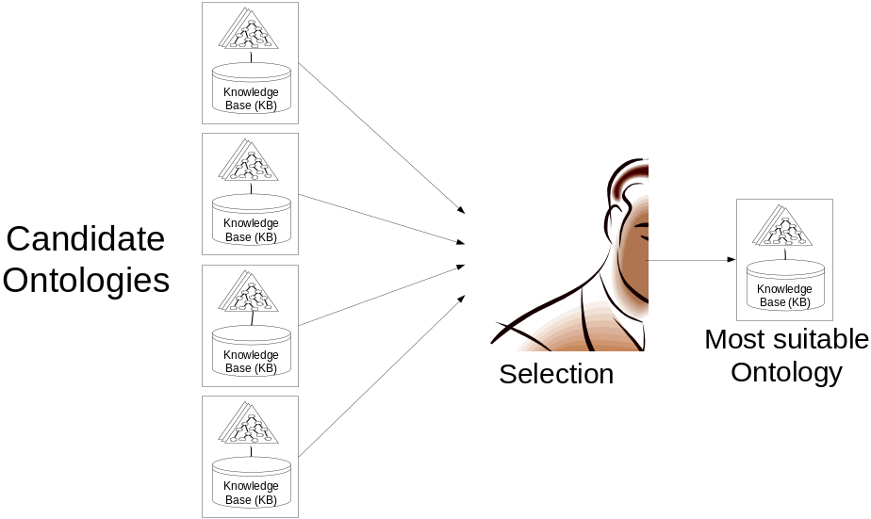
Why Ontology Evaluation?
Having several ontologies to choose from, users often face the problem of selecting the ontology that is most suitable for their needs.
Ontology developers need a way to evaluate their work

Slide 43
OntoQA
A suite of metrics that evaluate the content of ontologies through the analysis of their schemas and instances in different aspects.
OntoQA is
  tunable
  requires minimal user involvement
  considers both the schema and the instances of a populated ontology
  Highly referenced (40 citations)

Slide 44
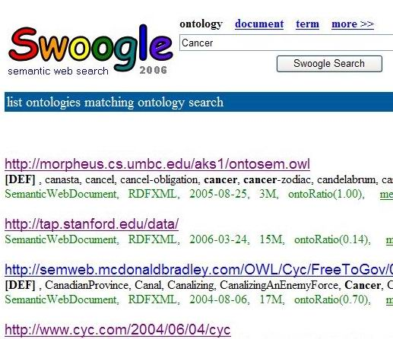
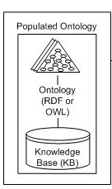
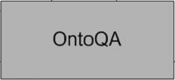
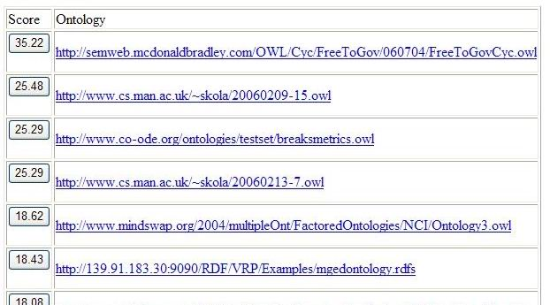
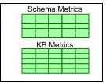

OntoQA Scenarios
Keywords

Slide 45
I. Schema Metrics
Address the design of the ontology schema.
Schema could be hard to evaluate: domain expert consensus, subjectivity etc.
Metrics:
  Relationship diversity
  Inheritance deepness

Slide 46
II. Instance Metrics
Overall KB Metrics
  This group of metrics gives an overall view on how instances are represented in the KB.
  Class Utilization, Class Instance Distribution, Cohesion (connectedness)
Class-Specific Metrics
  This group of metrics indicates how each class defined in the ontology schema is being utilized in the KB.
  Class Connectivity (centrality), Class Importance (popularity), Relationship Utilization.
Relationship-Specific Metrics
  This group of metrics indicates how each relationship defined in the ontology schema is being utilized in the KB.
  Relationship Importance (popularity)

Slide 47
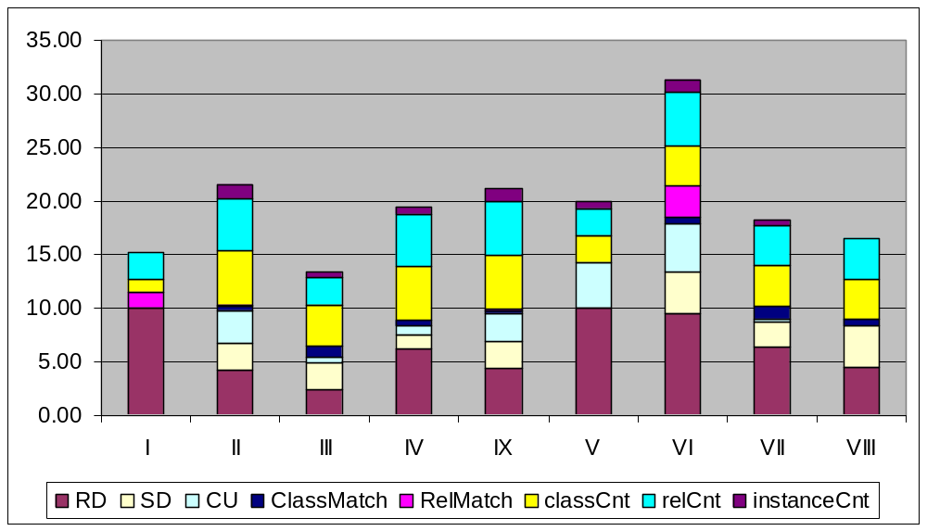
OntoQA Ranking - 1
OntoQA Results for "Paper“ with default metric weights

Slide 48
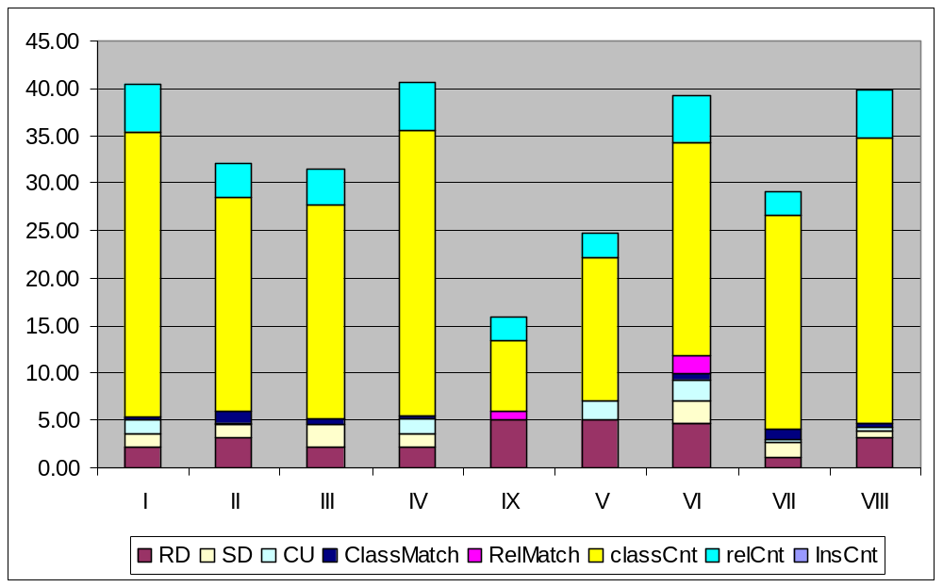
OntoQA Ranking - 2
OntoQA Results for "Paper“ with metric weights biased towards larger schema size

Slide 49
OntoQA vs. Users
Ontology | OntoQA Rank | Average User Rank
I | 9 | 9
II | 1 | 1
III | 7 | 5
IV | 3 | 6
V | 8 | 8
VI | 4 | 4
VII | 5 | 2
VIII | 6 | 7
Pearson’s Correlation Coefficient = 0.80

Slide 50
Comparison Details
Ontology | No. of Terms | Avg. No. of Subterms | Connectivity
GlycO | 382 | 2.5 | 1.7
ProPreO | 244 | 3.2 | 1.1
MGED | 228 | 5.1 | 0.33
Biological Imaging methods | 260 | 5.2 | 1
Protein-protein interaction | 195 | 4.6 | 1.1
Physico-chemical process | 550 | 2.7 | 1.3
BRENDA | 2,222 | 3.3 | 1.2
Human disease | 19,137 | 5.5 | 1
GO | 200,002 | 4.1 | 1.4

Slide 51
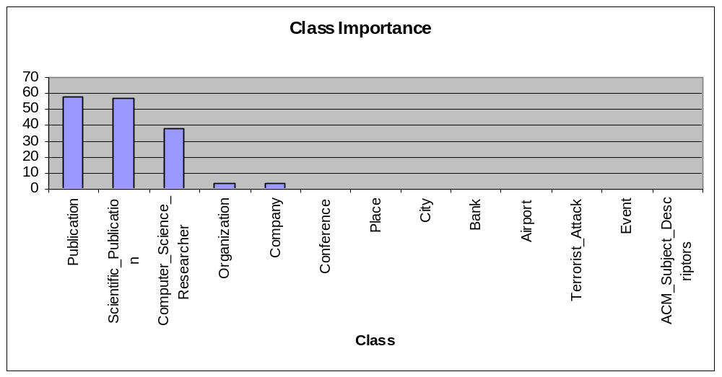
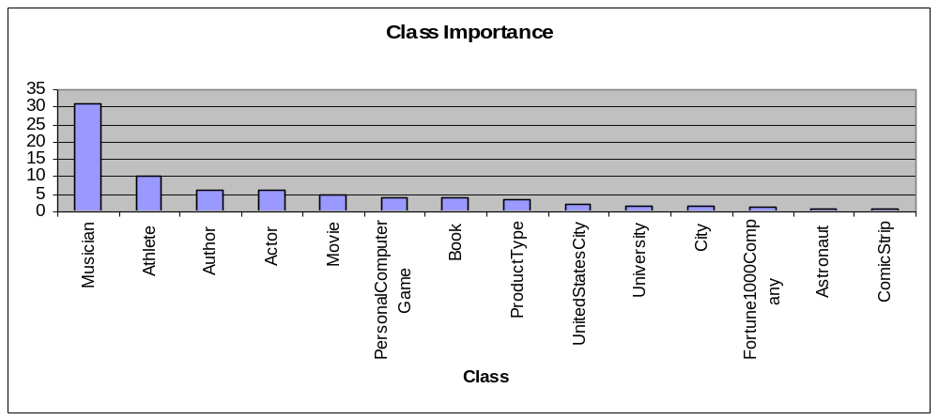
Ontology Details – Class Importance
SWETO
TAP

Slide 52
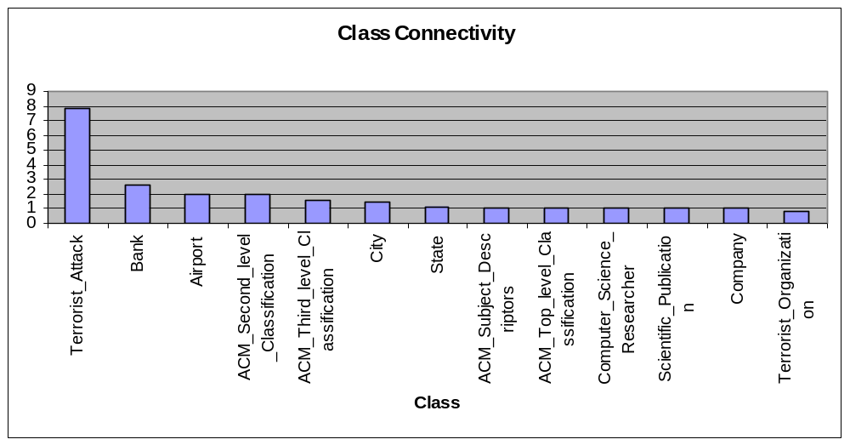
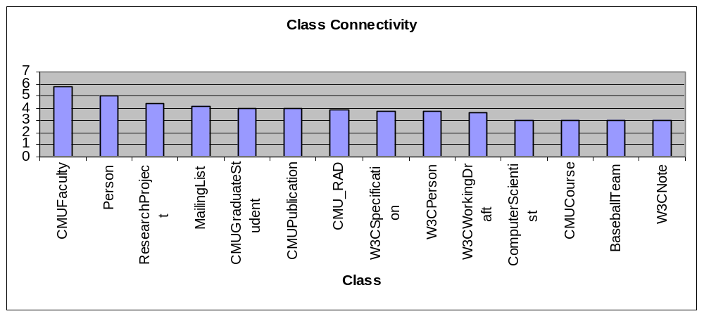
Ontology Details – Class Connectivity
SWETO
TAP

Slide 53
OntoQA Summery
As more ontologies are added, means to evaluation their content is needed.
Ontology users need means to capture the inner details of ontologies to help them compare similar ontologies.
Ontology developers need means to measure design, and instance harvesting.

Slide 54
Summary of Work
Ontology Evaluation and Ranking
  Designing a framework of metrics that measure multiple aspects of ontology design and usage
Ontology-based NL question answering
  Answer NL questions using an ontology, extract answers from ontology and Web documents

Slide 55
Remaining Research
Goal
  Enhance Question Answering approach by:
  Processing whole documents.
  Adding missing entities to the ontology.

Slide 56
Remaining Research
Goal
  Enhance Question Answering approach by:
    Improve entity-spotting (e.g. N-Gram)
    Processing whole documents.
    Adding missing entities to the ontology.
  Enhance Ontology Evaluation approach by:
    Add more metrics to capture more ontology features
    Improve performance
    Allow users to limit ontology search to certain domain

Slide 57
Query preparation and analysis
Question Analysis
Semantic Query
Planning
Query execution
for documents
NL
Question
Domain
graph
queries
keywords
Knowledge (RDF)
Domain Ontology
Wikipedia
Document Search
Engine
Answer
Semantic
graphs
Answer extraction
Semantic graph
generator
Important
paragraphs
Answer builder
Categorization
Source documents transformation
Documents
Result analysis and answer preparation

Slide 58
Published Papers - 1
Samir Tartir, Bobby McKnight, and I. Budak Arpinar. SemanticQA: Web-Based Ontology-Driven Question Answering. In the 24th Annual ACM Symposium on Applied Computing, Waikiki Beach, Honolulu, Hawaii, USA, March 8-12, 2009.
Samir Tartir, I. Budak Arpinar and Amit P. Sheth. Ontological Evaluation and Validation. In R. Poli (Editor): Theory and Applications of Ontology (TAO), volume II: Ontology: The Information-science Stance. Springer, 2008
Samir Tartir and I. Budak Arpinar. Ontology Evaluation and Ranking using OntoQA. Proceedings of the First IEEE International Conference on Semantic Computing, September 17-19, 2007, Irvine, California, USA
Nathan Nibbelink, G. Beauvais, D. Keinath, Xinzhi Luo, and Samir Tartir. The Element Distribution Modeling Tools for ArcGIS. White Paper, NatureServe.org, February 8, 2007

Slide 59
Published Papers - 2
Satya S. Sahoo, Christopher Thomas, Amit P. Sheth, William S. York, and Samir Tartir. Knowledge modeling and its applications in life sciences: A case study of GlycO and ProPreO. The 2006 World Wide Web Conference. May 22-26, 2006, Edinburgh, Scotland. (Acceptance rate: 11%)
Samir Tartir, I. Budak Arpinar, Michael Moore, Amit P. Sheth, Boanerges Aleman-Meza. OntoQA: Metric-Based Ontology Quality Analysis. IEEE ICDM 2005 Workshop on Knowledge Acquisition from Distributed, Autonomous, Semantically Heterogeneous Data and Knowledge Sources. Houston, Texas, November 27, 2005
Samir Tartir and Ayman Issa. SQLFlow: PL/SQL Multi-Diagrammatic Source Code Visualization. International Arab Conference on Information Technology ACIT'2005. Al-Isra Private University, Jordan. December 6-8, 2005.

Slide 60
References
Aleman-Meza, B., Hakimpour, F., Arpinar, I.B., Sheth, A.P. SwetoDblp Ontology of Computer Science Publications, Journal of Web Semantics, 5(3):151-155 2007
Battista, A.L., Villanueva-Rosales, N., Palenychka, M., Dumontier, M. SMART: A Web-Based, Ontology-Driven, Semantic Web Query Answering Application. ISWC 2007
Gruber, T. A Translation Approach to Portable Ontology Specifications. Knowledge Acquisition, 5 (2). 199-220, 1993.
Guo, Y., Pan, Z., Heflin, J. LUBM: A Benchmark for OWL Knowledge Base Systems. Journal of Web Semantics 3(2), 2005, pp158-182.
Harth, A. et al. SWSE: Answers Before Links! Semantic Web Challenge, 2007
Hildebrandt, W., Katz, B., Lin, J. Answering Definition Questions Using Multiple Knowledge Sources. Proceedings of HLT-NAACL 2004.
Katz, B., Felshin, S., Lin, J., Marton, G. Viewing the Web as a Virtual Database for Question Answering. In Mark T. Maybury, editor, New Directions in Question Answering. Cambridge, Massachusetts: MIT Press, 2004, pages 215-226.

Slide 61
References
Lopez, V., Uren, V., Motta, E., Pasin, M. AquaLog: An ontology-driven question answering system for organizational semantic intranets. Journal of Web Semantics, 2007.
Müller HM, Kenny EE, Sternberg PW (2004) Textpresso: An Ontology-Based Information Retrieval and Extraction System for Biological Literature. PLoS Biol 2(11)
Tartir, S., McKnight, B. Arpinar, I.B. SemanticQA: Web-Based Ontology-Driven Question Answering. In the 24th Annual ACM Symposium on Applied Computing, 2009.
Wang, C., Xiong, M., Zhou, Q., and Yu. Y. PANTO: A Portable Natural Language Interface to Ontologies. 4th European Semantic Web Conference 2007
Tim Berners-Lee, James Hendler and Ora Lassila. "The Semantic Web". Scientific American Magazine. May 17, 2001
CNN: http://scitech.blogs.cnn.com/2009/05/25/what-is-web-3-0-and-should-you-care/

