Slide 1
DETECTION OF BURSTY AND EMERGING TRENDS TOWARDS IDENTIFICATON OF INFLUENTIAL RESEARCHERS AT THE EARLY STAGE OF TRENDS
Sheron Decker
Computer Science Department
University of Georgia
Athens, GA 30602

Slide 2




Motivation

Slide 3

Goal
Semantic-Based Approach
  Detect “Bursty” Trends
  Identify Reason(s) (if any) for Bursty Behavior
In Addition
  Detect “Emerging” Trends
  Identify Researchers at the Early Stage of Trends

Slide 4
Approach
Created a Taxonomy of Topics
Performed Data Extraction
  Keywords and/or Abstracts
Created a Paper-to-Topics Dataset
Utilized Metadata Elements of the Dataset

Slide 5
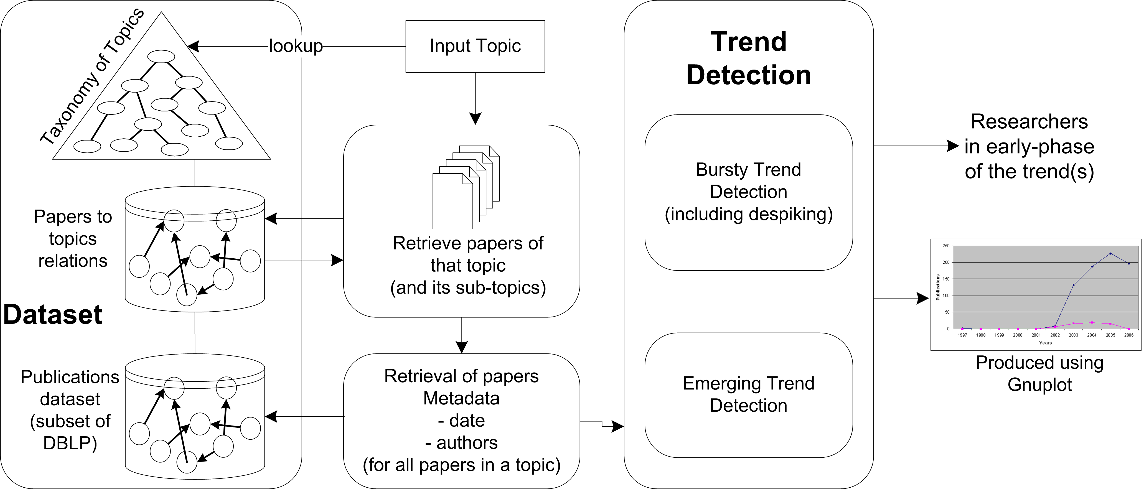
Schematic of Approach

Slide 6
Dataset Creation Approach

Slide 7
Dataset
Subset of SwetoDBLP
  One of the few available versions of DBLP data in rdf
Superset of another dataset
  [1] Elmacioglu, Lee, SIGMOD RECORD 05
  (pike.psu.edu/publications/sigmod-rec-05.pdf)
Includes articles from conferences, journals, and workshops

Slide 8
Paper-to-Topics Relationships
Focused crawling of URLs
  “ee” metadata element (51,886)
  Stored in local cache
  Data extraction obtained keywords/abstracts
  Yahoo! TermExtraction API used on abstracts for term extraction

Slide 9
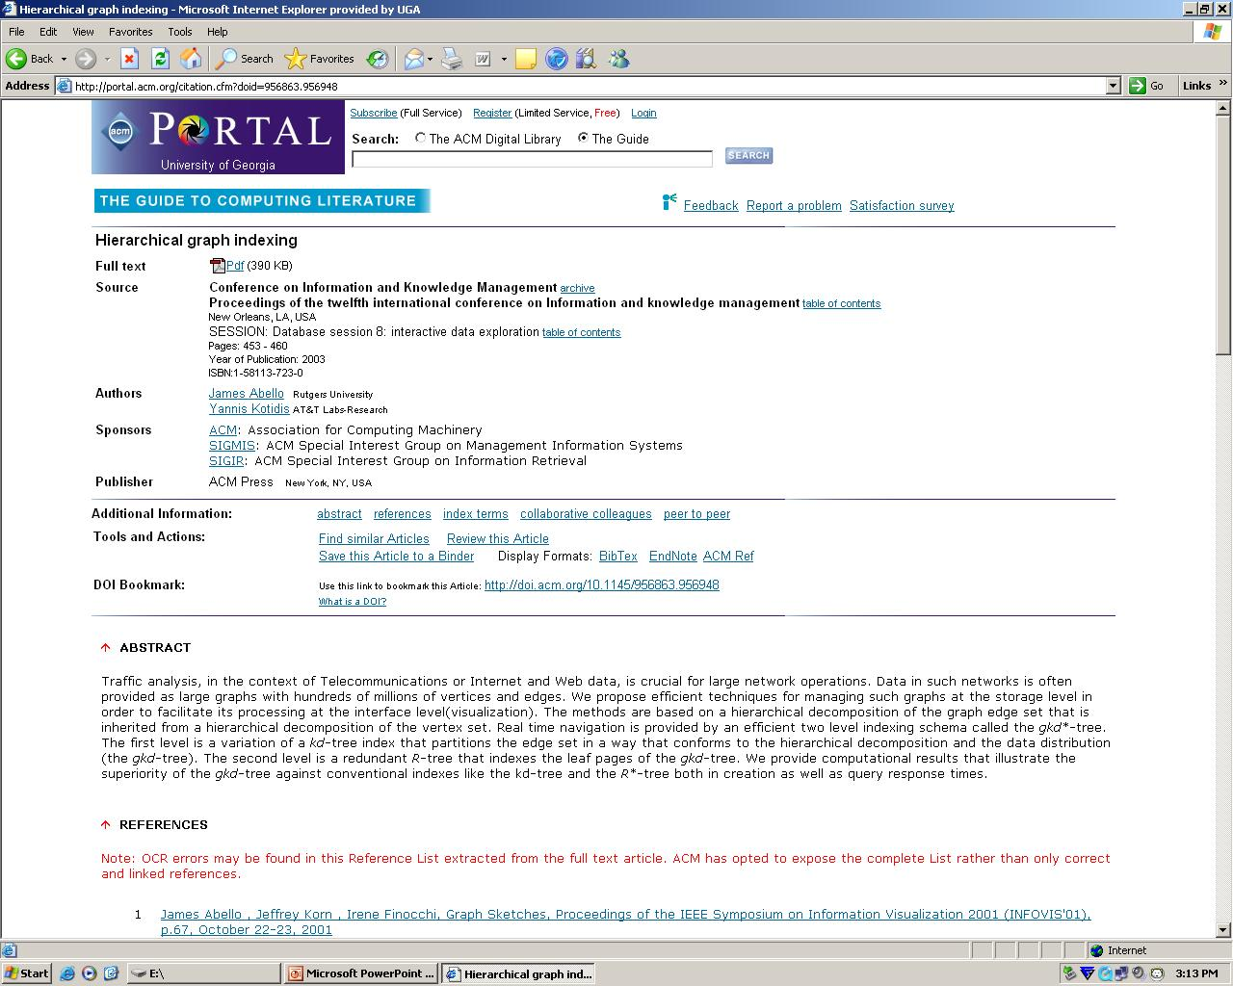
Web Page Extraction
<opus:Article_in_Proceedings rdf:about=“http://dblp.uni-trier.de/rec/bibtex/conf/cikm/AbelloK03”>
<opus:last_modified_date>2006-02-10</opus:last_modified_date>
<rdfs:label>Hierarchical graph indexing.</rdfs:label>
<opus:year>2003</opus:year>
<opus:ee>http://doi.acm.org/10.1145/956863.956948</opus:ee>
Cache of Extracted
Web Pages

Slide 10

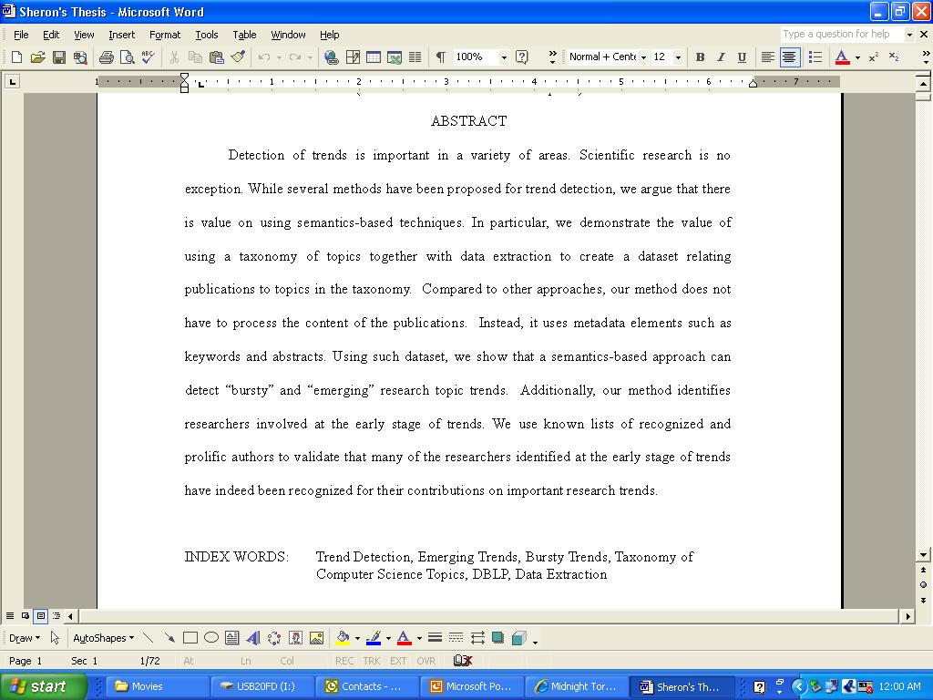
Extracting Terms With Yahoo API
Metadata elements, dataset, semantics, taxonomy, argue that there, important research, emerging research, research trends, research topic, data extraction, scientific research, prolific authors, validate, approaches, exception

Slide 11
Focused Web Crawling
(*based on doi prefix)
DBLP Data
URL of papers
(“ee”)
Web
ACM Digital Library
List of possible
terms to be added
as synonyms or
new topics in
the taxonomy
IEEE Digital Library
Taxonomy
of CS Topics
No
Science Direct
Keyword or term
lookup
Match?
Create Relationship
Others
Keywords
Yes
paper
topic
Data Extraction
has topic
Abstract
Term Extraction
Add to
Paper to
topics
dataset
ACM Extractor
IEEE Extractor
Science Direct Extractor
Yahoo
Term Extraction Service
Local Copy (Cache)

Slide 12
Paper-to-Topics Relationships
Based on conference theme
  (e.g. AAAI)
Names of sessions in conferences
  From DBLP (e.g. Conference – WWW)
    Session – Ontologies, OWL, etc.
    (This data is not included within SwetoDBLP)

Slide 13
Number of Extracted
Paper-to-Topics Relationships
Data Source and/or Data Extraction Method (77,175) | Relationships (Paper to Topic) | Papers With Relationships to Topics in Taxonomy
ACM (Keywords) (8352) | 2,795 | 1,859
Science Direct (Keywords) (7768) | 780 | 631
IEEE (Keywords) (3775) | 617 | 454
ACM (Abstract/Terms Extraction) | 5,641 | 3,574
Science Direct (Abstract/Terms) | 2,330 | 1,688
IEEE (Abstract/Terms) | 2,850 | 1,786
Crawling (Session-Names)* | 476 | 473
Conference Topics (Heuristics) | 25,229 | 23,083

Slide 14
Taxonomy of Topics
Lessons learned from creating small ontology of topics in Semantic-Web
  Crawling of DBLP
  Data Extraction
Improved with terms from data extraction methods
  Helps identify newer terms/topics
268 research topics / over 200 synonyms

Slide 15
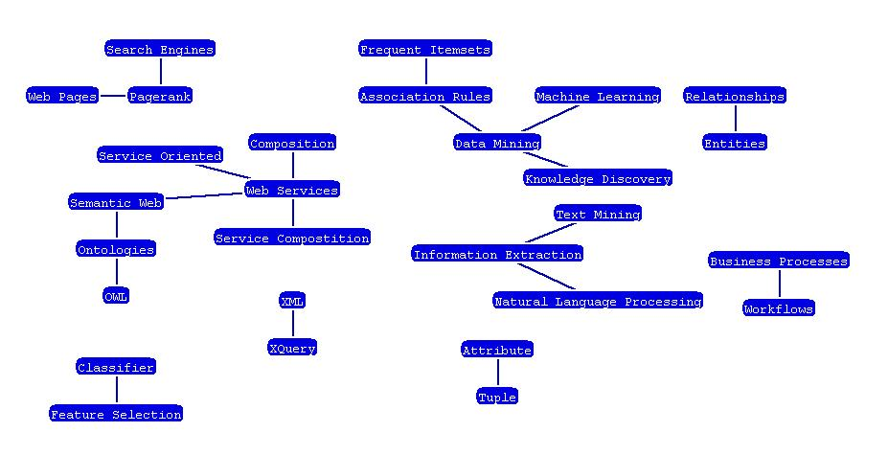
Taxonomy of Topics
Clues for structure determined by how close topics are related

Slide 16
Bursty and Emerging Trend Detection and Identification of Influential Researchers Approach

Slide 17
Detection of Bursty Trends
Based on approach in previous work
[2] Gruhl, Guha, WWW 04
  (theory.lcs.mit.edu/~dln/papers/blogs/idib.pdf)
Spike value (µ + 2σ)

Slide 18
Mean = 7
Standard Deviation = 0.9
Spike Value = 8.8
Spike
Date
Anything above µ + 2σ
is considered a spike date
Mean

Slide 19
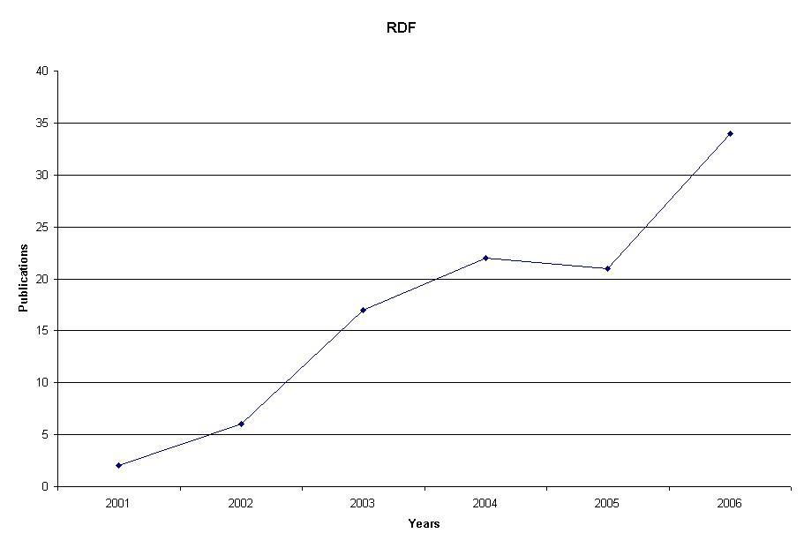
(Bursty Trends - Year) Example

Slide 20
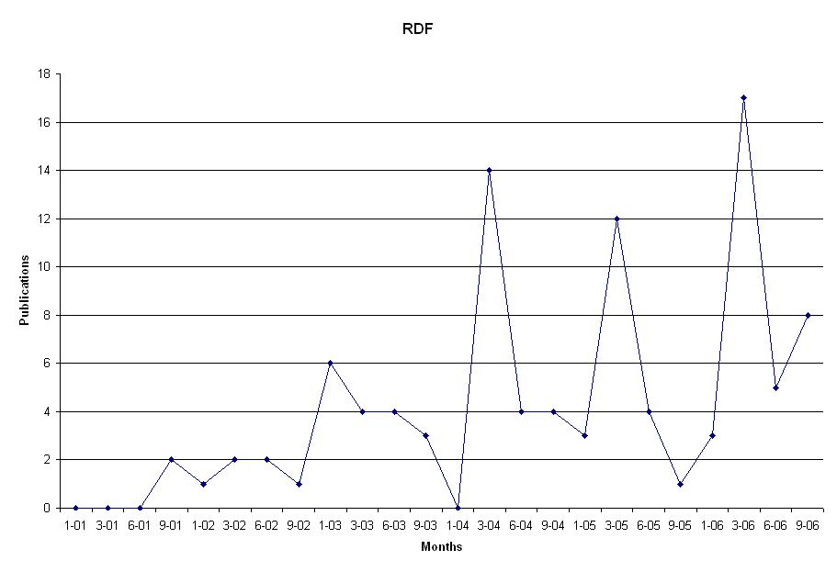
(Bursty Trends – Month) Example

Slide 21
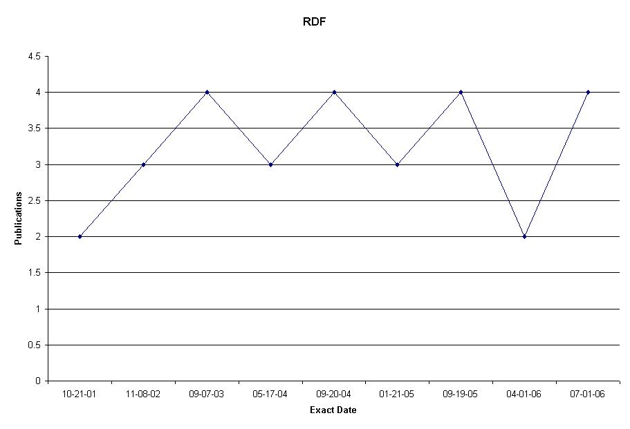
(Bursty Trends – Exact Date) Example

Slide 22
De-spiking
Determine if a subtopic(s) were the cause for a bursty behavior of topic
If subtopic has a spike remove the subtopic

Slide 23
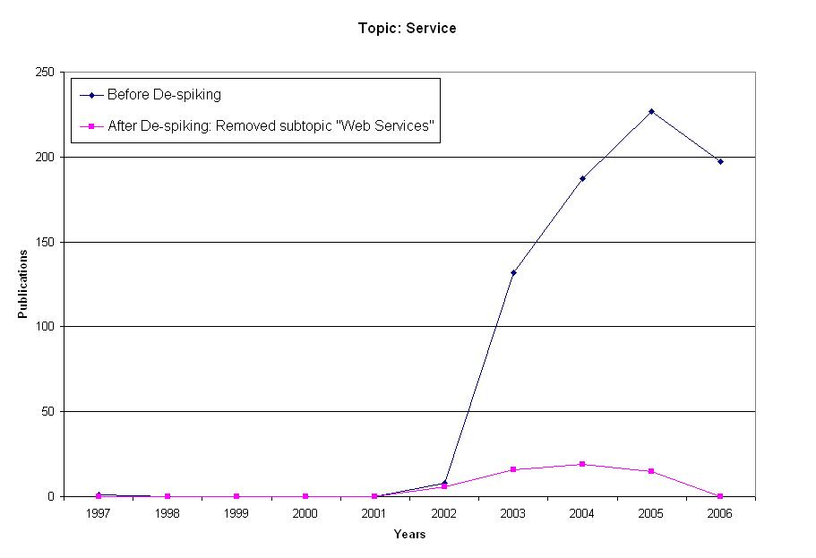
De-spiking Example

Slide 24
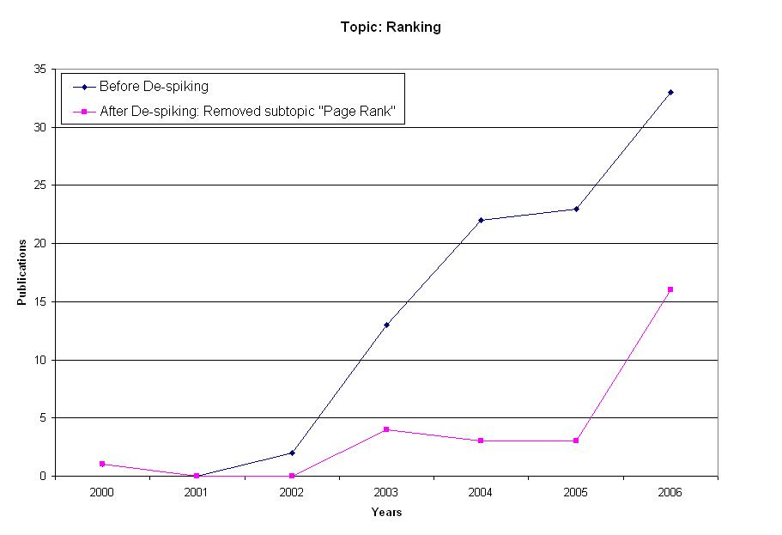
De-spiking Example

Slide 25
Detection of Emerging Trends
Adapted another algorithm
  [3] Tho, Hui, ICADL 03
Detects significant increase in the total number of publications within recent years

Slide 26
Results (Emerging Trend)

Slide 27
Identification of Researchers
RampUp – All days, months, or years in first 20% of post mass below mean.

Slide 28
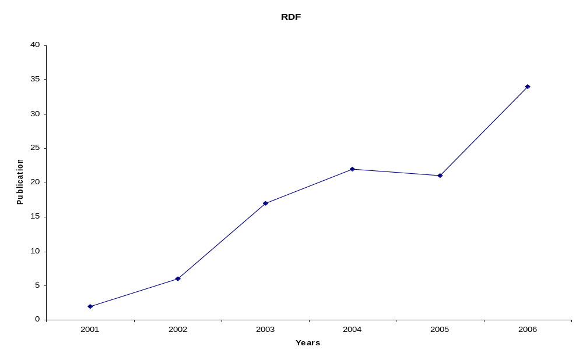
Ramp up dates: 2001, 2002
Total papers below mean: 8
20% of post mass: 2001
Mean = 17

Slide 29
Validation Against Recognized Individuals
ACM Fellows (503) (fellows.acm.org/)
IEEE Fellows (172) (ieee.org/web/membership/fellows/new_fellows.html)
H-Index (99) (www.cs.ucla.edu/~palsberg/h-number.html)
Prolific Authors (4525) (www.informatik.uni-trier.de/~ley/db/indices/a-tree/prolific/index.html)
Wikipedia Individuals (195)
Centrality Score (499)

Slide 30
Identified Researchers
Topic | Person | Appears in List | Contribution
Association Rules | Rakesh Agrawal | ACM Fellow H-Index Prolific Author (167) | “... contributions to data mining”
Query Languages | Donald D. Chamberlin | ACM Fellow IEEE Fellow | “For contributions to database query languages”
Knowledge Acquisition | Rudi Studer | Prolific Author (130) Wikipedia Person | “Head of the knowledge management research group at the Institute AIFB”

Slide 31
Observations

Slide 32
Observations
Trends Detected With/Without Particular Data
 | Bursty Trends Detected | Emerging Trends Detected
Using All Data | 142 | 74
Without Keywords | 119 | 58
Without Abstract Terms | 78 | 30
Without Keywords and Abstract Terms | 30 | 10

Slide 33
Observations
Number of influential researchers detected: 1721
Number of influential researchers detected who appear in lists of recognized people: 318

Slide 34
Observations
Influential researchers within all topics
  ACM Fellows: 52
  IEEE Fellows: 48
  Prolific: 214
  Wikipedia: 79
  H-Index: 131
  Centrality Score: 189

Slide 35
Related Work (1)
Identification of Prominent Researchers
Detected prominent researchers based on centrality measures with the use of a DBLP subset
  We detected influential researchers at the early stage of trends using validation measures including centrality with the use of a DBLP subset which in fact is a superset of their subset
  [1]Elmacioglu, Lee, SIGMOD RECORD 05

Slide 36
Related Work (2)
Detection of Bursts in Blogs
Determined topics by selecting all repeated sequences of uppercase words surrounded by lowercase text
  Instead, our approach used topics within our taxonomy and keywords from data extraction
  [2]Gruhl, Guha, WWW04

Slide 37
Contributions
Described a methodology for building a dataset that contains relationships from publications to topics in a taxonomy of topics
Demonstrated a semantics-based approach for detecting bursty and emerging trends and identifying influential researchers at the early stage of trends

Slide 38
Conclusions and Future Work
Pinpointed several topics that contributed to spikes
Identified many exact matches of influential researchers
Develop more data extractors for web pages

Slide 39
References
[1] Elmacioglu, E., Lee, D.: On Six Degrees of Separation in DBLP-DB and More. SIGMOD Record, 34(2):33-40 (June 2005)
[2] Gruhl, D., Guha, R., Liben-Nowell, D., Ding, L., Tomkins, A.: Information Diffusion Through Blogspace. WWW-2004, New York, New York (May 17-22, 2004)
[3] Tho, Q. T., Hui, S. C., Fong, A.: Web Mining for Identifying Research Trends. ICADL 2003, Berlin Heidelberg (2003) 290-301

Slide 40
Thanks
Dr. Budak Arpinar
Dr. John Miller
Dr. David Himmelsback
Boanerges Aleman-Meza
Delroy Cameron
Dr. Krzysztof J. Kochut

Slide 41
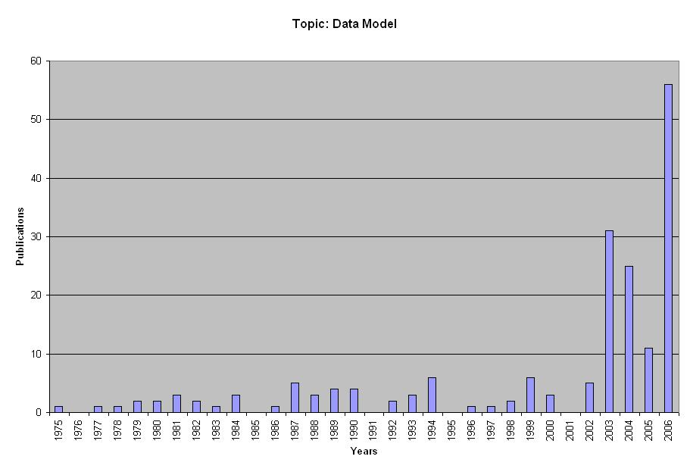
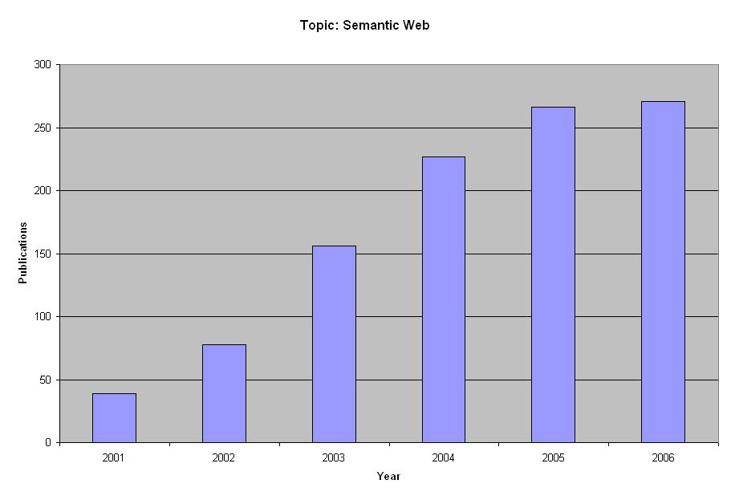
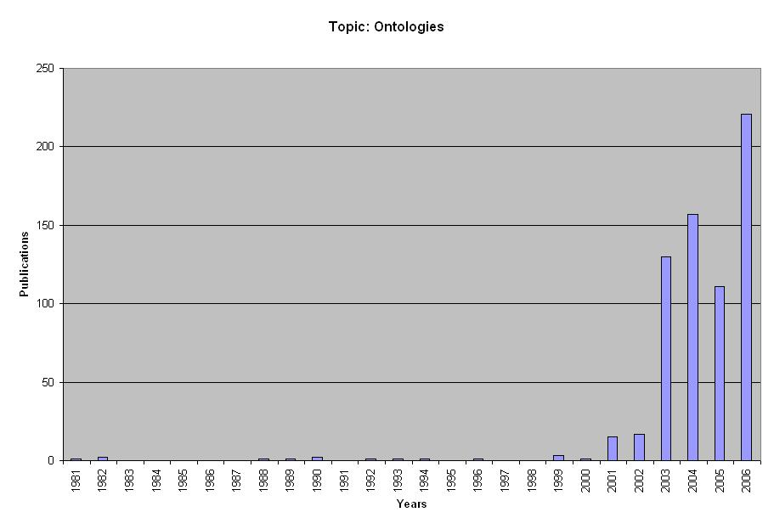
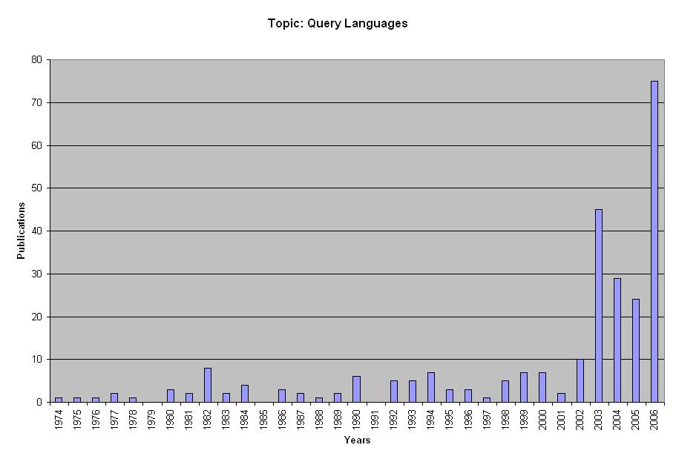
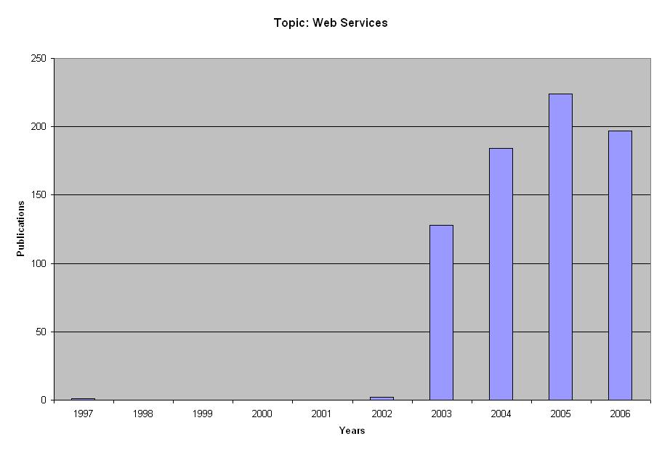
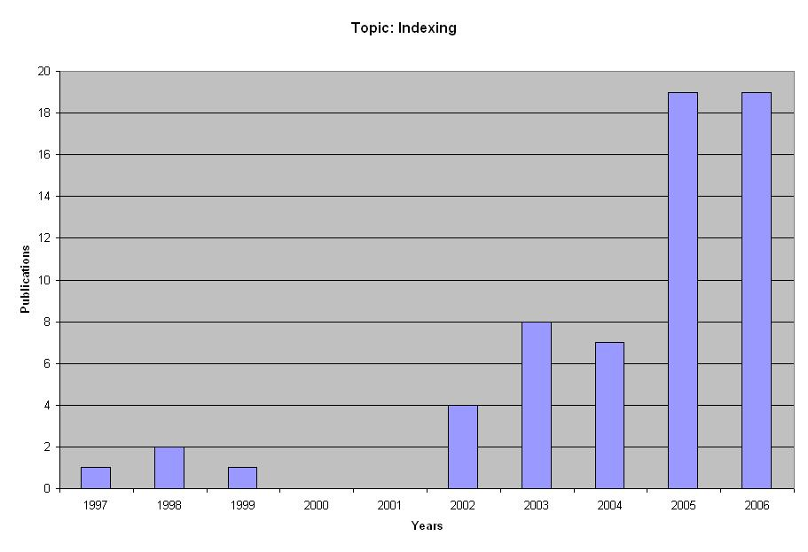

Slide 42
Greatest Number of Publications
60’s: 145
70’s: 602
80’s: 1498
90’s: 3860
2000’s: 6196

Slide 43
Strong Points
Complete solution for trends detection, from collecting source data to actual trend detection and evaluation
The identification of researchers working on emerging technologies is a potentially valuable application. This paper presents an efficient approach for such identification
The paper demonstrated that processing the full content of published papers is not required for trend identification

Slide 44
Instances in Main Class
Main Classes | Subset | DBLP
Proceeding (of conferences, etc) | 857 | 8,665
Articles in proceedings | 51,202 | 532,758
Articles in journals | 25,973 | 328,792
Authors | 67,366 | 539,301
Terms Extracted (over 60,000)

Slide 45
Publication Venues
Conferences (113)
AAAI, ADB, ADBIS, ADBT, ADC, ARTDB, BERKELEY, BNCOD, CDB, CEAS, CIDR, CIKM, CISM, CISMOD, COMAD, COODBSE, COOPIS, DAISD, DAGSTUHL, DANTE, DASFAA, DAWAK, DBPL, DBSEC, DDB, DEDUCTIVE, DEXA, DEXAW, DIWEB, DMDW, DMKD, DNIS, DOLAP, DOOD, DPDS, DS, DIS, ECAI, ECWEB, EDBT, EDS, EFDBS, EKAW, ER, ERCIMDL, ESWS, EWDW, FODO, FOIKS, FQAS, FUTURE, GIS, HPTS, IADT, ICDE, ICDM, ICDT, ICOD, ICWS, IDA, IDEAL, IDEAS, IDS, IDW, IFIP, IGIS, IJCAI, IWDM, INCDM, IWMMDBMS, JCDKB, KCAP, KDD, KR, KRDB, LID, MDA, MFDBS, MLDM, MSS, NLDB, OODBS, OOIS, PAKDD, PDP, PKDD, PODS, PPSWR, RIDE, RULES, RTDB, SBBD, SDB, SDB, SDM, SEMWEB, SIGMOD, SSD, SSDBM, TDB, TSDM, UIDIS, VDB, VLDB, W3C, WEBDB, WEBI, WEBNET, WIDM, WISE, WWW, XP, XSYM
Journals (28)
AI, AIM DATAMINE, DB, DEBU, DKE, DPD, EXPERT, IJCIS, INTERNET, IPM, IPL, ISCI, IS, JDM, JIIS, JODS, KAIS, SIGKDD, SIGMOD, TEC, TKDE, TODS, TOIS, VLDB, WS, WWW, WWJ

Slide 46
Top Terms Extracted
Topic | 1998 | 1999 | 2000 | 2001 | 2002 | 2003 | 2004 | 2005 | 2006 | 2007
Algorithm(s) | 87 | 99 | 111 | 89 | 219 | 222 | 381 | 418 | 608 | 71
Classifier(s) | 0 | 7 | 1 | 2 | 33 | 30 | 47 | 80 | 94 | 5
Data Mining | 12 | 10 | 20 | 13 | 46 | 62 | 88 | 104 | 184 | 8
Databases | 13 | 17 | 19 | 19 | 28 | 32 | 43 | 53 | 63 | 6
Semantic Web | 0 | 0 | 0 | 4 | 13 | 24 | 102 | 85 | 96 | 14
Semantics | 19 | 16 | 26 | 22 | 28 | 24 | 90 | 75 | 86 | 11
Web Service(s) | 0 | 0 | 0 | 0 | 4 | 2 | 67 | 82 | 69 | 1
XML | 0 | 4 | 4 | 11 | 22 | 20 | 36 | 58 | 54 | 1

Slide 47
Overlap of Lists of Recognized/Prolific Researchers
With our list included | # Individuals Appearing In | Percentage of Total
1 List | 4,292 | 83.19%
2 Lists | 636 | 12.33%
3 Lists | 187 | 3.62%
4 Lists | 34 | 0.66%
5 Lists | 10 | 0.20%
6 Lists | 0 | 0.00%
7 Lists | 0 | 0.00%

Slide 48
Overlap of Lists of Recognized/Prolific Researchers
 | # Individuals Appearing In | Percentage of Total
1 List | 4,464 | 86.53%
2 Lists | 577 | 11.18%
3 Lists | 97 | 1.88%
4 Lists | 21 | 0.41%
5 Lists | 0 | 0.00%
6 Lists | 0 | 0.00%

Slide 49
4292
4464
172
464
577
113
74
97
23
11
21
10

Slide 50
Newer Terms Identified
Friendship, grid middleware, grid technology, phishing, protein structures, service oriented architecture (SOA), social network analysis, spam, wikipedia

Slide 51
RDF Dates
(Sun Oct 21 00:00:00 EDT 2001) 2
(Tue Jan 01 00:00:00 EST 2002) 1
(Mon Apr 01 00:00:00 EST 2002) 1
(Fri Nov 08 00:00:00 EST 2002) 1
(Fri Jan 17 00:00:00 EST 2003) 4
(Thu Jun 26 00:00:00 EDT 2003) 4
(Tue Jul 01 00:00:00 EDT 2003) 1
(Thu Oct 23 00:00:00 EDT 2003) 1
(Fri Nov 07 00:00:00 EST 2003) 1
(Sun Dec 07 00:00:00 EST 2003) 1
(Mon May 17 00:00:00 EDT 2004) 13
(Mon Jun 14 00:00:00 EDT 2004) 1
(Mon Jun 21 00:00:00 EDT 2004) 1
(Mon Aug 30 00:00:00 EDT 2004) 2
(Mon Sep 20 00:00:00 EDT 2004) 2
(Mon Nov 08 00:00:00 EST 2004) 1
(Fri Nov 26 00:00:00 EST 2004) 2
(Sat Jan 01 00:00:00 EST 2005) 2
(Fri Jan 21 00:00:00 EST 2005) 1
(Fri Apr 01 00:00:00 EST 2005) 1
(Tue May 10 00:00:00 EDT 2005) 10
(Fri Jul 01 00:00:00 EDT 2005) 1
(Mon Sep 19 00:00:00 EDT 2005) 4
(Sun Oct 02 00:00:00 EDT 2005) 1
(Sun Jan 01 00:00:00 EST 2006) 2
(Sat Jan 07 00:00:00 EST 2006) 1
(Sat Apr 01 00:00:00 EST 2006) 2
(Mon Apr 03 00:00:00 EDT 2006) 4
(Tue May 23 00:00:00 EDT 2006) 8
(Sat Jul 01 00:00:00 EDT 2006) 2
(Sat Aug 19 00:00:00 EDT 2006) 1
(Mon Sep 04 00:00:00 EDT 2006) 1
(Fri Nov 10 00:00:00 EST 2006) 2
(Mon Dec 18 00:00:00 EST 2006) 4
(Sun Feb 04 00:00:00 EST 2007) 2
(Sun Apr 01 00:00:00 EDT 2007) 1

Slide 52
Total Papers Per Year
1963 14
1964 9
1965 4
1966 4
1967 20
1968 34
1969 145
1970 90
1971 182
1972 156
1973 265
1974 198
1975 457
1976 344
1977 602
1978 501
1979 456
1980 592
1981 785
1982 752
1983 1114
1984 784
1985 969
1986 1149
1987 1354
1988 1393
1989 1498
1990 1657
1991 2015
1992 2132
1993 2463
1994 2566
1995 2687
1996 2951
1997 3389
1998 3696
1999 3860
2000 4082
2001 4123
2002 4180
2003 5050
2004 5516
2005 6196
2006 5698
2007 1043

