Slide 1
SEMANTIC MATCH MAKING AND RANKING OF MEDICAL LITERATURE
By:Priya Wadhwa
Major professor:Dr. Arpinar
Committee:Dr. Ramaswamy
Dr. Taha

Slide 2
Outline
Introduction
Motivation
Goals
System Overview
System Workflow
Pillars
Match Making Overview
Document Ranking
Semantic Ranking
Demo
Test cases
Conclusion & Future Work

Slide 3
Introduction
Medical information & data increasing tremendously
Medline citations grew by more than 700,000 in 2009
Articles,journals,papers on new research or discovery or a change in medical therapy
Important information for doctors & patients
Semantics enabled framework for the retrieval, ranking and distribution of relevant medical information

Slide 4
Motivation
Scenario # 1
Patient Tom (Heart attack)
Prescription : Plavix
Symptoms: Acidity
Prescription: Prilosec
Plavix+Prilosec(Increased risk of heart attack)

Slide 5
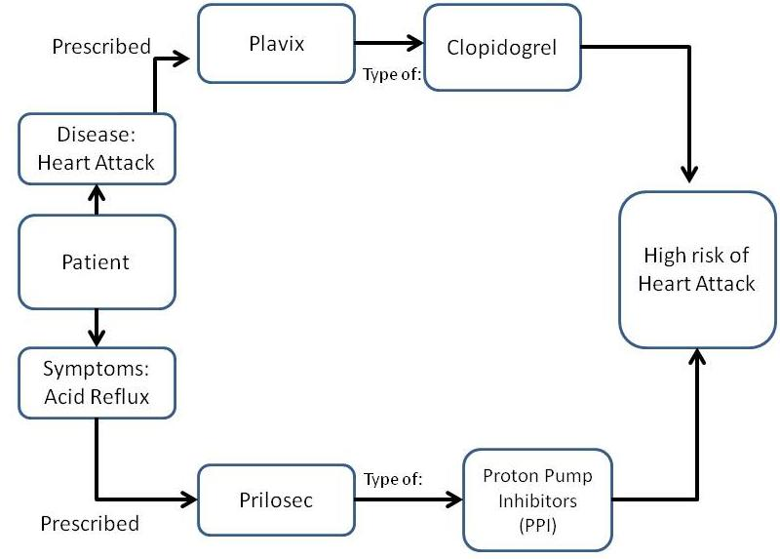
Notes:
Since the matchmaking in our system is done on the semantics rather than syntax, the knowledge discovery enables the system to find such relevant publications and provide the results to the patient.

Slide 6
Scenario # 2
Patient Smith (Asthma)
Medication(Primatene Mist Asthma Inhaler)
Visits doctor after every 6 months
The inhaler prescribed has been taken off shelves
Usually people have enough stock at home, so he won’t know about the update until:
He visits the doctor
Doctor informs him
Searches the internet
Notes:
This may be very dangerous and unsafe as he continues to use the inhaler which has been removed. In addition, he is unknowingly avoiding taking a better inhaler because of his lack of knowledge. In this case the affects of ignorance can be severe.
However, our System makes this knowledge discovery easier for her. With the help of our system any update related to her disease, drugs, medications, symptoms etc. will be sent to her. She does not need to read through several hundred new publications at PubMed or search through hundreds of pages on the internet to find the most relevant information.

Slide 7
Goals
Use of semantic relationship
Reduce the information overload
Reduce the end user workload
Timely dissemination of information

Slide 8
Challenges
EMR’S confidential
Finding Concepts and Relationships
Semantics based search and ranking

Slide 9
System Overview
The working of the system is broadly divided into two parts:
Semantic Match making:
The semantic match making finds the relevant publications for a particular health record by looking into all the semantic concepts and terms and the relationships among them.
Semantic Ranking
Once the publications are found for a particular health record the ranking of the documents is done based on the various syntactic and semantic criteria.

Slide 10
System Workflow
Creating sample health records
Parsing the health records
Adding the health records into the ontology.
Annotating the health records
Adding the annotations to the ontology.
Downloading medical publications from the PubMed and adding them to the ontology.
Annotating the papers and adding the annotations for corresponding papers into the ontology.

Slide 11
Workflow
Running a patient specific query.
Carrying out the match making.
Ranking the matched results.
Displaying the output

Slide 12
Architecture
NCBO BIOPORTAL ANNOTATOR
EMR’S
ANNOTATION &SEMANTIC PROCESSING
MEDICAL PUBLICATIONS
SEMATIC QUERY GENERATION
SEMANTIC MATCH MAKING &RANKING
DISPLAYING OUTPUT

Slide 13
Pillars
PubMed
Google EMR’s
NCBO Annotator
UMLS

Slide 14
PubMed
PubMed is a Web-based retrieval system developed by the NCBI.
Database developed from the life sciences literature.
Over 21 million records representing articles in the biomedical literature.
We used PubMed for downloading the medical literature related to various diseases.
Our knowledge base(the ontology) was built from the PubMed publications.
Notes:
NATIONAL CENTER FOR BIOMEDICAL INFORMATION

Slide 15
Navigating PubMed
PubMed homepage displays:
a database selection menu, where you can choose between PubMed and other NCBI databases
a search box where you enter your terms
a link to the Advanced Search, where you can construct a tailored search.

Slide 16
Google EMR’s
For the system to work, we need Electronic Health Records.
Sensitive & Confidential Information
No standard found
Considered Google health records’ format as the sample and generated our own health records.
The application will work even when fed with real health record.
Notes:
In order to carry out the match making and ranking we needed the health records. Since the information on a health record for a particular patient is very sensitive and confidential we could not have access to the real time health records. So we used google health records as a sample to generate the dummy health records for our research. Also there is no standard found on health records as different doctors generate it differently in their own way so we followed the pattern of google sample health records.

Slide 17
Sample Health Record
<Patient>
<Name>Marry Moremen</Name> <Address>1905 South Milledge Avenue</Address> <City>Athens</City> <State>GA</State> <Zip>30605</Zip> <Country>United States</Country> <Id>1235</Id> <Age>25</Age> <KnownDisease>Asthma</KnownDisease> <Medications>Aerobid, Alvesco</Medications> <Gender>Female</Gender> <symptoms>vomiting</symptoms> <PrimaryPhysician> Dr Brown</ PrimaryPhysician> <PhysicianId>dc1267</PhysicianId> <PrimaryPharmacy>CVS</PrimaryPharmacy> <PrimaryPharmacyId>427Phar</PrimaryPharmacyId>
</Patient>

Slide 18
Semantic Annotation
Annotation of a text is providing additional information about the text.
Attaching names, concepts, description and comments about the data present in the text.
The most important requirement for semantic web is semantic description of the text.
Makes the unstructured or semi-structured data rich and semantically meaningful with a context that is further linked to the structured knowledge of a domain.

Slide 19
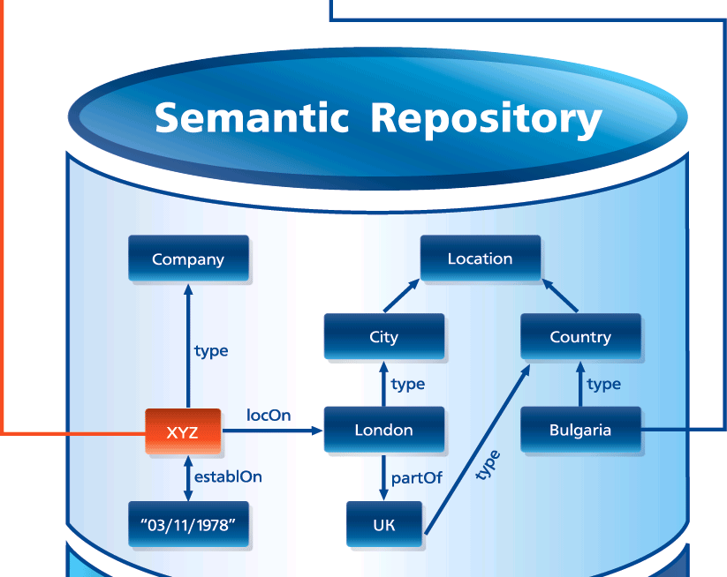
Semantic annotation example
Source: http://www.ontotext.com/kim/semantic-annotation

Slide 20
As we can see in the figure that Bulgaria is described in the annotated text by associating the type “Country” to it.

Slide 21
NCBO Bioportal
National Center for Biomedical Ontology provides a bioportal that can be used to access and share ontologies that are mostly used in the biomedical community.
BioPortal provides following services:
one can search the ontologies
search biomedical resources
obtain relationship between terms in different ontologies
obtain ontology based annotations of the text etc.

Slide 22
NCBO Bioportal services can be accessed through:
Web Browsers
Web Services (RESTful services)
The BioPortal library consists of the following:
Total number of ontologies: 173
Number of classes/types: 1,438,792
The ontologies provide us a basis of the domain knowledge which can be used for data integration, information retrieval etc.

Slide 23
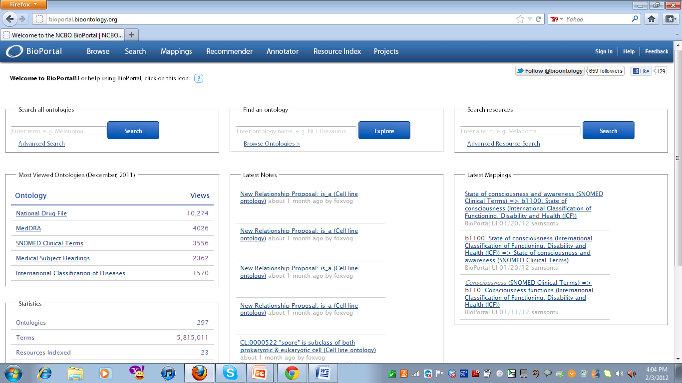
Snapshot

Slide 24
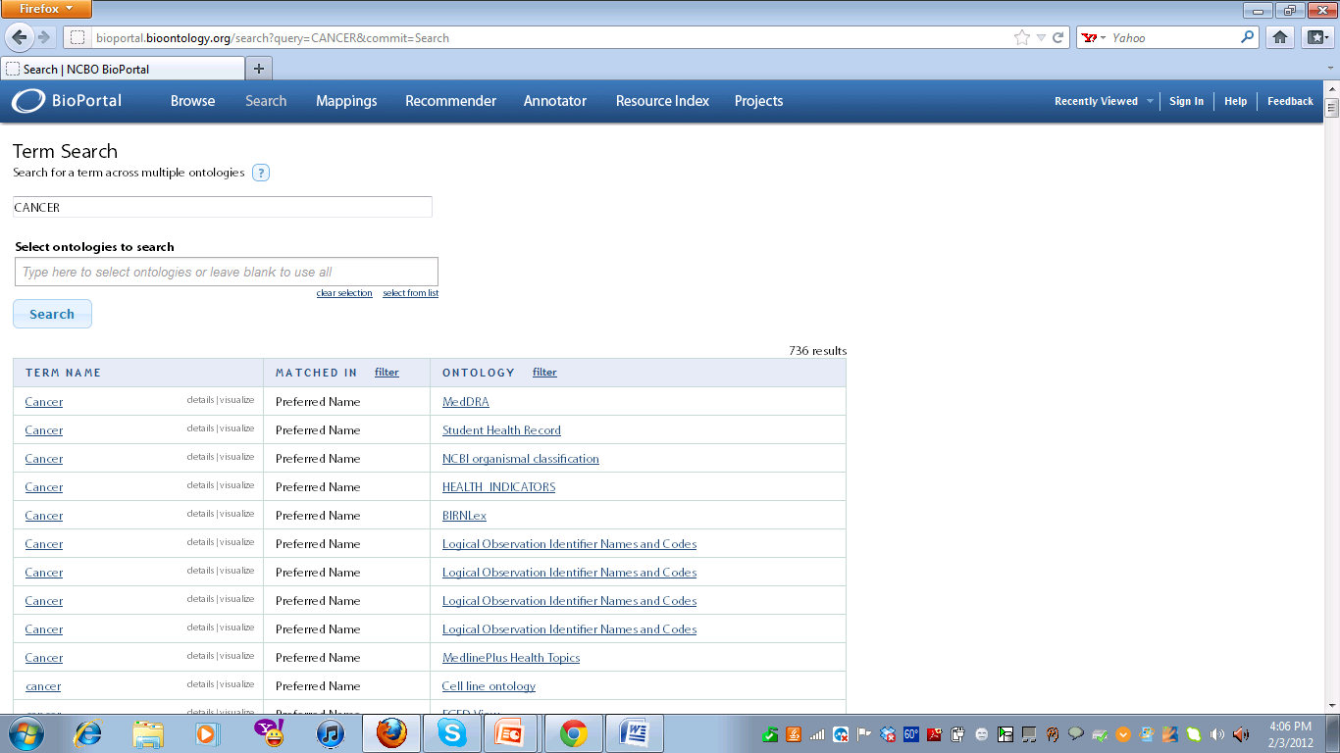

Slide 25
NCBO Bioportal Annotator
The National Center for Biomedical Ontology (NCBO) annotator is ontology based web service which can be used for the annotation of biomedical text.
Annotation is done by mapping the text with the biomedical ontology concepts that are present in the NCBO bioportal repository and the UMLS ontology.
Uses a set of more than 200 ontologies.
The web service is customizable for a particular domain or application.

Slide 26
The annotations are performed in two steps;
First is the direct annotations are created by matching the raw text with the preferred name from the various ontologies using the concept recognition technique.
Second expanding the annotations by considering the ontology mappings and hierarchy.

Slide 27
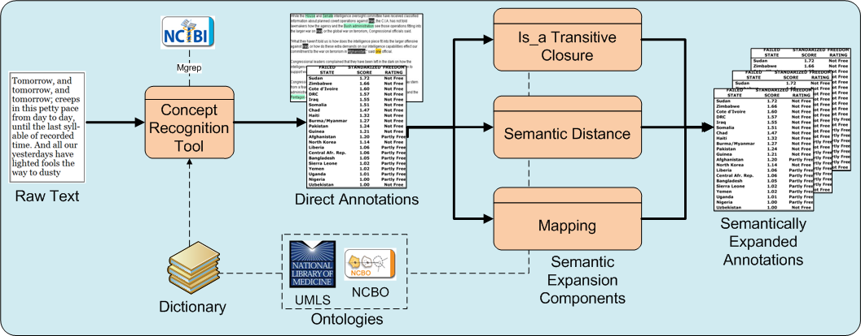
Workflow Diagram
Notes:
The concept recognition engine is called MGREP. It was developed by the National Center for Integrative Bioinformatics and is combined with BioPortal Ontology Web services to create the NCBO Annotator service to make the task of creating ontology-based annotations accessible for any biomedical researcher.
The process starts from raw text, from which direct annotations are obtained based on syntactic concept recognition. These annotations are obtained using the concept recognition tool provided by NCBI called Mgrep, which gives direct annotations from the given text. Once we have the direct annotations, these annotations are then expanded. Is_a Transitive Closure represents expanded annotations done with the is_a transitive closure expansion component.

Slide 28
The second step consists of :
The Is_a component : is the transitive enclosure, which exploits the parent child relationship of the ontologies. for example for the word melanoma; the Is_a component will generate annotations as skin tumor ,neoplasm etc. because skin tumor is the parent of melanoma.
The mapping component: It generates expanded annotations by mapping the annotations obtained from first step with different other ontologies.
The semantic distance component uses the semantic similarity measures between related concepts and creates new annotation.

Slide 29
UMLS
Unified Medical Language System
UMLS has a defined ontology which includes terms related to medical sciences including medical health records.
UMLS consists of three knowledge sources:
Metathesaurus
Semantic Network
SPECIALIST Lexicon and Lexical Tools

Slide 30
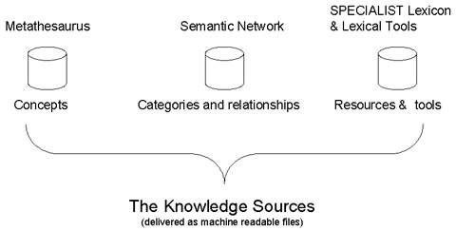
UMLS KNOWLEDGE SOURCES

Slide 31
The Metathesaurus
Methathesaurus is data base that has information stored in series of relational database tables and files.
It contains over 1 million biomedical concepts and 5 million concept names
It has the various terms organized as concepts with each concept having some attributes and semantic relationships among the various concepts.
There are several relationships between the concepts such as : is a, is part of, is caused by etc
All hierarchical information is stored in the Metathesaurus.

Slide 32
The Semantic Network
Metathesaurus has various concepts and terms stored in it.
Each concept is assigned a semantic type and the various concepts are related through semantic links.
The semantic network describes the various semantic types and relationships that can exit among the concepts.
135 semantic types and 54 relationships.
The semantic network is used to interpret the meanings of the various concepts.

Slide 33
Semantic types can be:
Organisms , Anatomical structures, Biologic function
Chemicals, Events, Physical objects etc for example clinical drug, disease name etc.
The concept breast cancer can be organized as type disease name

Slide 34
Semantic relationship
Hierarchical relationship(primary relationship)
Parent/child
Broader/Narrower
Sibling(Derived from hierarchies)
The network has another five (5) major categories of non-hierarchical relationships; these are:
"physically related to"
"spatially related to"
"temporally related to"
"functionally related to"
"conceptually related to"
Notes:
Breast cancer is a Disease.
Animal is an organism.
Chemotherapy treats breast cancer.
Symptom diagnoses a disease.

Slide 35
The specialist Lexicon
This contains information about English language, biomedical terms, terms in Metathesaurus.
The various sources for the lexical coding of these words are: the MEDLINE abstracts and Dorland's Illustrated Medical Dictionary.
The lexical tools are nothing but a collection of Java programs that help in natural language processing of these words and terms
It contains the syntactic information, morphological information as well as Orthographic information

Slide 36
Syntactic Information:
This contains the information on how the words can be put together to generate meaning, syntax etc.
Morphological Information:
This contains information about the structuring and forms.
Orthographic Information:
This contains information about the spellings

Slide 37
Match Making
Match making refers to the task of getting the required results based on certain specifications.
We did the semantic match making to obtain relevant publication for a particular patient.
Semantic Match making is different from any other matchmaking in a way that in semantic matchmaking the results are obtained through shared conceptualization for the knowledge domain at hand, which we call ontology.
Notes:
With respect to our domain, our purpose of matchmaking in this thesis is to obtain relevant publications to a particular patient (health record). We perform the matchmaking between the health record and paper publications to obtain relevant results.

Slide 38
To carry out the process of match making and ranking we have built two ontologies:
Health Records Ontology
Medical Literature Ontology

Slide 39
Health Record Ontology
The health record ontology has all the patients data obtained after parsing the EMR’s.
It has the following information:
Name
ID (Unique)
Age
Gender
Known Disease
Medications
Symptoms
Annotations results for Known Disease (including synonyms)
Annotations results for Medications (including synonyms)
Annotations results for Symptoms (including synonyms)

Slide 40
Medical Literature Ontology
Medical Literature ontology has all the downloaded publications from the PubMed for various diseases, symptoms, medications etc.
This ontology contains the following information:
Title
Abstract
URL(Unique)
Publication Date
Authors Names
Annotations for Title
Annotations for Abstract
Strength of the Paper

Slide 41
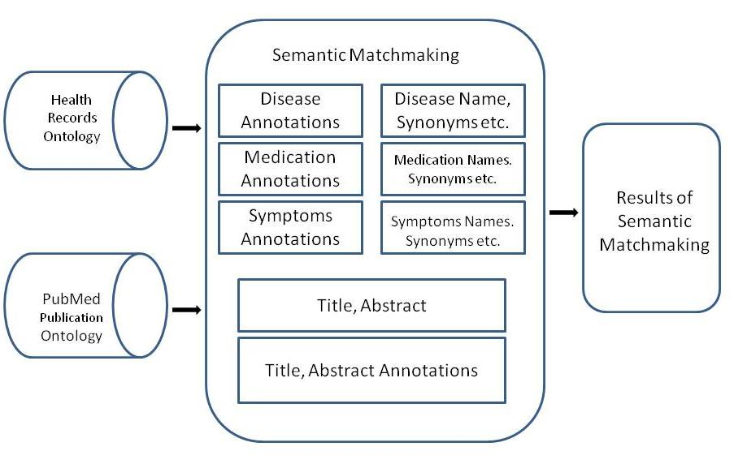
Match Making Algorithm
Image source: Asmita Rahman’s Thesis

Slide 42
The system uses the following criteria or the factors for performing the match making:
For the Heath Records:
Disease Name
Annotations and Synonyms of the Disease names
Medications
Annotations and Synonyms of the Medication names
Symptoms
Annotations and Synonyms of the Symptoms names
For the Publications:
Title of the Paper
Abstract of the Paper
Annotations of the Title
Annotations of the Abstract

Slide 43
In the matchmaking process, the system not only performs the keyword matching, but also takes into consideration the semantic hierarchy, synonyms, annotations etc.
This enables the user to get the relevant results regardless of the “word” or the “term” they enter. For example, a person has a symptom of vomiting, however, is unaware of the disease.

Slide 44
Suppose that there is a new discovery about people having symptoms of Haematemesis.
If that person were to search a normal keyword search for their symptoms(vomiting) he would NOT be able to find the paper, which discusses about Haematemsis, as the keyword based search would only look for the exact match.
However, with our system that person will get the results of this new discovery even if the paper does not have the word “vomiting” in it, since the annotations of the term vomiting are; Haematemesis, Bilious attack, Throwing up

Slide 45
Match Making Process In Detail
Step 1: Sample health record generation
<Patient>
<Name>Marry Moremen</Name> <Address>1905 South Milledge Avenue</Address> <City>Athens</City> <State>GA</State> <Zip>30605</Zip> <Country>United States</Country> <Id>1285</Id> <Age>25</Age> <KnownDisease>Asthma</KnownDisease> <Medications>Aerobid, Alvesco</Medications> <Gender>Female</Gender> <symptoms>vomiting</symptoms> <PrimaryPhysician> Dr Brown</ PrimaryPhysician> <PhysicianId>dc1267</PhysicianId> <PrimaryPharmacy>CVS</PrimaryPharmacy> <PrimaryPharmacyId>427Phar</PrimaryPharmacyId>
</Patient>

Slide 46
Step 2: Parsing the record to get the important information
Patient Details:
Name: Marry Moremen
Id: 1285
Age: 25
Gender: Female
Known Disease: Asthma
Medications: Aerobid, Alvesco
Symptoms: vomiting

Slide 47
Step 3: Enter the information in the ontology:
<!-- http://www.semanticweb.org/ontologies/2011/8/MedicalInoHealthRecords.owl#patient1 -->
<owl:Thing rdf:about="#patient1">
<Name>Marry Moremen</Name>
<Id>1285</Id>
<Age>25</Age>
<KnownDisease>Asthma</KnownDisease>
<Medications>Aerobid</Medications><Medications>Alvesco</Medications>
<Gender>Female</Gender>
<symptoms>vomiting</symptoms>
</owl:Thing>

Slide 48
Step 4:Getting the annotations for the patient’s profile based on the various terms in his profile. The snippet of the annotation obtained for Asthma based on the disease name is shown below. We obtained the annotations for medications and symptoms too.

Slide 49
annotations = [AnnotationBean [
score = 20
concept = [localConceptId: 46116/155574008, conceptId: 21567348, localOntologyId: 46116, isTopLevel: 1, fullId: http://purl.bioontology.org/ontology/SNOMEDCT/155574008, preferredName: Asthma, definitions: [], synonyms: [Asthma, Asthma (disorder)], semanticTypes: [[id: 25504782, semanticType: T047, description: Disease or Syndrome]]]
context = [MGREP(true), from = 1, to = 6, [name: Asthma, localConceptId: 46116/155574008, isPreferred: false], ]
], AnnotationBean [
score = 20
concept = [localConceptId: 46116/155574008, conceptId: 21567348, localOntologyId: 46116, isTopLevel: 1, fullId: http://purl.bioontology.org/ontology/SNOMEDCT/155574008, preferredName: Asthma, definitions: [], synonyms: [Asthma, Asthma (disorder)], semanticTypes: [[id: 25504782, semanticType: T047, description: Disease or Syndrome]]]
context = [MGREP(true), from = 1, to = 6, [name: Asthma, localConceptId: 46116/155574008, isPreferred: true], ]
],
Notes:
The annotation consists of socre (A score is a number assigned to an annotation that reflects the accuracy of the annotation. The higher the score is the better the annotation is.), the local concept ID for a particular ontology, local ontology ID, IsTopLevel (for hierarchical information), Preferred Name, definition, synonyms, semantic types (UMLS)

Slide 50
Step 5: Adding the annotations to the ontology.

Slide 51
<!-- http://www.semanticweb.org/ontologies/2011/8/MedicalInoHealthRecords.owl#patient1-->
<owl:Thing rdf:about="#patient1">
<symptoms>vomiting</symptoms>
<Name>Marry Moremen</Name>
<Id>1285</Id>
<Age>25</Age>
<KnownDisease>Asthma</KnownDisease>
<Medications>Aerobid</Medications><Medications> Alvesco</Medications>
<MedicationsAnnotations> flunisolide</MedicationsAnnotations><MedicationsAnnotations> Syntaris</MedicationsAnnotations><MedicationsAnnotations> Flunisolide</MedicationsAnnotations><MedicationsAnnotations> Apo-Flunisolide</MedicationsAnnotations><MedicationsAnnotations> Flunisolide</MedicationsAnnotations><MedicationsAnnotations> Rhinalar</MedicationsAnnotations><MedicationsAnnotations> Nasarel</MedicationsAnnotations><MedicationsAnnotations> ratio-Flunisolide</MedicationsAnnotations><MedicationsAnnotations> flunisolide hemihydrate</MedicationsAnnotations><MedicationsAnnotations> (6alpha</MedicationsAnnotations><MedicationsAnnotations>11beta</MedicationsAnnotations><MedicationsAnnotations>16alpha)-isomer</MedicationsAnnotations><MedicationsAnnotations> Nasalide</MedicationsAnnotations><MedicationsAnnotations> Apotex Brand of Flunisolide</MedicationsAnnotations><MedicationsAnnotations> Elan Brand 1 of Flunisolide</MedicationsAnnotations><MedicationsAnnotations> Roche Brand of Flunisolide</MedicationsAnnotations><MedicationsAnnotations> Forest Brand of Flunisolide</MedicationsAnnotations><MedicationsAnnotations> Ivax Brand of Flunisolide</MedicationsAnnotations><MedicationsAnnotations> Dermapharm Brand of Flunisolide</MedicationsAnnotations><MedicationsAnnotations> flunisolide</MedicationsAnnotations

Slide 52
Step 6: Downloading the medical literature from PubMed
Step 7: Building the medical literature ontology and adding all the information related to a particular paper into it.

Slide 53
<!-- http://www.semanticweb.org/ontologies/2011/8/MedicalPapers.owl#paper10 --> <owl:Thing rdf:about="#paper10">
<title >Strength and endurance of the respiratory and handgrip muscles after the use of Flunisolide in normal subjects.</title> <author>Jardim JR, Camelier A, Dal Corso S, Rodrigues JE.</author> <publishing_date>2009</publishing_date> <abstract >To evaluate the effects of the inhaled Flunisolide upon the strength and endurance of the respiratory and peripheral muscles of normal subjects.DESIGN:A randomized, double blind and placebo-controlled study.SETTING:A university-affiliated teaching hospital.PARTICIPANTS:Thirteen normal volunteers selected from a graduation course.INTERVENTION:Subjects were randomly allocated to receive a placebo or corticosteroid (Flunisolide) to be inhaled twice a day for 4 weeks. After 2 weeks of a washout period, subjects who were receiving the placebo, received Flunisolide and vise versa for another 4-week period.MEASUREMENTS AND RESULTS:Spirometry was used to define the volunteers as being normal in terms of pulmonary function. During the study, subjects performed tests of respiratory muscle function (strength and endurance), measurements of handgrip strength and endurance and anthropometric measurements. Muscle strength was measured each week while muscle endurance was measured every 2 weeks. There was no significant difference in the maximal inspiratory and expiratory pressure and handgrip strength during weeks 1-4 when the subjects used either Flunisolide or placebo. However, we observed an increase in the endurance time of the respiratory and handgrip muscles in the 4th week of both Flunisolide and placebo use, what may be considered due to a learning effect.CONCLUSION:Inhalation ofFflunisolide by normal subjects for 1 month does not cause any acute or clinically perceived effect in the peripheral or respiratory muscles.</abstract> <url >http://www.ncbi.nlm.nih.gov/pubmed/17509852</url>

Slide 54
Step 8: Getting the annotations for the papers using NCBO Bioportal Annotator, parsing the results and storing the annotation into the ontology.
Step9: Running the queries for match making and ranking.

Slide 55
Document Ranking
Document Ranking is the important part of information retrieval.
In general documents are ranked based on certain feature.
A feature is an attribute of a document that a computer can detect, and that we think may indicate relevance.

Slide 56
The general features for ranking documents for the information retrieval purposes are:
Term matching
System should prefer documents that contain the query terms.
Term frequency
System should prefer the documents that contain query terms many a times.

Slide 57
Term proximity
Words that are close together in the query should be close together in relevant documents.
Popularity
Page Rank

Slide 58
Semantic Ranking
Semantic web is the emerging web.
Computer scientists are working hard to come up with the information retrieval algorithms that take the semantics into consideration for ranking the documents.
The general ranking algorithms give really good results as compared to no ranking at all.
A lot of manual work is required to filter the documents.

Slide 59
Semantic ranking would take into consideration the semantics associated with the documents and the query based on the domain knowledge and then rank the documents for information retrieval.
Would reduce human effort.

Slide 60
Our Algorithm
Features/Factors for ranking:
Frequency and occurrence of a term
Term Proximity/Location of the term
Timeline
Semantics Involved
Strength of the paper

Slide 61
Features
Frequency and occurrence of a term
The system searches for any of the terms present in the patient’s profile in all of the papers in the database then the paper which has the terms is retrieved as a match and is given a rank.

Slide 62
Term Proximity/Location of the term
Look for the term location whether its in the title or in the abstract or in both and rank the paper based on the term location.

Slide 63
Timeline
The publication year of the various publications is also considered as one of factors in ranking of the medical literature.

Slide 64
Semantics Involved
Presence of symptoms’, disease name’s, or medications’ semantically related terms in a publication. Based on what all is present the publications are ranked. The algorithm goes one level deeper into the semantic relationship to look for the synonymy relationship and concepts which are obtained from the annotations of the literature.

Slide 65
Strength of the paper
Calculated by processing the results of the annotations obtained.
Considering the number of top Level concepts found in the Title and the Abstract of any particular paper; the strength of that paper is calculated.
Top Level indicates that a particular concept is in the Top Level; meaning it is a root in the ontology and not the leaf.
For example, a word like “disease” appears in many ontologies, however, it is not the Top Level concept in most of them. On the other hand, specific medication like “Aerobid” is a Top Level concept in all the ontologies that it appears.

Slide 66
The higher the number of top level concepts the better is the strength of the paper.
Formula for calculating the strength of the paper:
Strength of the Paper= (Number of Top Level Concepts/Total Number of Concepts)
The strength of the paper is between 0 and 1.
In the ontology the strength of the paper is either 0.5 (for the strength less than 0.5 )or 1 (for strength greater than 0.5).

Slide 67
Assigning the Rank
Score is based on following :
Publication Date Score: Higher score is given to the recent publication.
If the publication date is between 2009 and 2011 then this adds to +1 to the overall rank otherwise 0.5 is added

Slide 68
Strength of the paper:
The strength 0.5 adds +1 to the overall rank of the paper whereas the strength 1 adds +2 to the overall rank of the paper
Term location: If the paper has any of the terms present in the title also it adds +2 to the overall rank.

Slide 69
Match on Disease Name
If the paper has known disease in it this gives a score 3 to the overall rank. If there is no direct match found but the match is found based on the semantic relationship(synonymy) associated with the term in the query then also a score 3 is added.

Slide 70
Match on Medication Names
If the paper has medication in it this gives a score 2 to the overall rank. The semantics are exploited in this case as well. For example a patient suffering from Asthma is prescribed a medicine Alvesco but there is a paper which talks about Flunisolide then that paper is given a score 2 for the patient profile with Asthma as Flunisolide is obtained from the annotations of the term of Alvesco which says that it’s a synonym of Alvesco.

Slide 71
Match on Symptoms Names
If the paper has symptom of a particular patient in it this gives a score 2 to the overall rank. The same semantic measure is taken into account here also.

Slide 72
Overall rank of the paper is calculated by adding all the above scores and based on that the minimum rank is 3 and maximum is 12 for a particular publication.
Rank= score of title+ score of disease+ score of medication+ score of symptom+ strength score+ publication date score
Suppose the strength of the paper is +1 and publication year as 2011and the paper has match for all the above mentioned terms and any of the term is present in the title as well, then rank would be:
Rank=2+3+2+2+2+1=12

Slide 73
Demo
Test case# 1(Heart Attack)
<Name>Lowanda Jacobson</Name> <Id>1253</Id>
<Age>99</Age>
<KnownDisease>Heart attack</KnownDisease> <Gender>Female</Gender> <Medications>prilosec</Medication> <Medication>Bucindolol</Medication> <Medication>Plavix</Medications> <symptoms>chest pain</symptoms>
<symptoms>acidity</symptoms>

Slide 74
Name: Mathew burton Patient Record Number: 1284 Disease: Heart Attack
Here are all the related paper, please click the corresponding links: Rank : 6 Link: http://www.ncbi.nlm.nih.gov/pubmed/21944415 Preview: There is increasing concern regarding a possible adverse interaction between proton pump inhibitors (PPIs) and clopidogrel that could lead to reduced cardiovascular protection by clopidogrel We performed a literature search for relevant original studies and systematic reviews. PPIs likely affect the antiplatelet activity of clopidogrel as measured in vitro, and this may be a class effect. We conclude that the pharmacodynamic effect has not been translated into any clinically meaningful adverse effect. PPI cotherapy reduces the incidence of recurrent peptic ulcer and of upper gastrointestinal bleeding among patients on clopidogrel. Title: No Medication: Yes Symptoms: Yes Disease: No
Strength:0.5
Publication year:2011
Title: The interaction between proton pump inhibitors and clopidogrel and upper gastrointestinal bleeding.

Slide 75
Rank : 7 Link: http://www.ncbi.nlm.nih.gov/pubmed/21884023 Preview: Previous mechanistic studies have suggested a possible interaction between proton pump inhibitor (PPIs) and clopidogrel. However, the results of clinical trials about the effects of PPIs on safety and efficacy of clopidogrel are controversial. The study sought to estimate the impact of PPIs on antiplatelet effect of clopidogrel. The study performed a meta-analysis of comparative concomitant use of clopidogrel with PPIs versus clopidogrel without PPIs studies published or presented to October 2010. Cardiovascular death, readmission for myocardial infarction/readmission for acute coronary syndrome, and nonfatal stroke were set as clinical endpoints. In randomized control trials (RCTs), the clinical endpoints risk ratio for clopidogrel with PPIs versus clopidogrel without PPIs was 1.20 (P= 0.34) in the random-effects model and 1.03 (P= 0.63) in the fixed-effects model. In observational studies, the risk ratio for the clinical endpoints for clopidogrel with PPI versus clopidogrel without PPI was 1.40 (P less than 0.001) in the random-effects model and 1.49 (P less than 0.001) in the fixed-effects model. Different assay methods showed that coadministration of clopidogrel with PPIs was associated with attenuation of clopidogrel's antiplatelet effect in vitro. This meta-analysis indicated an obvious discrepancy between RCTs and observational studies with respect to the interaction between PPIs and Clopidogrel. Title: Yes Medication: Yes Symptoms: No Disease: No
Strength:1
Publication year:2011
Title: A Meta-Analysis of Impact of Proton Pump Inhibitors on Antiplatelet Effect of Clopidogrel

Slide 76
Rank : 7 Link: http://www.ncbi.nlm.nih.gov/pubmed/22226329 Preview: Heart rate recovery, defined as the fall in heart rate during the first minute after exercise, is an indicator of autonomic function, and has been found to be an independent predictor of mortality after acute Myocardial infarction. Exercise training has several well-known benefits in terms of cardiorespiratory fitness, modifiable cardiovascular risk factors and prognosis after acute coronary events. However, there are no randomized controlled studies in the literature evaluating the effects of exercise training per se, controlling for changes in medication and diet, on heart rate recovery. Thus, this study aims to assess the effects of exercise training on autonomic function in coronary artery disease patients recovering from acute myocardial infarction. Title: Yes Medication: No Symptoms: No Disease: Yes
Strength:0.5
Publication Year:2010
Title: Exercise training enhances autonomic function after acute myocardial infarction: A randomized controlled study

Slide 77
Rank : 8 Link: http://www.ncbi.nlm.nih.gov/pubmed/22053225 Preview: D dimer is a breakdown product of fibrin mesh after factor XIII stabilization. Previously, many authors have demonstrated a relationship between D dimer level and stroke progression or type. This study aimed to investigate the relationship between D dimer level and stroke volume. Between January 2008 and December 2009, we analyzed the D-dimer levels of 59 acute ischemic stroke patients in our neurosurgical department both upon admission and after seven days of initial treatment. Each patient's National Institute of Health Stroke Scale score, modified Rankin Scales score, Glasgow outcome score, and infarction volume were also evaluated. Title: Yes Medication: No Symptoms: No Disease: Yes
Strength: 1
Publication Year:2011
Title: Correlation between Serum D Dimer Level and Volume in Acute Ischemic Stroke

Slide 78
Test case #2 (Asthma)
<Name>Martha Jackson</Name>
<Id>1288</Id>
<Age>25</Age>
<Gender>Male</Gender>
<KnownDisease>Asthma</KnownDisease>
<Medications>Primatene Mist</Medications>
<Symptoms>Heavy breathing</Symptoms>

Slide 79
Test Case#3: (Rheumatoid Arthritis)
<Name>moon garcia</Name>
<Id>1285</Id>
<Age>48</Age>
<KnownDisease>rheumatoid arthritis</KnownDisease>
<Medications>naproxen </Medications><Medications> ibuprofen</Medications> <Medications>Prednisone </Medications>
<Gender>Female</Gender>
<Symptom>Morning stiffness</Symptom>

Slide 80
Conclusion
The task of knowledge discovery is made easier.
The system performs a semantic match making and ranking of medical literature and gives good results.
This can be used by physicians or by patients to discover resources related to their Personal Health Record. Since the system performs semantic matchmaking, the results are more precise and accurate.
As seen in the above two motivating examples; our system enables the user to discover papers/knowledge that would not have been possible to discover via syntactic matchmaking.

Slide 81
Future Work
The various other factors such as location, age and gender of a patient can be considered for match making and ranking.
The medical history of the ancestors can also be taken into account.
The involvement of the doctors and experts can be done to verify the accuracy of the results.

Slide 82
Referrences
http://www.ncbi.nlm.nih.gov/pubmed
Google health sample . “http://code.google.com/p/googlehealthsamples/source/browse/trunk/CCR_samples/”. Retrieved on September 2011.
L. Ramaswamy, and I. B. Arpinar, "Semantics-enabled Proactive and Targeted Dissemination of New Medical Knowledge", CSHALS 2011: Conference on Semantics in Healthcare and Life Sciences, Feb 2011, Cambridge/Boston MA.
Plavix Drug Information: Uses, Side Effects, Drug Interactions and Other Warnings
http://en.wikipedia.org/wiki/PageRank
Zolt´an Gy¨ongyi Hector Garcia-Molina Jan Pedersen,Combating Web Spam with Trust Rank
Julia Stoyanovich , William Mee , Kenneth A. Ross Semantic Ranking and Result Visualization for Life Sciences Publications
Chris Halaschek, Boanerges Aleman-Meza, I. Budak Arpinar, Amit P. Sheth, Discovering and Ranking Semantic Associations over a Large RDF Metabase
http://en.wikipedia.org/wiki/Google_Health
http://en.wikipedia.org/wiki/Microsoft_HealthVault
http://www.ontotext.com/kim/semantic-annotation
http://www.bioontology.org/wiki/index.php/Annotator_Web_service
http://www.bioontology.org/wiki/index.php/File:OBA_service_workflow.pn

Slide 83
Clement Jonquet, Stanford University, Nigam H. Shah, Stanford University, Cherie H. Youn, NCBO Annotator: Semantic Annotation of Biomedical Data.
S., Staab, S., eds, Vol. 96 of Frontiers in Artificial Intelligence and Applications IOSPress Annotation for the Semantic Web Handschuh
http://www.nlm.nih.gov/research/umls/new_users/online_learning
http://www.nlm.nih.gov/research/umls/new_users/online_learning/Meta_002.html
http://www.nlm.nih.gov/research/umls/new_users/online_learning/SEM_001.htm
http://www.nlm.nih.gov/research/umls/new_users/online_learning/LEX_001.htm
http://www.nlm.nih.gov/research/umls/presentations/2004-medinfo_tut.pdf
PubMed Quick Start. U.S. National Library of Medicine National Institutes of Health. “http://www.ncbi.nlm.nih.gov/books/NBK3827/#pubmedhelp.PubMed_Quick_Start”. Retrieved on Aug 2011.
PubMed FAQS. U.S. National Library of Medicine National Institutes of Health. “http://www.ncbi.nlm.nih.gov/books/NBK3827/#pubmedhelp.FAQs”. Retrieved on Aug 2011.

Slide 84
THANK YOU

