Slide 1
A PATTERN-BASED ANNOTATION APPROACH: AN ONTOLOGY-DRIVEN ROTE EXTRACTOR FOR PATTERN DISAMBIGUIATION
Sheng Yin
Dec. 4th, 2009
Notes:
Think about figure for comparing rdf-based and rdbms-based model.

Slide 2
Outline
Background
Motivation
Pattern generalization
Pattern application
Result and evaluation
Conclusions and future work

Slide 3
Background
Semantic Web overview
Natural language processing
The Rote method

Slide 4
Semantic Web
Semantic Web is an extension of the current web “the meaning of information and services on the web are defined, making it possible for the web to understand and satisfy the requests of people and machines to use the web content” - wikipedia.org
The rise of the Semantic Web?
  Difficulties to search, retrieve and process web content
  Need for a data representation to enable software products (agents) to provide intelligent access to heterogeneous and distributed information

Slide 5
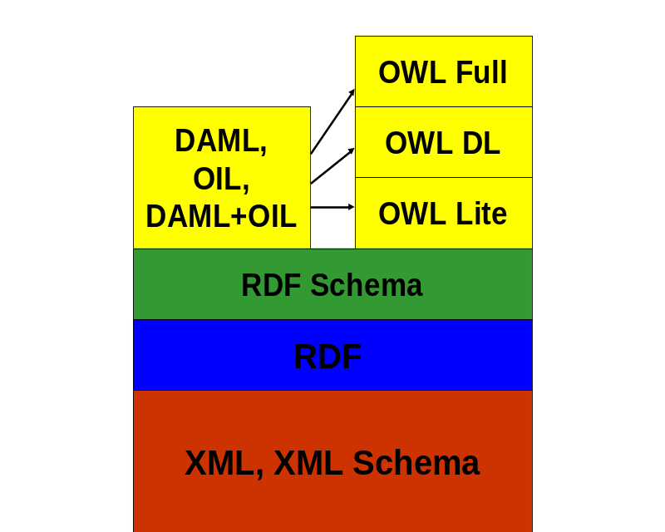
Ontology languages
Ontology languages:
RDF
RDF Schema
OWL
  OWL Full
  OWL DL
  OWL Lite

Slide 6
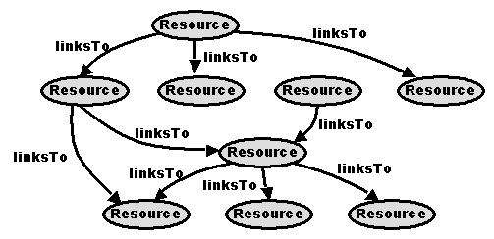
The current web
Minimal machine-processable information – Hypertext Markup Language

Slide 7
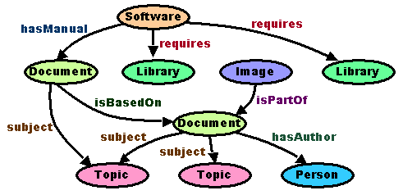
The Semantic Web
More machine-processable information

Slide 8
Ontology
An ontology is a formal representation of a set of concepts within a domain and the relationships among those concepts.
  It defines the domain concepts
  properties associated with those concepts
  and relations among concepts
Ontology examples:
  Yahoo! Categories
  Amazon.com product catalog
  Domain-specific standard terminology
    SNOMED Clinical Terms – terminology for clinical medicine
    UNSPSC - terminology for products and services

Slide 9
Natural language processing
Natural language processing (NLP) is a field of computer science and linguistics concerned with the interactions between computers and human languages.
It includes two directions
  one is how to convert computer readable information into readable human language
  the other is to convert human language sentences into computer readable information

Slide 10
NLP problems
Part-of-speech tagging (POS) is the process of marking up each word in a text corresponding to word’s definition and context. For example, it can identify which words are nouns, verbs, adjectives, etc.
Named entity recognizer (NER) can identify person, organization, and location from free text.
Segmentation is the process of dividing written text into meaningful units, such as words, sentences, or topics.
Stemming is the process to obtain the canonical form of all the words.
Chunking is a partial syntactic analyzer.

Slide 11
The Rote method
The Rote method can train extractors (rote extractors) to look for special patterns. Rote extractors can use the patterns to recognize a certain relation between two concepts.
  Mann and Yarowsky (2005) use it to extract a set of biographic facts about target individuals from a collection of Web pages
  Ruiz-Casado, Alfonseca and Castelss (2006) train rote extractors to recognize relations in Wikipedia

Slide 12
A common process for the Rote method
For a given relation, create a list of concept pairs as a seed. For example, select <Jim Rogers, 1942>, <Dan Brown, 1964> as the seed for a birth-year relation.
For each concept pair <hook, target> in the seed, collect a number of sentences containing both hook and target as the training corpus; collect sentences only containing hook as the testing corpus.
Extract surrounding context A1hookA2targetA3 from each sentence in the training corpus. Generalize those extracted surrounding contexts into patterns.
Apply the generalized patterns to extract new concept pairs in the testing corpus.
Repeat the procedure for other relations.

Slide 13
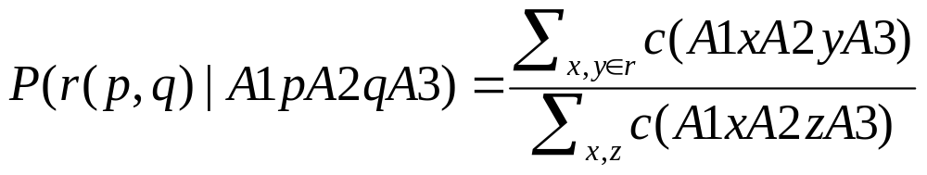
The probability of a relation given the relation’s surrounding context
Based on surrounding context A1xA2yA3, concept pair (x, y) has the relation r can be calculated.
x is called the hook; y is called the target.

Slide 14
Motivation
NER
Pattern ambiguities
  patterns which contain wildcards
  patterns which can be used to indicate several different relations

Slide 15
Problems
Named Entity Recognizer (NER)
In his book No Wonder They Call Him the Savior, Max Lucado tells of an encounter with Ian, a young Irish student at a Canadian university.
Pattern with wildcard would extract incorrect content
<Person> was born * in|, <BirthYear> ,|.|in|and
Janet Evanovich was born in 1943 in New Jersey and didn't begin writing until she was already married with children and in her thirties .

Slide 16
Problems (Cont…)
Patterns with fewer information could match different relationships
<Person> ‘s <Book>
<Person> ‘s <Song>
<Person> ‘s <Paint>
<Person> - <BirthYear>
<Person> - <Book>
<Person> - <Song>

Slide 17
Our contributions
Content window size in pattern must be greater than 0
  BOS <hook> an * year <target> .
  BOS <hook> - <target> EOS
  date|Musician <hook> was * in <target> .
  * <hook> - <target> EOS X
  BOS <hook> <target> EOS X
Use Ontology to solve disambiguation
Janet Evanovich was born in 1943 in New Jersey and didn't begin writing until she was already married with children and in her thirties .
(Janet Evanovich, 1943)
(Janet Evanovich, New Jersey)

Slide 18
Our approach
Surrounding content A1pA2qA3
Extract Lexical patterns
Lexical patterns
Apply patterns
Surrounding content A1xA2yA3
A list of p and q for relationship r
A list of x and y who has relationship r

Slide 19
Outline – Pattern Generalization
Textual Corpus Extraction
Natural Language Processing
Pattern Generalization
  Surrounding Context Extraction
  Pattern Representation
  Edit-Distance based Generalization
  Generalization Pseudocode

Slide 20
Textual Corpus Extraction
Yahoo search engine
Seed lists for birth-year, death-year, country-capital, writer-book, singer-song
Two normalization processes
  discard meaningless sentences
  remove Unicode symbols

Slide 21
Natural Language Processing
Stanford NER 2009
  Persons, Locations, and Organizations
  We add two new tags for Date Format: MMDD and YYYY
  YYYY-MM-DD (ISO 8601:2004)
  MM/DD/YYYY
  8(th) March,2008
  March 8(th),2008
Stanford Parser 2009

Slide 22
Natural Language Processing (cont…)
Janet Evanovich is an American writer, born in 1943, in New Jersey.
<PERSON>Janet Evanovich</PERSON> is an American writer, born in 1943, in <LOCATION>New Jersey</LOCATION>.
Janet/NNP Evanovich/NNP is/VBZ an/DT American/JJ writer/NN ,/, born /VBN in/IN 1943/CD ,/, in /IN New /NNP Jersey /NNP ./.

Slide 23
Natural Language Processing (cont…)
PERSON/Entity is/VBZ an/DT American/JJ writer/NN ,/, born /VBN
Janet Evanovich
in/IN 1943/CD ,/, in /IN LOCATION/Entity ./.
New Jersey
Use Entity as the POS tag for all extracted named entities.

Slide 24
Surrounding Context Extraction
A1hookA2targetA3
Max Lucado was born in San Angelo, Texas in 1955.
LaVern Baker was born in 1929.
BOS(Beginning of sentence) ; EOS (End of sentence)
Content window size (cWin)
  cWin is bigger, then surrounding content A1xA2yA3 contains more detail information
  cWin is smaller, then A1xA2yA3 has less information

Slide 25
Pattern Representation
Extract Lexical patterns from surrounding content A1xA2yA3
  Lexical patterns (wildcards are not allowed)
  Lexical patterns with wildcards
Wildcards can help patterns to be more general
Wildcards would extract incorrect content

Slide 26
Pattern Representation (Cont…)
Content window size in pattern must be greater than 0
BOS <hook> an * year <target> .
BOS <hook> - <target> EOS
date|Musician <hook> was * in <target> .
* <hook> - <target> EOS X
BOS <hook> <target> EOS X

Slide 27
Patterns
BOS <hook> was born in <target> . EOS
James Patterson was born in 1947 .
Herbie Hancock was born in 1940 .
LaVern Baker was born in 1929 .
BOS <hook> was born * in <target> . EOS
James Patterson was born in 1947 .
Herbie Hancock was born in 1940 .
LaVern Baker was born in 1929 .
James Patterson was born in New York in 1947 .
LaVern Baker was born in Chicago in 1929 .
Max Lucado was born in San Angelo, Texas in 1955 .

Slide 28
Patterns (Cont…)
BOS <hook> was born * in|, <target> ,|.|in|and
James Patterson was born in 1947 .
Herbie Hancock was born in 1940 .
LaVern Baker was born in 1929 .
James Patterson was born in New York in 1947 .
LaVern Baker was born in Chicago in 1929 .
Max Lucado was born in San Angelo, Texas in 1955 .
James Patterson was born in 1947 in Newburgh New York .
James Patterson was born in March 22, 1947 and is one of the biggest bestselling authors and novelists of all times and an award winning American Author .
Janet Evanovich was born in 1943 in New Jersey and didn't begin writing until she was already married with children and in her thirties .

Slide 29
Edit-Distance based Generalization
The original edit-distance algorithm is used to find the minimum number of edit operations needed to convert one string to another string
Inserting (I), Removing (R), Replacing (U) and Equal (E)
a b c d e
E E U R E
a b f - e

Slide 30
Modified Edit-Distance algorithm
Based on POS tag
  Classify VBD, VBN, and VBP as VBD
  Classify NN, NNS, NNP, and NNPS as NN
  Classify : . , - ( ) ? ; ... as .
  Entity
COST
If(POS(a[i])==POS(b[j])) COST=0;
Else COST=1;

Slide 31
Modified Edit-Distance algorithm (cont…)
Distance Matrix
Direction Matrix
M
B[j-1]
B[j]
D
B[j-1]
B[j]
A[i-1]
a
b
?
I
A[i]
c
A[i]
M[i][j]
R
M[i][j]=min(a+COST,
b+1,
c+1)
If (COST=0) ?=E
Else ?=U

Slide 32
Distance matrix
<hook> wrote/VBD the/DT very/IN old/JJ <target>
<hook> wrote/VBD the/DT classic/JJ <target>
M | null | <hook> | wrote/VBD | the/DT | classic/JJ | <target>
null | 0 | 1 | 2 | 3 | 4 | 5
<hook> | 1 | 0 | 1 | 2 | 3 | 4
wrote/VBD | 2 | 1 | 0 | 1 | 2 | 3
the/DT | 3 | 2 | 1 | 0 | 1 | 2
very/IN | 4 | 3 | 2 | 1 | 1 | 2
old/JJ | 5 | 4 | 3 | 2 | 2 | 2
<target> | 6 | 5 | 4 | 3 | 3 | 2

Slide 33
Direction matrix
<hook> wrote/VBD the/DT very/IN old/JJ <target>
<hook> wrote/VBD the/DT classic/JJ <target>
D | null | <hook> | wrote/VBD | the/DT | classic/JJ | <target>
null |  | I | I | I | I | I
<hook> | R | E | I | I | I | I
wrote/VBD | R | R | E | I | I | I
the/DT | R | R | R | E | I | I
very/IN | R | R | R | R | U | I
old/JJ | R | R | R | R | E | I
<target> | R | R | R | R | R | E

Slide 34
Generalized pattern
<hook> wrote/VBD the/DT very/IN old/JJ <target>
<hook> wrote/VBD the/DT classic/JJ <target>
<hook> wrote/VBD the/DT very/IN old/JJ <target>
E E E R U E
<hook> wrote/VBD the/DT - classic/JJ <target>
<hook> wrote/VBD the/DT * old|classic/JJ <target>

Slide 35

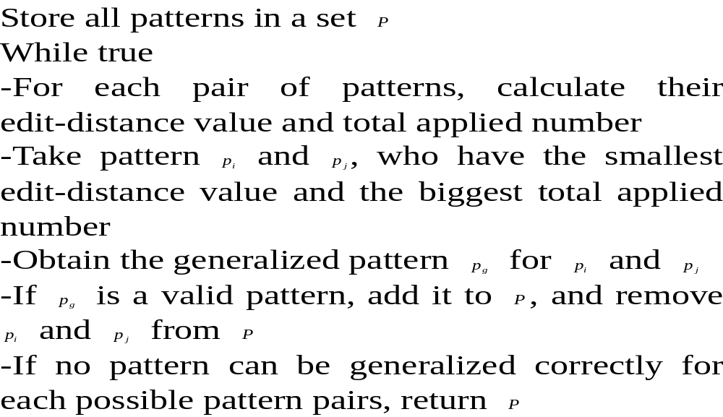
Pattern generalization

Slide 36
Pattern application
Ontology Creation
Pattern Application

Slide 37
Ontology Creation
Data source
  FreeDB
  Wikipedia
27 persons (10 writers, 17 singers)
11 countries
356 books
86 albums and 815 songs

Slide 38
Ontology Schema
rdfs:literal
rdfs:literal
base:Book
base:hasName
base:Genres
base:hasName
base:Album
rdfs:literal
base:writtenBy
base:publishData
base:hasBook
base:hasCD
base:Person
base:hasSongs
rdfs:literal
base:hasName
base:containIN
rdfs:literal
base:hasSong
base:Song
rdfs:literal
base:Birth
base:Death
base:hasName
base:hasCapital
rdfs:literal
rdfs:literal
rdfs:literal
base:Country

Slide 39
Pattern Application
  Ontology Inference
  -Submit the extracted hook and target to the ontology
  -Return relation
  Application process
  For each pattern, for example (A1hookA2targetA3), in the set
  For each sentence in the testing corpus
  Look for the left-hand-side content A1 in the sentence.
  Look for the middle content A2 in the sentence.
  Look for the right-hand-side content A3 in the sentence.
  The words between A1 and A2 are considered as hook, the words between A2 and A3 are considered as target.
  For each extracted hook and target, use the ontology to query their relation. If the returned relation equals the pattern’s relation, output hook, target and the relation.

Slide 40
Pattern Application (cont…)
<Person> was born * in|, <BirthYear> ,|.|in|and
Janet Evanovich was born in 1943 in New Jersey and ...
Janet Evanovich was born in 1943 in New Jersey and …
(Janet Evanovich, 1943)
(Janet Evanovich, New Jersey)
Query Ontology

Slide 41
Result and evaluation
The testing corpus
Jim Rogers, Keith Whitley, Herbie Hancock, Marty Robbins, Michael Jackson, Tanya Tucker, Bessie Smith, Beverly Lewis, Charlaine Harris, Dan Brown, Donald A Norman, Douglas Brinkley, Glenn Beck, Marjane Satrapi, James Patterson, Janet Evanovich and Max Lucado
1788 sentences

Slide 42
Result and evaluation (cont…)
Relation | Seeds | Pages | Unique Patterns | Gener. Patterns
Birth-year | 21 | 1331 | 634 | 182
Death-year | 5 | 423 | 130 | 24
Country-capital | 11 | 203 | 144 | 29
Writer-book | 279 | 4745 | 2033 | 441
Singer-song | 157 | 5232 | 1390 | 373
Number of seed pairs for each relation, number of downloaded pages, number of unique patterns after the extraction and number of generalized patterns

Slide 43
Result and evaluation (cont…)
Relation | recall | precision
Birth-year | 67.5% | 100%
Death-year | 70.2% | 100%
Country-capital | 82.1% | 100%
Writer-book | 52% | 100%
Singer-song | 58% | 100%

Slide 44
Result and evaluation (cont…)
Relation | Alfonseca’s approach | Ruiz-Casado’s approach | Our approach
Birth-year | 79.67% | 74.14% | 100%
Death-year | 96.71% | 90.20% | 100%
Country-capital | 72.43% | 11.45% | 100%
Writer-book | 28.13% | 37.29% | 100%
Singer-song | - | - | 100%

Slide 45
Result and evaluation (cont…)
the four cross-validation
Birth-year: 63.7%
Death-year: 69.4%
Country-capital: 84.1%
Writer-book: 56.2%
Singer-song: 59.6%

Slide 46
Conclusions and future work
More general
  Stemming
  "fishing", "fished", "fish" and "fisher" => fish
Automatically expand ontology knowledge

Slide 47
Questions
  ?

