Slide 1


www.studymafia.org
Seminar
On
Soft Skills
Submitted To: Submitted By:
www.studymafia.org www.studymafia.org
Notes:
1
1

Slide 2
Content
What are Soft skills?
Importance of Soft Skill
Important Soft Skills?
Communication skills
Body language
Making Decisions
Self Motivation
Leadership Skills
Team-Working Skills
Creativity and Problem Solving Skills
Time Management
Conclusion

Slide 3
What are Soft skills?
Soft skills is a synonym for "people skills." The term describes those personal attributes that indicate a high level of emotional intelligence.
Unlike hard skills, which describe a person's technical skill set and ability to perform specific tasks, soft skills are broadly applicable across job titles and industries.
It's often said that hard skills will get you an interview but you need soft skills to get -- and keep -- the job.

Slide 4
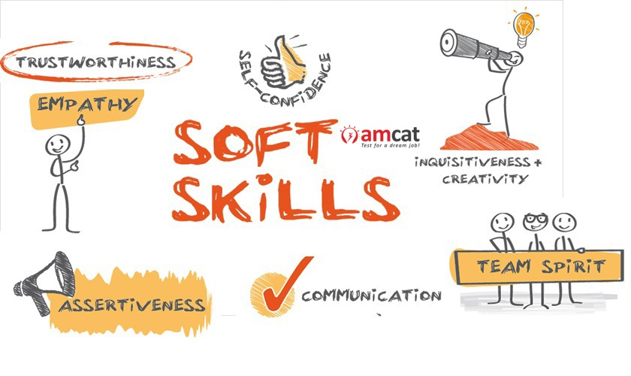
Importance of Soft Skill
To handle interpersonal relations
To take appropriate decisions
To communicate effectively
To have good impression and impact to gain professional development

Slide 5
What are the Most Important Soft Skills?
Communication skills
Body language
Making Decisions
Self Motivation
Leadership Skills
Team-Working Skills
Creativity and Problem Solving Skills
Time Management and ability to work under Pressure

Slide 6

Communication skills
Communication skills are always top of the ‘essential skills’ list in any job advertisement.
People with strong communication skills can build relationships (from the initial building rapport through to a longer-term relationship), listen well, and vary their communication to suit the circumstances.

Slide 7

Body language
Face is the index of the mind and it clearly displays the persons interest
Body language presents to the audience what we feel & think about the particular matter
Ex: Nodding one’s head
Body language (e.g, arms crossed, standing, sitting, relaxed)
Emotion of the sender & receiver (e.g, speaking clearly, enthusiastic)

Slide 8

Making Decisions
Valued by employers for many reasons, being able to make decisions is key to getting on in life.
Sometimes the actual decision doesn’t even matter; what matters is that you have made one and moved on.

Slide 9

Self Motivation
People who are self-motivated get on by themselves.
They don’t need close supervision and they are good to work with because they are generally positive about life and can be counted upon to keep going.
It also helps to work on your personal resilience and adaptability to change.

Slide 10

Leadership
Leadership is a soft skill you can show even if you’re not directly managing others.
Leadership can be thought of as a collection of various other soft skills, such as a general positive attitude and outlook, the ability to communicate effectively, and an aptitude for both self-motivating and motivating others.

Slide 11

Team-Work
Like leadership, good teamwork involves a combination of other soft skills.
Working in a team towards a common goal requires the intuition and interpersonal acumen to know when to be a leader, and when to be a listener.
Good team players are perceptive, as well as receptive to the needs and responsibilities of others.

Slide 12
Creativity and Problem-solving
Creativity and problem-solving skills are highly valued because they are hard to develop.
There are many people who believe that creative thinkers are born, not made, and there are certainly some people who find these skills much easier.
But, like other skills, you can develop them if you work to do so and our pages on these topics will give you some ideas about how to do this.

Slide 13
Time Management and Ability to work under pressure
Many would say that these two skills, which often go hand-in-hand, are more an attitude than a skill.
However they can also be developed and honed, which is why we include them as skills.
Highly valued by employers, they are also very useful for organizing a family or a team, and for making sure that the job gets done.

Slide 14
Conclusion
More and more businesses are considering soft skills as important job as an criteria.
An increase in service industry emphasizes the need for soft skills.
Soft skills are used in personal and personal life.

Slide 15
Thanks

