Slide 1
WordPress Plugins for Symbiota2
Venkatesh Kadali
Dr. Curtis Dyreson
Plan B Defense

Slide 2
Outline
Problem
Two WordPress Plugins
Conclusion

Slide 3
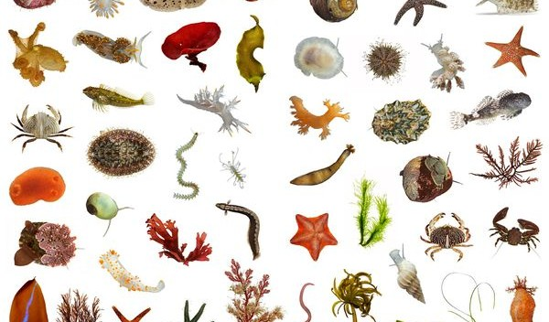
Symbiota
Leading open source platform in North America
Helps in finding the conceptual structure of traditional floras and faunas
Easy access to biodiversity data for anyone
Allows technicians to create the tools, freeing the biologists to concentrate their efforts on curation of quality datasets

Slide 4
Problem
GUI is hardcoded into many PHP files
  Poor maintainability
  Poor extensibility
Users cannot customize Symbiota features
  Poor extensibility

Slide 5
Solution
Code can be reduced in size and complexity by cleanly separating the GUI from core functionality
MVC – Model View Controller frameworks helps in such a separation
WordPress – Content Management System (CMS) helps in building websites
By Integrating Symbiota with CMS it gains many CMS features

Slide 6
Desired Symbiota Features
User control over the look and feel
CMS integration using WordPress
More maintainable and extensible code

Slide 7
Process and Goals
Step 1 - Refactor Symbiota Code into Model, View, Controller framework
Step 2 - Render View(s) in a CMS (WordPress)
Goal of this Project – To explore the feasibility of step 2, i.e., can we integrate Symbiota functionality with WordPress. To help users add Symbiota functionalities to their website.
Methodology - Implement two kinds of Symbiota functionality as WordPress plugins
  Read only - query
  Update

Slide 8
Outline
Problem
Two WordPress Plugins
Conclusion

Slide 9
Details of the Plugins
Two Plugins
  Symbiota Search WordPress plugin – (Read – only)
  Symbiota Validation Plugin – (Update)
Helps WordPress developers to add the Symbiota functionalities into their websites
Proof of concept – Can Symbiota functionalities be integrated with the WordPress?

Slide 10
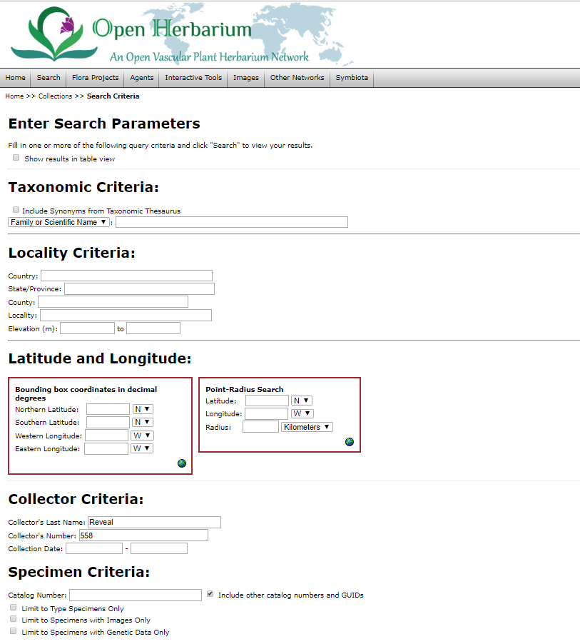
Symbiota specimen search Engine
Taxonomic Criteria
Geographic Criteria
Collector Criteria
Specimen Criteria

Slide 11
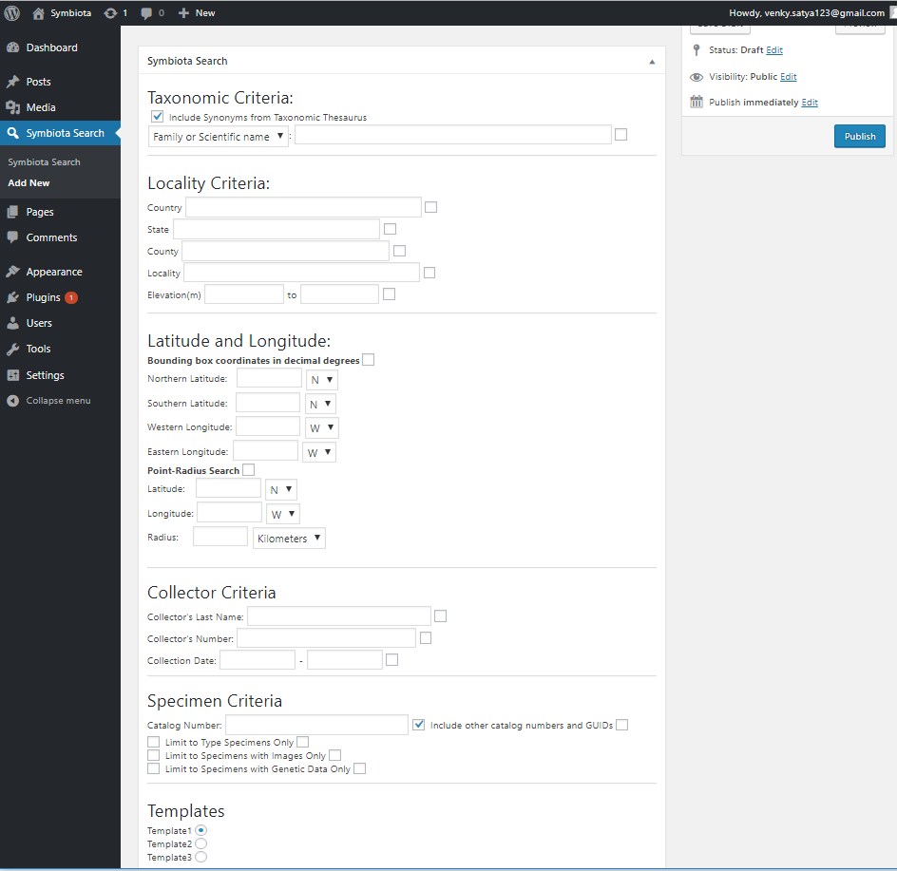
Symbiota search WordPress plugin page

Slide 12
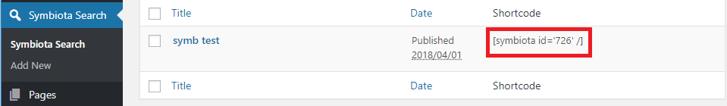
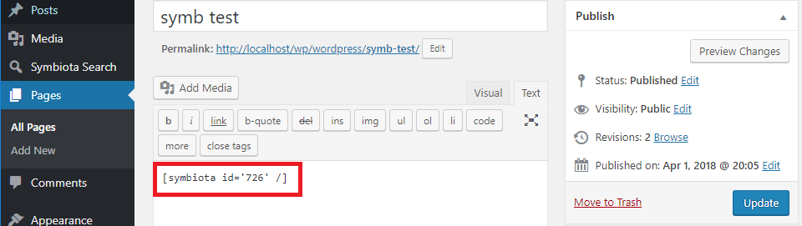
WordPress Shortcode

Slide 13
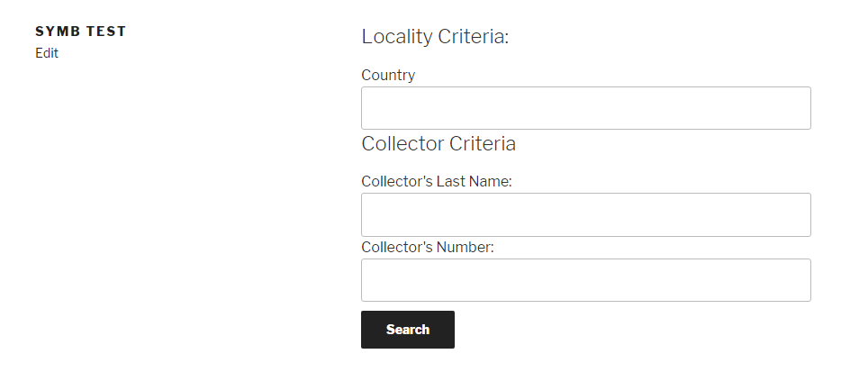
Symbiota search web page

Slide 14
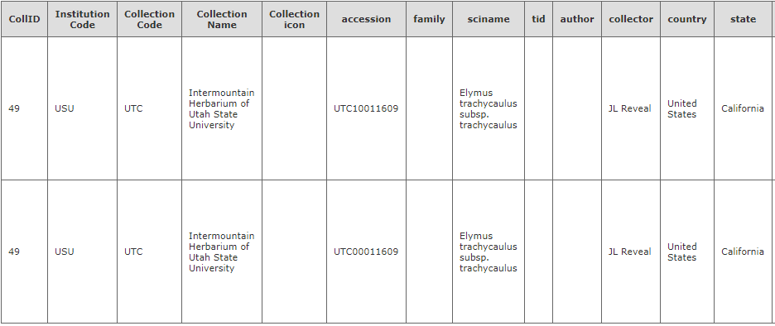
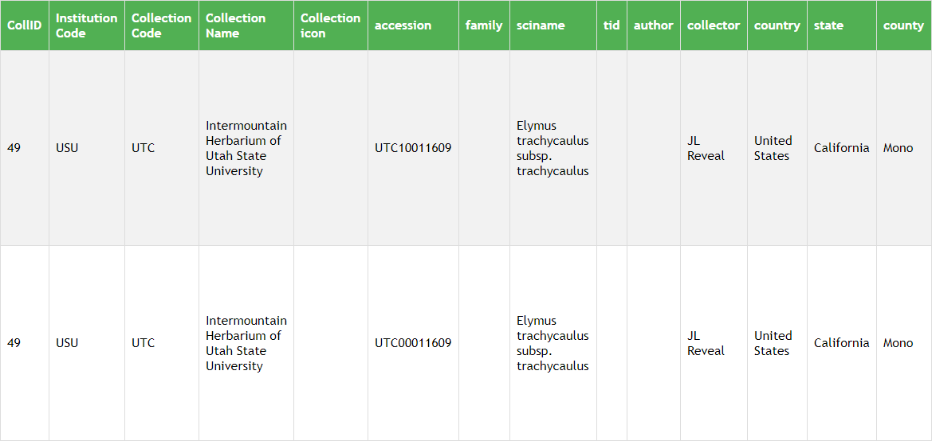
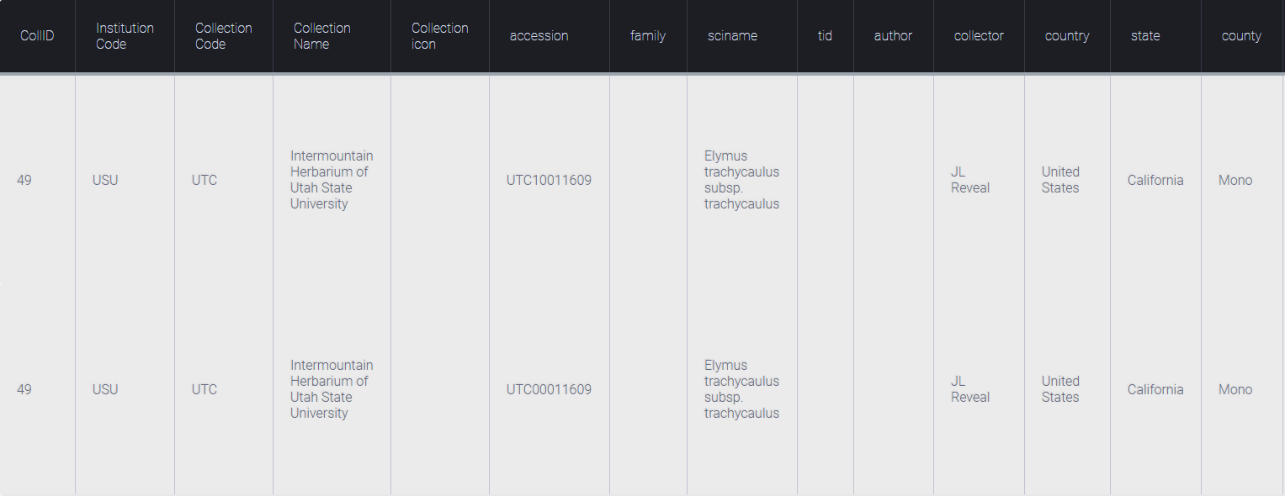
Templates
Template 1
Template 2
Template 3

Slide 15
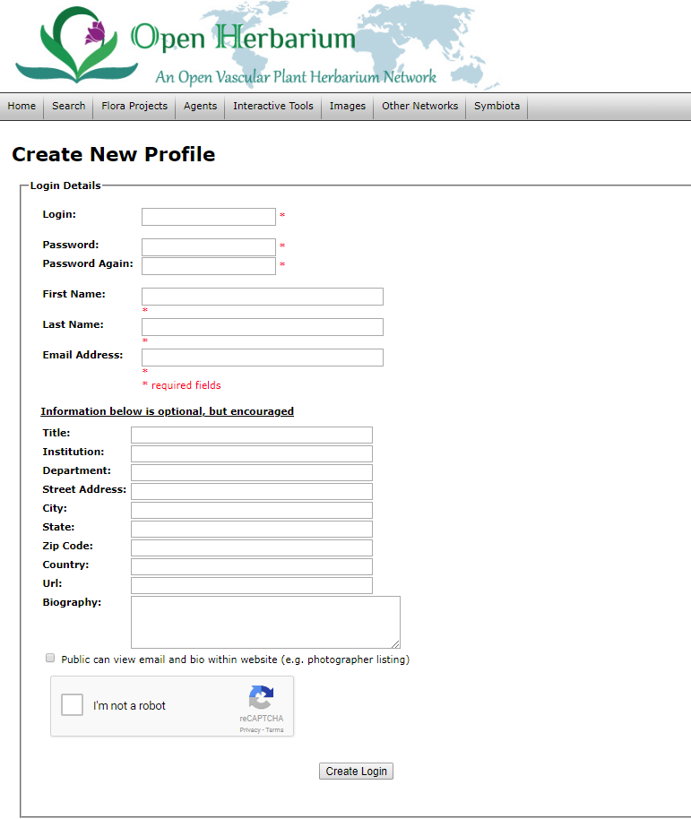
Symbiota Form Validation Page

Slide 16
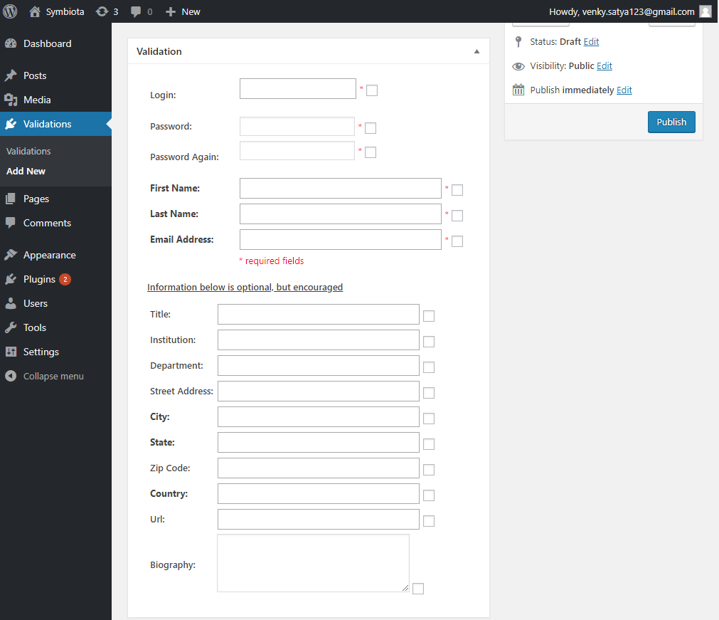
Symbiota Validation plugin page

Slide 17
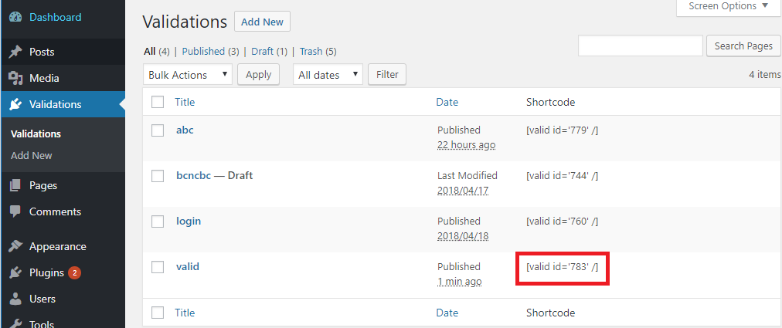
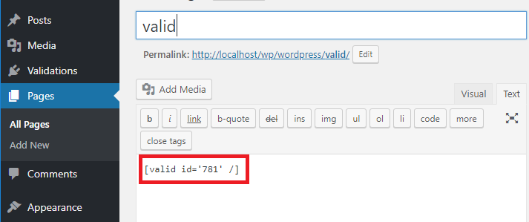
WordPress Shortcode

Slide 18
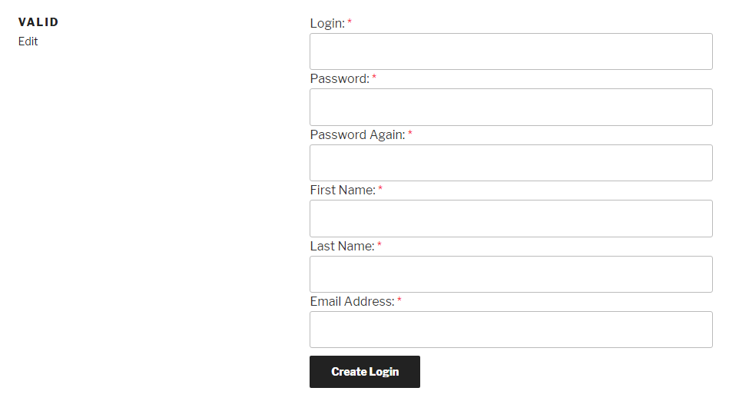
Validation page

Slide 19
Outline
Problem
Two WordPress Plugins
Conclusion

Slide 20
Conclusion and Future Work
Developed two WordPress plugins
Demonstrated feasibility
Implement all Symbiota features as Plugins
Implement Plugins in other CMSs like Joomla and Drupal

Slide 21
Thank You

